Slide 1
OO Systems and Roles
Curtis "Ovid" Poe
http://blogs.perl.org/users/ovid/
Notes:
My apologies if you've seen an earlier version of this talk

Slide 2
Not A Tutorial
"How" is easy
"Why" is not

Slide 3
One of These Things
Is Not Like The Others
Simula 67
  Classes
  Polymorphism
  Encapsulation
  Inheritance
Notes:
45 years of bickering

Slide 4
Multiple Inheritance
Perl
C++
Eiffel
CLOS
Python
Notes:
Note that many OO guides for these languages tell you to avoid MI

Slide 5
Single Inheritance
C#
Java
Delphi
Ruby
Smalltalk
Notes:
Note that many OO guides for these languages tell you to eagerly embrace their alternative

Slide 6
Inheritance Strategies
Liskov Substitution Principle
Strict Equivalence
C3
Notes:
These are used to mitigate the risk of inheritance

Slide 7
Inheritance Alternatives
Interfaces
Mixins
Delegation
Notes:
All have issues. Delegation sometimes requires a "fake object"

Slide 8
Four Decades of Pain
Code Smell
  In the language itself!

Slide 9
B:: Object Hierarchy

Slide 10
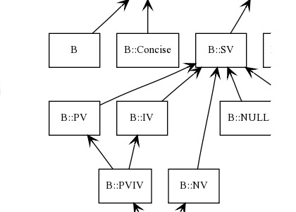
A Closer Look

Slide 11
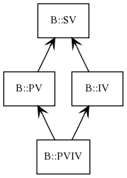
A Closer Look

Slide 12
B::PVIV Pseudo-Code
B::PVIV Internals
bless {
pv => 'three', # usually '3'
iv => 3,
} => 'B::PVIV';
Notes:
ASCII "3" is 51

Slide 13
Printing Numbers
Perl
Java
my $number = 3;
$number += 2;
# << fits on slide ☺
say <<"END";
I have $number apples
END
int number = 3;
number += 2;
System.out.println(
"I have "
+ number
+ " apples"
);

Slide 14
More Pseudo-code
sub B::PV::as_string { shift->pv }
sub B::IV::as_string { shift->iv }
package B::PVIV;
use parent qw( B::PV B::IV );
# later
say $pviv->as_string; # Str
say $pviv->B::IV::as_string; # Int
Notes:
I was asked "can you make a simpler example?"

Slide 15
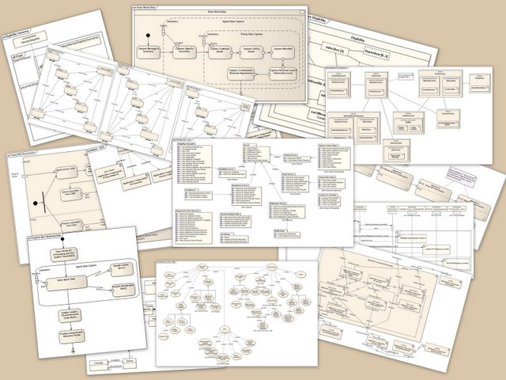
Systems Grow
Credit: Kishorekumar 62 http://en.wikipedia.org/wiki/File:UML_Diagrams.jpg

Slide 16
The Real Problem
Responsibility
  Wants larger classes
  Versus
Reuse
  Wants smaller classes

Slide 17
The Real Solution
Decouple!

Slide 18
Solutions
Interfaces
Delegation
Mixins

Slide 19
Practical Joke
Needs
  explode()
  fuse()

Slide 20
Code Reuse
 | Method | Description
✓ | Bomb::fuse() | Deterministic
 | Spouse::fuse() | Non-deterministic
 | Bomb::explode() | Lethal
✓ | Spouse::explode() | Wish it was lethal

Slide 21
Ruby Mixins
module Bomb
def explode
puts "Bomb explode"
end
def fuse
puts "Bomb fuse"
end
end
module Spouse
def explode
puts "Spouse explode"
end
def fuse
puts "Spouse fuse"
end
end

Slide 22
Ruby Mixins
class PracticalJoke
include Spouse
include Bomb
end
joke = PracticalJoke.new()
joke.fuse
joke.explode

Slide 23
Ruby Mixins
Bomb fuse
Bomb explode

Slide 24
Ruby Mixins
Bomb fuse
Bomb explode
irb(main):026:0> PracticalJoke.ancestors
=> [PracticalJoke, Bomb, Spouse, Object, Kernel]

Slide 25
Moose Roles
package Bomb;
use Moose::Role;
sub fuse {
say "Bomb explode";
}
sub explode {
say "Bomb fuse";
}
package Spouse;
use Moose::Role;
sub fuse {
say "Spouse explode";
}
sub explode {
say "Spouse fuse";
}

Slide 26
Moose Roles
{
package PracticalJoke;
use Moose;
with qw(Bomb Spouse);
}
my $joke = PracticalJoke->new;
$joke->fuse;
$joke->explode;

Slide 27
Moose Roles
Due to method name conflicts in roles
'Bomb' and 'Spouse', the methods 'explode'
and 'fuse' must be implemented or excluded
by 'PracticalJoke'
… plus
… the
… stack
… trace
… from
… hell

Slide 28
Moose Roles
{
package PracticalJoke;
use Moose;
with 'Bomb' => { excludes => 'explode' },
'Spouse' => { excludes => 'fuse' };
}
my $joke = PracticalJoke->new;
$joke->fuse;
$joke->explode;
# Bomb fuse
# Spouse explode

Slide 29
Moose Roles
{
package PracticalJoke;
use Moose;
with 'Bomb' => { excludes => 'explode' },
'Spouse' => {
excludes => 'fuse',
alias => { fuse => 'random_fuse' }};
}
my $joke = PracticalJoke->new;
$joke->random_fuse;

Slide 30
Moose Roles
Class
Role
package My::Object;
use Moose;
with 'Does::AsYAML';
sub to_hash {
…
}
package Does::AsYAML;
use Moose::Role;
use YAML::Syck;
requires qw(to_hash);
sub to_yaml {
my $self = shift;
return Dump(
$self->to_hash
);
}
1;

Slide 31
Languages With Roles (traits)
Xerox "Star" (the origin of traits in '79/'80)
Self
Perl 6
Perl 5 (via Moose and others)
Smalltalk (Pharo)
Fortress
Scala
Javascript (via Joose)
PHP (5.4 and above)
Slate

Slide 32
The Problem Domain
5,613 brands
6,755 series
386,943 episodes
394,540 versions
1,106,246 broadcasts
… and growing rapidly

Slide 33
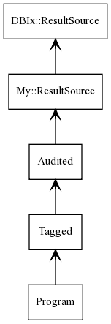
Real World Pain

Slide 34
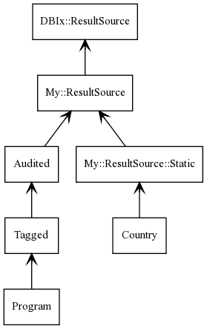
Real World Pain

Slide 35
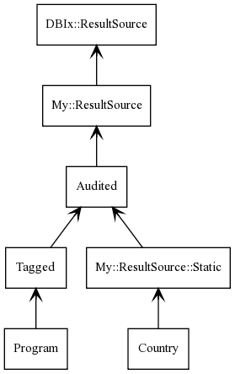
Real World Pain

Slide 36
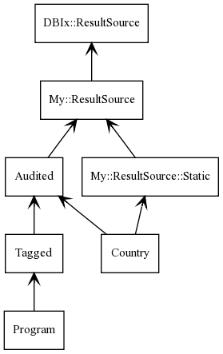
Real World Pain

Slide 37
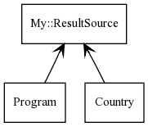
Switching to Roles

Slide 38
Switching to Roles
package Country;
use Moose;
extends "My::ResultSource";
with qw(
DoesStatic
DoesAuditing
);

Slide 39
Before

Slide 40
After

Slide 41
Increased Comprehension
package BBC::Programme::Episode;
use Moose;
extends 'BBC::ResultSet';
with qw(
Does::Search::ForBroadcast
Does::Search::ByTag
Does::Search::ByTitle
Does::Search::ByPromotion
Does::Identifier::Universal
);

Slide 42
Conclusions
Easier to understand
Simpler code
Safer code

Slide 43
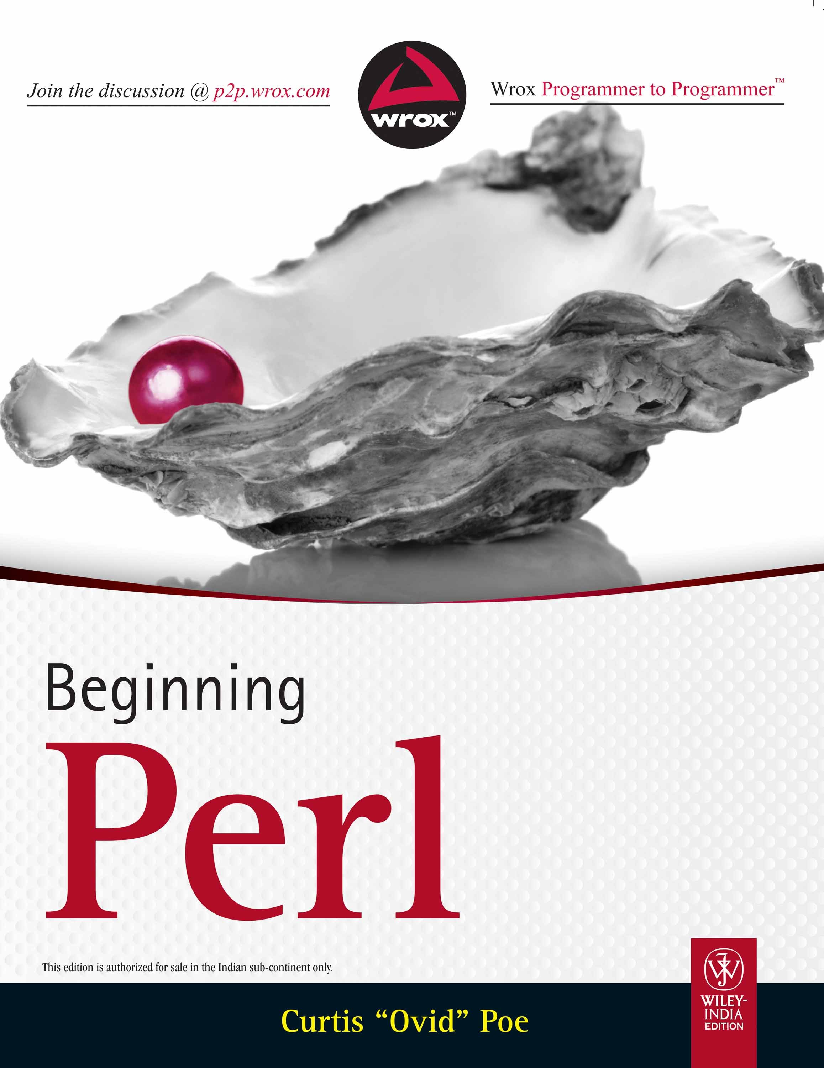
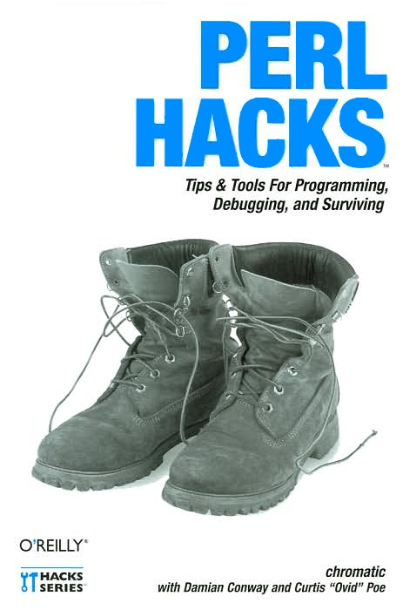
Buy My Books!

Slide 44
Questions
?

