Slide 1
Things we love and hate about
Perl @

Slide 2
Tevreden.nl - Facts & Figures
Vision: Improving the general satisfaction for the Netherlands
4th gen. satisfaction research
Divided into approx. 25 markets
Generic market platforms
Specific customer platforms

Slide 3
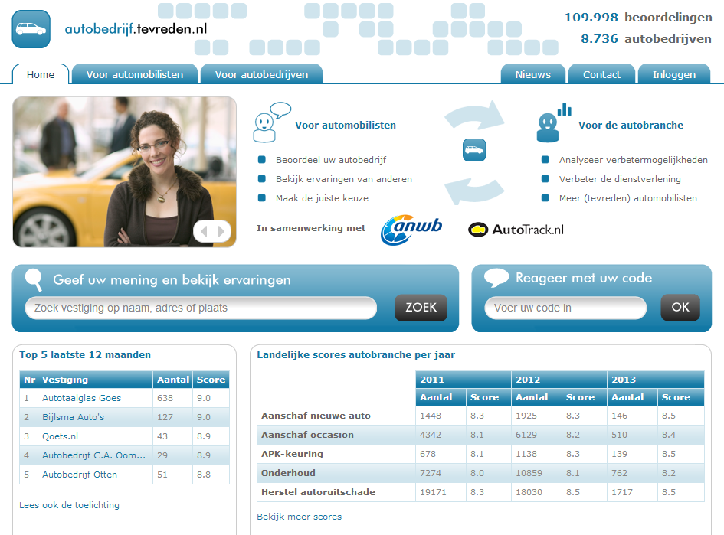
Tevreden.nl – e.g. Platform

Slide 4
Facts & Figures – Evaluation RMS
25 markets, 80 specific platforms
5M invitations sent
1M responses and counting
200k responses in 2012 alone
268,793 lines of Perl 5 code
5 full time developers
Steady 30% growth

Slide 5
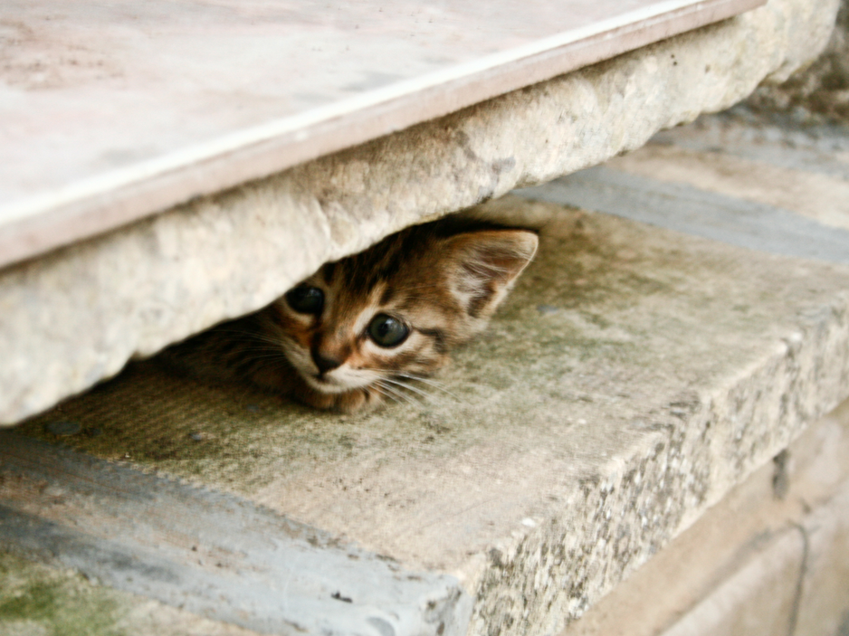
Love (about Perl)
Paolo Margari (flickr)
Notes:
Every presentation needs a picture of a cute kitten. Just kidding: what we love (about Perl)

Slide 6
Love Perl
Flexible
Timtowtdi
Expressive
Atmosphere
Straightforward
Non pretentious
Exclusivity
Syntax
TAP

Slide 7
Love Perl
Great
Community
(perlmonks, perlmongers, CPAN);

Slide 8
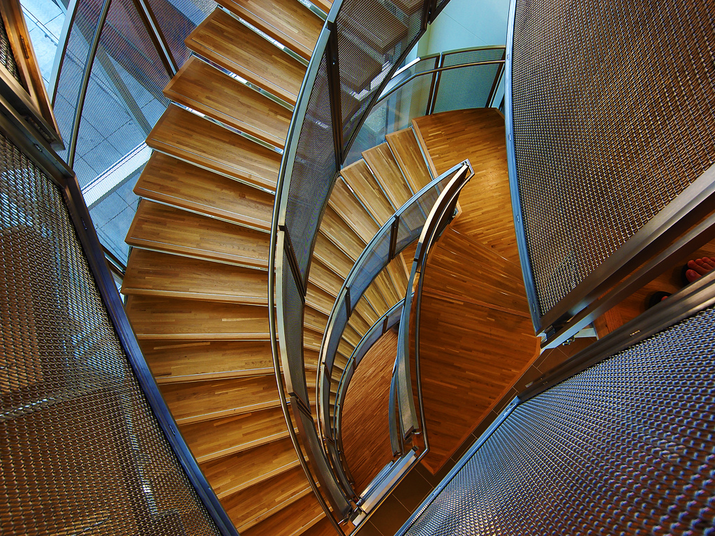
Challenges - Ugly code
paul bica (flickr)
Notes:
Beautiful architecture doesn’t necessarily lead to clear functionality

Slide 9
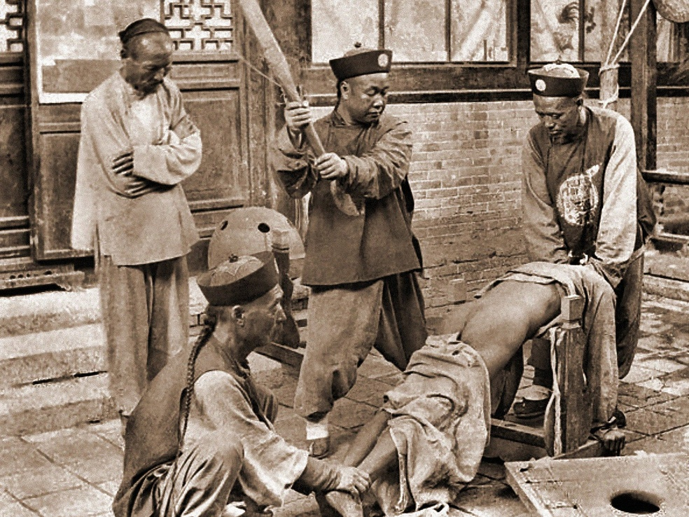
Challenges - Ugly code
ralphrepo

Slide 10
Challenges - CPAN vs Apt
CPAN
API Changes
Dependencies
Consistent deployment of packages
Autobundle
Developer love
Apt
No emotion

Slide 11
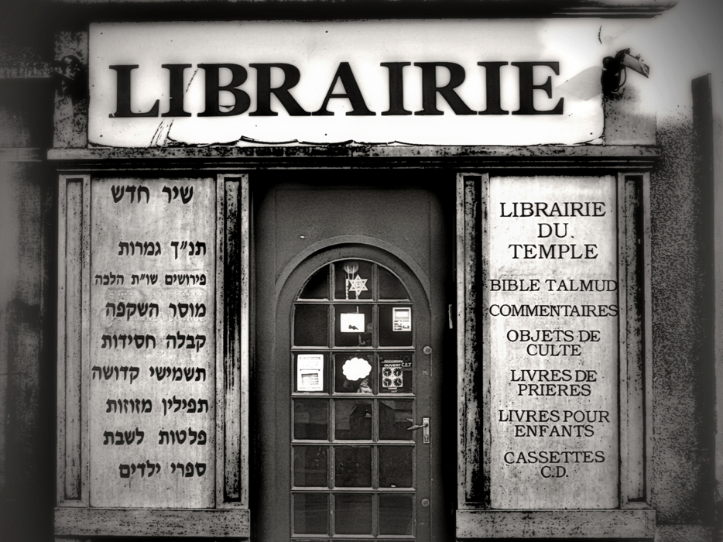
Challenges - CPAN vs Apt
nebojsa mladjenovic
Notes:
Beautiful architecture doesn’t necessarily lead to clear functionality

Slide 12
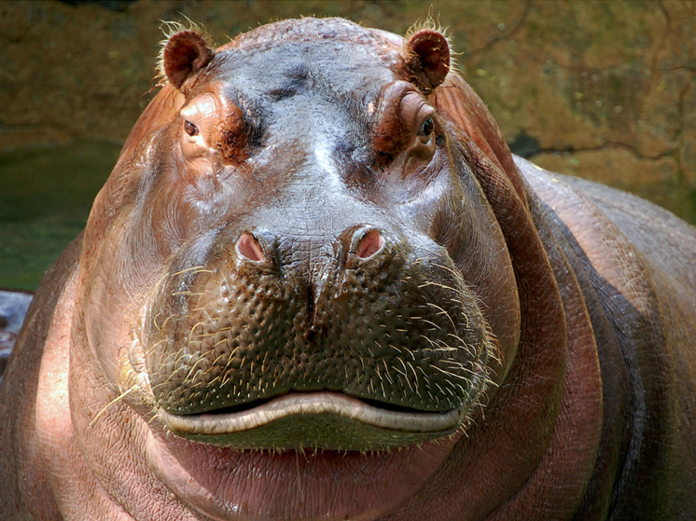
Challenges - mod_perl on Apache
digitalART2(flickr)
Notes:
Perl on mod_perl on Apache leads to great memory consumption. Apache::SizeLimit helps, but is a band-aid at best

Slide 13
Challenges - mod_perl on Apache
Performance per http request
Apache::SizeLimit
Band-aid
Counterproductive
Works
Apache::Registry
Soap::Lite
PerlRun

Slide 14
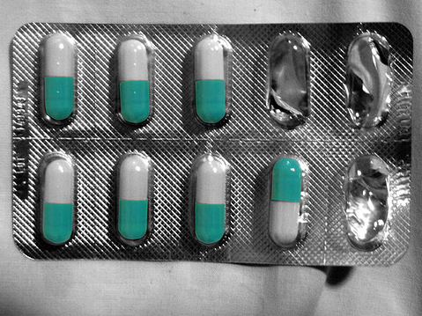
Challenges - Character Encodings
sacks08 (flickr)

Slide 15
Challenges - Character Encodings
Multiple choice (UTF8 vs the rest)
use Encode;
Encode::_utf8_off($val);
utf8::downgrade($val); # remove utf8-flag, convert to 8bit if necessary
utf8::decode($val); # convert UTF-X to the right characters
utf8::upgrade($val); # convert the string to utf8, set the utf8 bit
$val =~ s/\\x(.{2})/decode("iso-8859-1",sprintf("%c",hex($1)))/eg;
Input (Web, Templates, SOAP, Excel)
Transformation
Output (PDF, browser, e-mail)

Slide 16
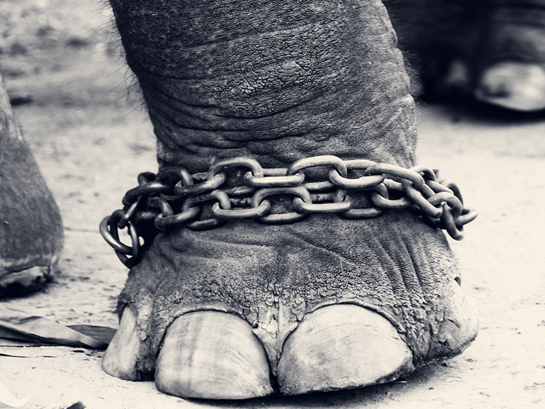
Challenges – Like a Chained Giant
VinothChandar(flickr)
Notes:
We often feel like a chained giant: we have a great body of research data, but

Slide 17
Challenges - timtowtdi
Performance
Use taint, use strict
5.6 vs 5.10 vs 5.18
Make research data available
Comprehensible
Summarize, interpret
Even historic data

Slide 18
Love (using Perl)
Paolo Margari (flickr)
Notes:
Every presentation needs a picture of a cute kitten. Just kidding: what we love (about Perl)

Slide 19
LAMP
Linux
Ubuntu Server, Hardy .. Quantal
Apache
Recent 2.4 version
MySQL
Recent 5.5 version
OLTP and OLAP
Perl
Code runs on 5.10-5.18

Slide 20
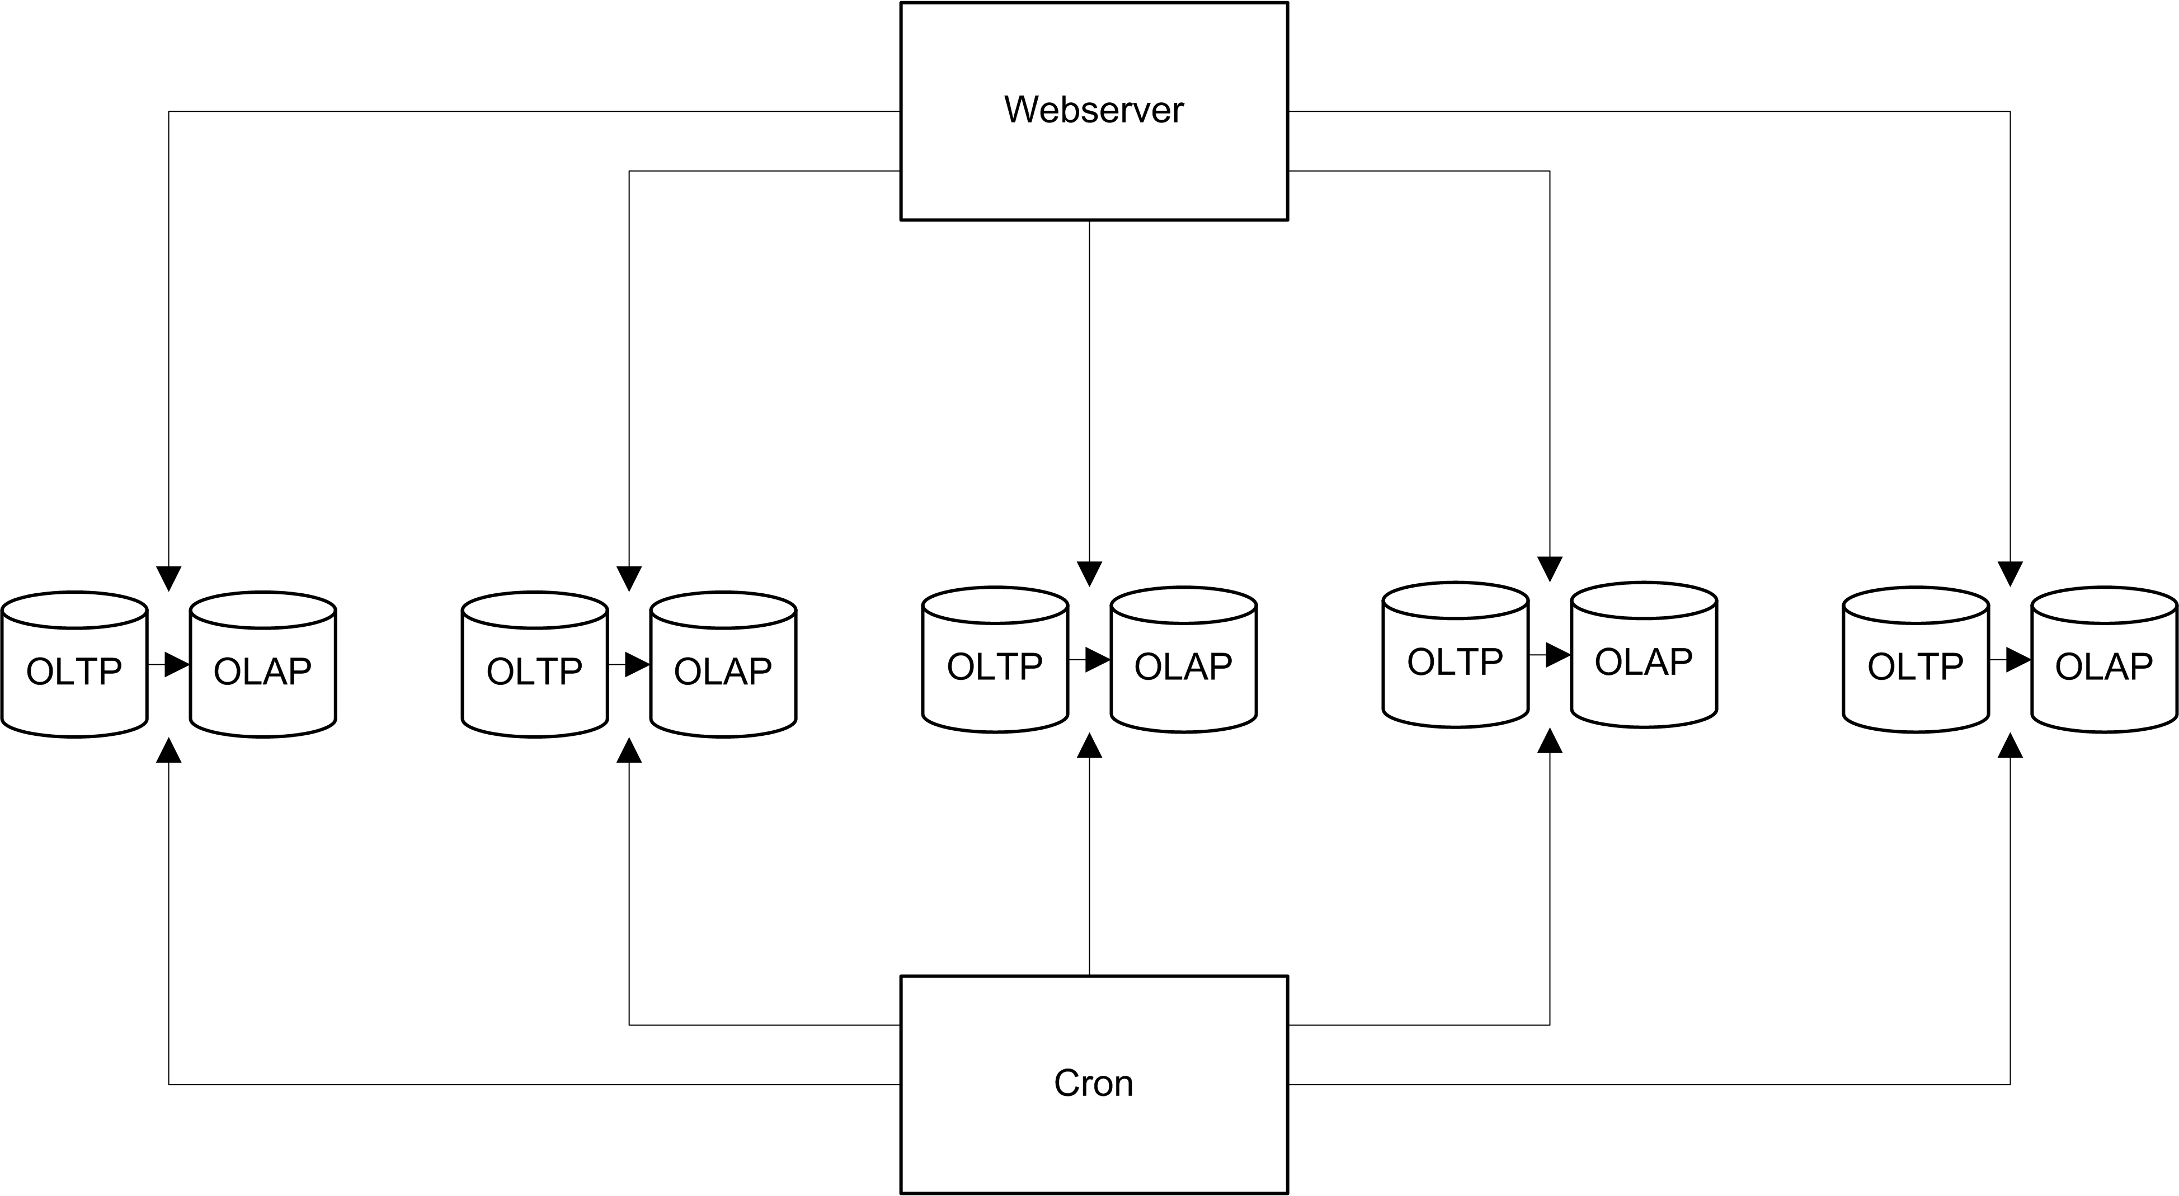
How We Scale, Simplified
Notes:
Central architectural concepts: many db’s for organic scaling: about 50 of them.

Slide 21
Our Current Challenge
Choosing the right test framework
Test::Simple
Test::More
Testing race conditions
Single point of failure
Testing
Building
Releasing

Slide 22
Bio
Pascal Vree Bsc
Open source tinkering since 1996
Twitter: @pascalvree
nl.linkedin.com/in/pascalvree
Bas Bloemsaat LL.M.
Open source tinkering since 1993
Twitter: @bbloemsaat
nl.linkedin.com/in/basbloemsaat

Slide 23
Questions?

