Slide 1
Using Gatling and Jenkins to Performance Test Puppet
Brian Cain (@brian_cain)
FOSDEM 2014
Testing and automation devroom

Slide 2
About the Speaker
Computer Science
Kansas State University in United States
Finishing up Masters this semester
Notes:
First time in Belgium so I’m excited to be here

Slide 3
About the Speaker
Notes:
Here is the building we have classes in on our great campus. The computer science building looks similar to a castle.

Slide 4
About the Speaker
Former Intern at Puppet Labs
Notes:
Summer 2013
Today I’m going to talk to you about a plugin I wrote that helps Puppet Labs performance test Puppet with Jenkins and Gatling

Slide 5
Talk Overview
Introduction
Section One: Motivation Behind Project
Section Two: Modifying Gatling/Anatomy of a Jenkins CI Plugin
Section Three: About Puppets Load Test Framework
Section Four: Displaying Useful Reports
Demo

Slide 6
Introduction

Slide 7
Load Testing
What is load testing?
Why is it important?
Notes:
Joke: Load testing in software isn’t as dangerous as it can be in other fields
As projects grow, load testing gives a way to ensure your project doesn’t have any major errors or flaws or bottlenecks
With load testing, you can see how performance has improved or gotten worse between commits in the project
Load testing can show a clear difference in performance throughout the life cycle of a project, good or bad

Slide 8
Load Testing
Gives idea about state of performance
Defined through a set of scenarios
Notes:
Load testing can help determine if there are any major slow downs or bottlenecks in your system
Scenarios can be thought of heavy use-cases that stretch software to its limits

Slide 9
What is Puppet?
Configuration management tool
“Infrastructure as code”
Automate all of the things
http://puppetlabs.com/
Notes:
In case anyone here isn’t familiar with Puppet….
Helps automate repetitive tasks that system administrators have to perform daily
“Infrastructure as code”
Programmatically define your system through the Puppet DSL

Slide 10
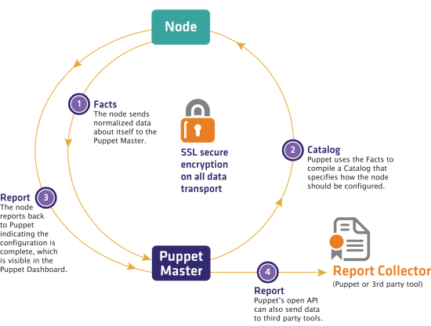
What is Puppet?
Notes:
Puppet Master pushes catalog to nodes in network. Catalog defines how a node should be configured.
After catalog has been compiled on node, a report is generated and collected.
Catalogs can define your infrastructure
Reports generated as puppet applies these catalogs over time
Facts can also be gathered that give information about each machine puppet is running on.

Slide 11
Jenkins
Continuous Integration Server
Contains various configurable jobs
Perfect for load testing
Can be expanded through plugin development
http://jenkins-ci.org/
Notes:
Jenkins CI is an important tool that allows for developers to practice continuous integration.
What is Continuous Integration?
The idea that developers will frequently commit their work to a project (hopefully through version control), and each integration will be verified through automated testing frameworks. Jenkins is a great tool to set up a system such as CI.
Apart of that CI can be load testing. A job can be set up to kick off at a given frequency, and the Jenkins Dashboard has the ability to display or graph results of load tests

Slide 12
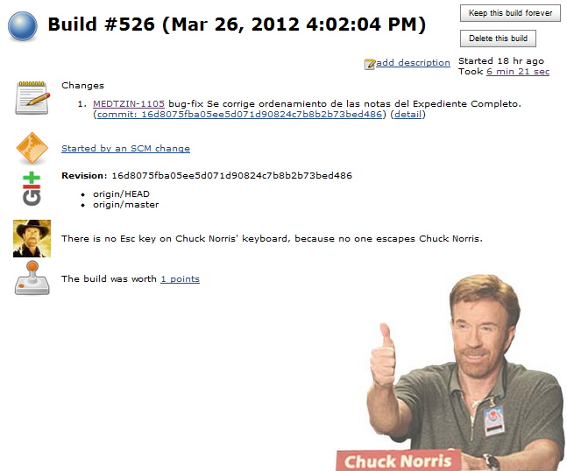
Jenkins
Notes:
If a job has no failures, you’ll get the thumbs up from Chuck Norris

Slide 13
Gatling
Load testing and stress test tool
Jenkins-CI plugin takes different scenarios and collects data on stress test result
Generates lots of useful graphs about tests
http://gatling-tool.org/
Notes:
What things does the regular gatling jenkins plugin do?

Slide 14
Motivation

Slide 15
Why was this needed?
Internal Marketing Department needed data on performance improvements
Notes:
Who was the customer?
The data was there, but not in a way that was easily available or readable by a human being

Slide 16
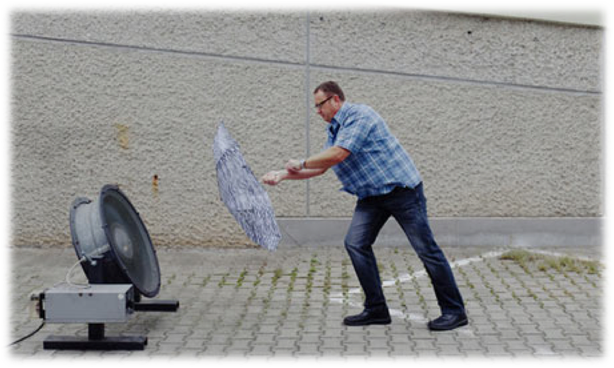
Why was this needed?
Needed an automated way to analyze data gathered by load testing framework
Notes:
Needed a way to performance test Puppet that was automated
In this case with the photo, that guy will have to test every umbrella. It would go much smoother if he had a way to test all of his umbrellas at once.
We wanted to give more information to people about how puppet is improving performance for different iterations

Slide 17
Why was this needed?
Needed a visual representation of performance changes over time
Notes:
It’s one thing to gather a bunch of data, but it is a pain to have to manually graph all of that performance data results on spreadsheets
Software projects over time can change very drastically. It might start of primitive, and by the current state of the project it might be much more complicated than what it use to be.
It is very useful to have an automated way to show these changes within the lifecycle of a project
Human Readable Data: Visualization of data can often reveal bottlenecks that might otherwise not be obvious

Slide 18
Why was this needed?
Needed a way to measure puppet life cycle
Notes:
Not only to we test overall time per scenario, we wanted to know how puppet performed compiling catalogs, report generation
It’s great to have a bunch of data and numbers, but this plugins goal was to turn that data into something visual for developers and marketing to look at.
Comparing all of the scenarios together can show a brief snapshot of the loadtest data

Slide 19
Why was this needed?
Why not just use the Gatling Jenkins-CI plugin?
Didn’t account for Puppet runs or other various details related to Puppet
Notes:
Gatling is general purpose tool
Such as how long it took puppet to compile a catalog, generate report, and agent runs in general
The techniques I talk about will not be limited to puppet, you can also be able to extend gatling if your project requires more refined calculations

Slide 20
Development

Slide 21
Developing Jenkins CI Plugins
Maven
Recommended toolset for Jenkins-CI plugin dev
Spawns a local Jenkins server instantly
Beginners Guide
https://wiki.jenkins-ci.org/display/JENKINS/Plugin+tutorial
Or search “plugin tutorial jenkins” on Google
Notes:
Maven has a good toolset for writing Jenkins-CI Plugins
After creating a new project with Maven, when you’re ready to run the project it will throw up a demo Jenkins instance for testing your plugin
This is important when you’re developing the UI. If you were testing this against a production Jenkins, you would have to reboot the server every time the plugin changed

Slide 22
Anatomy of a Jenkins CI Plugins
Project
java
resources
webapp
Notes:
Java
- Contains all of the java code required to run the project
Resources
- Contains all of the .jelly files for the Jenkins-CI Dashboard
- If you’re familiar with Groovy, I believe this has similar syntax
Webapp
- This folder is where you keep some images used by the plugin, for example the side logo

Slide 23
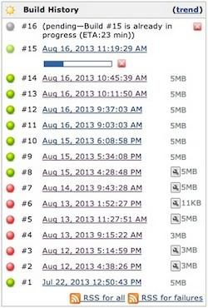
Anatomy of a Jenkins CI Plugins
java
*BuildAction.java
Notes:
BuildAction
Control of what is displayed when you click on each build
Displays relevant information gathered from the load test framework (like CPU, total RAM, Puppet version)

Slide 24
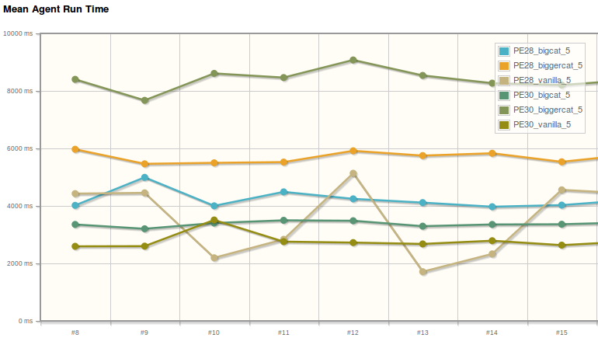
Anatomy of a Jenkins CI Plugins
java
*ProjectAction.java
Notes:
Controls what is shown when user clicks on the plugin icon within the Jenkins Dashboard
This plugin was designed to show all of the graphs in one view for easy comparison
(i.e. compare Mean Agent Run Time with Total Failures….trend might look really quick but the failures graph might show that it was fast because not all catalogs succeeded)

Slide 25
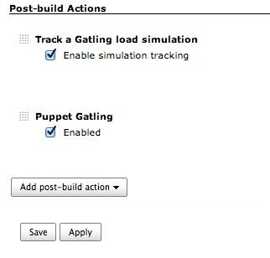
Anatomy of a Jenkins CI Plugins
java
*Publisher.java
Notes:
Publisher
Main logic behind plugin because my plugin takes place after job has completed
Does all the calculations, gathering of data, etc…
Publisher is a “post-build” action meaning it will run after the Jenkins job completes.
Order matters: If ran before gatling (which collects data), will not work since data doesn’t exist yet

Slide 26
Anatomy of a Jenkins CI Plugins
resources
*.jelly
Notes:
The jelly files are mostly for the Jenkins-CI dashboard
Strange at first, but can be similar to things like embedded ruby for views

Slide 27
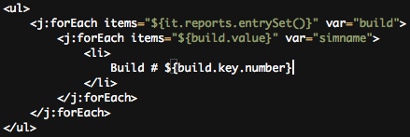
Anatomy of a Jenkins CI Plugins
Notes:
The jelly files are mostly for the Jenkins-CI dashboard
Strange at first, but can be similar to things like embedded ruby for views
Show an example of what a jelly file looks like in the slide

Slide 28
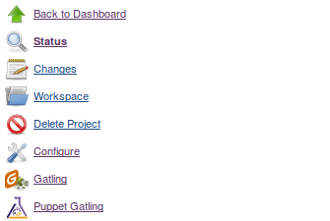
Anatomy of a Jenkins CI Plugins
webapp
Used for plugin image
Notes:
This folder was simply used to store an icon for the plugin entry on the side of the Jenkins CI dashboard

Slide 29
Puppet Load Test Framework
Notes:
THIS SECTION NEEDS WORK

Slide 30
Puppet Load Testing Framework
Framework designed to automate the load testing process
Notes:
2 to 3 other developers at Puppet were in charge of this framework
I helped modify the framework to use Facter for gathering data so plugin can display useful OS information

Slide 31
Puppet Load Testing Framework
Software designed to automate load testing
Quick overview responsibilities:
Provisions Machine
Installs and configures Puppet
Runs Puppet Labs QA testing frameworks
Gathers Facter Data*
Runs Puppet with Load Test Scenarios
* = New for my plugin
Notes:
Designed to give the framework a “fresh” machine each time
Spawns off load test, other project provisions OS, runs package load test, and generates data
Facter is also used for important facts of system
Things like CPU, RAM, Puppet Version, are displayed

Slide 32
Puppet Load Testing Framework
Ran with various scenarios or for load testing
Scenarios are various use-cases that attempt to push Puppet to its limits
Notes:
Each scenario has various catalogs that it attempts to apply to a given machine.
A catalog in this case is just defined as a set of various scenarios that we want to set up on a given machine.
The machine might be setting up a large variety of services that stress tess Puppets ability to do so

Slide 33
Puppet Load Testing Framework
An example scenario might be…
Simulation X
Vanilla
5 agents
5 repetitions
Big
10 agents
5 repetitions
Vanilla
Simulation X
Big
Notes:
Vanilla might be as simple as setting up apache with a mysql server
So in this case the Vanilla will have 5 agents compiling the vanilla catalog and repeating it 5 times.
Same with Big….
This specific simulation only has 2 groups or nodes
These are just examples of what the framework may use to test Puppet

Slide 34
Generating Useful Reports
Notes:
THIS SECTION NEEDS WORK

Slide 35
Modifying Gatling
Modified jenkins plugin to calculate different values for Puppet
Hooked into graphing libraries
Notes:
Calculating different results

Slide 36
Modifying Gatling
Grab reports and data from gatling
stats.tsv
Perform new calculations with data
Notes:
Stats.tsv is a large amount of data from the simulation breaking down the entire simulation.
These are the numbers used to calculate the data in relation to puppet runs
Calculations to come later
Show a snapshot of the data

Slide 37
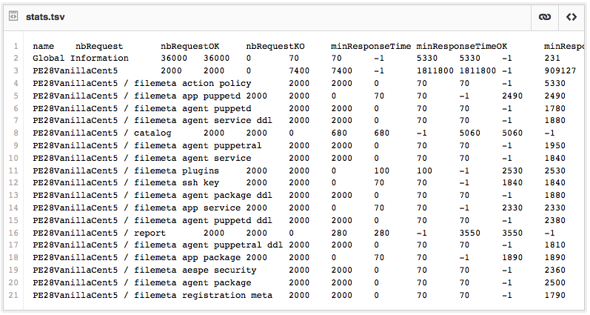
Modifying Gatling
Notes:
Stats.tsv is a large amount of data from the simulation breaking down the entire simulation.
These are the numbers used to calculate the data in relation to puppet runs
Show a snapshot of the data

Slide 38
Modifying Gatling Calculations
Total Mean Agent Run Time
n = number of nodes in simulation
Notes:
These are the numbers used to calculate the data in relation to puppet runs
Denominator is equal to total runs performed by load test here
\frac{\sum_{n}^{1} (Total Requests * Total Mean Response Time)}{Total Number Instances * Total Number Repetitions}

Slide 39
Modifying Gatling Calculations
Mean Catalog/Report Response Time Per Simulation
n = each simulation report
m = each node
Notes:
Number Instances * Number Repetitions == total runs
\frac{\sum_{1}^{n} (Num Instances * Num Repetitions)*(Catalog/Report MRT)}{\sum_{1}^{m} (Num Instances * Num Repetitions)}

Slide 40
How was it achieved
Obtained gatling data from each jenkins job run
Bootstraps into load testing framework by Puppet Labs
Notes:
It bootstraps into the load testing framework by simply being added as a post-build operation

Slide 41
Discovering Bottlenecks
Plugin revealed bottleneck that was otherwise hidden within load test framework data
Notes:
After the plugin was finished and it was graphing the results, the graph displayed an outlying load test
This slower load test was an issue recently fixed
Had this plugin been operating while the bug was present, it might of been more obvious and fixed sooner

Slide 42
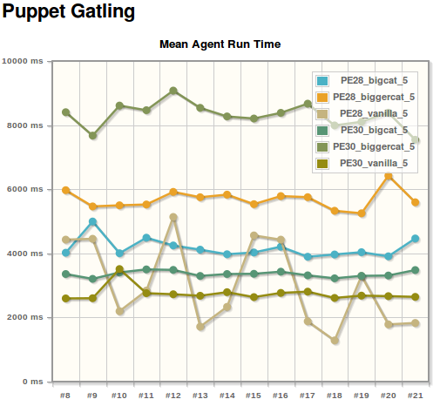
Discovering Bottlenecks
Notes:
That green line is much higher than it’s Puppet 2 version which is in the light blue.
We later discovered that issue had recently been fixed.
This issue might of been revealed sooner had developers had access to this load test data

Slide 43
Improving Reports
Making reports easier to use and analyze
Modification only took a little bit of jQuery
Change was merged into gatling jenkins plugin
Notes:
This involved making all of the graphs generated have clickable data points that would take you directly to the report

Slide 44
Improving Reports
Showing failed requests next to total mean agent run time
Notes:
This gives the user an idea of how accurate the total MRT is for agents

Slide 45
Improving Reports
Minimizing setup for developers using load testing framework
Notes:
This is as easy as adding the Puppet Gatling plugin as a “post build” action on the load test job.

Slide 46
Finally….

Slide 47
Quick Demo
Front Dashboard
Multiple Graph Breakdown
Pie Chart with OS Data
Clickable Graphs to Gatling Reports

Slide 48
Special Thanks
Chris Price
Jeff Weiss
Puppet Labs
FOSDEM
Notes:
Chris who was my mentor on the project throughout the development
Jeff who introduced me to FOSDEM
Puppet Labs for the great time I had as an intern
FOSDEM for letting me speak to you all

Slide 49
Link to Source Code
https://github.com/puppetlabs/puppet-gatling

Slide 50
Questions?

Slide 51
Thanks for listening!
Brian Cain
@brian_cain
github.com/briancain

