Slide 1

How compilers affect dependency resolution in Spack
Package Management Devroom at FOSDEM 2018
Brussels, Belgium
Todd Gamblin
Center for Applied Scientific Computing, LLNL
Feburary 3, 2018
@tgamblin

Slide 2
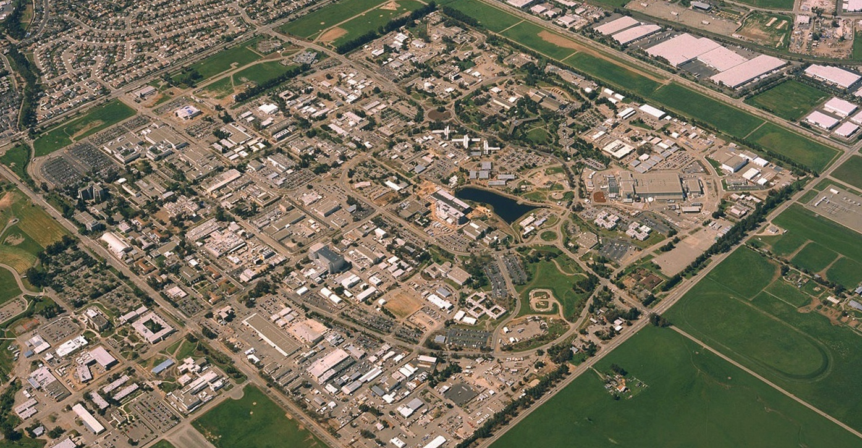
LLNL is a multidisciplinary national security laboratory
Established in 1952
Approximately 6,000 employees
1 square mile, 684 facilities
Annual federal budget: ~ $1.42B
2
Notes:
At least a couple of the committee members are new, so this might be useful.
Owned by the Federal Gov’t, operated by LLNS, LLC
LLNS, LLC: Bechtel, UC, B&W, URS Corp., Battelle
Population per SHRM March 1, 2014

Slide 3
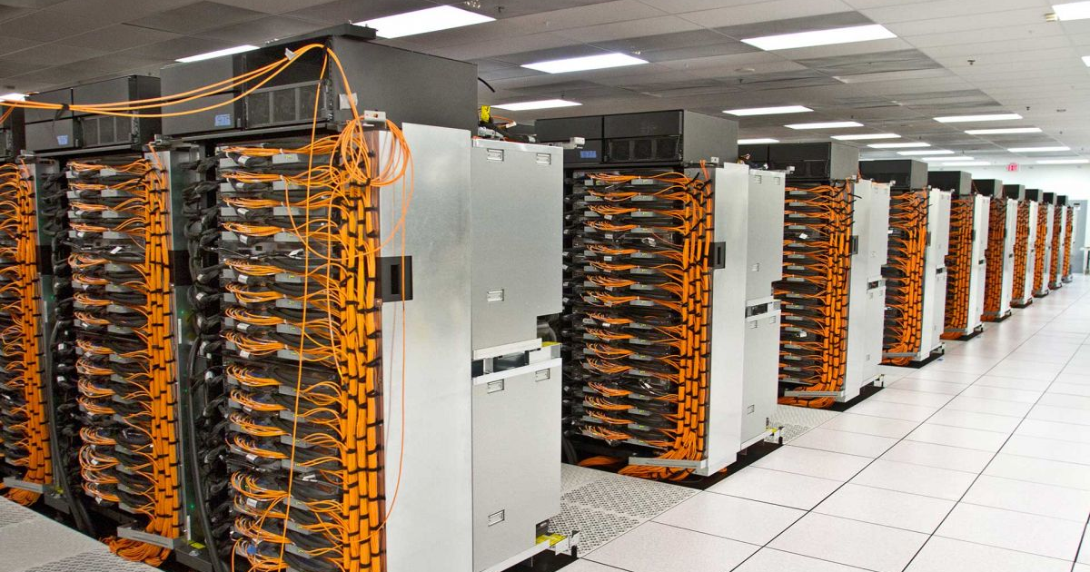



High-Performance Computing (HPC) is in the Lab’s DNA
Sequoia, a 1.5M-core Blue Gene/Q system.

Slide 4
Spack is a general purpose, from-source package manager
Inspired somewhat by homebrew and nix
Targets HPC and scientific computing
  Community is growing!
Goals:
  Facilitate experimenting with performance options
  Flexibility. Make these things easy:
    Build packages with many different:
      compilers/versions/build options
    Change compilers and flags in builds (keep provenance)
    Swap implementations of ABI-incompatible libraries
      MPI, BLAS, LAPACK, others like jpeg/jpeg-turbo, etc.
  Build software stacks for scientific simulation and analysis
  Run on laptops, Linux clusters, and some of the largest supercomputers in the world
Spack
https://spack.io

Slide 5
Spec CLI syntax makes it easy to install different ways
$ spack install mpileaks unconstrained
$ spack install mpileaks@3.3 @ custom version
$ spack install mpileaks@3.3 %gcc@4.7.3 % custom compiler
$ spack install mpileaks@3.3 %gcc@4.7.3 +threads +/- build option
$ spack install mpileaks@3.3 cflags="-O3 –g3" setting compiler flags
$ spack install mpileaks@3.3 ^mpich@3.2 %gcc@4.9.3 ^ dependency constraints
Each expression is a spec for a particular configuration
  Each clause adds a constraint to the spec
  Constraints are optional – specify only what you need.
  Customize install on the command line!
Spec syntax is recursive
  ^ (caret) adds constraints on dependencies

Slide 6
Spack packages are templates: they define how to build a spec
Simple Python DSL
  Packages are classes (ala homebrew)
  Directives use the same spec syntax
from spack import *
class Dyninst(Package):
"""API for dynamic binary instrumentation.""”
homepage = "https://paradyn.org"
url = "http://www.paradyn.org/release8.1.2/DyninstAPI-8.1.2.tgz"
version('8.2.1', 'abf60b7faabe7a2e’)
version('8.1.2', 'bf03b33375afa66f’)
version('8.1.1', 'd1a04e995b7aa709’)
depends_on("cmake", type="build")
depends_on("libelf", type="link")
depends_on("libdwarf", type="link")
depends_on("boost @1.42: +multithreaded")
def install(self, spec, prefix):
with working_dir('spack-build', create=True):
cmake('-DBoost_INCLUDE_DIR=‘ + spec['boost'].prefix.include,
'-DBoost_LIBRARY_DIR=‘ + spec['boost'].prefix.lib,
'-DBoost_NO_SYSTEM_PATHS=TRUE’
'..')
make()
make("install")
Metadata at the class level
Versions
Dependencies
Patches, variants, resources, conflicts, etc.
(not shown)
Install logic in instance methods

Slide 7
Depend on interfaces (not implementations) with virtual dependencies
mpi is a virtual dependency
Install the same package built with two different MPI implementations:
Virtual deps are replaced with a valid implementation at resolution time.
  If the user didn’t pick something and there are multiple options, Spack picks.
$ spack install mpileaks ^mvapich
Virtual dependencies can be versioned:
class Mpileaks(Package):
depends_on("mpi@2:")
dependent
$ spack install mpileaks ^openmpi@1.4:
class Mvapich(Package):
provides("mpi@1” when="@:1.8")
provides("mpi@2” when="@1.9:")
provider
class Openmpi(Package):
provides("mpi@:2.2" when="@1.6.5:")
provider

Slide 8
Spack builds packages with compiler wrappers
Spack
Process
Similar to homebrew “shims”
Forked build process isolates environment for each build
Use compiler wrappers to add include, lib, and RPATH flags
RPATHs ensure that the correct dependencies are found automatically at runtime.
do_install()
Install dep1
Install dep2
…
Install package
Fork
icc
icpc
ifort
Build
Process
Set up environment
CC = spack/env/intel/icc SPACK_CC = /opt/ic-15.1/bin/icc
CXX = spack/env/intel/icpc SPACK_CXX = /opt/ic-15.1/bin/icpc
F77 = spack/env/intel/ifort SPACK_F77 = /opt/ic-15.1/bin/ifort
FC = spack/env/intel/ifort SPACK_FC = /opt/ic-15.1/bin/ifort
PKG_CONFIG_PATH = ... PATH = spack/env:$PATH
CMAKE_PREFIX_PATH = ...
LIBRARY_PATH = ...
Compiler wrappers
(spack-cc, spack-c++, spack-f77, spack-f90)
-I /dep1-prefix/include
-L /dep1-prefix/lib
-Wl,-rpath=/dep1-prefix/lib
install()
configure
make
make install

Slide 9
Hashes handle combinatorial software complexity.
Dependency DAG
Each unique dependency graph is a unique configuration.
Each configuration installed in a unique directory.
  Configurations of the same package can coexist.
Hash of directed acyclic graph (DAG) metadata is appended to each prefix
  Note: we hash the metadata, not the artifact.
Installed packages automatically find dependencies
  Spack embeds RPATHs in binaries.
  No need to set LD_LIBRARY_PATH
  Things work the way you built them
Installation Layout
Hash
spack/opt/
linux-x86_64/
gcc-4.7.2/
mpileaks-1.1-0f54bf34cadk/
intel-14.1/
hdf5-1.8.15-lkf14aq3nqiz/
bgq/
xl-12.1/
hdf5-1-8.16-fqb3a15abrwx/
...

Slide 10
Spack’s dependency model centers around “concretization”
User input: abstract spec
mpileaks ^callpath@1.0+debug ^libelf@0.8.11
Solves for more than package/version, but similar to other resolvers
Dependencies need to be a DAG
Different dependency types:
  Build: tools run at build time
  Link: things linked with
  Run: things invoked at runtime
Only one instance of any dependency can be in the concrete DAG.
Nodes can have different compilers
Concretize
Abstract, normalized spec
with some dependencies.
Concrete spec is fully constrained
and can be built.

Slide 11
Why one configuration of a package per DAG?
Languages like Javascript have support for multi-versions in a DAG
  (most?) native linkers do not
You can link an executable with libraries that depend on two different versions of, say, libstdc++
You don’t want to do that:
  First one in which a function is called is loaded (this is a nasty race case)
  If ABI is different, you’ll get a fatal error when the second function version is called
In general, we can’t have two versions of one library
in the same process space

Slide 12
Why aren’t compilers proper dependencies?
compilers.yaml
They should be, but…
We want to mix compilers in one DAG
  Can’t do this with our restriction
  Dependency model flattens compilers
We needed to auto-detect vendor compilers
  Often required for fastest builds
  Needed an expedient way to use what’s available
compilers:
- compiler:
modules: []
operating_system: ubuntu14
paths:
cc: /usr/bin/gcc/4.9.3/gcc
cxx: /usr/bin/gcc/4.9.3/g++
f77: /usr/bin/gcc/4.9.3/gfortran
fc: /usr/bin/gcc/4.9.3/gfortran
spec: gcc@4.9.3
- compiler:
modules: []
operating_system: ubuntu14
paths:
cc: /opt/intel/17.0.1/bin/icc
cxx: /opt/intel/17.0.1/bin/icpc
f77: /opt/intel/17.0.1/bin/ifort
fc: /opt/intel/17.0.1/bin/ifort
spec: intel@17.0.1
...
$ spack compilers
==> Available compilers
-- gcc ----------------------------------
gcc@4.9.3 gcc@7.2.0
-- clang --------------------------------
intel@17.0.1
Auto-generated by searching environment

Slide 13
Why do HPC people care about compilers so much?
HPC people want to use fancy compilers for high performance
On many machines, this requires cross-compiling for the compute nodes
  Xeon Phi, Blue Gene, etc.
Some packages require compiler features, e.g.:
  OpenMP versions
  Language levels/verisons (C, C++, and Fortran have this)
  CUDA
  etc.
All of these pose some challenges for the dependency model

Slide 14
Fancy vendor compilers
Advantages:
Intel compiler gets better performance and vectorization than gcc
Similar for Cray, PGI, XL compilers
Issues:
Fancy compilers tend to be hard to work with
  At least most of the CLI options are consistent these days
Most OSS projects don’t test with them, so builds are fraught with peril
  Things like CMake (and its dependencies) don’t always build with XL
  Typically no reason to build these with anything but the system compiler
  No performance benefit for vectorizing build tools

Slide 15
How do we handle this?
We want to:
  Build build dependencies with the "easy" compilers
  Build rest of DAG (the link/run dependencies) with the fancy compiler
Works well for porting most scientific codes
  Results in consistent compilers within processes
What we actually do is run the concretizer separately for the pure build dependencies and the link dependencies
  If something is shared between build and link, go with the link version.
This is soon to be merged in.
spack install pkg1 %intel
1
1
L
B
L
B
B
5
2
5
2
B
L
B
L
L
B
L
B
6
6
7
4
7
3
4
3
R
R
R
Easy compiler
8
8
Fancy compiler
B: build L: link R: run

Slide 16
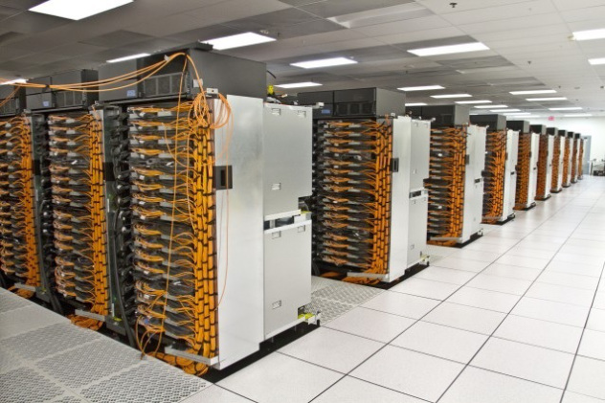
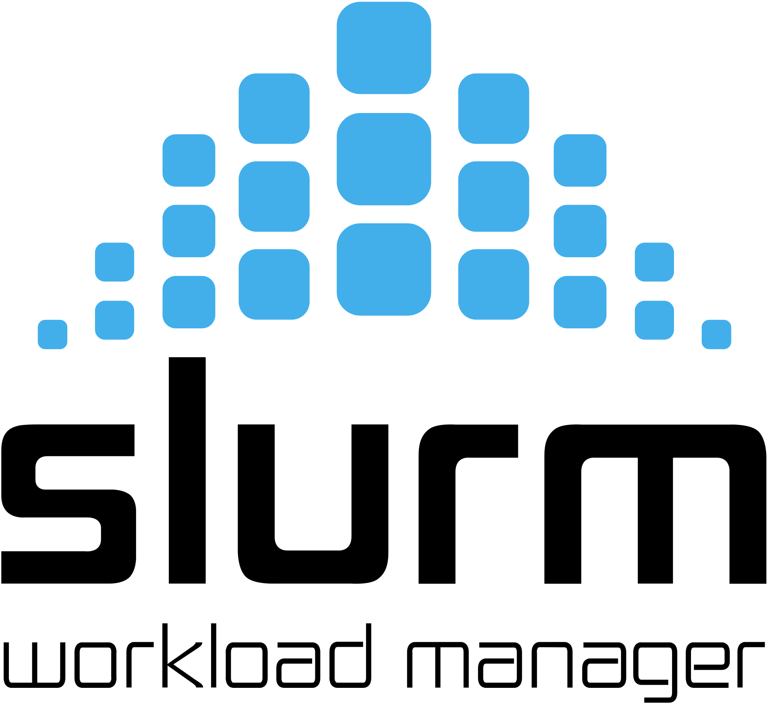




Cross-compilation
Why cross-compile?
  Your machine has Xeon Phi processors or maybe it’s a BlueGene/Q
  You need to run a cross-compiler to build for the compute nodes
Submit jobs
Login/build nodes
Run jobs
User login
Compute nodes
PowerPC A2 (incompatible ISA)
Incompatible OS/runtime

Slide 17
Why not build natively on the compute nodes?
In many cases, building on the compute nodes is very slow
  There are 72 Atom cores on a Knights Landing (Xeon Phi)
  Each is only 1.4 Ghz
  Typically only talk to network filesystem (diskless nodes)
Many tools (like compilers) are not ported to the compute node
  Compute node uses a stripped down OS (e.g., BG/Q)
  Maybe you don’t have that many licenses for your fancy compiler!
Generally you want to build on the machines with the big cores
  Fast Xeon front-end nodes
  Power8/Power9 nodes

Slide 18
How do build dependencies work with cross-compiles?
Recall some of the dependency types:
  Build: tools run at build time.
  Link: things the package links with
  Run: things the package invokes at runtime.
Well, now you have an issue:
  you need your build dependencies built for a the architecture where you’re building
  Sometimes you can get away with cheating (build everything for the compute arch)
    Depends how close the compute OS and ISA are to the build nodes
We can use our build dependency trick here, but it’s a bit more complex

Slide 19
Cross compiling and dependencies
spack install pkg1 target=knl
1
1
Can’t be a
build dep
Suppose you have a dependency that is both a build dependency AND a link dependency.
Build dependency trick definitely helps
Could previously share the fancy compiler version
  But now you can’t b/c the compute version won’t run in the build environment
B
L
B
5
2
5
2
B
L
B
L
6
6
7
4
7
3
4
3
R
R
R
Front end (Xeon)
Can’t be a
run dep of
a build dep
8
8
Compute (KNL)
B: build L: link R: run

Slide 20
Cross compiling and DAG splitting
spack install pkg1 target=knl
We can solve this problem by building two versions of the conflicting libraries
  Need to relax our DAG constraint
It’s ok to split these because the build and run environments are separate process spaces
  not actually going to ever cause a race in ld.so
Now there are 2 versions of 5 and 8, though
  We’d like to minimize redundant versions
1
1
B
L
B
B
5
2
5
2
5’
B
L
B
L
B
6
6
7
4
7
3
4
3
R
R
R
R
Front end (Xeon)
8
8
8’
Compute (KNL)
B: build L: link R: run

Slide 21
Interesting cross-architecture constraints
Python doesn’t really understand cross-compilation
  you might not think it’d need to
Setuptools is a build tool that adds code to the installed package
  generated code is python version-dependent.
  now you need front-end python and back-end and compute python to be the same version
  this constraint spans two parts of your DAG!
Your build env is not entirely separate from your run env
  Can’t just do independent resolution for build dependencies!
This is one reason we’re moving to SAT for dependency resolution
    Easier and more general to express constraints like this
native-pkg
B
R
setuptools
python
B
Must be same version!
python’

Slide 22
Last issue: Compiler dependencies
Compilers are still a special case in Spack
  Represented as attributes of nodes, not as dependencies
Two issues:
  Compiler can’t provide virtual dependencies like packages
  Compilers can’t easily have their own dependencies
We’d like packages to be able to depend on C++11, C++17, OpenMP 4.5, etc.
  Requires compiler to provide C++ and OpenMP as virtual deps
Some compilers actually depend on other compilers!
  Intel compilers rely on gcc to provide libstdc++
  Verison ranges need to match for this to work properly!
  Coordinating this is a constant source of user frustration at HPC centers

Slide 23
Compiler dependencies
Suppose we build a simple C++11 package with the Intel compiler
  We’ll model it as a build dependency
  Easy enough to represent this
Suppose we want to reuse an already-installed package built with an older Intel compiler version (that isn’t available anymore)
  With our relaxed constraint, build dependencies allow us to mix compilers
But how can we ensure that the
libstdc++ implementations are consistent?
  ld.so race!
1
L
2
B
B
intel@17
intel@16
R
R
gcc@4.9.3
gcc
Already-installed dependency

Slide 24
So what is a compiler anyway?
A compiler is a build dependency that IMPOSES a link dependency on a DAG
Each compiler has “hidden” dependencies
  These are proper runtime libraries, so we need to model them like they are
New plan:
  Still model compilers as build dependencies
  Bring out libstdc++ and other libraries from compilers as link dependencies
  of the thing being built
    Ensures consistency across each DAG
  We’ll Still “normalize” or “flatten” the (hidden) link dependencies in the DAG

Slide 25
New compiler dependency model
Already-installed dep
1
Compiler-imposed dep
2
L
Now consistency is enforced via link dependencies from 1 and 2
If the libstdc++ versions from 1 and 2 don’t match, then this won’t resolve
If they do, then we know that the C++ libs are compatible and can build this, even with the old dependency.
We currently use some heuristics to enforce
  Moving to SAT makes a lot of sense, again
B
B
intel@16
intel@17
L
L
R
R
gcc@4.9.3
gcc
libstdc++

Slide 26



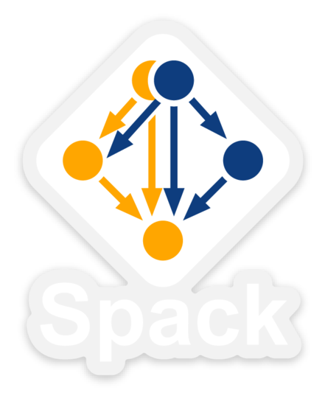

Summary
Working out constraints for compiler integration isn’t easy
Weird things can happen
  build/link/run environment distinctions
  Architecture distinctions
  Constraints that manifest in strange ways across seemingly separate parts of the DAG
    Setuptools
    Stdlib compatibility
We are aiming to automate this part of build configuration
  Better automate experimentation with build options
  Lower cost of supporting multiple compilers for code teams
Working on bringing out this new compiler model with the new dependency resolver (concretizer) in Spack this year.
Spack
https://spack.io
Come and get Spack stickers!

