Slide 1
.NET on the Web with Mono WebAssembly
Mikayla Hutchinson
mhutch@microsoft.com
@mjhutchinson

Slide 2
What’s WebAssembly?

Slide 3
Bytecode for the web
Runs in browser sandbox & node.js
Use language of choice
Reuse existing libraries

Slide 4
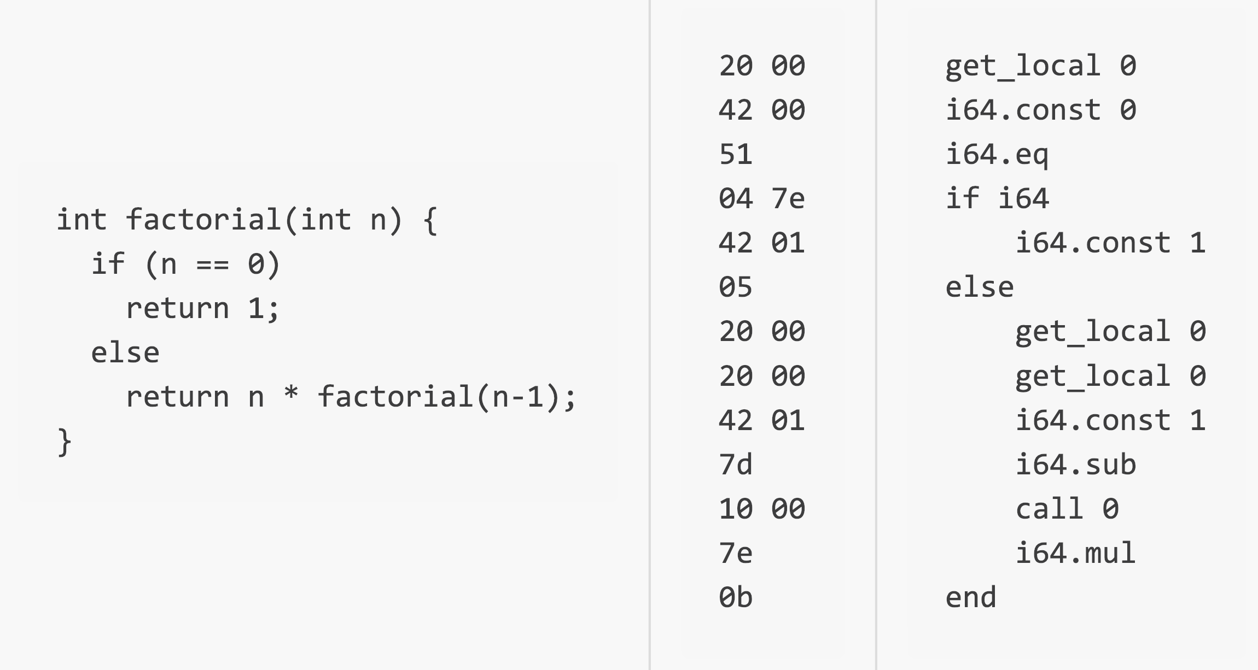

Slide 5
Started 2015, MVP consensus 2017
Chrome, Firefox, Safari, Edge
UE4, Unity, Godot, AutoCAD, Figma
Builds on older asm.js (2010)
webassembly.org

Slide 6
C/C++
clang
LLVM IR
wasm

Slide 7
.NET IL
Mono
LLVM IR
wasm

Slide 8
Not quite that simple
Can’t JIT
No threads
No signals

Slide 9
It mostly works
🎉
(and it’s getting better!)

Slide 10
Modes
Interpreter
Slower code, faster compile, smaller code
AOT
Faster code, slower compile, larger code
Mixed mode
Pick tradeoffs to get best of both

Slide 11
Bindings
C#:
Runtime.InvokeJS
JSObject.Invoke
JSObject.GetObjectProperty
…
JS:
Module.cwrap
Module.mono_method_invoke
Module.mono_call_static_method
…

Slide 12
Binding Generator
JavaScript typing is weak & dynamic
In practice, most APIs are not
TypeScript definitions: definitelytyped.org
Allows generating C# wrappers

Slide 13
Getting Started

Slide 14


Slide 15
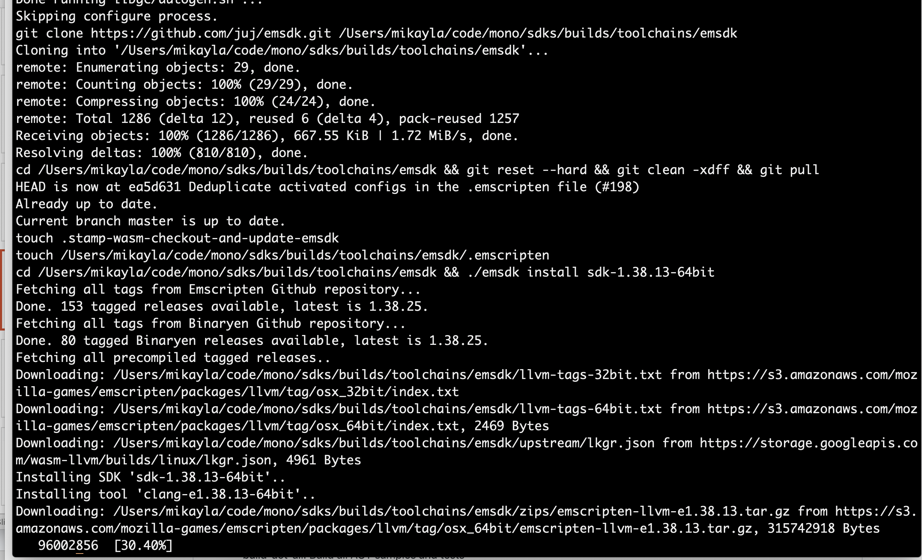

Slide 16
Higher-level Platforms
Blazor – blazor.net
Full-stack framework for SPAs
Uno – uno.platform
Cross-platform re-implementation of UWP
Ooui – ooui.mecha.parts
OO UI toolkit on web tech to native elements
WasmWinforms – github.com/roozbehid/WasmWinforms
Mono’s WinForms stack on wasm

Slide 17
DEMO

Slide 18
Resources
webassembly.org
github.com/mono/mono/tree/master/sdks/wasm
blazor.net
platform.uno

Slide 19
Thank you!
Please remember to fill out session evaluations 💯
@mjhutchinson
mhutch@microsoft.com

