Slide 1
Emitter: Scalable, fast and secure pub/sub platform in Go
emitter.io
by Tom Marechal and Florimond Husquinet

Slide 2
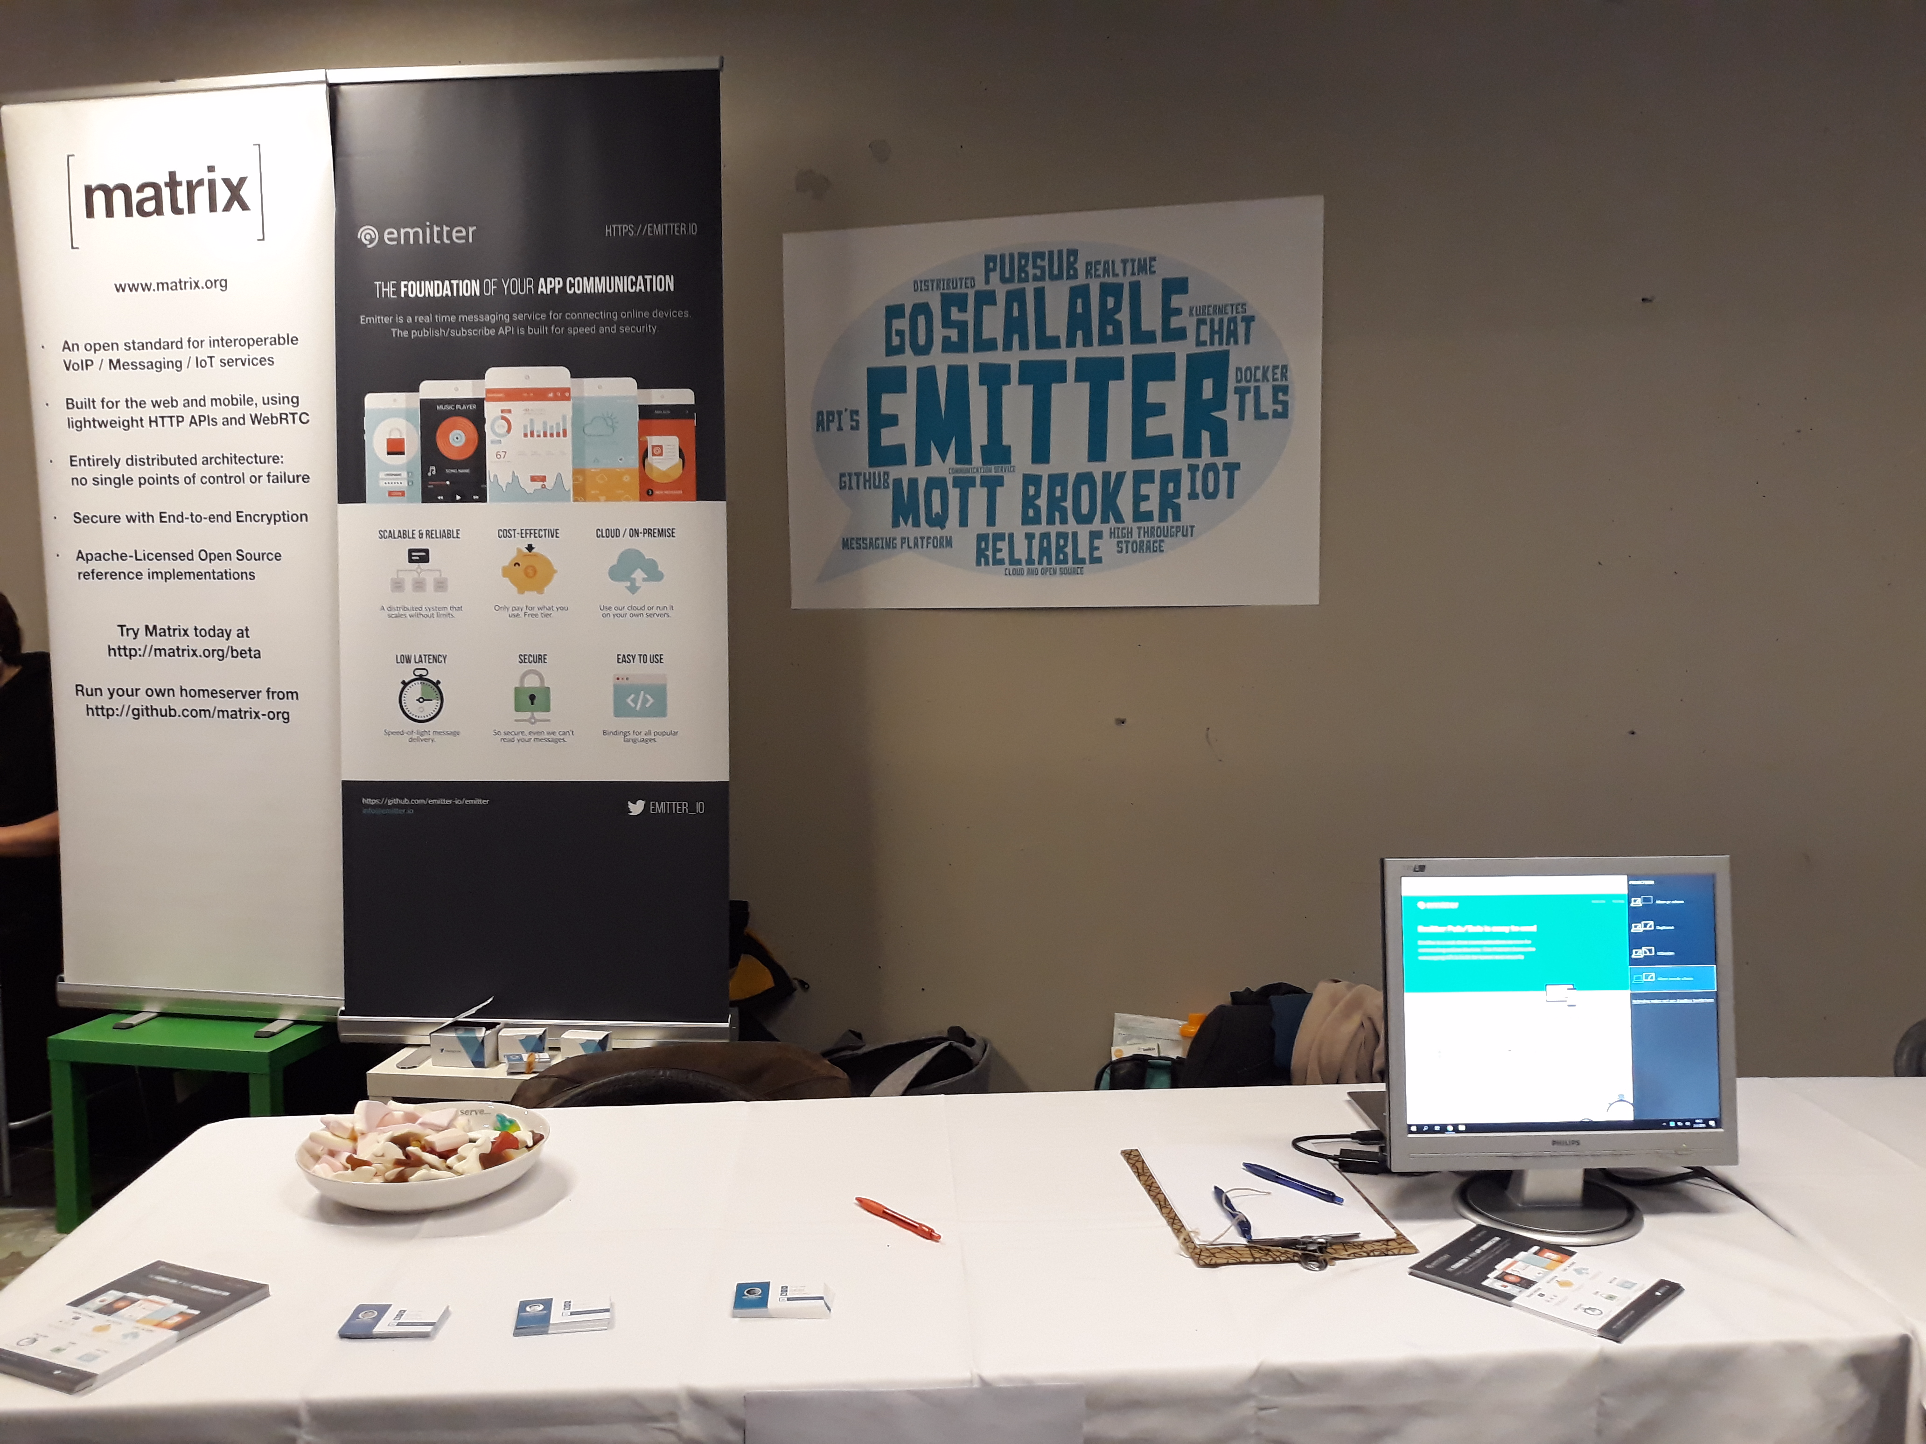

Visit us
Building K2.19
Level 2

Slide 3

Who are we
Based in the Benelux and Singapore
Don’t reinvent the wheel
Short time to market

Slide 4
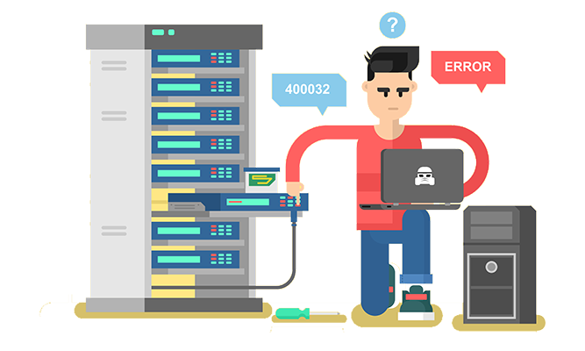

Communication Problem
How can Alice talk to Bob?
What’s Bob’s address?
Is Bob available?
How to bring Eve into the conversation?
Security?
Alice
Bob

Slide 5
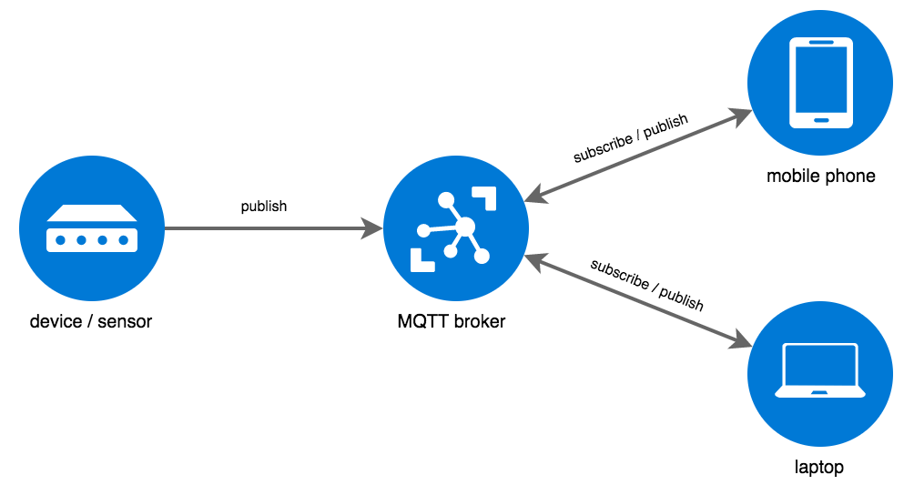
Space Decoupling
Publish/Subscribe systems are one of the ways to simplify network communication.
Publishers and subscribers don’t need to be aware of each other.
Central server: the broker
Channels: /hello/world/#
Storage

Slide 6
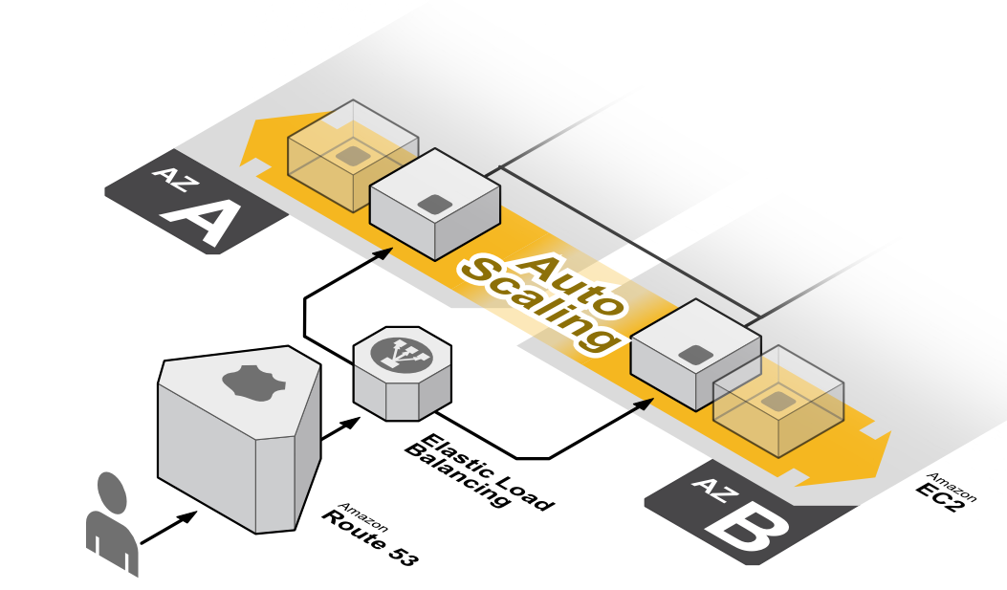
Challenges
Brokered pub/sub systems have their challenges:
Scaling
Message Routing
Partition tolerance
...

Slide 7


Solution
Wouldn’t it be nice if there would be an off-the-shelf and open source solution to overcome all these challenges?
Emitter:
Scalable publish/subscribe plateform written in Go.
Uses standard MQTT protocol with support for most languages.

Slide 8
Emitter
Scalable: Built to handle millions of messages and to scale horizontally.
Fast: Designed to ensure reliable, fast message delivery and high throughput.
Secure: Supports TLS encryption, expirable channel keys and permissions.
Persistent: Messages can be stored for a period of time and sent to subscribers on demand.
Light weight: Uses standard MQTT protocol, little overload, low battery usage.
Easy to use: Simple API, supports message filtering, binary (supports all data types).

Slide 9
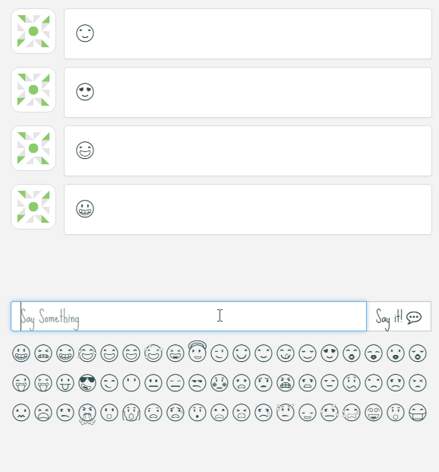
Real-time Chat
Publisher channel
Chat/room1/
Subscriber channel
Chat/room1/

Slide 10
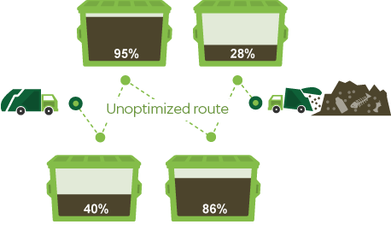
Smart cities
Publisher channel
fillingrate/bin1/ fillingrate/bin2/ fillingrate/bin3/ fillingrate/bin4/
Subscriber channel
fillingrate/#

Slide 11
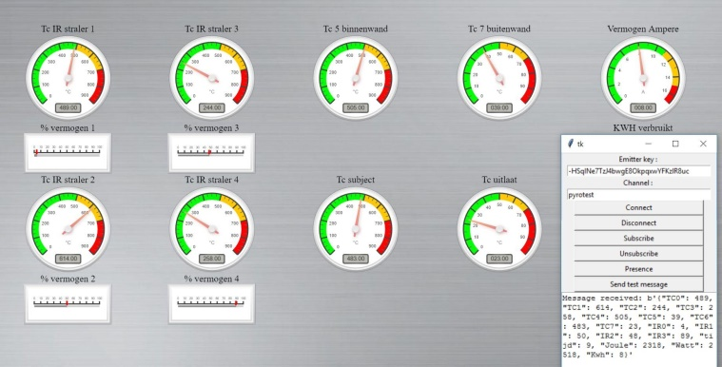
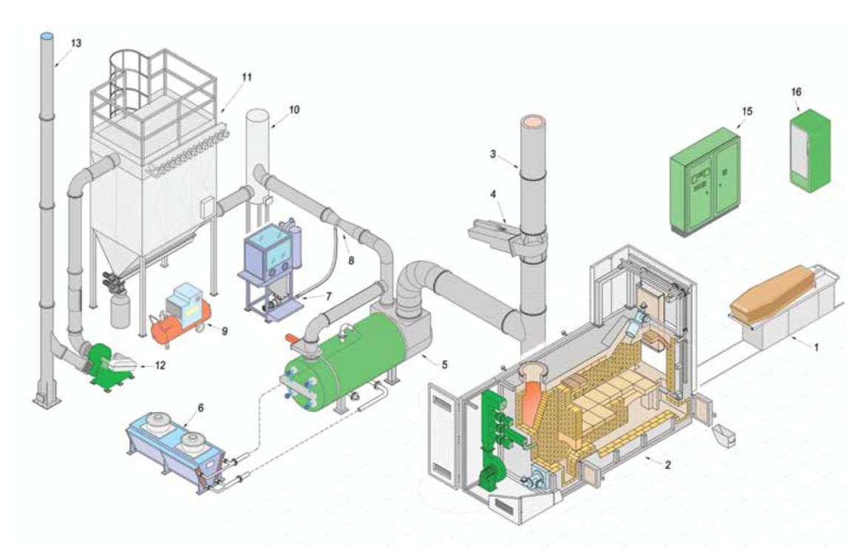
OT monitoring
Publisher channel
furnace1/silo/temperature/
Publish channel: furnace1/silo/temperature
Subscriber channel
furnace1/+/temperature/
Subscribe channel example: furnace1/+/temperature
Publisher channel
furnace1/chamber/temperature/
Publish channel: furnace1/chamber/temperature

Slide 12
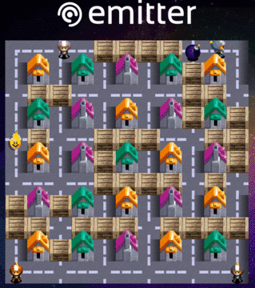
Online Games
Publisher channel
bomberman/[ID]/player1/ bomberman/[ID]/player2/ bomberman/[ID]/player3/ bomberman/[ID]/player4/
Subscriber channel
bomberman/[ID]/#

Slide 13
API: subscribe
// once we're connected, subscribe to the 'chat' channel
emitter.on('connect', function(){
emitter.subscribe({
key: "h-uvYdPeY8zdIhr-YaHgaFfFpP84OtRp",
channel: "chat/#",
last: 5
})
})

Slide 14
API: publish
emitter.publish({
key: "h-uvYdPeY8zdIhr-YaHgaFfFpP84OtRp",
channel: "chat/florimond",
ttl: 1200,
message: "hello, emitter!"
})

Slide 15
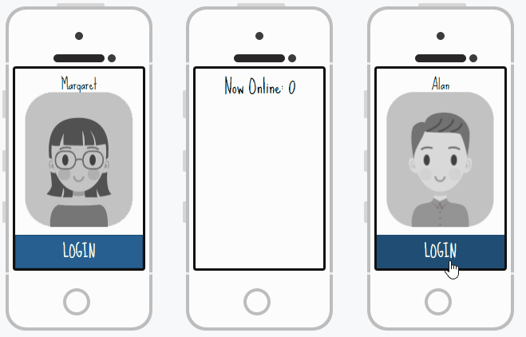
API: presence

Slide 16
API: presence
emitter.presence({
key: "h-uvYdPeY8zdIhr-YaHgaFfFpP84OtRp",
channel: "chat/sports",
status: true,
changes: false
});

Slide 17
API: presence
{
event: "status",
channel: "chat/sports",
time: 1471771395,
who: [{
id: "Ekm4hAAAAABesHHK",
username: "user1"
},
{
id: "A4EcAAAAABesHHE",
username: "user2"
}]
}
{
event: “unsubscribe",
channel: "chat/sports",
time: 1471771395,
who: [{
id: "Ekm4hAAAAABesHHK",
username: "user1"
}]
}

Slide 18


Emitter API
Publisher
Subscriber
Brokers
Channel X
Channel X
Publisher
Subscriber
Channel X
Channel X

Slide 19

Emitter
Open Source
github.com/emitter-io
AGPL licence
Free as in free beer
Set up in minutes (docker container)
Host on your own servers
Emitter Cloud
Don’t worry about servers
Don’t worry about scaling
Pay per usage

Slide 20
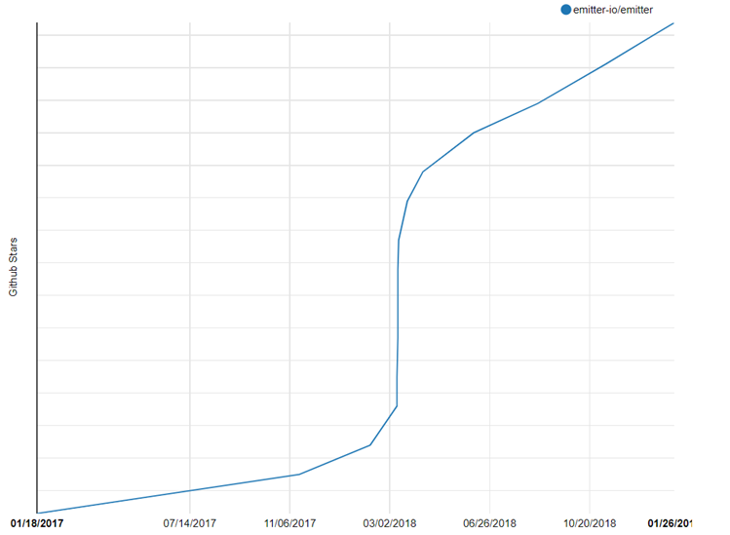
Stargazers

Slide 21
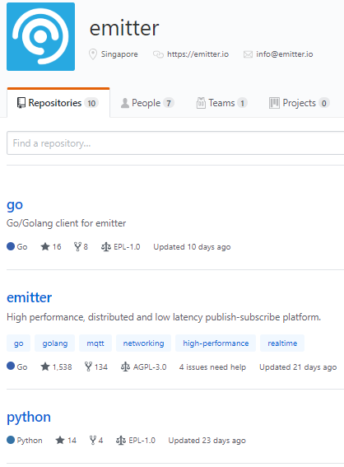
Contributions and SDKs
Available SDKs
  Go
  CSharp
  Python
  JavaScript
  Java
  …more to come

Slide 22
Visit us
Building K2.19
Level 2

Slide 23

emitter.io

