Slide 1
Mattermost’s Approach to Layered Extensibility in Open Source
Corey Hulen / Co-founder and CTO, Mattermost, Inc.
Feb 2019

Slide 2
Mattermost as an OS
Mattermost as a platform from the very beginning
Smart workflows
Real Estate
AI
BI
Salesforce
Finance
Healthcare
Etc
Etc
Mattermost Platform

Slide 3
ERP
Embedding Applications inside of Mattermost
Corporate
Directory
Analytics
Smart workflow
Smart workflow
Smart workflow
Mattermost
HR
Customer
Support
Smart workflow
Smart workflow
Smart workflow
Smart workflow
Operations
Salesforce

Slide 4
Developer Toolkit
Mattermost has Layers!
Slash Commands and Webhooks
REST API/Bots
Plugins
Open Source
Open Data

Slide 5
Mattermost is Open Source
Typical open source goodness
Fork, change what you want (heck change everything!)
Hard, takes a lot of resources
People love the idea but in reality very rarely happens
100% of what you see in the UI is accessible from our RESTful JSON web service API

Slide 6
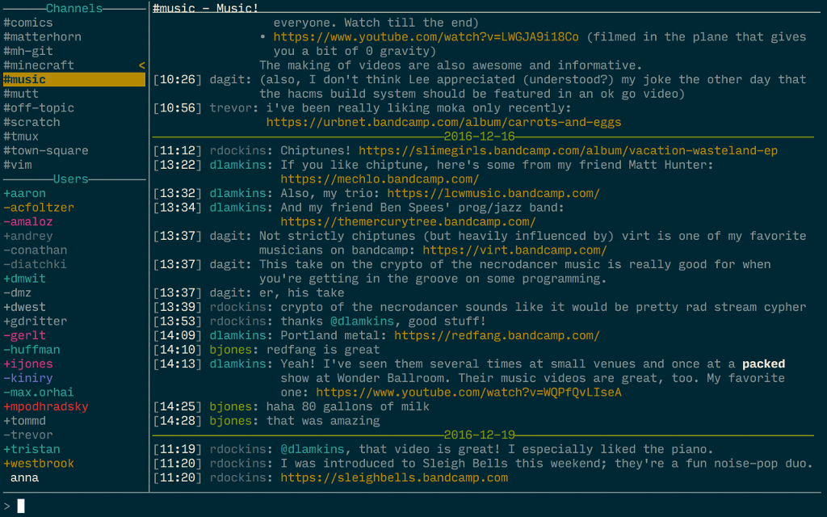
Open Source Example
Matterhorn is a terminal client for the Mattermost chat system.
https://github.com/matterhorn-chat/matterhorn

Slide 7
Mattermost is Open Data
You own 100% of your data
Easy extraction and manipulation with SQL
Easily chart, report, analyze
No proprietary data models; nothing hidden

Slide 8
Developer Toolkit
Incoming/Outgoing Webhooks
Slash Commands
Bots
REST API
Client-side Plugins
Server-side Plugins
https://developers.mattermost.com

Slide 9
Webhooks
Incoming Webhooks
Post messages to public, private and direct message channels
Simple HTTP POST request to a URL
Designed to easily allow you to post messages
Slack compatible
Outgoing Webhooks
Post automated responses to posts made by your users
Uses trigger words
Simple HTTP POST request to a web service
Slack compatible

Slide 10
Webhooks Example

Slide 11
Slash Commands
Easy way integrate external applications
Similar to outgoing webhooks, but can be used in any channel
Simple HTTP POST request to a URL, process response back into channel
Both built-in and custom slash commands
Slack compatible

Slide 12
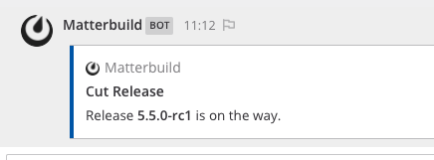
Matterbuild example

Slide 13
Bots
Official and community-built drivers for our web service API
Javascript
Golang
PHP
Python
https://api.mattermost.com
Golang bot sample code
Uses the go driver to interact with the Mattermost server
Login to the server, create a channel, modify a user, etc
https://github.com/mattermost/mattermost-bot-sample-golang

Slide 14
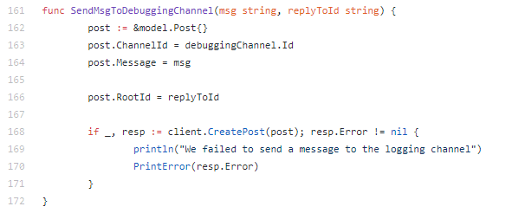
Sample Bot Example

Slide 15
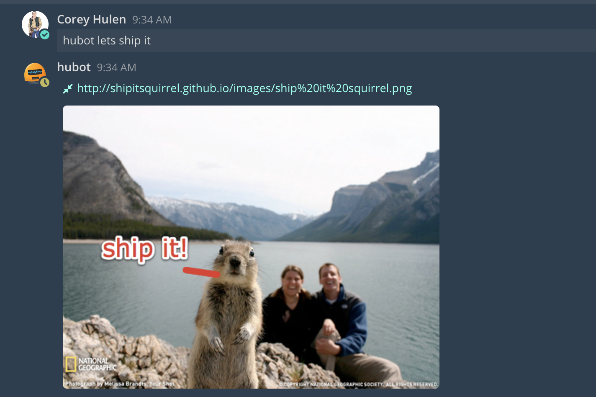
Hubot Example

Slide 16
Plugins Overview
Customize User Interfaces
Write a web app plugin to add to the channel header, sidebars, main menu and more. Register your plugin against a post type to render custom posts or wire up a root component to build an entirely new experience. All this is possible without having to fork the source code and rebase on every Mattermost release.
Launch Tightly Integrated Services
Launch and manage server plugins as services from your Mattermost server over RPC. Handle events via real-time hooks and invoke Mattermost server methods directly using a dedicated plugin API.
Extend the Mattermost REST API
Extend the Mattermost REST API with custom endpoints for use by web app plugins or third-party services. Custom endpoints have access to all the features of the standard Mattermost REST API, including personal access tokens and OAuth 2.0.

Slide 17
Customize User Interfaces (Client Side)
registerRootComponent(component)
registerPopoverUserAttributesComponent(component)
registerPopoverUserActionsComponent(component)
registerLeftSidebarHeaderComponent(component)
registerBottomTeamSidebarComponent(component)
registerPostMessageAttachmentComponent(component)
registerChannelHeaderButtonAction(icon, action, dropdownText, tooltipText)
registerPostTypeComponent(type, component)
registerMainMenuAction(text, action, mobileIcon)
registerPostDropdownMenuAction(text, action, filter)
registerPostDropdownMenuComponent(component)
registerFileUploadMethod(icon, action, text)
registerFilesWillUploadHook(hook)
unregisterComponent(componentId)
registerReducer(reducer)
registerWebSocketEventHandler(event, handler)
unregisterWebSocketEventHandler(event)
registerReconnectHandler(handler)
unregisterReconnectHandler()
registerMessageWillFormatHook(hook)

Slide 18
Channel Header Button Example
Add a button to the channel header
If there is more than one button, a dropdown menu is created
Great for things like video conferencing integration
Our built-in Zoom integration is actually a plugin

Slide 19
Zoom Integration adding a Header Button

Slide 20
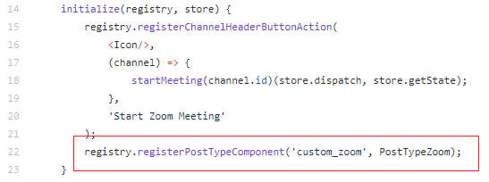
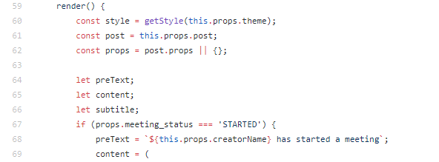
Override Post Rendering
Register a component to render a custom body for posts
Great for rich integrations with custom applications
More than simple text or a screenshot
The Zoom plugin uses this to render a custom post

Slide 21
Zoom Integration custom rendering

Slide 22
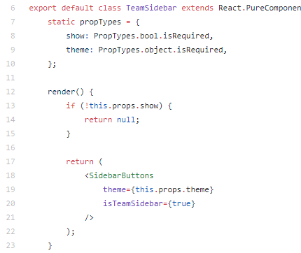
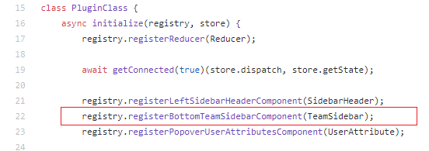
Render Component on the Team Sidebar
Register a component fixed to the bottom of the team sidebar
Used in our Github plugin

Slide 23
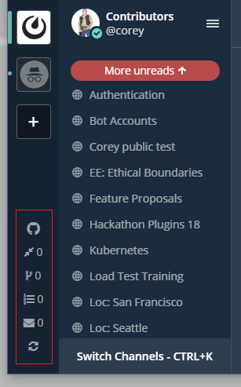
Github Integration

Slide 24
Rewrite the Message Client Side
Register a hook that will be called before a message is formatted into Markdown
Used in the Walltime plugin

Slide 25
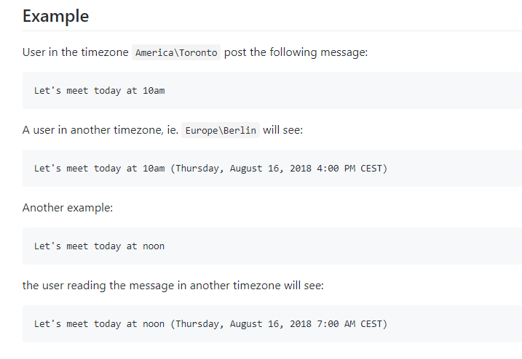
Walltime Plugin

Slide 26
Tightly Integrated Services (Server Side)
OnActivate() error
Implemented() ([]string, error)
OnDeactivate() error
OnConfigurationChange() error
ServeHTTP(c *plugin.Context, w http.ResponseWriter, r *http.Request)
ExecuteCommand(c *plugin.Context, args *model.CommandArgs) (*model.CommandResponse, *model.AppError)
UserHasBeenCreated(c *plugin.Context, user *model.User)
UserWillLogIn(c *plugin.Context, user *model.User) string
UserHasLoggedIn(c *plugin.Context, user *model.User)
MessageWillBePosted(c *plugin.Context, post *model.Post) (*model.Post, string)
MessageWillBeUpdated(c *plugin.Context, newPost, oldPost *model.Post) (*model.Post, string)
MessageHasBeenPosted(c *plugin.Context, post *model.Post)
MessageHasBeenUpdated(c *plugin.Context, newPost, oldPost *model.Post)
ChannelHasBeenCreated(c *plugin.Context, channel *model.Channel)
UserHasJoinedChannel(c *plugin.Context, channelMember *model.ChannelMember, actor *model.User)
UserHasLeftChannel(c *plugin.Context, channelMember *model.ChannelMember, actor *model.User)
UserHasJoinedTeam(c *plugin.Context, teamMember *model.TeamMember, actor *model.User)
UserHasLeftTeam(c *plugin.Context, teamMember *model.TeamMember, actor *model.User)
FileWillBeUploaded(c *plugin.Context, info *model.FileInfo, file io.Reader, output io.Writer) (*model.FileInfo, string)

Slide 27
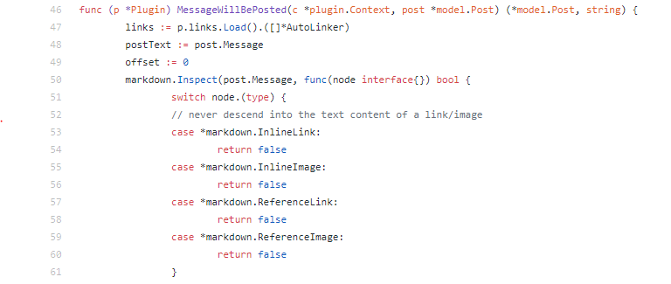
Rewrite the Message Server Side
Lots of opportunities to hook the message
Before it enters into the database
You can reject messages
You can also send back ephemeral messages
After it enters into the database

Slide 28
Autolink Plugin

Slide 29
Implement a http.Handler on the Server
ServeHTTP allows the plugin to implement the http.Handler interface.
Requests destined for the /plugins/{id} path will be routed to the plugin.

Slide 30
WelcomeBot Handling Custom Actions

Slide 31
Thank you

Slide 32
Mattermost is hiring!
https://mattermost.com/careers

Slide 33
Mattermost Mentor Program
Shepherding
Helping someone get involved in the Mattermost community
Need help submitting your first pull request?
Want some general advice?
Two 1-1 sessions with a core contributor
Mentorship
Focused on bringing more people into the Mattermost community
Application process
3 month program
Minimum commitments must be met
Paired with a core contributor for the entire time
Weekly 1-1 sessions with a core contributor
Interested? Talk with me afterwards!

Slide 34
Questions?

Slide 35
How to reach me?
Mattermost: @corey on https://community.mattermost.com
Twitter: @corey_hulen
Email: corey@hulen.com

