Slide 1
ONOS Introduction and Demo
Laszlo Papp
ONOS Ambassador
February 2nd, 2019

Slide 2
Agenda
What is ONOS
Architecture
Demo
Community

Slide 3
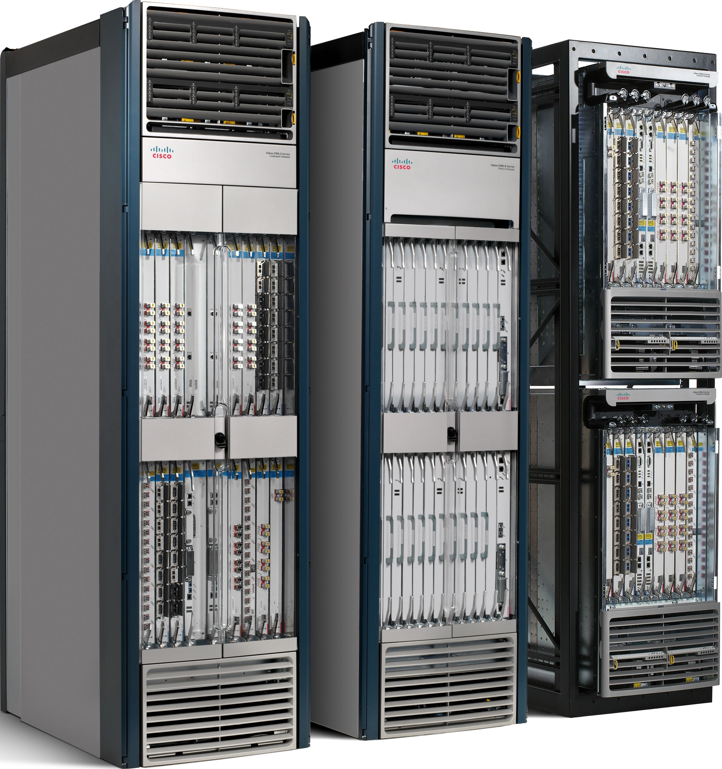
Closed market (until 2008)
Feature
Feature
Control plane
Same vendor, closed platform
Operating System
Data plane
Router or switch operating planes
Specialized packet forwarding HW
Little ability for small players and researchers to implement or try new features.
Notes:
The other problem is that the market of networking devices is a closed one.
HW, operating system and features are baked in the same box, from the same vendor, in a closed platform.
[CLICK]
The result is that small players or researchers have little ability to implement or try new features.
[CLICK]
The consequences of all this is that till 2008 we’ve assisted at a very slow evolution of networking, this is especially true when compared to other fields such as computing or storage.
[CLICK]
That’s why networking ended up being the bottleneck of the infrastructure. Because it was too hard for network operators to program the features they need in the network.

Slide 4
SDN Architecture
App
App
App
Control plane
Topology graph + metadata
Logically centralized i.e. distributed
Network OS
Handles state distribution, data plane configuration management, error recovery...
Forwarding API
Forwarding HW
Forwarding HW
Data plane
Forwarding HW
Forwarding HW
Notes:
This is what an SDN architecture looks like.
[CLICK]
We have the data plane at the bottom which comprises only the forwarding HW of network devices.
[CLICK]
The control plane is separated and [CLICK] logically centralized, i.e. it can be still distributed but in a different way from the data plane. For example in a few, 3 or 4 nodes.
The control plane is made by a network OS and some applications that run on top of it.
[CLICK]
On the bottom, the network OS controls the data plane via a standard forwarding API. As we will see later, this is pretty much a low level API to the data plane forwarding hardware.
[CLICK]
At the top, the network OS exposes API to applications to program the network in a centralized fashion. Essentially it maintains and exposes a topology graph, annotated with metadata.
[CLICK]
No the network OS is the one responsible for handling the state distribution, management of the data plane configuration, error recovery, so on and so forth. Thus hiding the complexity of the network to the applications that want to program it.

Slide 5
ONOS
Open Network Operating System

Slide 6
What is ONOS?
SDN controller platform
SDN/NFV Controller Platform
Java
Open Source: Apache 2.0 Source: https://github.com/opennetworkinglab/onos
Quarterly Releases, Quail (2.0.0) - 2019-01

Slide 7
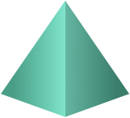
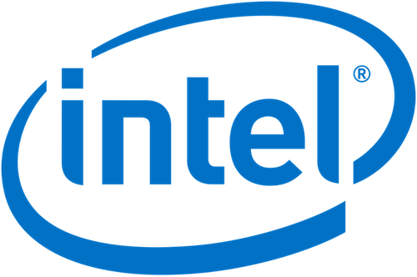
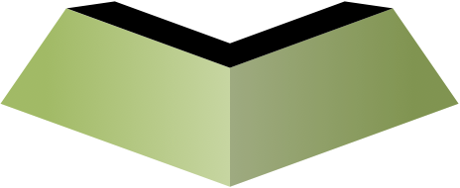
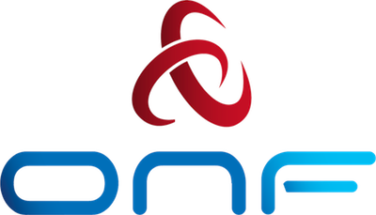
The ONF Ecosystem – 160+ Members Strong
Vibrant Operator Led Consortium Positioned for Success
ONF BOARD
CHAIR:
Andre Feutsch - CTO
Operator Partners
Jochen Appel - VP
Amin Vahdat - Fellow
Vendor Partners
Dai Kashiwa - Director
Rob Howald - VP
Innovator Operators
Shao Guanglu - SVP
Patric Lopez - VP
70+
Innovator Vendors
Firay Yaman Er - CSO
70+
Nick McKeown - Prof
Collaborators
Guru Parulkar, Exec Dir

Slide 8
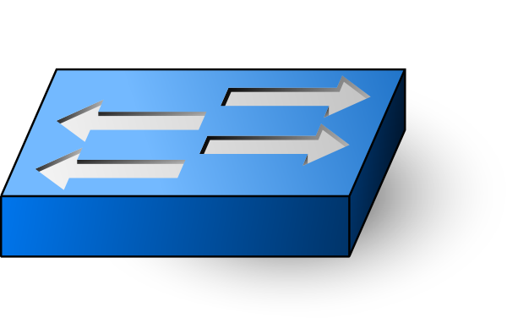
Distributed Core
Distributed Core
Apps
Apps
NB Core API
NB Core API
Distributed Core
(state management, notifications, high-availability & scale-out)
Distributed Core
(state management, notifications, high-availability & scale-out)
SB Core API
SB Core API
Multiple device Plugins
Multiple device Plugins
Multiple device Plugins
Multiple device Plugins
Notes:
ONOS is meant for real world deployments
High-availability, scalability and performance
required to sustain demands of service provider & enterprise networks → valid also for datacenters
Strong abstractions and simplicity
required for development of apps and solutions
Protocol and device behaviour independence
avoid contouring and deformation due to protocol specifics
Separation of concerns and modularity
allow tailoring and customization without speciating the code-base
Controller as a Single Point of faliure
By centralizing the logic in the controller it can become a single point of failure.
ONOS has multiple instances, distribution,
high availability, scalability

Slide 9
Notes:
By centralizing the logic in the controller it can become a single point of failure.
ONOS has multiple instances, distribution,
high availability, scalability

Slide 10
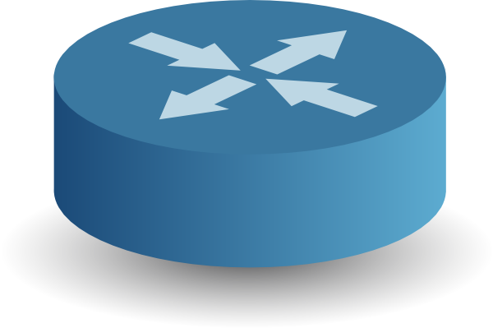
Notes:
The controllers coordinate with each other to elect a master and from the new master communicates this decision to the switch and from that point on the switch exclusively communicates with its master.

Slide 11
Notes:
If one controller fails,

Slide 12
Notes:
the switches automatically failover to the backup controller and you have everything up and running with zero downtime.

Slide 13
Northbound
Northbound
Apps
Apps
NB Core API
NB Core API
Distributed Core
(state management, notifications, high-availability & scale-out)
Distributed Core
(state management, notifications, high-availability & scale-out)
SB Core API
SB Core API
Multiple device Plugins
Multiple device Plugins
Multiple device Plugins
Multiple device Plugins

Slide 14
Key Northbound Abstractions
Network Graph
Directed, cyclic graph comprising of infrastructure devices, infrastructure links and end-station hosts
Flow Objective
Device-centric abstraction for programming data-plane flows in version and vendor-independent manner
Intent
Network-centric abstraction for programming data-plane in topology-independent manner
Notes:
This is a problem... complex... lots of code.
Provide a generalized mechanism for describing, processing and installing these objectives.
consistent behavior for failures
To solve these problems and more generally make it easier to write applications, we have built the Intent Framework as an abstraction layer.
Provide a flexible, high-level interface for declaring global network policy
Allow applications and operators to describe policy rather than device instructions
Abstract network complexity from higher layers
Extend easily to produce more complex functionality through combinations of other intents
To be more concrete, I would like to illustrate this using a simple example, using the same application objective. An application begins with by defining a high level object defined requests connectivity is established between specific hosts. That object is submitted to the Intent framework that will be responsible for processing it. The Intent Framework will first transform the intent into more specific intent objects through a process called compilation. Once the intents that contain enough information that they can be programmed, we convert these lower-level intents into resource reservations and work in a process called installation.

Slide 15
Southbound
Southbound
Apps
Apps
NB Core API
NB Core API
Distributed Core
(state management, notifications, high-availability & scale-out)
Distributed Core
(state management, notifications, high-availability & scale-out)
SB Core API
SB Core API
Multiple device Plugins
Multiple device Plugins
Multiple device Plugins
Multiple device Plugins

Slide 16
Southbound overview
Southbound protocols:
OpenFlow 1.0 to 1.5
OVSDB
NETCONF + YANG
SNMP
P4 → P4Runtime
BGP, ISIS, OSPF
PCEP
REST
LISP
gNMI
Apps
NB Core API
ONOS Distributed Core
SB Core API
Protocols and Drivers
Notes:
Driver
On-demand activation
Define device’s capabilities
Encapsulate specific logic and code
Goals of ONOS southbound:
Abstractions, modularity, interoperability
Live use of new devices
Customization without changing the core
Hidden complexity to upper layers

Slide 17
Applications
Apps
Apps
NB Core API
NB Core API
Distributed Core
(state management, notifications, high-availability & scale-out)
Distributed Core
(state management, notifications, high-availability & scale-out)
SB Core API
SB Core API
Multiple device Plugins
Multiple device Plugins
Multiple device Plugins
Multiple device Plugins
Notes:
ONOS applications:
Interact with the northbound Java or REST interface
Device and protocol agnostic
Augment ONOS though modularity
Provide GUI, REST, CLI and distributed stores.
Shape the network.
Add value to Controller Platform

Slide 18
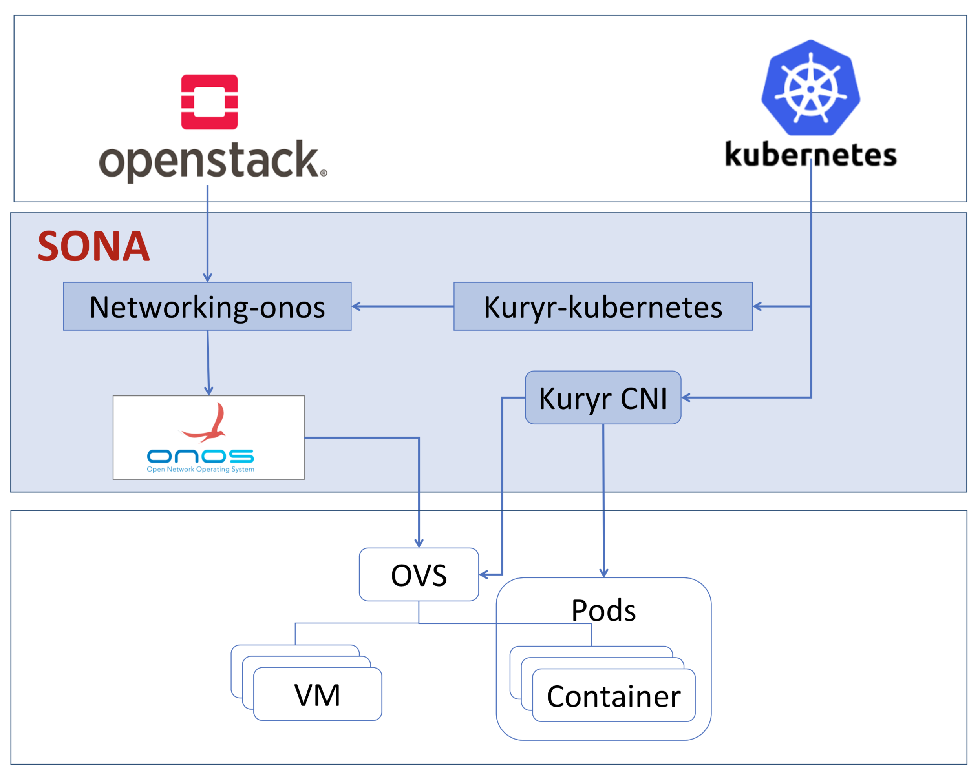
Simplified Overlay Network Architecture

Slide 19
Apps/Use Cases
Trellis and Segment Routing
DC leaf-spine fabric
Optical Disaggregated Transport Network
Control of optical devices
OpenRoadm
P4
Control of Data-Plane programmable switches
INT, VNF Offloading, Fabric.P4
vRouter
CORD virtual Router
OpenStack Integration
Sona Project
DHCP
DHCP app
DHCP relay
L2Monitoring and FaultManagement
Air Traffic Control
Notes:
Parlando con tutte le REN, ci sono 2 buone notizie:
1) all’inizio le REN hanno voluto sporcarsi le mani col codice e hanno sviluppato le loro applicazioni, molto figo ma non è che il modello scali tanto.
2) alla fine della sperimentazione pare che tutti vogliano una sola cosa semplice: rete con connettività L2/L3, avere un software per gestire L2/L3, layer ottico e virtualizzazione della rete
Far convergere in un unico stack tutte le applicazioni.
SDN-IP: trasforma una rete OpenFlow in una IP transit network, il tuo AS comunica con 2 altri AS esterni, questi due parlano insieme a L3 scambiandosi le rotte.
Sei un AS che espone routers BGP standard in modo da mettere in comunicazione le due reti esterne tramite di te.
VPLS: o tramite API o tramite UI puoi dire: crea una rete chiamata “x” a questa rete associa queste interfaccia: 1 - 2 - 3 (all’edge della rete). Creiamo un livello L2 di broadcast su tutte quelle reti.

Slide 20
How to develop applications
Clone or create new repository
Create a temple application or clone an existing
Write your code (Java, Javascript, etc)
Integrate it into the buildsystem
Build (Bazel or Maven)
Launch ONOS
Activate the application (OSGI)
Test, debug, and release

Slide 21
Interact with ONOS
Apps
Apps
NB Core API
NB Core API
Distributed Core
(state management, notifications, high-availability & scale-out)
Distributed Core
(state management, notifications, high-availability & scale-out)
SB Core API
SB Core API
Multiple device Plugins
Multiple device Plugins
Multiple device Plugins
Multiple device Plugins

Slide 22
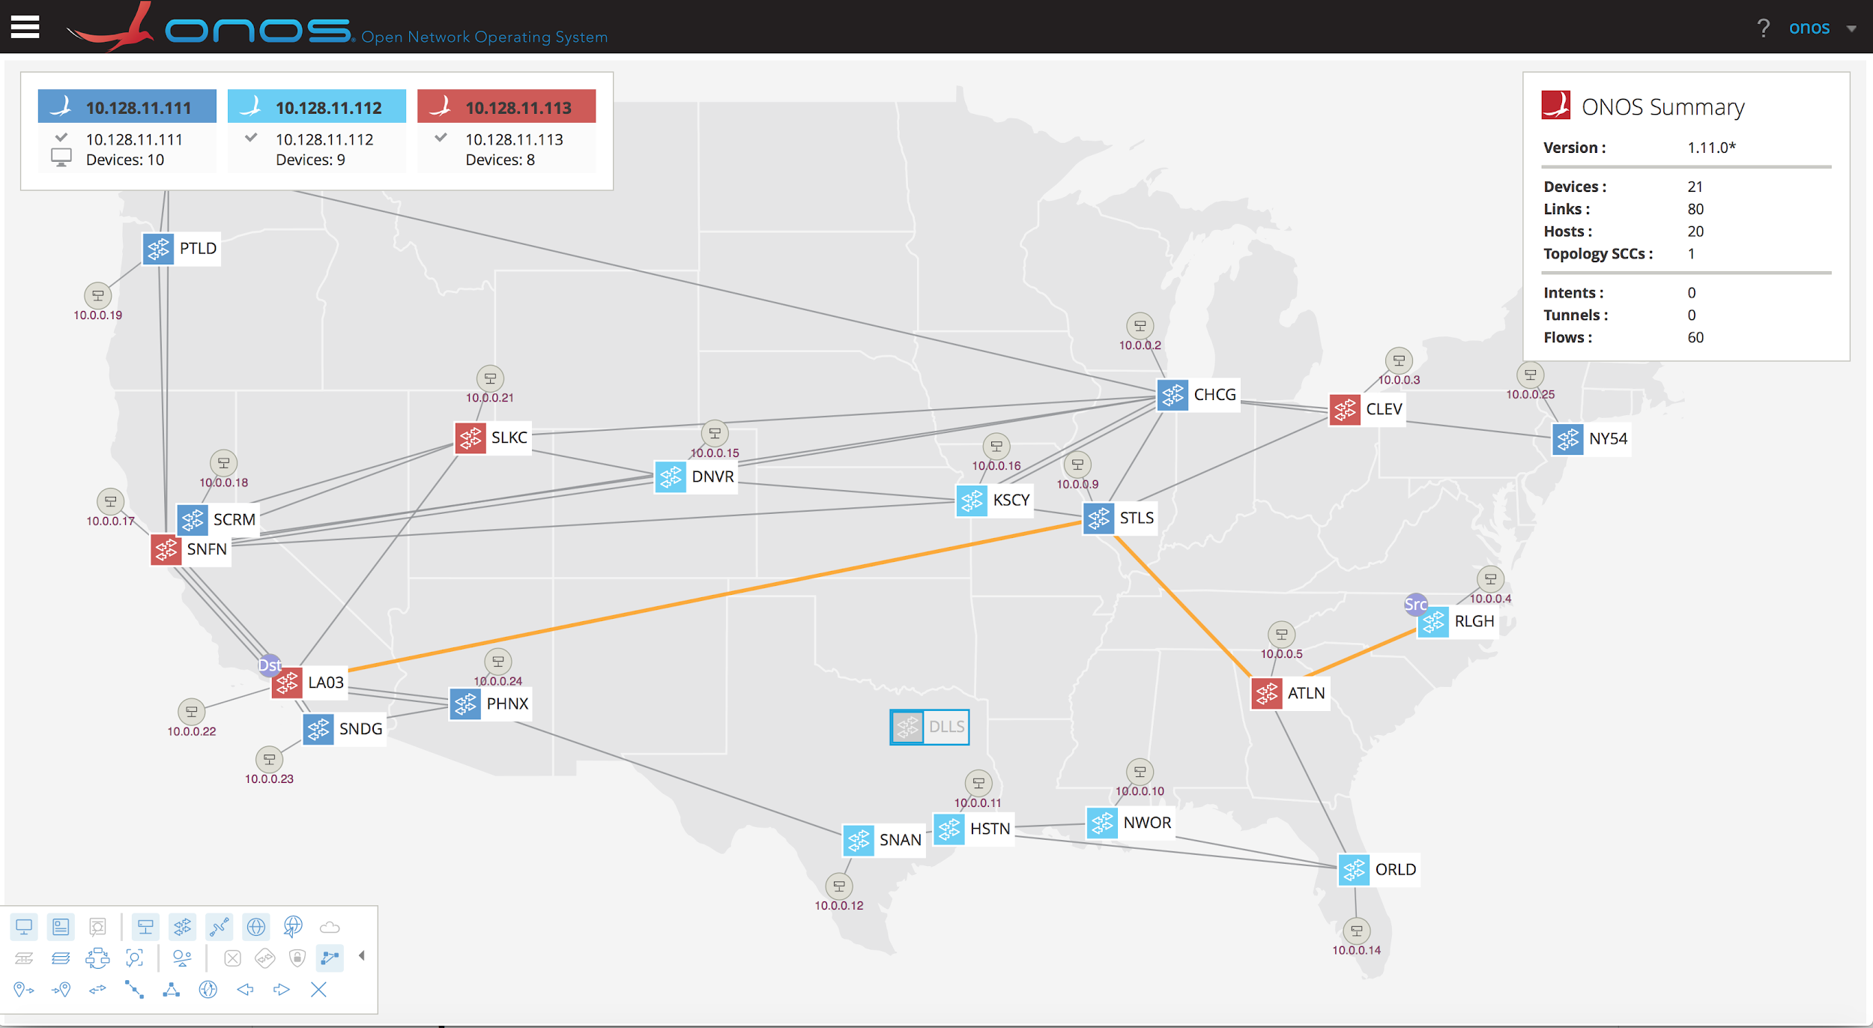
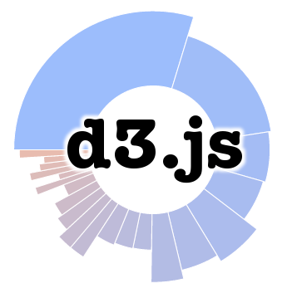
Interact with ONOS: GUI
UI: <onos-ip>:8181/onos/ui
Notes:
So I am going to tell you about a new abstraction in ONOS called Flow Objectives but before that let me set the stage a little.
SDN is supposed to enable to run simpler networks with hardware that could potentially come from different vendors with different pipelines. But currently, SDN application are either completely oblivious to pipelines causing them to make inefficient use of flow table space or they are written with full pipeline knowledge which binds them tightly to a hardware device. This is clearly unacceptable and defeats the value proposition of SDN.

Slide 23
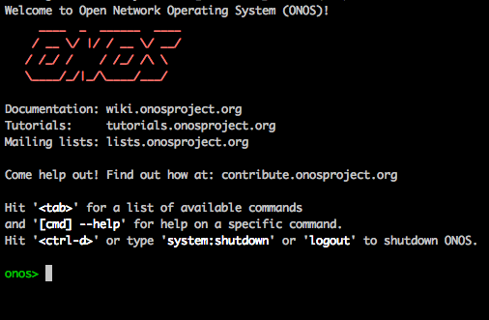
Interact with ONOS: CLI
$onos <controller_address>
Notes:
So I am going to tell you about a new abstraction in ONOS called Flow Objectives but before that let me set the stage a little.
SDN is supposed to enable to run simpler networks with hardware that could potentially come from different vendors with different pipelines. But currently, SDN application are either completely oblivious to pipelines causing them to make inefficient use of flow table space or they are written with full pipeline knowledge which binds them tightly to a hardware device. This is clearly unacceptable and defeats the value proposition of SDN.

Slide 24
Interact with ONOS: REST and GRPC
REST APIs: <onos-ip>:8181/onos/v1/docs/
Northbound GRPC with protocol buffers (.proto)
for ONOS network model
Notes:
So I am going to tell you about a new abstraction in ONOS called Flow Objectives but before that let me set the stage a little.
SDN is supposed to enable to run simpler networks with hardware that could potentially come from different vendors with different pipelines. But currently, SDN application are either completely oblivious to pipelines causing them to make inefficient use of flow table space or they are written with full pipeline knowledge which binds them tightly to a hardware device. This is clearly unacceptable and defeats the value proposition of SDN.

Slide 25
Demo

Slide 27
Community
Notes:
ONOS/CORD Ambassadors
a program to help push leadership to the edges of the community
Collaborations
Code contributions towards an agreed goal. Many Universities are collaborators.

Slide 28
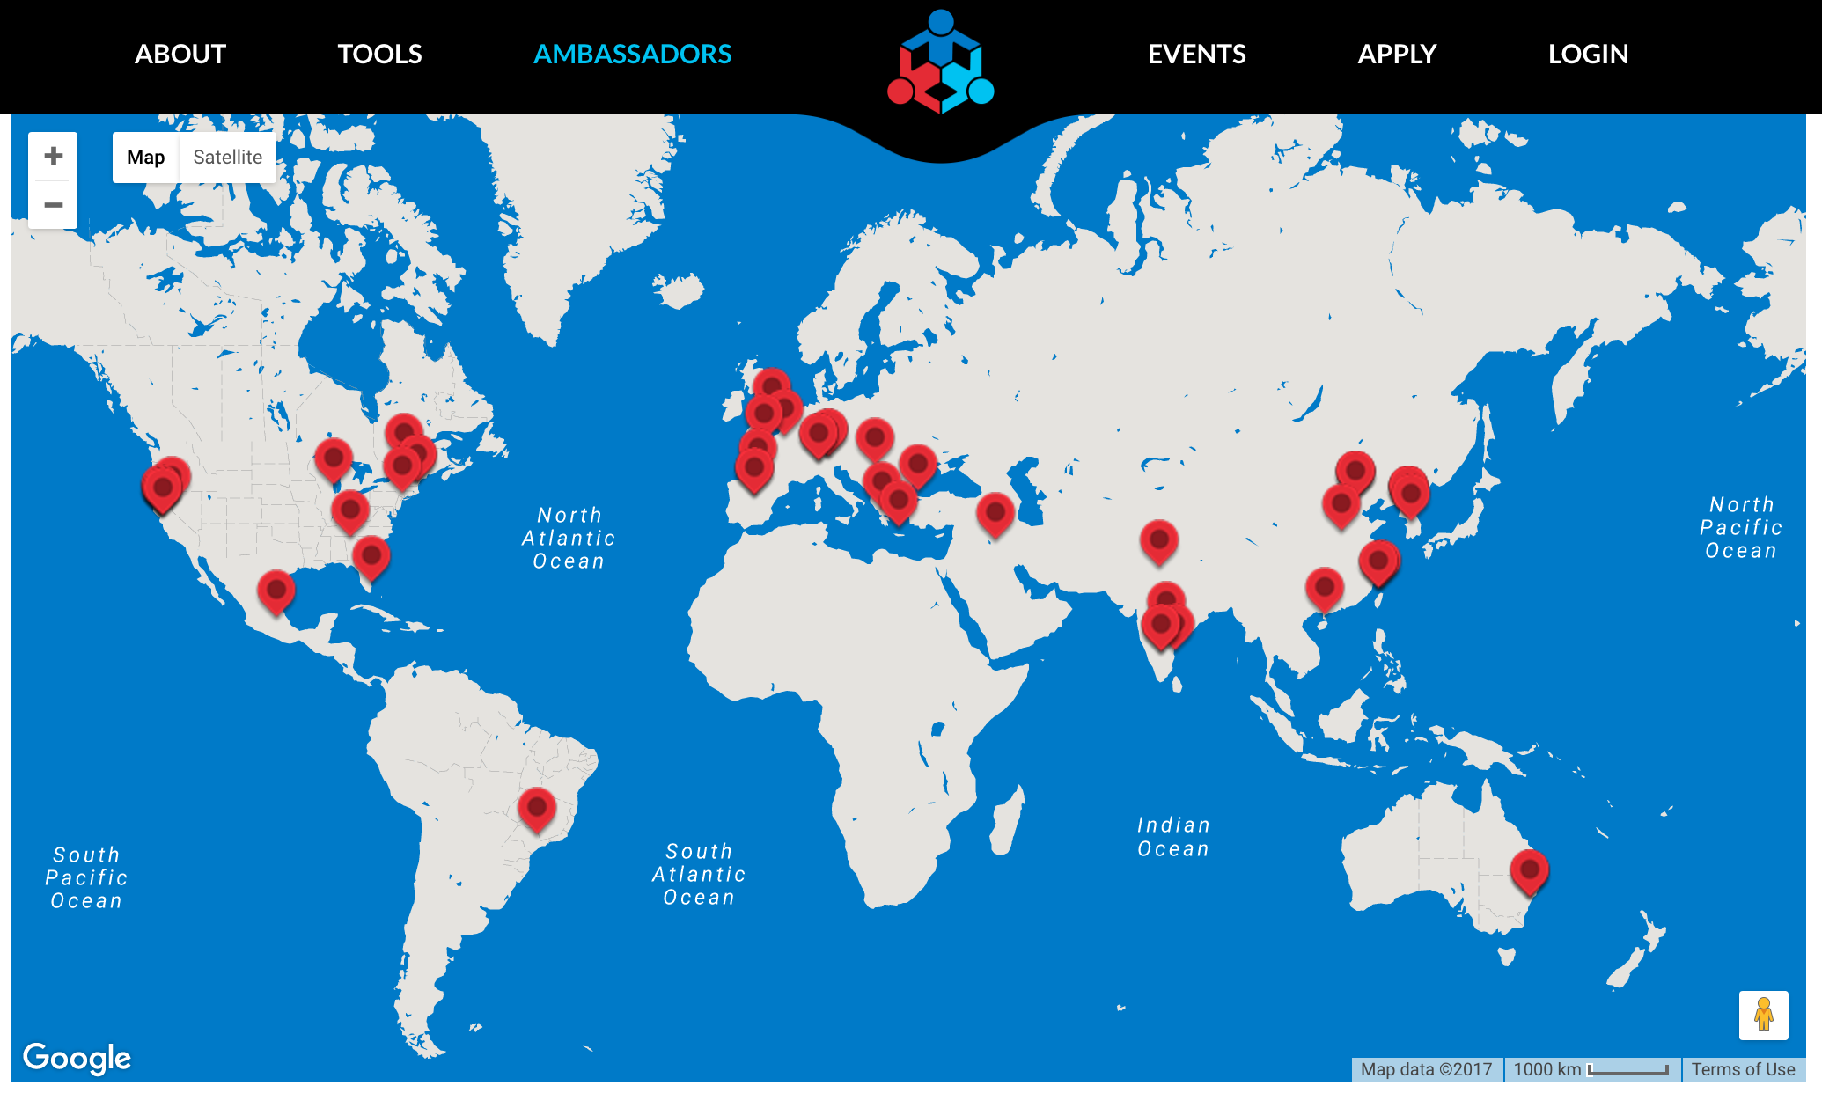
Ambassadors Program

Slide 29
ONOS takeaways
Production ready SDN controller
Distributed core for high availability
Modular, Clean and extensible architecture
High Performance
Scalability of the cluster
Extensive suite of applications that can suit your need
Easy to use through CLI, GUI and REST API
Drivers and protocol Subsystem to support different devices and makers
Control of networks made of heterogeneous devices
Simplifies network control and management
Open source
Great community
Notes:
Parlando con tutte le REN, ci sono 2 buone notizie:
1) all’inizio le REN hanno voluto sporcarsi le mani col codice e hanno sviluppato le loro applicazioni, molto figo ma non è che il modello scali tanto.
2) alla fine della sperimentazione pare che tutti vogliano una sola cosa semplice: rete con connettività L2/L3, avere un software per gestire L2/L3, layer ottico e virtualizzazione della rete
Far convergere in un unico stack tutte le applicazioni.
SDN-IP: trasforma una rete OpenFlow in una IP transit network, il tuo AS comunica con 2 altri AS esterni, questi due parlano insieme a L3 scambiandosi le rotte.
Sei un AS che espone routers BGP standard in modo da mettere in comunicazione le due reti esterne tramite di te.
VPLS: o tramite API o tramite UI puoi dire: crea una rete chiamata “x” a questa rete associa queste interfaccia: 1 - 2 - 3 (all’edge della rete). Creiamo un livello L2 di broadcast su tutte quelle reti.

Slide 30
Further reading
ONOS website:
http://onosproject.org
Tutorials, documentation and general reading at:
https://wiki.onosproject.org/
ONOS is on Github at:
https://github.com/opennetworkinglab/onos
Setup Tutorial
https://wiki.onosproject.org/display/ONOS/Installing+and+Running+ONOS
Screencasts:
https://wiki.onosproject.org/display/ONOS/Screencasts

Slide 31
lpapp@kde.org

