Slide 1
Tarantool Cartridge
Fosdem/IoT

Slide 2
Hi!
Artur Barsegyan, Tarantool Product Manager
2 years fall in ❤️ with Lua and Tarantool

Slide 3
What is Tarantool?
A feature-rich in-memory database.
...and we have on-board Lua application server.

Slide 4
What is Tarantool?
In context of IoT you can think about it like an data integration platform.

Slide 5
What is Tarantool?
two engines: in-memory/disk
sharding
replication
SQL
transactional
has a wealth of modules and connectors from popular languages

Slide 6
What is Tarantool?
lock-free engine for maximal performance:
one thread for database
one thread for application server
one thread for network
low latency
30 MB statically linked binary
Platforms: x86, ARM

Slide 7
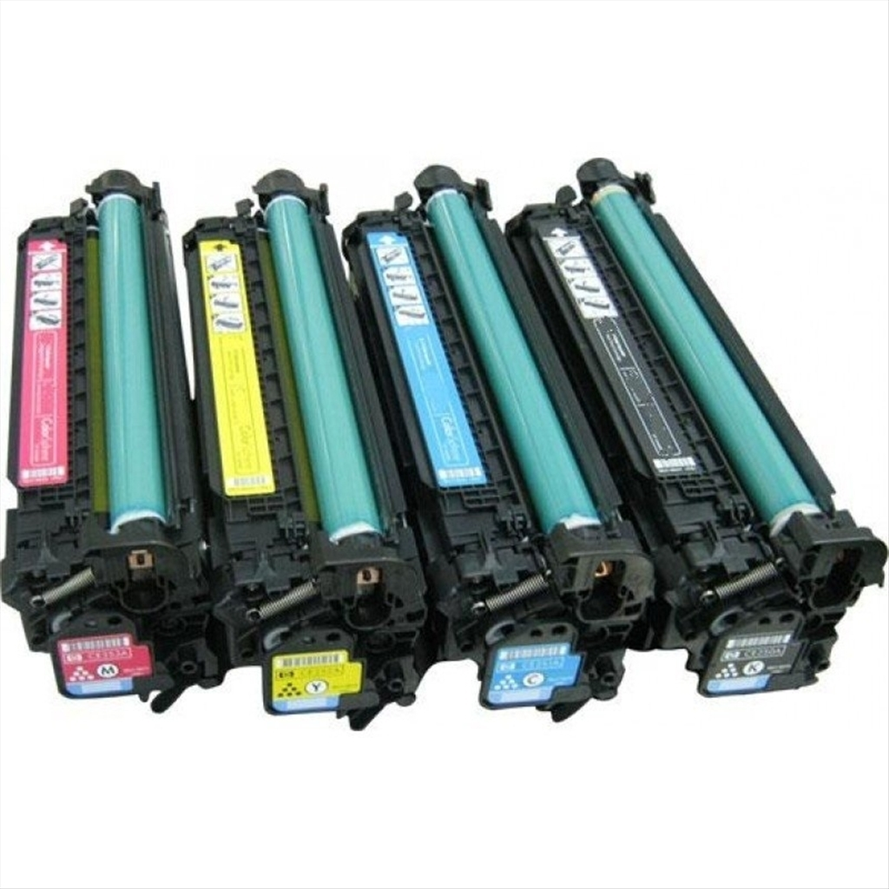
What is the Cartridge?

Slide 8
What is the Cartridge?
It’s a framework for creating distributed apps.

Slide 9
Cartridge’s responsibilities
orchestration of nodes by them status using the gossip protocol
orchestration of cluster-wide configuration
tool for creating and managing distributed apps
WebUI with dashboard and extras

Slide 10
IoT use cases
system for orchestration IoT devices
the 5G services

Slide 11
System for orchestration IoT devices
Ready data platform:
connect devices with different protocols. MQTT are already supported
push events to DB
trigger any logic on any action
(*) update code remotely within user cluster without reloading the service
(*) write/update your code/schema via WebIDE

Slide 12
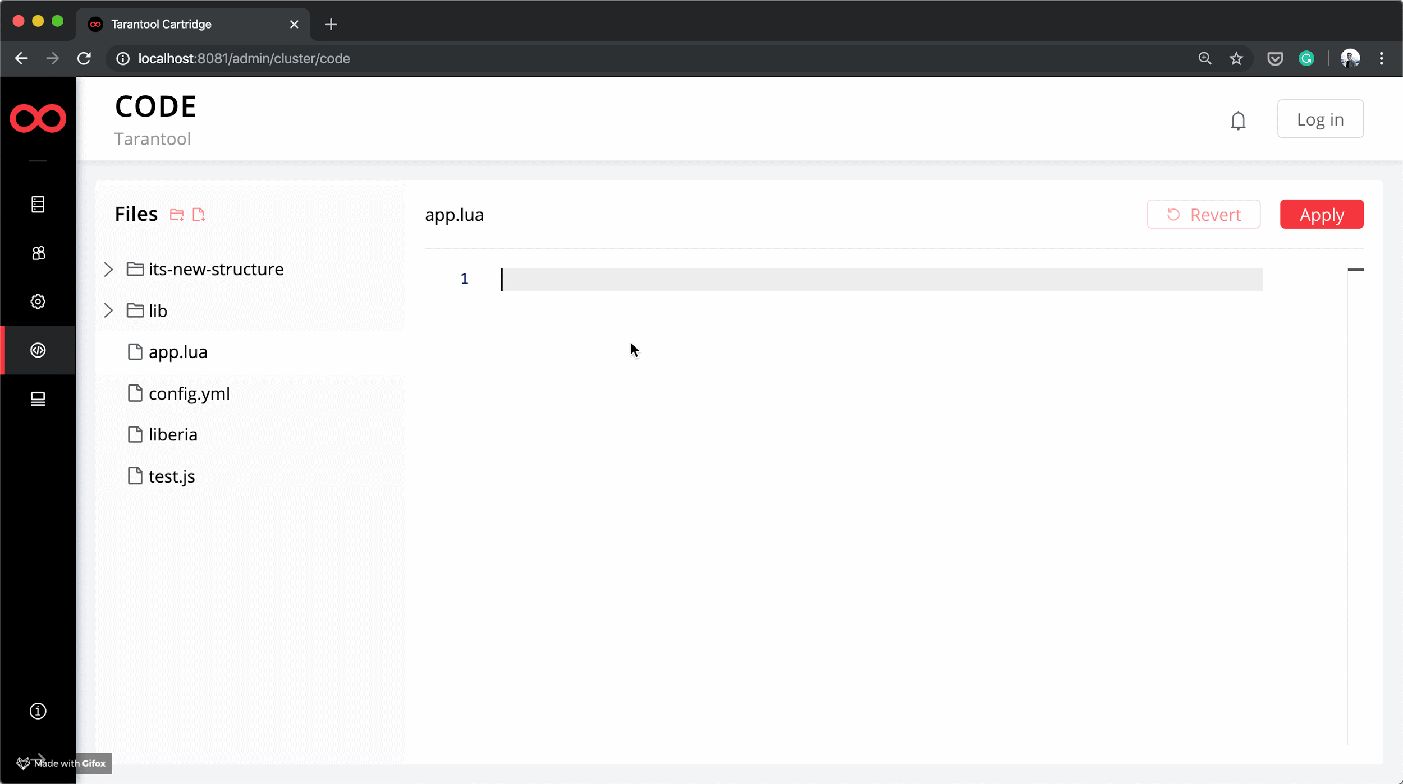

Slide 13
System for orchestration IoT devices
Ready solution based on Tarantool:
Nokia IoT platform,
https://github.com/glial-iot

Slide 14
The 5G services
The challenge is to provide the fast and low-latency services.
5G networks require 100 times higher transmission rates and bandwidth than 4G networks.

Slide 15
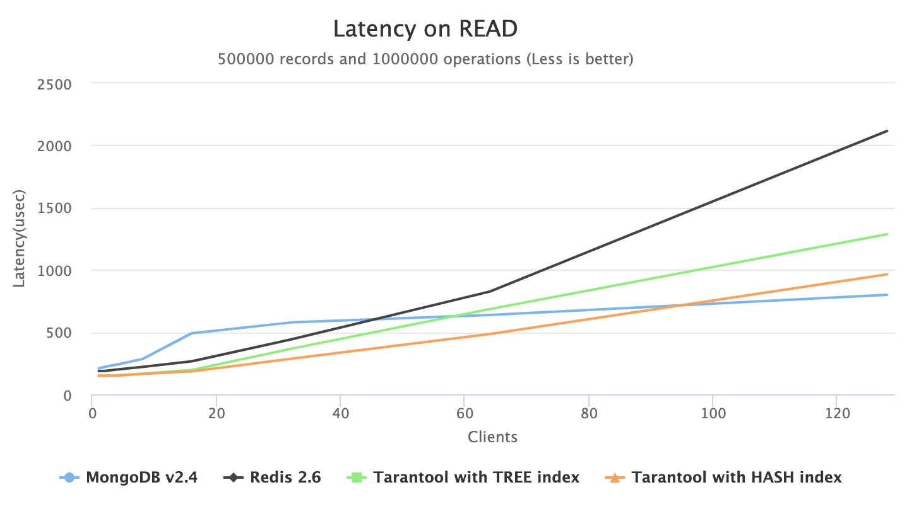
Low latency? Prove it!

Slide 16
Low latency? Prove it!
Check out our benchmark web page: http://15.tarantool.org/benchmark.html
Read more about all benchmarks, benchmark tools and other details.

Slide 17
How I can try it?
Visit our playgrounds:
Tarantool: https://www.tarantool.io/en/try-dev/
Tarantool Cartridge: https://try-cartridge.tarantool.io/

Slide 18
Questions?
https://tarantool.io
https://github.com/tarantool/tarantool
Artur Barsegyan
TG: @arturbrsg

