Slide 1

Prototyping the Internet of Things with Wyliodrin STUDIO

Slide 2

Software (and connected devices) will be allover

Slide 3
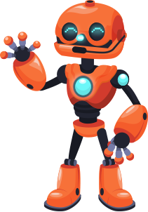

Everybody will need some kind of CS knowledge
(o poza funny cu mai multe device-uri cu software si un individ care se uita intrebator la ele)
(device-uri pot fi orice, de la centrale electrice, statui care se misca)

Slide 4

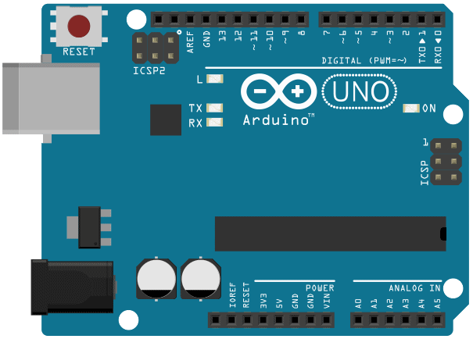
Everybody will need some kind of CS knowledge
(o poza funny cu mai multe device-uri cu software si un individ care se uita intrebator la ele)
(device-uri pot fi orice, de la centrale electrice, statui care se misca)

Slide 5
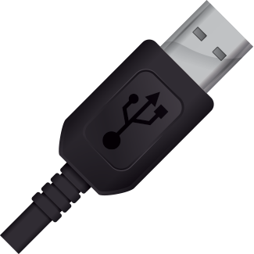


Why Arduino?
Easy to connect
Easy to program
Limitation: not suitable
for connected things
no special programmer, no special cable, just USB
very simple programming library
no IoT

Slide 6
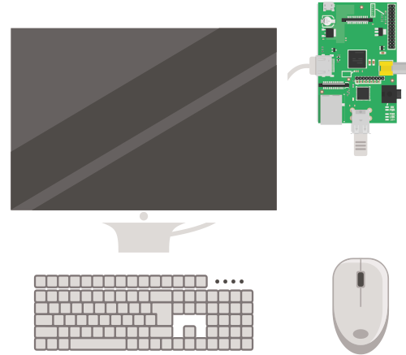
What about connected devices?
Raspberry Pi
Easy to use?
yes, as a computer, screen and keyboard

Slide 7
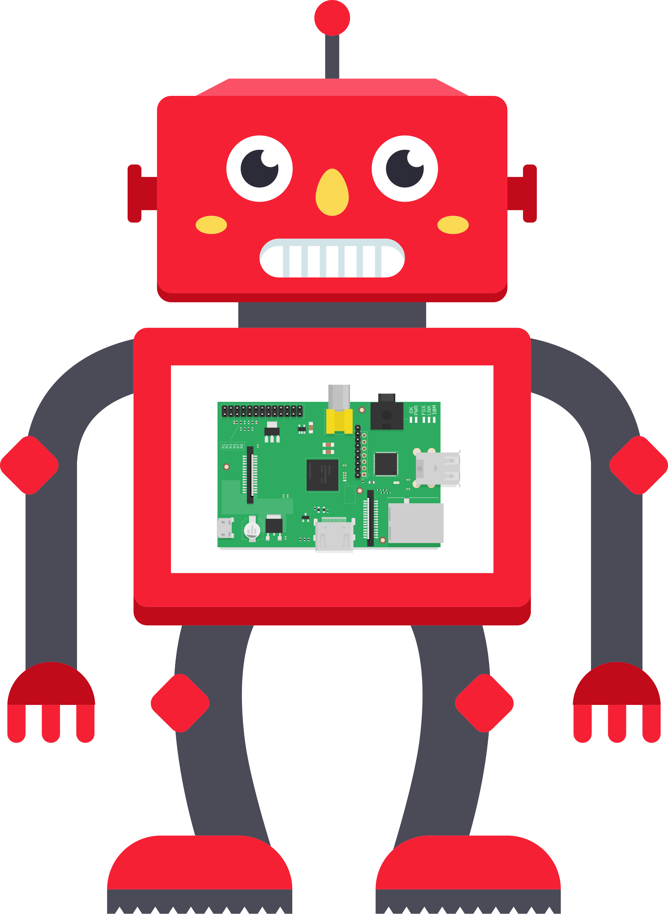

What about connected devices?
Raspberry Pi Robots
No simple tools
- ssh knowledge
- linux CLI knowledge
- deploying code is non trivial

Slide 8
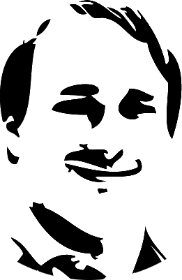


It is (sometimes) easy for geeks
What about non-geeks?

Slide 9
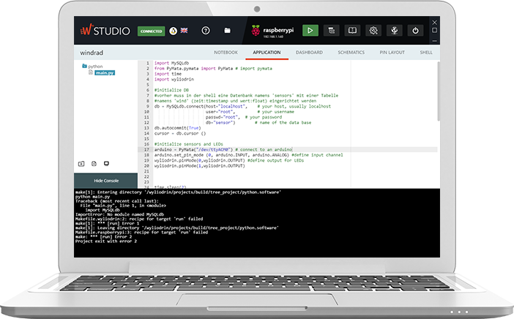
Wyliodrin STUDIO

Slide 10
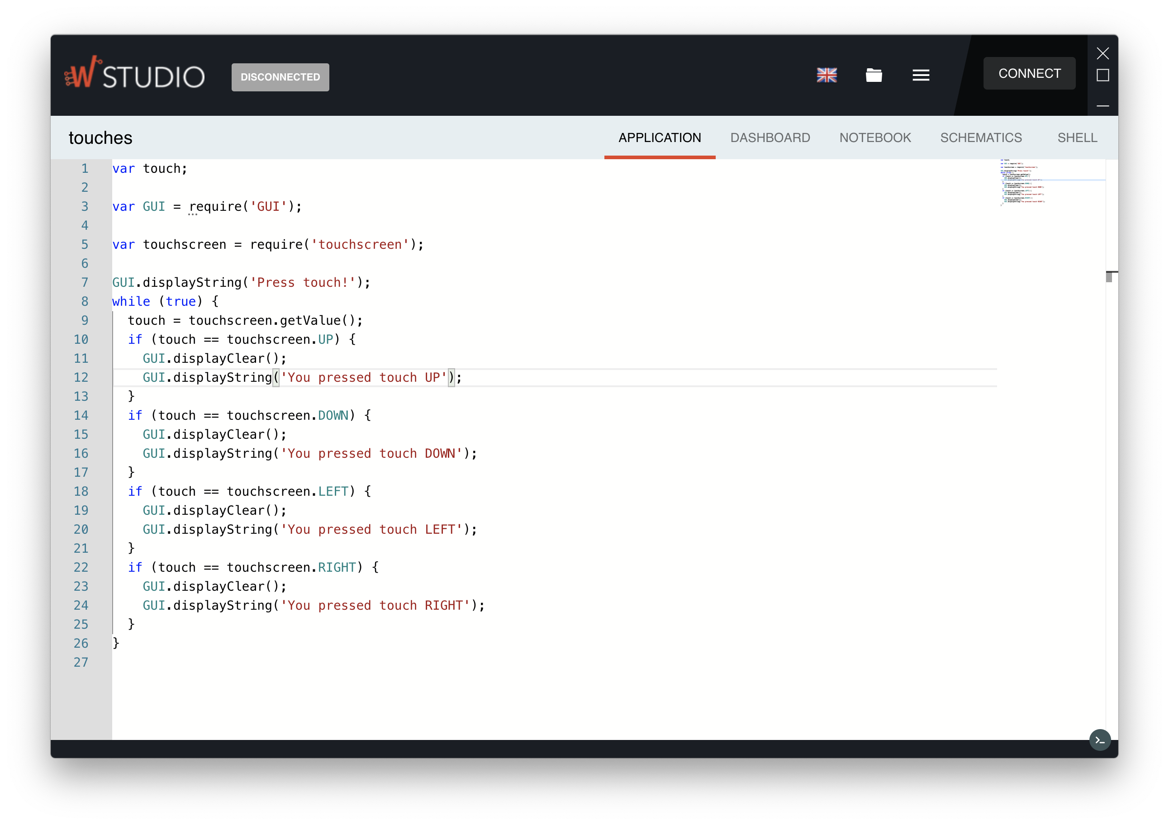
Simple Interface

Slide 11
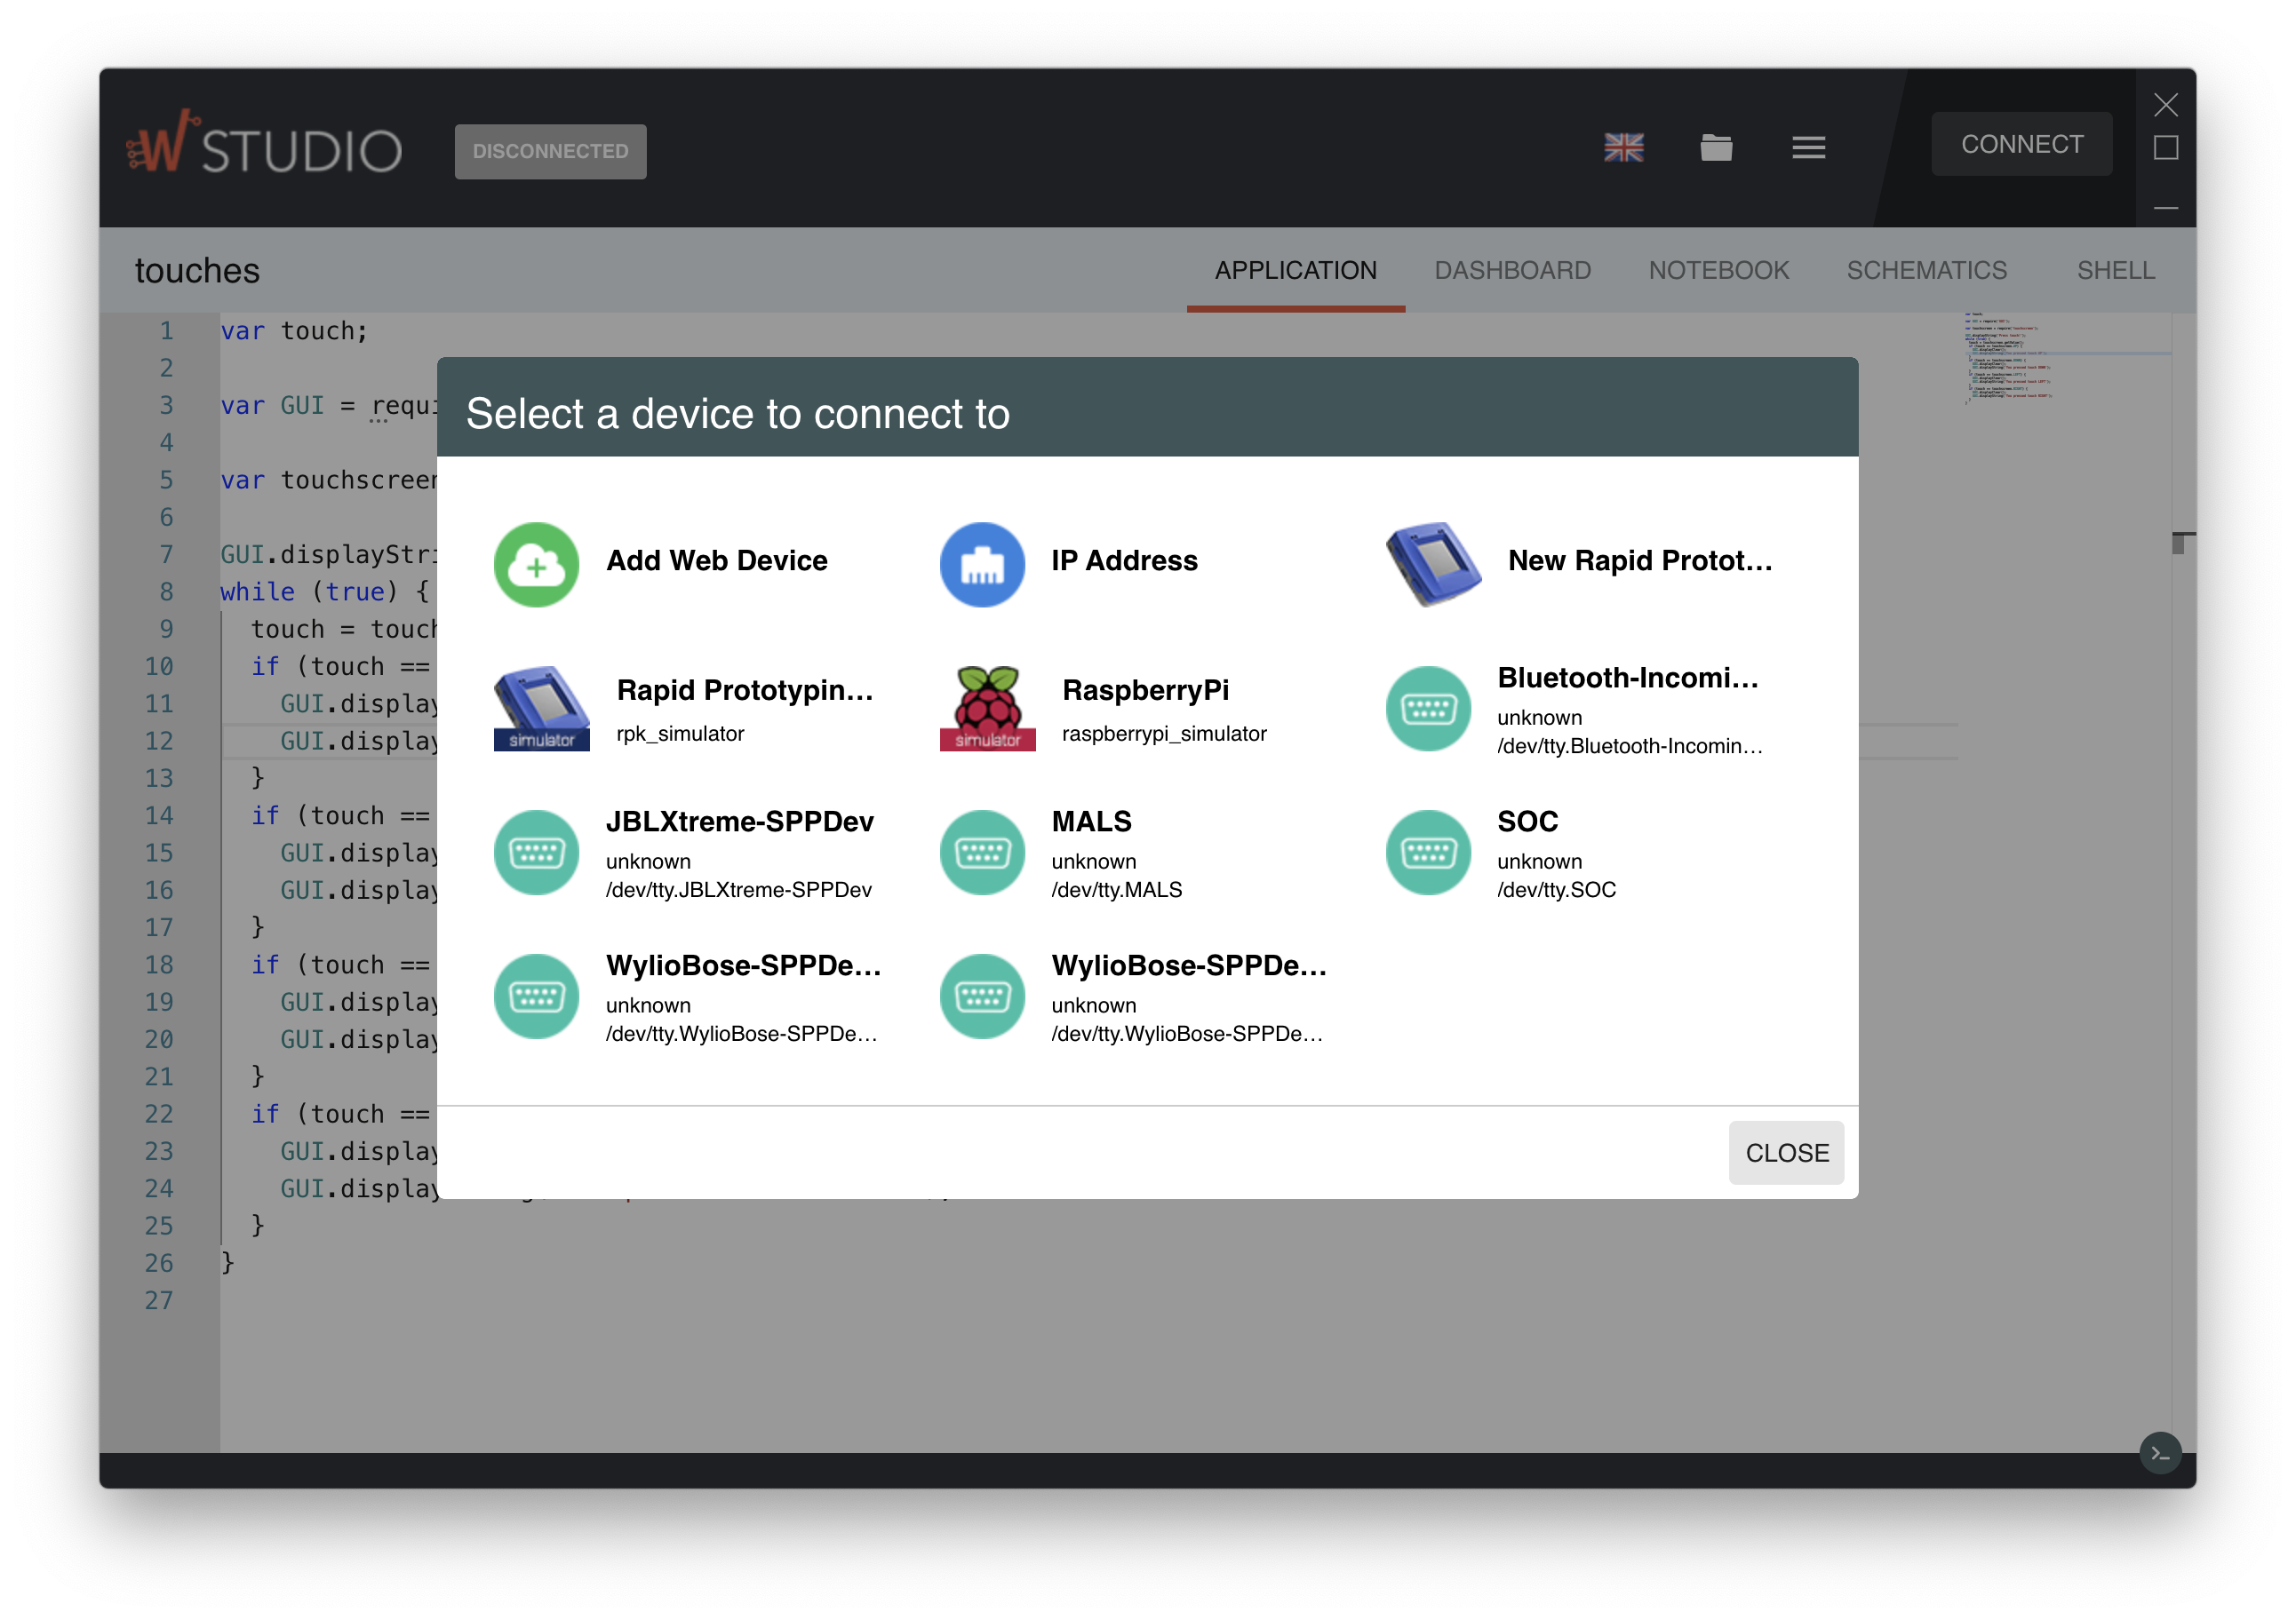
Device Connection

Slide 12
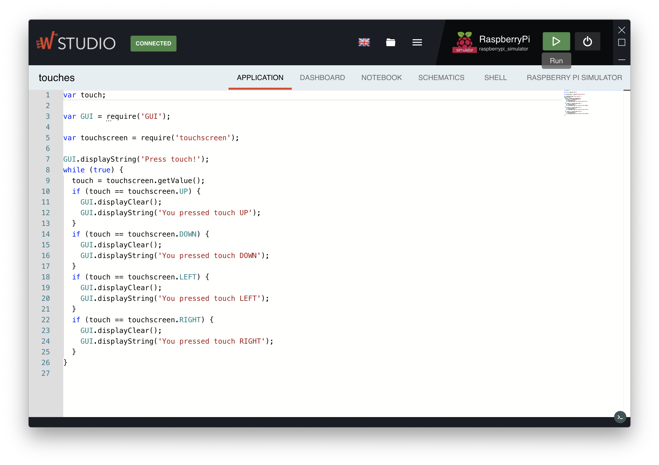
Run the application

Slide 13
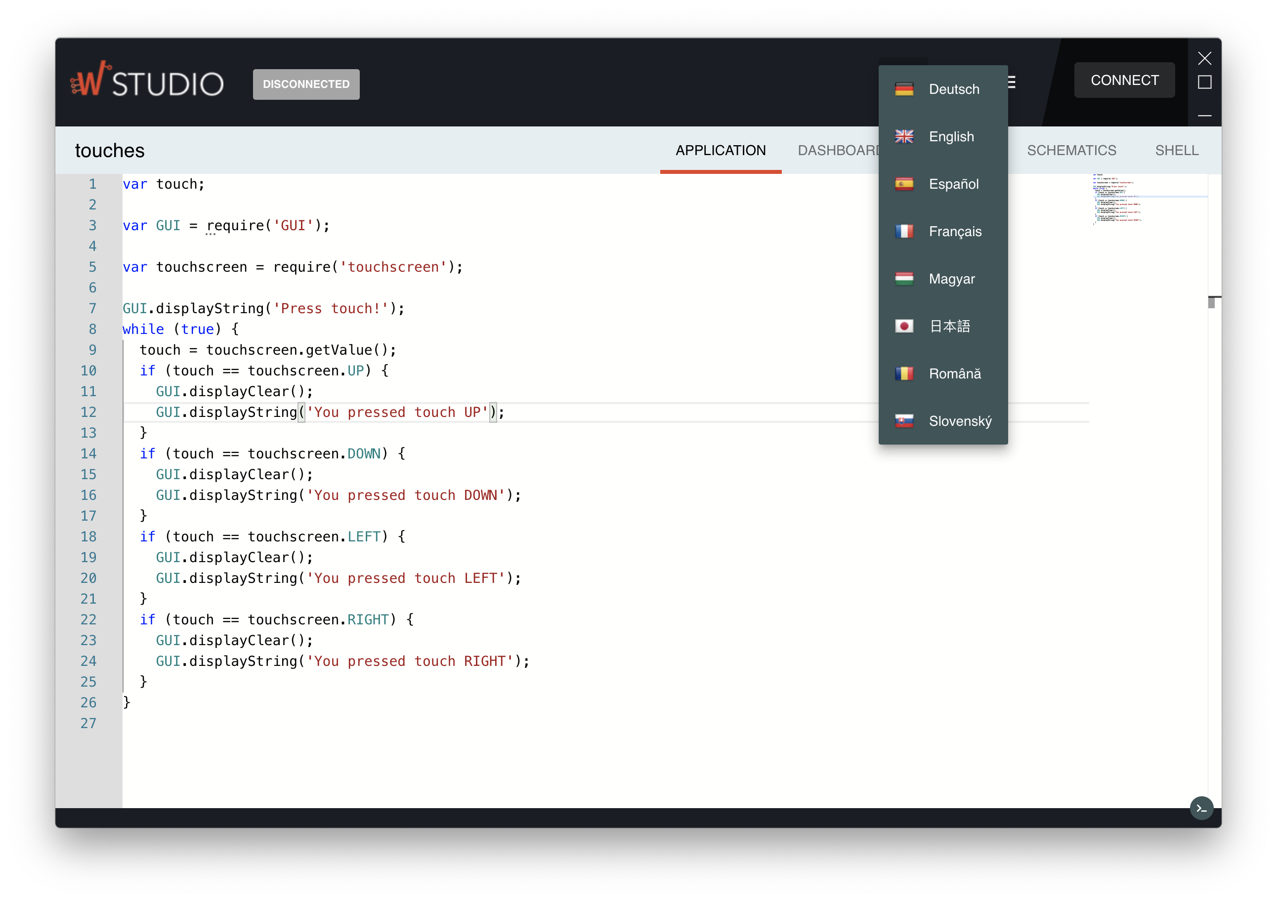
Several Languages
We are looking for translators

Slide 14
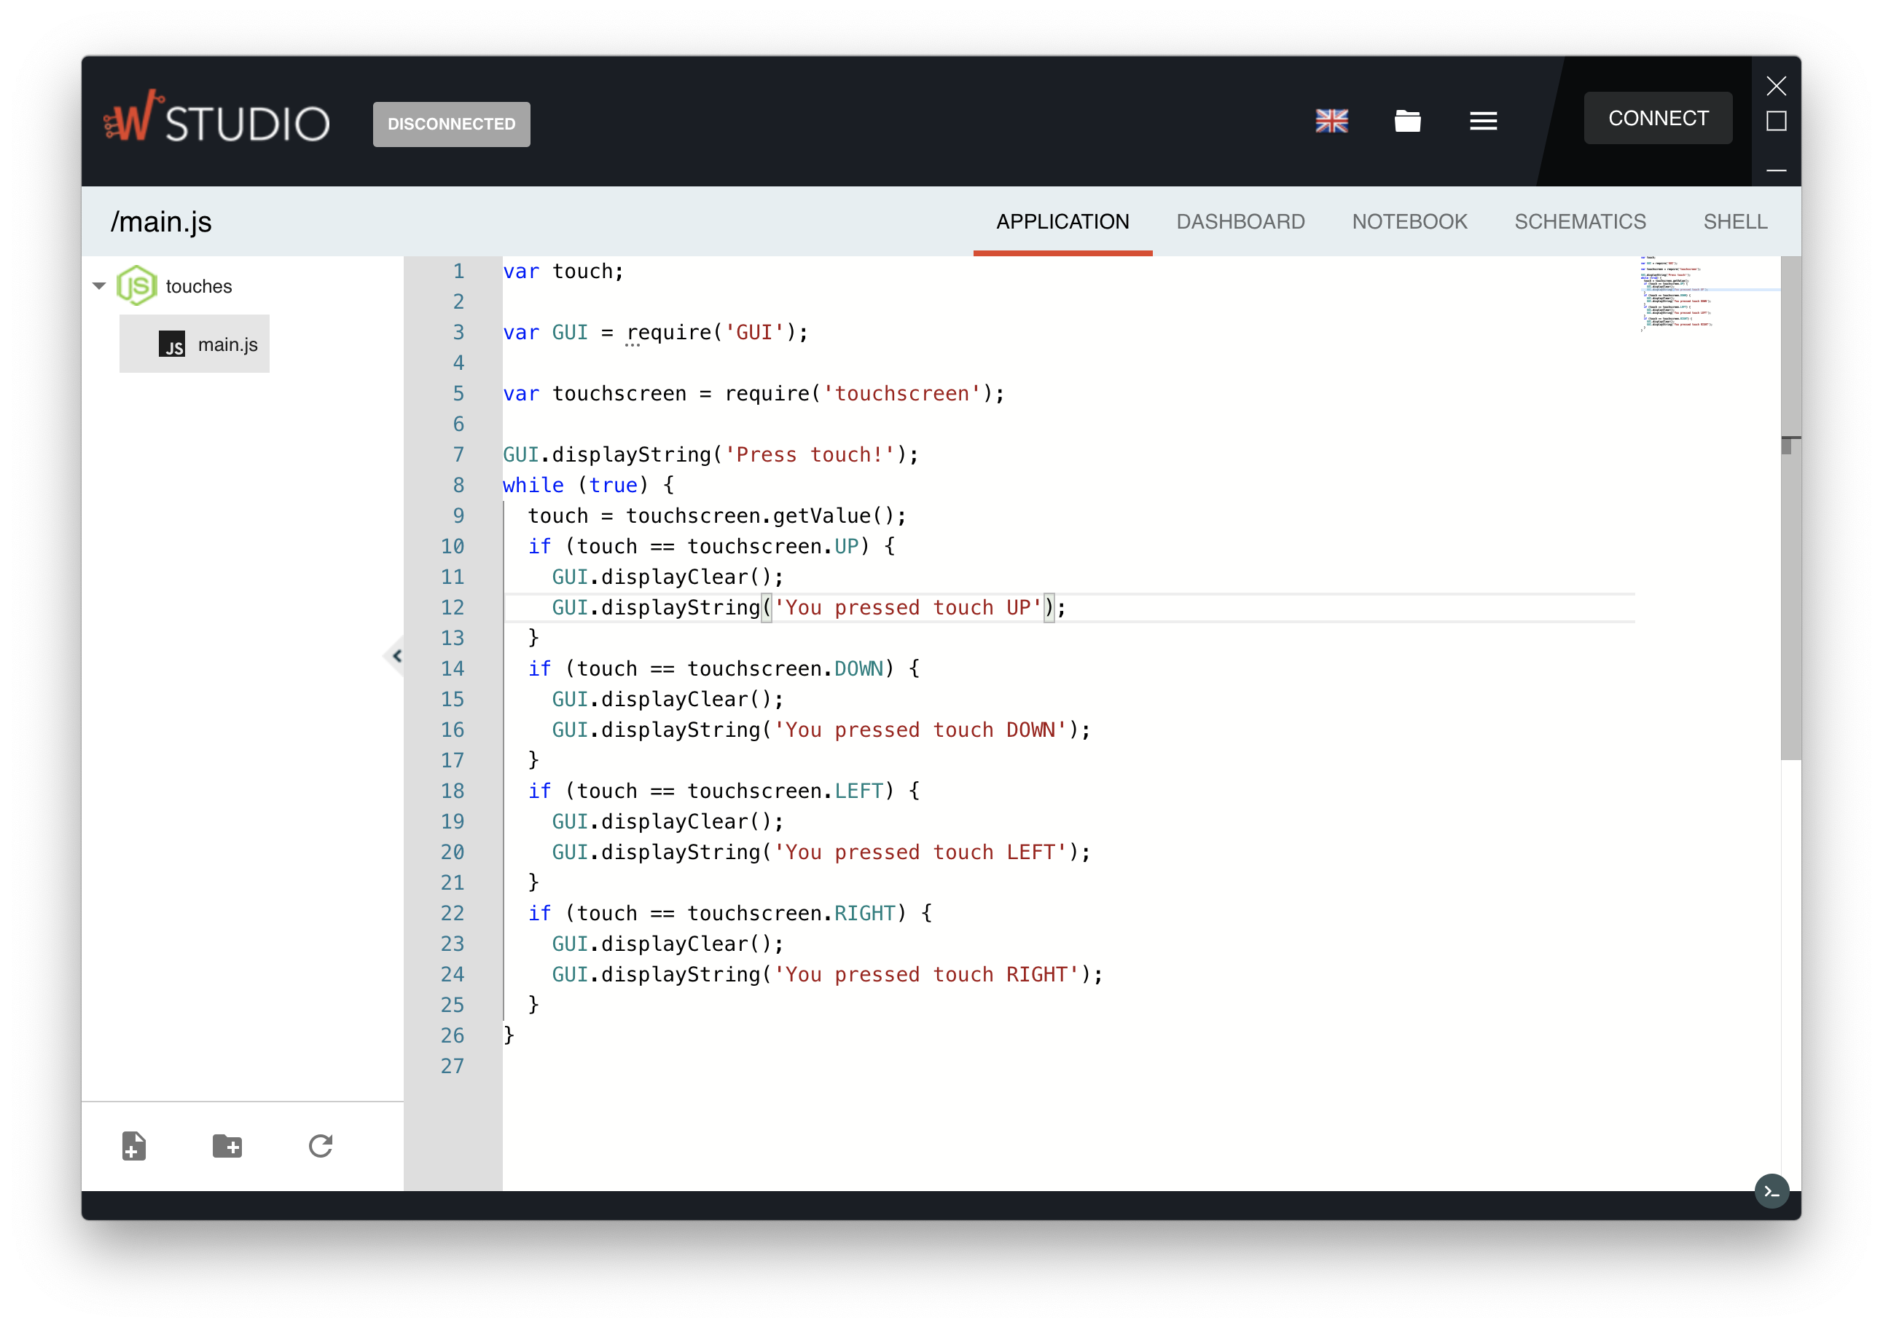
Advanced Interface

Slide 15
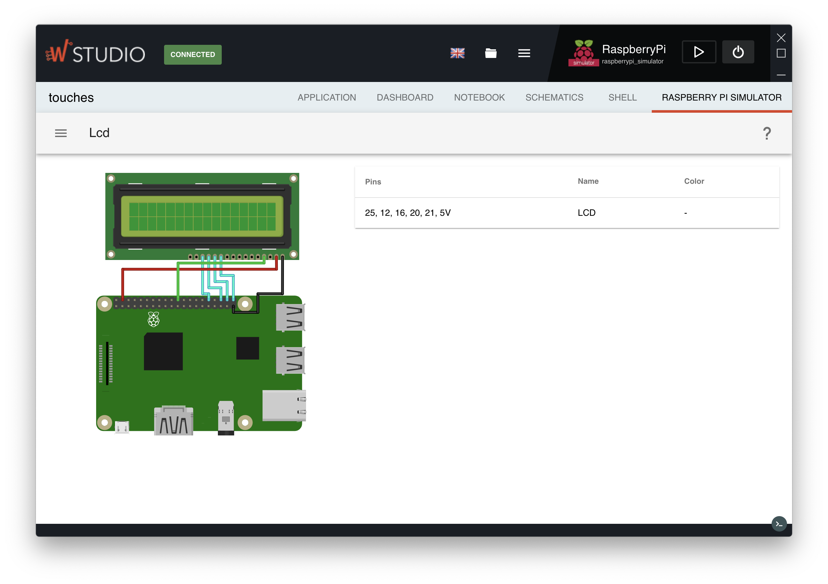
Device Simulation

Slide 16
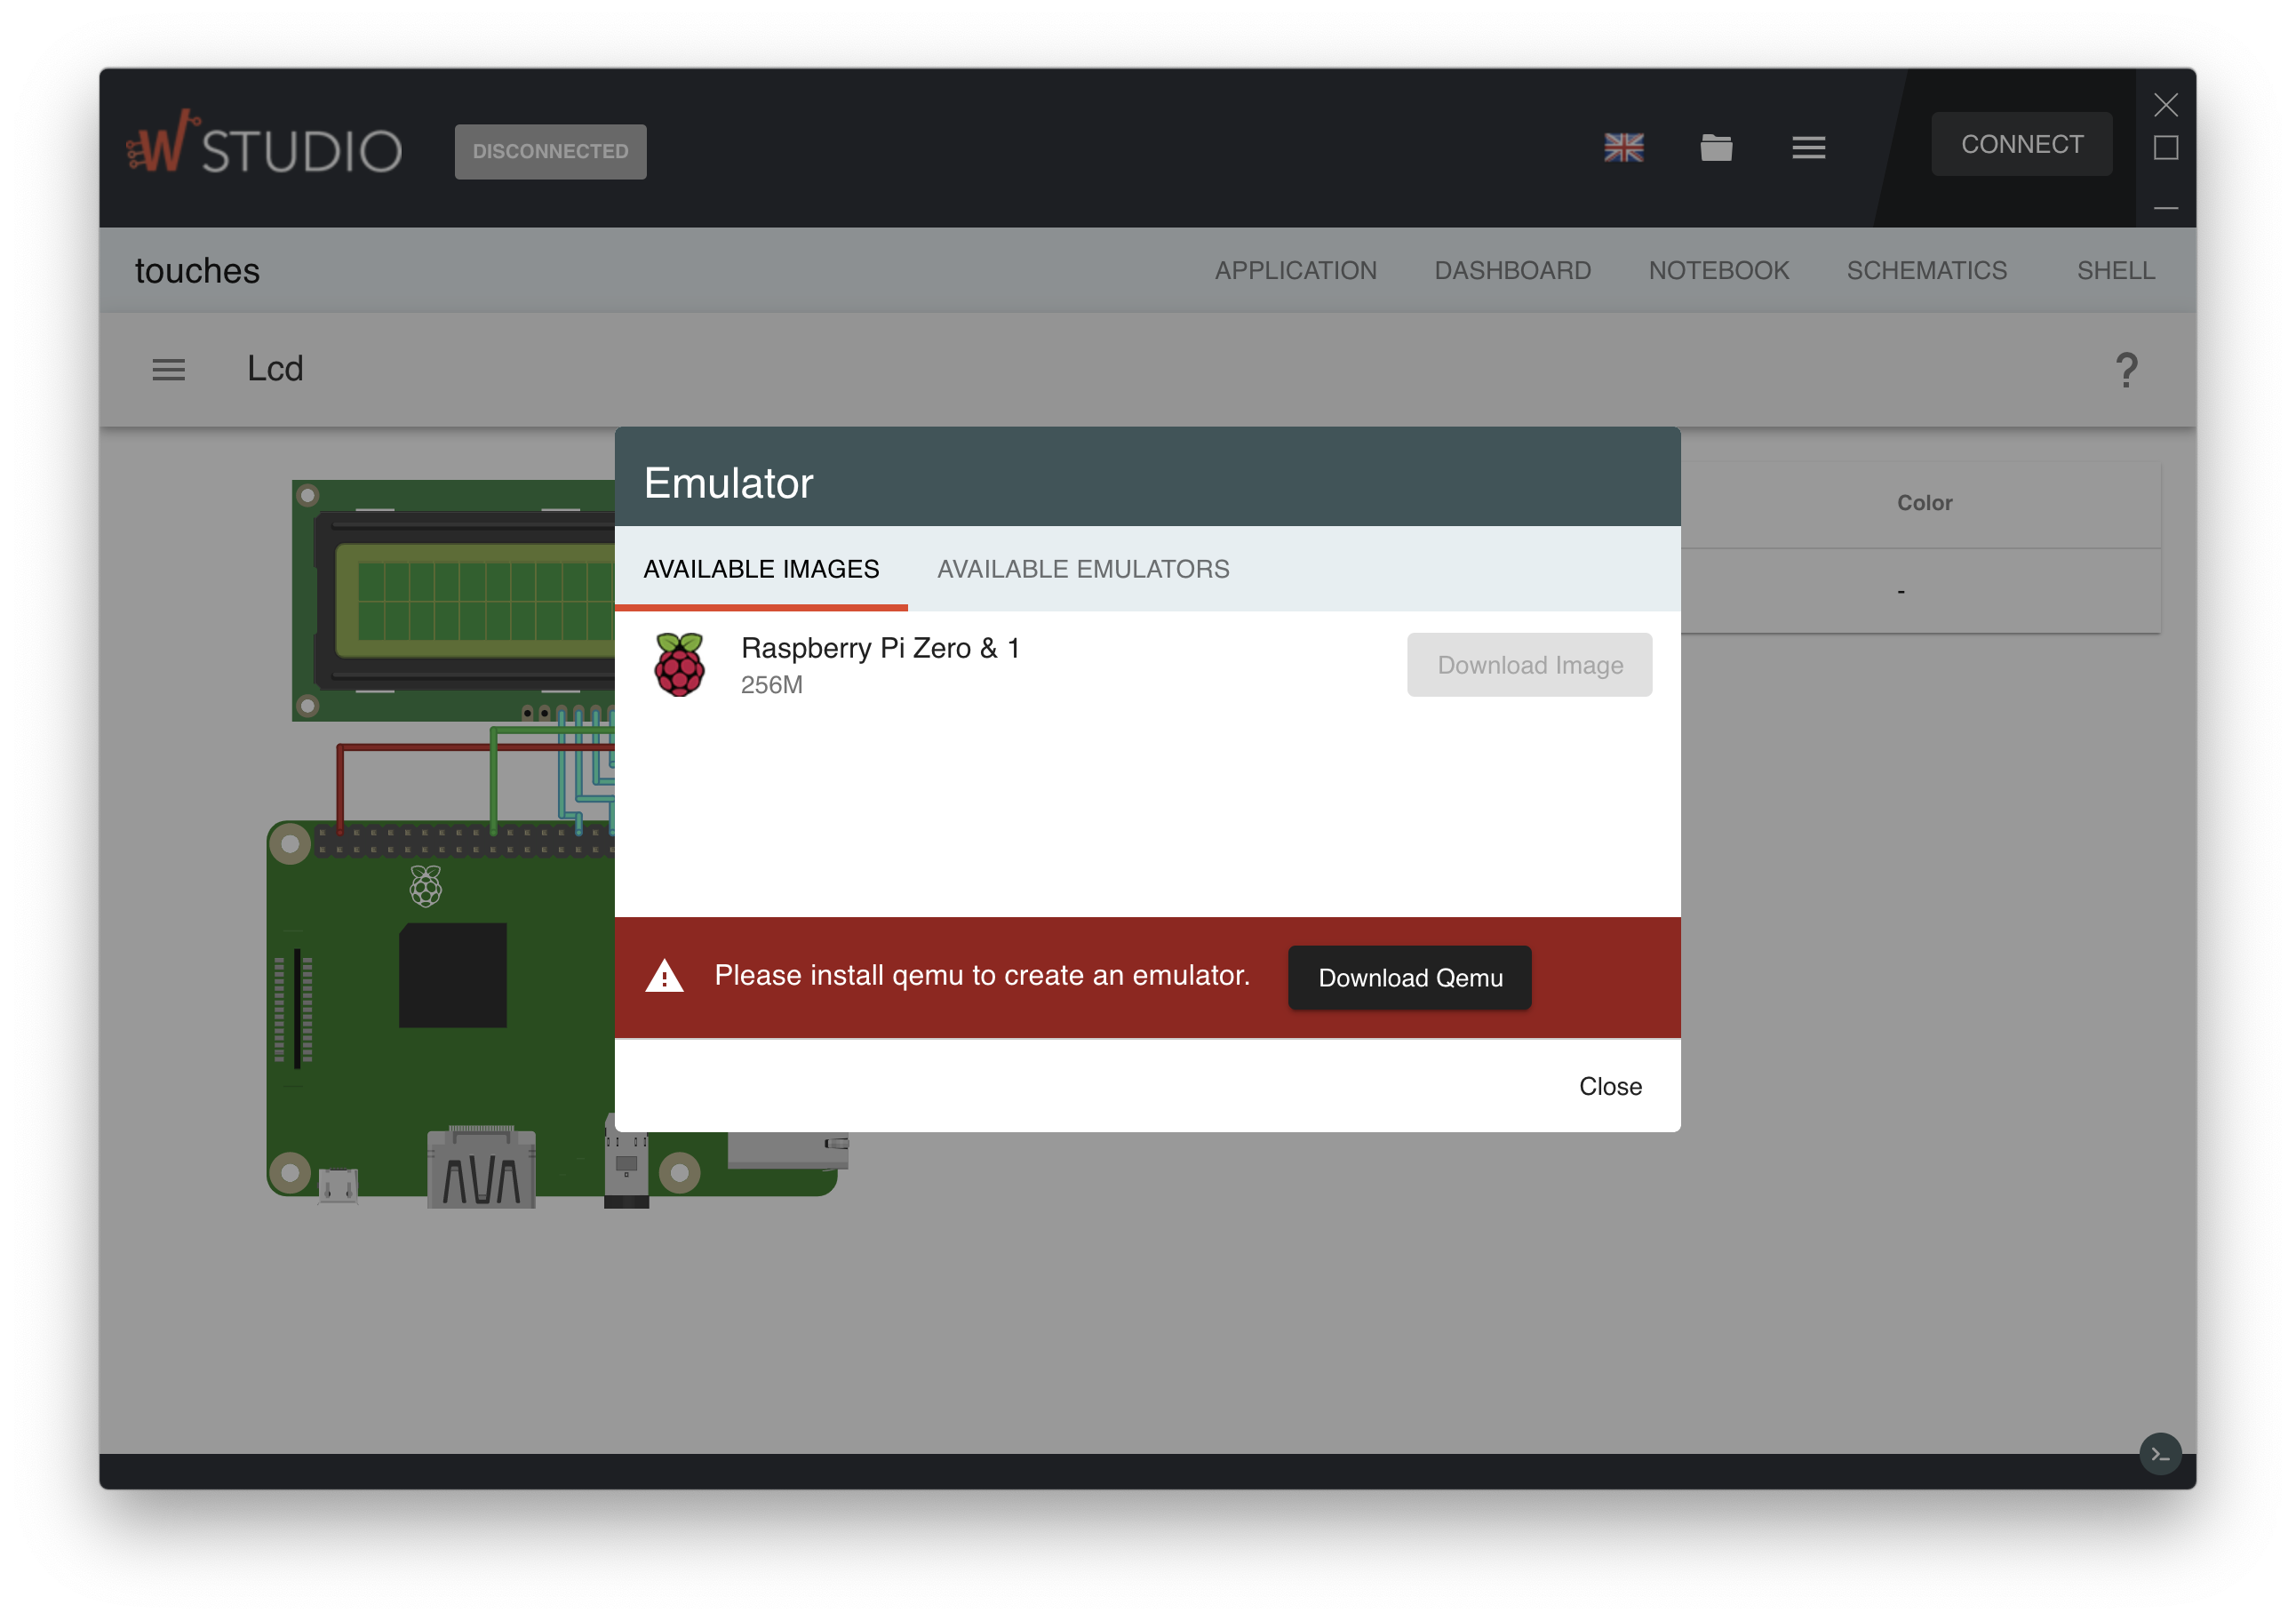
Device Emulator

Slide 17
Plugin Bases
Device Connectors
  WyApp
  Rapid IoT
Editors
  Monaco
  Blockly
  OPC-UA Model
Languages
  Python
  NodeJS
  Shell
  Visual
Virtual
  Simulator (limited)
  QEMU Raspberry Pi Emulator
Dashboard (graphs)
Notebook
Shell
  Full shell access

Slide 18
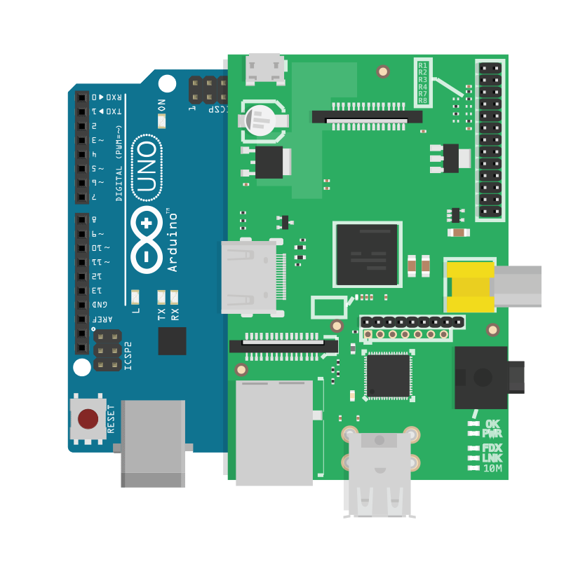





Wyliodrin STUDIO platform
Easy to use IDE
GDPR ready
Easy to extend
plugin based
Rapid IoT

Slide 19


Wyliodrin STUDIO platform
Desktop Application
Web Application
- Local computer storage
- Local connection to the boards
- Local browser storage
- Websocket connections (via studio servers)
- GDPR compliant (no account needed, no name stored, no data stored)

Slide 20



Wyliodrin STUDIO platform
Open source
Written in JavaScript
Apache 2.0 License
electron

Slide 21
Looking for
Contributors
Translators
Sponsors
- Hardware manufacturers
- Schools / Universities

Slide 22
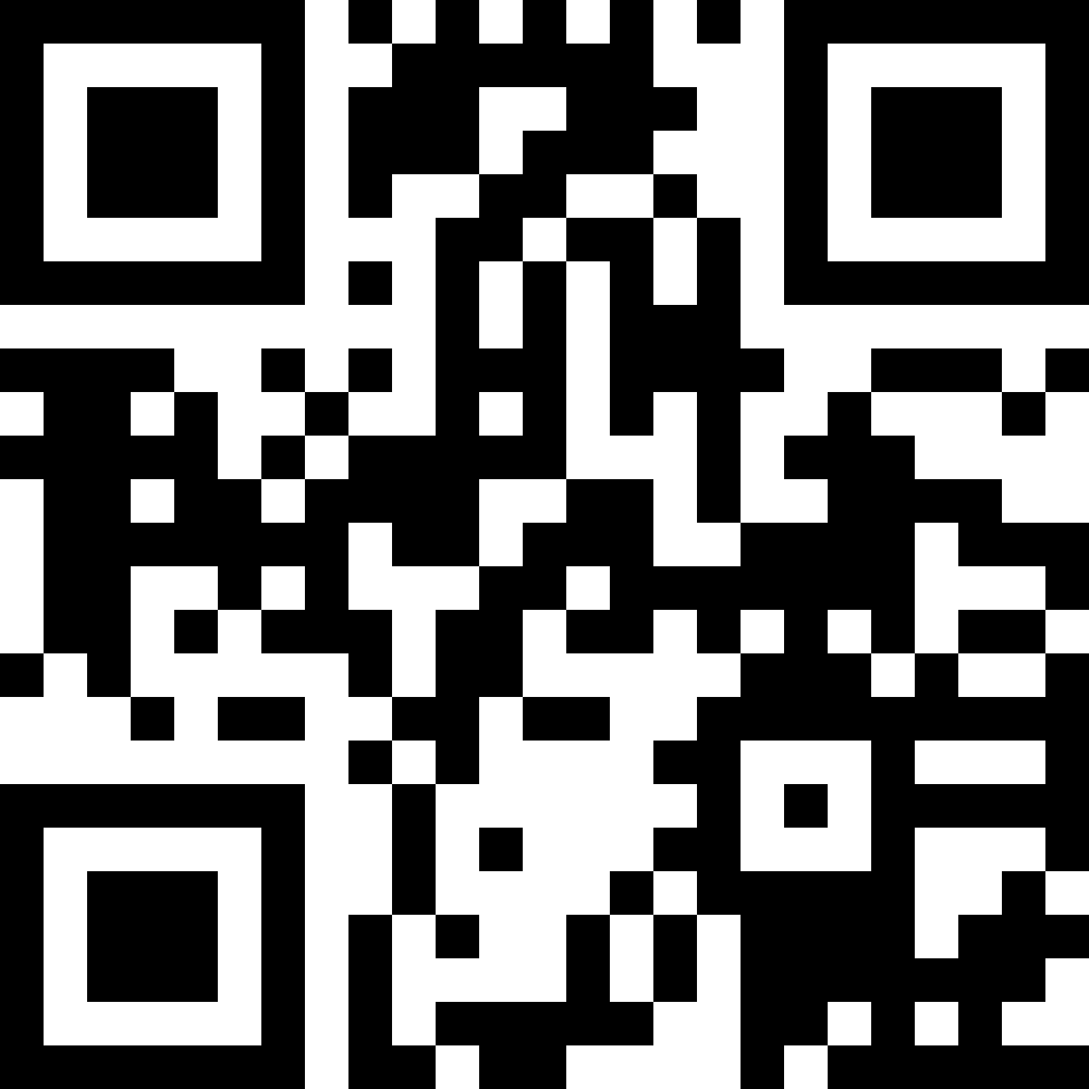


Thank you
https://wyliodrin.studio
https://github.com/WyliodrinSTUDIO

