Slide 1
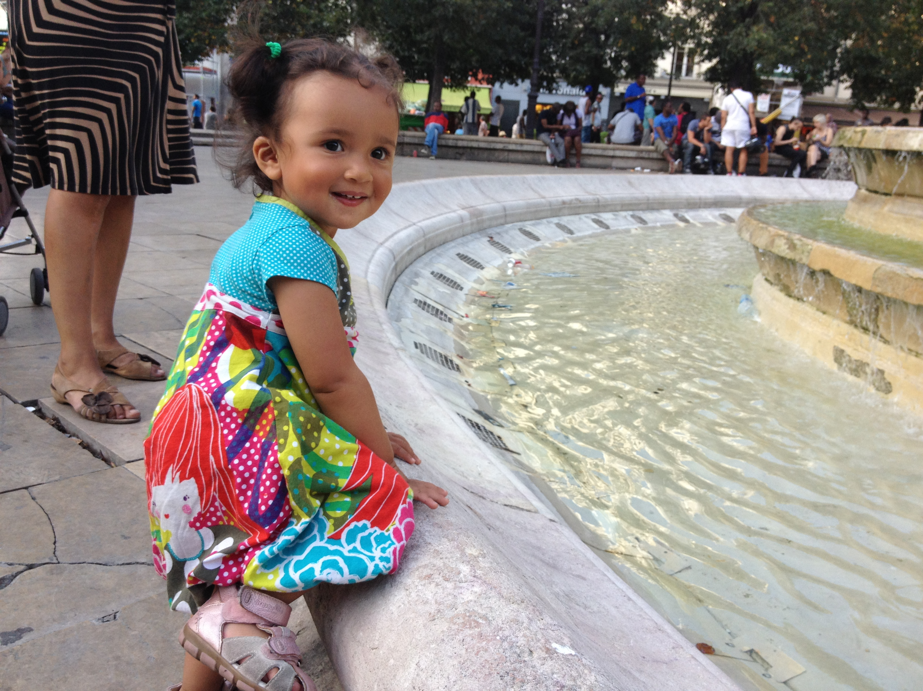
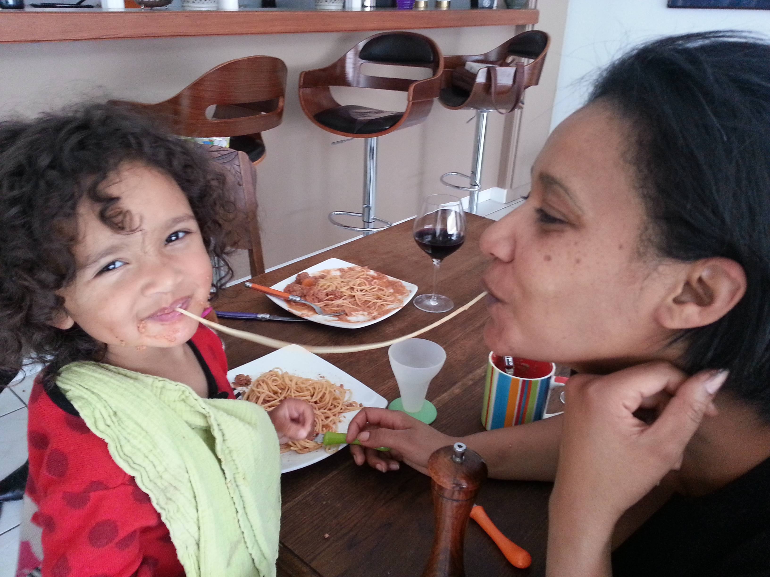

Slide 2
Raku for Mere Mortals
Curtis "Ovid" Poe
http://allaroundtheworld.fr/
https://twitter.com/OvidPerl
Notes:
This isn't a tutorial: I couldn't show you the cool stuff.
This isn't about advanced features, either. It's about a bunch of nice things that will make your life better.

Slide 3
Raku and Perl
Raku is a sister language to Perl
Some concepts are similar
But many things are cleaned up

Slide 4
The Big 3 (or more)
Types for humans, not just computers
Mind-bogglingly powerful OO
Working concurrency model
Infinite lazy lists
Grammars
Amazing Unicode
Metaprogramming
Other stuff
I’m still typing

Slide 5
Examples are great, but …
multi add_to_tree( $node, $tree ) {
[B, insert( $node, $tree )[1..3]];
}
multi insert( $node, Any:U ) { [R, Any, $node, Any] }
multi insert( $node, @tree [RedBlack $color, $left, $pivot, $right] ) {
when $node before $pivot { balance $color, insert($node, $left), $pivot, $right }
when $node after $pivot { balance $color, $left, $pivot, insert($node, $right) }
default { @tree }
}
multi balance(RedBlack $color, $a, $x, $b) { [$color, $a, $x, $b] }
multi balance(B, [R, [R,$a,$x,$b], $y, $c ], $pivot, $right ) {
[ R, [B,$a,$x,$b], $y, [B,$c,$pivot,$right]]
}
multi balance(B, [R, $a, $x, [R,$b,$y,$c] ], $pivot, $right ) {
[ R, [B,$a,$x,$b], $y, [B,$c,$pivot,$right]]
}
multi balance(B, $left, $pivot, [R, [R,$b,$y,$c], $z, $d] ) {
[ R, [B,$left,$pivot,$b], $y, [B,$c,$z,$d]]
}
multi balance(B, $left, $pivot, [R, $b, $y, [R,$c,$z,$d] ]) {
[ R, [B,$left,$pivot,$b], $y, [B,$c,$z,$d]]
}

Slide 6
Red Black Trees

Slide 7
Image Courtesy Luc Viator http://www.lucnix.be/

Slide 8
Basic Math

Slide 9
Solve for "x"
x = 7 ÷ 2
Notes:
Let’s do a few one-liners

Slide 10
Ruby
$ ruby -e 'puts 7/2'
3

Slide 11
Python (2)
$ ruby -e 'puts 7/2'
3
$ python -c 'print 7/2'
3

Slide 12
TCL
$ ruby -e 'puts 7/2'
3
$ python -c 'print 7/2'
3
$ echo "puts [expr 7/2]" | tclsh
3

Slide 13
bc
$ ruby -e 'puts 7/2'
3
$ python -c 'print 7/2'
3
$ echo "puts [expr 7/2]" | tclsh
3
$ echo "7/2" | bc
3

Slide 14
C
$ echo 'int printf(const char * restrict format, ... ); int main(void) { printf("\n%f\n", 7/2); return 0; }' \
> | gcc -xc - && ./a.out
<stdin>:1:82: warning: format specifies type 'double' but the argument has type 'int' [-Wformat]
1 warning generated.
0.000000

Slide 15
C
$ echo 'int printf(const char * restrict format, ... ); int main(void) { printf("\n%d\n", 7/2); return 0; }' \
> | gcc -xc - && ./a.out
3

Slide 16
The purpose of software is to help humans, not computers.

Slide 17
Perl
$ perl -E 'say 7/2'
3.5

Slide 18
Solve for "x"
x = -7 ÷ 2

Slide 19
-7/2
$ ruby -e 'puts -7/2'
?
$ python -c 'print -7/2'
?
$ echo "puts [expr -7/2]" | tclsh
?
$ echo "-7/2" | bc
?
$ perl -E 'say -7/2'
-3.5

Slide 20
-7/2
$ ruby -e 'puts -7/2'
-4
$ python -c 'print -7/2'
-4
$ echo "puts [expr -7/2]" | tclsh
-4
$ echo "-7/2" | bc
-3
$ perl -E 'say -7/2'
-3.5

Slide 21
C
$ echo 'int printf(const char * restrict format, ... ); int main(void) { printf("\n%d\n", -7/2); return 0; }' \
> | gcc -xc - && ./a.out
-3

Slide 22
C89 — ANSI-C (3.3.5)
When integers are divided and the division is inexact …
if either operand is negative …
the result …
is implementation-defined. …

Slide 23
Solve for "x"
x = .1 + .2 - .3

Slide 24
Solve for "x"
x = .1 + .2 - .3

Slide 25
Solve for "x"
x = .3 - .3

Slide 26
Solve for "x"
x = 0

Slide 27
Solve for "x"
0 = .1 + .2 - .3

Slide 28
Perl's Idea of Zero
$ perl -E 'say .1 + .2 - .3'
5.55111512312578e-17
# 0.0000000000000000555111512312578

Slide 29
One Divided by Zero
$ perl -E 'say 1/(.1 + .2 - .3)'
1.8014398509482e+16
# 18,014,398,509,482,000
# or roughly 18 quintillian

Slide 30
Mass of the Sun Multiplied by Zero
$ perl –E 'say 1.99E30 * (.1+.2-.3)'
110467190950203
# 110,467,190,950,203
# Roughly 110 trillion kilograms

Slide 31
http://en.wikipedia.org/wiki/Mount_Everest#mediaviewer/File:Everest_North_Face_toward_Base_Camp_Tibet_Luca_Galuzzi_2006.jpg

Slide 32
Other Languages
$ ruby -e 'puts 0.1 + 0.2 - 0.3'
5.551115123125783e-17
$ python -c 'print .1 + .2 - .3'
5.55111512313e-17
$ echo "puts [expr .1+.2-.3]"|tclsh
5.551115123125783e-17
$ echo ".1 + .2 - .3" | bc
0

Slide 33
Raku’s Idea of Zero
$ raku -e 'say .1 + .2 - .3'
0

Slide 34
Raku’s Idea of Zero
$ raku -e 'say 1/(.1 + .2 - .3)'
Attempt to divide by zero when coercing Rational to Str
in block <unit> at -e line 1
Notes:
This could be huge with many subtle errors just going away.

Slide 35
say WHAT?
$ raku
> say .3.WHAT
(Rat)
> say .3.numerator
3
> say .3.denominator
10
> say .3.nude.perl
(3, 10)
> say 3.1415927.nude.perl
(31415927, 10000000)
Notes:
This is just a peak under the covers to explain how Perl 6 does this.

Slide 36
But you can forget about that
$ raku
> say .1 + .2 - .3
0
Notes:
Really, this stuff *just works*. Ignore it and get back to hacking.

Slide 37
Functions
sub reciprocal {
return 1 / shift;
}

Slide 38
TIMTOWTEmbarrassYourself
sub reciprocal {
return 1 / shift;
}
sub reciprocal {
return 1 / (shift @_);
}
sub reciprocal {
1/$_[0];
}
sub reciprocal {
my $num = shift;
return 1/$num;
}
sub reciprocal {
my $num = shift @_;
return 1/$num;
}
sub reciprocal {
my $num = $_[0];
return 1/$num;
}
sub reciprocal {
my ($num) = @_;
return 1/$num;
}
Notes:
Function signatures were invented before most of us were born.

Slide 39
Let’s Pretend This Never Happened
sub reciprocal {
return 1 / shift;
}
sub reciprocal {
return 1 / (shift @_);
}
sub reciprocal {
1/$_[0];
}
sub reciprocal {
my $num = shift;
return 1/$num;
}
sub reciprocal {
my $num = shift @_;
return 1/$num;
}
sub reciprocal {
my $num = @_[0];
return 1/$num;
}
sub reciprocal {
my ($num) = @_;
return 1/$num;
}
Notes:
Function signatures were invented before most of us were born.

Slide 40
Fibonacci
Start with the list 0,1
Add last two elements
Append result to end of list
Go to step 2
F₀ = 0
F₁ = 1
F_{n} = F_{n-1} + F_{n-2}
I'd credit the original source if I could find it.
Notes:
1. Forgetting your base case. 2. Not checking your arguments. 3. Deep recursion blowing your stack.

Slide 41
Fibonacci – Hate Me If You Must
0, 1
0, 1 → 1
0, 1, 1 → 2
0, 1, 1, 2 → 3
0, 1, 1, 2, 3 → 5
0, 1, 1, 2, 3, 5 → 8
0, 1, 1, 2, 3, 5, 8 → 13
…

Slide 42
Basic Function Signatures
sub fib ($nth) {
given $nth {
when 0 { 0 }
when 1 { 1 }
default {fib($nth-1)+fib($nth-2)}
}
}
say fib(8);
# 21
Notes:
@_ is still there, but don't use if it if you don't need it.
Why use this forced example? Easy to explain, but many failure modes

Slide 43
Infinite Loop
sub fib($nth) {
given $nth {
when 0 { 0 }
when 1 { 1 }
default {fib($nth-1)+fib($nth-2)}
}
}
say fib(3.7);
# …

Slide 44
Raku – Gradually Typed
sub fib(Int $nth) {
given $nth {
when 0 { 0 }
when 1 { 1 }
default {fib($nth-1)+fib($nth-2)}
}
}
say fib(3.7);

Slide 45
Raku – Optional Type Checking
===SORRY!=== Error while compiling fib.raku
Calling fib(Rat) will never work with declared signature (Int $nth)
at fib.raku:8
------> say ⏏fib(3.7);

Slide 46
Infinite Loop
sub fib(Int $nth) {
given $nth {
when 0 { 0 }
when 1 { 1 }
default {fib($nth-1)+fib($nth-2)}
}
}
say fib(-3);

Slide 47
Raku — Constraints
sub fib(Int $nth where * >= 0) {
given $nth {
when 0 { 0 }
when 1 { 1 }
default {fib($nth-1)+fib($nth-2)}
}
}
say fib(-3);

Slide 48
Infinite Loop
Constraint type check failed in binding to parameter '$nth'; expected anonymous constraint to be met but got Int (-3)
in sub fib at fib.raku line 1
in block <unit> at fib.raku line 8
Notes:
@_ is still there, but don't use if it if you don't need it.

Slide 49
Raku — Constraints
sub fib(Int $nth where $nth >= 0) {
given $nth {
when 0 { 0 }
when 1 { 1 }
default {fib($nth-1)+fib($nth-2)}
}
}
say fib(-3);

Slide 50
Raku — Subsets (UInt)
subset NonNegativeInt of Int
where * >= 0;
sub fib(NonNegativeInt $nth) {
given $nth {
when 0 { 0 }
when 1 { 1 }
default {fib($nth-1)+fib($nth-2)}
}
}
say fib(-3);
Notes:
@_ is still there, but don't use if it if you don't need it.

Slide 51
Function Signatures
sub optional {…}
sub basic($foo) {…}
sub default($foo = 3) {…}
sub named(:$name) {…}
sub typed(Bool $is_foo) {…}
sub constraint(Str $name where *.chars > 0) {…}

Slide 52
Function Signatures
subset NonEmptyString of Str
where *.chars > 0;
sub foo(NonEmptyString $name){…}

Slide 53
Function Signatures
subset FirstName of Str
where 0 < *.chars < 256;
sub first-name(FirstName $name){ …
}

Slide 54
Speed It Up
sub fib(UInt $nth) {
state %cache;
unless %cache{$nth}:exists {
given $nth {
when 0 { %cache{0} = 0 }
when 1 { %cache{1} = 1 }
default {
%cache{$nth} = fib($nth-1)+fib($nth-2);
}
}
}
return %cache{$nth};
}

Slide 55
Speed It Up
sub fib(UInt $nth) {
return $nth if $nth <= 1;
my ( $prev, $next ) = 0, 1;
my $result;
for 0 .. $nth - 2 {
$result = $prev + $next;
($prev, $next) = $next, $result;
}
return $result;
}

Slide 56
Fibonacci Sequence
F₀ = 0
F₁ = 1
F_{n} = F_{n-1} + F_{n-2}
when 0 { 0 }
when 1 { 1 }
default { fib($nth-1) + fib($nth-2) }

Slide 57
Speed It Up
use experimental :cached;
sub fib(NonNegativeInt $nth) is cached {
given $nth {
when 0 { 0 }
when 1 { 1 }
default {fib($nth-1)+fib($nth-2)}
}
}
say fib(3000);

Slide 58
https://taustation.space/

Slide 59
Multi Subs
sub travel_to ( $self, $location ) {
# my kingdom for MMD :(
if ( $location->isa('StationArea') ) {
$self->_travel_to_area($location);
} elsif ( $location->isa('Station') ) {
$self->_travel_to_station($location);
} elsif ( $location->isa('Star') ) {
$self->_travel_to_star($location);
} else {
croak("I don't know how to travel to $location");
}
}
Notes:
Testing the type is a code smell

Slide 60
An ugly alternative
sub travel_to ( $self, $location ) {
if ( $location->does('Travelling') ) {
# OVS instead of SVO
$location->travel_to($character);
} else {
croak("I don't know how to travel to $location");
}
}

Slide 61
If We had Raku
multi method travel_to(StationArea $location) { ... }
multi method travel_to(Station $location) { ... }
multi method travel_to(Star $location) { ... }
Notes:
Classnames shortened for legibility

Slide 62
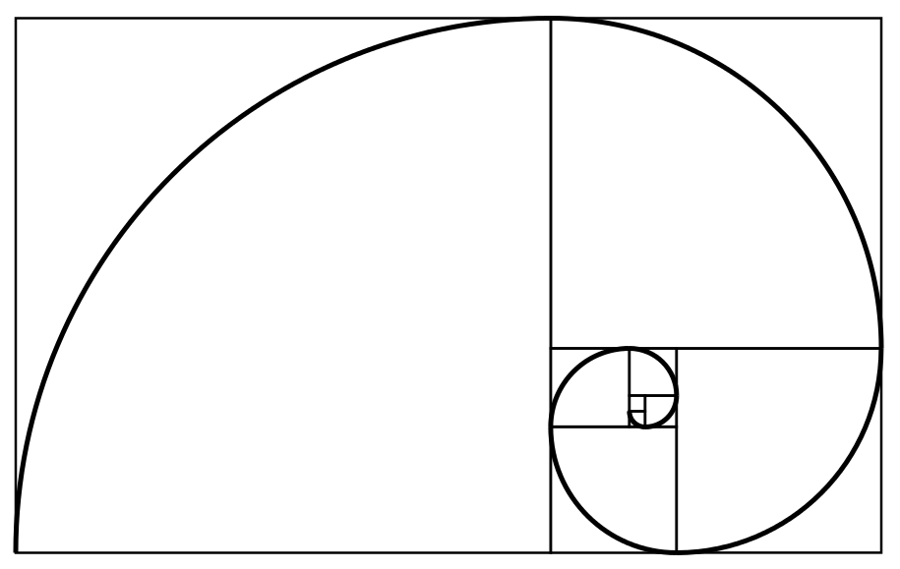
And the Fibonacci Numbers Again
F₀ = 0
F₁ = 1
F_{n} = F_{n-1} + F_{n-2}
multi fib(0) {0}
multi fib(1) {1}
multi fib(Int $n where * > 1) {
fib($n-1) + fib($n-2);
}

Slide 63
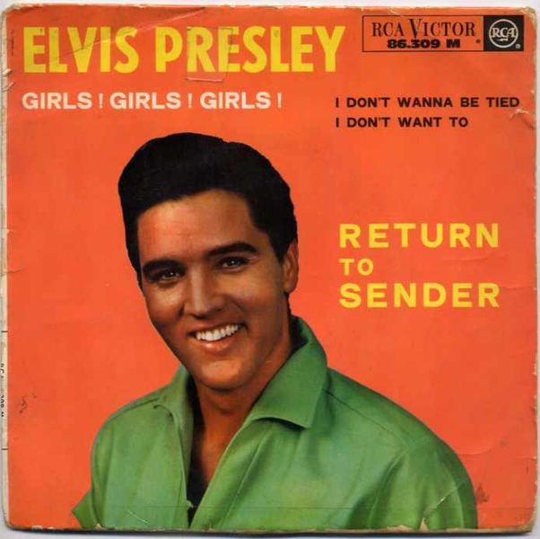
Asserting Return Types
sub foo() returns Bool {
return "Foo";
}
say "Yes" if foo();
Type check failed for return value; expected Bool but got Str ("Foo")
in sub foo at bool.raku line 3
in block <unit> at bool.raku line 4
Notes:
A common failure mode of dynamic languages eliminated.

Slide 64
Asserting Return Types
sub foo() returns Bool {
return some-other-func(); # what does this return?
}

Slide 65
Asserting Return Types
subset EvenInt where * %% 2;
sub foo() returns EvenInt {
return some-other-func();
}
Notes:
A common failure mode of dynamic languages eliminated.

Slide 66
Classes
A gentle introduction to awesomeness

Slide 67
Classes
class Point {
has $.x = 0;
has $.y = 0;
method Str { "[$.x,$.y]" }
}
my $point = Point.new( x => 5, y => 3 );
say $point.x; # 5
say $point.y; # 3
say "$point"; # [5,3]

Slide 68
Classes
class Point {
has $.x = 0;
has $.y = 0;
method gist { "[$.x,$.y]" }
method set( :$x = $.x, :$y = $.y ) {
$!x = $x; $!y = $y;
}
}
my $point = Point.new( x => 5, y => 3 );
say $point; # [5,3]
$point.set( y => 17 );
say $point; # [5,17]

Slide 69
And as you learn more …
class Point {
has Rat $.x = 0.0;
has Rat $.y = 0.0;
method gist { "[$.x,$.y]" }
method set( :$x = $.x, :$y = $.y ) {
$!x = $x; $!y = $y;
}
}
my $point = Point.new( x => 5.0, y => 3.0 );
say $point; # [5,3]
$point.set( y => "foo" ); # Boom!

Slide 70
And as you learn more …
class Point {
has Rat $.x is rw = 0.0;
has Rat $.y is rw = 0.0;
method gist { "[$.x,$.y]" }
}
my $point = Point.new( x => 5.0, y => 3.0 );
say $point; # [5,3]
$point.y = 17.3;
say $point; # [5,17.3]

Slide 71
And as you learn more …
class Point {
subset PointLimit of Rat where -10 <= * <= 10;
has PointLimit $.x is rw = 0.0;
has PointLimit $.y is rw = 0.0;
method gist { "[$.x,$.y]" }
}
my $point = Point.new( x => 5.0, y => 3.0 );
say $point; # [5,3]
$point.y = 17.3; # Boom!

Slide 72
The default values are silly …
class Point {
subset PointLimit of Rat where -10 <= * <= 10;
has PointLimit $.x is rw is required;
has PointLimit $.y is rw is required;
method gist { "[$.x,$.y]" }
}
my $point = Point.new( y => 3.0 ); # Boom!

Slide 73
Or …
class Point {
subset PointLimit of Rat where -10 .. 10;
has PointLimit $.x is rw is required;
has PointLimit $.y is rw is required;
method gist { "[$.x,$.y]" }
}
my $point = Point.new( x => 5.0, y => 3.0 );
say $point; # [5,3]
$point.y = 17.3; # Boom!

Slide 74
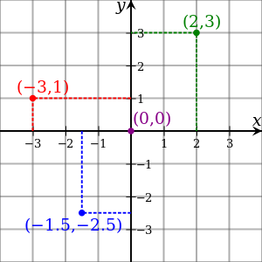
Raku Versus Raw Perl
class Point {
subset PointLimit of Rat where -10.0 .. 10.0;
has PointLimit $.x is rw is required;
has PointLimit $.y is rw is required;
method gist { "[$.x,$.y]" }
}
package Point {
use Carp;
use overload '""' => \&Str, fallback => 1;
sub _pointlimit {
my ( $class, $num ) = @_;
unless ( $num >= -10 && $num <= 10 ) {
croak "…";
}
}
sub new {
my ( $class, $x, $y ) = @_;
my $self = bless { x => undef, y => undef } => $class;
$self->x($x);
$self->y($y);
return $self;
}
sub x {
my ( $self, $x ) = @_;
$self->_pointlimit ($x);
$self->{x} = $x;
}
sub y {
my ( $self, $y ) = @_;
$self->_pointlimit ($y);
$self->{y} = $y;
}
sub Str {
my $self = shift;
return sprintf "[%f,%f]" => $self->x, $self->y;
}
}

Slide 75
Raku Versus Moose
class Point {
subset PointLimit of Rat where -10.0 .. 10.0;
has PointLimit $.x is rw is required;
has PointLimit $.y is rw is required;
method gist { "[$.x,$.y]" }
}
package Point {
use Moose;
use overload '""' => \&Str, fallback => 1;
use Moose::Util::TypeConstraints;
subtype "PointLimit" => as 'Num'
=> where { $_ >= -10 && $_ <= 10 }
=> message { "$_ must be a Num between -10 and 10, inclusive" };
has [qw/x y/] => (
is => 'rw',
isa => 'PointLimit',
required => 1,
);
sub Str {
my $self = shift;
return sprintf "[%f,%f]" => $self->x, $self->y;
}
}

Slide 76
Raku Versus C++
class Point {
subset PointLimit of Rat where -10.0 .. 10.0;
has PointLimit $.x is rw is required;
has PointLimit $.y is rw is required;
method gist { "[$.x,$.y]" }
}
#include <iostream>
#include <sstream>
class Point {
double x_, y_;
public:
Point (double x, double y) : x_(constrain(x)), y_(constrain(y)) {}
double x () const { return x_; }
double y () const { return y_; }
void x (double num) { x_ = constrain(num); }
void y (double num) { y_ = constrain(num); }
friend std::ostream & operator<< (std::ostream & stream, const Point & point) {
stream << '[' << point.x() << ',' << point.y() << ']';
return stream;
}
private:
static double constrain (double num) {
if (num < -10 || num > 10) {
std::stringstream ss;
ss << "'" << num << "' is not a real number between -10 and 10, inclusive";
throw(ss.str());
}
return num;
}
};
int main () {
try {
Point point(5, 3);
std::cout << point << std::endl;
point.y(17.3);
}
catch (const std::string & error) {
std::cerr << error << std::endl;
}
}

Slide 77
Raku Versus Java
class Point {
subset PointLimit of Rat where -10.0 .. 10.0;
has PointLimit $.x is rw is required;
has PointLimit $.y is rw is required;
method gist { "[$.x,$.y]" }
}
public class Point {
private static final double X_MIN = -10.0, X_MAX = 10.0;
private static final double Y_MIN = -10.0, Y_MAX = 10.0;
private double x, y;
public Point(double x, double y) throws IllegalArgumentException {
setX(x);
setY(y);
}
public double getX() { return x; }
public double getY() { return y; }
public void setX(double x) throws IllegalArgumentException {
if (x < X_MIN || x > X_MAX)
throw new IllegalArgumentException("…");
this.x = x;
}
public void setY(double y) throws IllegalArgumentException {
if (y < Y_MIN || y > Y_MIN)
throw new IllegalArgumentException("…");
this.y = y;
}
@Override
public String toString() {
return String.format("[%.1f,%.1f]", x, y);
}
}

Slide 78
Raku Versus Python 3
class Point {
subset PointLimit of Rat where -10.0 .. 10.0;
has PointLimit $.x is rw is required;
has PointLimit $.y is rw is required;
method gist { "[$.x,$.y]" }
}
class PointLimit:
def __init__(self, name):
self.name = name
def __get__(self, point, owner):
return point.__dict__.get(self.name)
def __set__(self, point, value):
if not -10 < value < 10:
raise ValueError('Value %d is out of range' % value)
point.__dict__[self.name] = value
class Point:
x = PointLimit('x');
y = PointLimit('y');
def __init__(self, x, y):
self.x = x
self.y = y
def __str__(self):
return "[%f,%f]" % (self.x, self.y)

Slide 79
Raku Versus Javascript
class Point {
subset PointLimit of Rat where -10.0 .. 10.0;
has PointLimit $.x is rw is required;
has PointLimit $.y is rw is required;
method gist { "[$.x,$.y]" }
}
function definePointLimit(point, name) {
Object.defineProperty(point, name, {
set: function (value) {
if (value < -10 || value > 10)
throw 'Value ' + value + ' is out of range';
point['_' + name] = value;
},
get: function () {
return point['_' + name];
}
});
}
function Point(x, y) {
definePointLimit(this, 'x');
definePointLimit(this, 'y');
this.x = x;
this.y = y;
}
Point.prototype.toString = function() {
return '[' + this.x + ',' + this.y + ']';
}
var point = new Point(5, 5);
point.y = 100; // Boom!

Slide 80
Raku Versus Ruby
class Point {
subset PointLimit of Rat where -10.0 .. 10.0;
has PointLimit $.x is rw is required;
has PointLimit $.y is rw is required;
method gist { "[$.x,$.y]" }
}
class Point
POINT_RANGE = -10..10
attr_constrained x: POINT_RANGE, y: POINT_RANGE
def initialize
@x = 0
@y = 0
end
def to_s
"[#{x},#{y}]"
end
private
def self.attr_constrained(attrs_and_constraints)
attrs_and_constraints.each do |attr, constraint|
attr_reader attr
define_method(:"#{attr}=") do |value|
raise "#{value} is not a valid value for #{attr}" \
unless constraint === value
instance_variable_set :"@#{attr}", value
end
end
end
end

Slide 81
Raku Versus Go
class Point {
subset PointLimit of Rat where -10.0 .. 10.0;
has PointLimit $.x is rw is required;
has PointLimit $.y is rw is required;
method gist { "[$.x,$.y]" }
}
package point
import "fmt"
import "errors"
type Point struct {
x, y float64
}
func NewPoint(x, y float64) (*Point, error) {
p := &Point{x, y}
if !IsValid(x) {
return nil, errors.New("Point x out of range!")
}
if !IsValid(y) {
return nil, errors.New("Point y out of range!")
}
return p, nil
}
func IsValid(p float64) (result bool) {
if p >= -10 && p <= 10 {
result = true
}
return
}
func (p *Point) String() string {
return fmt.Sprintf("[%v,%v]", p.x, p.y)
}
func (p *Point) SetX(x float64) (float64, error) {
ox := p.x
if !IsValid(x) {
return ox, errors.New("Point out of range!")
}
return ox, nil
}
func (p *Point) SetY(y float64) (float64, error) {
oy := p.y
if !IsValid(y) {
return oy, errors.New("Point out of range!")
}
return oy, nil
}
func (p *Point) GetX() float64 {
return p.x
}
func (p *Point) GetY() float64 {
return p.y
}

Slide 82
Review
Math that works
Powerful function signatures
Types you can actually use
Powerful, expressive classes

Slide 83
Killer FeatureS

Slide 84
Summary
Raku is large
So is Perl, C++, etc.
Proper OO
Easy to read
Safer
Very powerful

Slide 85
Resources
https://www.raku.org/
https://rakubrew.org/
https://course.raku.org/
https://learnxinyminutes.com/docs/raku/
https://www.reddit.com/r/rakulang/
irc.freenode.net #raku

Slide 86
Bonus Slides!

Slide 87
Type Inference (wip)
sub something(Int $nth) {...}
say "Hello.";
say something(3.7);
===SORRY!=== Error while compiling fib.raku
Calling something(Rat) will never work with declared signature (Int $nth)
at fib.raku:3
------> say ⏏something(3.7);

Slide 88
Type Inference (wip)
sub something(Int $nth where * > 0) {...}
say "Hello.";
say something(3.7);
Hello.
Type check failed in binding to parameter '$nth'; expected Int but got Rat (3.7)
in sub something at fib.raku line 1
in block <unit> at fib.raku line 3

Slide 89
Run Time
sub fib(Int $nth) {...}
my $var = 3.7;
say "Hello";
say fib($var);
Hello.
Type check failed in binding to parameter '$nth'; expected Int but got Rat (3.7)
in sub something at fib.raku line 1
in block <unit> at fib.raku line 4
Notes:
@_ is still there, but don't use if it if you don't need it.

Slide 90
Compile Time
sub fib(Int $nth) {...}
my Rat $var = 3.7;
say “Hello”;
say fib($var);
===SORRY!=== Error while compiling fib.raku
Calling something(Rat) will never work with declared signature (Int $nth)
at fib.raku:4
------> say ⏏something($var);
Notes:
The check is in the optimizer and if can see a type matches, it will eliminate the type check at

Slide 91
Type Checks/Inference
Compile-time failures!
Deliberately limited in scope
Type checks at compile time are not duplicated at run time
Multi-sub checks can often be eliminated at run time

Slide 92
Infinite Lazy Lists
constant @primes = grep { .is-prime }, 1 .. *;
say @primes[^10];
# 2 3 5 7 11 13 17 19 23 29

Slide 93
Infinite Lazy Lists
constant PRIMES = grep { .is-prime }, 1 .. *;
say PRIMES[^10];
# 2 3 5 7 11 13 17 19 23 29

Slide 94
But it worked when I tested it!
open my $fh, '<', $file
or die "Can't read $file: $!";
foreach (<$fh>) {
print if /abcd/;
}

Slide 95
This is lazy
my $fh = open($file);
for $fh.lines -> $line {
say $line if $line ~~ /abcd/;
}
Notes:
Take the time to explain the pointy block (aka the lambda block in other languages)

Slide 96
So is this
my $fh = open($file);
for $fh.lines.grep({/abcd/}) ->$line {
say $line;
}

Slide 97
Lazy Fibonacci Numbers
my @fib = 0, 1, * + * ... *;
say @fib[^$num];

Slide 98
Lazy Fibonacci Numbers
my @fib = 0, 1, * + * ... *;
say @fib[^$num];

Slide 99
Arithmetic Sequences
my @evens = 0, 2 ... *;
say @evens[^10];
# 0 2 4 6 8 10 12 14 16 18

Slide 100
Geometric Sequences
my @powers_of_two = 2, 4, 8 ... *;
say @powers_of_two[^10];
# 2 4 8 16 32 64 128 256 512 1024

Slide 101
Complex Sequences
my @fib = 0,1,-> $a,$b {$a+$b} ... *;
say @fib[^10];
# 0 1 1 2 3 5 8 13 21 34

Slide 102
Complex Sequences
my @fib = 0,1,-> $a,$b {$a+$b} ... *;
say @fib[^10];
# 0 1 1 2 3 5 8 13 21 34
for 1..5 -> $var { say $var; }

Slide 103
Complex Sequences
my @fib = 0, 1, * + * ... *;
say @fib[^10];
# 0 1 1 2 3 5 8 13 21 34

Slide 104
Complex Sequences
my @fib = 0, 1, * + * ... *;
say @fib[^10];
# 0 1 1 2 3 5 8 13 21 34
my @fib = 0,1,-> $a,$b {$a+$b} ... *;
say @fib[^10];

Slide 105
Buy My Books!

Slide 106
Thank You!

