Slide 1
Pre-read
The slides in this deck are publicly available!
These are the slides that correspond to Kris Nóva’s 2023 FOSDEM talk.
All comments on the slides will be publicly visible.
For private feedback please email: nova@nivenly.org.
The Go gopher was designed by Renee French licensed under Creative Commons.
I have written permission to use the Untitled Goose Game art form House House and Panic.
Ferris the Crab was designed by Dzuk and licensed under Creative Commons.
The Kubernetes logo is Apache 2.0 licensed.

Slide 2
Watch the Recording below
https://www.youtube.com/watch?v=5a277u4j6fU

Slide 4
Aurae
Distributed Systems Runtime

Slide 5
Kris Nóva
hachyderm.io/@nova
Principal Engineer
Author
Computer Science

Slide 6
Overview and Context
github.com/aurae-runtime/aurae

Slide 7
What is Aurae?
An open source Rust project aimed at simplifying node management at scale.
A generic “execution engine” for containers, VMs, and processes

Slide 8
Thesis Statement
Bringing deliberate runtime controls to a node will unlock a new generation of higher order distributed systems.
Simplifying the execution stack will foster secure and observable systems while reducing complexity and risk.

Slide 9
What is a “node”?
..not Node JS
hachyderm.io/@nova
A single compute unit in a set.
EG: A server in a cluster.

Slide 10
What does Aurae do?
Control of every runtime process on a node.
Runs as a minimal init system with a remote API.
Manages processes, containers, virtual machines.
Runs on Linux.

Slide 11
What doesn’t it do?
Generic desktop support is out of scope.
Higher order scheduling is out of scope.
Does not run on Darwin.
Does not run on Windows.

Slide 12
Where did it come from?
Challenges with complexity at scale.
Desire to simplify and secure the stack.
Hope for a stronger node API.
Hope for managing nodes at scale.

Slide 13
All workloads are untrusted
The reality of scale.

Slide 14
Guiding Principles
Boring
Attainable
Functional
Single Binary
Plays nice with others
Strong Interfaces
Polymorphic, easy to ship, lightweight, strong scope, low risk
Kubernetes Container Runtime Interface
(all of them…)
Wanted to build a “standard library” for multiple purposes.

Slide 15
We want boring systems!
The Kubelet has an API?
Istio?
Template render?
Attack Surface?
Network interfaces?
DNS?
Security context?
Observability?
Which YAML?
Container Escapes?
Federation?
kube-proxy?
Iptables? nftables?
Label selector templates?
Most problems stem from complexity, drift, and disparate systems
What about systemd?
Service Mesh?
Resource quota?
Pod boundary?
Node upgrades?
Docker?
Kernel versions?

Slide 16
Guiding Principles
Safe
Tenant Security
How do we make it easy to do the right thing?
How do we bake security into systems that are already online?

Slide 17
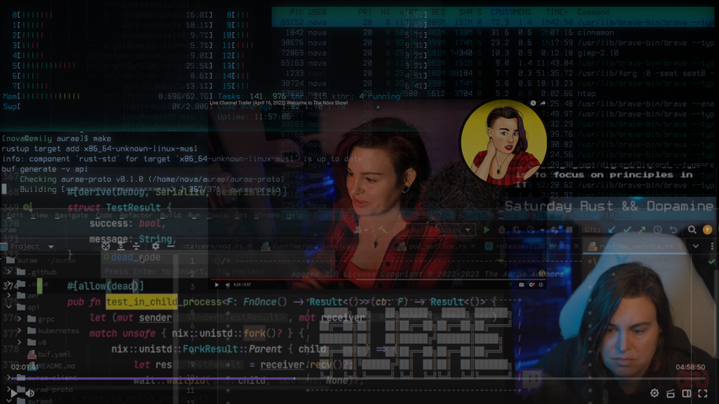
Aurae
We wrote a paper

Slide 18
Started in Go
“Aurae Legacy”
NAML
Daemon Proof of Concept
Turing Complete Manifests
Created familiar interfaces.
Needed to re-create the JSON/YAML dance.
What about access to libc?
“Not Another Markup Language”
Kubernetes objects in Go.
Basically the Go SDK.
github.com/aurae-runtime/aurae-legacy
github.com/krisnova/naml

Slide 19
..but
libc
eBPF
virtualization
hachyderm.io/@nova
Pid 1
Probes
Existing Libs
Cgroups V2
Clone3, Ptrace
init semantics, udev
We want to instrument our isolation zones.
What about writing the probe bytecode?
C Libraries
KVM
Firecracker
Cgroup controllers

Slide 20
Go 1.20 Update
Unwrap()
Clone()
Errors
Memory
Go 1.20
Go is starting to take memory safety seriously

Slide 21
Rust
I made the decision to move to Rust.

Slide 22
Rust
to help us solve the YAML problem

Slide 23
All Config Drifts Towards Turing Completion
hachyderm.io/@nova

Slide 24
AuraeScript
Rust binary that embeds connection logic for auraed

Slide 25
Deno and TypeScript
In order to keep the system attainable I wanted a simple and safe Turing complete language in favor of static config.
Deno is a simple runtime for TypeScript written in Rust.
github.com/denoland/deno

Slide 26
AuraeScript as a Client
hachyderm.io/@nova
AuraeScript embeds Deno and a Rust client.
TypeScript as a replacement for YAML

Slide 27
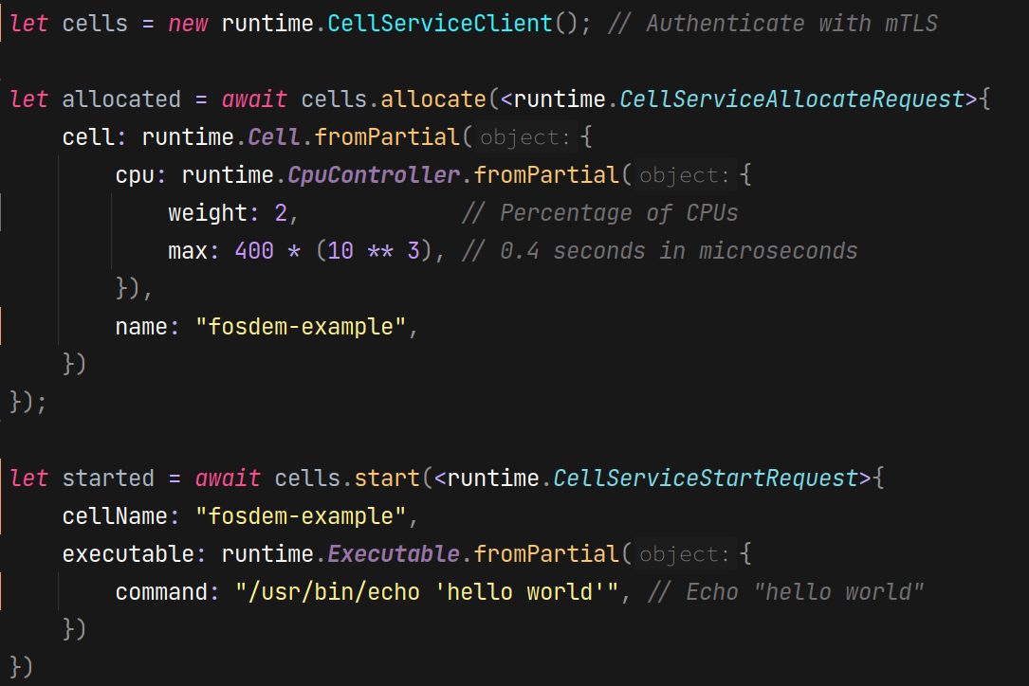
sleep.ts

Slide 28
sleep.ts
YAML but with math

Slide 29
Patterns Emerged
hachyderm.io/@nova
Static Service Definitions
nginx.ts
dashboard.ts
Turing Complete Generic Functionality
start
stop
status

Slide 30
Rust
to help us solve the sidecar problem with auraed

Slide 31
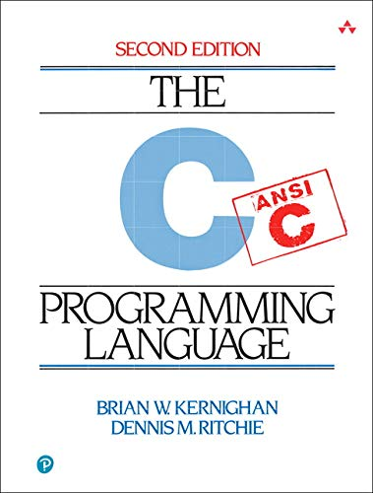
A sidecar that is always available with the same features as the host.
hachyderm.io/@nova
Rust memory safety is key.
Notes:
Writing rust reminds me of writing C

Slide 32
Any sufficiently mature infrastructure service will evolve into a sidecar.
hachyderm.io/@nova

Slide 33
Features for Both:
The host and your workload
Logging
Identity
Tokio streams
RustTLS
Substantially simpler
Authn / Authz
Network
#derive[]
Derive access controls at the feature level in Rust
Direct access to Linux network devices
eBPF facilities

Slide 34
Rust unlocks “Spawn”
Rust gives us access to virtualization, containers, processes, and the kernel
Single API for both nodes and inter-workload features
What we bring to the host, we bring to your workload
All memory safe
Notes:
Namespaces

Slide 35
Spawn
Assemble nested images from host filesystem at runtime No downloading images
No pause containers
Cell Sandbox
Nested Aurae Daemon
Pod Sandbox
Nested Aurae Daemon
Aurae Host Daemon
Privileged
/proc/self/exe
VM Sandbox
Nested Aurae Daemon

Slide 36
Rust
to help solve the untrusted workload problem

Slide 37
Memory Safety
Init Container
Reduced attack surface
Borrow checker pays off here
Hi Ian! I love you!
Isolation Zone
(Pod Sandbox, VM, Cells)
Untrusted Workload
pid=2
Nested Aurae Daemon
pid=1
Untrusted Workload
pid=3

Slide 38
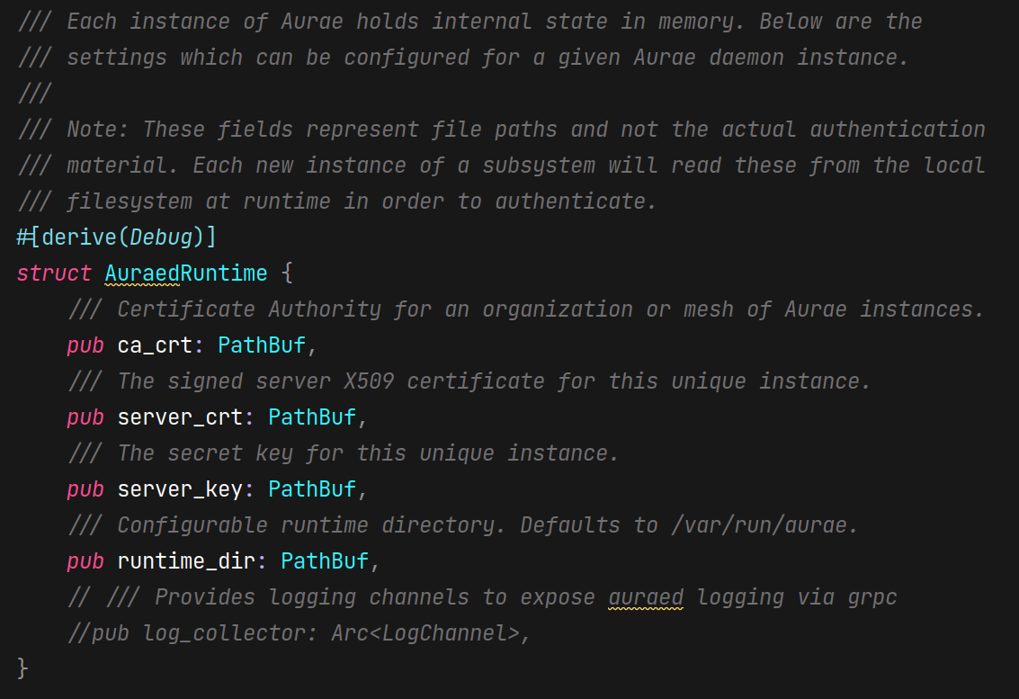
Managing Memory for mTLS in Auraed

Slide 39
Rust
to help us solve the maintainability problem

Slide 40
Did somebody say macros?
@future_highway
Third party resources? Custom Resource Definitions? YAML? Controllers? But what does it mean?

Slide 41
Go/Kubernetes Want Macros
API Machinery, Third Party Resources, CRDs
Starting with generic objects
//go:generate
zz_kube_types.go

Slide 42
What are Rust macros?
Rust lets you write code that can write other code.
cells_call.rs
aurae_macros.rs
pods_call.rs
ae_macro.rs
vms_call.rs
aer_macro.rs

Slide 43
What are Rust macros?
Rust lets you write code that can write other code.
cells_call.rs
aurae_macros.rs
pods_call.rs
ae_macro.rs
ae_cells.rs
vms_call.rs
aer_macro.rs

Slide 44
What are Rust macros?
Rust lets you write code that can write other code.
These are unique needs of Aurae!

Slide 45
Macros in Aurae
hachyderm.io/@nova
Rust Source Code
Documentation
Rust Client
AuraeScript
Deno Ops
TypeScript library

Slide 46
Macros as an Investment
Manual Plumbing
Improve
Refine
Binary
Rust Macro

Slide 47
Macros as an Investment
Rust Macro
Binary

Slide 48
The State of the Art
auraed is the main static binary written in Rust and compiled with musl
aer is completely generated from .proto with Rust macros
auraescript is completely generated from .proto with Rust macros
ae is an alternative command line client written in Go

Slide 49
Rust
to help us solve the boring problem

Slide 50
Takeaways
Completely stateless
Nodes are declarative
can just be TypeScript or JSON
Easy to manage nodes like containers

Slide 51
What’s Next?
Harden deployment
Support for service config
Support for supply chain authentication
Kernel virtualization
OCI support for micro VMs
Minimal distribution of lightweight Linux + Auraed

Slide 52
Getting Involved
GitHub
Docs
github.com/aurae-runtime/aurae
aurae.io
Twitch
Discord
twitch.tv/krisnova
discord.gg/T76jkkMbSj

Slide 53
Twitch Crew
@future_highway
@dma42
@orz
@taniwha3
@kuxaku
@malte_aero
@zunderscore
@lastchain
@quintessence
@esk
@hazelweakly
@rrethy

Slide 54
Demo
hachyderm.io/@nova

Slide 56
Interesting Takeaways
hachyderm.io/@nova
A gopher’s first year of Rust

Slide 57
Is it..?
It depends.
A microkernel?
A unikernel?
A system system?

Slide 58
Rust Development Flow
0m
+10m
+30m
+31m
Idea
Setup
Implement
Profit
Establish feature to add to code base
Basic plumbing, Cargo.toml, build.rs, etc
Design and fight with the borrow checker
It’s kind of just done now

Slide 59
There is only the “right” way
..there isn’t really any other way.

Slide 60
Rust is easy to hate
…if you try to fight the language instead of letting the language show you the way.
- @togglebit

Slide 61
Go vs Rust
Frequently Asked Question

Slide 62
My Opinion
Rust
Go
I feel lucky to know both and have access to both.
auraed
ae
Safe, Reliable
Ship “right”
Fight the compiler
Libc is a super power
Fast, Practical
Ship “right now”
Fight the debugger
Libc is a risk

Slide 63
Node Config
Management
hachyderm.io/@nova
Why are we trying to
“get better”
at hacking user level configuration for systems with no users?
…is the wrong conversation to be having.
Notes:
Most of the complexity with config management comes from undoing the work that puts thea

