Slide 1
Mercator Mapping the Information System
February, 4th 2023

Slide 2
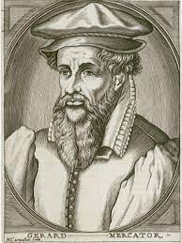
Mercator
Mercator?
Mercator is a web application that allows you to manage the mapping of an information system as described in the Information System Mapping Guide from ANSSI.fr
What is a mapping ?
Mapping is a way to represent the information system of an organization as well as its connections with the outside world. The term "mapping" refers to a schematic representation of a set of information.
Mapping <-> Inventory
Who is Mercator?
Mercator is a cartographer. He is the author of the Mercator projection, which is a conformal projection, i.e. it keeps the angles (very useful in sailing in the 16th century).
Notes:
Les attaques informatiques interviennent dans un environnement en constante évolution. Pour répondre à ces enjeux, il est nécessaire de mettre en place une approche globale de gestion des risques au sein de son organisation.
La cartographie du Système d’Information permet d’avoir une vue globale de l’ensemble des éléments qui constituent le système d’information pour d’obtenir une meilleure lisibilité, et donc un meilleur contrôle.
L’élaboration d’une cartographie participe à la protection, à la défense et à la résilience du système d’information.
C’est un outil indispensable à la maitrise de son système d’information et qui s’intègre dans une démarche globale de gestion des risques.

Slide 3
Mercator
Why map?
Essential tool to control the information system. It allows you to have knowledge of all the components of the information system and to obtain a better understanding of it by presenting it under different views.
Four challenges of digital security
The control of the information system: the cartography allows to have a common and shared vision of the information system within the organization.
Protection of the information system: mapping makes it possible to identify the most critical and most exposed systems, to anticipate possible attack paths on these systems and to implement adequate measures to ensure their protection.
Defense of the information system: mapping enables a more effective response in the event of an incident or digital attack, to qualify the impacts and predict the consequences of the defensive actions taken
Information system resilience: mapping makes it possible to identiﬁer the organization's key activities to deﬁnie a business continuity plan and is an essential tool for crisis management, whether digital or not.

Slide 4
Mercator
Composition of a map
1. Business
- The ecosystem view presents the different entities or systems with which the IS interacts to fulfill its function.
- The business view of the information system represents the IS through its main processes and information.
2. Application
- The application view describes the software components of the information system, the services they provide, and the ﬂow of information between them.
- The administration view lists the scopes and privilege levels of users and administrators.
3. Infrastructure
- The logical infrastructure view illustrates the logical partitioning of networks, including the deﬁnition of IP address ranges, VLANs, and ﬁltering and routing functions ;
- The physical infrastructure view describes the physical equipment that are used by the information system.

Slide 5
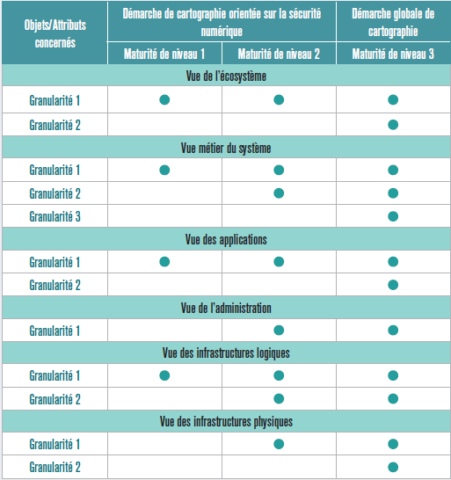
Mercator
Levels of granularity
Each step has its own level of granularity.
Minimum granularity level 1:
Initial elements essential to digital security operations
Intermediate level 2 granularity:
Digital security oriented mapping. Vital information systems must have a mapping with this minimum level of maturity.
Level 3 fine granularity:
Comprehensive and detailed mapping that incorporates digital security requirements.

Slide 6
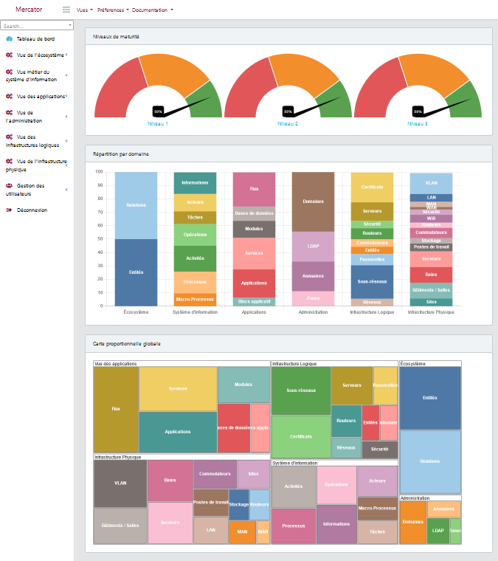
Mercator
Main screen
- Maturity level
- Breakdown by domain
- Global proportional map

Slide 7
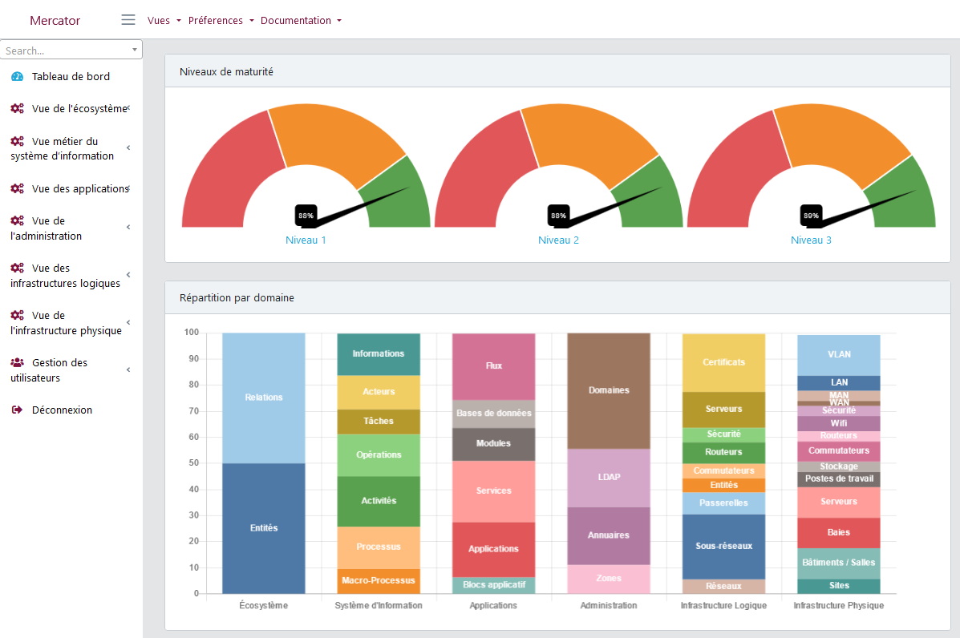
Mercator
Top panel
- Views
- Preferences
- Documentation
Left panel
- Data entry

Slide 8
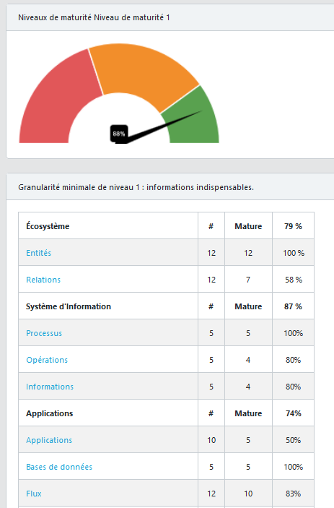
Mercator
Computing the maturity level
Presence of information :
- no description
- no responsible
- no type ...
Links between assets :
- entity without relations
- process without operations
- application that does not support any process
- server without applications
Computation :
conforming assets / total number of assets
% represents the effort to be compliant

Slide 9
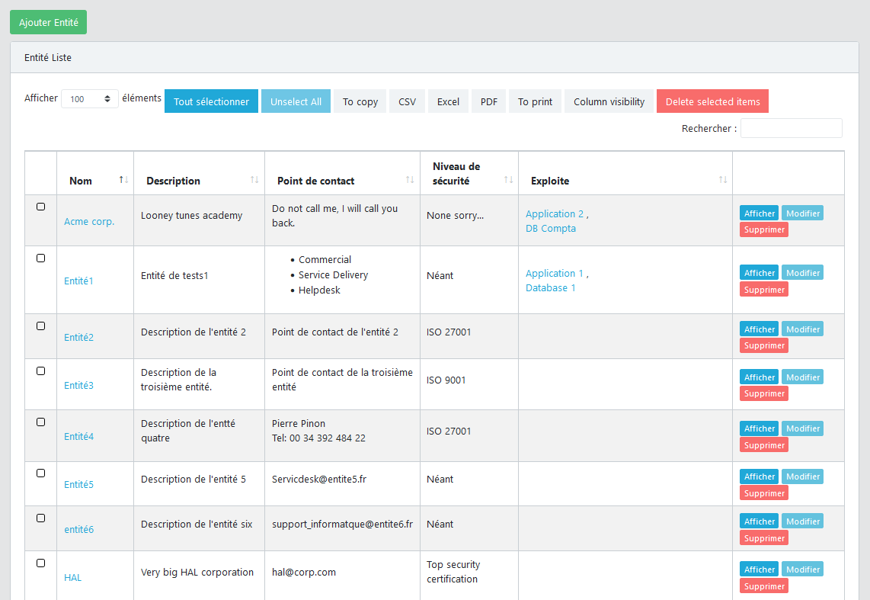
Mercator
Lists
- Sort on each column
- Search for
- Hide a column
- Show / Modify / Delete
- Copy
- Print
- Export : Excel, PDF, CSV, ...

Slide 10
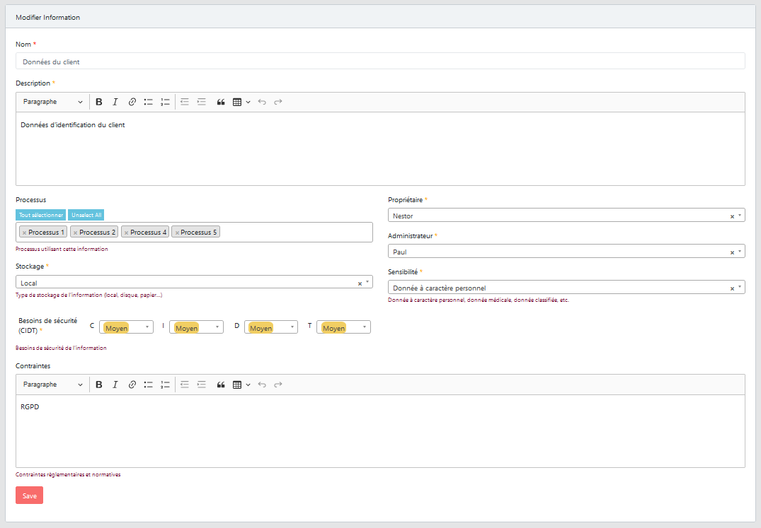
Mercator
Forms
- RFT Editor
- Drop-down list
- Links between objects
- Security requirements
- Roles management
- History of changes

Slide 11
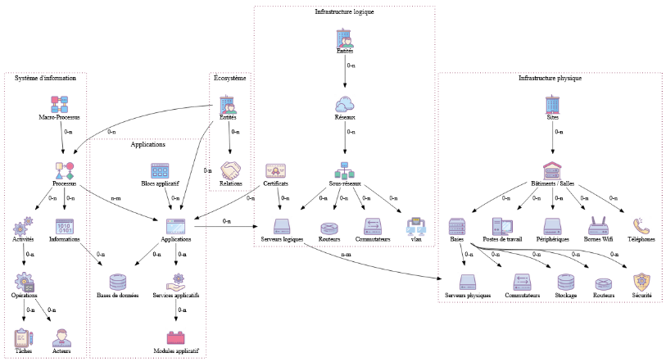
Mercator
Data Model

Slide 12
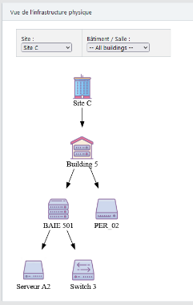
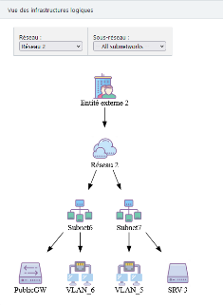
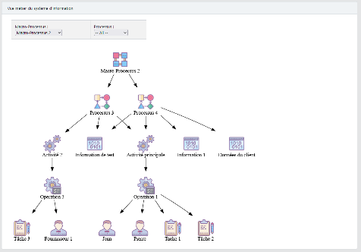
Mercator
Links between objects

Slide 13
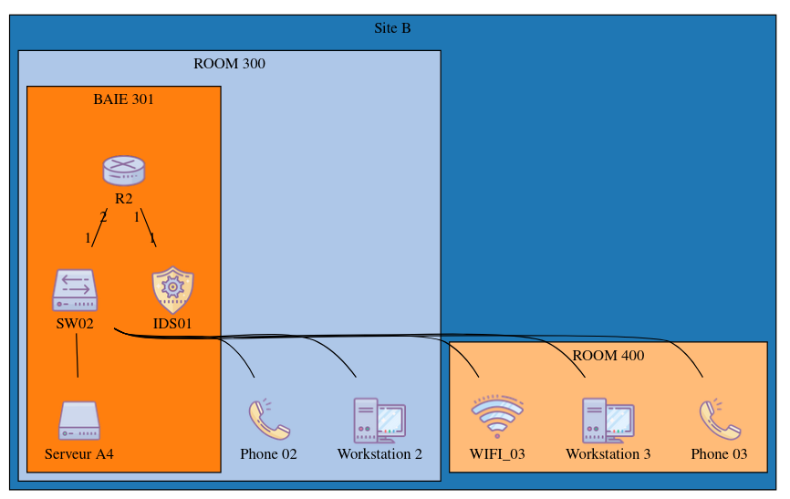
Mercator
Physical network schema

Slide 14
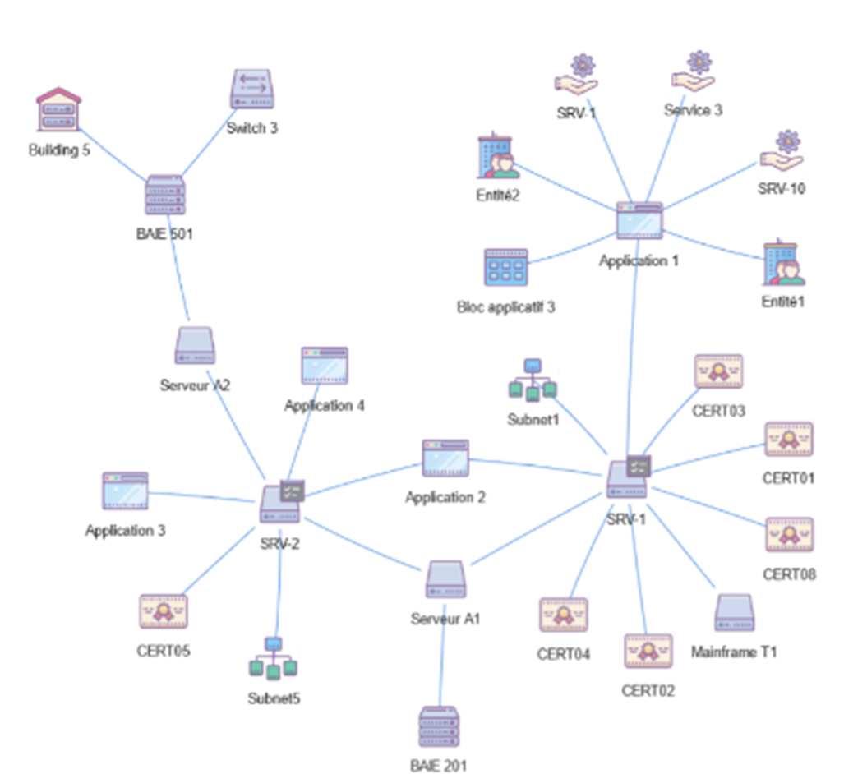
Mercator
Explore cartography

Slide 15
Mercator
Reports
Information System Mapping Report
Lists
Supported entities and applications
List of information system entities and their supported applications
Applications by application group
List of applications by application group
Logical servers
List of logical servers by applications and managers
Analysis of security needs
List of security needs between macro-processes, processes, applications, database and information.
Logical servers configuration
List of logical servers configuration
Inventory of the physical infrastructure
List of equipment by site/location
Audit
Maturity levels
Lists the maturity levels reached by the different objects of the mapping
Update / changes
Traces the changes made to the map in the last 12 months

Slide 16
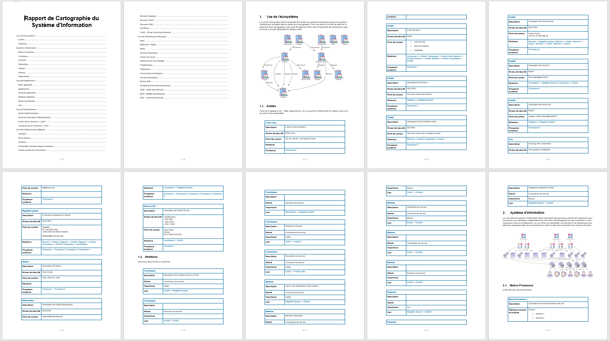
Mercator
Information System Mapping Report

Slide 17
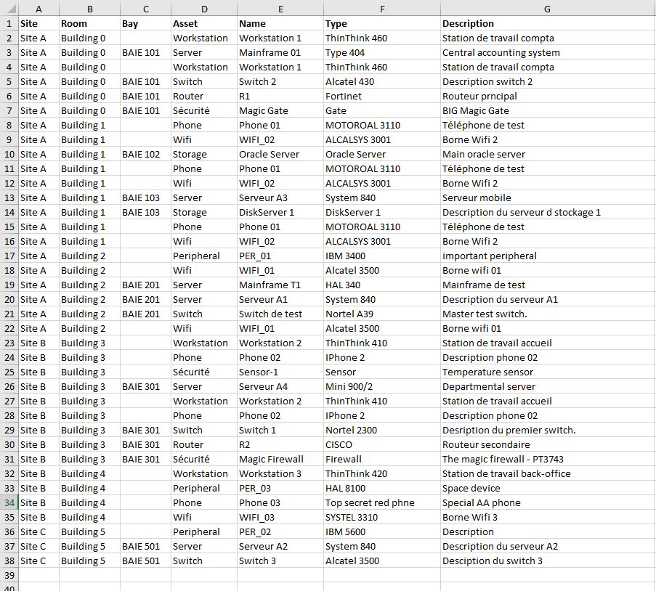
Mercator
Physical inventory

Slide 18
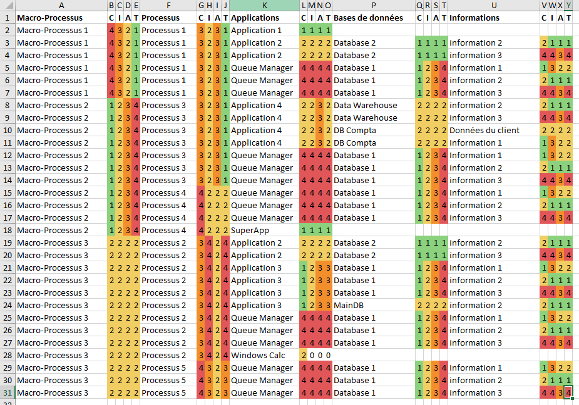
Mercator
Analysis of the security needs
Analysis of the security needs
Denormalize the links between macro-processes, processes, applications, databases and information
Analyze the differences in requirements between each object.

Slide 19
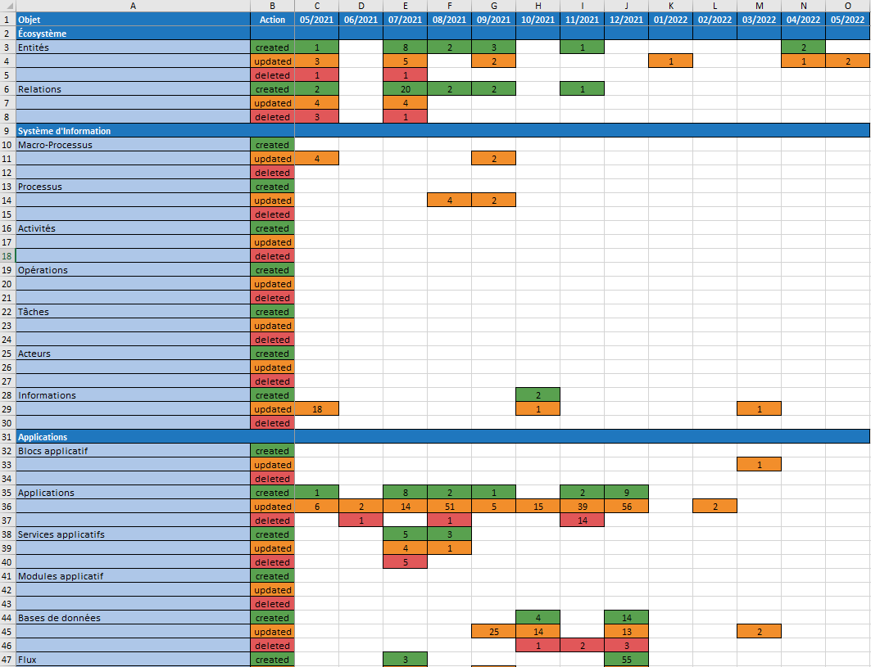
Mercator
Cartography updates
Track the changes made to the mapping over the last 12 months
Track the updating of the map
Demonstrate that the mapping is updated regularly

Slide 20
Mercator
Links with ISO 27001:2013
Section | Titre
A8.1.1 | Inventory of assets
A.8.1.2 | Ownership of assets
A.8.2.1 | Labelling of information
A.11.2.1 | Location and protection of assets
A.12.1.2 | Change management
A.12.1.3 | Capacity management
A.12.6.1 | Vulnerability management
A.13.1.3 | Segregation of networks
A.15.1.2 | Security in supplier agreements
A.16.1.4 | Assessment of information security events
A.17.2.1 | Availability of information processing resources

Slide 21
Mercator
Application available on GitHub https://github.com/dbarzin/mercator
under Open Source License
Usage
3 hospitals in Luxembourg
10 hospitals in France
3 administrations of French municipalities
Contributions
10 contributors
Roadmap
Treatment registry (GDPR), crisis directory, link with Monarc

