Slide 1
Auto Instrumentation for your NodeJS application on Kubernetes

Slide 2
About me
Yuri Oliveira Sá
Software Engineer @RedHat on the Operator Enablement Team.
OpenTelemetry Operator contributor
/yurioliveirasa
/yuriolisa
/yurioliveirasa

Slide 3
What is OpenTelemetry?
OpenTelemetry is a collection of tools, APIs, and SDKs. Use it to instrument, generate, collect, and export telemetry data (metrics, logs, and traces) to help you analyze your software’s performance and behavior.

Slide 4
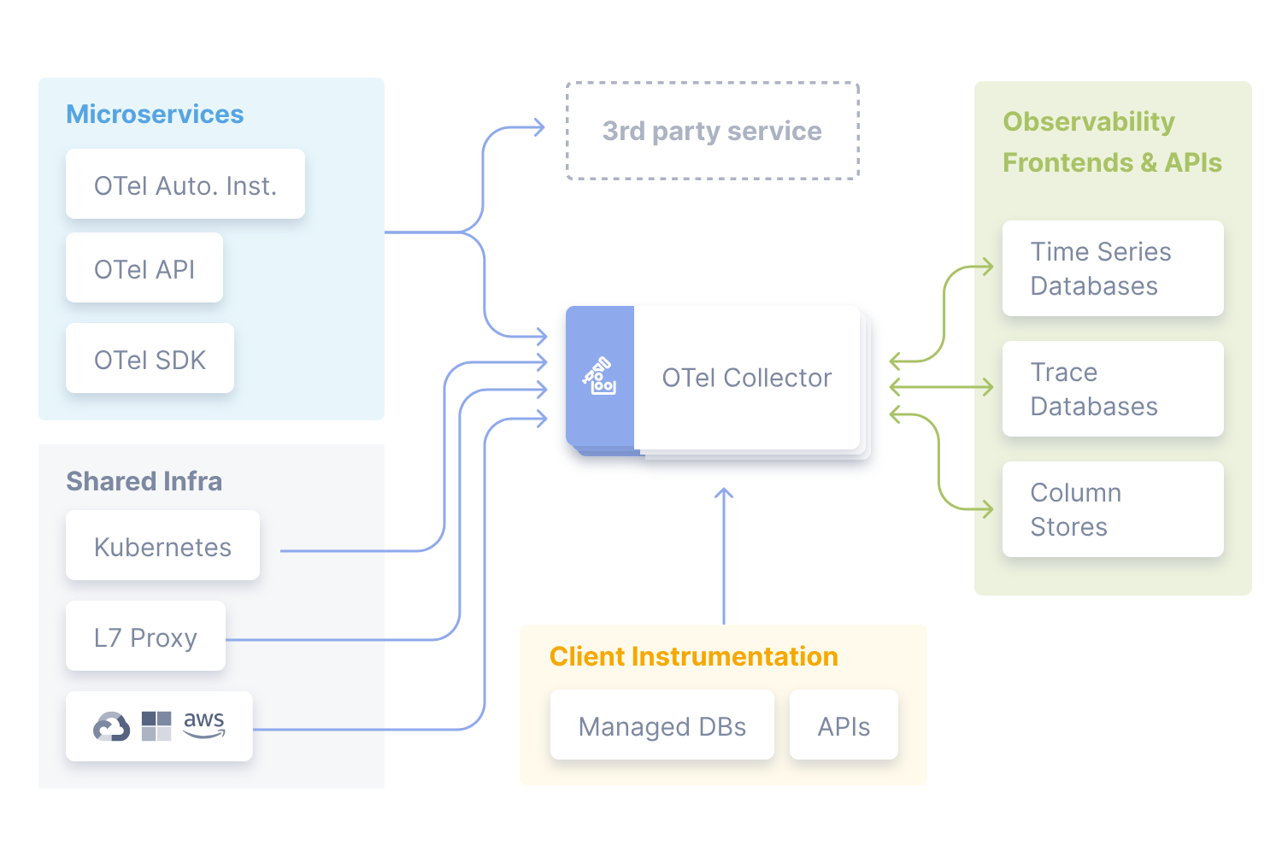
source: https://opentelemetry.io/

Slide 5
Receivers
A Receiver, which can be push or pull based, is how data gets into the Collector. Receivers may support one or more data sources. Examples:
Fluentd
Host Metrics
Jaeger
Kafka
Otlp
Prometheus
Zipkin

Slide 6
Receivers
Receivers

Slide 7
Receivers, Processors
Processors will run over the telemetry data before they got exported. Processors are optional though some are recommended:
Attributes
Batch
Metrics
Memory_Limiter
Resource Attributes

Slide 8
Receivers, Processors, Exporters!
An Exporter, which can be push or pull-based, defines the destination where you send the received telemetry data to one or more backends/destinations. Exporters may support one or more data sources.
File Path
Logging
Jaeger
Otlp
Otlp/Http
Prometheus
Zipkin

Slide 9
Exporters

Slide 10
OpenTelemetry Operator
Why to use it?
Simplified Deployment and Configuration.
Automatic Management
Integration with Kubernetes Ecosystem
Scalability

Slide 11
OpenTelemetry Operator
Installation Methods
Manual
Helm Chart
(OLM) / Operatorhub.io
Github Operator Repo
Github Helm Charts Repo

Slide 12
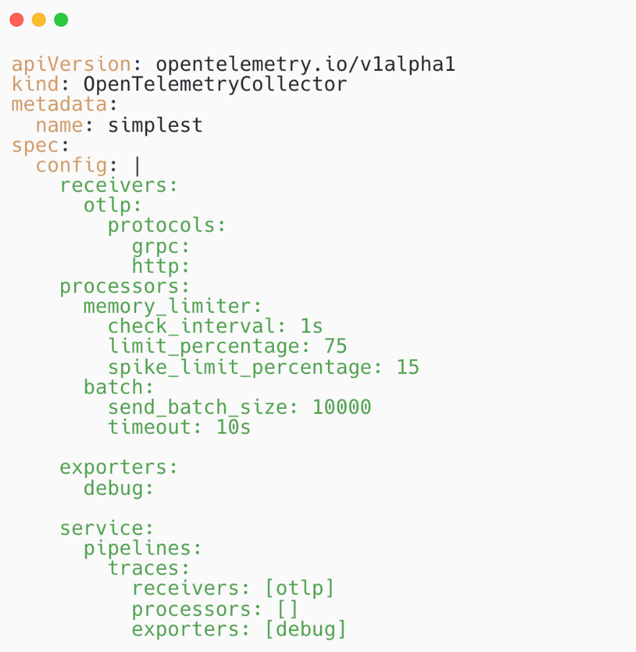
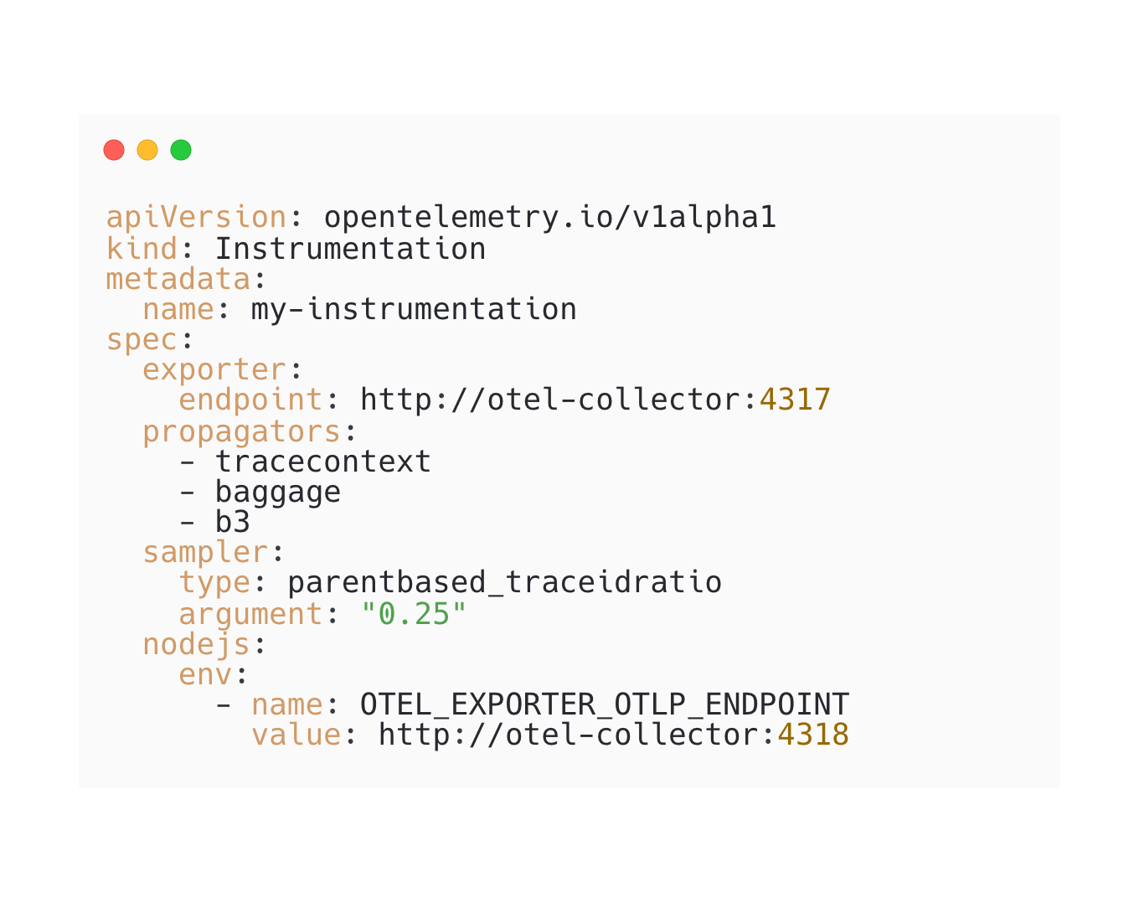
OpenTelemetry Operator
Custom Resources Definitions (CRDs)

Slide 13
OpenTelemetryCollector
Deployment Modes
Deployment
Statefulset
Daemonset
Sidecar (It requires annotation on the target Pod).
Possibility to configure different Images (Default and Contrib repo).
Internal Metrics.
AutoScaler.
PodDisruptionBudget.
Target Allocator.

Slide 14
Auto-Instrumentation
How the spans will be recorded.
Which Collector will receiver the auto instrumented data.

Slide 15
Auto-Instrumentation
OpenTelemetry code instrumentation supports different libraries:
Auto-instrumentation: NodeJS, Python, Java, Go, Apache.
Manual instrumentation: C++, Go, Elixir, .NET, PHP, Ruby, Rust,Swift.

Slide 16
Auto-Instrumentation
The operator can inject and configure OpenTelemetry auto-instrumentation libraries.
Requirements:
Resource kind:OpenTelemetryCollector.
Resource kind: Instrumentation.
One of the defined annotations.

Slide 17
Auto-Instrumentation
Annotations:
Java: instrumentation.opentelemetry.io/inject-java: "true"
NodeJS: instrumentation.opentelemetry.io/inject-nodejs: "true"
Python: instrumentation.opentelemetry.io/inject-python: "true"
.Net: instrumentation.opentelemetry.io/inject-dotnet: "true"

Slide 18
What's new in Operator?
Support to Kubernetes v1.29 (Operator 0.91.0).
New API Version v1alpha2.

Slide 19
Demo
+
+

Slide 20
Takeaways
If you have no visibility over your application, use OpenTelemetry.
Auto-instrumentation will help during the development process to leverage telemetry of the application.
If you can't see any receiver or exporter for your tool, I encourage you to start contributing to the project.

Slide 21
Thank you!
/yurioliveirasa
/yuriolisa
/yurioliveirasa

