Slide 1
FOSS for FOSS:
DejaCode is your new
FOSS control center for SBOMs

Slide 2
Agenda
About me, about AboutCode
DejaCode
Now open source!
Demo
Other projects in AboutCode stack
Roadmap
Questions
Notes:
AboutCode is an open source community committed to making open source safer and easier to use by building modular open source tools, data, and standards for Software Composition Analysis (SCA).

Slide 3
About me
On a mission to enable easier and safer to reuse FOSS code with best-in-class open source Software Composition Analysis (SCA) tools, data, and standards for open source discovery, license & security compliance
Lead maintainer of AboutCode projects (ScanCode, DejaCode, VulnerableCode and others)
CTO and co-founder of nexB, Inc.
pombredanne@nexb.com
GitHub: https://github.com/pombredanne
LinkedIn: https://www.linkedin.com/in/philippeombredanne
Often assisted by Chihuahua Technical Advisor
Notes:
AboutCode is an open source community committed to making open source safer and easier to use by building modular open source tools, data, and standards for Software Composition Analysis (SCA).

Slide 4
About AboutCode
AboutCode's FOSS-first mission: FOSS for FOSS
Open source tools and open knowledge base (AboutCode stack)
Simple and practical standards (Package-URL / PURL https://github.com/package-url )
Applications for Legal & Business users (DejaCode) with APIs for everything
Co-founders of SPDX: https://spdx.org
Contributors to CycloneDX: https://cyclonedx.org
Co-founders of ClearlyDefined: https://clearlydefined.io
Anchors for a community of SCA tools user and developers
Supported by contributors, nexB and others generous sponsors and supporters!
nexB provides professional services and support for SCA to sustain FOSS tools development
Notes:
AboutCode is an open source community committed to making open source safer and easier to use by building modular open source tools, data, and standards for Software Composition Analysis (SCA).

Slide 5
The problem
We can assemble code like Lego™.
And it is easy to forget how and where we got the code from.
Yet, this is important for:
License?
Security?
But also quality, sustainability and more!
Notes:
AboutCode is an open source community committed to making open source safer and easier to use by building modular open source tools, data, and standards for Software Composition Analysis (SCA).

Slide 6
Software Composition Analysis

Slide 7
SCA: proprietary tools and data problem
Increasingly expensive with the surge of interest in SBOMs and pricing based on number of developers
Large companies may be able to “afford” proprietary SCA scanning tools, but they do not scale across the FOSS supply chain
The cost of scan curation is prohibitive with high false positive rates and poor origin and license detection accuracy
Most current data about FOSS packages and vulnerabilities is proprietary
Vendors may offer some free or open source tools but you must pay for access to their data
Vulnerability databases data quality and accuracy is abysmally low
Barrier to community access and analysis
Openwashing/Fauxpen: Many vendors use open source for marketing only

Slide 8
The AboutCode stack

Slide 9
SCA Tools
Management Apps
Open Knowledge Base

Slide 10
SCA Tools
Management Apps
ScanCode
DejaCode
Scan
Match
Analysis pipelines
Policies
Curations
Software inventory
Binary analysis
Dependency analysis
Workflows
SBOMs
Custom reports
Open Knowledge Base
Licenses
Packages
Vulnerabilities

Slide 11
The AboutCode stack for SCA
SCA Tools
Web-based "enterprise" management application
DejaCode for ensuring license and security compliance, today's focus
SCA tools for identifying third-party code license and origin
Scan for package, dependencies, license and copyright
Match for code origin
Open knowledge base with open data
all the licenses,
all the packages
all the known vulnerabilities
Standards: Package-URL, vers: Package version ranges
Common identifiers across SCA and vulnerability management
Management Apps
Open Knowledge Base

Slide 12
AboutCode: Who is using it?
SCA Tools
Many organizations, and most SCA providers use AboutCode tools, libraries or standards:
Most free software and open source foundations
Five of the top big tech companies
A leading database company and a leading Linux company
European and US government agencies
All major European car manufacturers and most of their vendors
Major US chip and microprocessor providers
Four leading European industrial companies
All SBOM and VEX standards
All open source SCA and SBOM tools
Most proprietary SCA, SBOM or code hosting tools
Management Apps
Open Knowledge Base

Slide 13
The AboutCode stack: SCA Tools
SCA Tools
ScanCode, industry-leading scanning engine
Scripted scan pipelines for large codebase, containers, VMs, and deployed binary-to-source analysis
Code matching integrated with the open knowledge base
Many other libraries and tools
ABOUT files for curations/corrections stored in the codebase
Inspectors for packages and dependencies
univers: parse and compare package versions and version ranges
license-expression: parse and compare License expressions
package-url (PURL) adopted by CycloneDX, CSAF, SPDX and the whole SCA ecosystem

Slide 14
The AboutCode stack: Open Data
Licenses: 2,000+ licenses and 35,000 rules
No known alternative with comparable depth and breadth
Packages: 21M+ package, their files and fingerprints
All Package-URL / PURL-based, public and open data
All major ecosystems and distributions - sources AND binaries
Metadata, scans, and index of all the packages sources, binaries and VCS repos
Index with code fingerprints used for code matching
Vulnerabilities: 760K+ packages and 240K+ vulnerabilities
All Package-URL / PURL-based, public and open data
All major ecosystems and vulnerability DBs aggregated and correlated
Surface conflicting data for vulnerable ranges, fixed versions or affected packages
Open Knowledge Base

Slide 15
The AboutCode stack: DejaCode [1]
SCA Tools
Integrate all tools and data in one web-based application for SCA and compliance management
Consume and enrich SBOMs (CycloneDX or SPDX)
Generate FOSS compliance documents, such as product Attribution Notices and SBOMs (CycloneDX or SPDX)
Manage product and component inventories
Curate code origin and licenses
Identify package vulnerabilities
Launch scans and access the Knowledge Base
Define and apply license policies
Management Apps
Open Knowledge Base

Slide 16
The AboutCode stack: DejaCode [2]
SCA Tools
Integrate all tools and data in one web-based application for SCA and compliance management
Standard and custom reports
JSON API and webhooks
Built-in basic workflows
Integrated with AboutCode SCA Tools and open knowledge Base
Management Apps
Open Knowledge Base

Slide 17
DejaCode Benefits
FOSS on FOSS, and open data, free as in puppy
Establish code provenance as core to compliance
Reduce potential licensing and vulnerability risks for using FOSS or other third-party software components responsibly
Share risk management responsibilities among business, legal, engineering and security concerns and teams
Provide a comprehensive view of open source and other third-party components used in your software
Support safe and compliant use of FOSS

Slide 18
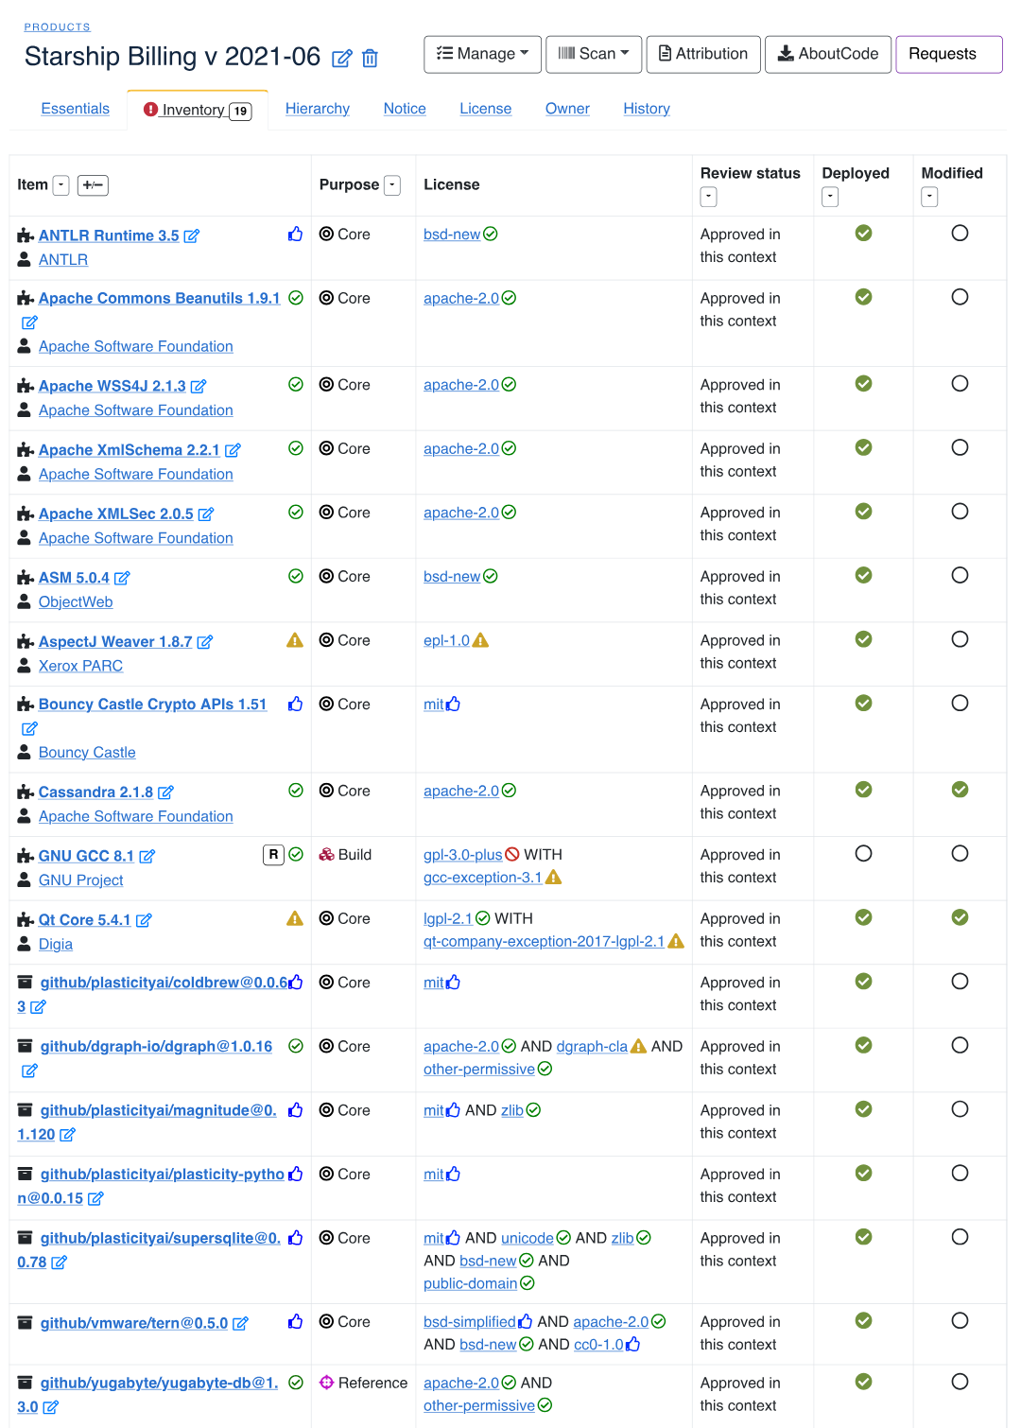
Get started with DejaCode
Download and run DejaCode
https://github.com/nexb/dejacode
Or sign up for a free demo hosted account to use DejaCode in a public dataspace
Explore, create, and modify components, packages, licenses and assign usage policies to them.
Create your own test products and generate attribution.
Exercise the DejaCode API and DejaCode integrations with open source tools, such as ScanCode.io.
Create SBOMs, run reports and use workflow requests.
https://public.dejacode.com/account/register

Slide 19
DejaCode
DEMO

Slide 20
Why AboutCode?
Free and open source software AND free and open data
FOSS for FOSS
Open knowledgebase with open data for licenses, packages and vulnerabilities
Modular and integrated best-in-class SCA tools for developers
Tackling the harder code analysis problems so you do not have to
PURL-based for easier integration in/out
Bespoke pipelines enable true end-to-end automation
Working towards management by exception to focus on the complex cases of origin and license
Decentralized analysis, close to the developers
Management web app for centralized policies, curations and compliance workflows and data
Supports engineering, business and legal stakeholders with features tailored for each using common/shared information

Slide 21
Benefits of the AboutCode stack
Supports safe and compliant use of FOSS, with FOSS
Recognized worldwide as best-in-class tools
Modular design for adaptation to development team processes, tools and environment
Coverage for all languages and frameworks
Package URL (PURL) used throughout as the package identifier
Code AND data licensed under open source licenses, no gimmicks
Reduce licensing and vulnerability risks from using FOSS or other third-party software components
Share risk management responsibilities among business, legal, engineering and security teams
Provide a comprehensive view of open source and other third-party components used in your software
Active community of contributors and users, including many FOSS tools
Technical support, implementation, advisory services available from nexB

Slide 22
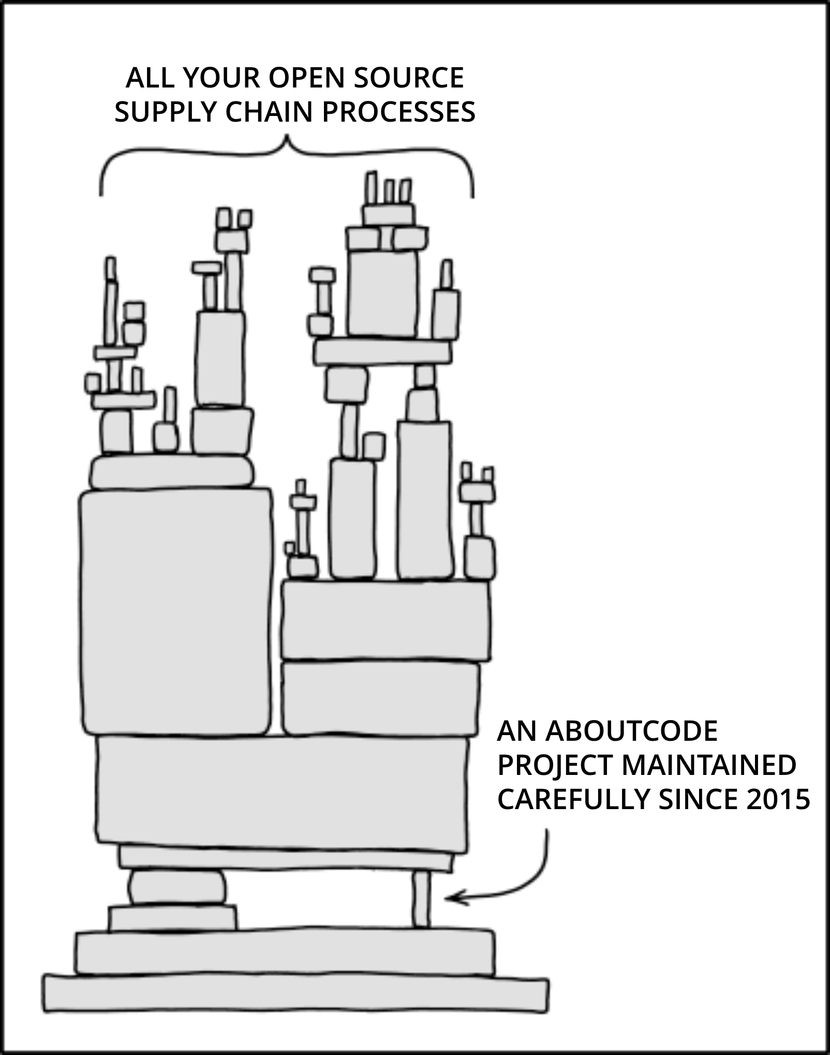
AboutCode also needs your help!
Contribute to an AboutCode project with code, documentation, use cases, bug reports
https://github.com/nexB
Join the community:
https://www.aboutcode.org/
https://gitter.im/aboutcode-org/discuss
Sponsor AboutCode project maintainers
Accelerate development of new features and fund contributors
Buy support, implementation, retainers and advisory services to pay the maintainers
"Dependency" by xkcd, used under CC BY-NC 2.5 / Modified text from original

Slide 23
Roadmap

Slide 24
Roadmap for AboutCode: ScanCode Toolkit
SCA Tools
Build single exe standalone apps for ScanCode for easier deployment in Ci/CD
Improve copyright and license detection speed
Build smaller single-purpose tools and libraries from "mono repo"
Improve data models for Packages and Dependencies/Requirements
Parse more package manifests and lock files
Improve support for license exceptions (WITH)
Move inconclusive, unknown license detection to clues
Add post-processing to rematch using SPDX matching guidelines

Slide 25
Roadmap for AboutCode: SCA Tools
SCA Tools
Integrate with CI and other tools
Create Ci/CD pre-configured integrations with main CI (GitHub, GitLab, Jenkins)
Extend binary analysis and deployment tracing workflows
Support ELF/Native, Go, Ruby, Android in addition to Java and JS
Find the exact subset of the code that is deployed and used in production
Automate analysis review in ScanCode.io
End to end automated pipelines for embedded devices, Android and C/C++
Multi-stack deployment analysis for Java, JS, C/C++
Report TODO items to review only "by exception"

Slide 26
Roadmap for AboutCode: Code matching
SCA Tools
Code match smart ranking and disambiguation
Avoid false positives
Accurately match to the correct package version
Match code snippets approximately
Using our new approximate fingerprinting
Integrate other code matching schemes from SWH and SCANOSS
Match source symbols and binary symbols to sources and binaries
New matching pipelines
Decentralized curation and corrections using in-codebase ABOUT files

Slide 27
Roadmap for AboutCode: Other SCA Tools
SCA Tools
Compare scans to focus review work on changes only (DeltaCode)
APIs and CLI to query all the things by PURL from the KB (purl2all)
More code inspectors
Lightweight package dependency resolution
Dedicated ecosystem-focused libraries
New lightweight package-inspector
Single executable to find packages and dependencies
Trace build execution to find the exact subset of source code that is deployed and used (TraceCode)

Slide 28
Roadmap for AboutCode: Management Apps
Add support for CycloneDX 1.5 and 1.6 and SPDX 3.0
Create new review automation apps:
License detection review
Code match review
Vulnerability review
Overall goal is to reduce review and curation work
Extend license clarity scoring to code matches with origin clarity scoring
"Auto conclude" matches that are conclusive
New app for advanced Vulnerability management and support for CRA (Cyber Resiliency Act) compliance
Automated triage of vulnerabilities and workflow triggers
VEX creation, VEX import and export (Vulnerability Exploitability Exchange) with CSAF and CycloneDX
Management Apps

Slide 29
Roadmap for AboutCode: Licenses
Extend License data with compatibility matrix
Add new license aliases dataset
Add more extensive tagging and categorization
Extend License data with improved exception details
To disambiguate license detections of L/GPL with/without exceptions
Extend License data with improved "or later" details
To disambiguate detection of "or later" notices with their primary texts
Add "key phrases" to all license detection rules
Add variable text segments to license rules
Add Fedora alternative SPDX identifiers
Work with CycloneDX to become their license reference
Open Knowledge Base

Slide 30
Roadmap for AboutCode: Vulnerabilities
Extend Non-vulnerable dependency resolution
Beyond Python - add Java and JS
Extend vulnerability data with new upstream data sources
Add fix commit details and support for vulnerability reachability
Mine the graph to surface related package fixes
Mine git logs, issues and forums to enrich vulnerability data
Surface inconsistencies and conflicts between different advisory data sources (VulnTotal throughout)
Add source/binary discrepancy data (from back2source)
Open Knowledge Base

Slide 31
Roadmap for AboutCode: Packages
Confirm the true origin of code to avoid ambiguous matches
Supply chain package verification
Map deployed binary packages to their corresponding source code
Find suspicious code drift between package versions
Mine extensive list of "off registry" packages
Common native C/C++ code and libraries for embedded
Glibc, Busybox, zlib, etc. that are not published on ecosystem package registries
Collect code symbols from source and binaries (for matching)
On demand, just in time code mining to build your KB on the fly
Federated, decentralized shared KB data with Git and ActivityPub
Share scans, vulnerabilities, origin facts and curations
Scan once, analyze once and collaborate on reviews to clear out the junk!
Open Knowledge Base

