Slide 1
THE CONSPIRACY
TO
SOLVE VIDEO
FOR
EVERYBODY FOREVER

Slide 2
Eli Mallon
Director of Engineering at Livepeer
@iame.li
@iameli@iame.li
iameli.lens
Notes:
EthAmsterdam anecdote

Slide 3
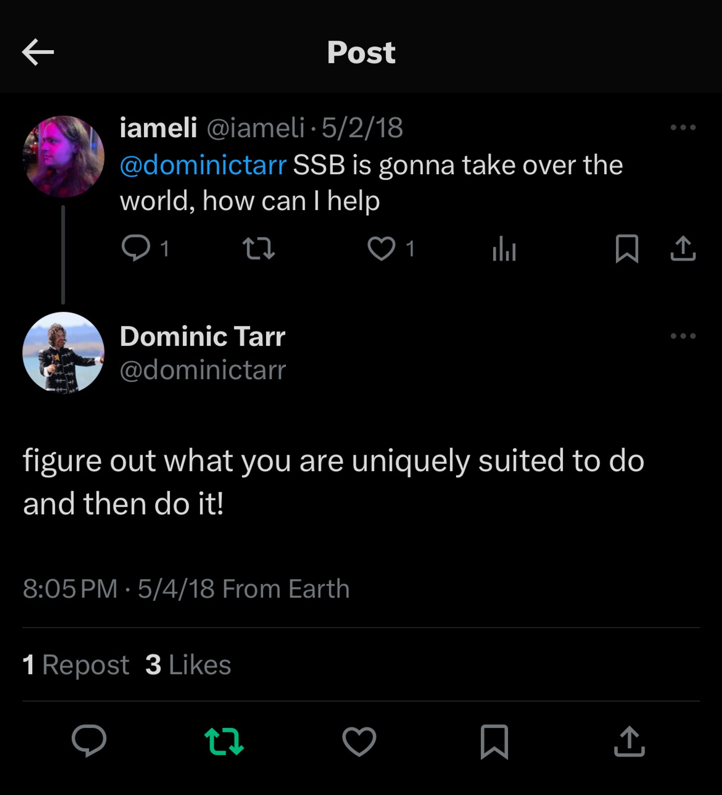
Working in decentralized video since 2016

Slide 4
SETBACKS

Slide 5
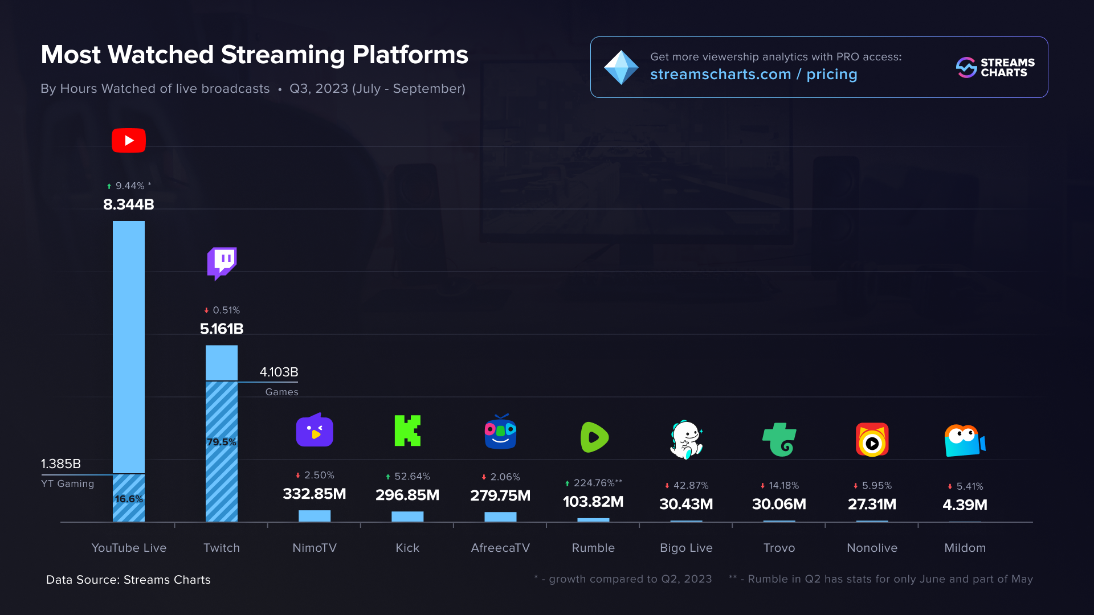

Slide 6
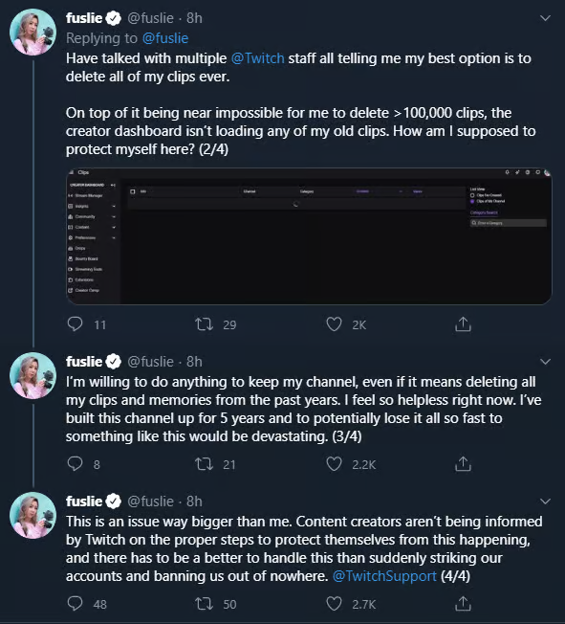
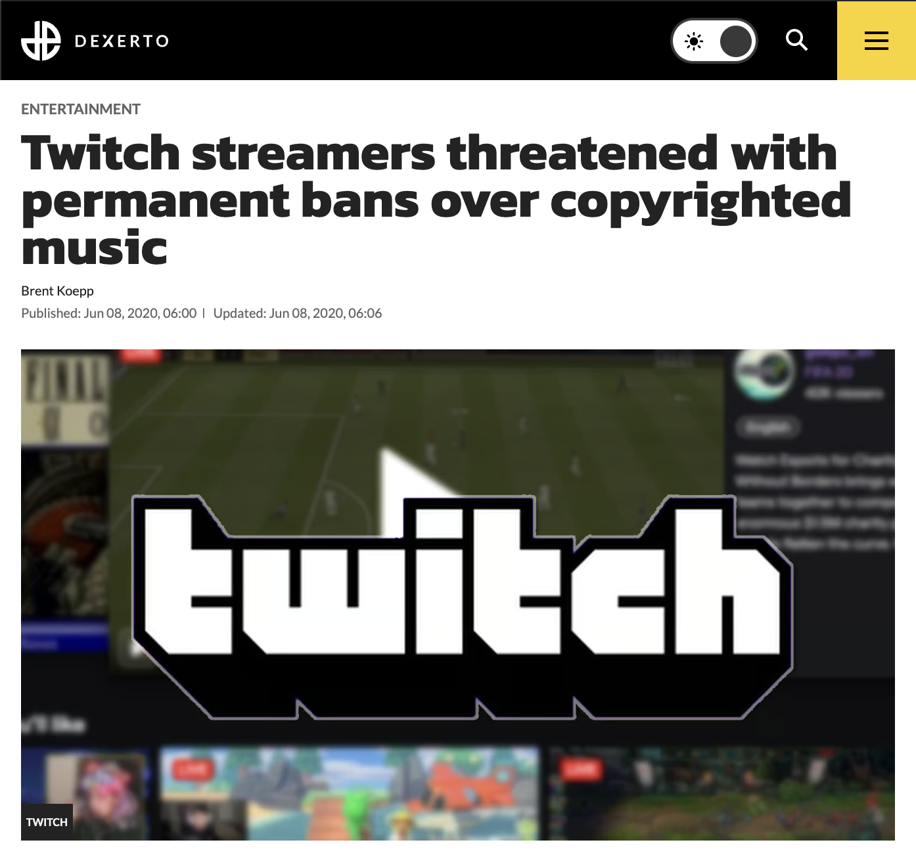

Slide 7
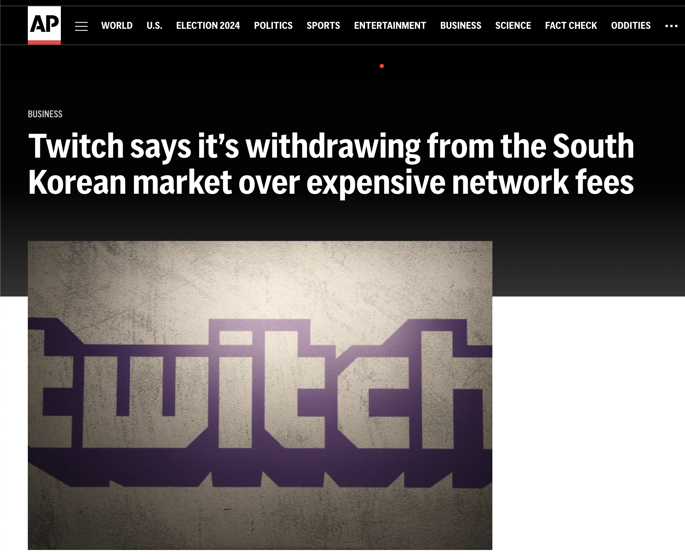

Slide 8
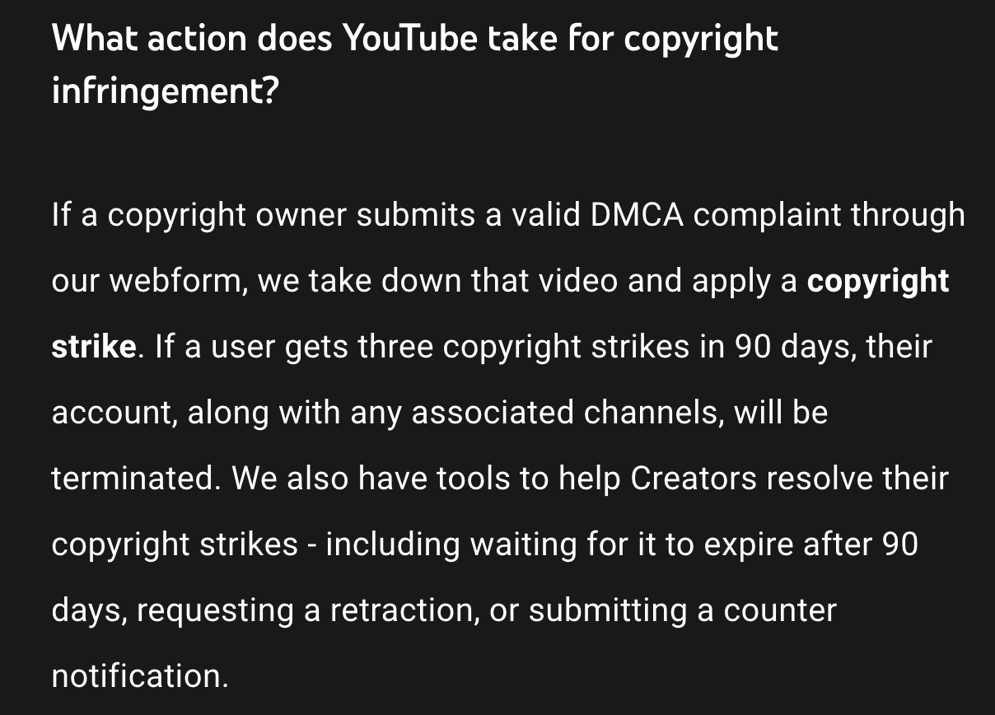

Slide 9
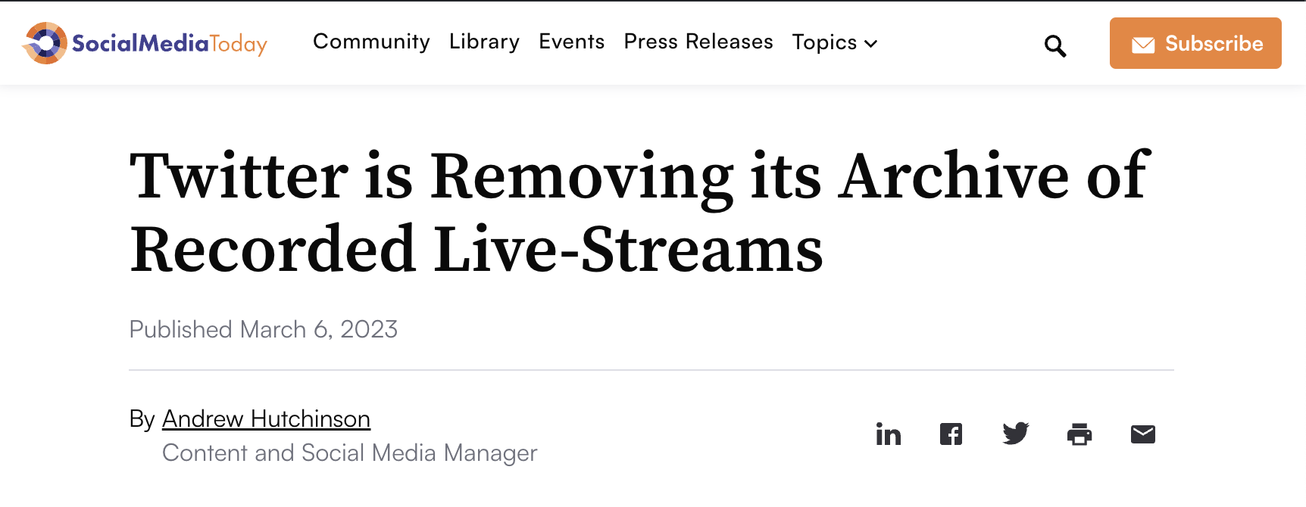
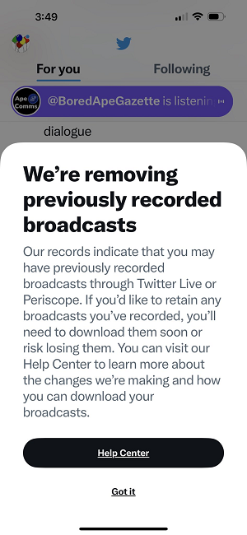
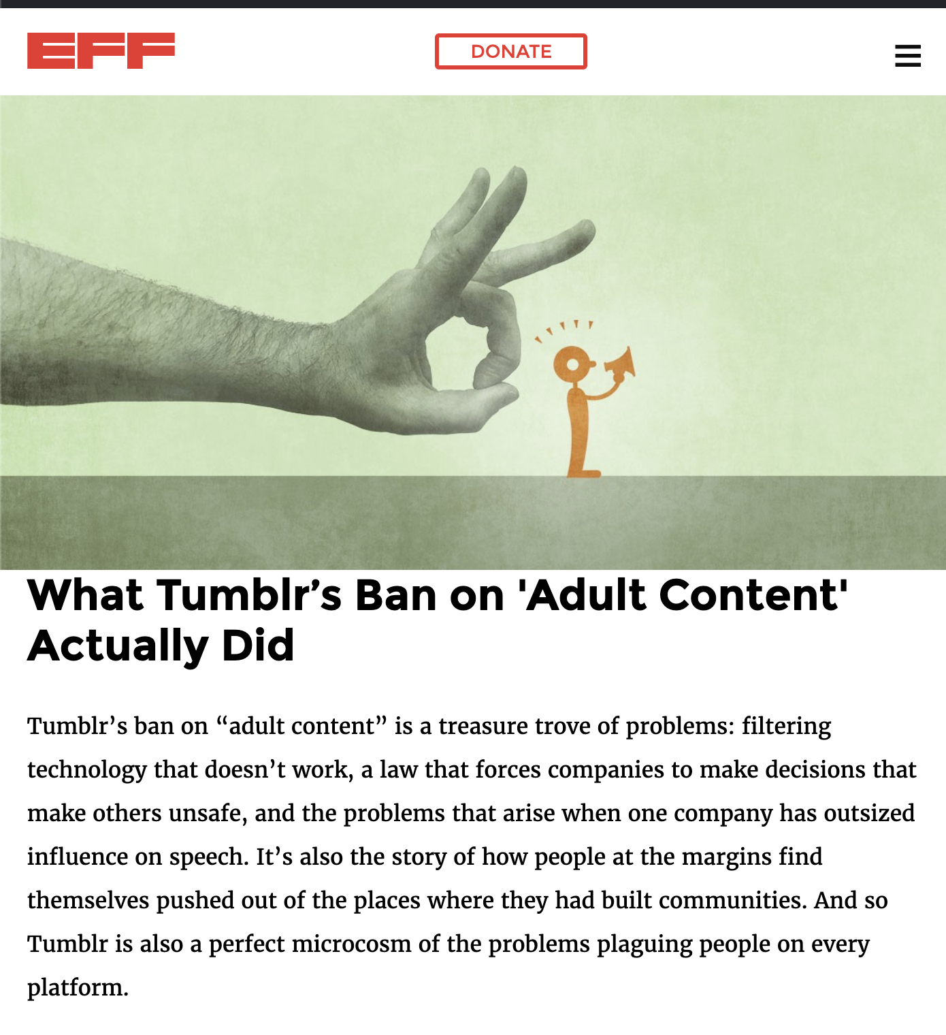

Slide 10
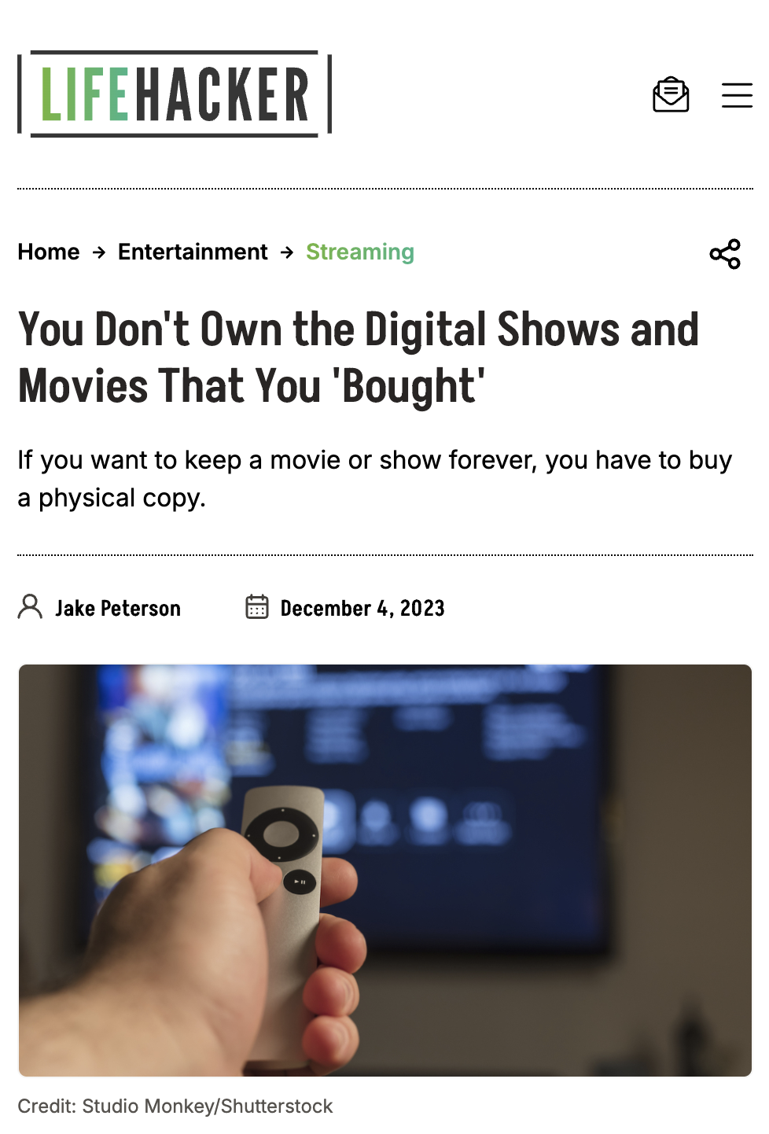
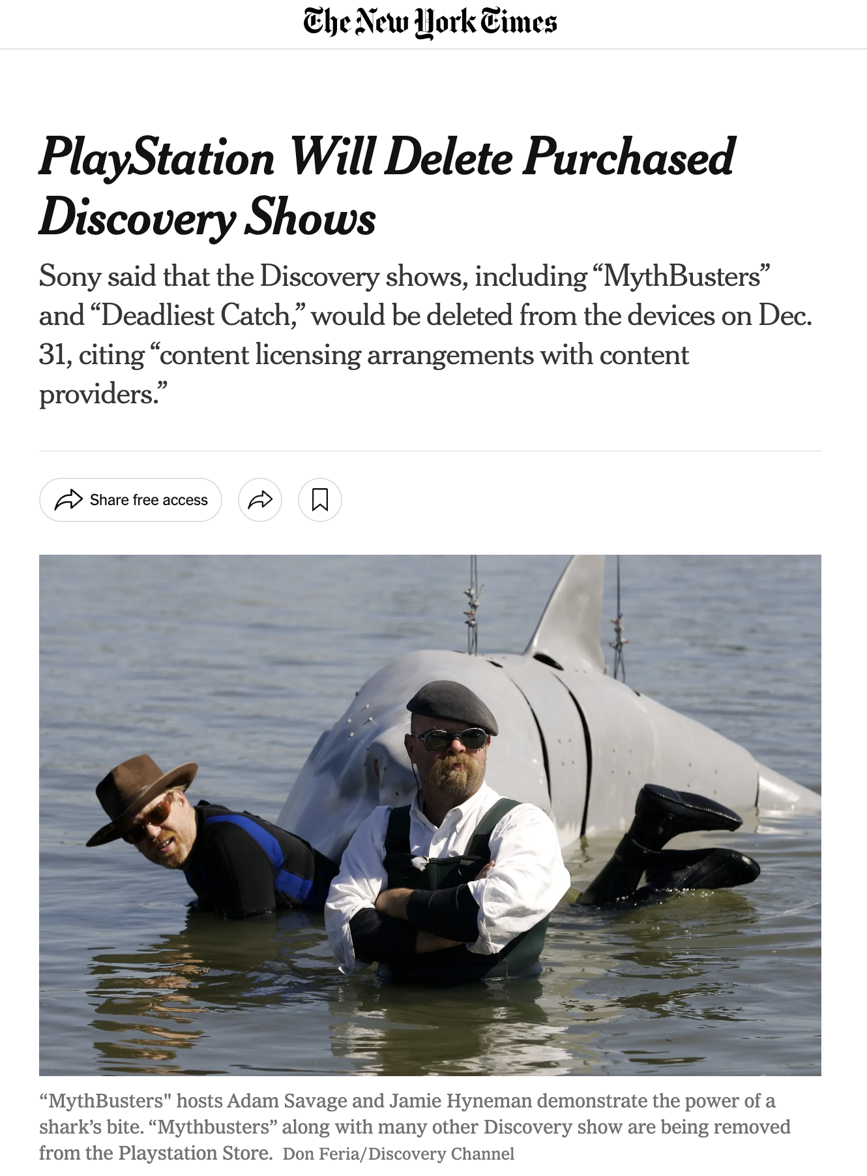

Slide 11
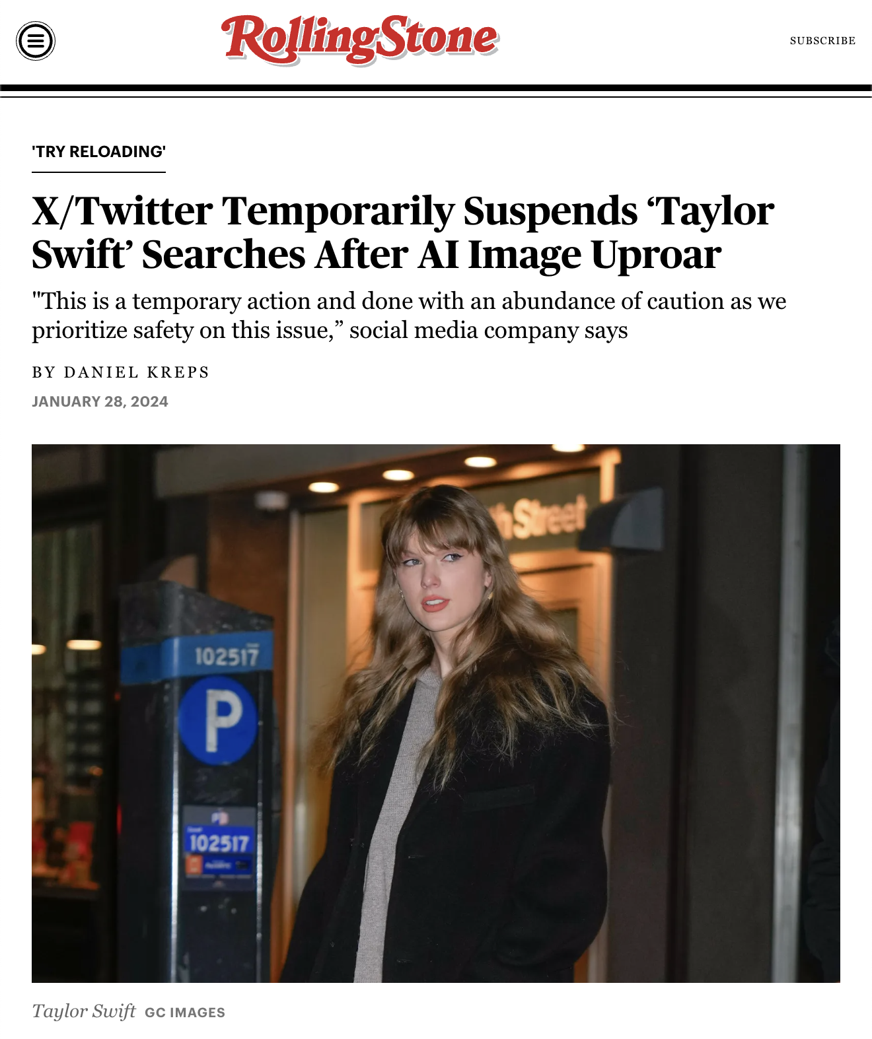
DEEPFAKES

Slide 12
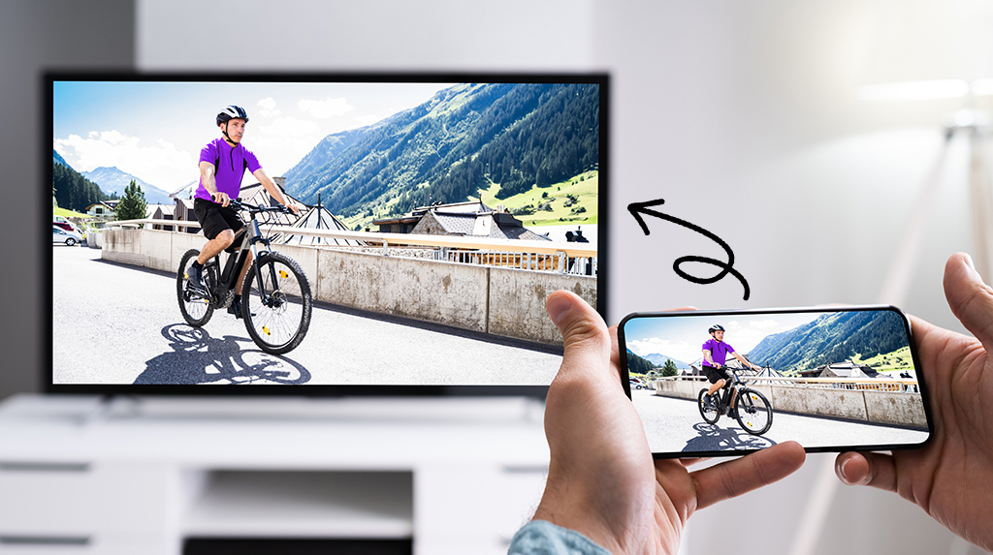
PROPRIETARY
$130

Slide 13
B2B SAAS
Notes:
Imagine paying for an HTTP server in 2024

Slide 14
SUCCESSES
Notes:
Shout-outs!

Slide 15
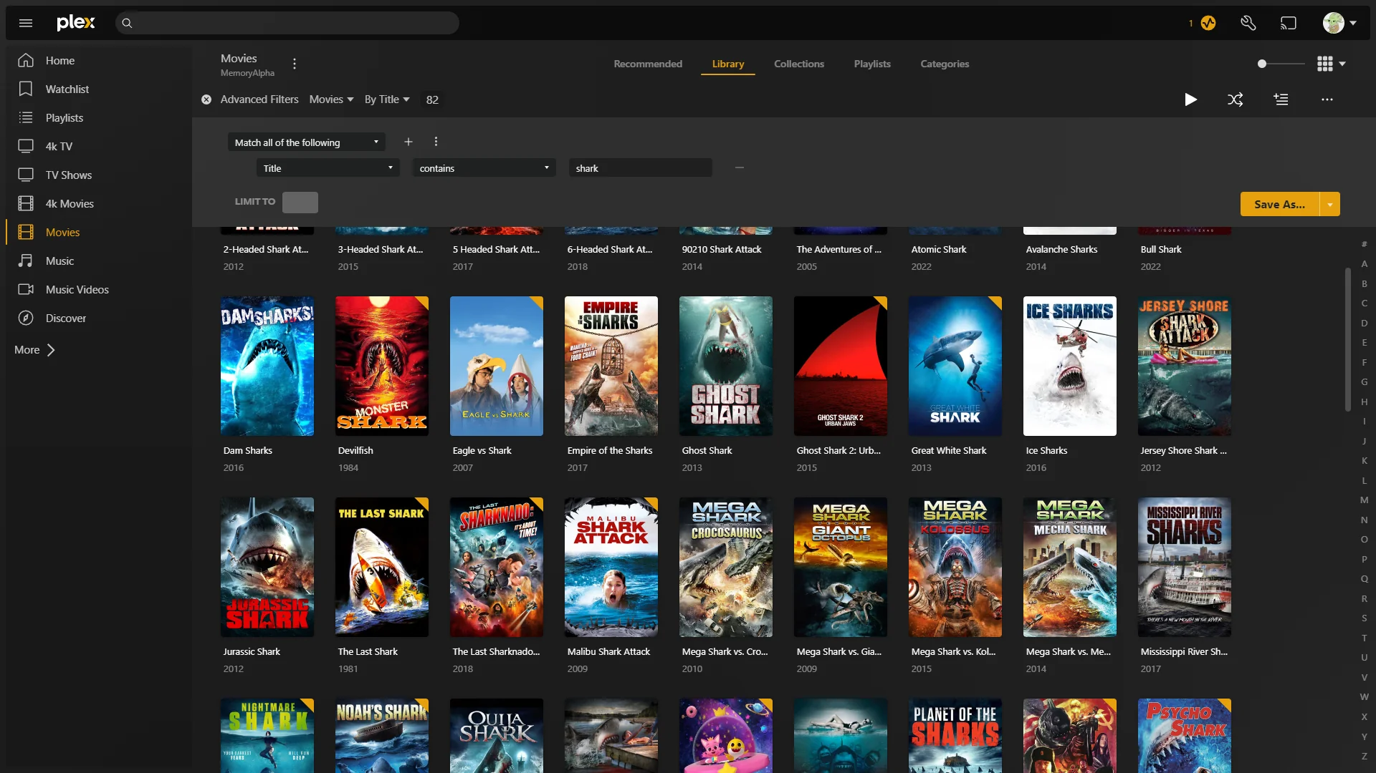
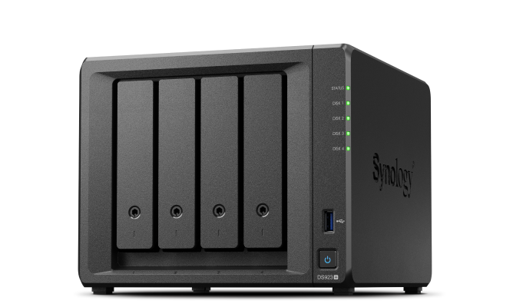
Notes:
Shout-out to my mom, who has ripped more DVDs than anyone in America. Sharing Plex logins.

Slide 17
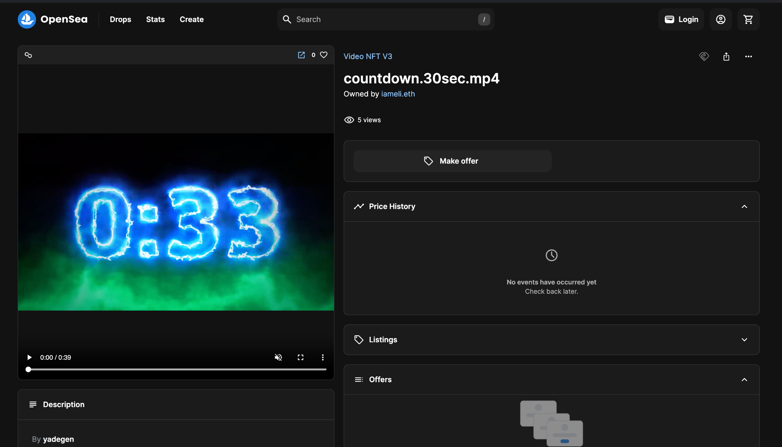
Notes:
I’ve mostly been complaining about copyright in front of a very sympathetic crowd. Here’s one some of you won’t like very much: Video NFTs kick ass.

Slide 18
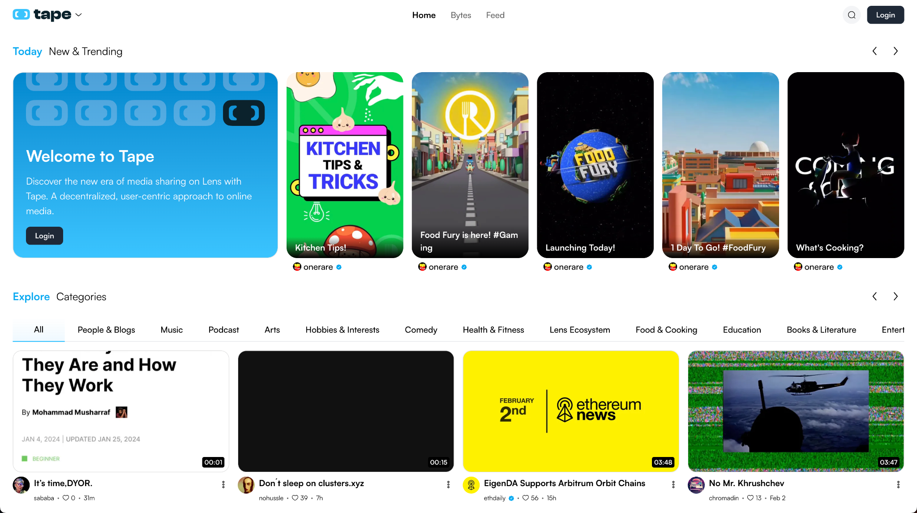

Slide 19
HOPE

Slide 21
THE FUNDAMENTAL PRINCIPLE OF DECENTRALIZATION:
USER ACTIONS ARE SOVEREIGN
Notes:
Some of these projects make sense, some of them are bullshit. How do you tell the difference?

Slide 23
Verifiable Video Provenance
Livestream
Transcode
Clip

Slide 24
Verifiable Video Provenance
Video Provenance:
User SpaghettETH.lens livestreamed on Bluesky
User iameli.eth clipped on Livepeer
User 0x129384 duetted this video on Mastodon

Slide 25
OUR CONTRIBUTION

Slide 26
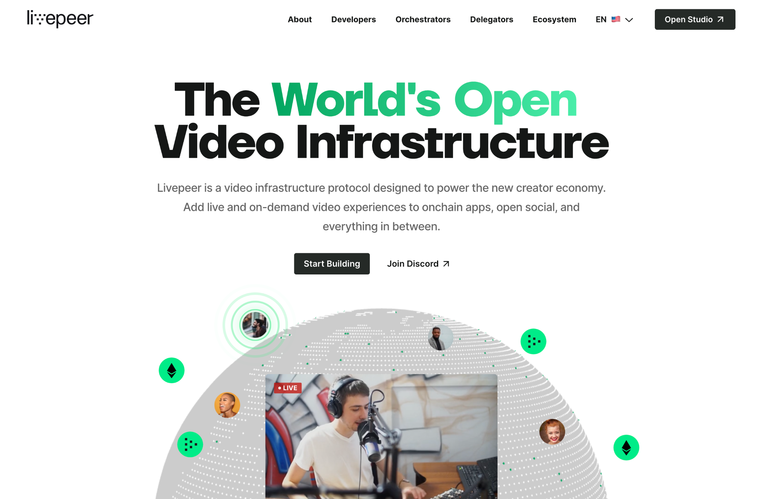

Slide 27
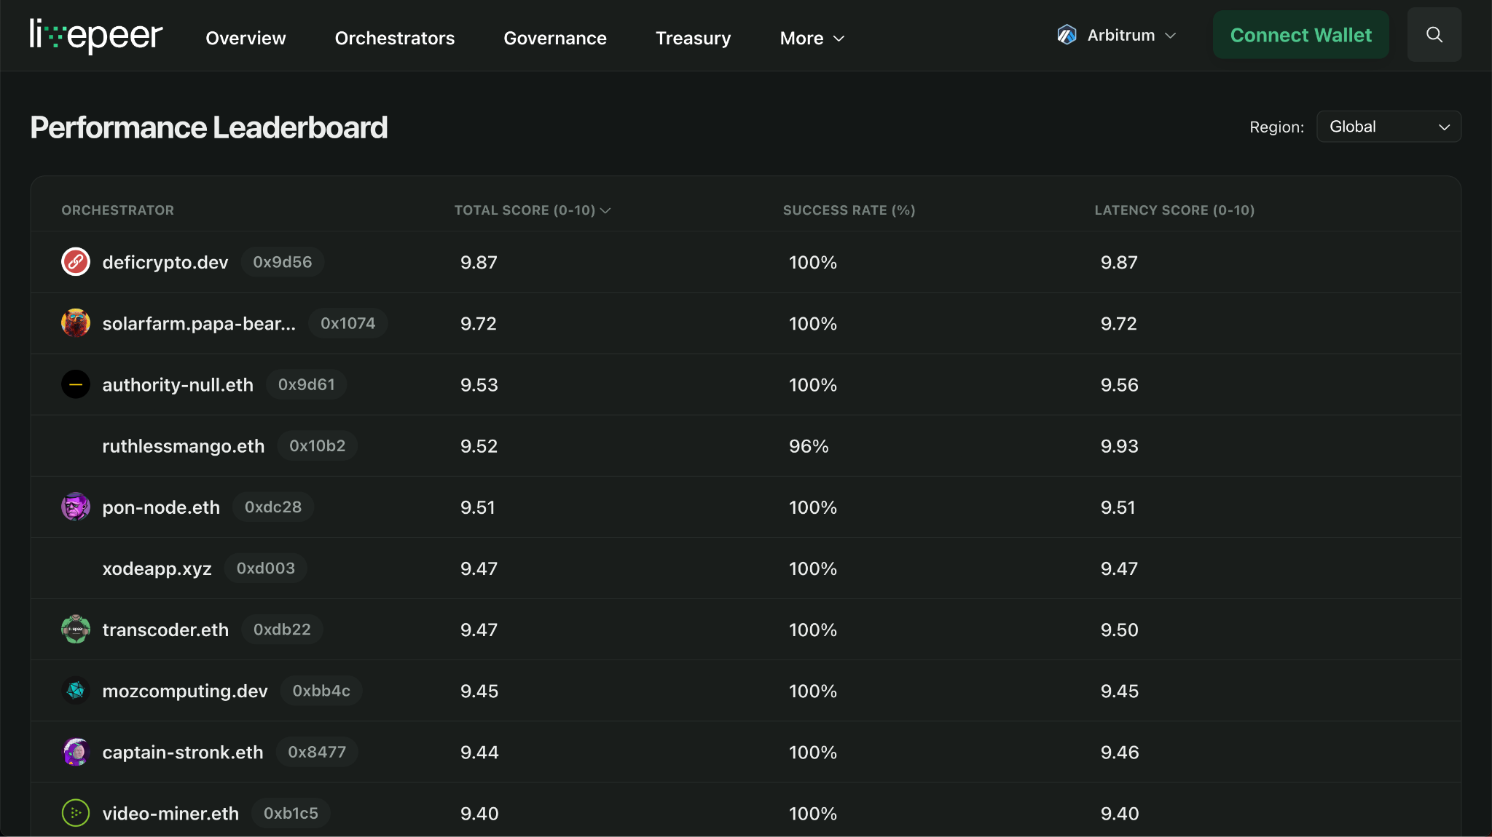
explorer.livepeer.org

Slide 28
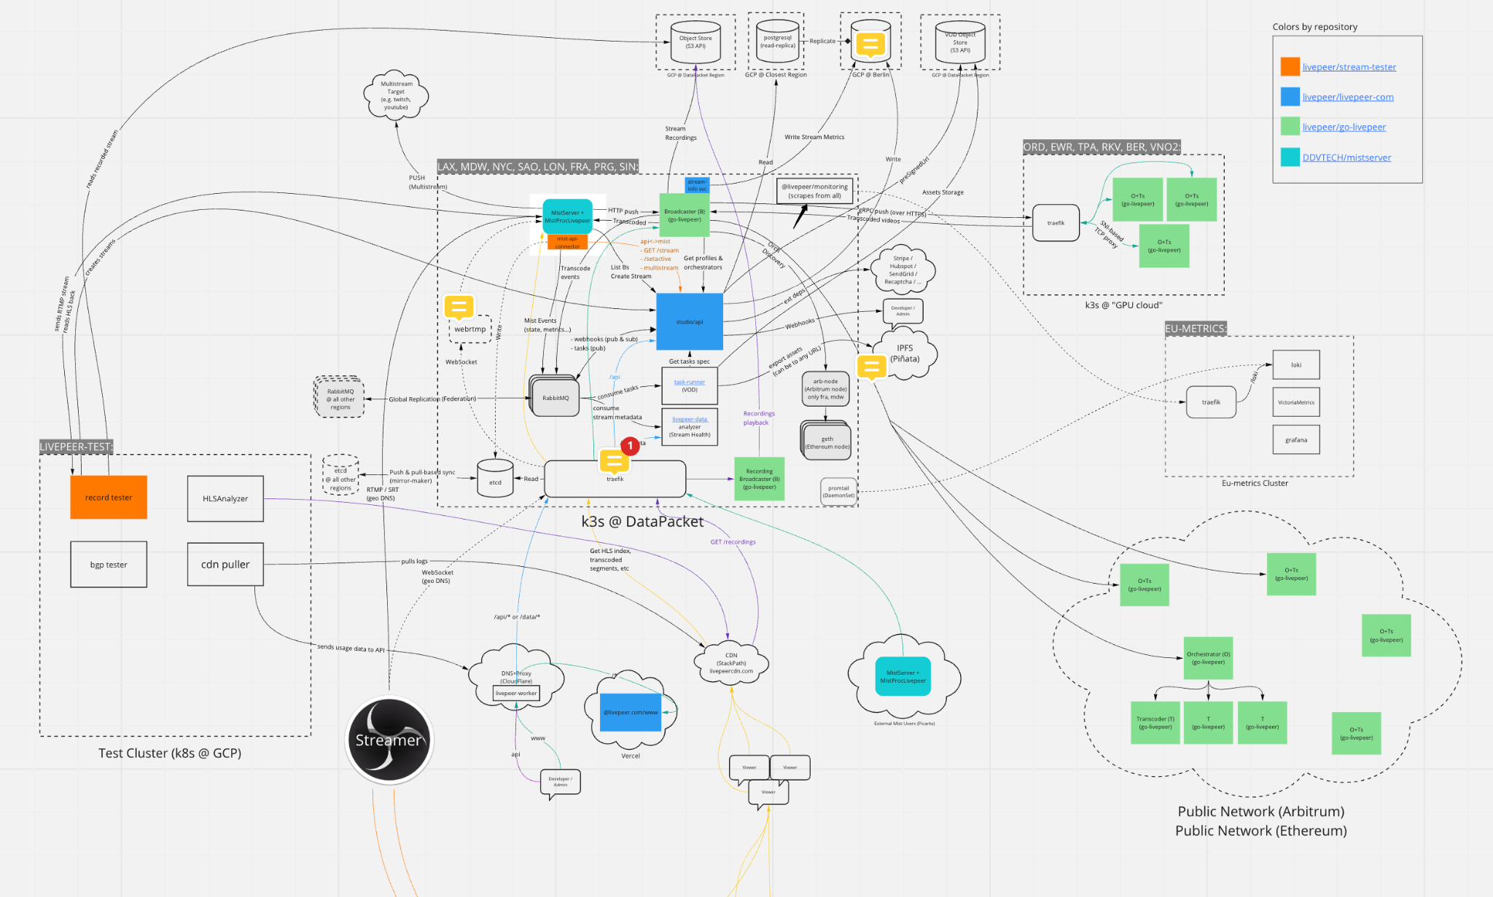
So we built a SaaS - Bad Parts

Slide 29
So we built a SaaS - Bad Parts
“Livepeer in a Box”

Slide 31
DECENTRALIZED
SOCIAL

Slide 32
DECENTRALIZED
SOCIAL
?

Slide 33
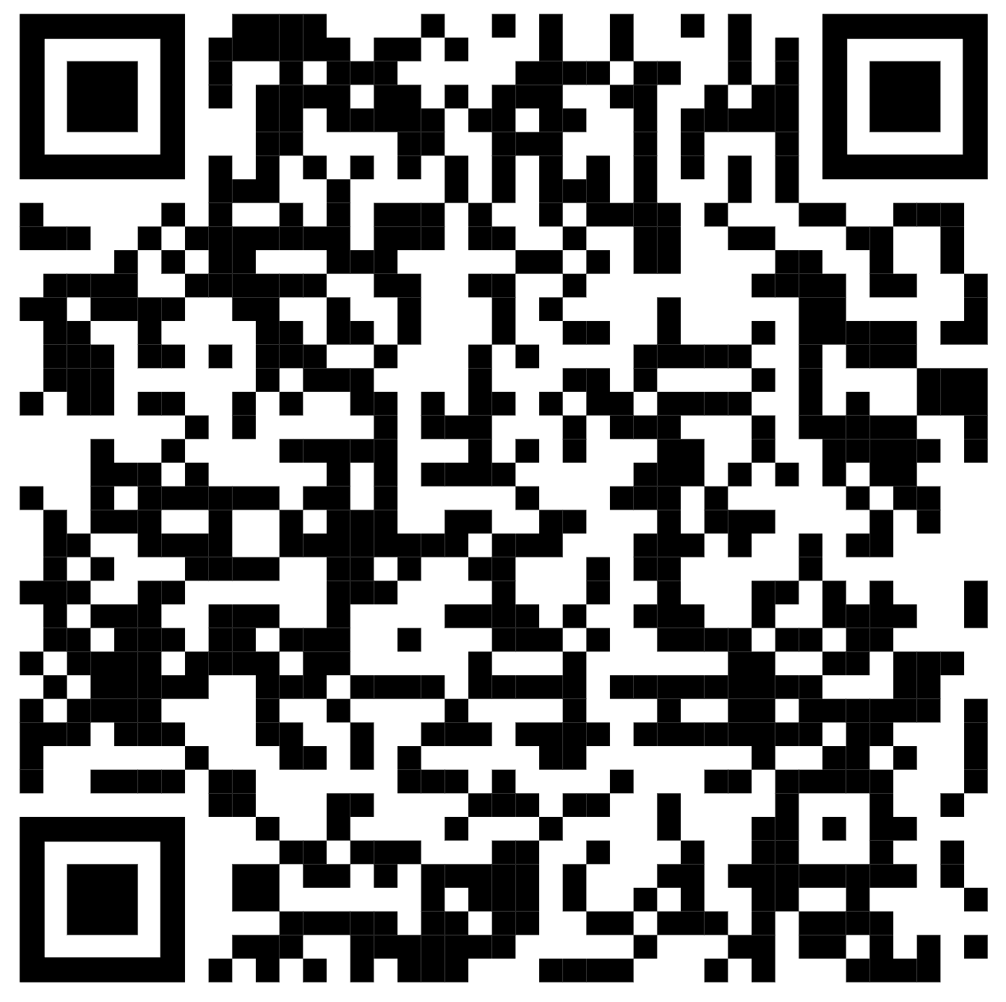
JOIN THE
CONSPIRACY
Join the Party 🍻 TONIGHT

