Slide 1
BIFUZ – Broadcast Intent FUZzing Framework for Android

Slide 2
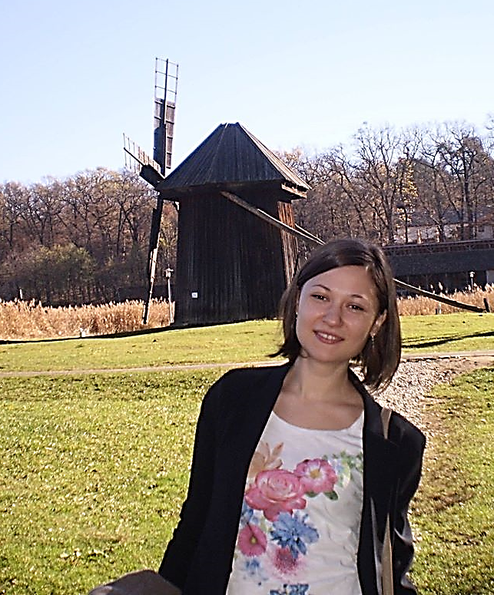
Andreea Brînduşa Proca
Răzvan-Costin Ionescu

Slide 3
Agenda
Why do we need BIFUZ?
What is BIFUZ?
BIFUZ’s Architecture
Walk-through
Results
Conclusions

Slide 4
Why do we need BIFUZ?
Intent Fuzzing
Android Security
Important Target
Android Apps
Broadcast Intents

Slide 5
What is BIFUZ?
Broadcast Intent FUZzing Framework for Android
Python
Bugs
Broadcast / Fuzzed Intents
Negative Testing
Open Source

Slide 6
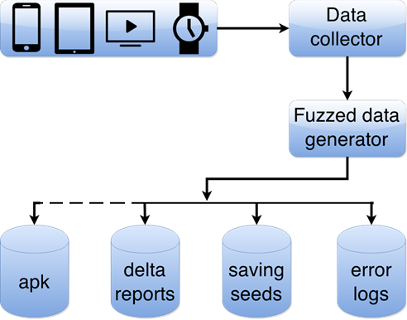
BIFUZ’s Architecture

Slide 7
Walk-through
BIFUZ’s Menu Options
= = = = = = = = = = = = = = = = =
### # #### # # ####
# # # # # # ##
### # #### # # ##
# # # # # # #
### # # #### ####
= = = = = = = = = = = = = = = = =
Select one option from below
1. Select Devices Under Test
2. Generate Fuzzed Intent calls
3. Generate Broadcast Intent calls for the DUT(s)
4. Generate a delta report between 2 fuzzing sessions
5. Run existing generated intents from file
6. (Future) Generate apks for specific Intent calls
Q. Quit

Slide 8
Walk-through
Fuzzed Intent Example
Generate broadcast intent calls for the following DUT(s): 4df1914411a36fc9 Insert the packages wanted or type 'all' for all packages: earth, calendar Device 4df1914411a36fc9: Insert the name of the logs folder: FOLDER_NAME
adb -s 4df1914411a36fc9 shell am start
-a android.intent.action.VIEW
-c android.intent.category.BROWSABLE
-n com.google.earth/com.google.earth.EarthActivity
-f 0x00400000
-d http://YIV6HT9RKSNRCYDGCA6ONAX2Z0M3E3PXZI4W09VZEMA2G03KK0LNIAJ15911OAA.com
-e boolean android.intent.extra.ALARM_COUNT True

Slide 9
Walk-through
Broadcast Intent Example
Select one option from below
1. Select Devices Under Test
2. Generate Fuzzed Intent calls
3. Generate Broadcast Intent calls for the DUT(s)
4. Generate a delta report between 2 fuzzing sessions
5. Run existing generated intents from file
6. (Future) Generate apks for specific Intent calls
Q. Quit
Insert your choice: 3
adb -s 4df1914411a36fc9 shell am broadcast
-n com.google.earth/com.google.analytics.tracking.android.CampaignTrackingReceiver

Slide 10
Walk-through
Error Log Example
--------- beginning of main
F/BIFUZ_BROADCAST( 9395): adb -s 4df1914411a36fc9 shell am broadcast -n com.google.earth/com.google.analytics.tracking.android.CampaignTrackingReceiver.
--------- beginning of system
I/ActivityManager( 3056): Start proc com.google.earth for broadcast com.google.earth/com.google.analytics.tracking.android.CampaignTrackingReceiver: pid=9411 uid=10049 gids={50049, 9997, 3003, 1028, 1015} abi=x86
--------- beginning of crash
E/AndroidRuntime( 9411): FATAL EXCEPTION: main
E/AndroidRuntime( 9411): Process: com.google.earth, PID: 9411
E/AndroidRuntime( 9411): java.lang.RuntimeException: Unable to instantiate receiver com.google.analytics.tracking.android.CampaignTrackingReceiver: java.lang.ClassNotFoundException: Didn't find class "com.google.analytics.tracking.android.CampaignTrackingReceiver" on path: DexPathList[[zip file "/system/app/GoogleEarth/GoogleEarth.apk"],nativeLibraryDirectories=[/system/app/GoogleEarth/lib/x86, /vendor/lib, /system/lib]]

Slide 11
Results
javaNullPointerException
javaClassNotFoundException
DoS attack
Buffer Overflow
SQL injection

Slide 12
Conclusions
BIFUZ is an open source testing tool
easy setup
assess if an application is more stable than another from security perspective
bugs might be sent to Google for verification
reproducibility and debugging

Slide 13
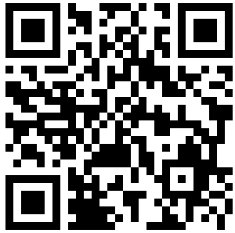
Source code: https://github.com/fuzzing/bifuz
You may find us @:
andreea.brindusa.proca@intel.com
razvan.ionescu@intel.com

