Slide 1
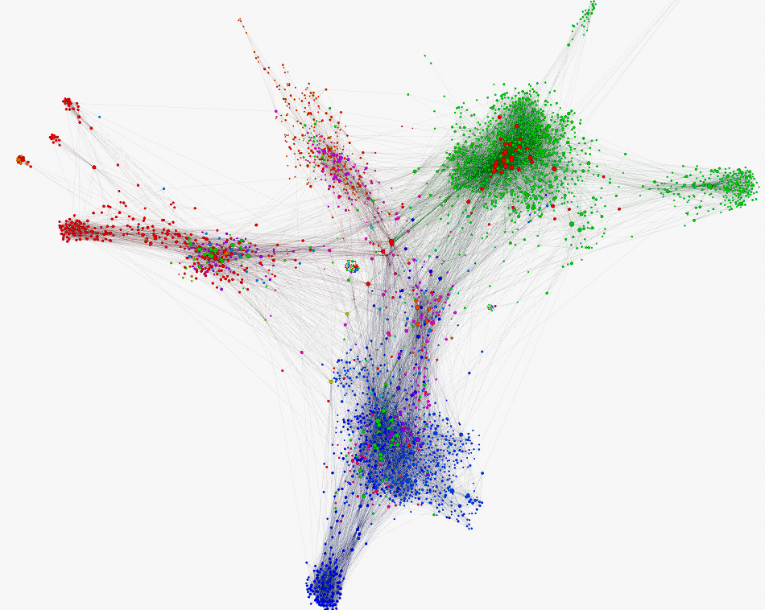
Tesseract
Distributed Graph Database
FOSDEM 2015
Courtney Robinson courtney@zcourts.com 31 Jan 2015
Background from Gephi
Notes:
[1] Heuristics for parallel graph partitioning, ftp://ftp.cs.brown.edu/pub/techreports/89/cs89-41.pdf
https://gephi.github.io/features/

Slide 2
I can be found around the web as “zcourts”, Google it…
The web is one very prominent example of a graph
Too big for a single machine
So we must split or “partition” it over multiple
Partitioning is hard…in fact, it has been shown to be np-complete
All we can do is edge closer to more “optimal” solutions
The Tesseract is an ongoing research project
Its focus is on distributed graph partitioning
The rest of this presentation is a series of solutions, which together, takes one step closer to faster distributed graph processing
Notes:
[1] Heuristics for parallel graph partitioning, ftp://ftp.cs.brown.edu/pub/techreports/89/cs89-41.pdf
https://gephi.github.io/features/

Slide 3
Terminology
Graph - A graph G is made up of a set of vertices and edges,
G = (V,E)
Vertex - Smallest unit of user accessible datum
Edge - Connects two vertices, may have a direction
Property - Key value pair available on an Edge or Vertex
V2
V5
V7
V1
V3
V4
V6
Notes:
Vertex degree - Number of edges connected to a vertex
Undirected graph - is one where no distinction is made between an edge's two vertices.
Directed graph - each edge determines it's direction, i.e. e= (A1,B1) is interpreted as A1 points to B1.
Mixed graph - is on which contains both directed and undirected edges.
Isomorhpic - Two graphs G & H are isomorphic if each adjacent vertex in G is also in H i.e. G ~ H
Sub Graph - is a graph whose vertices are a subset of another
Super Graph - a graph from which sub-graphs can be obtained
Order - of a graph is the number of vertices |V|
Size - of a graph is the number of edges |E|
Vertex ID - Globally unique (within the cluster) ID for each vertex
Edge ID - Globally unique ID of each Edge (hash of it’s vertex IDs)
In degree - Number of directed edges coming into a vertex
Out degree - Number of directed edges leaving a vertex
Closed walk - a walk in which the first and last vertices are the same
Open walk - a walk in which the first and last vertices are different

Slide 4
Aims of the Tesseract
Implement distributed eventually consistent graph database
Develop a distributed graph partitioning algorithm
Develop a computational model able to support both real time and batch processing on a distributed graph

Slide 5
Aims of the Tesseract
Implement distributed eventually consistent graph database
Develop a distributed graph partitioning algorithm
Develop a computational model able to support both real time and batch processing on a distributed graph

Slide 6
CRDTs…in one slideTM
Conflict free replicated data types
i.e provably eventually consistent ^{(Shapiro et al)} replicated & distributed data structures.
(1+2) + 3 = 1 + (2+3)
1 + 2 = 2 + 1
1 + 1 ≠1
Unfortunately addition isn’t enough. The CIA properties are required to have a CRDT
Luckily, graphs can be represented by a common mathematical structure which exhibits all 3 properties… Sets!
Addition with sets is done using ∪
(1 ∪ 2) ∪ 3 = 1 ∪ (2 ∪ 3)
1 ∪ 2 = 2 ∪ 1
1 ∪ 1 = 1
Associative
Commutative
Not Idempotent
Associative
Commutative
Idempotent!
Notes:
Shapiro et al http://hal.upmc.fr/file/index/docid/555588/filename/techreport.pdf
"Consistency without consensus in production systems" by Peter Bourgon https://www.youtube.com/watch?v=em9zLzM8O7c

Slide 7
I lied, two slides…^{TM?}
Merge takes symmetrical difference of the local and remote sets resulting in aλ being in the set
Several types of CRDTs are available.
They provide us with “Strong Eventual Consistency” i.e. given states propagate we’re provably guaranteed to converge.
OR-set i.e. “Observed Removed”…add wins!
Each node adds “a” with a unique tag locally
s
Mark only -aπ as deleted.
add(a)
del(a)
S1
{}
{aλ}
{aπ}
{aπ}
{-aπ}
{-aπ}
{aλ,-aπ}
S2
add(a)
{aλ}
{}
{aλ}
{aλ}
{aλ,-aπ}
S3
{}
{aλ}
{aλ}
{aλ,aπ}
{aλ,-aπ}
User never sees tags!
Query time checks are used to enable DAGs (if violation of DAG constraint is detected then the runtime simply says the violating edge does not exist and triggers clean up)
Note,the deleted “a” is optionally kept as a tombstone if the runtime is configured to support “snapshots”
= insert
= merge
= replicate
= remove
Notes:
Sean Cribbs - Eventually Consistent Data Structures - http://vimeo.com/43903960 OR set starts at 26 mins in

Slide 8
Aims of the Tesseract
Implement distributed eventually consistent graph database
Develop a distributed graph partitioning algorithm
Develop a computational model able to support both real time and batch processing on a distributed graph

Slide 9
CRDTs again…because they’re important
One very important property of a CRDT is:
{a,b,c,d} :⇔ {a,b} ∪ {c,d}
Those two sets being logically equivalent is a desirable property
Enables partitioning (with rendezvous hashing for e.g.)

Slide 10
Naïve “cascading vertices”
Naïve graph partitioning
Depends on the query model to make up for its Naïvety
Uses hashing to place data
Two cascading algorithms formulated from: V = the vertex to cascade n = max nodes to cascade across ń = auto-determined value of n, using logistics growth model d = deg(v) = Degree of V e = ⟨∀deg(v) ∈ G⟩ i.e. average degree of all vertices in the graph |nV| = Max number of edges per node for a vertex
i.e. cascading point (min number of edges before cascading occurs)
|nV| = d / n - user provides n, split evenly across nodes
|nV| = max(d,e) / n - user provides n, split evenly based on d or e if e is bigger
Notes:
|nV| could be determined automatically by using globally available statistics about the entire graph OR this could be a static user supplied value. Needs experiment.

Slide 11
“Cascading vertices” by example
Let’s use Twitter followers as an example
Each letter represents a unique follower
wrap and repeat
add(…) performs a cascade(deg(V))
cascade(deg(v)) >= threshold
s
add(…) x f
S1
{}
{a,b…n/threshold}
S2
{}
add(…) x f
{r,s…n/2*threshold}
add(…) x f
S3
{}
{w,x…n/3*threshold}
= insert
= cascade
￼

Slide 12
Aims of the Tesseract
Implement distributed eventually consistent graph database
Develop a distributed graph partitioning algorithm
Develop a computational model able to support both real time and batch processing on a distributed graph

Slide 13
Distributed computation
Localised calculations
Amortisation
Memoization

Slide 14
Amortisation
Optimise to perform more “cheap” computations
This allows us to occasionally pay the cost of more “expensive” operations such that they computationally balance out
e.g. Checking data locally on a node vs querying over a network
1
7
1
1
1
1
1
1
Notes:
Robert Tarjan's, Amortised Computational Complexity (Tarjan, 1985) formally introduced the idea of amortised computational costs. It's a simple but note worthy idea. My premise is in effect rested on this idea. That is, computational complexity isn't a simple matter of determining 'big O'. A system's purpose is to perform a given set of tasks, these tasks typically are broken down into smaller tasks. Each requiring a varying amount of computing resources/time. Amortization rests on the idea that some tasks are more "expensive" than others. If there are enough "cheap" tasks, each time they run the acrue "credit" that can eventually be spent performing the more expensive tasks. It follows that, if there are enough cheap tasks to consistently provide enough credit then the effects of performing more expensive tasks can effectively be thought of has being negligable...or there abouts.

Slide 15
Memoization
Cache the results of computations
A luxury afforded by immutability
Sacrifices disk space and memory
Provides improved query performance
1st query
Traverse n secs
Cache results
2nd query
Cache n/r
Notes:
Memoization is an optimization technique used primarily to speed up computer programs by keeping the results of expensive function calls and returning the cached result when the same inputs occur again

Slide 16
Wormhole traversals
Immutability offers guarantees
Place markers at every n vertex intervals
When traversing, don’t visit every vertex, jump to markers instead.
Markers at A, G, F, D
By pass B,C,E during traversal, almost halving the time.
The resulting data has any skipped vertex asynchronously fetched
A key part of this is in the use of “Path summaries”
Path summary is an optimisation that enables the runtime to skip network requests
Allows traversal to continue locally and async request is made to gather the remote results
follows
follows
A
B
C
knows
follows
G
knows
D
F
friends
E

Slide 17
Going functional
Early implementation was in Haskell
Why? Because it did everything I wanted.
Later realised it’s not Haskell in particular I wanted
…but its semantics
Immutability
Purity
and some other stuff
and, well…functions!
The whole graph thing is an optimisation problem
The properties of a purely functional language enables a run time to make a lot of assumptions
These assumptions open possibilities not otherwise available (some times by allowing us to pretend a problem isn’t there)

Slide 18
Distributed Query Model: TQL, Tesseract Query Language
Haskell?
…before you start sneaking out the back doors
What would that even look like…?
What you’re looking at is TQL
a pure
functional language
it has type inferencing and all the cool functional widgets!

Slide 19
Distributed Query Model: TQL pt2
How was that functional?
It employed use of:
Functions - relation between a set of input and a set of permissible outputs
Monads - structures that allow you to define computation in terms of the steps necessary to obtain the results of the computation.
Monoids - a set with a single associative (1+ 2) + 3 == 1 + (2+3) binary operation an identity element (an element where, when applied to any other in the set, the value of the other element remains unchanged. e.g. given * as the binary operation and the set S={1,2,3}, 1 is the identity element since 1 * 1 = 1, 2 * 1 = 2 and 3 * 1 = 3)
Currying - where a function which takes multiple arguments is converted into a series of functions which take a single argument, the currying technique produces partially applied functions.
Higher order functions - functions which takes other functions as its parameter
Function composition - the process of making the result of one function the argument of another
Don’t believe me? Let’s look at a definition for “INSERT” shown on the previous slide

Slide 20
Distributed Query Model: TQL pt3
… = var-arg + Homogeneous
Result of “INSERT”
Edge type
INSERT :: ( (String -> (V…) -> (E…) -> PartialTransform) ) -> Transform
Result of lambda function
Types are optional and are inferred using Hindley–Milner style type system
Functions are translated to “enriched” lambda calculus for reduction & evaluation
Built on top of LLVM
TQL comes with a useful “standard” library like most languages
An “Algorithms & machine learning” module will ship as an add-on module
Ability to define new modules/add or override functions
Include additional modules (yours or a third party’s)
From here…
Vertex type
…to here!
Function name
Graph namespace
Lambda function you say?
Where, where?
Notes:
http://en.wikipedia.org/wiki/Hindley%E2%80%93Milner_type_system

Slide 21
Distributed Query Model: Runtime
The model places a lot of additional work server side.
Previously enumerated properties enable the server to make a lot of assumptions and by proxy optimisations
Client interface remains consistent
While on going research can improve the run time without major client changes
Tesseract runtime
CRDTs
Cascading vertices
Wormhole traversals
Optimisations (Memoization/Amortisation/etc)
TQL

Slide 22
Compaction & Garbage collection
Immutability means we store data that’s no longer needed i.e. garbage
CRDTs can accumulate a large amount of garbage
This can be avoided by not keeping tombstones at all
Without tombstones the system is unable to do a consistent snapshot
If snapshots are disabled, tombstones are not needed
Short synchronisation are used out of the query path to do some clean up (currently evaluating RAFT for GC consensus)
Current work is modelled off of JVM’s generational collectors
Algorithm needs more investigation…
Compaction also serves as an opportunity to optimise data location
Write only means vertex properties and edges aren’t always next to each other in a data file
During compaction we re-arrange contents
Helps reduce the amount of work required by spindle disks to fetch a vertex’s data

Slide 23
First release due in 2-3 months
Will be Apache v2 Licensed
github.com/zcourts/Tesseract

Slide 24
End…
Questions?
Courtney Robinson
Google “zcourts” courtney@zcourts.com
github.com/zcourts/Tesseract

