Slide 1
LLVM: built-in scalable code clone detection
based on semantic analysis
Institute for System Programming
of the Russian Academy of Sciences

Slide 2
Clone Types
Identical code fragments except the variations in whitespace, layout and comments.
Structurally/syntactically identical code fragments except the variations in identifiers, literals, types, layout and comments.
Copied fragments of code with further modifications. Statements can be changed, added or removed in addition to variations in identifiers, literals, types, layout and comments .

Slide 3
Formulation Of The Problem
Design code clone detection tool capable for real projects analysis.
Requirements :
Semantic based ( based on Program Dependence Graph )
High accuracy
Scalable (analyze up to million lines of source code)

Slide 4
Architecture : First part
clang
PDG for one module
LLVM
PASS
PDG
Generation of Program Dependence Graphs (PDG)
Construction of PDG
Optimizations of PDG
Serialization of PDG
PASS
executable

Slide 5
Example of Program Dependence Graph
void foo() {
int b = 5;
int a = b*b;
}
%b = alloca i32
%a = alloca i32
store i32 5, i32* %b
define void @foo() #0 {
%b = alloca i32
%a = alloca i32
store i32 5, i32* %b
%1 = load i32* %b
%2 = load i32* %b
%3 = mul nsw i32 %1, %2
store i32 %3, i32* %a
}
%1 = load i32* %b
%2 = load i32* %b
%3 = mul nsw i32 %1, %2
store i32 %3, i32* %a

Slide 6
Architecture : Second part
PDG for one module
Load dumped PDGs
Split PDGs to sub graphs
Fast checks (check if two graphs are not clones)
Maximal isomorphic sub graphs detection (approximate)
Filtration
Printing
Code Clone Detection Tool

Slide 7
Automatic Testing System
List of PDGs for the project
PDG 1
PDG 2
PDG n
Modified list of PDGs
PDG’ 1
PDG’ 2
PDG’ n/2
PDG’ j
Check for clone
PDG i
PDG’ j
PDG i
PDG k

Slide 8
Advantages
Compile-time generation of PDGs.
No need of extra analysis for dependencies between compilation modules.
High accuracy.
Scalable to analyze million lines of source code (С/С++).

Slide 9
Results
Copy00.cpp modified to get 3 types of clones.
Test Name | **CCFinder(X) | MOSS | CloneDR | CCD
copy00.cpp | yes | yes | yes | yes
copy01.cpp | yes | yes | yes | yes
copy02.cpp | yes | yes | yes | yes
copy03.cpp | yes | yes | yes | yes
copy04.cpp | yes | yes | yes | yes
copy05.cpp | yes | yes | yes | yes
copy06.cpp | no | no | yes | yes
copy07.cpp | no | yes | yes | yes
copy08.cpp | no | no | no | yes
copy09.cpp | no | no | yes | yes
copy10.cpp | no | no | yes | yes
copy11.cpp | no | no | no | yes
copy12.cpp | no | yes | yes | no
copy13.cpp | no | yes | yes | yes
copy14.cpp | yes | yes | yes | yes
copy15.cpp | yes | yes | yes | yes
Copy00.cpp
1: void foo(ﬂoat sum, ﬂoat prod) {
2: ﬂoat result = sum + prod;
3: }
4: void sumProd(int n) {
5: ﬂoat sum = 0.0; //C1
6: ﬂoat prod = 1.0;
7: for (int i = 1; i<=n; i++) {
8: sum = sum + i;
9: prod = prod * i;
10: foo(sum, prod);
11: }
12: }
**CCFinder(X) – Chanchal K. Roy : Comparison and evaluation of code clone detection techniques and tools : A qualitative approach

Slide 10
Results
Intel core i3, 8GB Ram.
 | Source code lines (million lines) | Compile time without PDGs generation (seconds) | Compile time with PDGs generation (seconds) | Size of PDGs (megabytes)
Firefox Mozilla | 11 | 5231 | 5525 | 221
LLVM + Clang | 1.9 | 1965 | 2520 | 150
Openssl | 0.46 | 81 | 130 | 8.7

Slide 11
Results
Similarity level higher 90%.
 | Detection time (seconds) | Detected clones | False Positive | Size of PDGs (megabytes)
Firefox Mozilla | 28219 | 91 | 7 | 221
LLVM + Clang | 20491 | 23 | 3 | 150
Openssl | 83 | 101 | 4 | 8.7

Slide 12
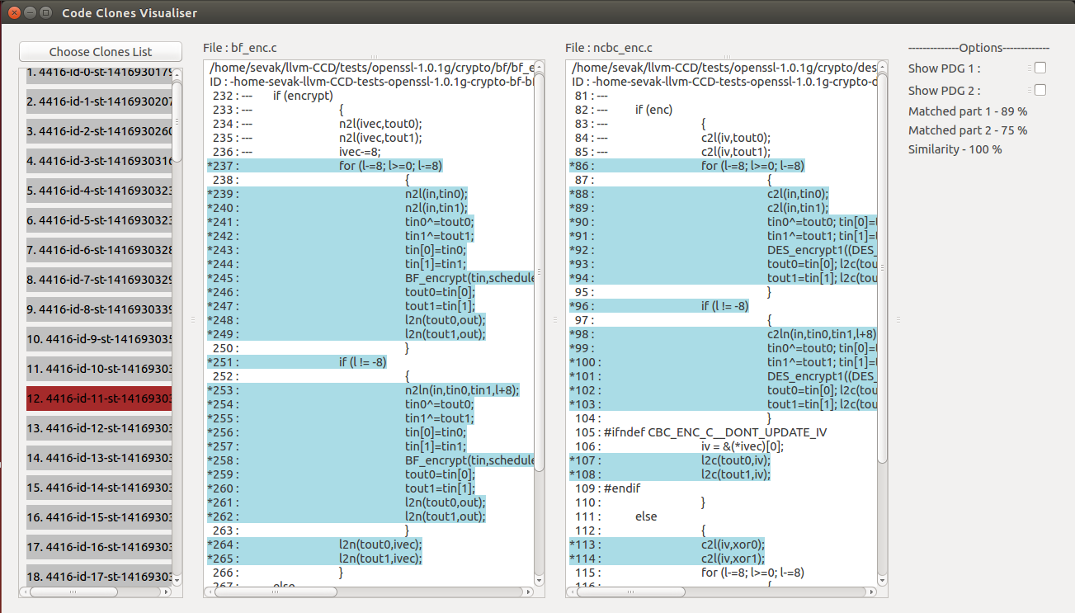
Results

Slide 13
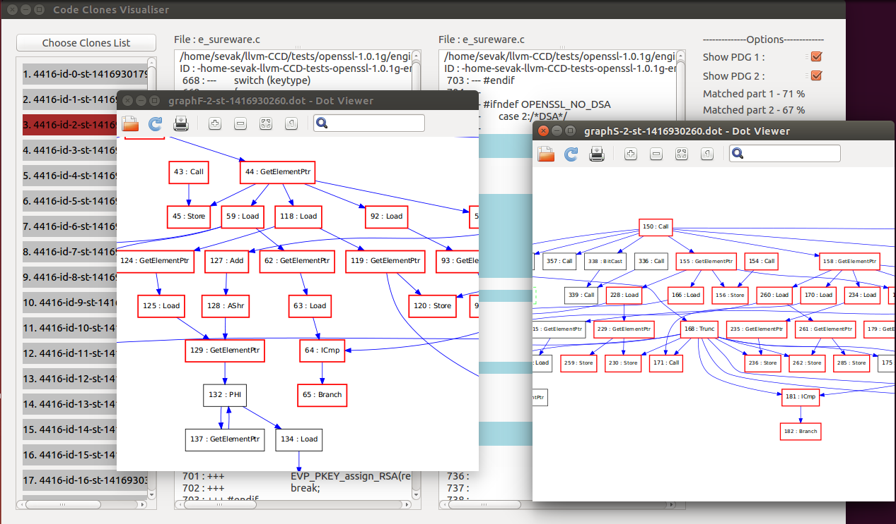
Results

Slide 14
Results
openssl-1.0.1g/crypto/cast/c_enc.c | openssl-1.0.1g/crypto/bf/bf_enc.c
141 : for (l-=8; l>=0; l-=8) 142 : { 143 : n2l(in,tin0); 144 : n2l(in,tin1); 145 : tin0^=tout0; 146 : tin1^=tout1; 147 : tin[0]=tin0; 148 : tin[1]=tin1; 149 : CAST_encrypt(tin,ks); 150 : tout0=tin[0]; 151 : tout1=tin[1]; 152 : l2n(tout0,out); 153 : l2n(tout1,out); 154 : } | 237 : for (l-=8; l>=0; l-=8) 238 : { 239 : n2l(in,tin0); 240 : n2l(in,tin1); 241 : tin0^=tout0; 242 : tin1^=tout1; 243 : tin[0]=tin0; 244 : tin[1]=tin1; 245 : BF_encrypt(tin,schedule); 246 : tout0=tin[0]; 247 : tout1=tin[1]; 248 : l2n(tout0,out); 249 : l2n(tout1,out); 250 : }

Slide 15
Results
openssl-1.0.1g/crypto/bf/bf_ofb64.c | openssl-1.0.1g/crypto/des/ofb64ede.c
79 : n2l(iv,v0); 80 : n2l(iv,v1); 81 : ti[0]=v0; 82 : ti[1]=v1; 83 : dp=(char *)d; 84 : l2n(v0,dp); 85 : l2n(v1,dp); 86 : while (l--) 87 : { 88 : if (n == 0) 89 : { 90 : BF_encrypt((BF_LONG *)ti,schedule); 91 : dp=(char *)d; 92 : t=ti[0]; l2n(t,dp); 93 : t=ti[1]; l2n(t,dp); 94 : save++; 95 : } 96 : *(out++)= *(in++)^d[n]; 97 : n=(n+1)&0x07; 98 : } | 81 : c2l(iv,v0); 82 : c2l(iv,v1); 83 : ti[0]=v0; 84 : ti[1]=v1; 85 : dp=(char *)d; 86 : l2c(v0,dp); 87 : l2c(v1,dp); 88 : while (l--) 89 : { 90 : if (n == 0) 91 : { 92 : /* ti[0]=v0; */ 93 : /* ti[1]=v1; */ 94 : DES_encrypt3(ti,k1,k2,k3); 95 : v0=ti[0]; 96 : v1=ti[1]; 97 : 98 : dp=(char *)d; 99 : l2c(v0,dp); 100 : l2c(v1,dp); 101 : save++; 102 : } 103 : *(out++)= *(in++)^d[n]; 104 : n=(n+1)&0x07; 105 : }

Slide 16
Results
openssl-1.0.1g/crypto/bn/asm/x86_64-gcc.c | openssl-1.0.1g/crypto/bn/asm/x86_64-gcc.c
468 : mul_add_c(a[0],b[1],c2,c3,c1); 469 : mul_add_c(a[1],b[0],c2,c3,c1); 470 : r[1]=c2; 471 : c2=0; 472 : mul_add_c(a[2],b[0],c3,c1,c2); 473 : mul_add_c(a[1],b[1],c3,c1,c2); 474 : mul_add_c(a[0],b[2],c3,c1,c2); 475 : r[2]=c3; 476 : c3=0; 477 : mul_add_c(a[0],b[3],c1,c2,c3); 478 : mul_add_c(a[1],b[2],c1,c2,c3); 479 : mul_add_c(a[2],b[1],c1,c2,c3); 480 : mul_add_c(a[3],b[0],c1,c2,c3); 481 : r[3]=c1; 482 : c1=0; 483 : mul_add_c(a[3],b[1],c2,c3,c1); 484 : mul_add_c(a[2],b[2],c2,c3,c1); 485 : mul_add_c(a[1],b[3],c2,c3,c1); 486 : r[4]=c2; 487 : c2=0; 488 : mul_add_c(a[2],b[3],c3,c1,c2); 489 : mul_add_c(a[3],b[2],c3,c1,c2); 490 : r[5]=c3; 491 : c3=0; | 535 : sqr_add_c2(a,7,0,c2,c3,c1); 536 : sqr_add_c2(a,6,1,c2,c3,c1); 537 : sqr_add_c2(a,5,2,c2,c3,c1); 538 : sqr_add_c2(a,4,3,c2,c3,c1); 539 : r[7]=c2; 540 : c2=0; 541 : sqr_add_c(a,4,c3,c1,c2); 542 : sqr_add_c2(a,5,3,c3,c1,c2); 543 : sqr_add_c2(a,6,2,c3,c1,c2); 544 : sqr_add_c2(a,7,1,c3,c1,c2); 545 : r[8]=c3; 546 : c3=0; 547 : sqr_add_c2(a,7,2,c1,c2,c3); 548 : sqr_add_c2(a,6,3,c1,c2,c3); 549 : sqr_add_c2(a,5,4,c1,c2,c3); 550 : r[9]=c1; 551 : c1=0; 552 : sqr_add_c(a,5,c2,c3,c1); 553 : sqr_add_c2(a,6,4,c2,c3,c1); 554 : sqr_add_c2(a,7,3,c2,c3,c1); 555 : r[10]=c2; 556 : c2=0; 557 : sqr_add_c2(a,7,4,c3,c1,c2); 558 : sqr_add_c2(a,6,5,c3,c1,c2); 559 : r[11]=c3; 560 : c3=0;

Slide 17
Thank You.

