Slide 1
Open source tools for new subtitle standards
Fosdem¹⁵
Andreas Tai
Production Systems Television

Slide 2


Slide 4

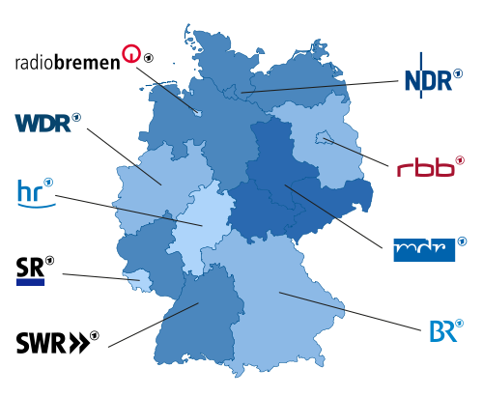




Slide 5


Standards
(Open Source) Code

Slide 6


Different Subtitle Standards
TTML
WebVTT
EBU-STL
EBU-TT
Notes:
WHATWG

Slide 7
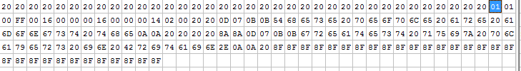
Use case format conversion
EBU-STL, binary based
EBU-TT XML Based

Slide 8
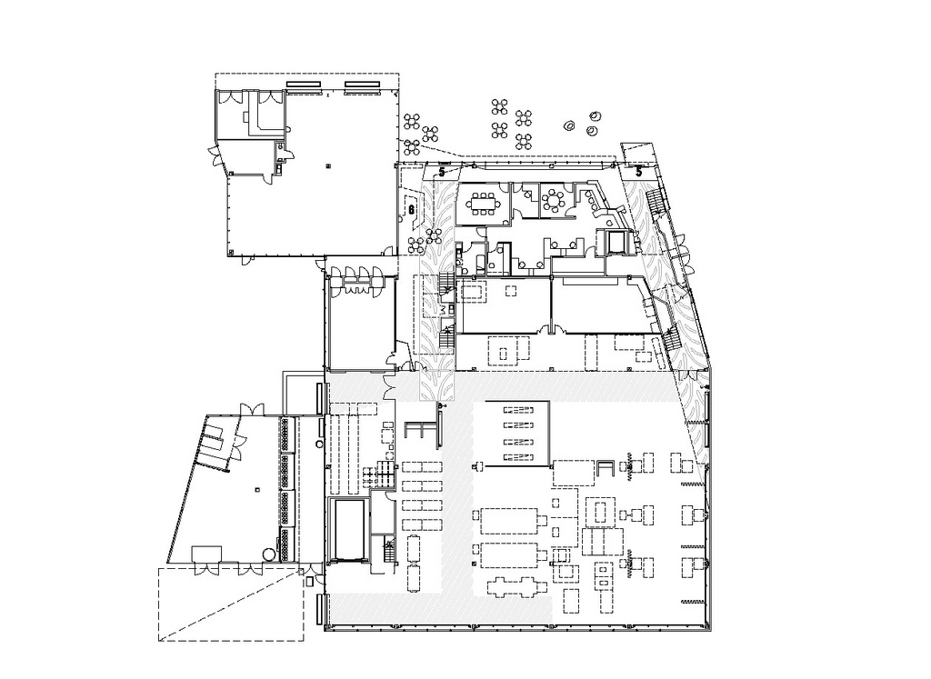
Why reference implementation are so important….
A standard is only an architectural plan
… not the house!
Lyons Architects
Notes:
Beispiel Berliner Schloss

Slide 9


Why open source?
Commercial Software
Open source software
Attribution:lewing@isc.tamu.edu
Customer requests
Standard conformance
higher priority … possible

Slide 10
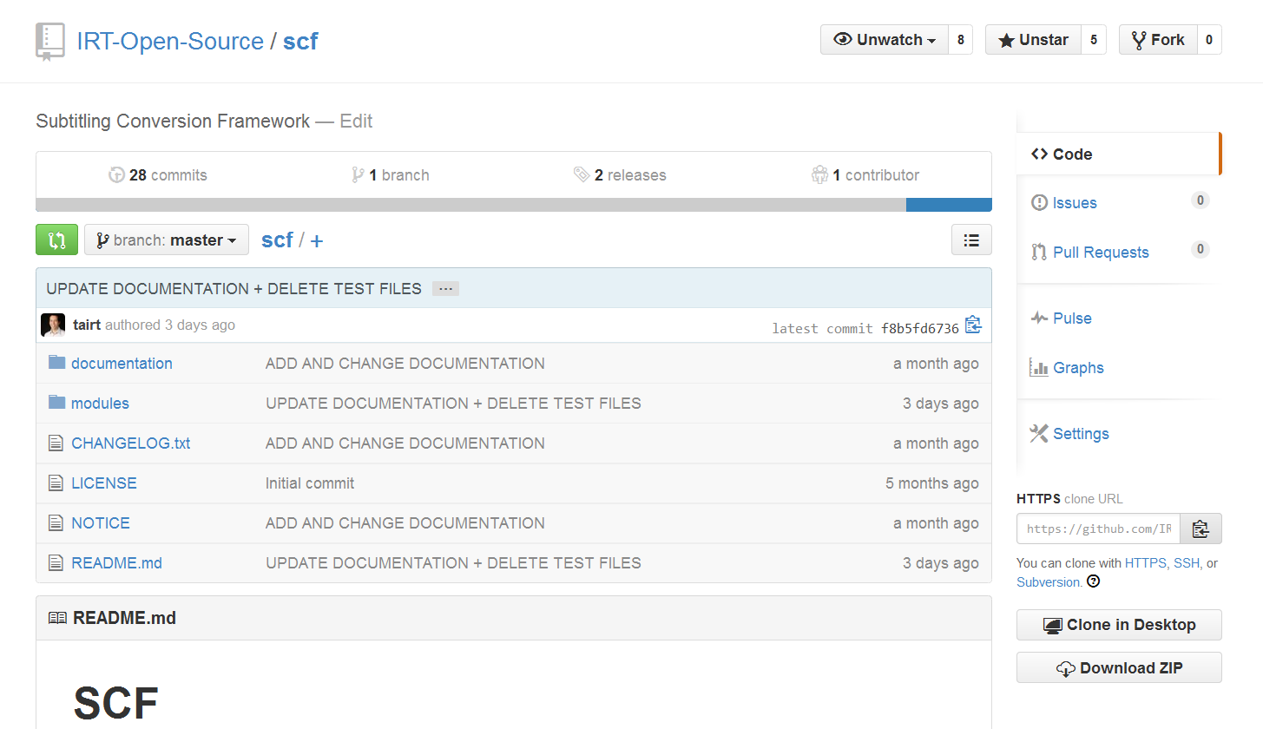
Subtitle Conversion Framework - SCF
https://github.com/IRT-Open-Source/scf

Slide 11
SCF - „Non Functional Requirements“
Integration
  different platforms
  different programming languages
Transparency
  requirements
  source code

Slide 12
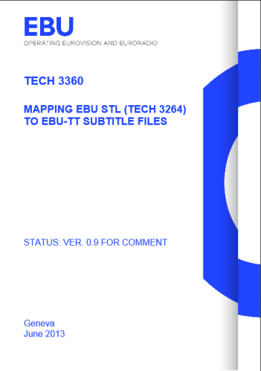
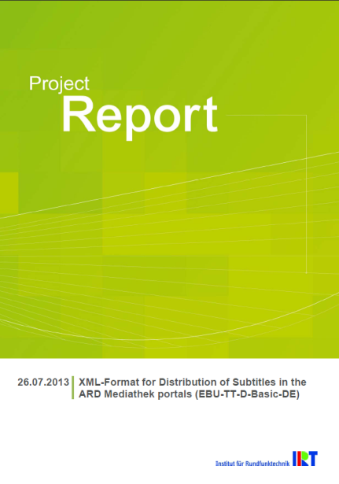
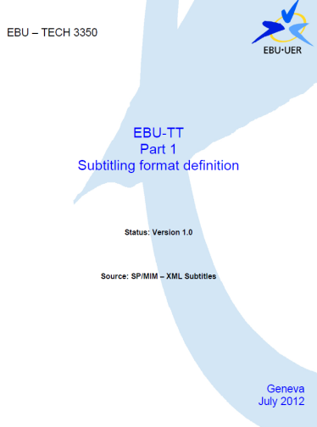
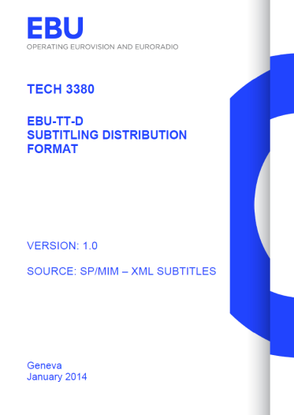
SCF – Functional Requirements
STL
EBU-TT
EBU-TT-D
EBU-TT-Basic-DE

Slide 13
SCF – Implementation
STL
EBU-TT
EBU-TT-D
EBU-TT-Basic-DE
XSLT
XSLT
python
XSLT
STL-XML

Slide 14
Simple Pipeline
python stl2stlxml.py %1 > STLXML.xml
java -jar saxon9he.jar -s:STLXML.xml -xsl:STLXML2EBU-TT.xslt -o:EBU-TT.xml
java -jar saxon9he.jar -s:EBU-TT.xml -xsl:EBU-TT2EBU-TT-D.xslt offsetInSeconds=36000 o:EBU-TT-D.xml
java -jar saxon9he.jar -s:EBU-TT-D.xml -xsl:EBU-TT-D2EBU-TT-D-Basic-DE.xslt o:EBU-TT-D-Basic-DE.xml

Slide 15
System Requirements
Python 2.7 (!)
XSLT 1 Processor (+ EXSLT nodeset func)
  Saxon from 6.5.5
  libxslt
  Xalan
  Web Browser

Slide 16
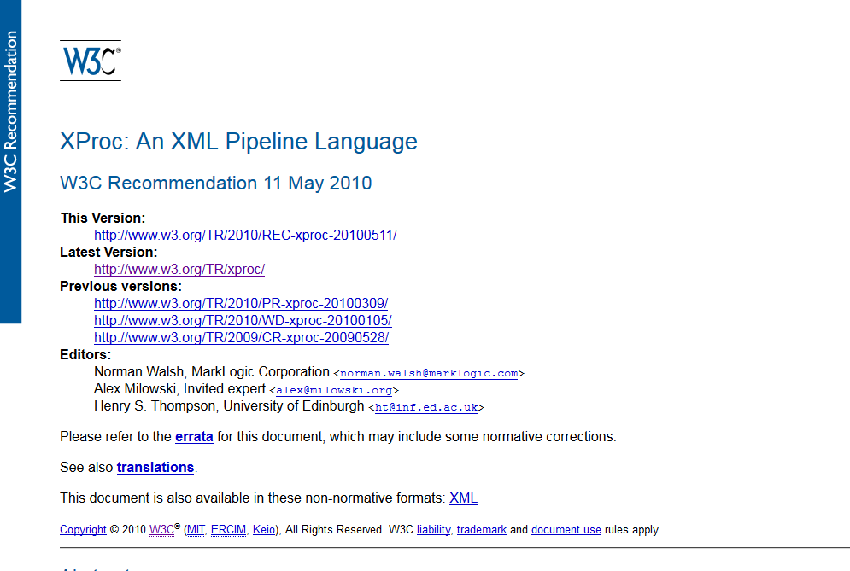
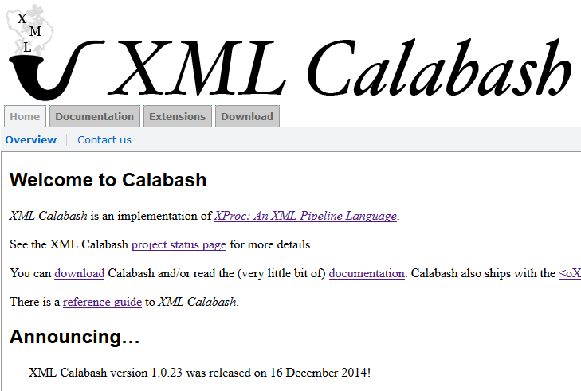

Slide 17
Building up pipeline using XPROC
<input port=„source">
<document href=„StlXml.xml"/>
</input>
<xslt>
<input port="stylesheet">
<document href="STLXML2EBU-TT.xslt"/>
</input>
</xslt>
<xslt>
<input port="stylesheet">
<document href="EBU-TT-D2EBU-TT-D-Basic-DE.xslt"/>
</input>
</xslt>

Slide 18
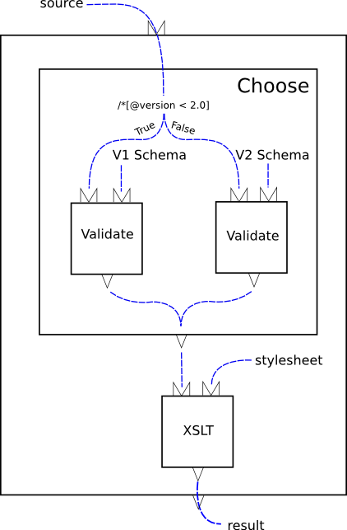
XPROC pipeline
From XProc: An XML Pipeline Language
Copyright © 11.10.2010
Word Wide Web Consortium

Slide 19
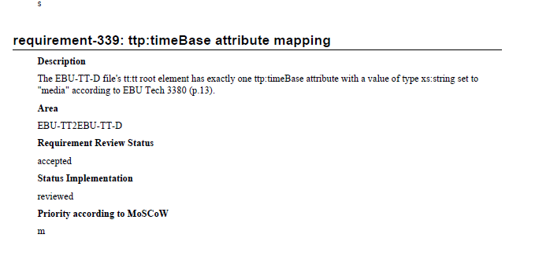
Documentation SCF requirements

Slide 20
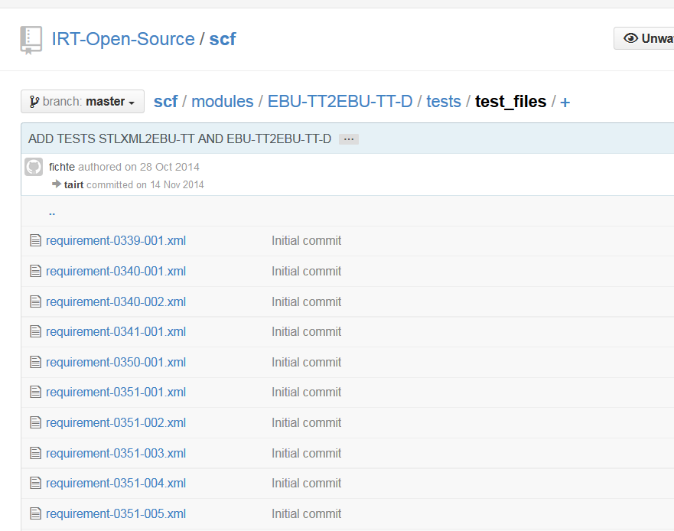
SCF – Requirements covered by tests

Slide 21
SCF Licence
Apache Licence, Version 2.0
Allows: integration in commercial software
Goal:
  standard compliance in open source and commercial software

Slide 22
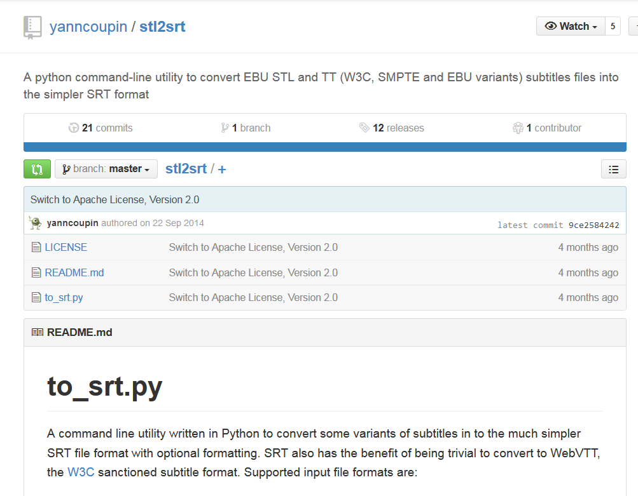
Big thanks to Yann Coupin
Stl2stlxml module is
derived from
stl2srt from Yann Coupin!

Slide 23
More…..

Slide 24
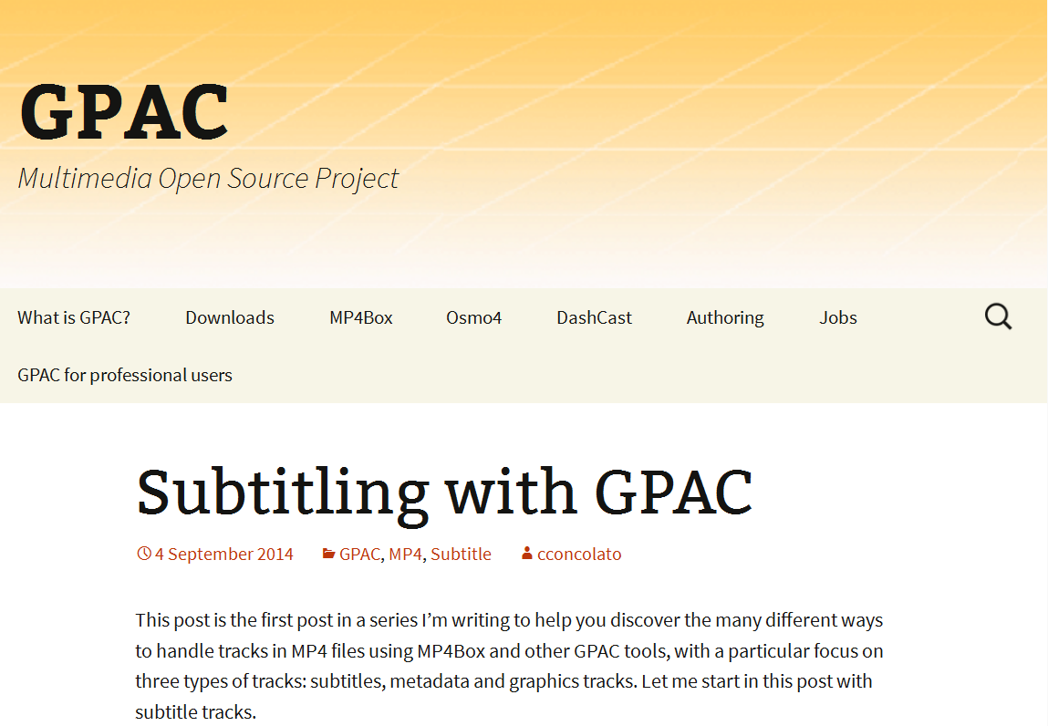
Subtitles in ISOBMFF
Mux ISOBMFF
DASH Segmentation
Different Subtitle formats
  WebVTT, TTML/EBU-TT, 3GPP Timed Text
Standard Compliance
ISO/IEC 14496-30

Slide 25
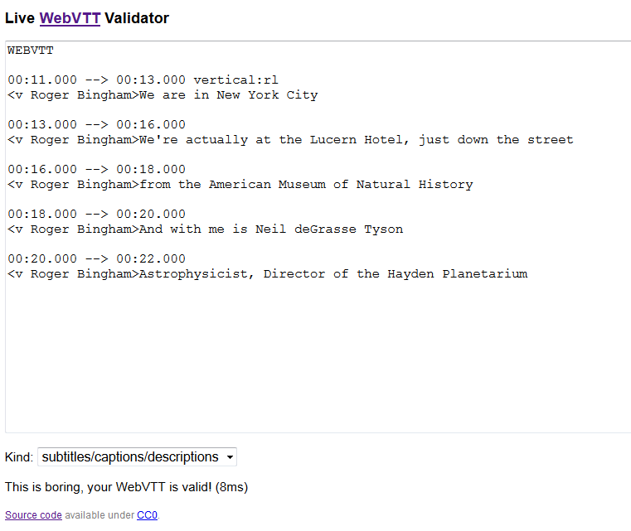
WebVTT parser and validator (Anne van Kesteren)

Slide 26
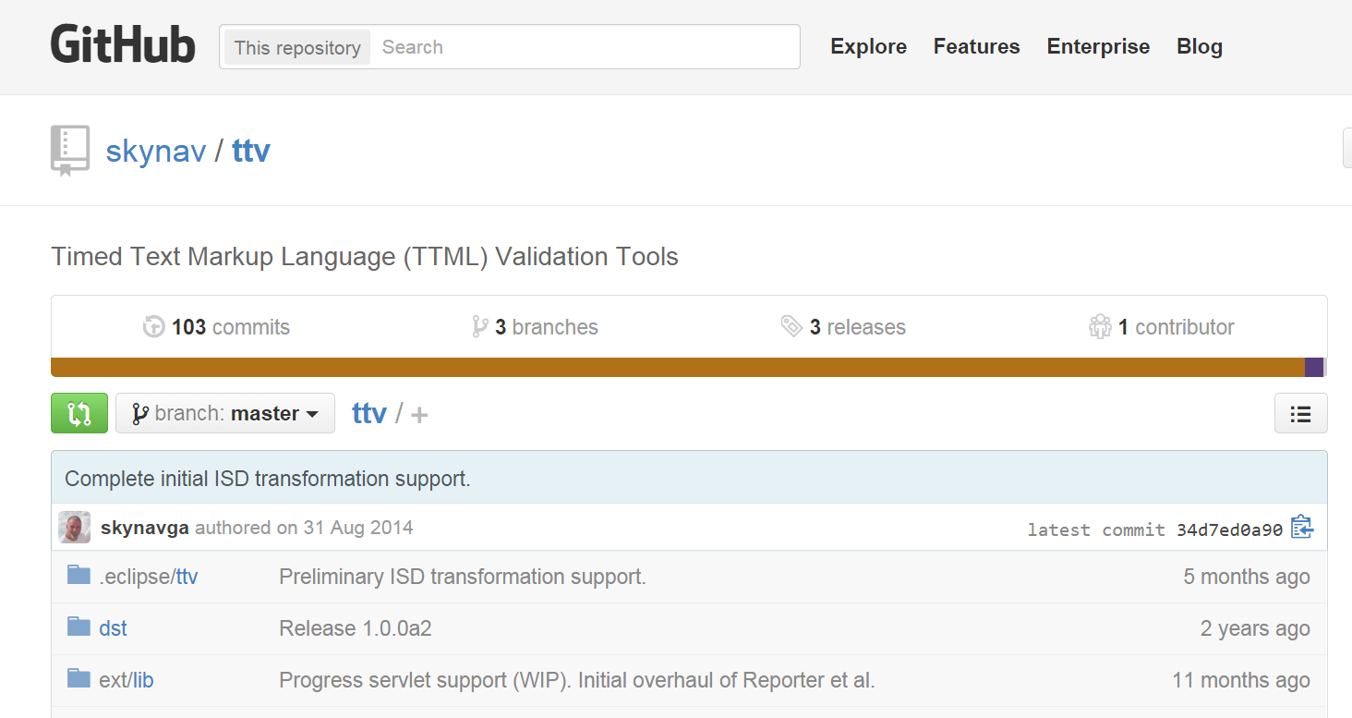
TTML Validator

Slide 27
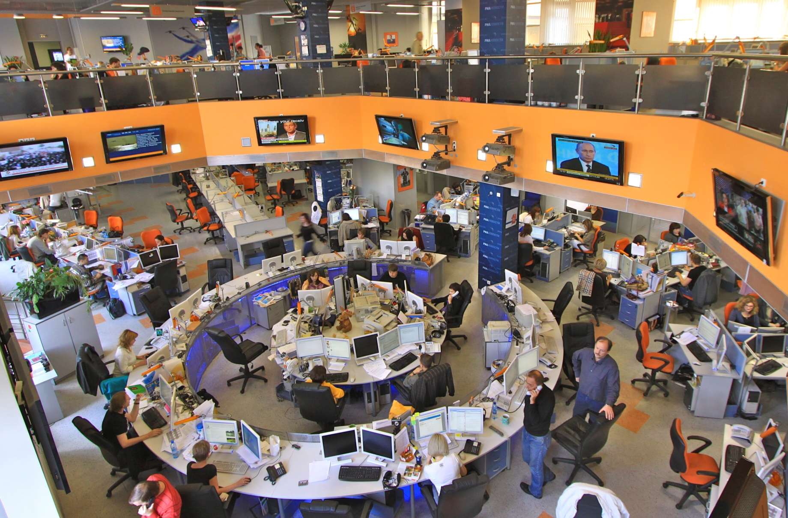

VLC + Broadcaster
Image: Jürg Vollmer / maiak.info

Slide 28
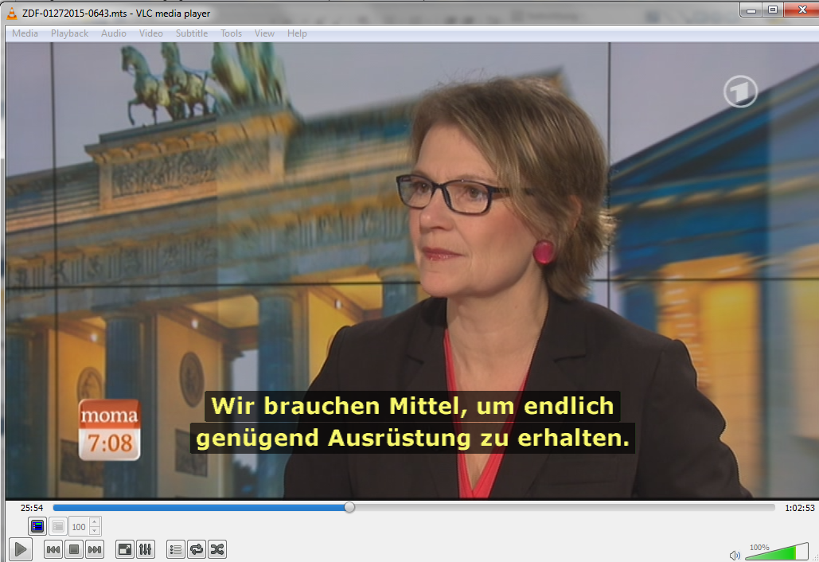

Advanced Subtitle features in VLC

Slide 29
Summary
Open Source Software is essential for subtitle standards
  market adoption
  standard compliance
  transparent reference
Industry and Broadcaster can help through:
  Test content, Test Content, Test Content …..

Slide 30
Thank you!
Andreas Tai
Production Systems Television
Institut für Rundfunktechnik
Floriansmühlstraße 60
80939 München
Tel. +49-(0)89-32399-0
Fax +49-(0)89-32399-351
E-Mail: tai@irt.de

