Slide 1
​Babylon.js
Unleash the
power of 3D across devices​

Slide 2
Hello there!
Julian Chenard
@temechon
Raanan Weber
@raananw

Slide 3
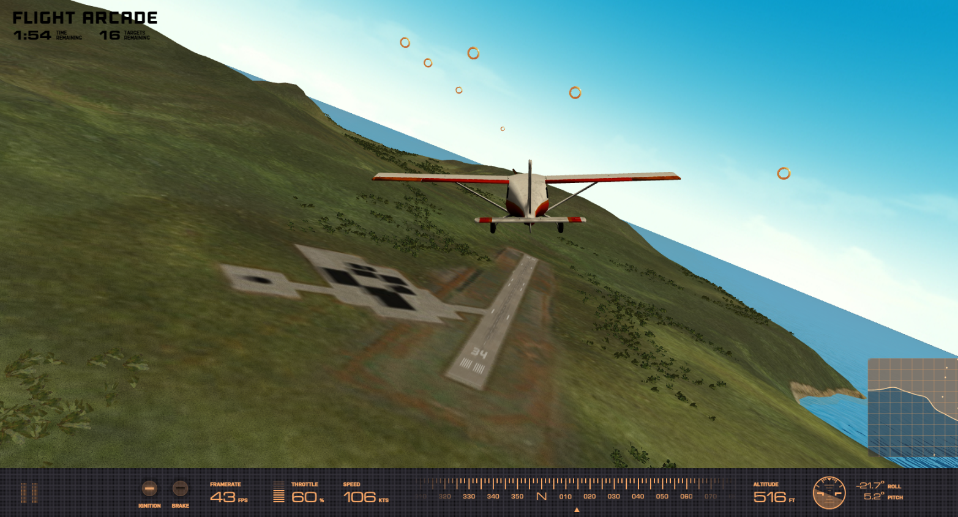

Slide 4
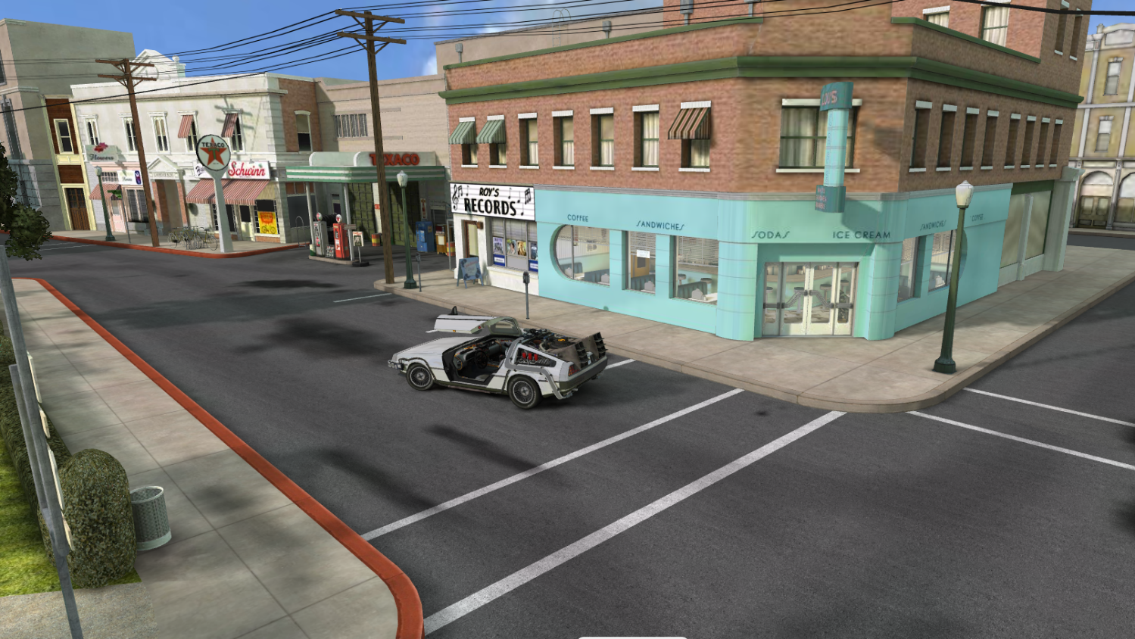

Slide 5
WebGL is…
A JavaScript API
Based on OpenGL ES 2.0
Standardized by Kronos Group

Slide 6
Using WebGL directly
You need to handle everything except the rendering
You have to:
Create shaders code
Create geometry and topology
Handle textures and resources management
Manage the render loop

Slide 8
Using WebGL directly is like…

Slide 9
BABYLON.JS to the rescue
An average of 1 version per month 69 contributors 39 releases 2 704 commits 16000+ lines of code More than 140 files of code More than 700 forks A bandwidth of 1 TB per month for the website 1.3GB (Code and samples) An open-source documentation

Slide 10
How to use BABYLON.JS?
Open source project (Available on Github)
http://www.babylonjs.com
http://cdn.babylonjs.com/2-2/babylon.js
How to use it? Include one file and you’re ready to go!
To start Babylon.js, you’ve just need to create an engine object:
<script src="babylon.js"></script>
var engine = new BABYLON.Engine(canvas, true);

Slide 11
How to use BABYLON.JS?
Babylon.js is a scene graph: All complex features are abstracted for YOU!
Handling rendering can be done in one line:
var scene = new BABYLON.Scene(engine);
var camera = new BABYLON.FreeCamera("Camera", new BABYLON.Vector3(0, 0, -10), scene);
var light0 = new BABYLON.PointLight("Omni0", new BABYLON.Vector3(0, 100, 100), scene);
var sphere = BABYLON.Mesh.createSphere("Sphere", 16, 3, scene);
engine.runRenderLoop(function() { scene.render(); });

Slide 12
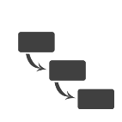
FIRST CONTACT
Hello world Babylon.js
Notes:
Step 0 – step 4

Slide 13
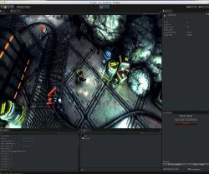
Working with Assets
Blender 3D
3DS Max incl. Action Builder
Unity 5
Exporters
.BABYLON

Slide 14
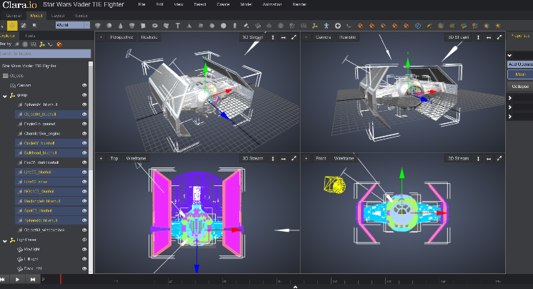
And now…Clara.io
Notes:
http://www.clara.io/

Slide 15
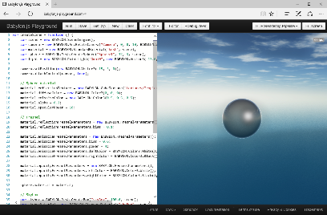
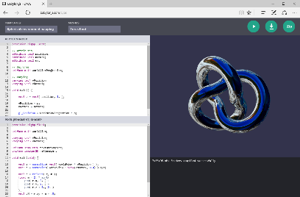
Learn & Experiment
Playground
CYOS
Notes:
Select code from Playground and copy/paste to previous page

Slide 16
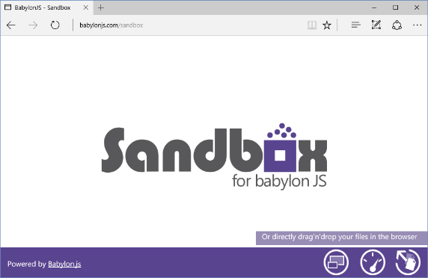
Test it LIVE
Notes:
Select code from Playground and copy/paste to previous page

Slide 17
Playing with inputs
Touch
Device Orientation
Virtual Joysticks
Anaglyph
VR
Gamepad
Camera based on pointer events
Camera based on Device Orientation API
Using pointer events, this camera generates two joysticks on top of the scene
Use this camera with Red/Green glasses
Control camera orientation with:
Oculus Rift
WebVR
CardBoard
Use your gamepad to control your camera

Slide 18
WEBAUDIO
Notes:
Opening demo with Mansion

Slide 19
COLLISIONS & PHYSICS
Notes:
Step 9
http://www.babylonjs.com/playground/?9

Slide 20
COOL STUFF
SIMD.js, Hardware instances and bones
Notes:
http://www.babylonjs.com/?REFPROBE
http://www.babylonjs-playground.com/#LYCSQ#25
http://www.babylonjs.com/scenes/simd.html
http://www.babylonjs.com/?INSTANCEDBONES

Slide 21
Did you say features?
Complete scene graph with lights, cameras, materials and meshes
Collisions engine
Physics engine (thanks to cannon.js)
Scene picking
Antialiasing
Animations engine
Particles Systems
Sprites and 2D layers
Frustum clipping
Sub-meshes clipping
Hardware scaling
Selection octrees
Offline mode (Assets are saved locally to prevent reloading them)
Incremental loading
Binary format
Hardware accelerated instances
Diffuse lightning and texture
Ambient lightning and texture
Specular lightning
Opacity texture
Reflection texture (Spheric, planar, cubic and projection)
Mirror texture
Emissive texture
Specular texture
Bump texture
Up to 4 lights (points, directionals, spots, hemispherics)
Custom materials
Skybox
Vertex color
4 bones per vertex
Fresnel term
Fog
Alpha blending
Alpha testing
Billboarding
Fullscreen mode
Shadow Maps and Variance Shadow Maps
Rendering layers
Post-processes (blur, refraction, black'n'white, fxaa, customs...)
Lens flares
Multi-views
Render target textures
Dynamic textures (canvas)
Video textures
Compressed (DDS) textures
Arc rotate camera
Free camera
Touch camera
Virtual Joysticks camera
Oculus Rift camera
Gamepad camera
Mesh cloning
Dynamic meshes
Height maps
Bones
Constructive solid geometries
Babylon scene file can be converted from .OBJ, .FBX, .MXB
Exporter for Blender
Exporter for Cheetah3d
Exporter for 3ds Max
Exporter for Unity
Support for drag'n'drop
….

Slide 22
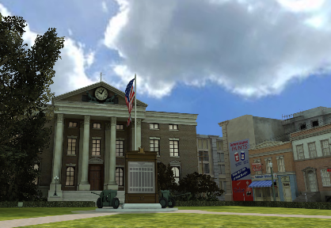
USEFUL LINKS
http://www.babylonjs.com
http://www.babylonjs.com/playground
http://www.babylonjs.com/cyos
https://doc.babylonjs.com
http://www.html5gamedevs.com/forum/16-babylonjs

Slide 23
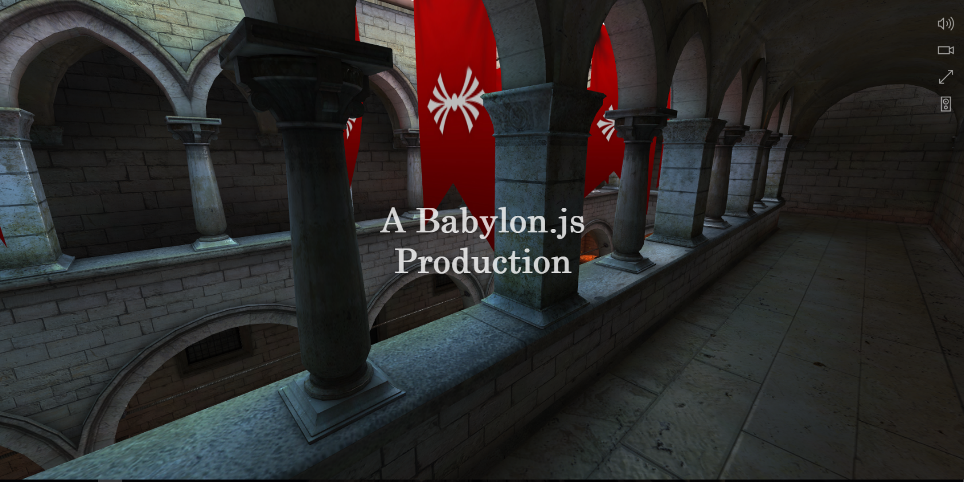
DEMO TIME !

