Slide 1
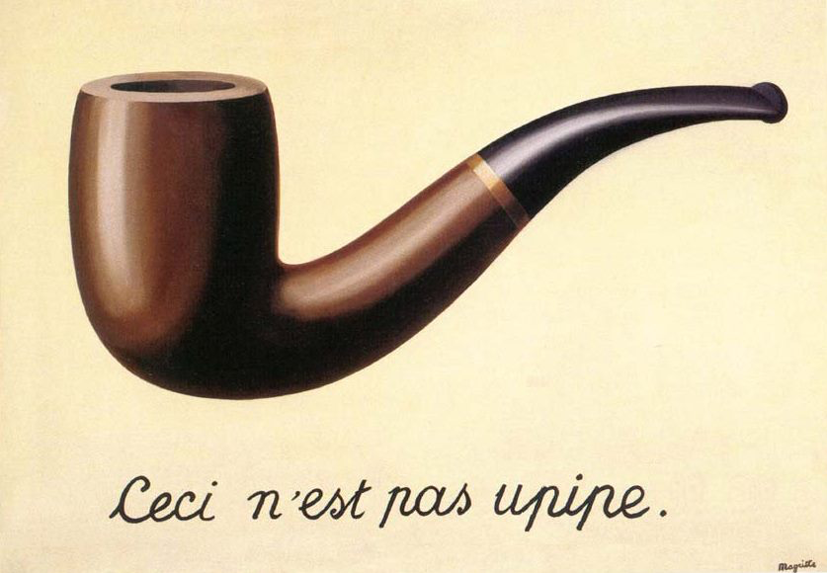
What makes Upipe great for video processing
Christophe Massiot (FOSDEM 2016)
cmassiot@upipe.org
http://upipe.org/

Slide 2
What is Upipe?
A young (2012) C multimedia framework
Initiated by OpenHeadend team
3 supporting companies, 7 contributors
Pre-release 4 just out, plans for 1.0 to be discussed
Focus on reliability, efficiency and compliance, for broadcast and professional applications
MIT and LGPL

Slide 3
Upipe main structures
struct upipe: unit of data processing, part of a pipeline
struct uprobe: internal exception catcher, interaction with application
struct upump: external event catcher, event loop
struct uclock: system clock management
struct urequest: inter-pipe negotiation
struct uref: unit of data and metadata
struct ubuf: container of data

Slide 4
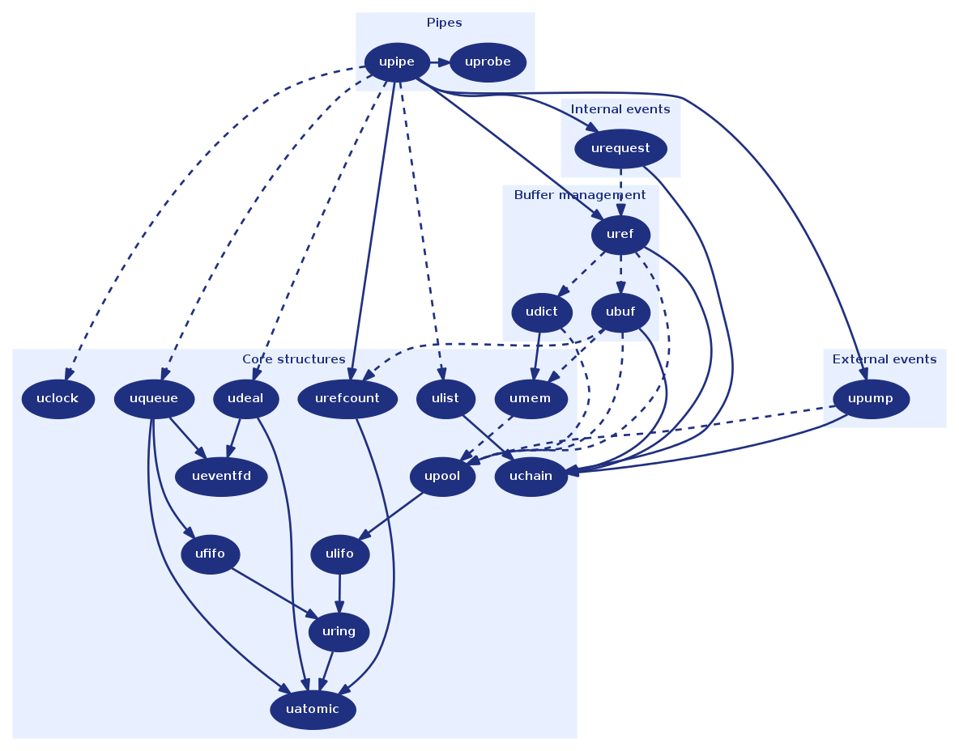

Slide 5
Advanced buffer management
Refcounts allow buffer-sharing
struct ubuf *new = ubuf_dup(ubuf);
Copy-on-write semantics
﻿ubuf_block_write(ubuf, offset, &size, &buf);
﻿new = ubuf_block_copy(ubuf_mgr, ubuf, skip, new_size);
Zero-copy primitives for data blocks
ubuf_block_append(ubuf1, ubuf2);
ubuf_block_insert(ubuf1, offset, ubuf2);
ubuf_block_delete(ubuf, offset, size);
ubuf_block_resize(ubuf, offset, new_size);

Slide 6
Arbitrary meta-data attributes
struct uref carried across pipes embeds timestamps & pointers to ubuf and attribute dictionary
Preprocessor macros allow easy attribute declarations:
﻿UREF_ATTR_UNSIGNED(foo, bar, “foo.bar", example of attribute)
Accessors to manipulate the attribute:
uref_foo_set_bar(uref, 42);
uref_foo_get_bar(uref, &uint64_var);
uref_goo_delete_bar(uref);
Implemented with inline buffer (no memory allocation)

Slide 7
Three clock variants
Packet timestamps are stored in three clock variants:
orig: original timestamp scaled to 27MHz units
prog: same scale as orig but origin moved to be monotonically increasing, used to encode PTS/DTS
sys: scale of the system clock (uclock), used to output packets
Allows to keep a compliant difference between PTSs based on frame rate (eg. 40 ms)
At the same time skew the system clock to output packets faster or slower to keep up with transmitter

Slide 8
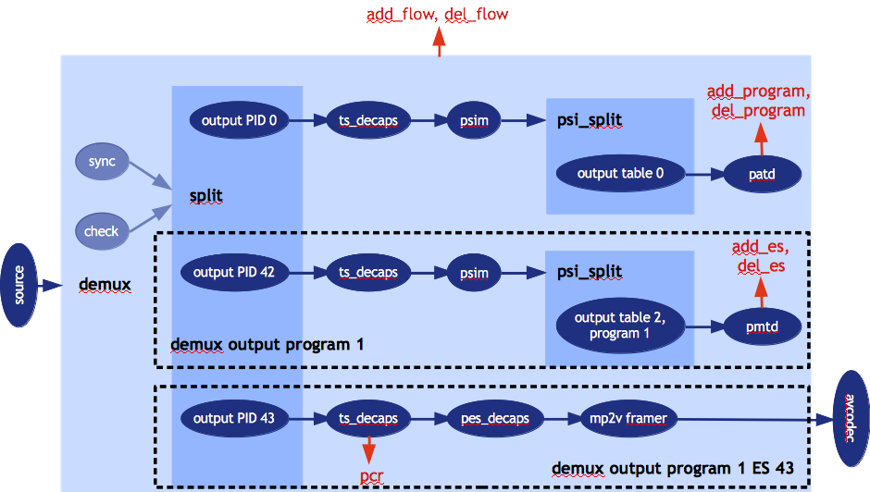
Inner pipes
Pipes can “embed” other pipes
Allows for more granularity and flexibility

Slide 9
Event loop
Upipe’s event loop can be exposed to all pipe types via an abstract API (upump)
Allows to have timers in any pipe, for instance event handling (SCTE-35 splicing)
upump = upump_alloc_timer(upump_mgr, callback, opaque, refcount, timeout, repeated);
Or to interact with the external world
upump = upump_alloc_fd_read(upump_mgr, callback, opaque, refcount, file_descriptor);

Slide 10
Dynamic pipeline construction
The uprobe API allows the application to receive exceptions from the pipe
Application can be notified when a pipe needs an output (UPROBE_NEED_OUTPUT), or the list of elementary streams of a demux changes (UPROBE_SPLIT_UPDATE)
Useful for dynamic formats such as transport streams

Slide 11
Threading & buffering
Pipes are low-level — threading is decided by the application
Queues and workers can move pipelines to threads
local_pipe = upipe_wlin_alloc(remote_thread, local_probe, remote_pipe, remote_probe, input_queue_len, output_queue_len);
Local pipe takes the place of the remote pipe in the local thread and can be acted upon
Lockless FIFOs and LIFOs handle and recycle data structures + eventfd abstraction

Slide 12
Inter-pipe negotiation
Pipes can register struct urequest on their output
The request is passed from pipe to pipe until handled, the reply flows backwards from callback to callback
Requests cross threads boundaries via queues and are resent in case of pipeline changes
request
Pipe 1
Pipe 2
Pipe 3
Pipe 4
data
callback
thread 1
queue
thread 2

Slide 13
Available pipes
upipe-modules: pipes for basic manipulation and I/O
upipe-ts: standards-compliant TS demux and mux
upipe-framers: bitstream conversion of common codecs (mp2v, h264, mp2, aac, a52, opus, telx, dvbsub, s302)
upipe-av: avformat demux and mux, avcodec decoder and encoder
upipe-swresample, upipe-swscale, upipe-x264, upipe-blackmagic

Slide 14
Application development
Currently C API
Work for LuaJIT bindings under way: https://github.com/nto/lj-upipe
Transcode example application:
﻿Usage: transcode [-d] [-m <mime>] [-f <format>] [-p <id> -c <codec> [-o <option=value>] ...] ... <source file> <sink file> -f: output format name -m: output mime type -p: add stream with id -c: stream encoder -o: encoder option (key=value)

Slide 15
cmassiot@openheadend.tv
Upipe meet-up in BOF room Sunday 14:00

