Slide 1
What do you mean ’SDN’ on traditional routers?
Peter Van Eynde <pevaneyn@cisco.com>

Slide 2
Who is this guy?

Slide 3
pevaneyn@cisco.com
Physics/Lisp/ML/Networking/Security
Almost 10 years at Cisco, mostly in the Brussels TAC
Member of security, content and SAN teams
now doing Data Science and Machine Learning
Helping with FOSDEM network also for almost 10 years

Slide 4
The FOSDEM network

Slide 5
Logical L2 layout
VS-2
VS-1
J AP’s
Internet
ASR1006
K
J
Core
Info desk
AW
H
ULB
U
WLC

Slide 6
Traffic flow
VS-2
VS-1
J AP’s
Internet
ASR1006
K
J
Core
Info desk
AW
H
ULB
U
WLC

Slide 7
Traffic flow
VS-2
VS-1
J AP’s
Internet
ASR1006
K
J
Core
Info desk
AW
H
ULB
U
WLC

Slide 8
The hart of the network: the ASR-1006

Slide 9
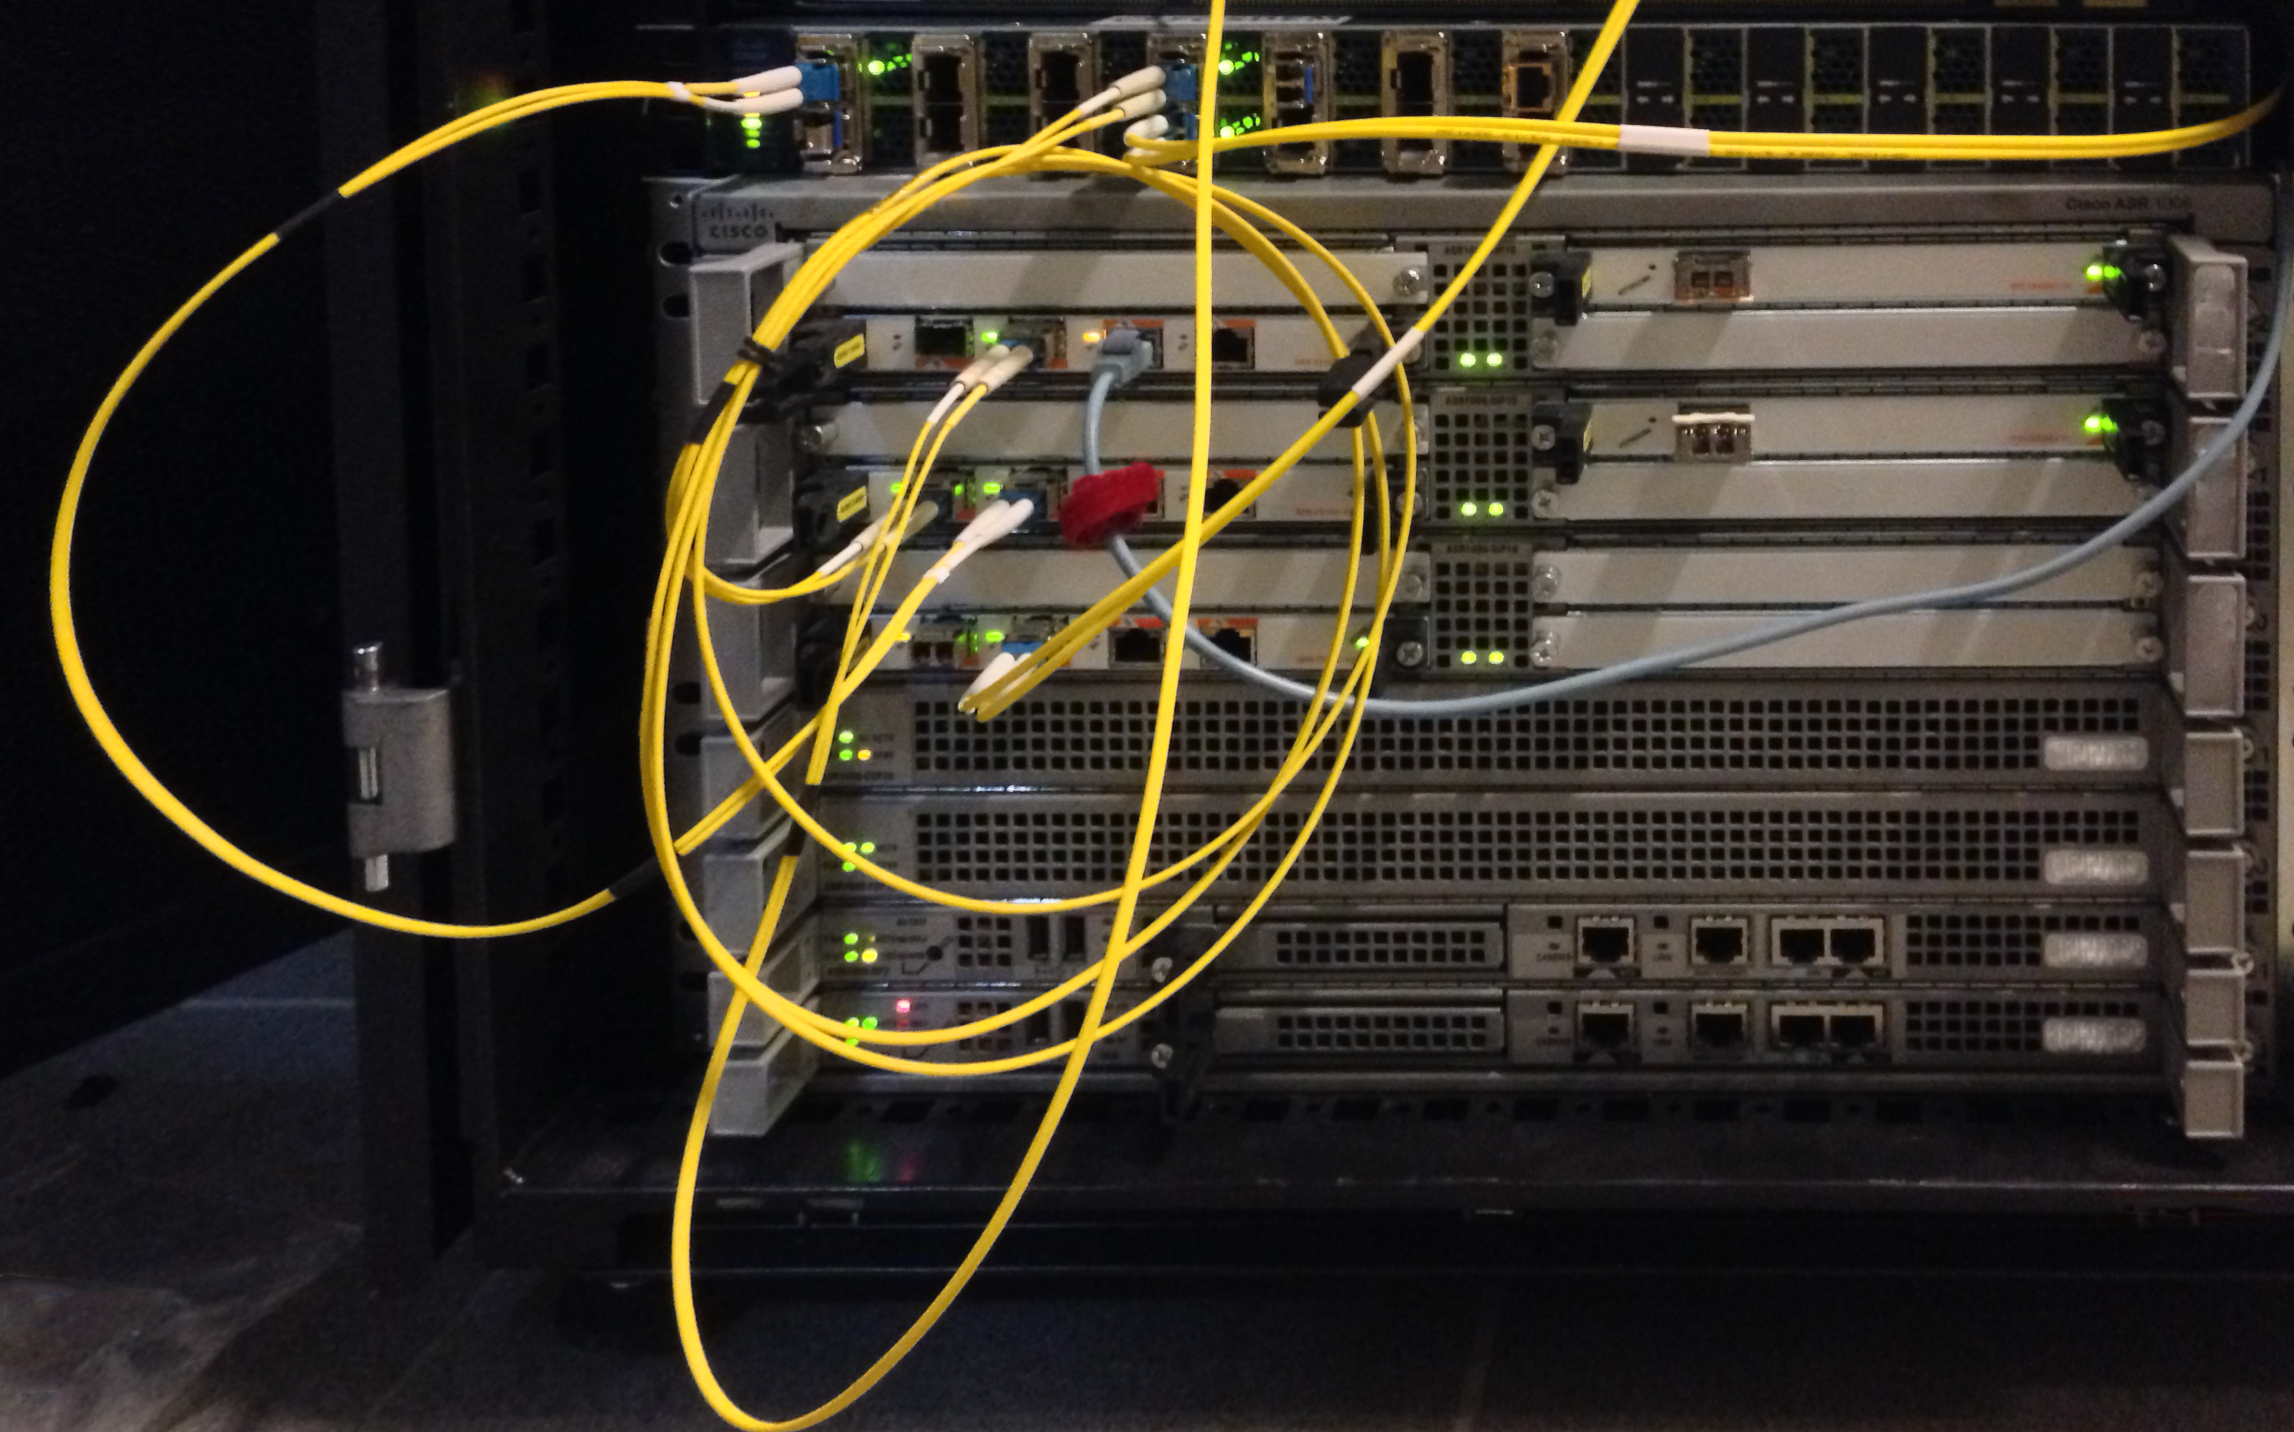
Picture here

Slide 10
Main Features
ISSU
Non-Stop Forwarding and SSO
100 Gpbs throughput
OIR (hotplug)
Runs IOS-XE
Notes:
http://www.cisco.com/c/en/us/products/routers/asr-1006-router/index.html
http://www.cisco.com/c/dam/en/us/products/collateral/routers/asr-1002-router/isocore_asr_1000_validation.pdf

Slide 11
High level architecture
We have several levels:
RP2: Route Processor
DP with:
ESP20: Embedded Service Processor
FP: flow processor
CP
SPA Interface Procesor: SIP10: 10 Gbps/slot, doing classification, buffering
SPA: Shared Port Adaptor
CP
Notes:
http://www.cisco.com/c/en/us/products/collateral/routers/asr-1000-series-aggregation-services-routers/white_paper_c11-452157.html

Slide 12
RP2
Dual Intel Xeon running at 2.66GHz
16 GB of memory
80 GB HDD
Runs the routing protocols and services
This is the part you log into and where you configure the router
Newer versions can run ‘service modules’ = KVM
Notes:
http://www.cisco.com/c/en/us/products/collateral/routers/asr-1000-series-aggregation-services-routers/data_sheet_c78-441072.html

Slide 13
ESP20
CP: PowerPC based with 4G of memory
40 Mb TCAM
256 MB packet buffer
FP with 256 cores
This part actually handles the data traffic
Communicates with the RP over an internal bus, exposes an API

Slide 14
SPA
CP: PowerPC based with 512 MB of memory
Interface cards plug into this
Handles the OIR and health checking

Slide 15
How we monitor: 1/2 SNMP

Slide 16
S
N
M
P

Slide 17
Simply
Not
My
Problem

Slide 18
What is SNMP exactly?
Notes:
http://blogs.cisco.com/sp/is-snmp-here-forever-or-coauld-it-vanish-sooner-than-expected

Slide 19
What is SNMP exactly?
Old
First release: 1988
Notes:
http://blogs.cisco.com/sp/is-snmp-here-forever-or-coauld-it-vanish-sooner-than-expected

Slide 20
SNMP: gets and traps
On the router we have an ”Agent”
Agent sends traps to management station
Ex. Interface Gi0/2/0 down
Management station gets values from Agent
Ex. Get 1.3.6.1.2.1.1.3.0

Slide 21
SNMP: gets and traps
On the router we have an ”Agent”
Agent sends traps to management station
Ex. Interface Gi0/2/0 down
Management station gets values from Agent
Ex. Get 1.3.6.1.2.1.1.3.0
Ancient SDN: you can also SET values on the Agent

Slide 22
What is SNMP exactly?
SNMP represents metrics in a tree, a path is an OID.
You can walk across this tree or ask for the value at a leaf.
Uses UDP to exchange information
V1 : no auth
V2: cleartext auth
V3: complex AAA
Notes:
http://blogs.cisco.com/sp/is-snmp-here-forever-or-coauld-it-vanish-sooner-than-expected

Slide 23
What do you mean?
To translate an OID into a human form you need a MIB
Actually to need several.
A MIB describes the tree using ASN.1 like syntax.

Slide 24
MIB example
CISCO-IP-IF-CAPABILITY DEFINITIONS ::= BEGIN
… VARIATION ciiIPAddressType SYNTAX INTEGER {ipv4(1)} DESCRIPTION "Only limited set of enumerated values are supported."

Slide 25
MIBs are messy
Downloading all standard and Cisco MIBs on Debian and enabling gives:
$ snmpget -m ALL -v2c -cpublic wlc SNMPv2-MIB::sysDescr.0 2>&1 >/dev/null | wc –l
13488
$ time snmpget -m ALL -v2c -cpublic wlc SNMPv2-MIB::sysDescr.0 2> /dev/null
RFC1213-MIB::sysDescr.0 = STRING: Cisco Controller real 0m1.183s user 0m1.124s sys 0m0.056s

Slide 26
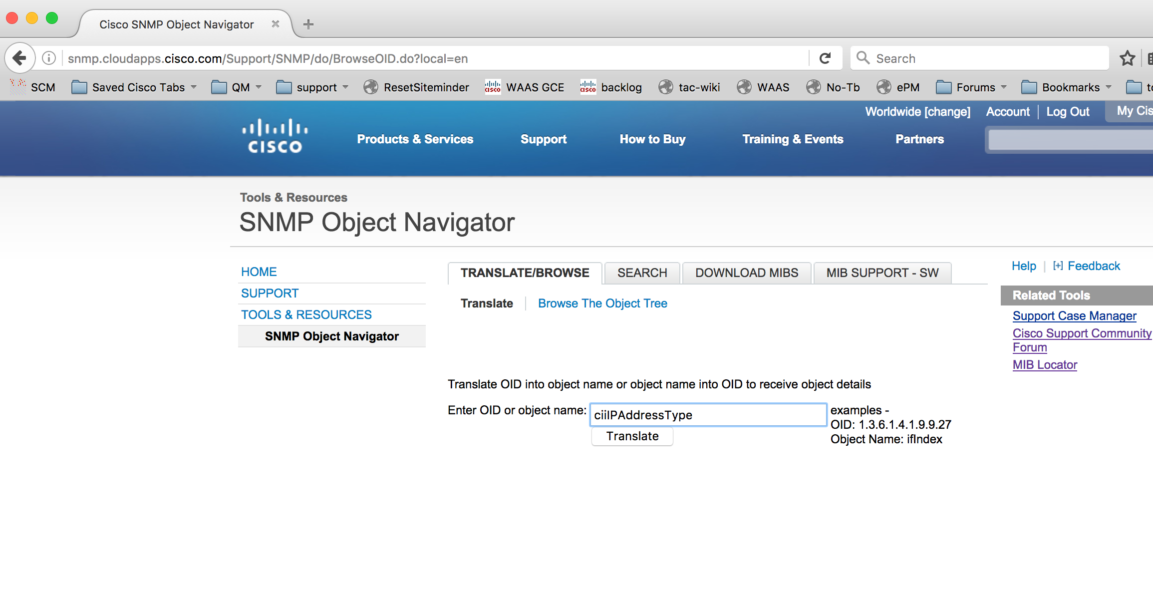

Slide 27
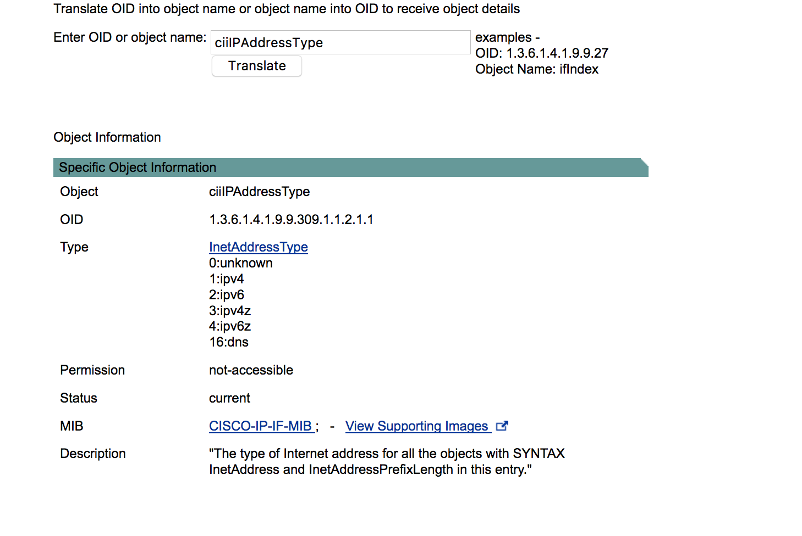

Slide 28
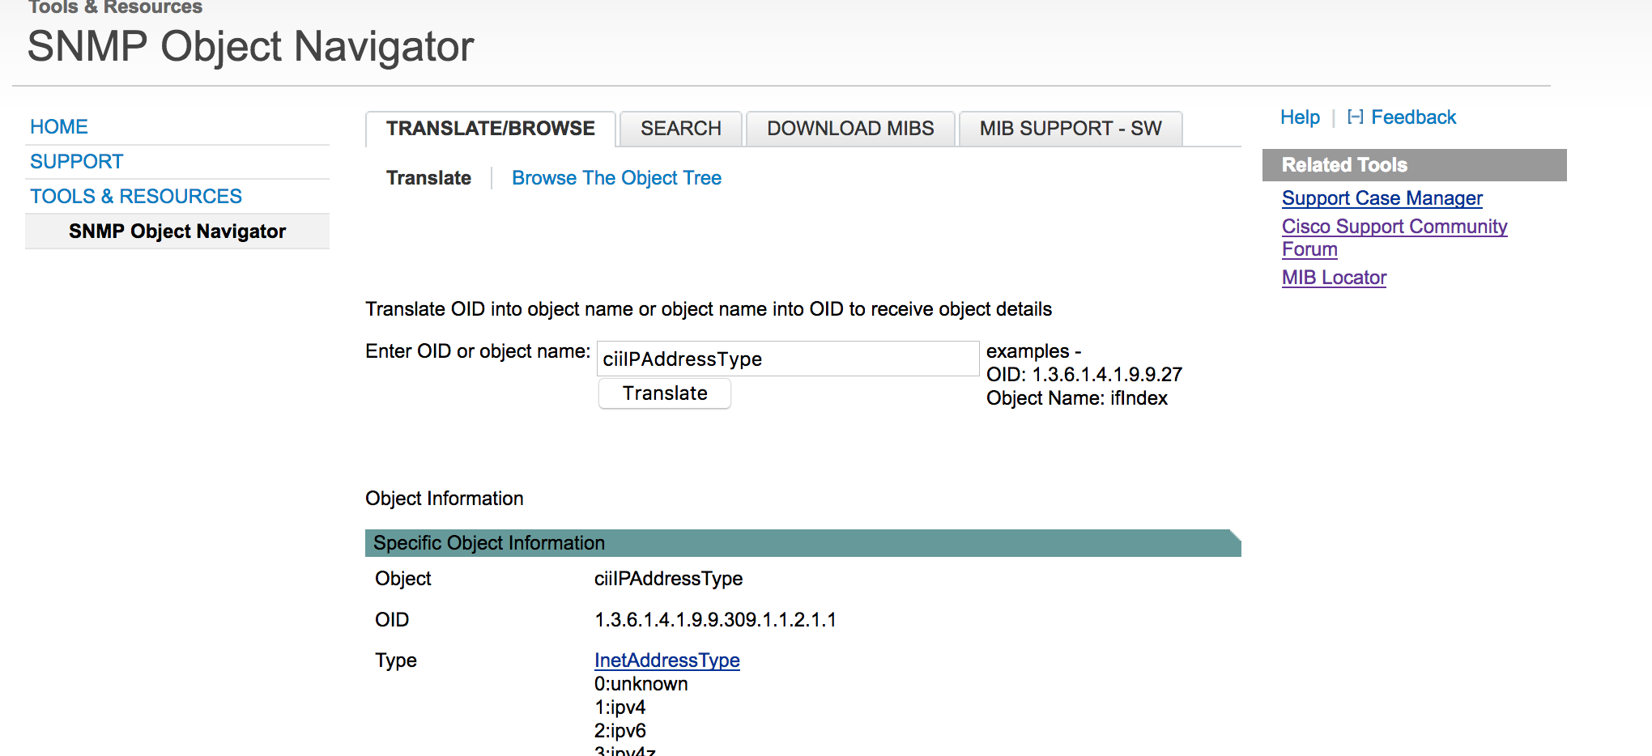

Slide 29
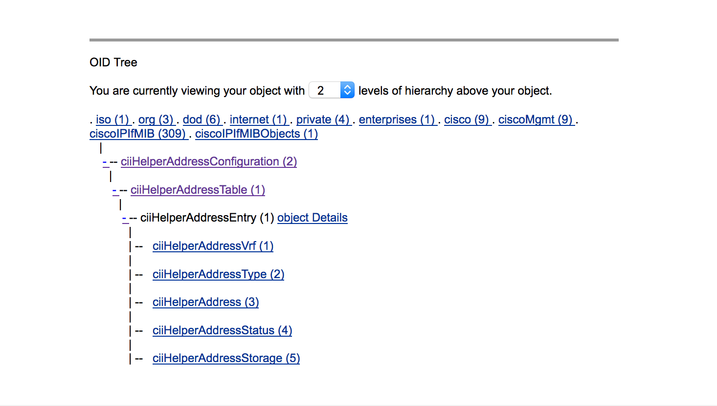

Slide 30
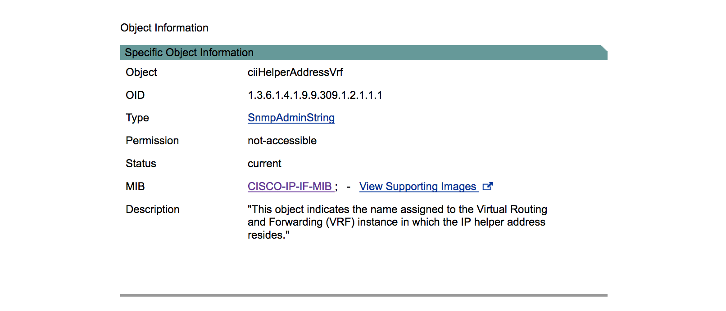

Slide 31
Example:
$ snmpwalk -Of -mALL -v2c -cpublic wlc .1.3.6.1.2.1.2 2> /dev/null | head
.iso.org.dod.internet.mgmt.mib-2.interfaces.ifNumber.0 = INTEGER: 2 .iso.org.dod.internet.mgmt.mib-2.interfaces.ifTable.ifEntry.ifIndex.1 = INTEGER: 1 .iso.org.dod.internet.mgmt.mib-2.interfaces.ifTable.ifEntry.ifIndex.2 = INTEGER: 2 .iso.org.dod.internet.mgmt.mib-2.interfaces.ifTable.ifEntry.ifDescr.1 = STRING: Unit: 0 Slot: .iso.org.dod.internet.mgmt.mib-2.interfaces.ifTable.ifEntry.ifDescr.2 = STRING: Virtual Inter .iso.org.dod.internet.mgmt.mib-2.interfaces.ifTable.ifEntry.ifType.1 = INTEGER: ethernetCsmac .iso.org.dod.internet.mgmt.mib-2.interfaces.ifTable.ifEntry.ifType.2 = INTEGER: ethernetCsmac .iso.org.dod.internet.mgmt.mib-2.interfaces.ifTable.ifEntry.ifMtu.1 = INTEGER: 1500 .iso.org.dod.internet.mgmt.mib-2.interfaces.ifTable.ifEntry.ifMtu.2 = INTEGER: 1500 .iso.org.dod.internet.mgmt.mib-2.interfaces.ifTable.ifEntry.ifSpeed.1 = Gauge32: 1000000000

Slide 32
These counters we collect from:
VS-2
VS-1
J AP’s
Server
ASR1006
K
J
Core
Info desk
AW
H
U
WLC

Slide 33
Problems of SNMP
UDP
Getnext/getbulk
No HA
Pull not push (expect delays)
Verbose packet format
Goes across data the wrong way
AAA in v3 is complex
Notes:
http://blogs.cisco.com/sp/the-limits-of-snmp

Slide 34
How we monitor: 2/2 NetFlow

Slide 35
What is NetFlow?
Actually it’s
Internet Protocol Flow Information eXport
aka IPFIX
aka FnF
aka NetFlow

Slide 36
Ok what is FnF?
With FnF you can export details about the traffic passing through an interface of the router to a ’Flow Collector’
You can filter and sample the traffic and select what details to send to which collector with a subscription model.
This is not ‘legal intercept’, so no traffic itself is captured or exported.

Slide 37
Details like?
TCP/IP tuple (source, dest, ports)

Slide 38
Details like?
TCP/IP tuple (source, dest, ports)
TCP flags, header fields

Slide 39
Details like?
TCP/IP tuple (source, dest, ports)
TCP flags, header fields
Flow statistics (packets, bytes)

Slide 40
Details like?
TCP/IP tuple (source, dest, ports)
TCP flags, header fields
Flow statistics (packets, bytes)
QoS measurements

Slide 41
Details like?
TCP/IP tuple (source, dest, ports)
TCP flags, header fields
Flow statistics (packets, bytes)
QoS measurements
VoIP performance data: jitter, drops, etc

Slide 42
Details like?
TCP/IP tuple (source, dest, ports)
TCP flags, header fields
Flow statistics (packets, bytes)
QoS measurements
VoIP performance data: jitter, drops, etc
BGP AS or neighbor information

Slide 43
Details like?
TCP/IP tuple (source, dest, ports)
TCP flags, header fields
Flow statistics (packets, bytes)
QoS measurements
VoIP performance data: jitter, drops, etc
BGP AS or neighbor information
NBAR classification and analysis

Slide 44
NBAR?
Technically NBAR2
Deep packet protocol inspection on routers
Fed from ‘protocol packs’ describing new or changed protocols.
Used to classify traffic for QoS or FnF

Slide 45
An example protocol
asr1k#show ip nbar protocol-id 4chan Protocol Name id type ---------------------------------------------- 4chan 763 L7 STANDARD

Slide 46
What can we extract?
asr1k(config-flow-record)#collect application smtp ? sender SMTP Sender Mail Address server SMTP Server Name

Slide 47
What can we extract?
asr1k(config-flow-record)#collect application http ? host Host name of Origin Server containing resource referer Address the resource request was obtained from uri List of URIs and associated hit counts url Uniform Resource Locator path user-agent Software used by agent sending the request

Slide 48
How expensive is this?
The analysis itself is fine, the ASR’s multi-processor architecture helps
Keeping track of connections uses up a lot of TCAM resources

Slide 49
Let’s look at this live…

Slide 50
How is the CPU load? On the RP?
asr1k#show processes cpu sorted 5min CPU utilization for five seconds: 97%/2%; one minute: 92%; five minutes: 80% PID Runtime(ms) Invoked uSecs 5Sec 1Min 5Min TTY Process 628 5751647 293028 19628 91.57% 85.45% 72.55% 0 SNMP ENGINE 114 1161336 26654467 43 1.92% 1.68% 1.66% 0 IOSXE-RP Punt S 295 1338510 43429 30820 0.00% 1.14% 1.34% 0 Flow Exporter T 407 584401 12761 45795 0.00% 0.43% 0.59% 0 BGP Scanner 611 61701 578969 106 0.48% 0.60% 0.59% 0 IPv6 ND 9 469199 28282 16590 0.72% 0.50% 0.50% 0 Check heaps
The first split is for interface traffic processing/control plane processing time.

Slide 51
How is the CPU load? On the CP?
asr1k#show platform software status control-processor brief
Load Average Slot Status 1-Min 5-Min 15-Min RP0 Healthy 0.79 0.72 0.64 RP1 Healthy 0.00 0.00 0.00 ESP0 Healthy 0.00 0.00 0.00 ESP1 Healthy 0.02 0.04 0.01 SIP0 Healthy 0.00 0.03 0.08 SIP1 Healthy 0.00 0.00 0.00 SIP2 Healthy 0.00 0.00 0.00

Slide 52
How is the CPU load? On the CP? (cont)
Memory (kB) Slot Status Total Used (Pct) Free (Pct) Committed (Pct) RP0 Healthy 16342672 5032196 (31%) 11310476 (69%) 11696072 (72%) RP1 Healthy 16342672 4016600 (25%) 12326072 (75%) 11690312 (72%) ESP0 Healthy 3876564 1088140 (28%) 2788424 (72%) 921056 (24%) ESP1 Healthy 3876564 1082940 (28%) 2793624 (72%) 919192 (24%) SIP0 Healthy 471812 308096 (65%) 163716 (35%) 250396 (53%) SIP1 Healthy 471812 338612 (72%) 133200 (28%) 304712 (65%) SIP2 Healthy 471812 338488 (72%) 133324 (28%) 304712 (65%)

Slide 53
How is the CPU load? On the CP? (cont)
CPU Utilization Slot CPU User System Nice Idle IRQ SIRQ Iowait RP0 0 7.30 1.90 0.00 90.60 0.00 0.20 0.00 1 27.60 1.50 0.00 70.60 0.00 0.30 0.00 RP1 0 2.80 2.00 0.00 95.20 0.00 0.00 0.00 1 1.59 1.79 0.00 96.40 0.00 0.09 0.09 ESP0 0 12.47 17.66 0.00 69.26 0.09 0.49 0.00 ESP1 0 12.58 15.78 0.00 71.02 0.19 0.39 0.00 SIP0 0 1.20 1.40 0.00 97.30 0.10 0.00 0.00 SIP1 0 3.09 1.39 0.00 95.40 0.09 0.00 0.00 SIP2 0 2.89 1.39 0.00 95.50 0.09 0.09 0.00

Slide 54
How is the CPU load? On the DP?
asr1k#show platform hardware qfp active datapath utilization CPP 0: Subdev 0 5 secs 1 min 5 min 60 min Input: Priority (pps) 14 9 10 10 (bps) 9608 9232 9960 10000 Non-Priority (pps) 149265 134495 131931 129176 (bps) 1140690592 1032720912 1014169936 1031210168 Total (pps) 149279 134504 131941 129186 (bps) 1140700200 1032730144 1014179896 1031220168 Output: Priority (pps) 728 421 420 390 (bps) 652648 407728 409936 386848 Non-Priority (pps) 126557 113798 110238 106377 (bps) 913961248 810312280 789140784 788663960 Total (pps) 127285 114219 110658 106767 (bps) 914613896 810720008 789550720 789050808 Processing: Load (pct) 8 7 7 7

Slide 55
How is the TCAM load?
asr1k#show platform hardware qfp active tcam resource-manager usage QFP TCAM Usage Information 80 Bit Region Information -------------------------- Name : Leaf Region #0 Number of cells per entry : 1 Current 80 bit entries used : 0 Current used cell entries : 0 Current free cell entries : 0

Slide 56
How is the TCAM load? (cont)
160 Bit Region Information -------------------------- Name : Leaf Region #1 Number of cells per entry : 2 Current 160 bits entries used : 148 Current used cell entries : 296 Current free cell entries : 3800 320 Bit Region Information -------------------------- Name : Leaf Region #2 Number of cells per entry : 4 Current 320 bits entries used : 144 Current used cell entries : 576 Current free cell entries : 3520

Slide 57
How is the TCAM load? (cont)
Total TCAM Cell Usage Information ---------------------------------- Name : TCAM #0 on CPP #0 Total number of regions : 3 Total tcam used cell entries : 872 Total tcam free cell entries : 523416 Threshold status : below critical limit

Slide 58
How many flows?
asr1k#show flow monitor FE-FM-IPv4 statistics Cache type: Normal (Platform cache) Cache size: 1000000 Current entries: 13997 High Watermark: 18415 Flows added: 19863507 Flows aged: 19849510 - Active timeout ( 1800 secs) 7626 - Inactive timeout ( 15 secs) 19841884 Packet size distribution (4403M total packets): 1-32 64 96 128 160 192 224 256 288 320 352 384 416 .000 .133 .008 .013 .005 .025 .007 .001 .016 .000 .000 .000 .012 448 480 512 544 576 1024 1536 2048 2560 3072 3584 4096 4608 .001 .001 .000 .000 .000 .020 .748 .000 .000 .000 .000 .000 .000 Protocol Total Flows Packets Bytes Packets Active(Sec) Idle(Sec)-------- Flows /Sec /Flow /Pkt /Sec /Flow /FlowTCP-Telnet 326922 3.4 5 791 17.7 0.4 15.5

Slide 59
How many flows? (cont)
asr1k#show flow monitor FE-FM-IPv4 statistics …
Protocol Total Flows Packets Bytes Packets Active(Sec) Idle(Sec) -------- Flows /Sec /Flow /Pkt /Sec /Flow /Flow TCP-Telnet 561022 5.4 3 689 18.8 0.4 15.5 TCP-FTP 3276 0.0 6 69 0.2 2.4 15.5 TCP-FTPD 591 0.0 1 45 0.0 0.1 15.4 TCP-WWW 1322174 12.8 74 1004 957.6 4.4 15.5 TCP-SMTP 260 0.0 2 60 0.0 2.4 15.5 TCP-X 13198 0.1 1 448 0.1 0.0 15.5 TCP-BGP 117 0.0 1 40 0.0 0.0 15.5 TCP-NNTP 753 0.0 8 230 0.0 1.1 15.5 TCP-Frag 77 0.0 21 32 0.0 13.0 15.5 TCP-other 8257760 80.3 500 1153 40196.3 4.4 15.4 UDP-DNS 7407328 72.0 1 73 78.8 0.1 15.5 UDP-NTP 171090 1.6 1 75 2.2 0.8 15.5 UDP-TFTP 154 0.0 1 40 0.0 0.0 15.4

Slide 60
What is collected?
get for a flow: 2001:07fe:0000:0000:0000:0000:0000:0053:53 -17> 2001:067c:1810:f054:0000:0000:ffff:0053:55318 get for a flow: 2001:07fe:0000:0000:0000:0000:0000:0053:53 -17> 2001:067c:1810:f054:0000:0000:ffff:0053:40506 get for a flow: 2001:067c:1810:f054:0000:0000:ffff:0053:53 -17> 2001:067c:1810:f051:f913:6325:1546:bcbc:63204 get for a flow: 2001:067c:1810:f054:0000:0000:ffff:0053:53 -17> 2001:067c:1810:f051:f913:6325:1546:bcbc:63181 get for a flow: 2001:067c:1810:f051:f913:6325:1546:bcbc:62282 -17> 2001:067c:1810:f054:0000:0000:ffff:0053:53 get for a flow: 0064:ff9b:0000:0000:0000:0000:b009:9d72:80 -6> 2001:067c:1810:f051:f913:6325:1546:bcbc:52788 get for a flow: 2001:067c:1810:f051:f913:6325:1546:bcbc:49733 -17> 2001:067c:1810:f054:0000:0000:ffff:0053:53 get for a flow: 2001:067c:1810:f055:a45a:5f85:2900:a2ef:30124 -17> 2001:067c:1810:f054:0000:0000:ffff:0053:53 get for a flow: 2001:067c:1810:f055:a45a:5f85:2900:a2ef:47471 -17> 2001:067c:1810:f054:0000:0000:ffff:0053:53g

Slide 61
How we analyze this?

Slide 62
FOS software support is … sparse
Most FnF/IPFIX collectors don’t handle the extra fields
Wrote a minimalistic perl collector to just dump the packets
Then we use awk/grep/wc/gnuplot to generate statistics

Slide 63
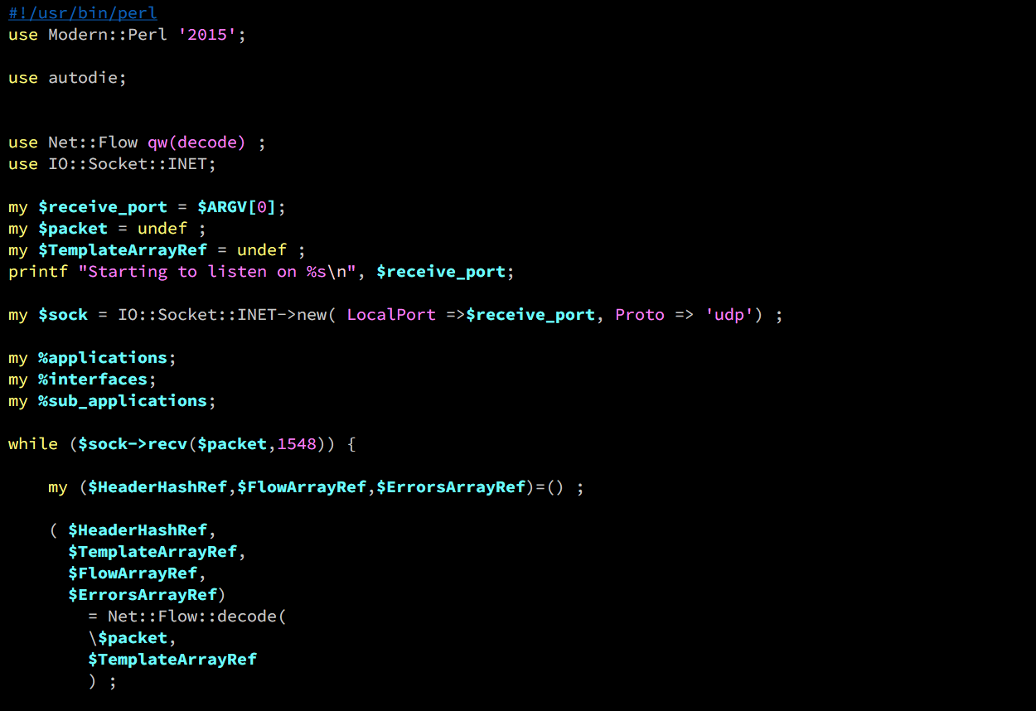

Slide 64
Back to the future… YANG and Telemetry

Slide 65
You people all know YANG/NETCONF right?

Slide 66
Recap: What’s wrong with SNMP?
Verbose (externally but also internally)
Doesn’t handle HA
UDP
Pull not push
Collects data in the wrong order

Slide 67
The solution: Telemetry
Subscription based
Efficient google Google Protocol Buffer encoding
Collect once, send to all monitoring stations
More metrics, faster

Slide 68
Models are on github:
Notes:
https://github.com/YangModels/yang/tree/master/vendor/cisco

Slide 69
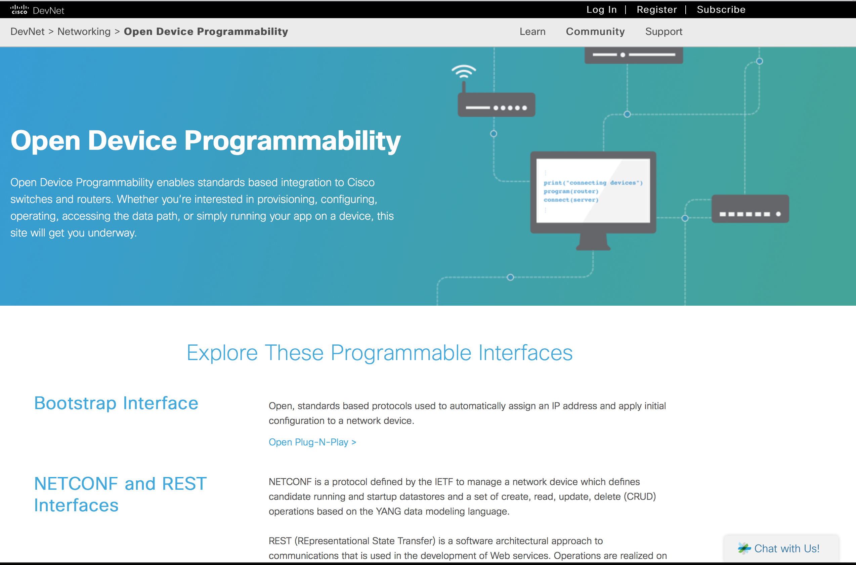
Open Device Programmability Landing Page
Notes:
https://developer.cisco.com/site/odp/

Slide 70
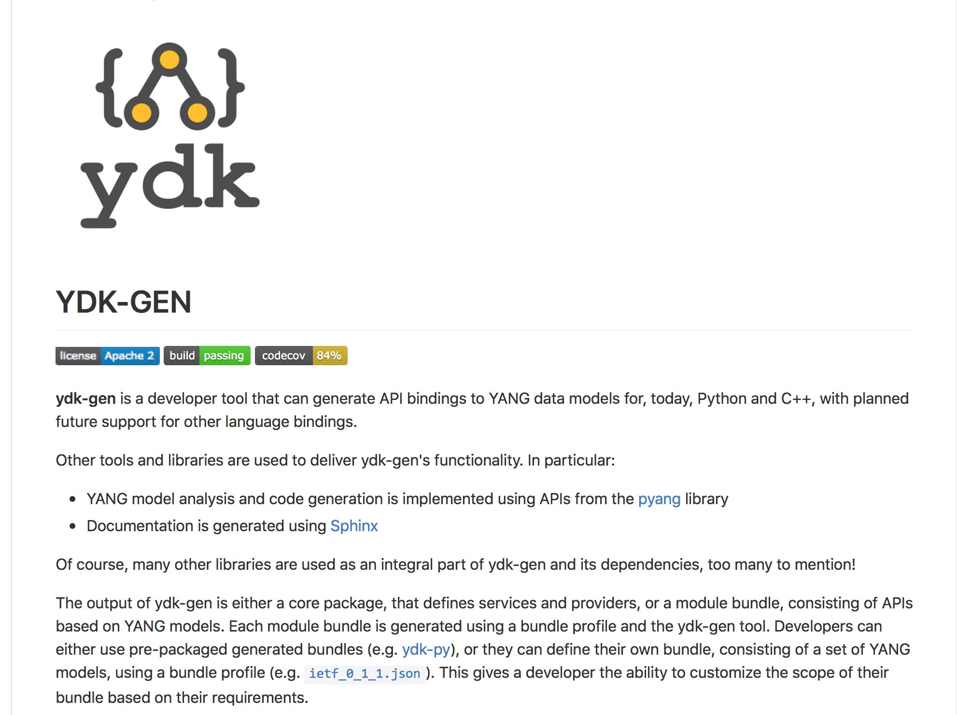
Yang development kit
Notes:
http://cs.co/ydk-gen

Slide 71
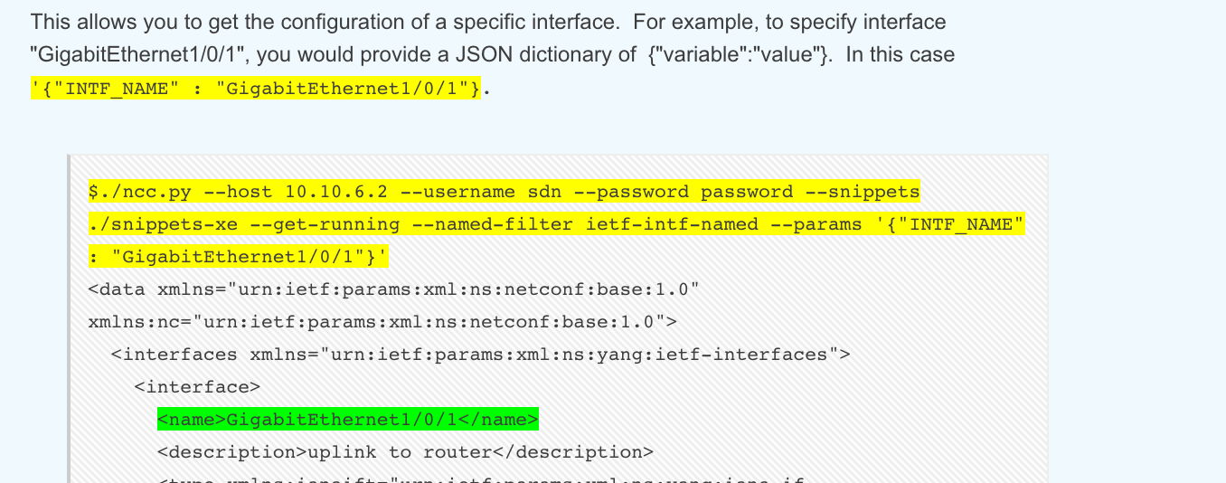
Interesting recent blogs posts
Notes:
https://communities.cisco.com/community/developer/dna/blog/2017/01/04/next-generation-network-device-programming-part1
https://communities.cisco.com/community/developer/dna/blog/2017/01/17/next-generation-network-device-programming-part2

Slide 72
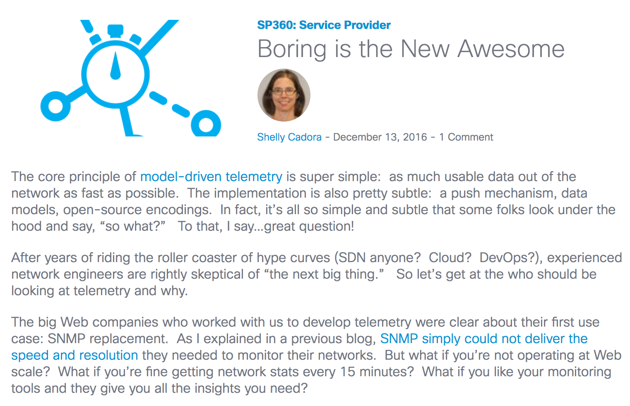
Interesting posts from the SP world:
Notes:
http://blogs.cisco.com/sp/the-limits-of-snmp
http://blogs.cisco.com/sp/boring-is-the-new-awesome

Slide 73
Programmability on IOS-XR
Notes:
https://xrdocs.github.io/

Slide 74
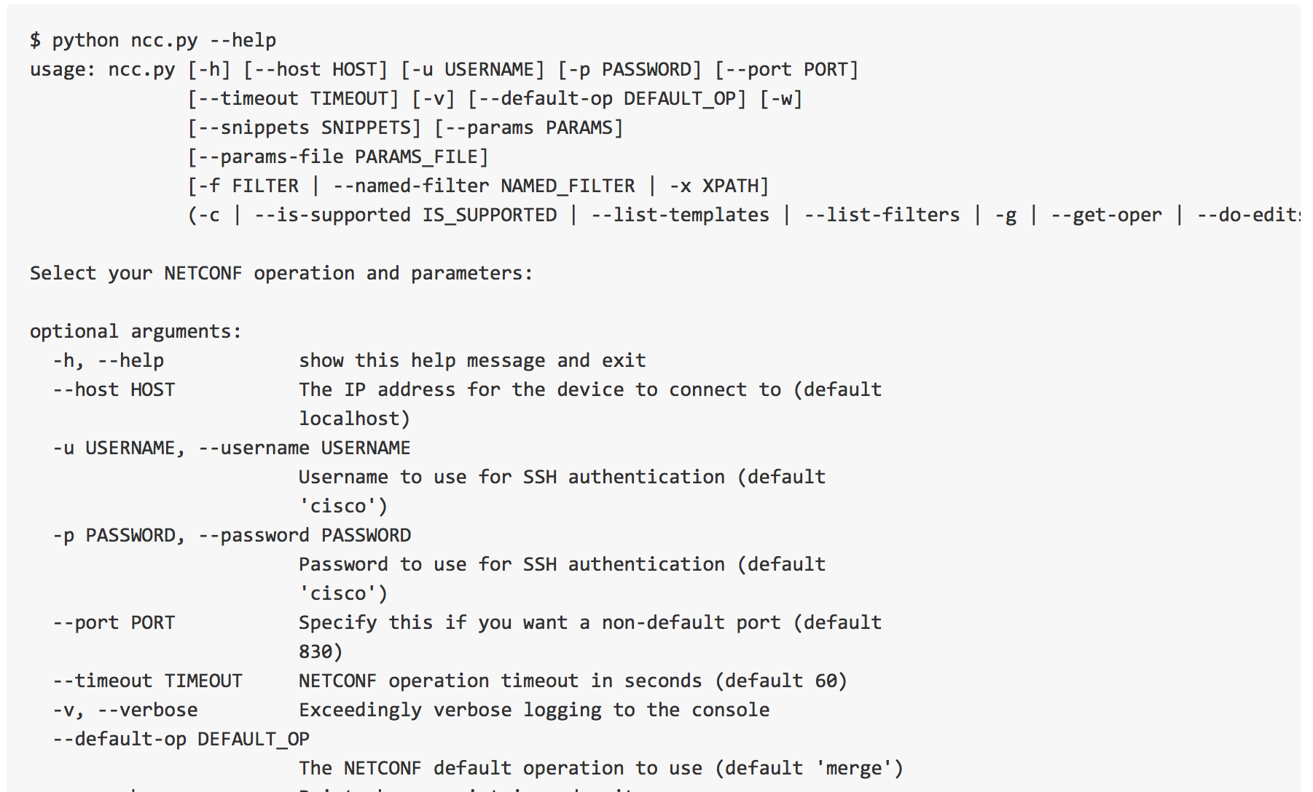
Ncc: example scripts and notebooks
Notes:
https://github.com/CiscoDevNet/ncc

Slide 75
One more thing…

Slide 76
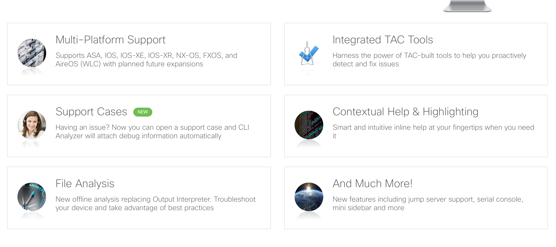
Cisco CLI Analyzer
Notes:
http://www.cisco.com/c/en/us/support/web/tools-catalog.html
https://software.cisco.com/download/type.html?mdfid=286311499&catid=null&softwareid=286312309

