Slide 1
Chips4Makers Toolchain
Is an ASIC made with fully open source
tool chain possible ?
Is it affordable ?
Staf Verhaegen

Slide 2
Overview
Chips want to be free
I have a dream
Pilot Project: Retro-uC
ASIC toolchain
PCB toolchain
Summary

Slide 3





Chips want to be free
Linux: hackers (makers) coding at night on their PC
For custom ASICs high start-up cost but now we have:
Crowdfunding
Distributed Development

Slide 4
I have a dream
Low-volume Open Source ASIC service
  ASIC production targets high-volume:
  high startup costs, low per unit costs
    Mask costs
    EDA tools license
    Engineering
    IP blocks
    The fine print is not maker friendly

Slide 5
I have a dream
Low-volume Open Source ASIC service
  Cost < €100/piece for 100+ devices/boards;
  lower prices for higher volume
    Open source RTL
    not reinvent/repay for the wheel
    Pool different chips to share set-up cost;
    use multi-project wafer services
    Push button open source EDA flow;
    not only cost but also flow innovation
    Intermediate in the legal affairs

Slide 6
Pilot Project: Retro-uC
Why ?
  Find the shape of puzzle pieces
    Start set of open source reusable RTL cores
    Open source EDA flow
    Investigate startup cost reduction and sharing potential
    Dismantling legal minefield
    (took more time then projected and continuous effort)

Slide 7
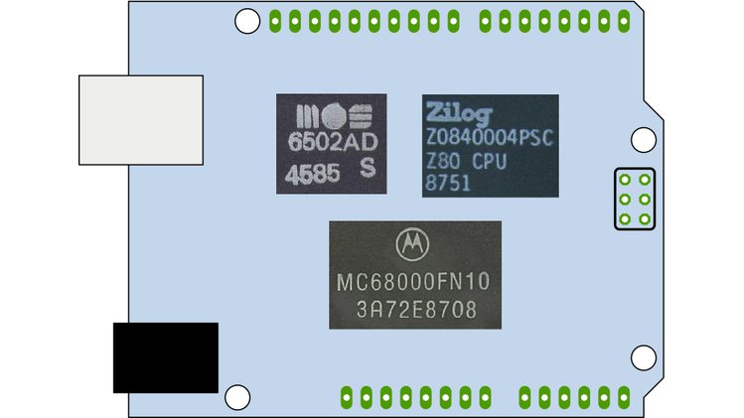
Pilot Project: Retro-uC
Retro-uC
micro-controller with Z80, MOS6502, Motorola 68000 cores
Tomorrow Talk @ Retrocomputing Devroom: Retro-uC

Slide 8
ASIC toolchain
RTL Development
Synthesis
Layout (P&R)
Sign-off
Production
Test
Product

Slide 9
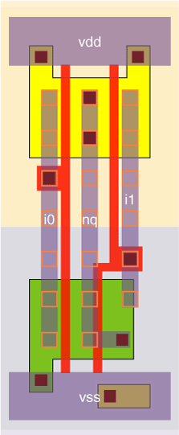
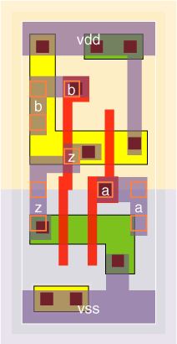
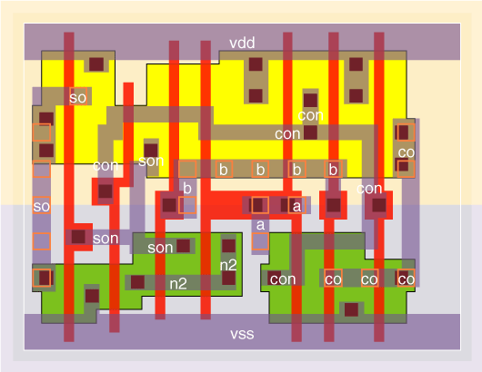
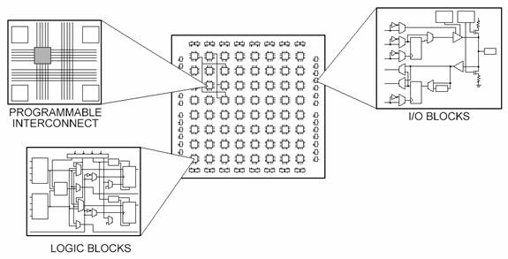
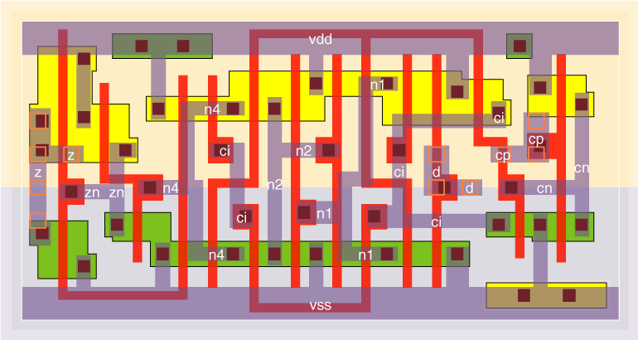
ASIC toolchain
FPGA vs ASIC
RTL Development
Synthesis
Layout (P&R)
Sign-off
Production
Test
Product
FPGA:
fixed programmable blocks
Standard cells:
small blocks with logical function
NAND2
HALFADD
Courtesy National Instruments
D-flipflop
Courtesy vlsitechnology.org

Slide 10
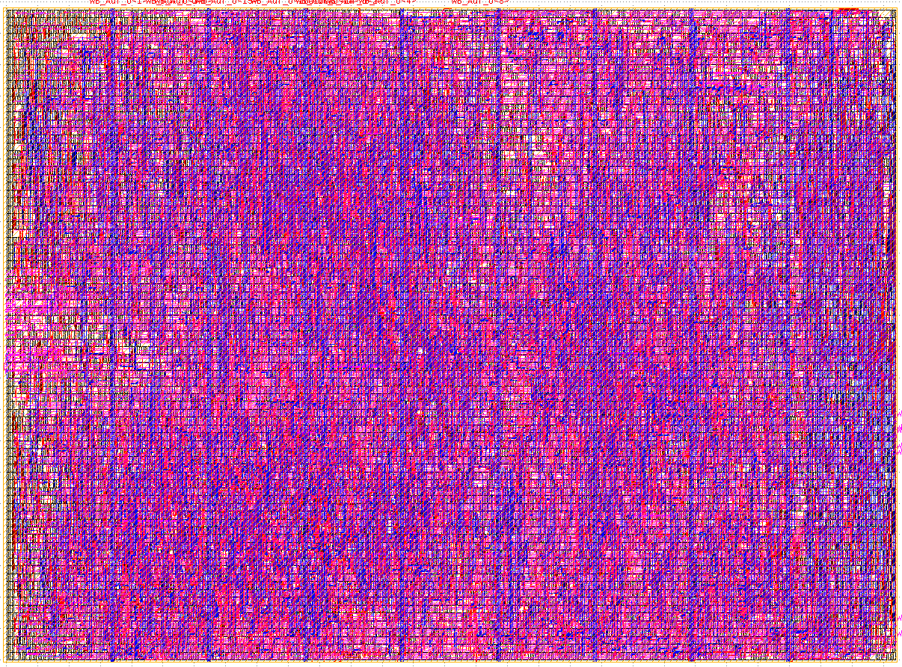
ASIC toolchain
FPGA vs ASIC
RTL Development
Synthesis
Layout (P&R)
Sign-off
Production
Test
Product
FPGA:
fixed programmable blocks
Standard cells:
small blocks with logical function
Combined on chip
Courtesy National Instruments

Slide 11
ASIC toolchain
Tasks
RTL (register transfer language):
event driven description of circuit
Entry
Simulation/FPGA
(Formal) Verification
RTL Development
Synthesis
Layout (P&R)
Sign-off
Production
Test
Product

Slide 12
ASIC toolchain
Tasks
RTL Development
Synthesis
Layout (P&R)
Sign-off
Production
Test
Product
Synthesis:
RTL → netlist of std. cells

Slide 13
ASIC toolchain
Tasks
RTL Development
Synthesis
Layout (P&R)
Sign-off
Production
Test
Product
Place
Route
CTS: clock tree synthesis

Slide 14
ASIC toolchain
Tasks
RTL Development
Synthesis
Layout (P&R)
Sign-off
Production
Test
Product
Checks if chip will work
DRC: design rule check
LVS: layout versus schematic
STA: static timing analysis
Power
LEC: logic equivalent check
IR-drop
SI: signal integrity (cross-talk)

Slide 15
ASIC toolchain
Tasks
RTL Development
Synthesis
Layout (P&R)
Sign-off
Production
Test
Product
Tape-out: send to foundry
Wait
Pay

Slide 16
ASIC toolchain
Tasks
RTL Development
Synthesis
Layout (P&R)
Sign-off
Production
Test
Product
Find design erros and
failing devices
Test pattern from ATPG
(auto test pattern generation)
Functional (stress) test

Slide 17
ASIC toolchain
IP
  T80: VHDL
  T65: VHDL
  ao68000: Verilog
=> mixed language support needed
  I think this is a general requirement if we want a vibrant open source IP portfolio
RTL Development
Synthesis
Layout (P&R)
Sign-off
Production
Test
Product

Slide 18
ASIC toolchain
Tools
  Editing
    Emacs
    Quartus (propr.)
    ISE (propr.)
  Simulation
    cocotb+iverilog: Verilog
    cocotb+GHDL: VHDL
    Modelsim (propr.): mixed language
  Looking for open source mixed language simulator
  vhdlpp for iverilog not complete, other ?
RTL Development
Synthesis
Layout (P&R)
Sign-off
Production
Test
Product

Slide 19
ASIC toolchain
Tools
  Yosys (in qflow) for Verilog
  Verific parser (propr.) in Yosys for VHDL
  PS: I’m not aware of modern open source VHDL synthesis tools.
  Alliance nor vhdl2vl could parse the cores I used.
  ghdlsynth-beta is mainly proof-of-concept.
RTL Development
Synthesis
Layout (P&R)
Sign-off
Production
Test
Product

Slide 20
ASIC toolchain
Tools
  Qflow
    Place: graywolf
    Route: qrouter
  Coriolis
    Place: Etasian
    Global router: Knik
    Detail router: Kite
Status
  Qflow: first tests show room for improvement
  Coriolis: support for standard file formats under development
  In contact with both authors (Tim Edwards and Jean-Paul Chaput) and I am convinced these problems will be solved.
RTL Development
Synthesis
Layout (P&R)
Sign-off
Production
Test
Product

Slide 21
ASIC toolchain
Did not do thorough search but feeling is that existance of open source tools is limited
  Magic: DRC/LVS support but lambda rules
  Electric: same if I remember correctly
RTL Development
Synthesis
Layout (P&R)
Sign-off
Production
Test
Product

Slide 22
ASIC toolchain
Mature technology node
  TSMC/OnSemi/…, 0.35um or 0.25um technology
  silicon cost starting from below $10000
  5V and for future high voltage,
  should still be perfect for analog designs.
Other big costs
  Subdicing of MPW dies
  Packaging setup costs
  => references welcome
RTL Development
Synthesis
Layout (P&R)
Sign-off
Production
Test
Product

Slide 23
ASIC toolchain
Implemented JTAG interface with boundary scan
I’m not aware of open source ATPG software (but did not look hard yet)
RTL Development
Synthesis
Layout (P&R)
Sign-off
Production
Test
Product

Slide 24
PCB toolchain
Design: KiCad
  Has lot’s of features but sometimes it still feels I’m fighting with the tool
Production: eurocircuits.com
  PCB production
  Assembly under beta
Test
  Eating own food: plan is to use FPGA board with Retro-uC core for test.

Slide 25
Summary
Is an ASIC made with fully open source
tool chain possible ?
Yes but renewed effort in mixed language support needed.
For smaller nodes new tools needed for sign-off and test needed.
Is it affordable ?
Should be affordable for crowdfunded low-volume projects.
Would like to reduce setup costs for packaging more.

