Slide 1
Knowledge Graph
meets
CMS

Slide 2
~$ whoami
Sander Van Dooren - Leuven, Belgium
Independent consultant @ISA
Software architecture
(complex systems, resilience engineering,...)
Mail: sander@essentialcomplexity.eu
Twitter: @sandervd
First time FOSDEM: 2007

Slide 3
ISA² - Interoperability solutions
Multiple actions that promote 'Open':
European Interoperability Framework (EIF)
European Interoperability Reference Architecture (EIRA)
Open source observatory (@OSOReu)
Joinup
Licensing assistant

Slide 4
Agenda
Knowledge graphs
CMS – Drupal
System architecture
Conclusions
Q&A

Slide 5
Knowledge graphs

Slide 6
What is a knowledge graph?
Set of facts (triples or statements)
AW1.120 is a room in ULB
ULB has address Avenue Franklin Roosevelt
Knowledge graph (~2020) == semantic web (~2010)
Now with tooling
Linked (Open) Data, SemWeb, knowledge graph, RDF

Slide 7
W3C standards
RDF – Resource description framework
How to make statements
RDFS/OWL
Data models
SPARQL
Query language for Triplestore databases
RDF is to information what HTML is to documents

Slide 8
Resource Description Framework
ID | Name | Style
1 | Rochefort 10 | Trappist
2 | Delvaux | Blonde
3 | Orval | Trappist
Subject | Predicate | Object
http://beer/id/1 | http://beer/name | Rochefort 10
http://beer/id/1 | http://beer/style | http://beer/style#trappist
http://beer/id/2 | http://beer/name | Delvaux
http://beer/id/2 | http://beer/style | http://beer/style#blonde
http://beer/id/3 | http://beer/name | Orval
http://beer/id/3 | http://beer/style | http://beer/style#trappist
Subject (uri) - Predicate (uri) - object (uri/XML types)

Slide 9
What is the big deal?
The magic is in the URIs
Data merges like water:
cat file1.ttl file2.ttl > merged.ttl
Applications can ignore facts (application profiles)
RDF can be represented in:
RDF/XML
JSON-LD
Turtle, N3
RDFa

Slide 10
Why?
The data-centric manifesto
Applications are allowed to visit the data
Elegant data model (ontology) extension (application profiles)
Integrate multiple data sources
Interoperability
Reference data

Slide 11
Chatbots
Interactive assistants (Amazon telescreens)
Improve google search

Slide 12
Database
Triplestore
Queried with SPARQL
SELECT ?trappist
WHERE
{ ?trappist <http://beer/style> <http://beer/style#trappist> }
Start at Wikidata

Slide 13
Content management with Drupal

Slide 14
Project - Joinup
Catalogue of re-usable solutions (FOSS, open standards, …)
Federated portal
Harvesting data from multiple EU member states
Standardized data model (ADMS)
Open Source under EUPL license (GPL compatible)

Slide 15
Requirements
FOSS (code on GitHub)
Drupal
Publish as Open Data
Harvesting of other catalogs (CTT)
Stay compatible with Drupal ecosystem

Slide 16
Drupal work
A database abstraction layer
'ORM': store Drupal entities as triples
Drupal query API implementation: SPARQL
Content entity implementation (like Drupal nodes)
Taxonomy support (mapping Drupal taxonomies to SKOS)
No linked data concepts used outside the infrastructure layer!

Slide 17
Drupal work
Public SPARQL-endpoint
Content negotiation (demo)
Harvester (Open Source, not contributed as Drupal module)
A lot of work on Drupal core and contrib
e.g. numeric to URI identifiers

Slide 18
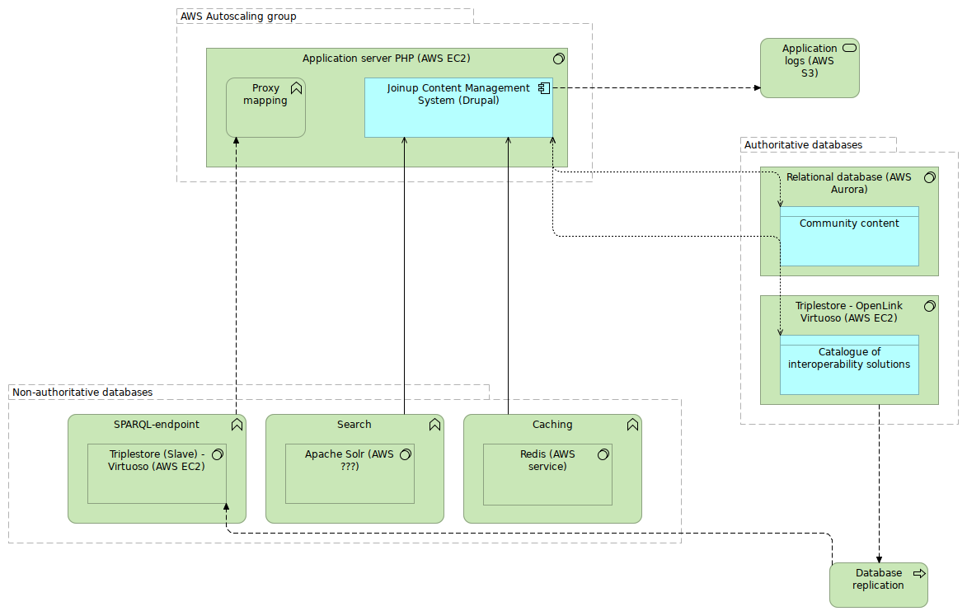

Slide 19
Lessons learned
Objects: Redis, Queries: Apache Solr index
Revisions: still a bit problematic
Potential for large organizations
Application profiles, reference data
Excellent for data integration
Working with reference data is a joy

Slide 20
Q&A

Slide 21
ISA² programme
You click, we link!
Stay in touch
ec.europa.eu/isa2
@ EU_isa2
ISA² Programme
DIGIT-ISA2-COMM@ec.europa.eu
Run by the Interoperability Unit at DIGIT (European Commission) with 131€M budget, the ISA² programme provides public administrations, businesses and citizens with specifications and standards, software and services to reduce administrative burdens.

Slide 22
Resources
Code: https://github.com/ec-europa/joinup-dev
The semantic web for the working ontologist
Learning SPARQL

