Slide 1
Runtime Strategies and Task Scheduling of Software-Defined Radio on Heterogeneous Hardware
Is an accelerator always the best option?
Joshua Mack

Slide 2
Who are we?

Slide 3
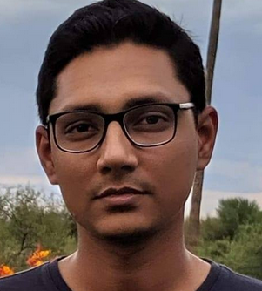
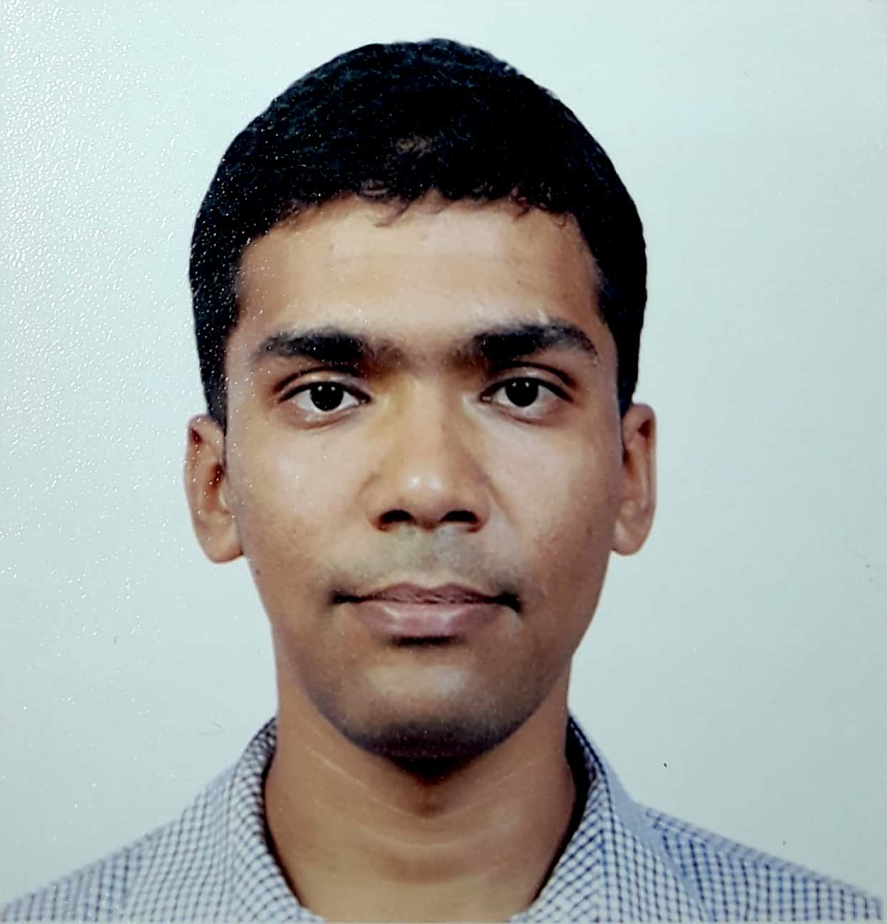
Who are we?
Joshua Mack
Advisor:
Ali Akoglu
Sahil Hassan
Advisor:
Ali Akoglu
Samet Arda
Supervisor:
Dan Bliss
Anish NK
Advisor:
Umit Ogras
Nirmal Kumbhare
Supervisor:
Ali Akoglu
Miguel Castro
Advisor:
Ali Akoglu
Liangliang Chang
Advisor:
Chaitali Chakrabarti

Slide 4
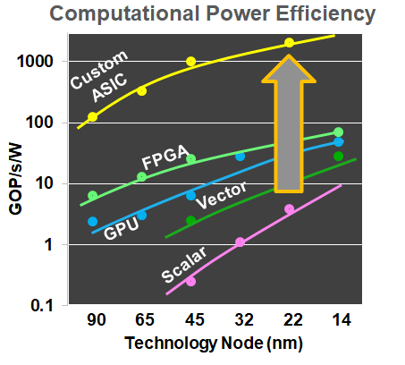
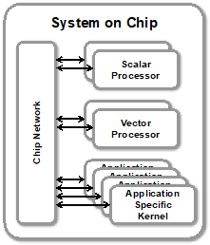
Motivation
“General Purpose” heterogeneous chip? No
Domain specific; focus on tooling & ease of use
A methodology for designing DSSoCs
Notes:
It’s really easy to build a complicated system that performs great but no one wants to use
“General purpose heterogeneous” is a bit of an oxymoron -- it’s not going to happen.
Mobile devices in particular have strict perf/watt requirements and are an excellent target for increasing heterogeneity
The space of all heterogeneous programs is large, but if you restrict to a domain, then particular optimization opportunities may open up, and we want to explore/are exploring those
Heterogeneous system design challenges from software point of view

Slide 5
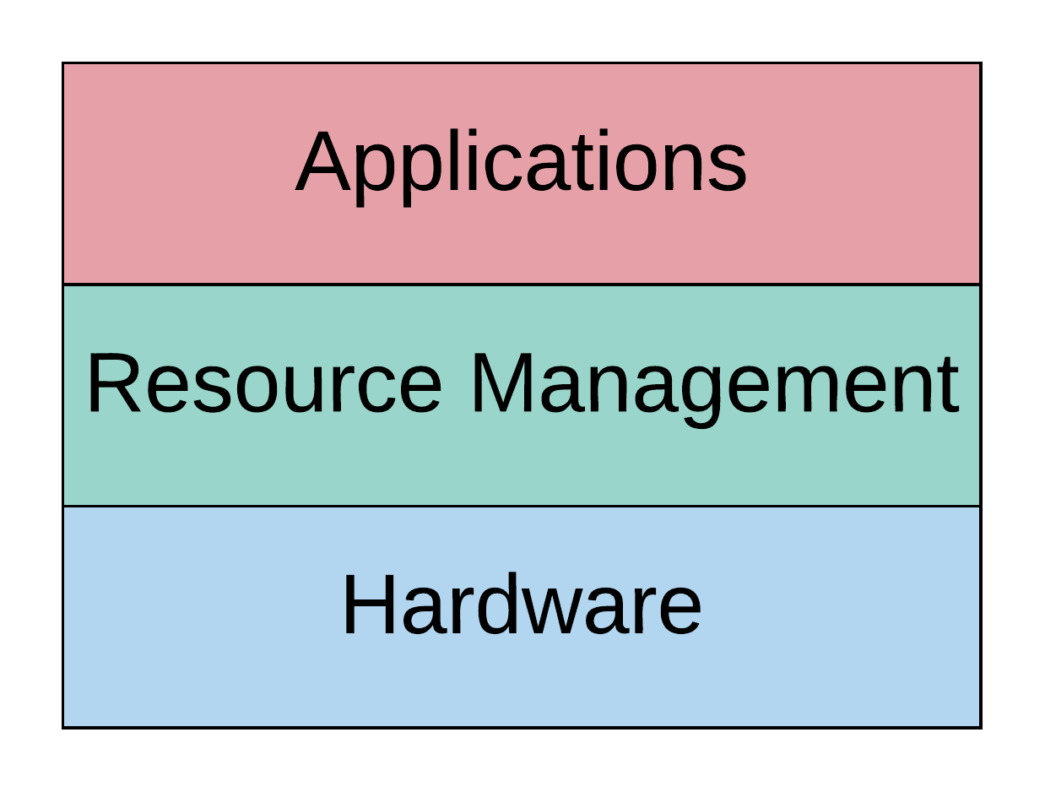
Challenges of DSSoCs
How do we integrate new applications?
How do you debug accelerators?
What are we scheduling?
How do we launch work on accelerators?
What accelerators do we have?
Notes:
From a software developer’s point of view, it’s broadly speaking been possible to view computing as the interaction of three distinct components: the hardware, an overlay program that manages the hardware and provides nice interfaces (typically the operating system), and the user applications running on top of that. We think this is a good model -- we don’t want to get rid of it -- but when you think about this in the context of building a DSSoC, you can find yourself asking a lot of questions
What accelerators?: what processors do you want to have for your applications of interest, and how do you want to connect them all together? Is is going to be an on-chip network? How do you transfer data between nodes? Direct transfer? DMA access intermediated by DRAM?
How do we launch work on accelerators?: with all the accelerators defined, how do you actually provide work to them in some normalized way?
What is our unit of scheduling?: operating systems are built around threads and execution contexts as their baseline schedulable unit. An accelerator doesn’t even necessarily have a program counter or stack pointer or any coherent unit of execution context. How do we deal with that?
How do we integrate new applications?: CPUs have been wildly abstracted away from users at this point, but for general purpose accelerators, not so much. A traditional approach might be to just give the hardware to the user, give them a complex datasheet, and they’ll give up. How can we provide meaningful software interfaces with our DSSoC that abstract away difficulties without hindering its capabilities?
How do we package application binaries?: in a general purpose environment where the execution platform isn’t known statically at compile time, binaries need to be built a bit differently
Compilation of binaries for incompatible/widely varied architectures is difficult.
(What debugging look like in this? - maybe at the end in future work)
Why are we here? We want to contribute to the community

Slide 6
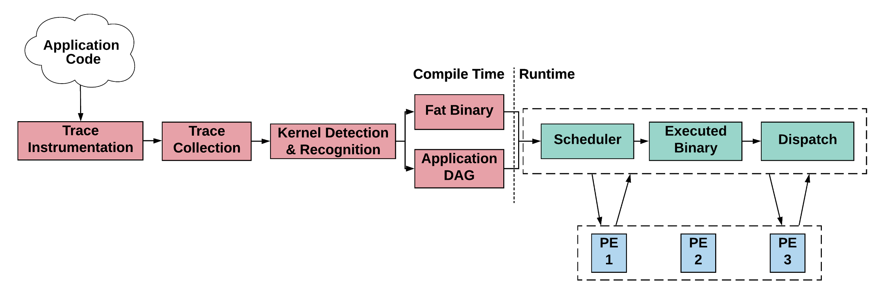
Our Envisioned Architecture (So Far)

Slide 7
FOSDEM ‘20
Discussed at last year’s FOSDEM in the LLVM devroom: https://archive.fosdem.org/2020/schedule/event/llvm_aut_prog_het_soc/
How do we integrate new applications?

Slide 8
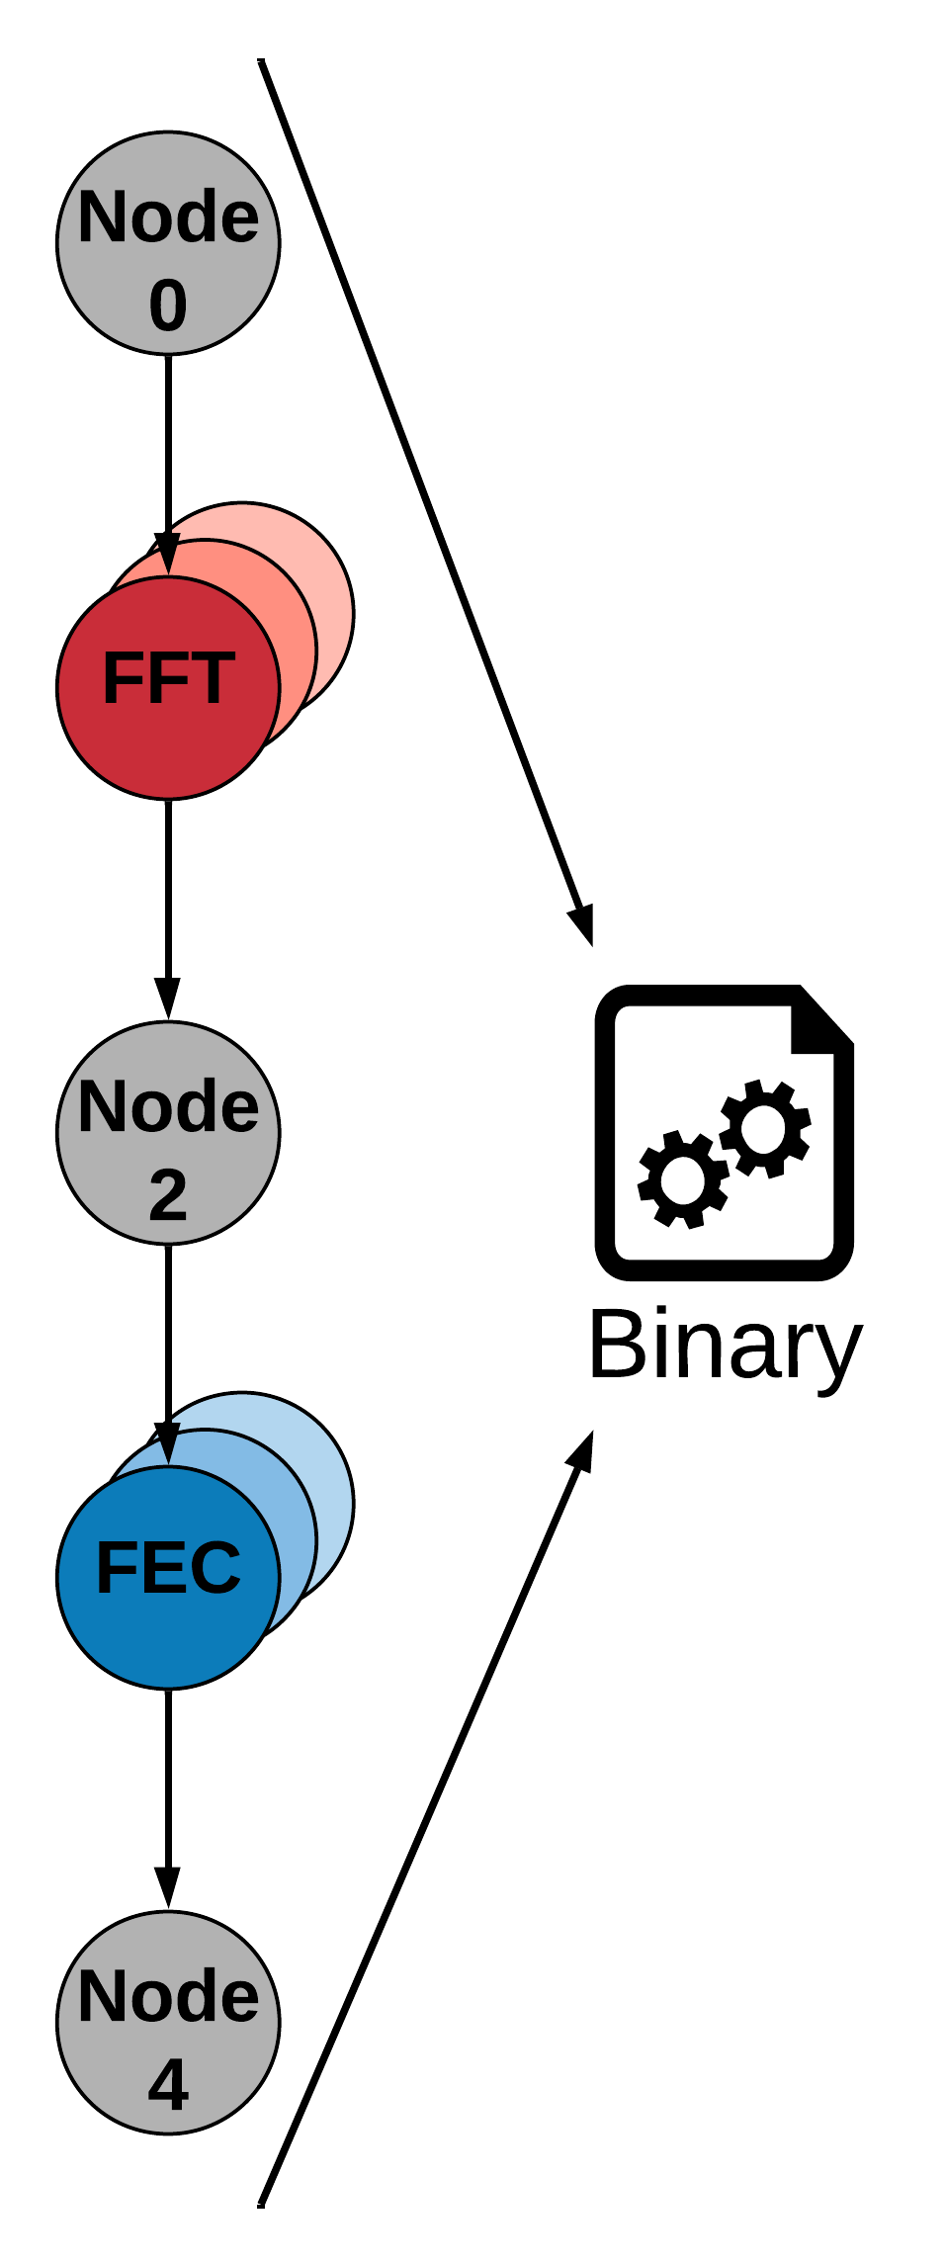
FOSDEM ‘20

Slide 9
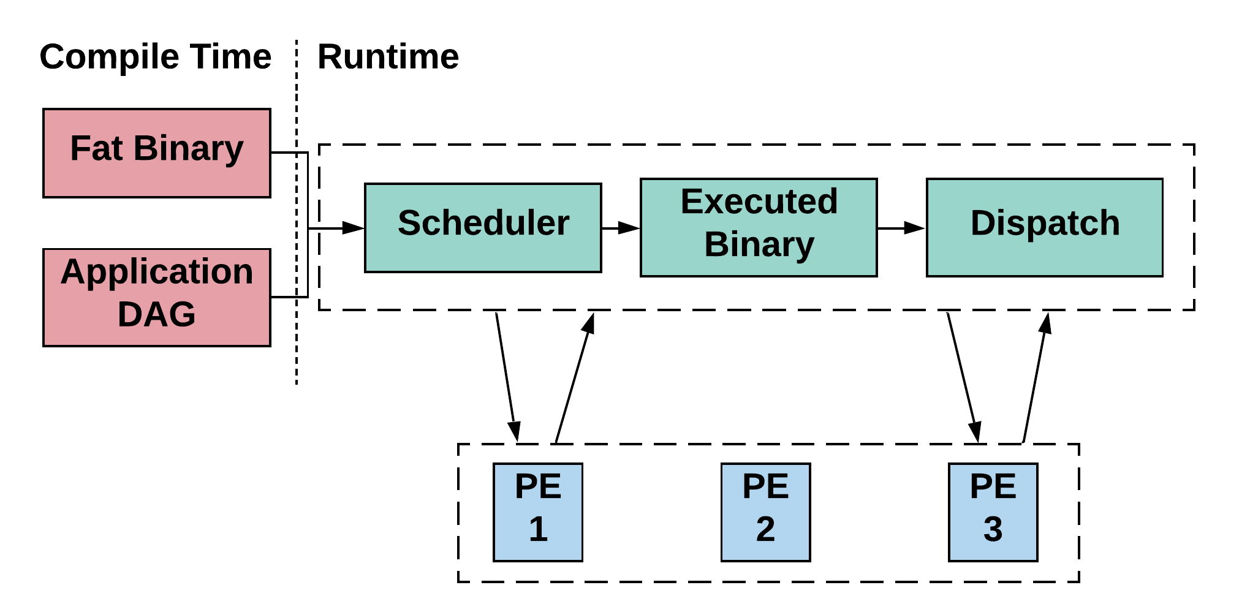
FOSDEM ‘21
How do we schedule & launch work onto a pool of heterogeneous resources?

Slide 10
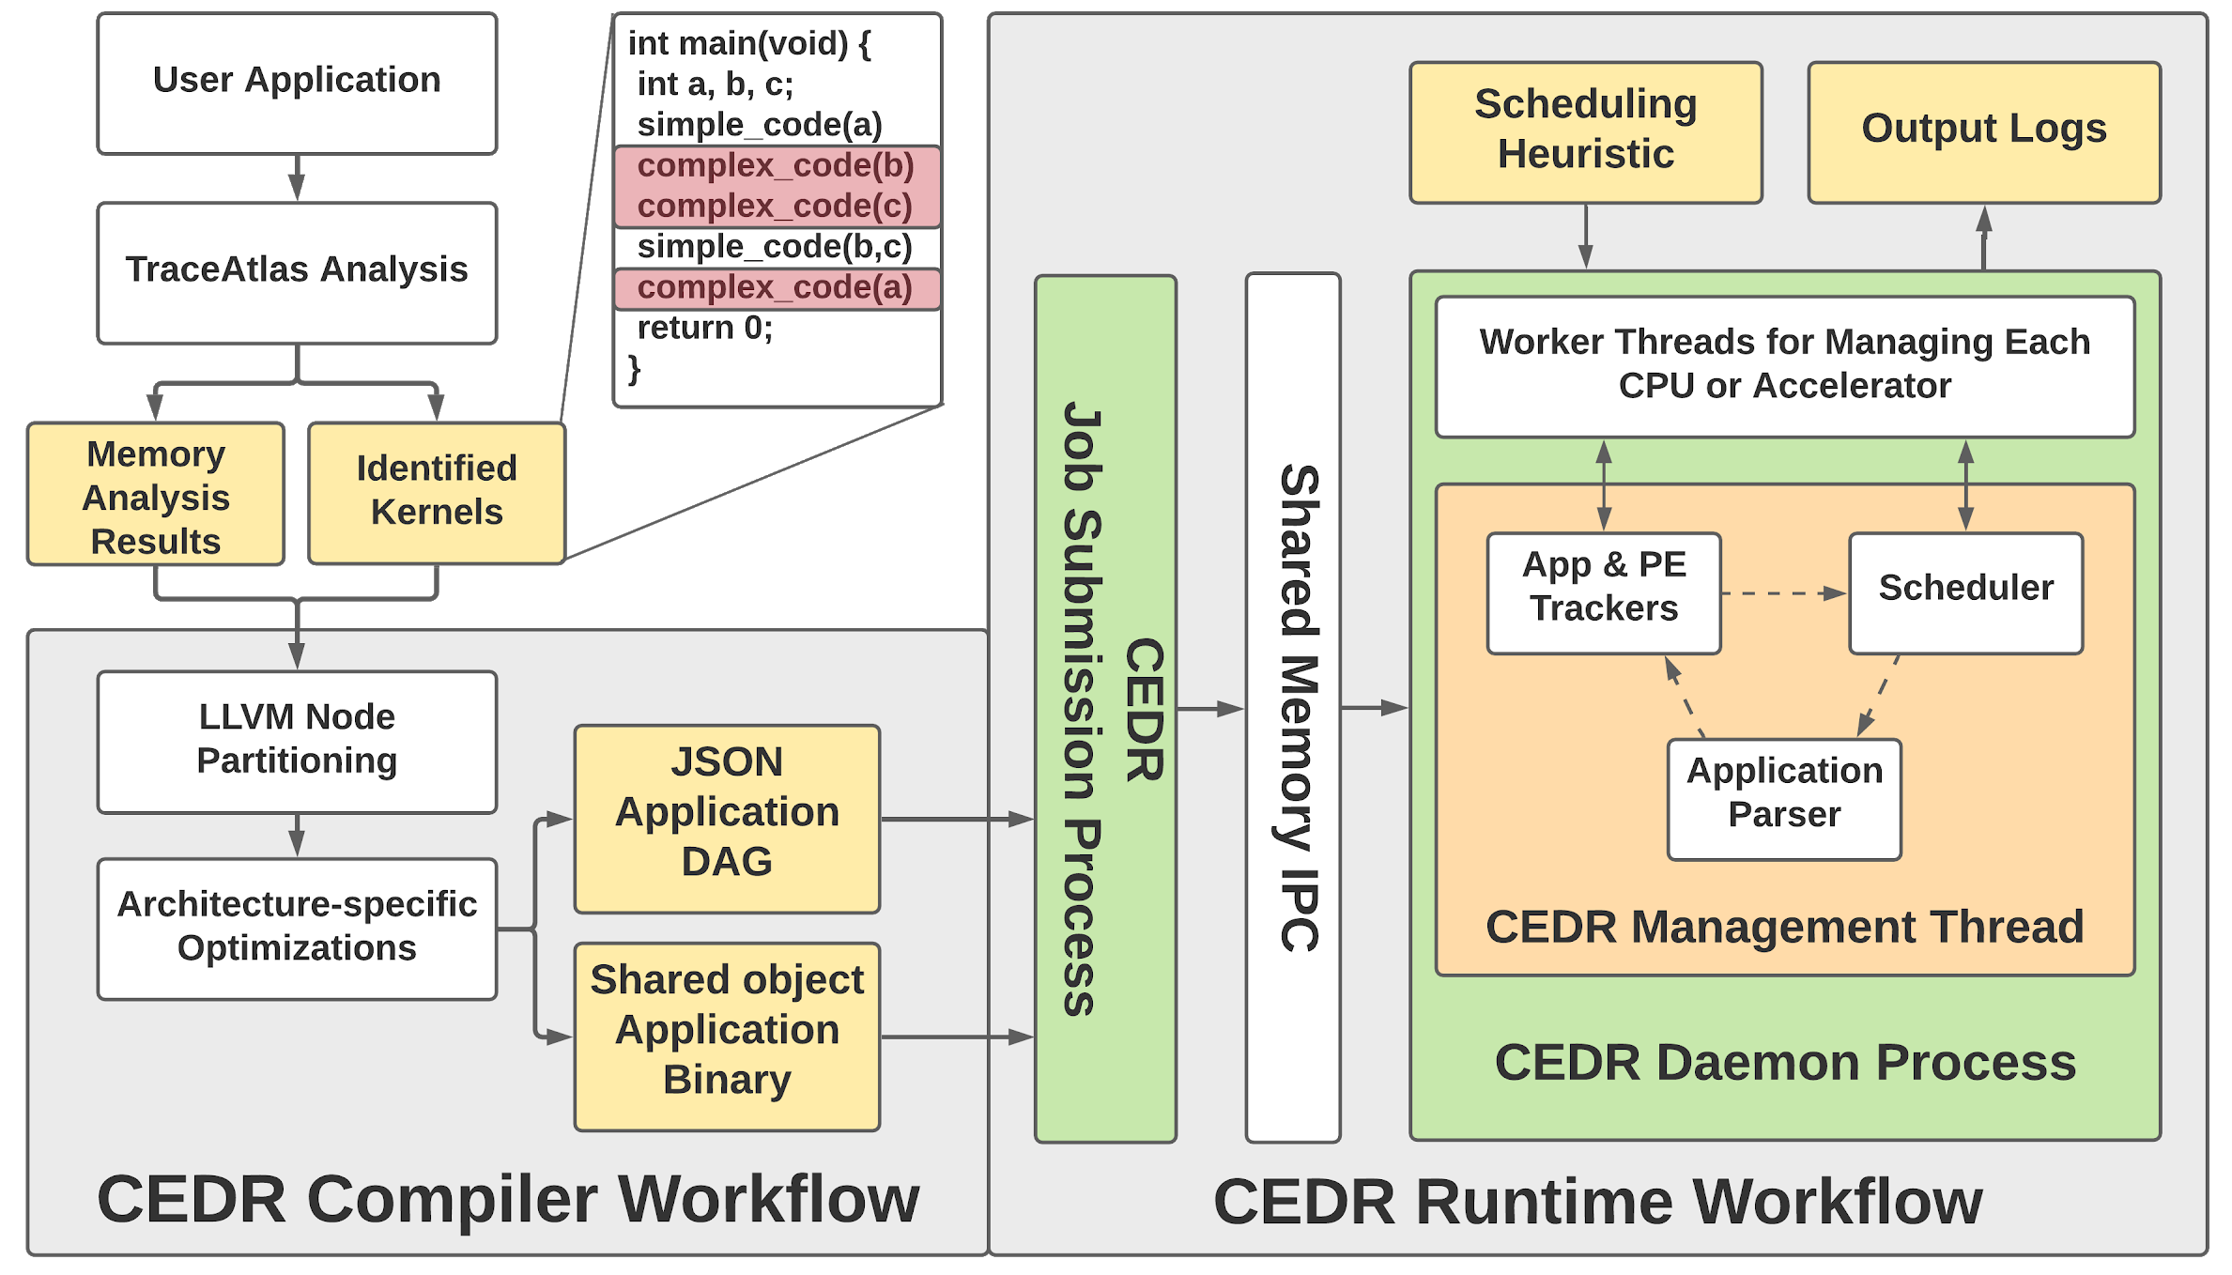
CEDR - Compiler Integrated, Extensible DSSoC Runtime
Key Features:
Userspace runtime compatible with any linux-based system
Supports allocation and scheduling for arbitrary mixtures of task-based workloads
Provides hooks for easy integration of new applications, schedulers, and hardware accelerators
Allows for collection of detailed execution statistics and hardware counters about task executions
https://ua-rcl.github.io/CEDR
https://github.com/UA-RCL/CEDR
Notes:
CEDR: Compiler-Integrated Extensible DSSoC Runtime
Describe the key architecture (“CEDR is composed of a daemon process along with two helper processes that allow the user to submit jobs or halt the daemon’s execution”)
Key Features
Supports arbitrary mixtures of workloads
Streaming workloads
Rapid accelerator/scheduler integration
PAPI Counters
B
C
D

Slide 11
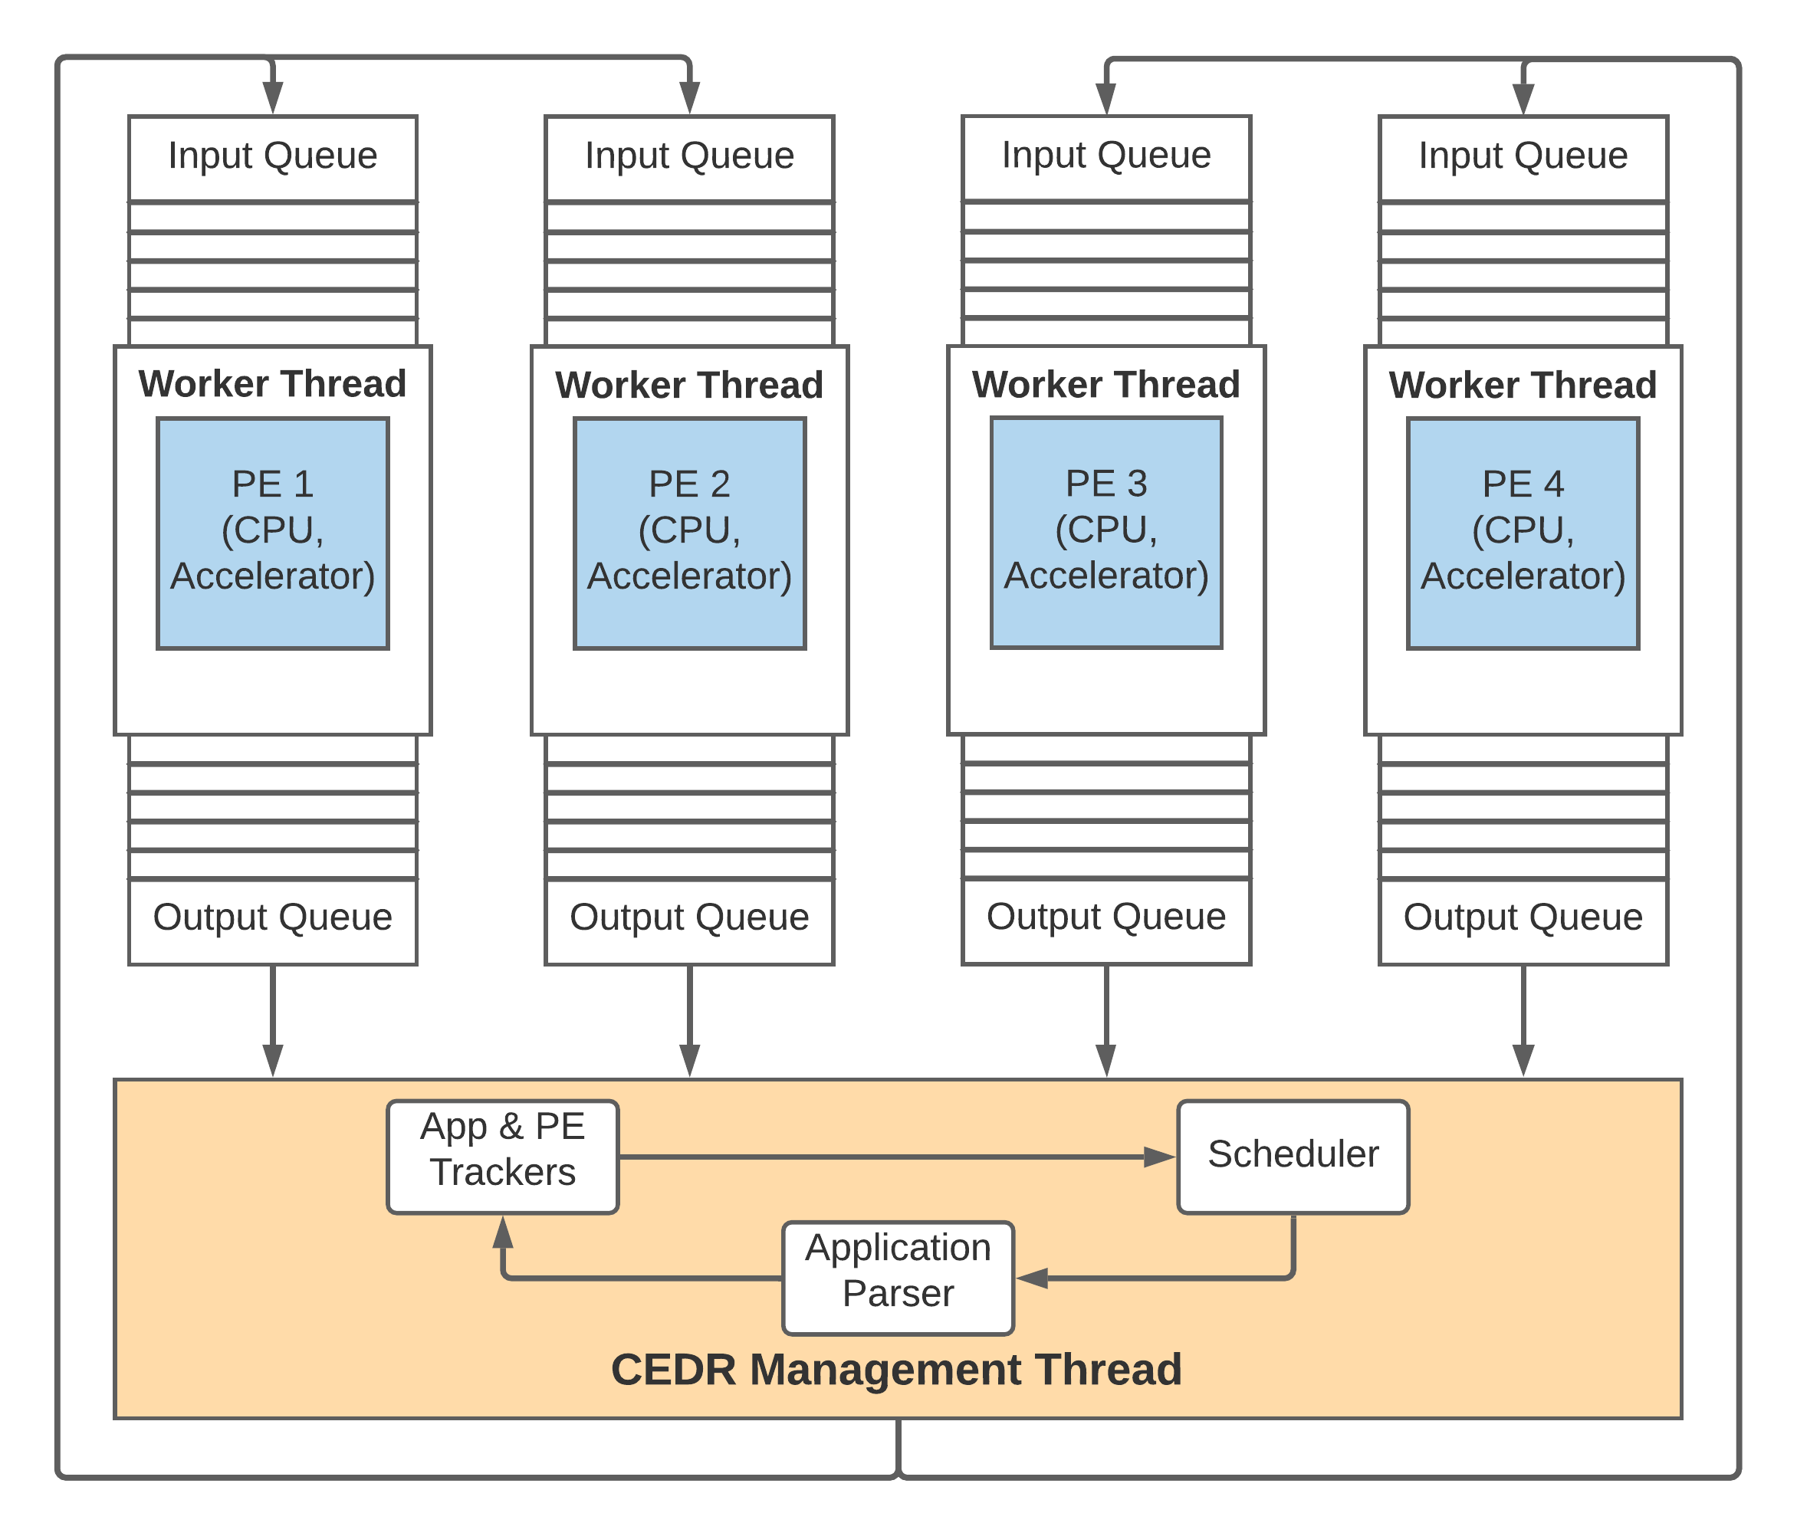
CEDR - Runtime Process Overview
Notes:
“The daemon works by spawning one thread-per-PE in the underlying hardware, where each thread is responsible for managing the workload of its associated PE”

Slide 12
CEDR - Current State
Applications tested:
Radar correlator, pulse-doppler Radar, WiFi TX, WiFi RX, temporal interference mitigation, “RF convergence” (combination of comms + radar)
Scheduling policies implemented:
Round-Robin, Random, Minimum Execution Time (MET), Earliest Finish Time (EFT), Imitation Learning (IL) based either on Deep Neural Networks or Regression Trees⁽¹⁾
Accelerators integrated:
FFT (256Pt, 2048Pt complex), matrix multiplication
Hardware architectures evaluated:
Various Intel x86 platforms, Xilinx Zynq Ultrascale+ ZCU102, Odroid XU3
(1) A. Krishnakumar et al., "Runtime Task Scheduling Using Imitation Learning for Heterogeneous Many-Core Systems," in IEEE Transactions on Computer-Aided Design of Integrated Circuits and Systems, vol. 39, no. 11, pp. 4064-4077, Nov. 2020, doi: 10.1109/TCAD.2020.3012861.
Notes:
Types scheduling policies we have implemented, accelerators we’ve tested, and applications we’ve run

Slide 13
CEDR - Basic Usage - Demo
Notes:
Demo goals:
Show how to use CEDR, including “help” output for ./cedr and ./sub_dag commands
Show the compiled app binaries
Show the app JSON
Go over the config file and connect it to the previous discussions
Run one instance of WiFi TX to show what it looks like, go over the timing log
Run 20 instances and plot a gantt chart

Slide 14
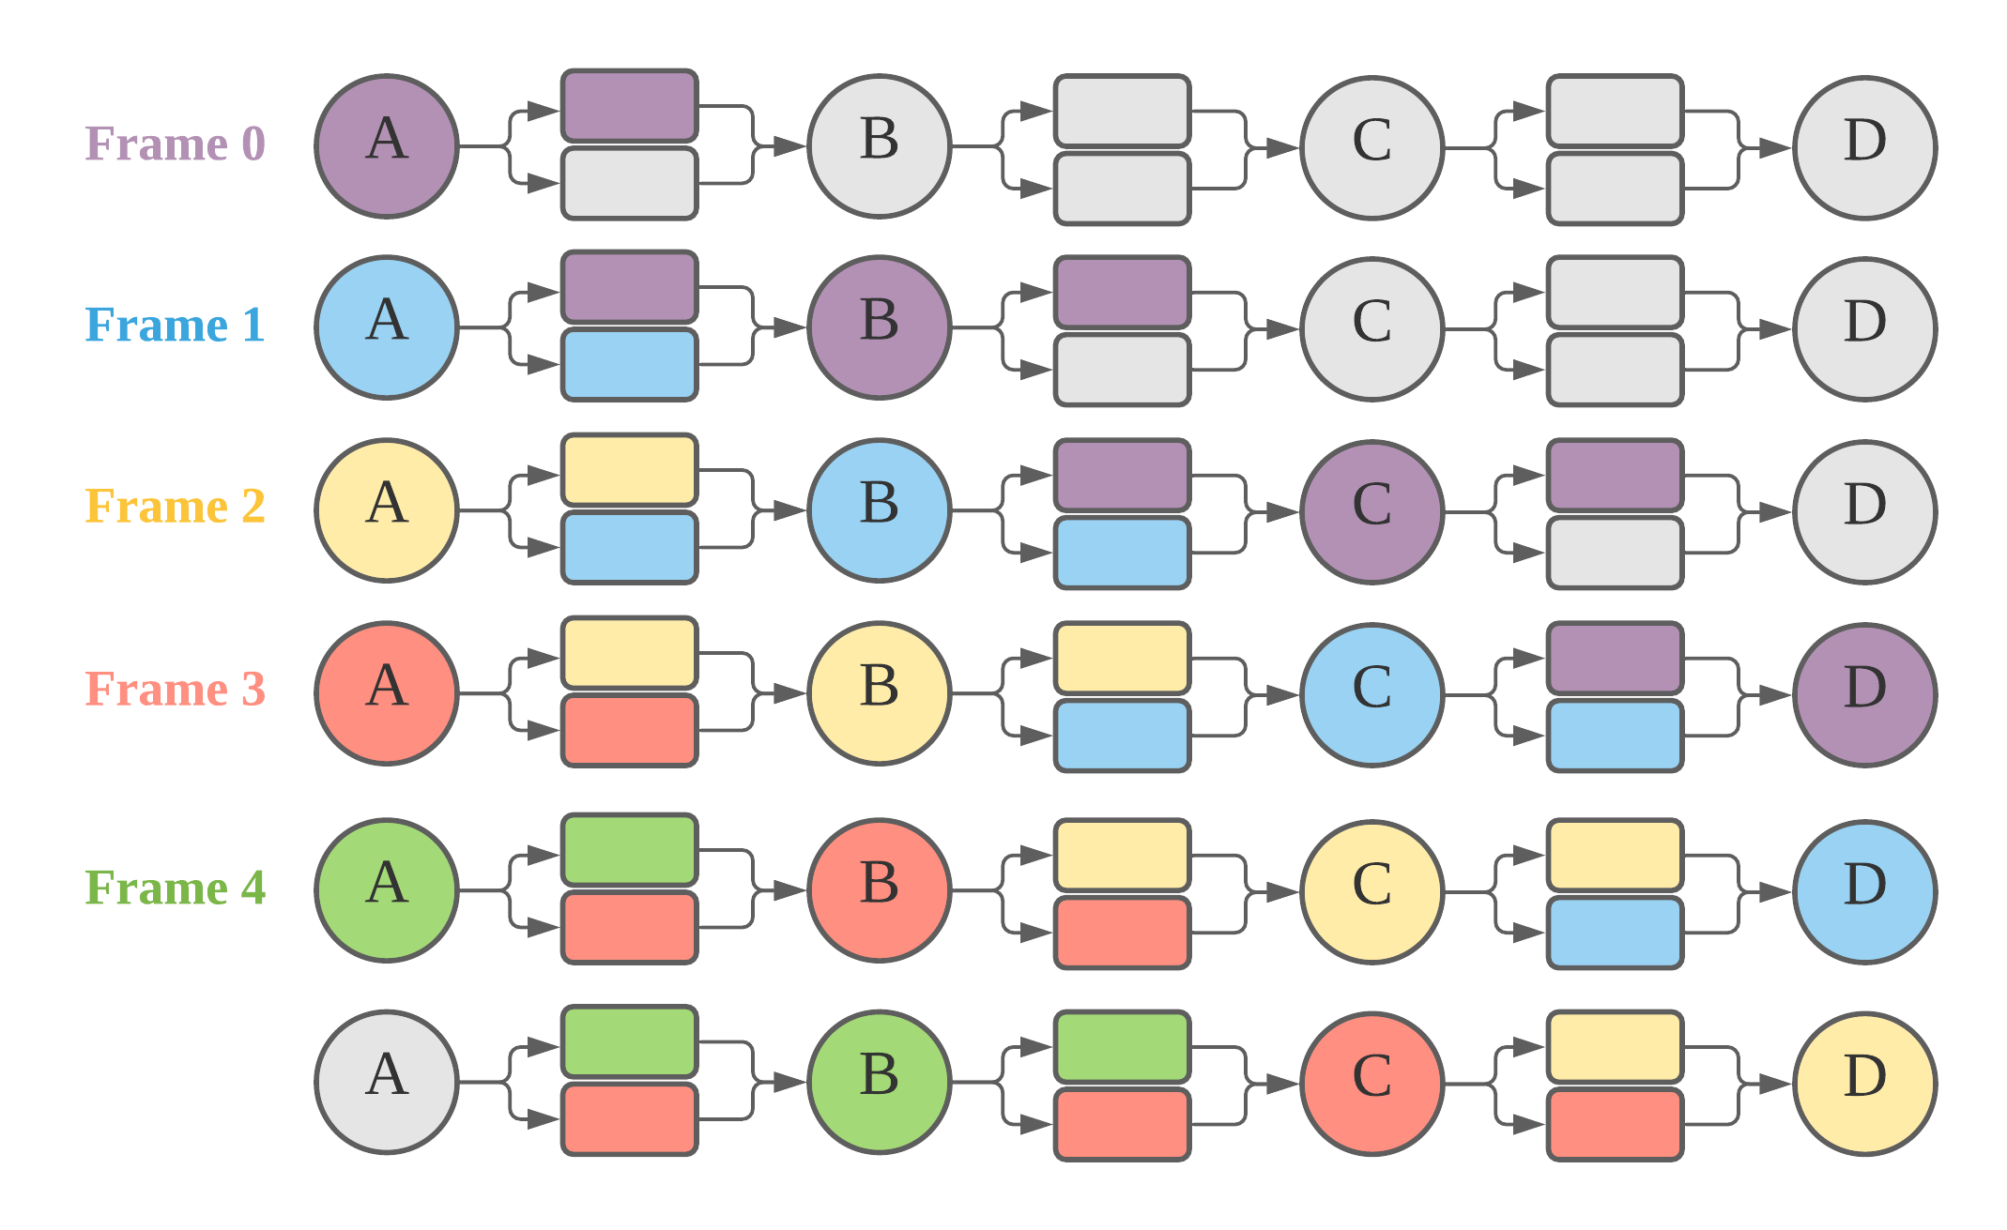
CEDR - Streaming
Motivation
RF applications operate on steady stream of input frames
Enhancements
Inter-node communication buffers for streaming based execution
Reduced memory initialization overhead
Increased throughput and resource utilization

Slide 15
CEDR - Streaming - Demo

Slide 16
CEDR - PAPI Counters + Workload Profiling
Enables low-level performance profiling and workload characterization without changes in the user code at the granularity of individual kernels/DAG nodes
Xilinx ZCU102: 113 different performance counters
perf::INSTRUCTIONS, perf::CACHE-MISSES, perf::BRANCHES, perf::STALLED-CYCLES-FRONTEND …
Application (aarch64) | Total Instructions | Branches (%) | Branch Miss Rate (%) | L1 Dcache Loads (%) | L1 Dcache Miss Rate (%)
RF Convergence | 12,499,388,090 | 12.51841421 | 0.123051641 | 48.48505961 | 0.052480327
WiFi TX | 4,296,072 | 9.011836859 | 4.634319588 | 40.15528604 | 0.22016115
Temporal Mitigation | 3,624,745 | 9.952286299 | 3.874204771 | 37.47011169 | 0.306141382
Radar Correlator | 1,430,563,533 | 9.878737766 | 3.813579267 | 34.91474328 | 0.032470326
Notes:
Lays the groundwork for future advancements in leveraging accelerator-integrated performance counters to make more informed profiling and scheduling decisions

Slide 17
CEDR - PAPI Counters + Workload Profiling - Demo

Slide 18
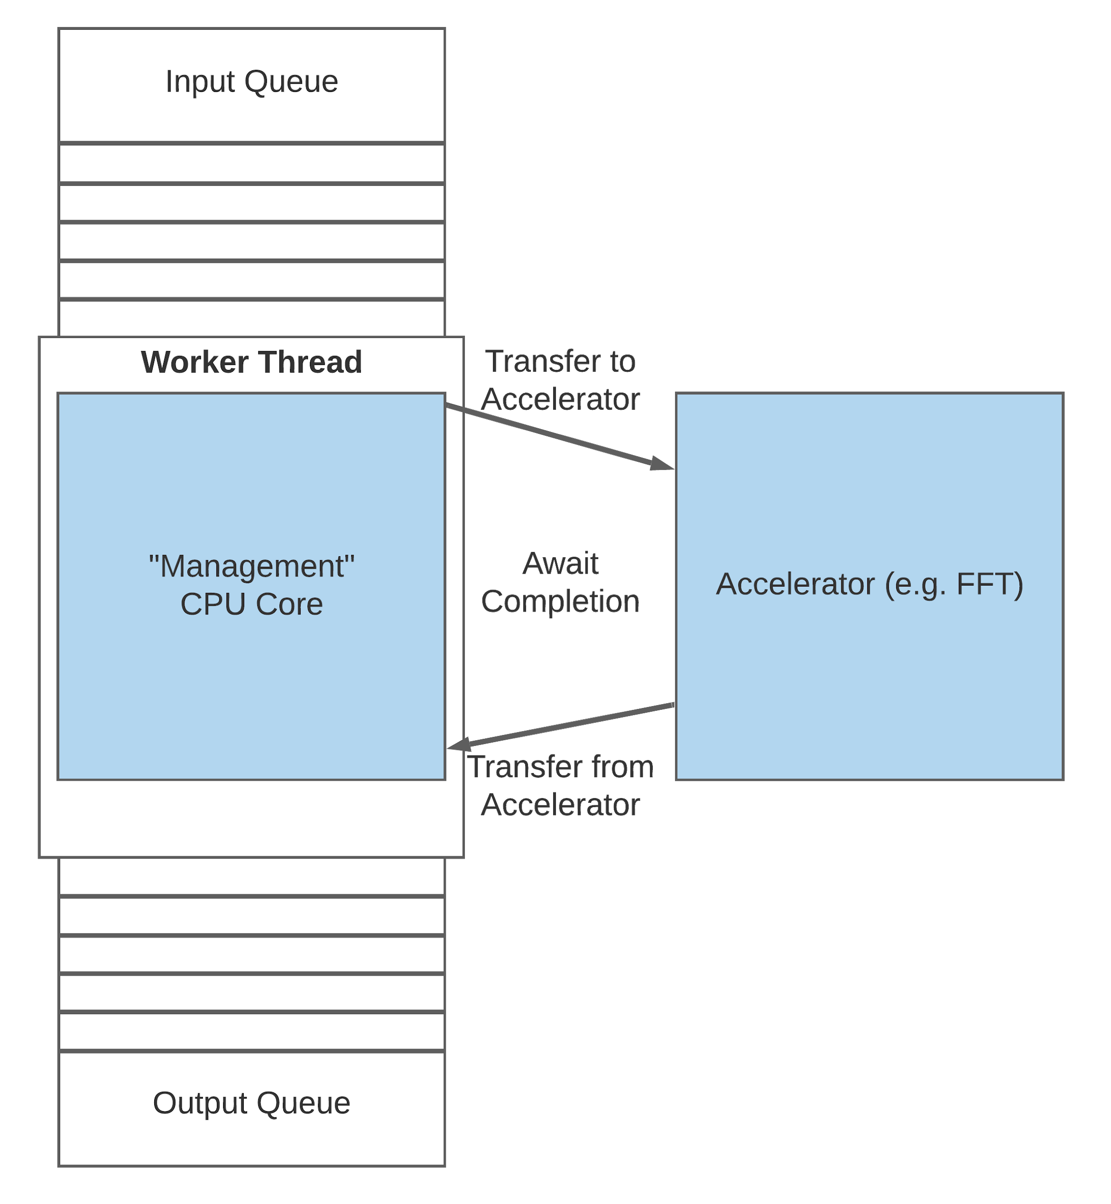
CEDR - Accelerator Integration
Accelerators generally can’t run threads
Managed by supporting CPU threads
Data transfer methodology determined by the accelerator
In our case: userspace DMA buffers⁽¹⁾ + DMA engines in FPGA PL
Ex: FFT - copy data to udmabuf, configure DMA engine, transfer to accelerator, receive results, and copy out from udmabuf
Potential future optimizations:
Zero-copy transfers (although, need contiguous memory chunks for DMA)
Optimize thread yields + signaling to reduce CPU overhead
(1) https://github.com/ikwzm/udmabuf
Notes:
Feature to emphasize: Accelerator integration
Streaming with accelerator integration?
IL scheduler?

Slide 19
CEDR - Accelerator Integration - Demo
Notes:
Demo of Accelerator Integration:
“Is the accelerator always the best?” - heavy workload such that EFT chooses i.e. CPU to do FFT rather than accelerator, compare with MET (which always chooses accel) and show a worse overall execution

Slide 20
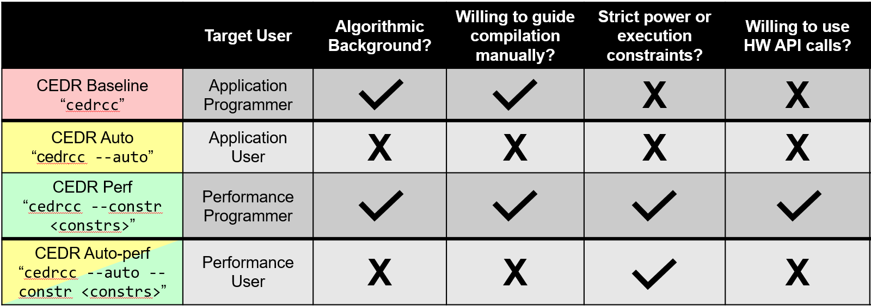
Types of Users
Notes:
QPR10 “User Overview” slide
“Who are you, what are your needs, how can we build an environment that’s useful for you?”

Slide 21
Future Plans/Future Work
Implement a more unified structure for performance monitoring to allow for schedulers to use dynamic execution statistics in their scheduling decisions
Investigate potential compiler analysis & transformation techniques to convert non-streaming applications into streaming ones
Implement support for hardware-based scheduler units
Experiment with different methods of signaling task completion back to the main thread in order to reduce overhead
Explore means to utilize zero-copy data transfers with accelerators

Slide 22
Thank You
Questions?

