Slide 1
luox: An open-source, open-access web platform implementing international standards for the quantification of light
Somang Nam, Ph.D., Jennifer A. Veitch, Ph.D., & Manuel Spitschan, Ph.D. FOSDEM Lightning talks, 2022-02-06

Slide 2
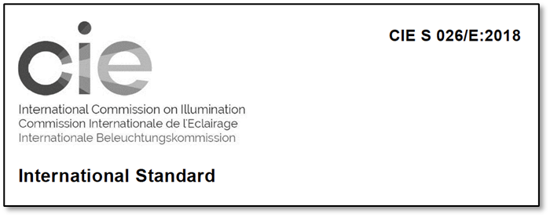
Background: Quantities that describe light sources and exposures
Light influences human perception, physiology, and behaviour
Vision, including colour perception and image interpretation
Circadian, neuroendocrine and sleep physiology
International consensus documents define quantities, units, and characterizations for light sources and exposures calculated from spectral data
CIE S 026:/E:2018 defines the quantification of light exposures for retinal photoreceptors
CIE 015:2018 and CIE 224:2017 define parameters related to colour

Slide 3
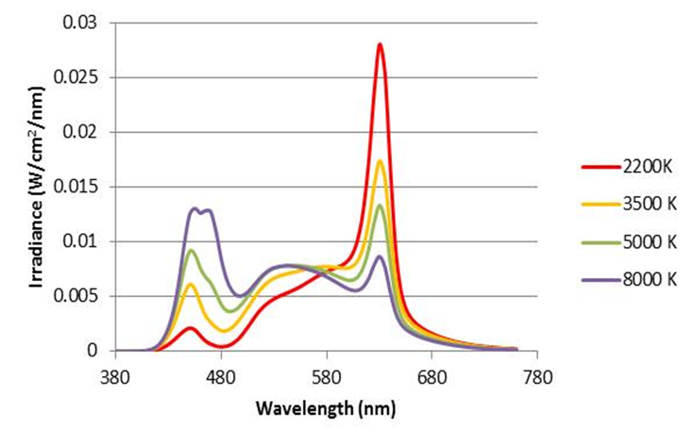
Background: Reporting of light quantities
No guidelines for measuring and reporting the stimulus conditions in chronobiology/sleep research studies until recently
There are many parameters to calculate
Calculations can seem non-trivial to beginners
Goal: develop an easy-to-use, open-access web platform for calculations related to light

Slide 4
luox
Lightweight platform for calculations based on spectral information
Open source (GPLv3)
No data stored anywhere
ES6, React, and webpack
Formatting: Prettier, ESLint - Airbnb style guide
https://luox.app/
https://github.com/luox-app/luox

Slide 5
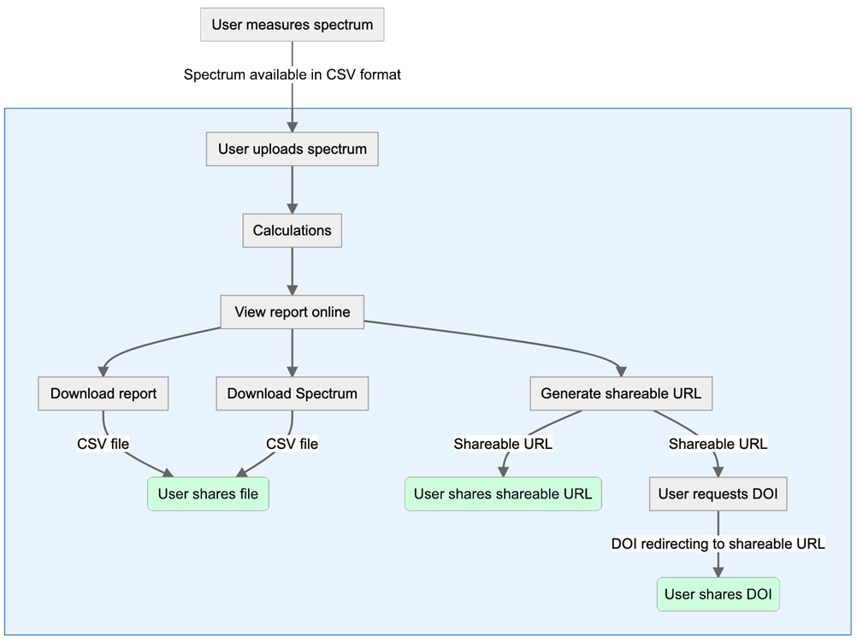
luox user flow

Slide 6
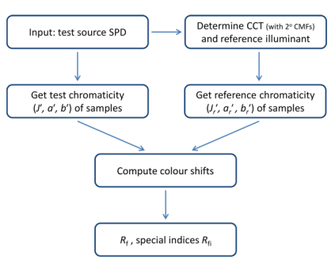
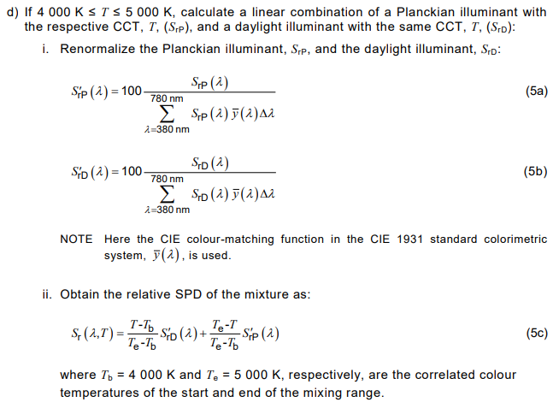
luox
Calculations follow guidance from the International Commission on Illumination (CIE)
CIE reports and standard formula were translated into JS functions using math.js
Example: Colour Fidelity Index, Rf (CIE 224:2017)
44 formula

Slide 7
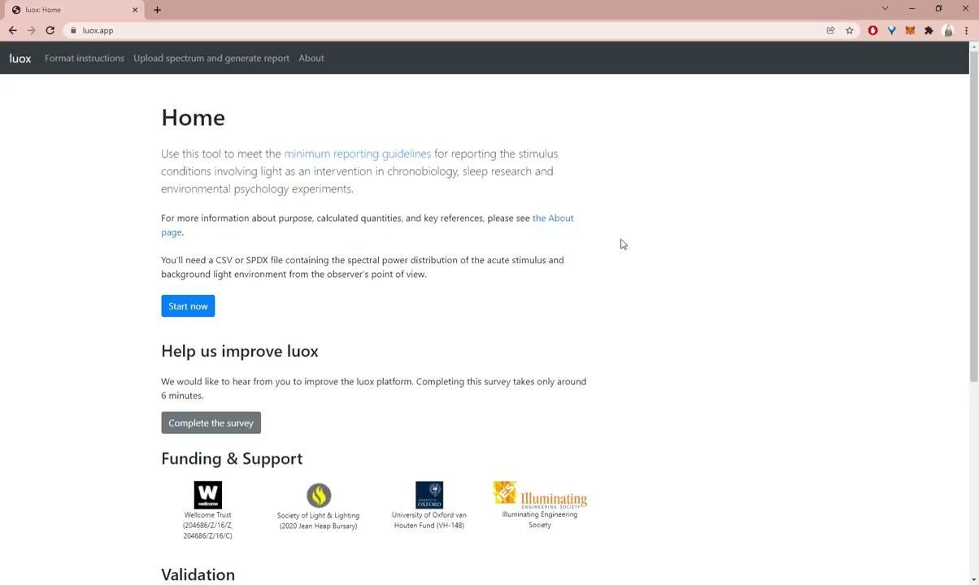
Demo

Slide 8
Current challenge
Precision
Displays floating point precision up to four decimals for all quantities
Downloaded .csv file carries higher precision
Users demand higher precision accuracy, but JS is limited to using the IEEE 754 standard
Temporary mitigation:
displaying intermediate calculations for power users

Slide 9
Status and future work
The CIE has validated luox calculations related to CIE S026:2018 and CIE 1931 (x,y) chromaticity, as a black box check.
Checks will be conducted on new code for additional CIE parameters before they are launched on the site.
Additional features may be added.
Documentation on Wellcome Open Journal: https://doi.org/10.12688/wellcomeopenres.16595.2.

Slide 10
THANK YOU
somang.nam@nrc-cnrc.gc.ca jennifer.veitch@nrc-cnrc.gc.ca
manuel.spitschan@tum.de

