Slide 1
Expanding IQEngine into a Hub for Previewing RF Signal Processing Software
Marc Lichtman
Roman Ziske
https://IQEngine.org
Notes:
primary: '#4CE091',
secondary: '#136f63',
accent: '#84cae7',
neutral: '#0f172a',
'base-100': '#05041C',
'base-content': '#f4f4f5’,
My slot is 25m and that’s NOT including another 5m for speaker transition
My GRCon talk was 25m + 1m questions

Slide 2
What is IQEngine Currently?
RF recording
preview
management
analysis
(light) processing
sharing
… all in your browser

Slide 3
Overview Demo
<live>
Notes:
Overview demo
4m

Slide 4
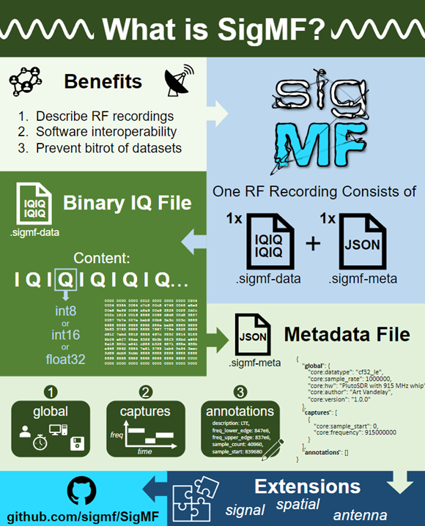
Built on Top of
An open standard for saving RF recordings
It’s a binary IQ file + a JSON file
SigMF specifies how to write the JSON
At a minimum, store
Sample rate
Center frequency
Datatype of IQ
Avoid data bitrot
Notes:
Keep in mind binary iq is the simplest and most natural way to save IQ to a file so any other method comes with pros/cons

Slide 5
Built on Top of
An open standard for saving RF recordings
It’s a binary IQ file + a JSON file
SigMF specifies how to write the JSON
At a minimum, store
Sample rate
Center frequency
Datatype of IQ
Avoid data bitrot
Learn more about SigMF at IQEngine.org

Slide 6
Code
Frontend uses React, TailwindCSS
Notable deps- CodeMirror, Pyodide, PlotLy
Backend uses Python, FastAPI
A little bit of webassembly, for fast FFTs
Docs live as .mdx markdown files and render into the live docs
https://iqengine.org/docs

Slide 7
Running a Server with Local Recordings
While you can always open local recordings on any IQEngine instance, “serving” recordings to users who go to the site requires storing recordings in either:
Cloud blob storage
File based storage, accessible to server running the backend
On the server itself
NAS, mounted to file system
Any other option that Python open() can “see”
Specify location in .env by setting IQENGINE_BACKEND_LOCAL_FILEPATH
<show how>
Notes:
Setting up local directory of recordings
Docker command
Refresh button

Slide 8
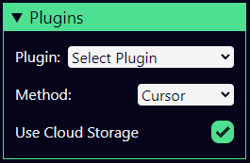
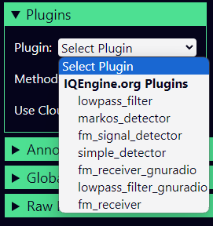
Plugins
RF signal processing on the backend, triggered from browser
REST-based API defined in our OpenAPI spec
Allows for plugins to be written in any language
We have examples/templates for Python, GNU Radio, Rust
SatDump
Loïc Fejoz created a Rust-based plugin
https://github.com/loic-fejoz/iqengine-fm-receiver-plugin

Slide 9
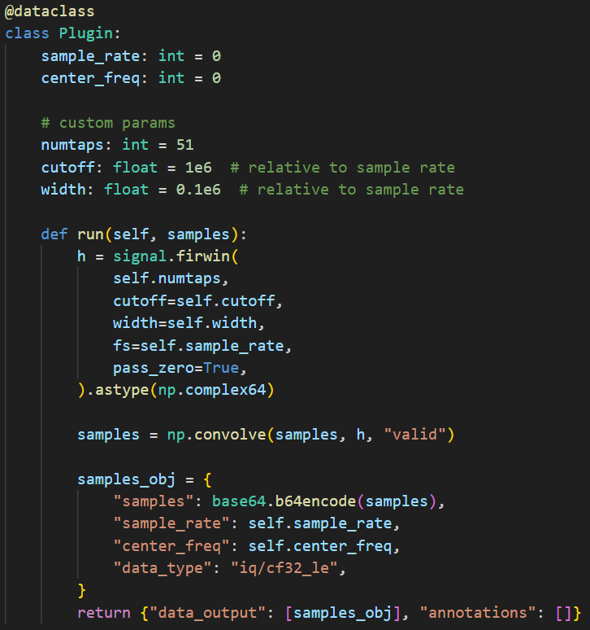
Python Plugin Example
Specify custom params
run() function that takes in samples
Returns either IQ samples, annotations, image, .wav

Slide 10
GNU Radio Plugin Example
Define Python flowgraph using zeromq’s sub_source & pub_sink
run() function has its own pub/sub for feeding in samples and getting the output
Example of a three-block flowgraph to demod FM radio:
class flowgraph(gr.top_block):
def __init__(self, samp_rate):
gr.top_block.__init__(self, "GNU Radio-based IQEngine Plugin", catch_exceptions=True)
self.zmq_sub_source = zeromq.sub_source(gr.sizeof_gr_complex, 1, 'tcp://127.0.0.1:5001', 100, False, -1)
self.zmq_pub_sink = zeromq.pub_sink(gr.sizeof_float, 1, 'tcp://127.0.0.1:5002', 100, False, -1)
self.pfb_arb_resampler = pfb.arb_resampler_ccf(500e3/samp_rate, taps=[], flt_size=32)
self.analog_wfm_rcv = analog.wfm_rcv(quad_rate=500e3, audio_decimation=10)
self.rational_resampler = filter.rational_resampler_fff(interpolation=50, decimation=48, taps=[], fractional_bw=0)
self.connect(self.zmq_sub_source, self.pfb_arb_resampler)
self.connect(self.pfb_arb_resampler, self.analog_wfm_rcv)
self.connect(self.analog_wfm_rcv, self.rational_resampler)
self.connect(self.rational_resampler, self.zmq_pub_sink)

Slide 11
Plugins Demo
<live>
Notes:
1.5m

Slide 12
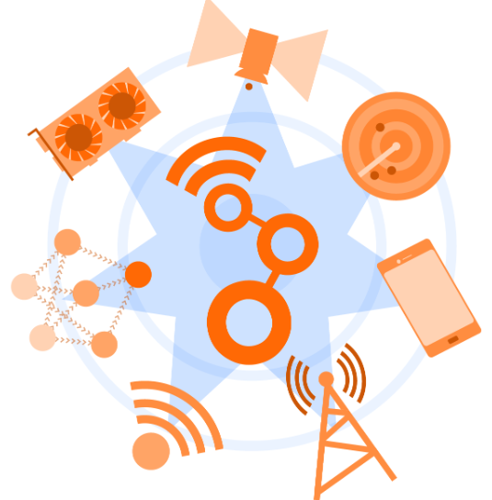
Value of GNU Radio
Implement your RF signal processing as GNU Radio blocks
Standard framework for implementation (in C++ or Python)
Standard installation procedure
Standard usage of blocks/apps, including alongside other blocks and GUIs
Sharing through CGRAN.org
With a standard way to do something comes limitations, boilerplate, streaming-style interfaces

Slide 13
FOSS RF Functionality
FOSS Dev
Build something
Share
Demo

Slide 14
FOSS RF Functionality: Sharing ⟷ Discovery
FOSS Dev
User
Build something
Share
Demo
Discover
Install
Run
Evaluate

Slide 15
FOSS RF Functionality: Sharing ⟷ Discovery
FOSS Dev
Build something
Share (e.g., code on GitHub)
Demo (e.g., FOSDEM talk)

Slide 16
FOSS RF Functionality: Sharing ⟷ Discovery
User
Discover (e.g., google topic of interest)
Install (can be a barrier for some)
Run (figure out correct params/signal)
Evaluate (e.g., on user’s SDR or recordings)

Slide 17
Concept for Low Barrier Sharing + Discovery
Centralized and community-driven site for devs to share and users to discover
RF signal processing functions exposed as plugins
No implementation or deployment constraints (e.g., could be GPU-based)
Must support being triggered and results returned using Plugins API
Example RF recordings to go along with plugin
Universities, individuals, orgs can show off their expertise
All in the browser for max accessibility and convenience
⟷
FOSS Dev
User

Slide 18
Concept for Low Barrier Sharing + Discovery
Users would be able to play around with the RF function using:
Example recordings on IQEngine
Their own recordings
E.g., try lowering SNR to see how well it works
Effort on the author's side:
Add IQEngine’s REST-based interface to their function/app, or at least make it easy to call via CLI and retrieve “results”
Containerize so it’s easy to add to plugins server base Docker image
Multiple plugins servers connected to IQEngine.org

Slide 19
Just a concept for now
Currently IQEngine lets you preview RF recordings and datasets
With this concept you could preview RF functions/apps/software
Current plugins system offers a starting point

Slide 20
Limitations
Some RF functions/apps can’t be easily used with recordings
E.g., srsRAN implements the LTE and 5G radio stack, which is bidirectional with tight latency requirements

Slide 21
Ways to Contribute
Can always use more web devs!
Other ways to contribute:
RF recordings
Open-source signal processing implementations via the plugins system
Python transmitter code via the siggen tool (education-oriented)
We can also use help curating recordings hosted at IQEngine.org
Discord link at top-right of IQEngine.org
Notes:
Make the RF open source ecosystem more centralized, more ways to build the community

Slide 22
Questions?
Show your support by starring the GitHub Repo! https://github.com/iqengine/iqengine

