Slide 1
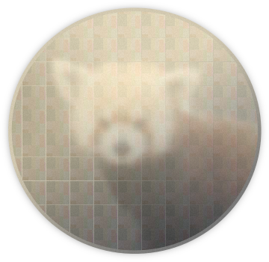
Panda3DS Climbing the tree of 3DS emulation
FOSDEM 2024 – Emulation Track
George Poniris Electrical & Computer Eng. Undergrad @ NTUA gponiris@pandasemi.co
Paris Oplopoios Information & Electronic Eng. Undergrad
parisoplop@pandasemi.co
Davit Margarian Electrical & Computer Eng. @ UC San Diego
mar@pandasemi.co
Notes:
Hello everyone! Welcome to our talk on Panda3DS. We'll cover a variety of topics, but first I would like to start
by saying that unfortunately George, the creator of Panda3DS and this presentation, couldn't make it here. We were going to do the presentation
together but since he couldn't make it, I was given… adequate preparation to do the talk on my own. But if you do have any questions during or
after this talk, your best bet would be to either ask them on the Panda3DS discord server or on the FOSDEM live chat where Giorgos (aka peach) should be online Lastly, if any questions come up to you at a later date, you can... <look at screen> you can send an email to these two

Slide 2
What is Panda3DS?
Panda3DS is a Nintendo 3DS emulator for Windows, MacOS, Linux and Android. Some goals and aspirations include:
Providing end-users with a pleasant experience playing their 3DS games on all their devices
Creating a portable, modern, easy-to-maintain codebase
Exploring new possibilities in 3DS emulation: Virtualization, ubershaders, and more
Researching the 3DS software and hardware architecture
Expanding the red panda cult
Aiding homebrew devs in writing their own 3DS software
Fun (...mostly)!
Notes:
So, what is Panda3DS?
Panda3DS is a new emulator of the Nintendo 3DS for Windows, MacOS, Linux and Android. It has been in active development since September 2022.
Some goals and aspirations include:
- Providing end-users with a pleasant experience
- Creating a portable, easy-to-maintain codebase
- Exploring new possibilities in 3DS emulation
- Researching the 3DS
- Expanding the red panda cult
- Aiding homebrew devs And Fun! ...most of the time

Slide 3
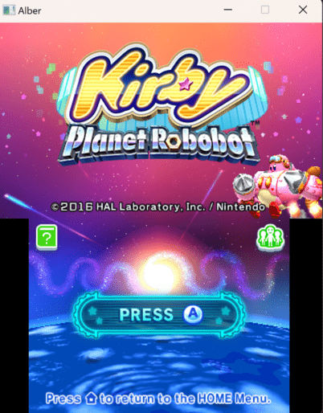
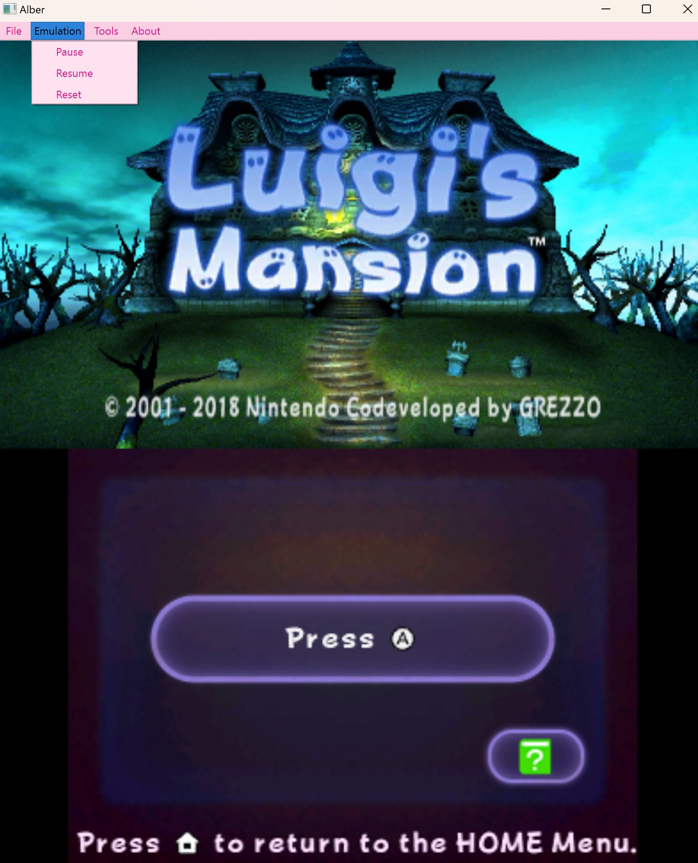
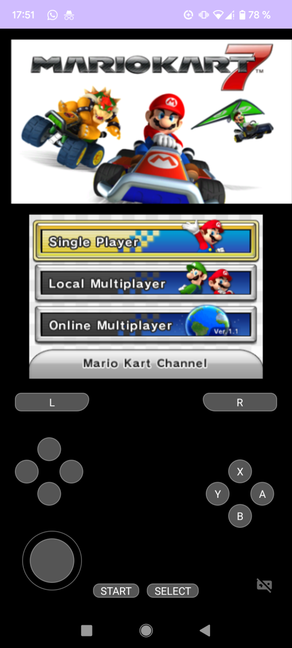
A peek at Panda3DS
The SDL frontend
panda-sdl
The Qt frontend
panda-qt
The Android version pandroid
Notes:
Here's a peek at Panda3DS. There's the SDL frontend which is the most reliable and stable one and the Qt build that works and has more features that we're going to see later, but is also missing some features that the SDL build has such as controller support.
Finally we also have a separate Android frontend with various features and customization options.

Slide 4
Agenda
Hardware Architecture
CPUs (There's too many)
GPU The PICA200
3DS Software Stack
Nintendo’s Horizon OS
The 3DS Userland
Emulating the 3DS
The “Levels” of Emulation
Difficulties & Points of Interest
Audio DSP XpertTeak
New & Unexplored Territory
The Rest of the System
Notes:
Now let's take a look at what we're going to be discussing today.
First, we're going to talk about the hardware architecture of the 3DS. We're going to go over the (many) CPUs, the GPU, the Audio Digital Signal Processor and the rest of the many pieces of hardware.
Next comes the 3DS software stack: The operating system named Horizon and the 3DS userland.
Lastly, we're going to go over emulating the 3DS in general, the various levels of emulation, difficulties and points of interest and new & unexplored territory.

Slide 5
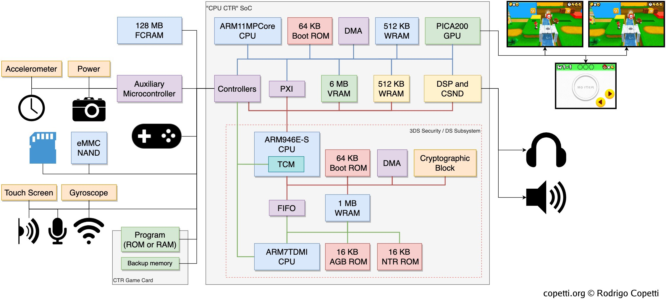
First glance 3DS hardware
Source copetti.org
Notes:
Let's begin by taking a first glance at the 3DS hardware.
The star of the system is this big system-on-a-chip codenamed "CTR" (that's where Citras name comes from).
Inside the system-on-a-chip exist 3 CPUs.
The ARM11, the main CPU of the 3DS that runs the 3DS game code,
the ARM9, the main CPU that was used in the Nintendo DS,
and the ARM7, one of Nintendo DS's CPUs and the main CPU of the Gameboy Advance.
Inside the SoC there's also the GPU of the system named the PICA200 and the XpertTeak digital signal processor for audio.
The GPU outputs to a top and bottom screen. The top screen is notable however because it displays two slightly different frames. Through a layer called the parallax barrier, each eye gets light from a different frame creating a 3D effect. Sometimes this 3d effect would prove to be straining

Slide 6
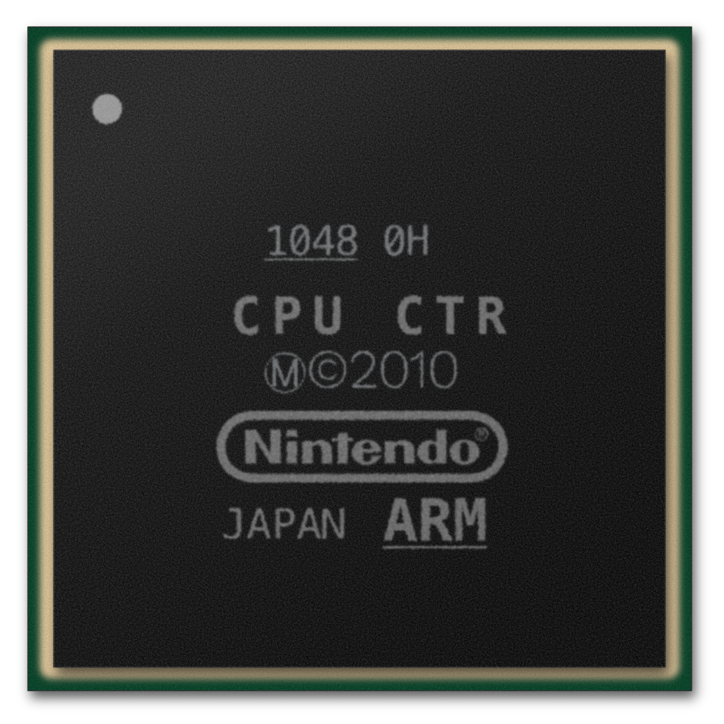
The System-on-a-Chip SoC
The Nintendo 3DS is capable of natively running Game Boy Advance, Nintendo DS, and 3DS software. Most of the hardware used to achieve this resides in a small System-on-a-Chip, named “CPU CTR”
Fun facts:
Many people don’t know the 3DS can run GBA games natively, since only those who were part of Nintendo’s “Ambassador program” could use this feature officially. Nowadays, there’s an open-source interface for running GBA games natively, called open_agb_firm.
Diffused by Panasonic in Japan on their 45nm process
Notes:
Because the SoC includes the processors used in the Nintendo DS and the Gameboy Advance, it features backwards compatibility with games from those consoles
and is capable of natively running them. As we saw, most of the hardware used to achieve this lies inside the SoC.
Many people don't know that the 3DS can run Gameboy Advance games natively as only those who were part of Nintendos "ambassador program" could use this feature officially. The Ambassador Program, is a program that Nintendo launched for the Nintendo 3DS, which was made in recognition of players who bought the 3DS for $250 before the price dropped to $170. Nowadays, there’s an open-source interface for running GBA games natively, called open_agb_firm.

Slide 7
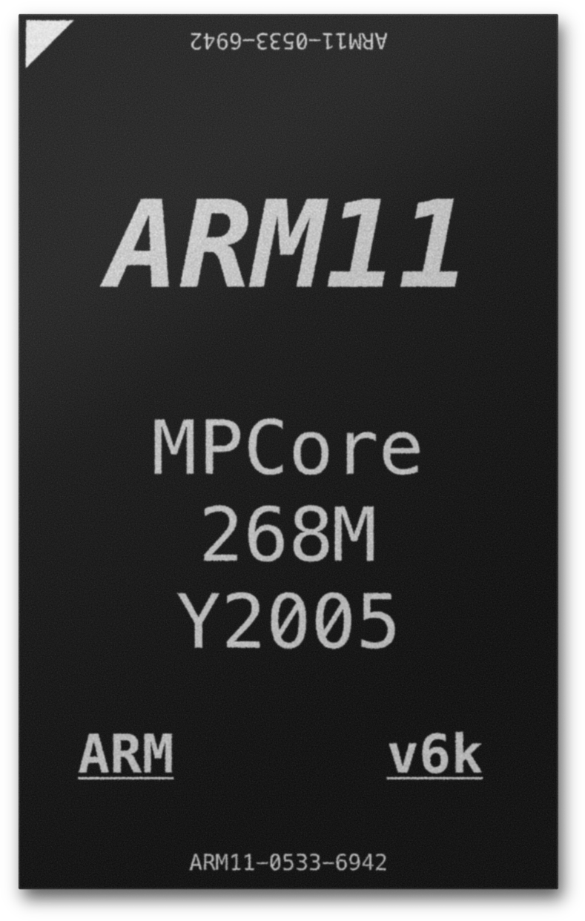
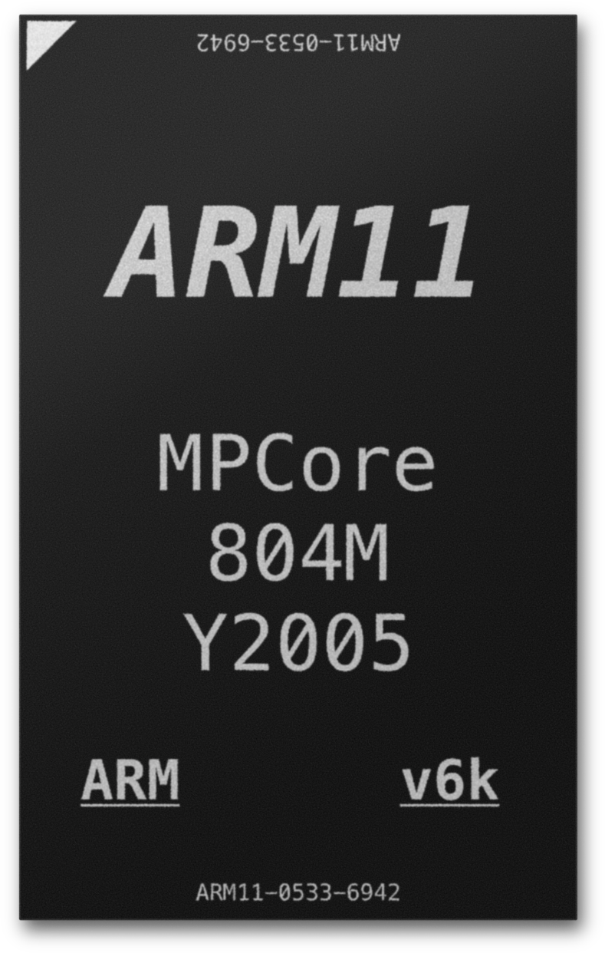
Inside the SoC: The ARM11
Running most of the code in 3DS mode
Original 3DS
268 MHz
268 MHz
New 3DS
804 MHz*
804 MHz*
804 MHz*
804 MHz*
Notes:
So the ARM11 had 2 cores running at 268MHz each in the Original 3DS and 4 cores running at 804MHz in the new 3DS.
Let's take a look at how one of these cores looks like.

Slide 8
Making use of the multiple ARM11 cores
Aiming to make good use of the multicore ARM11, the 3DS OS allocates different tasks to each core
Core 0 Appcore
Runs userland apps
including games & system apps
Core 2 New 3DS Only
Reserved for “QTM”, the camera-based head tracking service.
Core 1 Syscore
Dedicated to OS. Runs many processes often known as “services” used to interface with world.
Apps can borrow some syscore compute time.
Core 3 New 3DS Only
Available as another Appcore.
Notes:
However not all cores are used to run game code. The 3DS OS allocates different tasks to each core
.
In the Original 3DS, there's 2 cores as we saw and one of them is the App core, which runs userland apps including games and system apps
The second core is the syscore which is dedicated to the operating system. Runs many processes known as services which we will look into later on
Apps can however borrow some compute time from this core.
In the new 3DS, there's 2 extra cores. One is reserved for QTM which is a head tracking service to adjust the 3D effect based on head position
The other core is entirely available as another appcore.

Slide 9
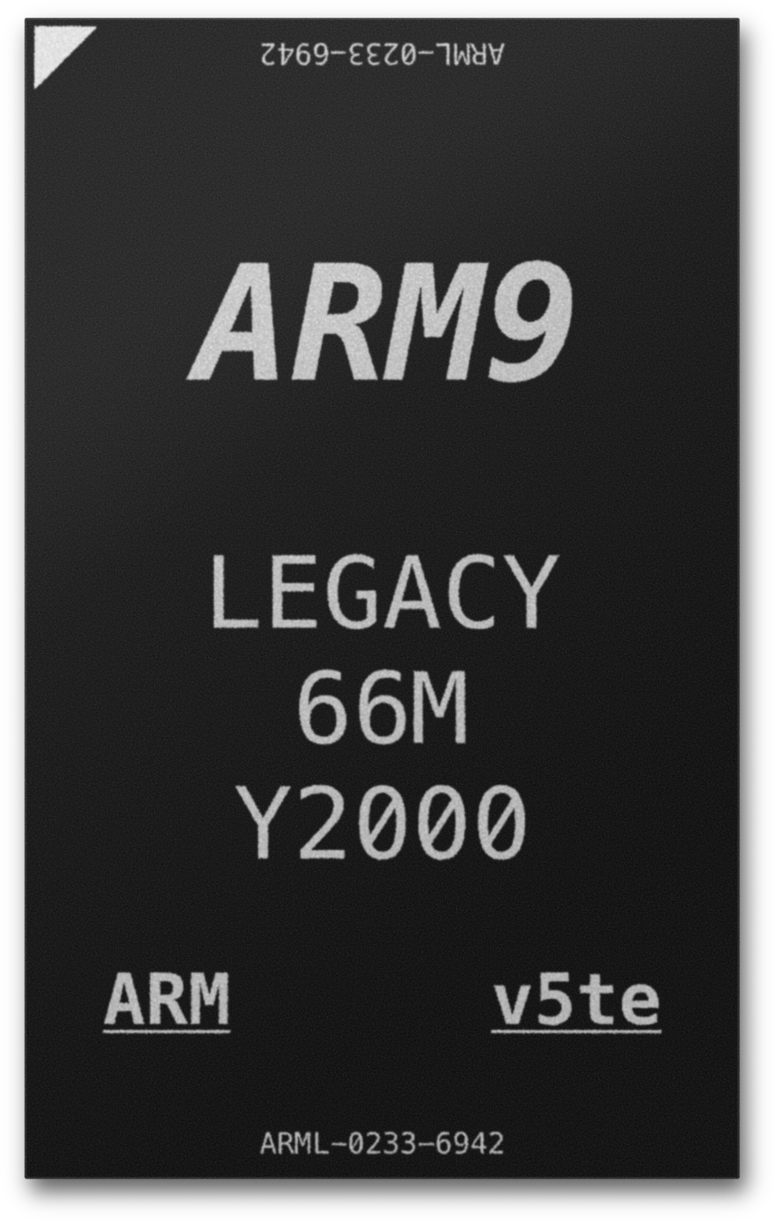
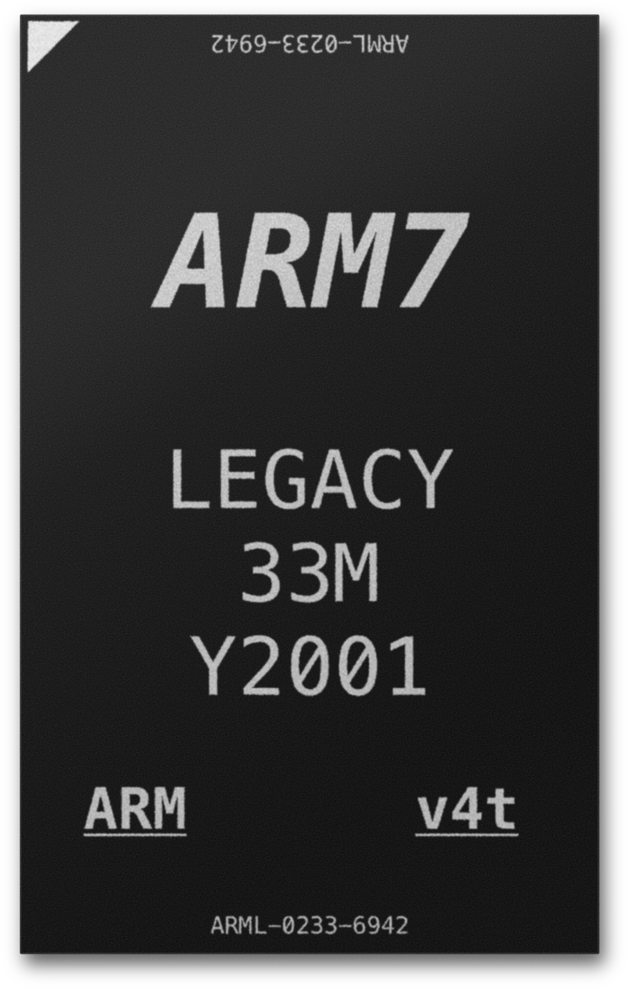
Inside the SoC: The ARM9 & ARM7
ARM946E-S
ARM7TDMI-S
ARMv5TE Architecture 32-bit
ARMv4T Architecture 32-bit
Same model as DS/DSi ARM9
66 MHz in DS compatibility mode 133 MHz in DSi mode and 3DS mode
3DS Mode
manages storage and cryptography hardware
Cartridge/NAND/SD
Same model as GBA/DS/DSi ARM7
33 MHz in DS compatibility mode 16 MHz in GBA compatibility mode
DS/DSi
Compatibility Mode
GBA
Compatibility Mode
Disabled in 3DS Mode
DS/DSi
Compatibility Mode
Notes:
And that leaves us with the ARM9 and the ARM7 CPUs.
The ARM9 is the same one found in the DS as mentioned earlier and part of its use comes for running DS code natively.
However it also executes a part of Horizon OS, particularly the part that has to do with storage (accessing the Cartridge and SD card) and cryptography
Then there's the ARM7 which is disabled in 3DS mode and exists solely for DS and Gameboy Advance backwards compatibility.

Slide 10
CPU Intercommunication
64b AXI Main Bus
via Snoop Control Unit for
inter-ARM11 cache coherency
”PXI” FIFO
64b FIFOs, bidirectional
”IPC” FIFO
64b FIFOs, bidirectional
Interrupt Distribution Controller
Notes:
CPU Intercommunication in the ARM11 cores happen through the use of shared memory and interrupts.
The ARM11 can communicate with the ARM9 using a 2-way fifo which is typically called the "PXI" (Processor Exchange Interface/Processor Interconnect Interface/Pixie?)
and the ARM9 and ARM7 through the use of a another FIFO, typically called "IPC", that's what it was called in the DS

Slide 11
DMP PICA200 Everyone’s favourite GPU
Me?
Custom Programmable Shaders
OpenGL ES 1.1 Compatible Features *
Vertex Shaders
Geometry Shaders
DMP MAESTRO
Fragment Lighting
Per-pixel
fixed-function effects
Hardware Shadow Mapping & Texture Projection
+ More Procedural Graphics Effects (DMP MAESTRO technology)
Nintendo’s first off-the-shelf GPU in a handheld.
*But most 3DS games don’t actually use GLES
Notes:
Here we have the PICA200, Nintendos first off the shelf GPU in a handheld. It implements OpenGL ES 1.1 with certain proprietary extensions, although most 3DS games don't actually use GLES Some of the extensions include:
Per-fragment lighting: can calculate lighting for each pixel instead of just per vertex
Hardware shadow mapping
Polygon subdivision through geometry shaders
Subsurface scattering which is the scattering of light as it penetrates a translucent object & more Games communicate with the GPU using a piece of shared memory, which is used to store GPU commands and some interrupt info.
They write to PICAs external registers, to configure the framebuffers and some other secondary things.
And then they need to initialize the rendering context, which is done by configuring PICAs internal registers. This is done through the use of GPU commands
PICA command lists are nothing more than a list of values describing patterns and data for writing to the GPU internal registers

Slide 12
Mikage A PICA demo by DMP
Notes:
Here's a demo of the PICA that was presented at SIGGRAPH 2006 by DMP to demonstrate the capabilities of their brand new GPU
The demo also shows off the PICA's impressive shadow and fragment lighting functionality and the beautiful scenes it can produce The wood grain on the floor was generated using PICA200's procedural texture generation capabilities, which generates textures via a mathematical algorithm rather than using pre-baked pixel data. Also: The Mikage 3DS emulator was named after this demo. And at this point you might be wondering, Citra got their name from the system-on-a-chip, Mikage got their name from this demo, where did Panda3DS get its name from? <Pause> That is a really good question so if you do find the answer let me know

Slide 13
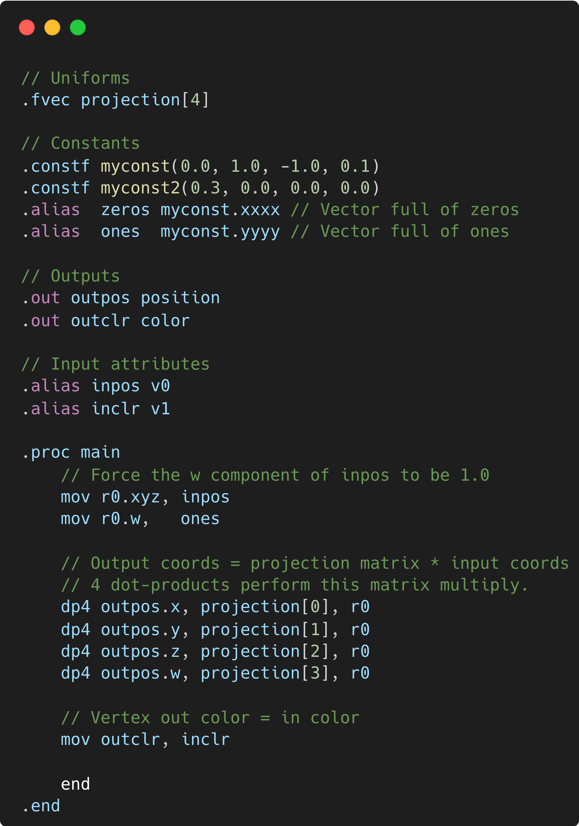
PICA200 A Vertex Shader
Notes:
Here's what a vertex shader for the PICA looks like. PICA shaders are usually written in assembly instead of a shading language like GLSL, as the PICA's odd architecture is not suitable for high level languages. So you have a uniform at the top, which is just a read only piece of data, much like modern shaders, in this case being our projection matrix. Next, we have some constants, our shader outputs (vertex position and color), and our input attributes. In the main function you have four dot products, multiplying our projection matrix by our input coordinates to get our output coordinates, and passing the input color to the output color

Slide 14
Notes:
Here's what a vertex shader for the PICA looks like. PICA shaders are usually written in assembly instead of a shading language like GLSL, as the PICA's odd architecture is not suitable for high level languages. So you have a uniform at the top, which is just a read only piece of data, much like modern shaders, in this case being our projection matrix. Next, we have some constants, our shader outputs (vertex position and color), and our input attributes. In the main function you have four dot products, multiplying our projection matrix by our input coordinates to get our output coordinates, and passing the input color to the output color

Slide 15
The pixel pipeline
Modern GPUs use programmable shaders to fill in pixels (fragments).
PICA200 uses a configurable pipeline.
Texture Unit
2D
Shadow
Cube
Projective
Colour Combiner
Vertex Colors
Lighting
Data
Colour
Combiner
Vertex Colors
Lighting
Data
Vertex data from programmable shader units
Colour
Combiner
Texture Unit
2D
Vertex Colors
Lighting
Data
Colour
Combiner
Rasterizer
Triangle Setup → Fragment issue
Vertex Colors
Lighting
Data
Post Processing
Texture Unit
2D
Colour
Combiner
Vertex Colors
Lighting
Data
Texture Unit
2D
Procedural
Colour
Combiner
Vertex Colors
Lighting
Data
+ Other effects like blending
it's a omg I love floof
Notes:
Modern GPUs use small programs called fragment shaders to fill in pixels The PICA instead uses a configurable fragment pipeline with 6 stages, called color combiners. First off, the rasterizer receives vertex data from the shader units, such as vertex coordinates, texture coordinates, and lighting information. After that, it starts drawing triangles from said vertex data.
For every pixel or fragment of a triangle, the PICA starts by calculating fragment lighting and fetching texture data from the texture units. There's 4 texture units, which means that up to four different textures can be used for calculating each pixel. All four texture units can render regular 2D textures. The first texture unit also supports functionality like 3D "cubemap" textures and shadow maps, and the fourth texture unit supports also procedural texturing.
After calculating light and texture colours, the PICA passes this data to the 6-stage colour combiner alongside some more things like the vertex color. You can think of each stage of the colour combiner as an "instruction" that tells the GPU how to combine this input data to form the final output colour. For example, a stage can be something like "Mix the colour from a texture with lighting" or "Add the colours from 2 texture units together". After going through all 6 stages colour combiner, each pixel goes through a few more steps like optional blending with the current framebuffer, and then voila! (*laser points at Kirby*)

Slide 16
Using the Color Combiners
The beanstalk texture is mixed with the lighting from a light source using the colour combiner – creating a sheen.
On the leaf Kirby is standing on, there’s a darkening gradient from left to right.
Notes:
Here you can see the color combiner at work: The beanstalk texture is mixed with lighting from a light source using the colour combiner, creating a sheen. Then on the leaf kirby is standing on, there's a darkening gradient applied from left to right, by combining the leaf texture with vertex colours.

Slide 17
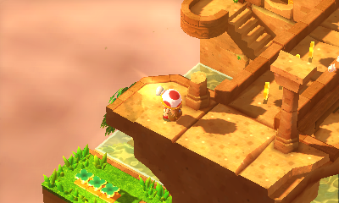
Showing off the PICA
Captain Toad: Treasure Tracker, a game known for being clever with all sorts of lighting and shadow effects
Notes:
Some notable examples of games: Captain Toad Treasure tracker, a game known for being clever with all sorts of lighting and shadow effects

Slide 18
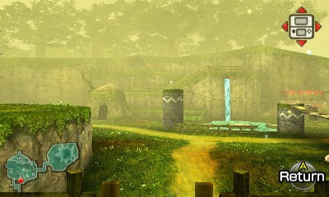
Showing off the PICA
The Legend of Zelda: Ocarina of Time 3D
using the PICA’s fog rendering hardware
Also texture compression with ETC1 and ETC1A4!
Notes:
Legend of zelda ocarina of time: Uses PICAs fog rendering hardware.
Also uses ETC1 which is a compressed texture format that compresses blocks of 4x4 pixels into 64 bit integers

Slide 19
Showing off the PICA
Mario and Luigi: Paper Jam generates the seawater via procedurally-generated textures
Notes:
Mario and Luigi Paper jam: Like the Mikage demo, also makes use of the procedural texture generation engine

Slide 20
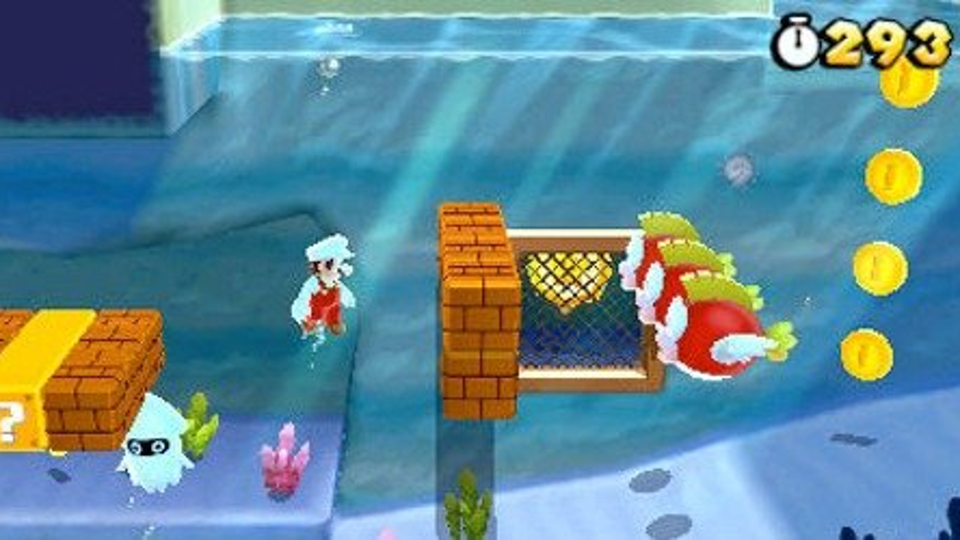
Showing off the PICA
Super Mario 3D Land uses all sorts of features, such as stencil testing, logic ops, good usage of lighting, GPU command lists that invoke other command lists, and more
Notes:
And finally Super Mario 3D land, which uses all sorts of features such as sentil testing, logic operations, good usage of lighting, command lists that invoke other command lists and more

Slide 21
The XpertTeak DSP
More Processors! The 3DS also has a Digital Signal Processor for audio.
It’s the same model as the DSi DSP but it’s used far more.
Most games shipped a common DSP firmware which includes:
Support for up to 24 audio channels
Multiple Audio Encodings
PCM8
PCM16
ADPCM
Effects
Reverb
Delay
Filters
One-pole & Biquad
Mono Input
Stereo Input
AAC Audio Decoder
Used in games like Pokémon X/Y
Stereo Output
Notes:
The final major piece of hardware we'll take a look at is the XpertTeak DSP which is the audio unit of the system. It is the same model as the DSi, but it's used far more often. Most games ship a common DSP firmware which includes: Support for up to 24 audio channels, an AAC audio decoder which is used in games like Pokemon X/Y or Fire Emblem, support for multiple audio encodings such as PCM16 and ADPCM, effects such as reverb, delay and one-pole and biquad filters. Finally it supports both mono and stereo audio input but the final audio output is always stereo.

Slide 22
Teak architecture
Signal Processing Instructions
Plenty for multiply, multiply-add, division, etc.
16-bit Bytes
Instead of the typical 8b
256KB Instruction
Memory
ARM11 Synchronization
With data exchange and a semaphore register
256KB Data Memory
Loop Instructions
Supporting tight loops
With awful complicated instruction encodings
Notes:
The Teak is a DSP instead of a regular CPU, so it's got all sorts of features that would be considered unusual on a normal CPU. First, it features 16 bit bytes instead of the typical 8 bits. This may seem rather peculiar initially but it makes sense for an audio processing unit when you realize samples are usually 16 bit integers. It also features signal processing instructions such as various forms of multiply-add, division, and loop instructions that are very useful for working with lots of samples in tight loops. The DSP also has rather complicated instruction encodings, and other fun features such as built-in timer hardware.
It's a little bit complicated, and for that reason George included a picture, an artist's representation of the DSP doing math really fast.

Slide 23
Misc hardware
128 / 256* MB FCRAM
64-bit “Fast Cycle RAM” Built by Fujitsu
Arm CoreLink DMA
programmable
DMA engine
WiFi Controller
2 LCDs
Xtensa CPU
PDC PICA Display Controller
Bottom Display Resistive Touch
Hardware Cryptography Engine
AES / SHA / RSA / RNG
GBA & DSi Hardware
for game compatibility
6 / 10 MB of VRAM
Inside the chip
Motion Sensors
Gyroscope & Accelerometer
eMMC NAND
Stores system data
One-Time-Programmable Memory
Stores console-unique keys
Cameras
2 Back Cameras
Front Camera
SD Card Slot
Expandable Game Storage
Microcontroller
For extra IO & Power Management
IR Transceiver
for Amiibo & CirclePadPro
IR Front LED
for New 3DS Face Tracking
NFC Reader
for New 3DS Amiibo Support
Notes:
That's all for the most important pieces of hardware, and there's some miscellaneous (μισελενιουσ) hardware such as the RAM and VRAM that we saw earlier, the one time programmable memory that stores console unique keys, a programmable DMA engine, a hardware crypto engine, a wifi controller, an IR transciever, the IR front LED for the face tracking we talked about, 2 screens and 3 cameras, 2 for the back and one for the front.

Slide 24
Software stack!
I love floof.
Notes:
Now that we’ve taken a look at the mildly terrifying hardware architecture, it’s time to explore the software stack, starting from HorizonOS™, Nintendo’s beautifully architected operating system. We’ll split HorizonOS (HOS) into two parts: The part which runs on the ARM11 syscore, which includes most of the OS’ facilities, and the part which runs on the ARM9 CPU.

Slide 25
The 3DS OS: Horizon®
To tame this hardware,
We have Nintendo’s beautifully architected operating system
We’ll look at Horizon on ARM11 Syscore
& Horizon on ARM9 for Security & I/O
Notes:
Now that we’ve taken a look at the mildly terrifying hardware architecture, it’s time to explore the software stack, starting from HorizonOS™, Nintendo’s beautifully architected operating system. We’ll split HorizonOS (HOS) into two parts: The part which runs on the ARM11 syscore, which includes most of the OS’ facilities, and the part which runs on the ARM9 CPU.

Slide 26
Getting a firm grasp of FIRMs
The 3DS comes with multiple different “firmware” programs running on the ARM cores with low-level control of the underlying hardware:
NATIVE_FIRM
AGB_FIRM
TWL_FIRM
SAFE_FIRM
Runs 3DS Games Natively: “3DS Mode”
Runs GBA Games Natively
Runs DS or DSi Games Natively
Older, bare-bones version of NATIVE_FIRM for recovery
Use a button combo to enter Safe Mode with
System Updater
ARM11
Runs Userland
Majority of OS code
ARM7
Downclocked to GBA speeds
Runs game code
ARM9
Downclocked to DS or DSi speeds
Runs game code
ARM7
Downclocked to DS(i) speeds
Runs game code
ARM9
Cryptography
Cartridge & SD I/O
Internal GBA Hardware
Internal DSi Hardware
Notes:
But first, we need to get a firm grasp of the firmware programs that run on the ARM cores: There's the Native firm, that runs the userland, the 3DS games and the majority of the operating system code – it's also called 3DS mode. In this mode, the ARM9 is used for cryptography and storage operations as we saw. There's the AGB firmware, which runs GBA games natively. The ARM7 is the star of the show in this mode which runs the game code – while being downclocked to GBA speeds. The rest of the work is done by the internal GBA hardware. Then there's the twilight firmware which runs DS or DSi games natively. In this case the ARM9 is the star of the show, while the ARM7 is used as the secondary processor, just like an original DS. Finally there's SAFE FIRM, which is a sort of recovery mode for when your system is broken and also used by the system updater. Native firm is the one we are going to be talking about from now on.

Slide 27
A microkernel architecture
kernel11
The kernel is the core of an OS. The 3DS ARM11 kernel is called kernel11.
Kernel calls are performed with the Arm SVC (Supervisor Call) instruction.
Memory Management
Map Memory to processes
&
configure their access permissions
Process & Thread Management
Creation, multithreading primitives, Lifecycling
Service & Process Inter-communication
Via the sync request API and shared memory
An ARM assembly function for calling the exitThread SVC.
Notes:
Every operating system has a kernel which is considered the core of the OS and handles various critical functionality. The 3DS ARM11 has a kernel too, called the kernel11, and is what we call a microkernel <briefly explain types of kernels, micro vs monolithic> Micro: - OS runs its services in userspace (fs, networking etc) - less code, less vectors of attack
- more reliable (if something crashes, not the whole thing crashes) (example kernel11, minix) Monolithic: - all or most services included in kernel proper - fewer context switches, faster as everything is inside kernel (example linux)
Kernel calls happen via the supervisor call instruction (SVC). Here is an example of an assembly function calling the exitThread supervisor call to terminate the running thread. Like most operating systems, kernel11 is not pure microkernel, memory management doesn't have to happen in kernel space – minix for example runs it as a userland process

Slide 28
HorizonOS services
Service Handle
Request a service handle from “Service Manager”
Set Up The Parameter Buffer
with the function to call
Send Request To Service
Call SendSyncRequest SVC with service handle & buffer
Receive Output Buffer
Function-Specific Output Data
Potential Error Codes
and necessary parameters
Notes:
So services are userland processes which are managed by another service called the service manager. In order to interact with services, first you need to get a handle to the service manager itself through the ConnectToPort Supervisor Call
Then you can ask the service manager for a handle to the service you want to use via a SendSyncRequest SVC.
Once you are ready to send a message to your service, you prepare a buffer describing what you want it to do and you call the SendSyncRequest SVC once again to send your request.
The majority of communication with services is implemented via requests like this, though shared memory is used to reduce latency when interacting with some crucial services, such as the GPU one. Requests and responses are written in thread local storage and SendSyncRequest is as the name suggests synchronous, but some services can queue something to happen later For example, the Y2R service (which is typically used for decoding videos and FMVs such as cutscenes) doesn't stall until it's finished, instead it notifies you of when it's ready using a kernel event.

Slide 29
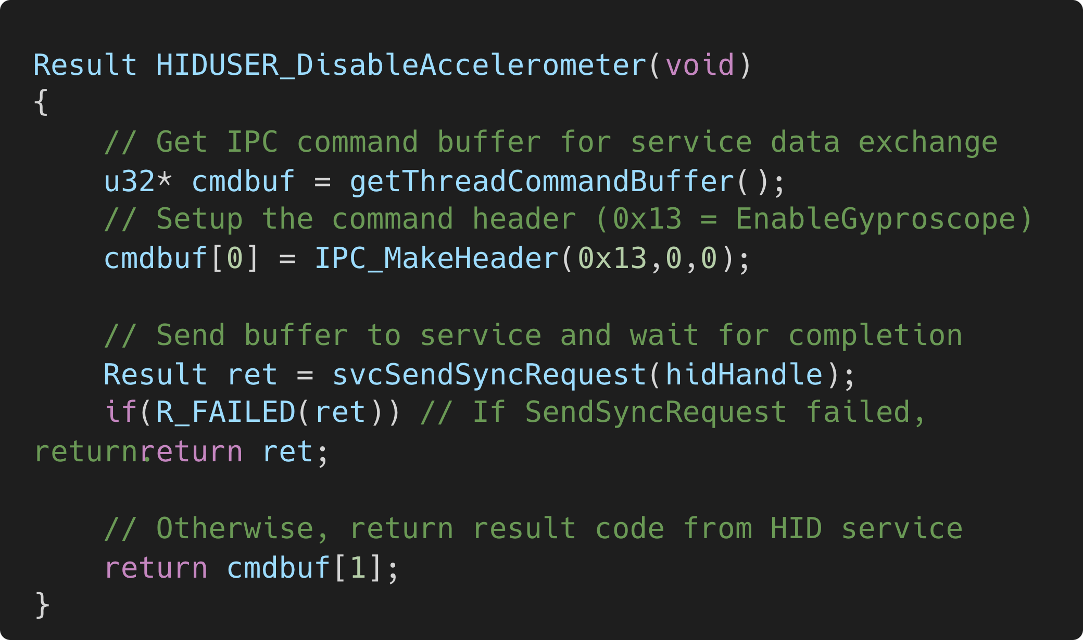
Some important services
FS
Filesystem IO for Cartridge, SD, Save Data & more
DSP
Communication with Audio DSP
GSP
GPU & Display Communication
APT
Inferface with system applets & manage some app controls
HID
Interface with many input devices like
gamepad, motion, ...
CFG
Read system configuration data like console model & region
AC / HTTP / SSL / SOC
Networking Tasks
CAM / MIC / NFC
Camera, Mic, & NFC Input
Function that asks the HID service to enable the gyroscope
adapted from libctru
Notes:
:wrage:
SLET Some important services include the FS service for filesystem I/O, the HID service which communicates with input devices, GSP which communicates with the GPU and displays, DSP should be pretty self explanatory CFG for allowing apps to read configuration data, some networking related services such as HTTP and SSL, APT that interfaces with system applets, manages some application controls and more and some others such as MIC and CAM. And right here you can see an example function that asks the HID service to kindly enable the gyroscope. It does so by getting a pointer to the thread command buffer, writing a header and once again using the SendSyncRequest supervisor call. The results are then written in the command buffer, which may contain an error code if our call fails.

Slide 30
Process9
Unlike ARM11, the ARM9 in 3DS mode handles all its tasks in one big process called Process9.
Cryptography
Data encryption & decryption with crypto hardware
Device I/O
Talks to various devices like
Cartridge / SD Card / ...
Overcomplicated C++
That reverse engineers hate :(
Really big
Notes:
As opposed to the ARM11, the ARM9 in 3DS mode handles all its tasks in one big process, called Process9, a monolithic single-process kernel – which, unlike kernel11, decides to handle everything in one process.
That includes encryption and decryption using the crypto hardware and talking with various storage devices. It involves overcomplicated C++ code that reverse engineers hate and is very very big. A funny quote by PSI, creator of Corgi3DS goes "If you ever feel useless just know that process9 calculates a SHA hash on the CPU despite having access to a full hardware SHA engine"

Slide 31
A lil’ breather Some live demos!
Notes:
Yarkhushta !

Slide 32
I knew this would fail
Here's a video instead

Slide 33
This failed too?
Here's a video instead

Slide 34
Emulation! finally...
Notes:
Yarkhushta ! Omg foggy?

Slide 35
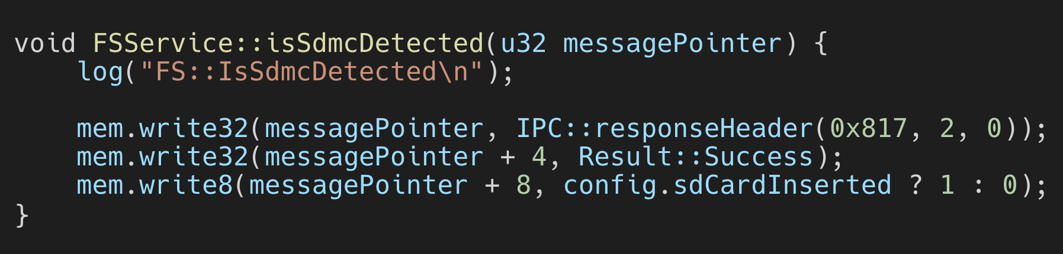
High & Low-Level Emulation
HLE Reimplementing parts of the emulated system’s software in our own code, to avoid emulating the hardware needed to run said software. Eg. An LLE Audio DSP is expensive to emulate performance-wise
LLE & Actual Device
HLE
Audio DSP Hardware
C++ model
reimplementing DSP
firmware features
DSP Firmware
Compatible Interface
DSP Firmware
For the 3DS, we can HLE the OS:
Kernel
Services
Process9
& ...
HLE implementation of FS service function that returns if an SD card is inserted
We avoid emulating the complex SD hardware interface.
Notes:
We've reached the last part of our agenda: Emulating the 3DS, which we are going to kick off with a brief explanation of high and low level emulation. High level emulation or HLE: is when parts of the emulated systems software are reimplemented in our own code, to avoid needing to emulate the hardware that runs said software. For example, to avoid emulating the entire DSP, we can reimplement its firmware in C++. Other things that can be HLE'd are the OS (kernel, services and process9 to avoid emulating the ARM9), the arm11 syscore and hardware such as the wifi controller.
Some notable HLE emulator examples include: the N64 emulator UltraHLE which intercepted N64 SDK functions, and Dolphins approach for the Wii security processor. Low level emulation or LLE: is quite the opposite. Emulating said hardware and running the original code as is – in the previous example we would instead emulate the DSP hardware and run the actual firmware on it. And here you can see an HLE implementation of the 3DS OS function that checks if an sd card is inserted, which of course helps us avoid emulating the very complicated SD hardware interface.

Slide 36
As an Emudev What parts to LLE, what to HLE?
LLE
Tedious to implement so much hardware
That much hardware reduces performance and is error-prone.
Beneficially, it can run any 3DS software incl. baremetal firms like
3DS Linux / GodMode9
HLE
Tedious to implement so many services
Performant but still error-prone.
Many elements left to reverse engineer.
Hybrid
We can HLE kernel11 & process9
We can LLE most OS services.
Balance
Minimizing work
Improving Performance
Maintaining Accuracy
Notes:
As a 3DS emulator developer what are some things you need to consider when it comes to level of emulation? Well LLEing everything is tedious and slower as theres so much hardware to emulate but it allows us to run any software that can run on a 3DS, including baremetal firms such as LINUX for the 3DS or GodMode9 HLEing everything is again tedious, there's a lot of services, it's error prone and many things still have to be reverse engineered. A hybrid approach which is interesting, is HLEing the ARM11 kernel and ARM9 but LLEing most OS services. This would be done by running the actual service process code in your emulated hardware. This way you can avoid doing too much grunt work and have respectable performance and accuracy.

Slide 37
As an Emudev: The CPU
Interpreters
Loop and process CPU instructions in normal code. Slow, portable, good for a start but not for fullspeed emulation
Just-in-Time (JIT) Recompilation
Convert ARM code to host CPU code. This is the most common solution.
Citra & Panda3DS both use the Dynarmic library to perform Arm32 to x86 / Arm64
Virtualization (Potentially)
On Arm32/Arm64 devices, virtualization could be used to execute 3DS code natively. An ongoing Panda3DS PR is aiming to add this.
Ahead-of-Time (AOT) Recompilation (Potentially)
Recompile ARM code from the code section of 3DS executables to host CPU assembly ahead of time.
Notes:
When it comes to the 3DS there's various ways to go about emulating the CPU, some of which are still unexplored: One choice is an interpreter, which is slow, but portable and a good start and not for fullspeed emulation. Portability however might be a big thing for you, especially if you want to target a system that would be hard to use a recompiler for, because one doesn't currently exist.
A just in time recompiler on the other hand is the most common solution. It's less portable but it's portable enough for the architectures most users care about, x64 and ARM64. Panda3DS and Citra both use Dynarmic which can recompile to both! You can also potentially explore Virtualization: Virtualization is the way apps like VMWare and VirtualBox work, and on some ARM32 and ARM64 devices we have the possibility to execute the 3DS code natively Notable examples of such CPUs would be some raspberry pis and rooted android phones (because unrooted don’t have access to kvm) Fun backstory: before Panda3DS was public, it was named Virtual3DS as the inspiration for the project was running an emulator under a virtual machine. You could also explore AoT recompilation: Feasible since there's very little dynamic code execution in userland, and programs can't allocate executable memory on their own. There's "CROs" which are the 3DS equivalent of DLLs, but can be handled specially. For AoT recompilation, we can perform various optimizations that we can't in a JIT, since JITs need to compile code fast. Maybe we could even use something like LLVM to output optimal code

Slide 38
As an Emudev: The GPU
Software Rendering
Draws emulated triangle on the CPU in software.
Very slow but portable and simpler™️
How can we speed it up?
Multithreading drawing with several concurrent threads
Recompilers Much like the CPU JIT, we can parse the PICA200 confiuguration for a draw call and generate optimized rasterization code at runtime.
Hardware Rendering
Draws on the GPU via a graphics API like OpenGL / Vulkan / DirectX / Metal.
Much faster - suitable for gameplay.
Challenges
Choosing the ideal API
Efficient & Correct Surface Management textures, color buffers, depth buffer
Many, many other problems to solve
Notes:
The next thing to consider when building your 3DS emulator is the GPU: there's different types of renderers you can employ. You could do A software renderer, which renders everything on the CPU in software. This is of course very slow, but again portable and simpler. And you could do a hardware renderer, which draws on the GPU via a graphics API like OpenGL, Vulkan etc. This is much faster and is ideal for playing games. Software renderers can be made faster, using some smart techniques. For one, you can render on multiple threads concurrently, but you can also use a recompiler – much like a JIT in CPU emulation, you can parse PICAs current configuration and generate optimized rasterization code at runtime. This is also useful because you can reuse said generated code, if the same rendering configuration arises again!
This is what PCSX2 does, which has a recompiler for its software renderer, turning the current GPU state into an optimized rasterizer written in assembly.
When making hardware renderers, you need choose the API ideal for you, ensure you do efficient and correct management of surfaces, and many many other problems to solve such as tracking when a texture has changed and is no longer valid, or dealing with the parts that aren't really OpenGL compliant, or for example games that use depth buffers as color buffers and write to them directly. Panda currently has two hardware renderers using opengl and vulkan.

Slide 39
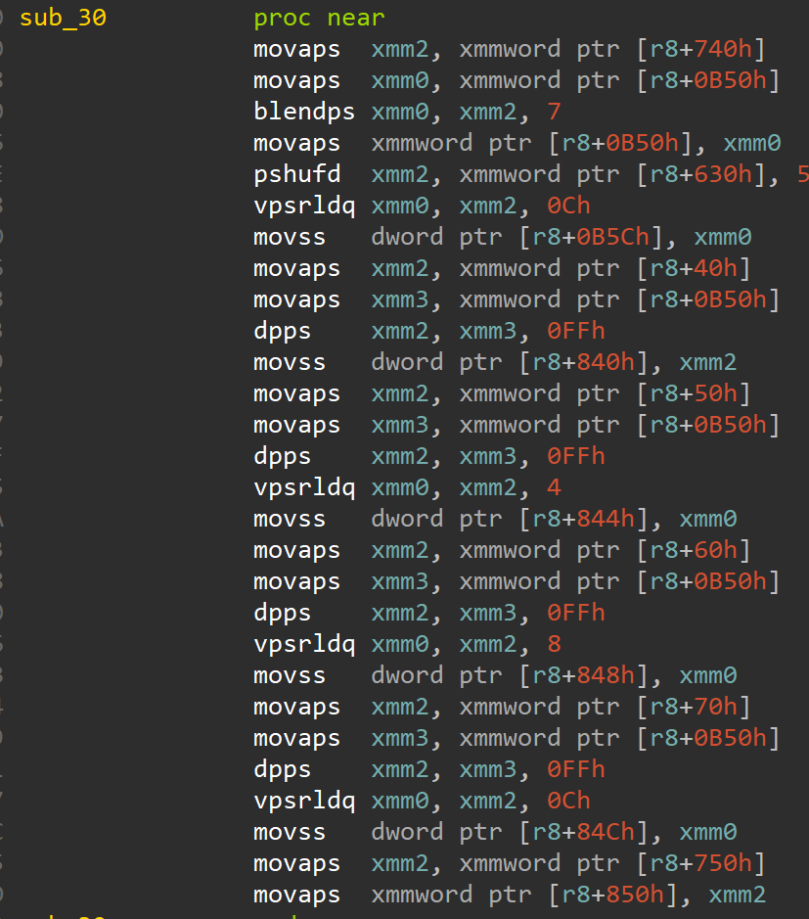
Emulating PICA shaders
Interpreter
Simple
Too slow
JIT on CPU
Decent Performance
But could be better
Recompiling Shaders for GPU
Good Performance
Only for HW Rendering
Might not be possible for select PICA shaders
CPU JIT
Notes:
You also need to consider the PICA shaders! Again, they can be interpreted much like the CPU, which is slow We can recompile them to native instructions for your CPU as you see in the image below, where the shader from before is recompiled to some scary looking x64 assembly (although x64 assembly is imo often scary looking) Or we can recompile them to shaders for our own GPU, recompiling them to GLSL or Spir-V for example. This gives even better performance, is only possible in hardware renderers however and might not be entirely possible for select PICA shaders. And here you see an example of the PICA shader from before recompiled into x64 assembly.

Slide 40
Emulating the PICA pixel pipeline
Specialized Shaders
Compile a specialized shader for each PICA pixel pipeline configuration.
Low GPU Usage
However lots of time is spent compiling shaders,
Causing stutters.
Most common approach, currently WIP in Panda3DS
Ubershaders
Include an entire “emulator” for the pixel pipeline inside a GPU fragment shader.
Higher GPU usage but no compilation stutter.
Works well on modern PC GPUs but struggles on mobile GPUs.
Implemented in Panda3DS
Hybrid emulation
Compile specialized shaders in the background. The ubershader is used for each draw call until the relevant shader is ready.
Good performance with minimum stutter.
Works well on all GPUs. Higher code complexity.
What Panda3DS wishes to achieve.
Notes:
Another thing you need to do is emulating the pixel pipeline, w:
One approach is compiling specialized shaders for each pixel pipeline configuration. This is the most common approach and has low gpu usage but a lot of CPU time spent on compiling shaders, which can mean stuttering or long loading times. Another approach and what Panda3DS does is using an Ubershader, a term coined by dolphin, which essentially describes including an entire emulator for the pixel pipeline inside a fragment shader. This means you get no shader compilation stuttering . Ubershaders work great for modern GPUs, but maybe not so great for not-so-modern ones.
Thus, much like HLE vs LLE, the solution is in the middle, a hybrid approach where you compile specialized shaders asynchronously, and use the ubershader until they finish compiling this is what panda aims to achieve.

Slide 41
As an Emudev Audio DSP
LLE
How do we optimize it?
Recompiling firmware
AOT Compilation
Teakra
An emulator / assembler / disassembler for the Teak DSP used in Citra & MelonDS
HLE
Improving current DSP reverse engineering efforts
By making test ROMS &
RE tooling.
Techniques for optimized audio mixing
SIMD / Multithreading / ...
Notes:
As for the DSP, how do we make it fast? If we're taking an LLE approach, we could recompile the DSP code to machine code for our computer, we could translate the DSP binary, we could do other things. Teakra comes to mind, an emulator, assembler and disassembler for the Teak DSP, used in Citra and MelonDS If instead we were to take an HLE approach, we could try to improve the current DSP reverse engineering efforst, by making test ROMs or reverse engineering tooling. We could also try techniques for optimized audio mixing such as SIMD and multithreading

Slide 42
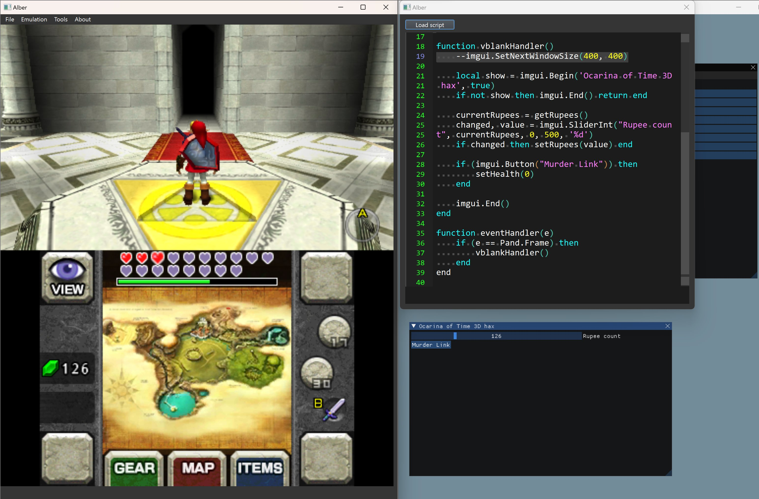
Exploring new territory in 3DS emulation
Panda3DS comes with Lua scripting, including a text editor, so developers can make all sorts of scripts & mods, testing them fully within the app!
Notes:
Panda exposes several functions such as memory handlers you can call from Lua and events you can register a callback into such as the Frame event

Slide 43
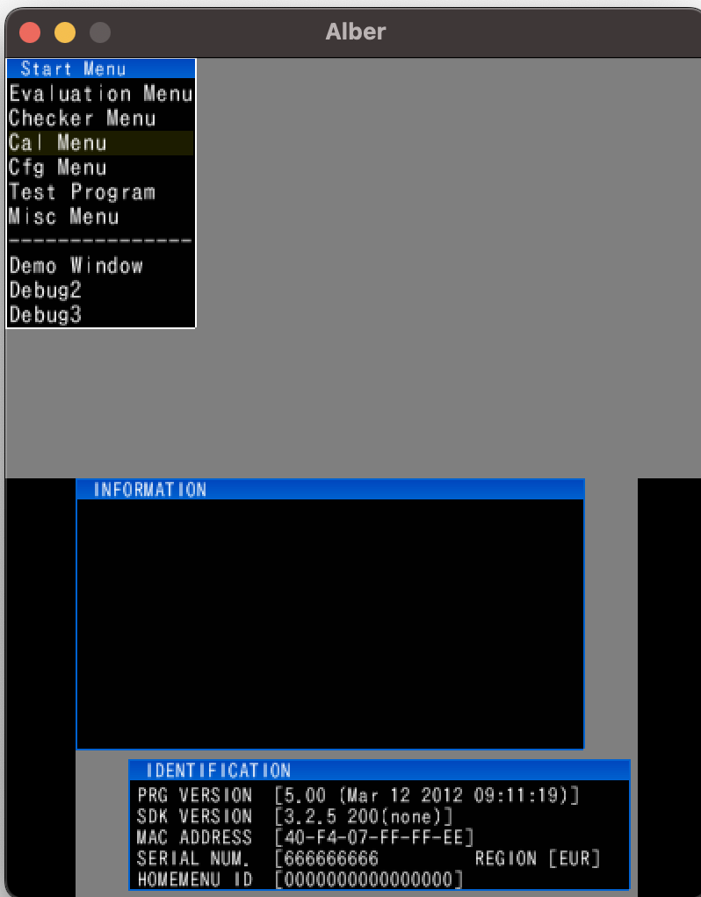
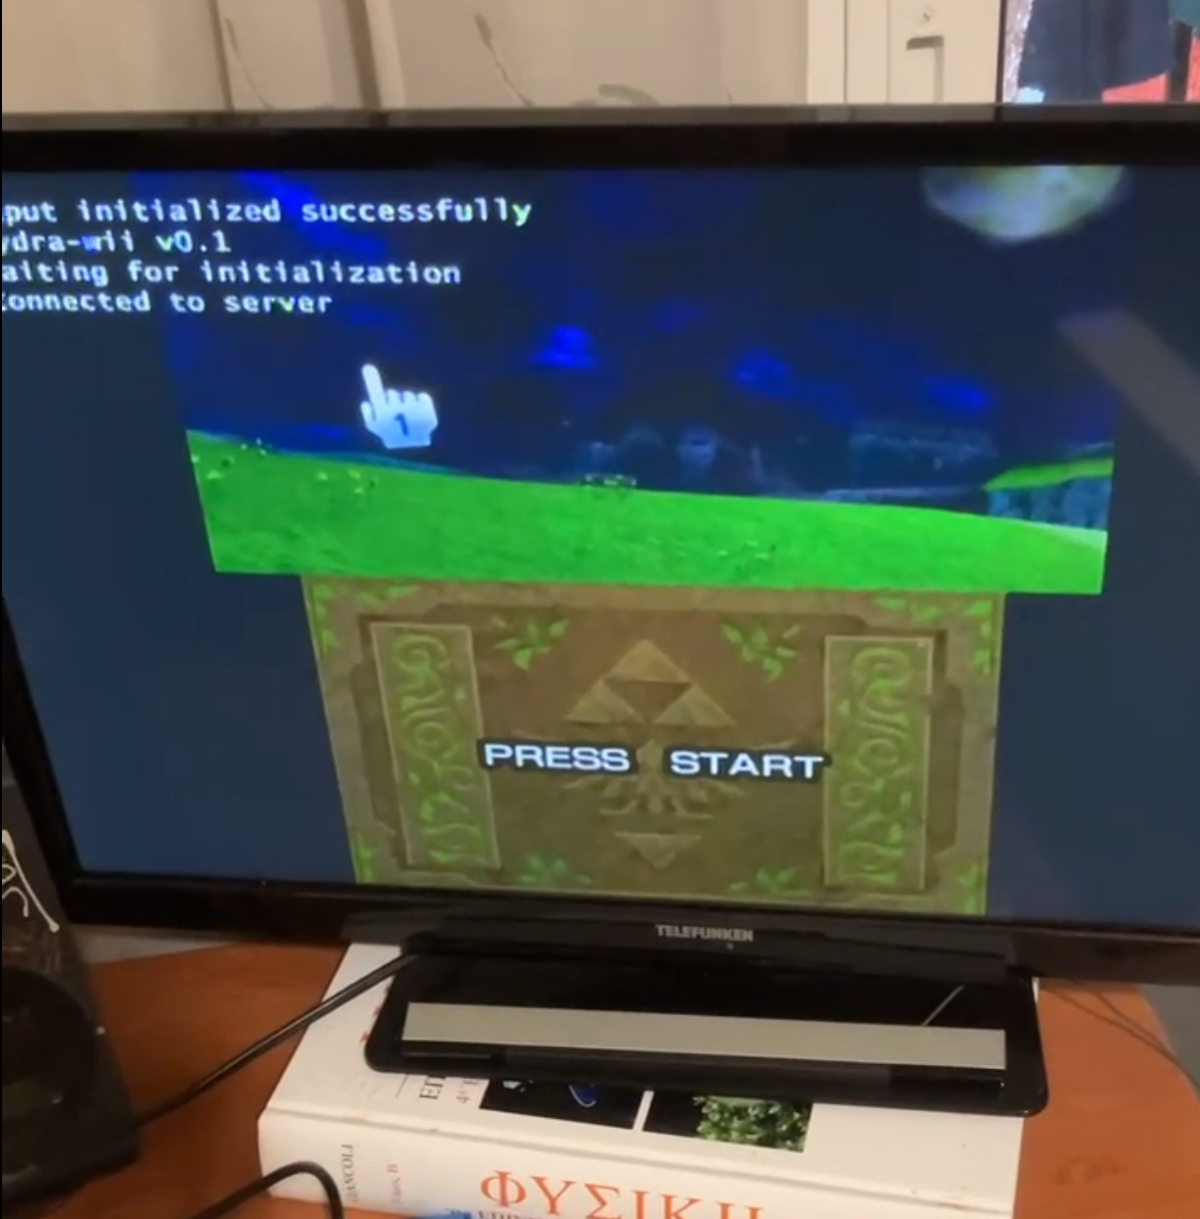
Exploring new territory in 3DS emulation
A Panda3DS dev branch running CTRAging, a factory test program some other emulators may struggle with
Panda3DS running on Wii, via HTTP streaming
Notes:
TODO: Why would other emulators struggle? Panda contains a web server that implements a REST API that can be used to control Panda3DS from other programs and scripts

Slide 44
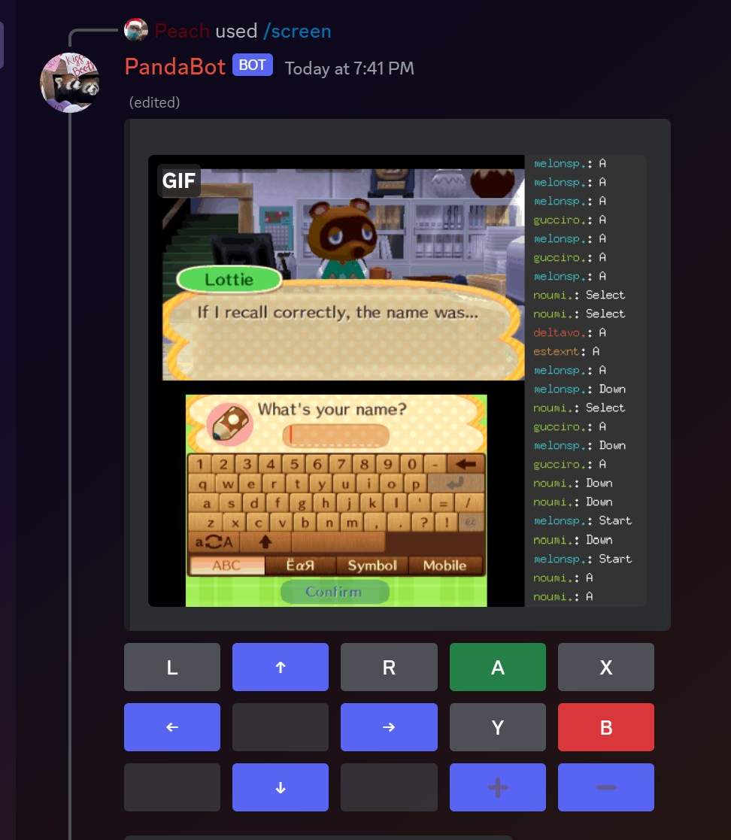
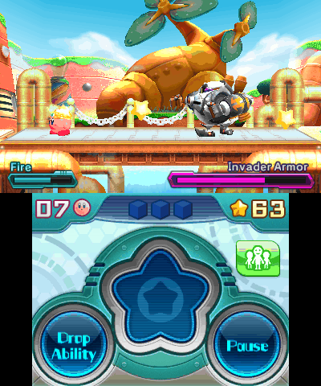
Exploring new territory in 3DS emulation
Revolutionary UI (Has panda icons)
Play on Discord with all of your friends!

Slide 45
Star us on GitHub Thx
panda3ds.com
Panda Πάντα 熊猫 Панда Պանդա पांडा 팬더 الباندا パンダ

Slide 46
Inside ARM11 MPCore
3 Instruction Sets
ARMv6K Architecture 32-bit
ARM
Thumb
Jazelle
VFPv2
Vector Floating Point Faster processing of single/double precision
floats
Media Instructions for Video/Audio
16KB I-Cache
Branch Predictor
MMU for running multitasking OSes
16KB D-Cache
Out-of-Order Completion for some instructions
+ Multicore Coherency & More
Notes:
The ARM11 MPCore features the ARMv6k architecture, comprised of 3 instruction sets.
- ARM, the 32 bit main instruction set
- Thumb, a 16 bit reduced instruction set for backwards compatibility and improved code density
And Jazelle, a proprietary extension that executes Java bytecode in hardware, wasn't reverse engineered until recently nor is it used in the 3DS aside from some homebrew.
There's a vector floating point unit that deals with the 32 floating point registers, SIMD instructions for media support, mostly used for decoding, an MMU for running multitasking Operating systems a 16 KB instruction and data cache, branch predictor and Out of order completion for some instructions. 3DS code mostly uses the ARM instruction set, though Thumb is also used in the OS and in some game code.

