Slide 1
Netdata the open-source observability platform everyone needs
Costa Tsaousis

Slide 2
About Netdata
Born out of a need While migrating a large infra from on-prem to cloud, we were facing unexplainable issues - existing monitoring solutions (open-source and commercial) failed to diagnose, or even surface.
Born out of curiosity Experimented to understand if and how a monitoring solution could be real-time, high-resolution, easier, simpler and out of the box.
Born on GitHub, open-source from the very beginning The love and adoption by the community gave substance and a future to Netdata.
GitHub URL:

Slide 3
The Netdata way
Auto-discover 800+ integrations and k8s autodiscovery supported.
Collect Pull and Push model, using the optimal protocol for each application.
Store Embedded high performance time-series database.
Learn Unsupervised Machine Learning for every metric.
Check Predefined & custom alerts and notifications.
Query & Score API for querying, analyzing, scoring and correlating time-series data.
Visualize Fully automated dashboards.
Stream & Replicate Build metrics centralization points.
Netdata is a monitoring in a box

Slide 4
Netdata on an empty VM
200+ dashboard chars, 2000+ unique time-series CPU, Memory, Disks, Mount Points, Filesystems, Network Interfaces, the whole Networking Stack for all Protocols, Firewall, systemd Units, Processes, Users, User Groups and more. All collected and visualized with 1-second granularity.
50+ unique alerts, on 100+ components Checking the health of every single component the system has, for common errors, misconfigurations, and error conditions.
systemd-journal logs explorer Visualize the explore system and application logs, by directly querying systemd journals, without the need of logs database server.
Network explorer Visually explore all network sockets (to be release this month).
Unsupervised anomaly detection 18 Machine Learning models are trained for each time-series collected, modeling the behavior of each metric over the last few days, offering outlier detection in real-time, during data collection.
2 months of retention using 500MB of disk space 3 days of high-res (per-sec), 2 weeks of mid-res (per-min), 2 months of low-res (per-hour).
1% CPU of a single core, 120MB RAM, almost zero disk I/O Optimized for speed and efficiency, a nice companion for production systems and applications.
What you get by just installing Netdata on an empty VM

Slide 5
The Netdata way - standalone
Install the agent on all your systems.
Dashboards
Metrics & Logs
Alerting
S1
S2
S3
S4
S5
Servers

Slide 6
The Netdata way - distributed fully on-prem
Install the agent on all your systems,
Use a Netdata Parent for a unified view.
Dashboards
Metrics & Logs
Netdata Parent
Alerting
S6
Netdata Parent is the same open-source software to all other Netdata.
S1
S2
S3
S4
S5
Servers
Cloud Provider 1

Slide 7
The Netdata way - multi-level
Netdata Grandparent
Dashboards
Metrics & Logs
Alerting
GP
Netdata Parent
PA
PC
Netdata Parent
Netdata Parent
PB
A1
A2
A3
A4
A5
C1
C2
C3
C4
C5
Data Center 1
Data Center 2
B1
B2
B3
B4
B5
Cloud Provider 1

Slide 8
Netdata vs Prometheus
-35% CPU Utilization Netdata: 1.8 CPU cores per million of metrics/s Prometheus: 2.9 CPU cores per million of metrics/s
-49% Peak Memory Consumption Netdata: 49 GIB Prometheus: 89 GiB
-12% Bandwidth Netdata: 227 Mbps Prometheus: 257 Mbps
-98% Disk I/O Netdata: 3 MiB/s (no reads, 3 MiB/s writes) Prometheus: 129 MiB/s (73.6 MiB/s reads, 55.2 MiB/s writes)
-75% Storage Footprint Netdata: 10 days per-sec, 43 days per-min, 467 days per-hour Prometheus: 7 days per-sec
Stress tested Netdata parent and Prometheus with 500 servers, 40k containers, at 2.7 million metrics/s
:full comparison URL

Slide 9
Netdata is the most energy efficient platform!
In December 2023, University of Amsterdam published a study related to the impact of monitoring tools for Docker based systems, aiming to answer 2 questions:
What is the impact of monitoring tools on the energy efficiency of Docker-based systems?
What is the impact of monitoring tools on the performance of Docker-based systems?
They tested ELK, Prometheus, Netdata and Zipkin, under 9 different configurations.
This is how Netdata stands:
Netdata excels in energy efficiency: "... Netdata being the most energy-efficient tool ...", as the study says.
Netdata excels in CPU Usage, RAM Usage and Execution Time.
Netdata outperforms all other monitoring solutions in energy efficiency!
:full comparison URL

Slide 10
Netdata in CFNF
Netdata 66.9k stars The open-source observability platform everyone needs!
Elasticsearch 66.6k stars Free and Open, Distributed, RESTful Search Engine.
Grafana 59.1k stars The open and composable observability and data visualization platform. Visualize metrics, logs, and traces from multiple sources like Prometheus, Loki, Elasticsearch, InfluxDB, Postgres and many more.
Prometheus 51.6k stars The Prometheus monitoring system and time series database.
Jaeger 19.0k stars CNCF Jaeger, a Distributed Tracing Platform.
Fluentd 12.6k stars Fluentd: Unified Logging Layer (project under CNCF).
Netdata is leading the observability category in the CNCF landscape, in terms of users’ love.
Disclaimer: Netdata is a member of, and supports CNCF, but the project is not endorsed nor incubating in CNCF (because we don’t want to). This list indicates only users’ love, expressed as Github stars.

Slide 11
Netdata Challenge 1: from zero to hero, today!

Slide 12
We have a lot in common
Similar physical or virtual hardware We all use a finite set of physical and virtual hardware. This hardware may be different in terms of performance and capacity, but the technologies involved are standardized.
Similar operating systems We all use flavors of a small set of operating systems, exposing a finite set of metrics covering the monitoring of all system components and operating system layers.
Packaged applications Most of our infrastructure is based on packaged applications, like web servers, database servers, message brokers, caching servers, etc.
Standard libraries Even for our custom applications, we usually rely on packaged libraries that expose telemetry in a finite and predictable way.
Since we have so much in common, why it takes so long to set up a monitoring solution?

Slide 13
NIDL, the model for rapid deployment
Nodes The node the data are coming from.
Contexts The kind of metrics, like “disk.io”, “cgroup.cpu”, “nginx.requests”. Equivalent with the metric name in Prometheus.
Instances The unique instances of the things being monitored. For example “/dev/sda” and “/dev/sdb” are two instances (disks) for which we monitor “disk.io” (context). Equivalent of a combination of some of the labels of a metric in Prometheus.
Dimensions The attributes of the instances monitored. For example “read” and “write” are Dimensions of the “disk.io” context, of the “/dev/sda” instance (disk). Dimensions get values and maintain a time-series. Equivalent of a unique time-series in Prometheus.
NIDL stands for: - Nodes - Instances - Dimensions - Labels The name comes from the slicing and dicing controls on all Netdata charts.

Slide 14
NIDL: how it looks?
Every chart on the dashboard is a context, aggregating all the instances from all nodes selected, for the visible timeframe. Dashboard configuration is done per context. Example: apply units to all dimensions, set default dicing settings, provide additional information to help users understand what they see, and more.
Context (disk.io)
Alerts are configured for contexts, but they are applied to instances. Example: “apply this disk.io alert to all disks” or even “apply this disk.io alert to all NVME disks”.
Instance (/dev/sda)
Instance (/dev/sdb)
Instance (/dev/sdc)
Instances have labels, and alert variables related to the component they refer to (for example, disks have a model, a serial number, a kind, etc).
Variables lookup is smart to match the component the alert is linked to.
read
write
read
write
read
write
Dimensions have values, time-series data.

Slide 15
NIDL: how it looks?
Component 1 /dev/sda
Component 2 /dev/sdb
Common Label Values
Instance (of disk.io) MiB/s
Instance (of disk.ops) IOPs
Instance (of disk.busy) ms
Instance (of disk.io) MiB/s
Instance (of disk.ops) IOPs
Instance (of disk.busy) ms
Common Label Values
read
write
read
write
busy
read
write
read
write
busy
Common Units, Dimension names, Variable names
Common Label names

Slide 16
NIDL: the result
Netdata incorporates all the knowledge and skills required to set up a monitoring system
Fully automated visualization Netdata visualizes all metrics in a meaningful way, by correlating the right dimensions together and applying the right settings for each case.
Fully automated alerts Netdata comes with preconfigured alerts for 350 unique components and applications. All these alert templates are applied automatically to the right components, applications and charts.
Slice and dice easily from the UI The NIDL framework enables easy slicing and dicing of the data from the UI, without the need to learn a query language.

Slide 17
Mission accomplished!
Just install it One moving part: Netdata. Batteries included! (i.e. data collection plugins and all needed modules are shipped with Netdata).
Auto-discovers all metrics Data collection does not require configuration, unless the monitored data are password protected (Netdata needs the password). Data collection plugins provide metrics with the NIDL framework embedded into them.
Fully automated visualization Dashboards are available 1 second after Netdata starts.
Pre-configured alerts If something is wrong, an alert will fire-up just a few seconds after installation.
High Fidelity High granularity: per second data collection and visualization as a standard. High cardinality: the more metrics the better the troubleshooting gets.
Designed to be installed mid-crisis!

Slide 18
Netdata Challenge 2: get rid of the query language for slicing and dicing data

Slide 19
Slice and dice from the UI
Netdata collects a vast number of metrics you will probably see for the first time
Since users haven’t configured the metrics themselves, can we provide a UI that can explain what users see?
How users will be able to slice and dice the data on any chart, the way it makes sense for them?

Slide 20
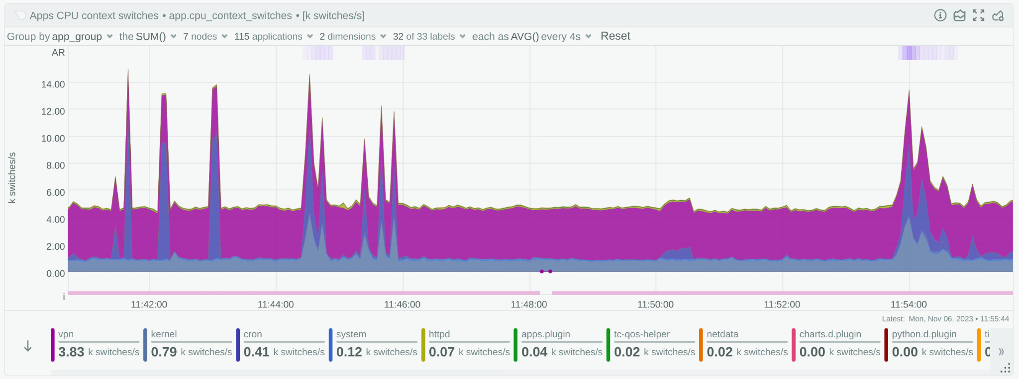
A Netdata Chart
:Netdata Parent URL
Netdata Cloud Live Demo URL:

Slide 21
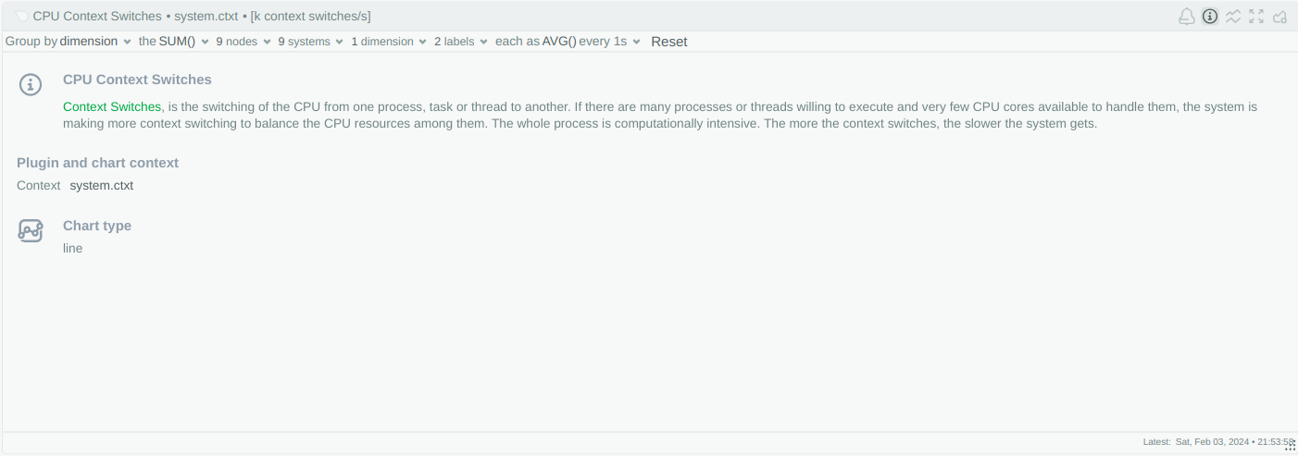
Info Button: Help about this chart
Info button includes links to relevant documentation and/or some helpful message about the metrics on each chart.

Slide 22
A Netdata Chart - controls
NIDL Controls - review data sources and slice/filter them
(NIDL = Nodes, Instances, Dimensions, Labels)
Aggregation across metrics
Aggregation
across time
Dice
the data
Anomaly
rate ribbon
Info
ribbon

Slide 23
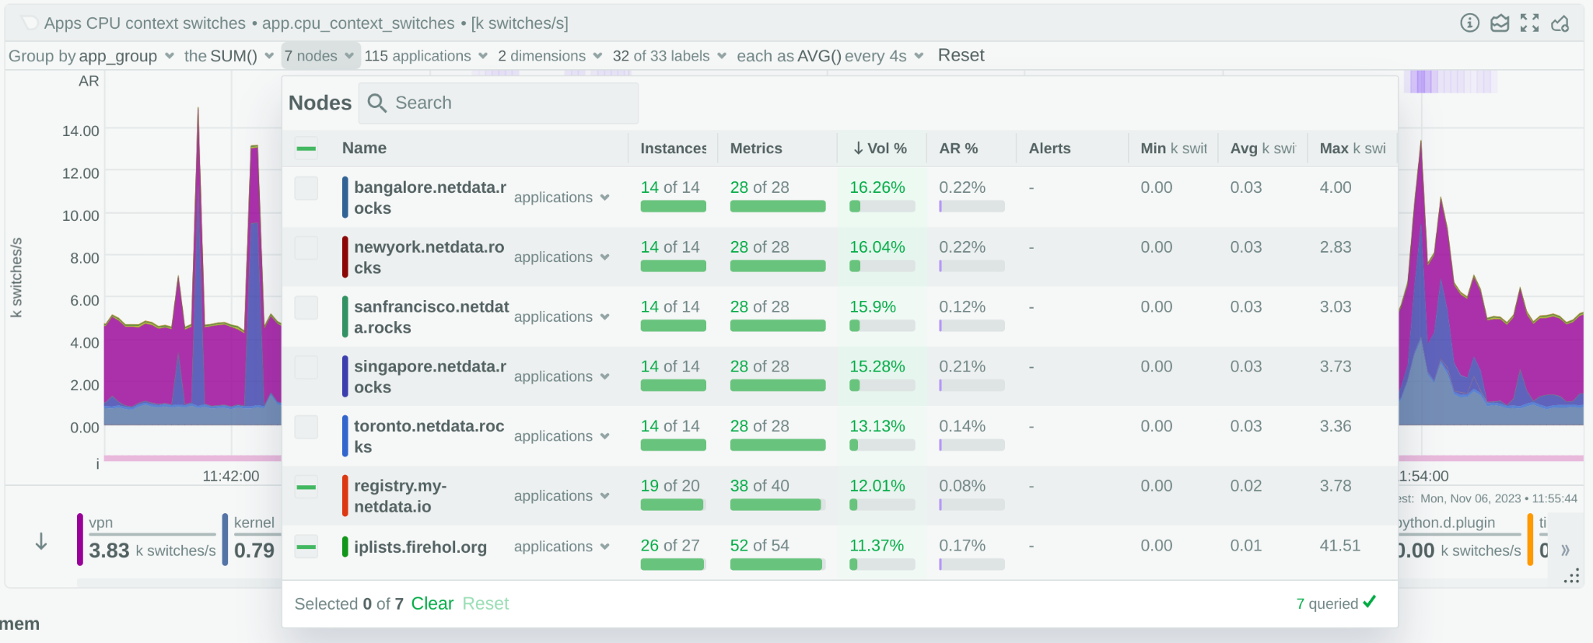
A Netdata Chart - anomaly rate per node
Similar analysis is available per Instance (“application” in this chart), dimensions, and labels.
Clicked on Nodes
Instances per Node contributing to this chart
The visible volume each Node is contributing to this chart
The minimum, average and maximum values across all metrics this Node contributes
Filter Nodes
contributing data to this chart
Unique time-series per Node contributing to this chart
The anomaly rate each Node contributes to this chart

Slide 24
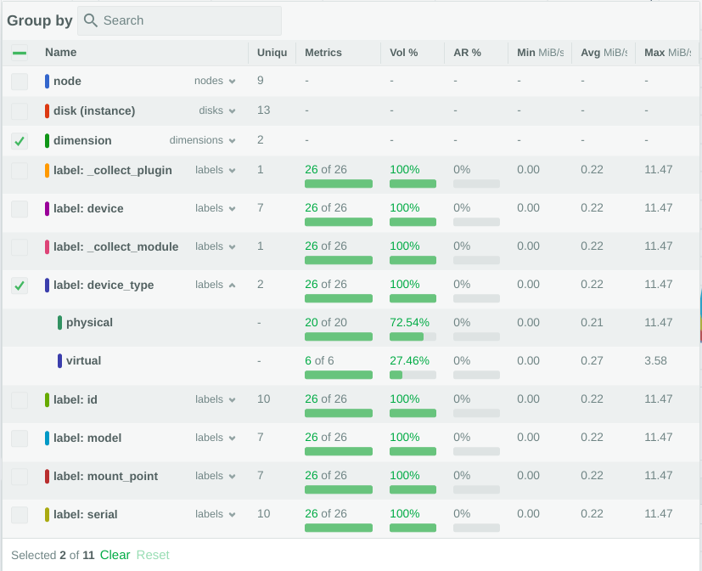
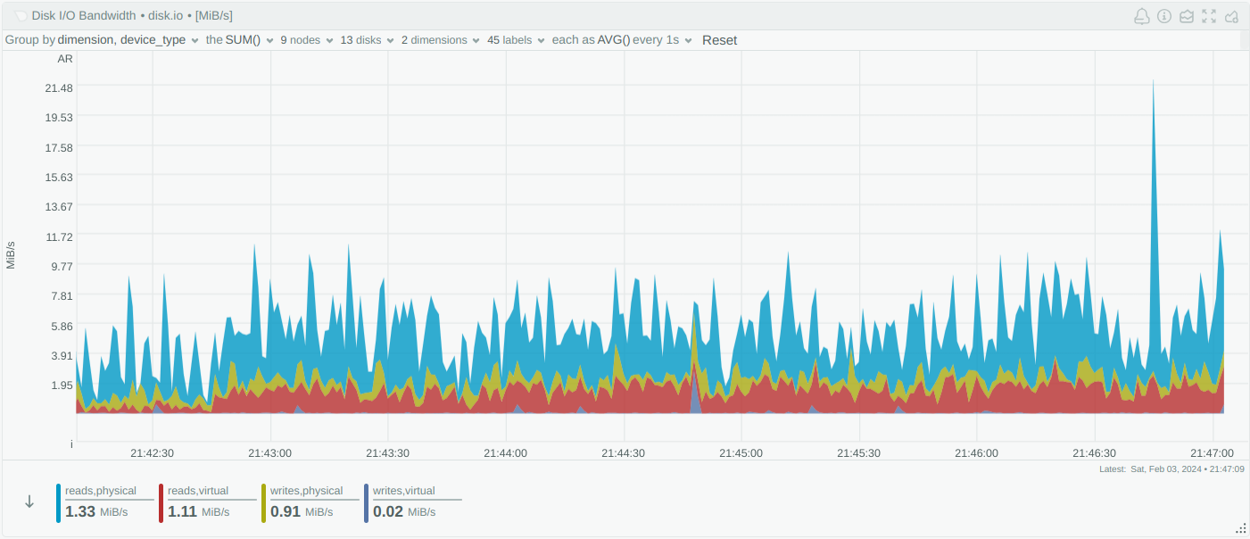
Dicing any chart, without queries
Result: dimension,device_type

Slide 25
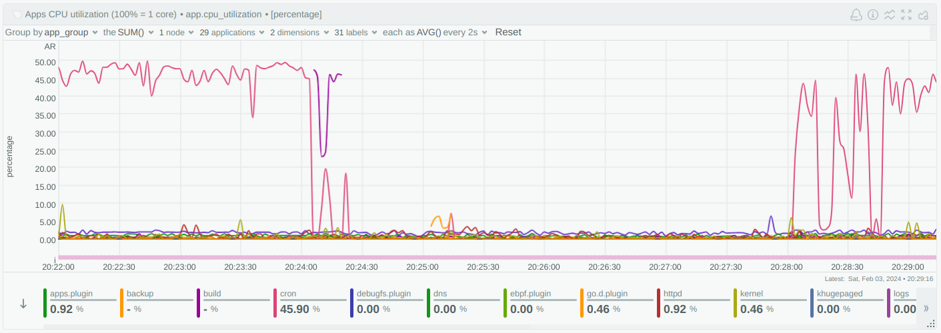
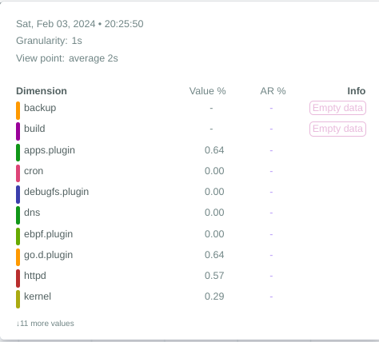
Info Ribbon: Missing data collections
A missed data collection is a gap, because something is wrong!
Netdata does not smooth out the data.

Slide 26
Mission accomplished!
The Netdata query engine, does all the calculations, for all drop down menus and ribbons in one go and returns everything in a single query response.
All queries, include all information needed:
Per Node
Per Instance (disk, container, database, etc)
Per Dimension
Per Label Key
Per Label Value
Providing:
Availability of the samples (gaps), over time
Min, Average and Maximum values
Anomaly Rate for the visible timeframe
Volume contributing to the chart
Number of Nodes, Instances, Dimensions, Label Keys, Label Values matched
All this additional information is available on every query, every chart, every metric!

Slide 27
Netdata Challenge 3: make machine learning and anomaly detection useful for observability

Slide 28
AI for observability is tricky
Google:
All of Our ML Ideas Are Bad (and We Should Feel Bad)
Wednesday, 2 October, 2019
Todd Underwood, Google
The vast majority of proposed production engineering uses of Machine Learning (ML) will never work. They are structurally unsuited to their intended purposes. There are many key problem domains where SREs want to apply ML but most of them do not have the right characteristics to be feasible in the way that we hope. After addressing the most common proposed uses of ML for production engineering and explaining why they won't work, several options will be considered, including approaches to evaluating proposed applications of ML for feasibility. ML cannot solve most of the problems most people want it to, but it can solve some problems. Probably.
:URL

Slide 29
What does Netdata do with Machine Learning?
Trains a ML model per metric, every 3 hours, using the last 6 hours of data of each metric.
Maintains 18 ML models per metric, covering the last few days.
Detects anomalies in real-time, while data are being collected every second.
All available ML models for a metric need to agree that a collected sample is an outlier, for Netdata to consider it an Anomaly.
Stores Anomaly Rate together with collected data.
Calculates Host-level Anomaly Score.
Default ML Configuration In Netdata

Slide 30
Netdata’s scoring engine
A scoring engine, a unique feature across all monitoring systems.
All metrics, independently of their context, can be scored across time, based on various parameters, including their anomaly rate.
Metrics correlations is a subset of the scoring engine, that can score metrics based on their rate of change (data), anomaly rate of change (anomaly rate), but also based on volume, similarity, and more.
Netdata can score all metrics based on their anomaly rate for any given time-frame!

Slide 31
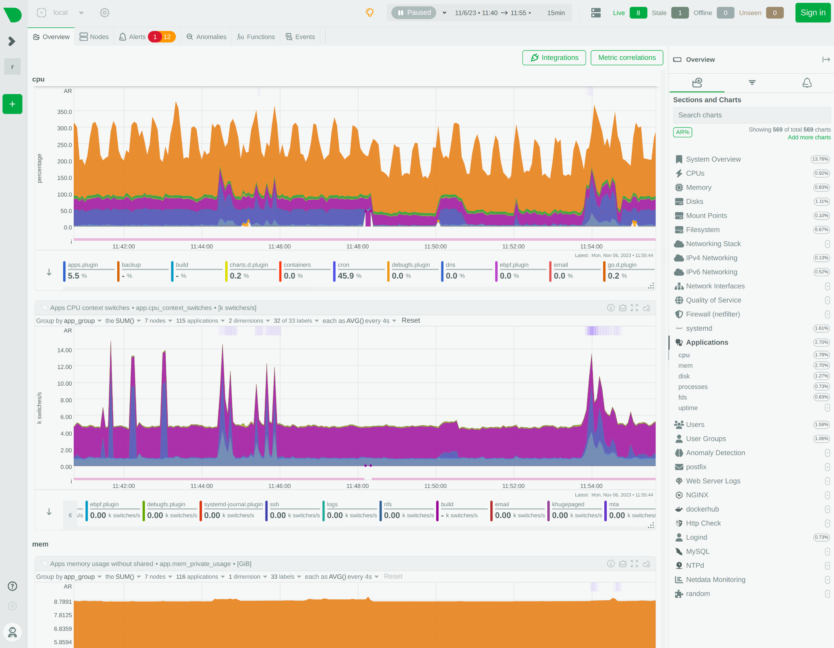
A Netdata dashboard
One fully automated dashboard, with infinite scrolling, presenting and grouping all metrics available.
Quick access to all sections using the index on the right.
Multi-dimensional data on every chart, using chart controls to slice and dice any dataset.
AI assisting on every step.

Slide 32
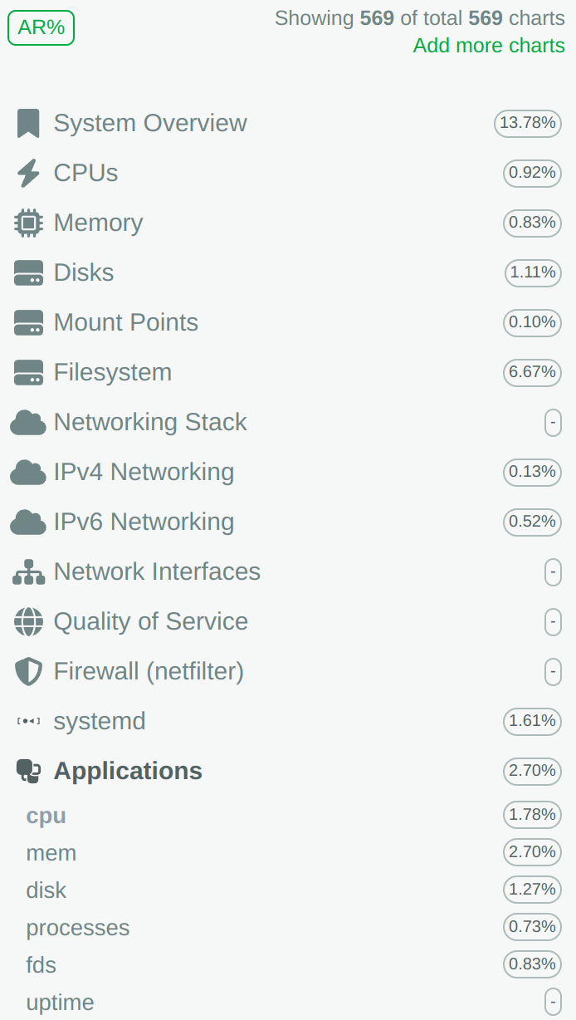
A Netdata Dashboard - what is anomalous?
Anomaly Rate button
Time-frame picker
Anomaly rate per section for the time-frame

Slide 33
Anomaly Advisor
Anomaly advisor assists in finding the needle in the haystack.
Uses Host Anomaly Rate to identify durations of interest.
Host Anomaly Rate is the percentage of the metrics of a host, that were found to be anomalous concurrently.
So, 10% host anomaly rate, means that 10% of all the metrics the host exposes, were anomalous at the same time, showing the spread of an anomaly.

Slide 34
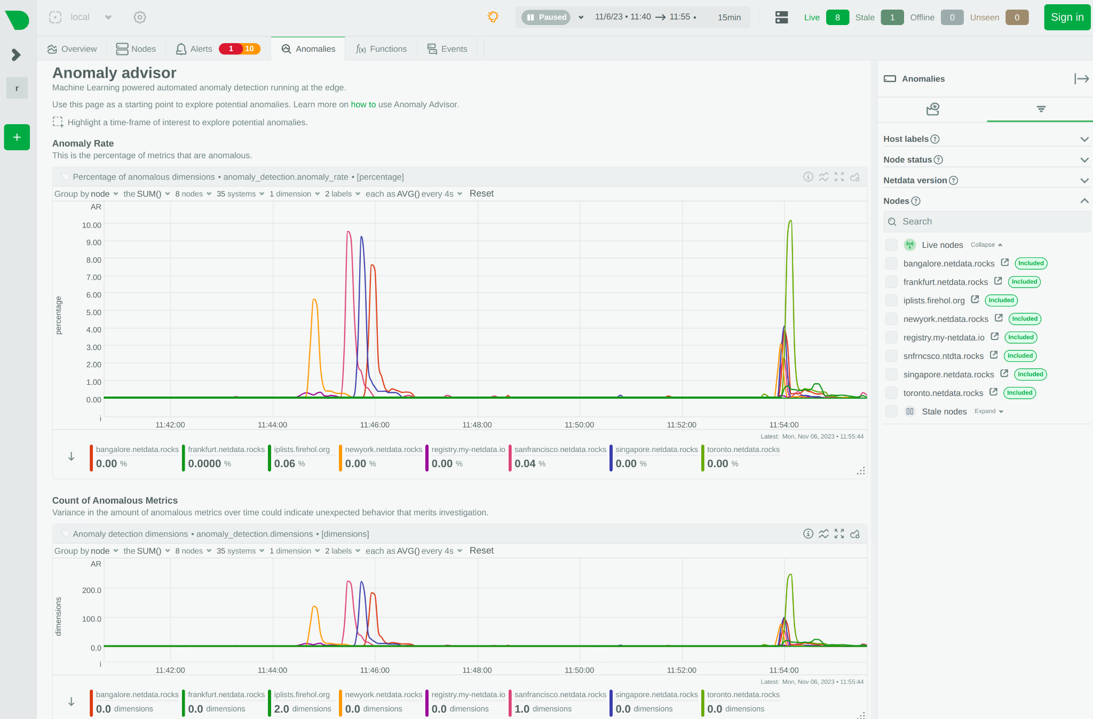
Anomaly Advisor - starting point
Percentage of Host Anomaly Rate
Number of metrics concurrently anomalous

Slide 35
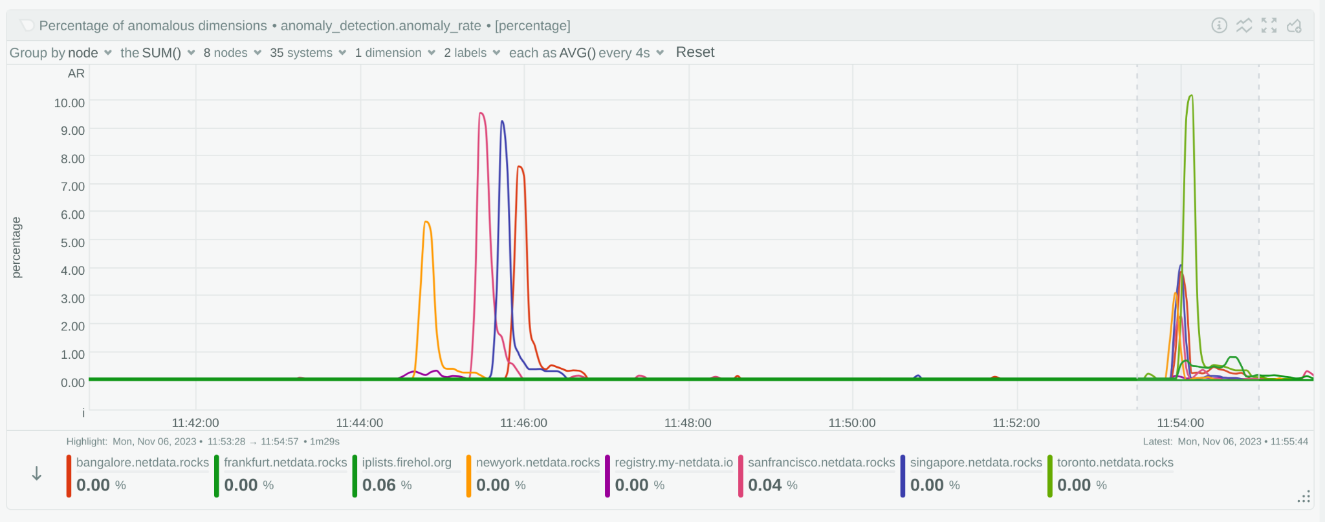
Anomaly Advisor - triggering the analysis
Highlighting an area on the chart, triggers the analysis

Slide 36
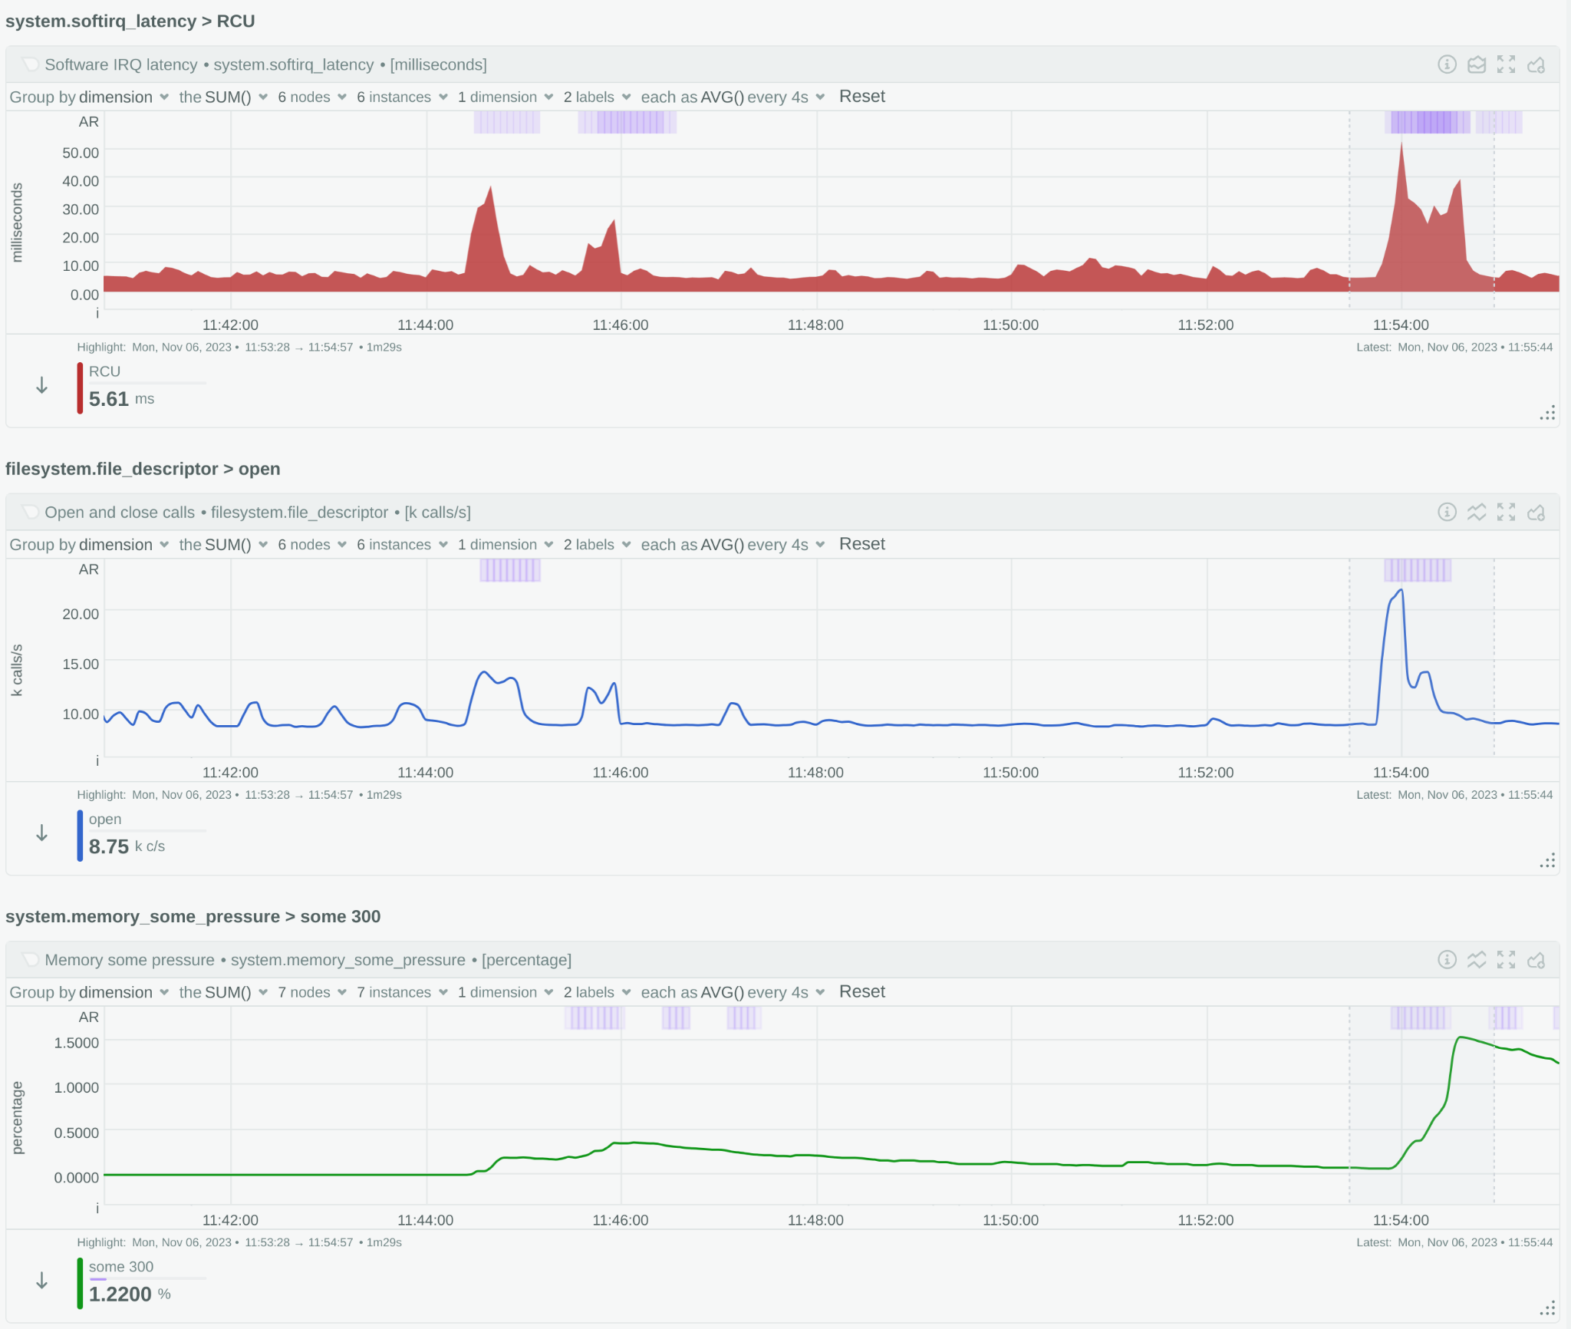
Anomaly Advisor - the analysis
Anomaly advisor presents a sorted list of all metrics, ordered by their anomaly rate, during the highlighted time-frame.

Slide 37
Mission accomplished!
Netdata turns AI to a consultant that can help you spot what is interesting, what is related, what needs your attention.
Unsupervised There are plenty of settings, but it just works behind the scenes, learning how metrics behave and providing an anomaly score for them.
It is just another attribute for each of your metrics Anomaly Rate is stored in the metrics database together with every sample collected, making it possible to query the past for anomalies.
Can detect the spread of an anomaly across systems and applications.
Can assist finding the aha! moment while troubleshooting.
Unsupervised Anomaly Detection is an advisor!

Slide 38
Netdata Challenge 4: Make logs exploration and analytics, easy and affordable.

Slide 39
Systemd-journald
Is available everywhere! We use it already, even when we don’t realize it.
Is secure by design!
FSS, to seal the logs
Survives disk failures (uses tmpfs)
Its file format is designed for minimal data loss on disk corruption
Is unique!
Supports any number of fields, even per log entry (think huge cardinality)
Indexes all fields provided
Queries on any combination of fields
Maintenance free - just works!
Amazing ingestion performance!
Can build logs centralization points It provides all the tools and processes to centralize all the logs of an infra to a central place.
systemd-journald is a hidden gem, that already lives in our systems!

Slide 40
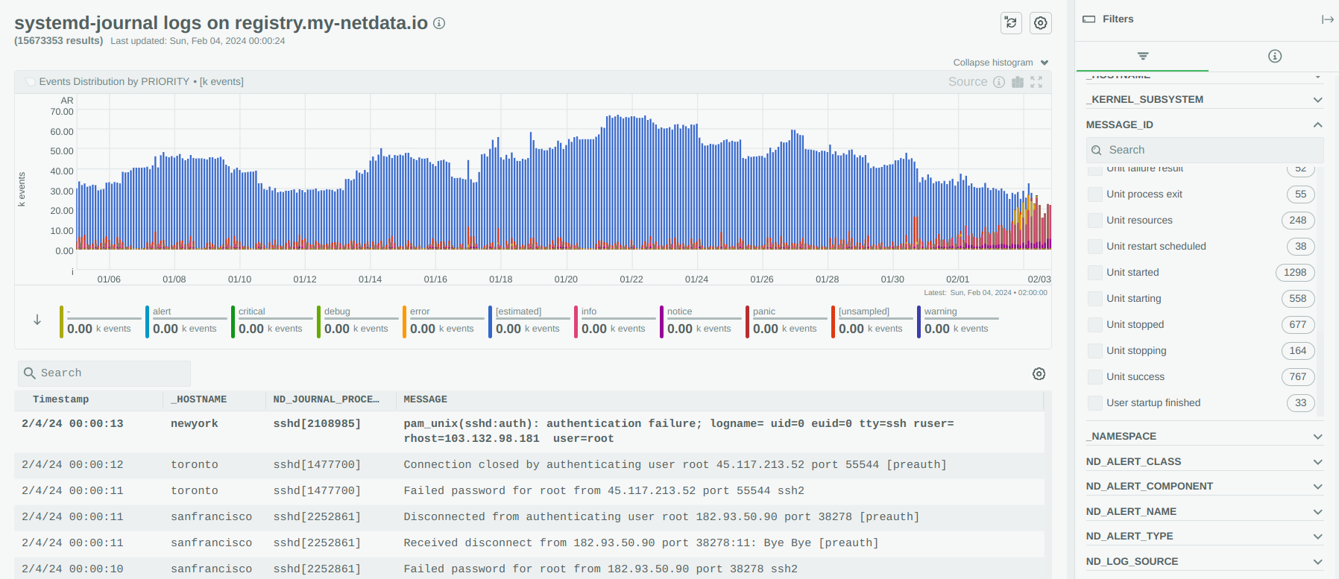
Netdata systemd-journal Logs Explorer

Slide 41
Systemd-journald: it is slow to query
Yes and No. The query performance issues are simple implementation glitches, easy to fix.
We submitted patches to systemd We analyzed journalctl and found several issues that once fixed they improve query performance 14x. We submitted these patches to systemd.
Netdata systemd-journal Explorer We managed to bypass all the performance issues systemd-journal has, independently of the version of systemd installed on a system. Netdata is fast when querying systemd-journal logs on all systems, even with a slow systemd-journal and journalctl.
systemd-journal is not slow when used with Netdata

Slide 42
Systemd-journald: it lacks integrations
Yes it did. Generally, very few tools are available to push structured logs to systemd-journals.
Netdata log2journal We released log2journal, a powerful command line tool to convert any kind of log into structured systemd-journal entries. Think of it as the equivalent to promtail. For json and logfmt formatted logs, almost zero configuration is needed.
Netdata systemd-cat-native We released systemd-cat-native, a tool similar to the standard systemd-cat, which however allows sending a stream of entries formatted in the systemd-journal native format to a local or remote systemd-journald.
The value of a logging system depends on its integrations
:URL for log2journal

Slide 43
Systemd-journald: key weakness
The storage requirements for systemd-journal files are significantly higher than other log management solutions, like Loki.
So, systemd-journald:
outperforms others in ingestion performance
uses significantly less resources during ingestion,
is way more secure, reliable and fault tolerant,
is the definition of flexibility, supporting any number of fields, in any cardinality,
It has a drawback: it needs a lot more disk space for the same data!
In our tests: 10 times more. A compressed filesystem can help reduce this to 4 times more.
The key weakness of systemd-journald is its storage space requirements

Slide 44
Mission accomplished!
Netdata provides the easiest and more efficient way to access your logs, by utilizing resources and tools you already use today.
Netdata provides all the tools and dashboards to explore and analyse your system and applications logs, without actually requiring a dedicated logs database server.
Despite the storage requirements of systemd-journald, the tool is amazing, especially for developers, since it provides great flexibility and troubleshooting features.
Even if you don’t want to push your traefik, haproxy or nginx access logs to it due to its storage requirements, we strongly recommend to use it for application error logs and exceptions. Your troubleshooting efforts can become a lot simpler with this environment.

Slide 45
Netdata Challenge 5: Observability is more than metrics, logs and traces. What is missing?

Slide 46
Challenge
To completely understand or effectively troubleshoot an issue, metrics, logs and traces may not be enough.
What if we need to examine:
the slow queries on a database,
the list of network connections an application has,
the files in a filesystem,
… and the plethora of non-metric, non-log, non-tracing information available?
Most monitoring systems give up. You have to use the console of your database server, ssh to the server, or (for others :) restart the problematic component or application and hope the issue goes away…
Can a monitoring system help?
To completely understand, or effectively troubleshoot an issue, we need more!

Slide 47
Netdata Functions
Netdata Grandparent
User is accessing a function exposed by a data collection plugin on B5
Alerting
GP
Netdata Parent
PA
PC
Netdata Parent
Netdata Parent
PB
A1
A2
A3
A4
A5
C1
C2
C3
C4
C5
Data Center 1
Data Center 2
B1
B2
B3
B4
B5
plugin
function
Cloud Provider 1

Slide 48
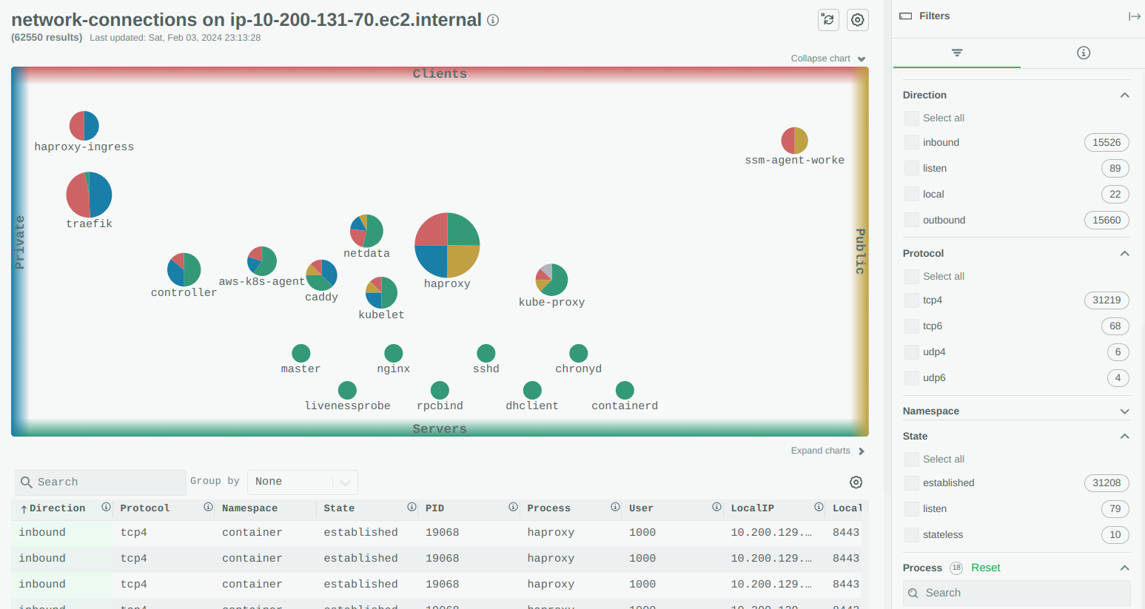
Example: Network Connections Explorer

Slide 49
Mission accomplished!
Data collection plugins expose Functions. Functions have a name, some parameters, accept a payload, return a payload and require some permissions to access them. All these can be custom for each and every function.
Parents are aware of their childrens’ Functions. Parents are updated in real-time about changes to Functions, so that all nodes involved in a streaming and replication chain are always up to date for the available functions of the entire infra behind them.
Dashboards provide the list of Functions.
Netdata UI supports widgets for Functions. We are standardizing a set of UI widgets capable of presenting different kinds of data, depending on which is the most appropriate way for them to be presented.
Functions are data collection plugin features to query non-metric data of any kind

Slide 50
Netdata Monetization Strategy

Slide 51
Monetization through SaaS
Horizontal Scalability NC provides unified dashboards and alerts, and dispatches alerts centrally, without the need to centralize all data on one server. Behind the scenes it queries multiple Netdata and aggregates their responses on the fly.
Role Based Access Control (RBAC) NC allows grouping infrastructure and users in “war rooms”, limiting and controlling users’ access to the infrastructure. NC also acts as a Single-Sign-On provider for all your Netdata, limiting what users can see even when they access Netdata directly.
Access from anywhere NC allows accessing your Netdata servers from anywhere, without the need for a VPN.
Mobile App for Notifications NC enables the use of the Netdata Mobile App (iOS, Android) for receiving alert notifications.
Persisted Customizations and Dynamic Configuration NC enables dynamic configuration and stores user settings, custom dashboards, personalized views and related settings and options, per node, user, room, and space.
Netdata Cloud (NC) complements Netdata
IMPORTANT Netdata Cloud does not centralize your data. Your data are always, and exclusively on-prem, inside the Netdata you install. Netdata Cloud queries your Netdata in real-time, to present dashboards and alerts.

Slide 52
Thank You!
:GitHub URL, https://github.com/netdata/netdata
Costa Tsaousis

Slide 53
The Netdata way
High fidelity monitoring All metrics are collected per second. Thousands versus hundreds of metrics. Hundreds versus dozens of alerts.
All metrics are visualized Fully automated infrastructure level dashboards, visualizing all metrics collected.
Powerful visualization Slice and dice any dataset, using controls available on all charts. No need to learn a query language.
Unsupervised anomaly detection Detects anomalies by learning the behavior of each metric.
Out of the box alerts Predefined alerts use rolling windows and statistical functions to detect common issues, without fixed thresholds.
From Zero
To Hero
Today!

Slide 54
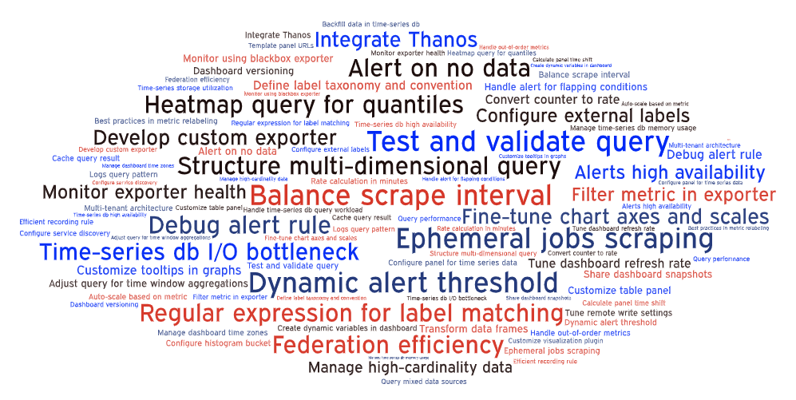
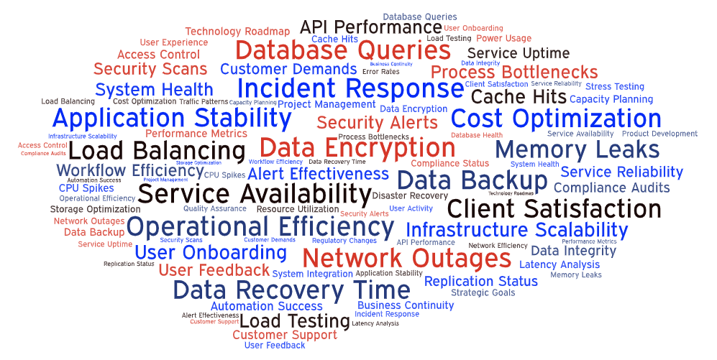
Why Netdata?
We get lost in a sea of challenges related to monitoring…
…instead of improving our infrastructure!

