Slide 1
Tansu, a reactive library for all
Florent Exbrayat
3/02/2024
Amadeus. It’s how travel works better.
Notes:
Reactivity system
Computed
Batch
Synchrone
Usage in utils
What makes AgnosUI unique

Slide 2
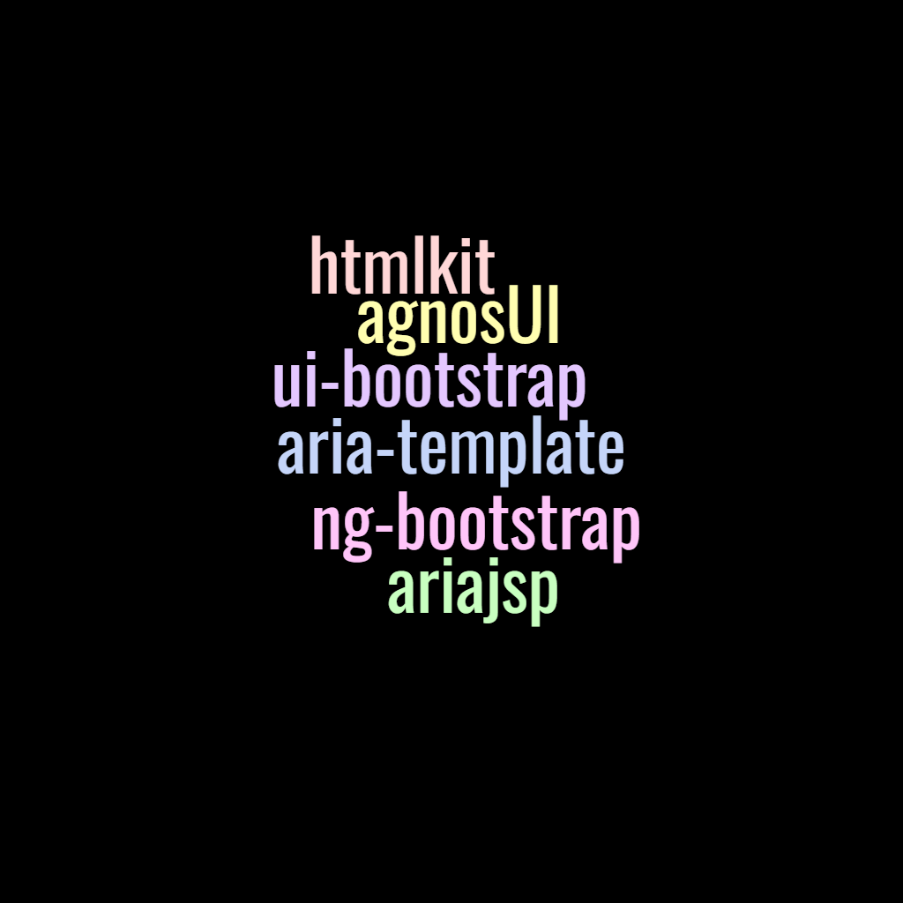

Slide 3
Agenda
Tansu a Signal library
Tansu’s features
AgnosUI
Why Tansu for AgnosUI

Slide 4
Tansu a signal library
Notes:
A signal library is a library to do state management in a reactive way.
Signals is an event-driven programming paradigm that enables developers to create custom events and event listeners within their JavaScript code

Slide 5
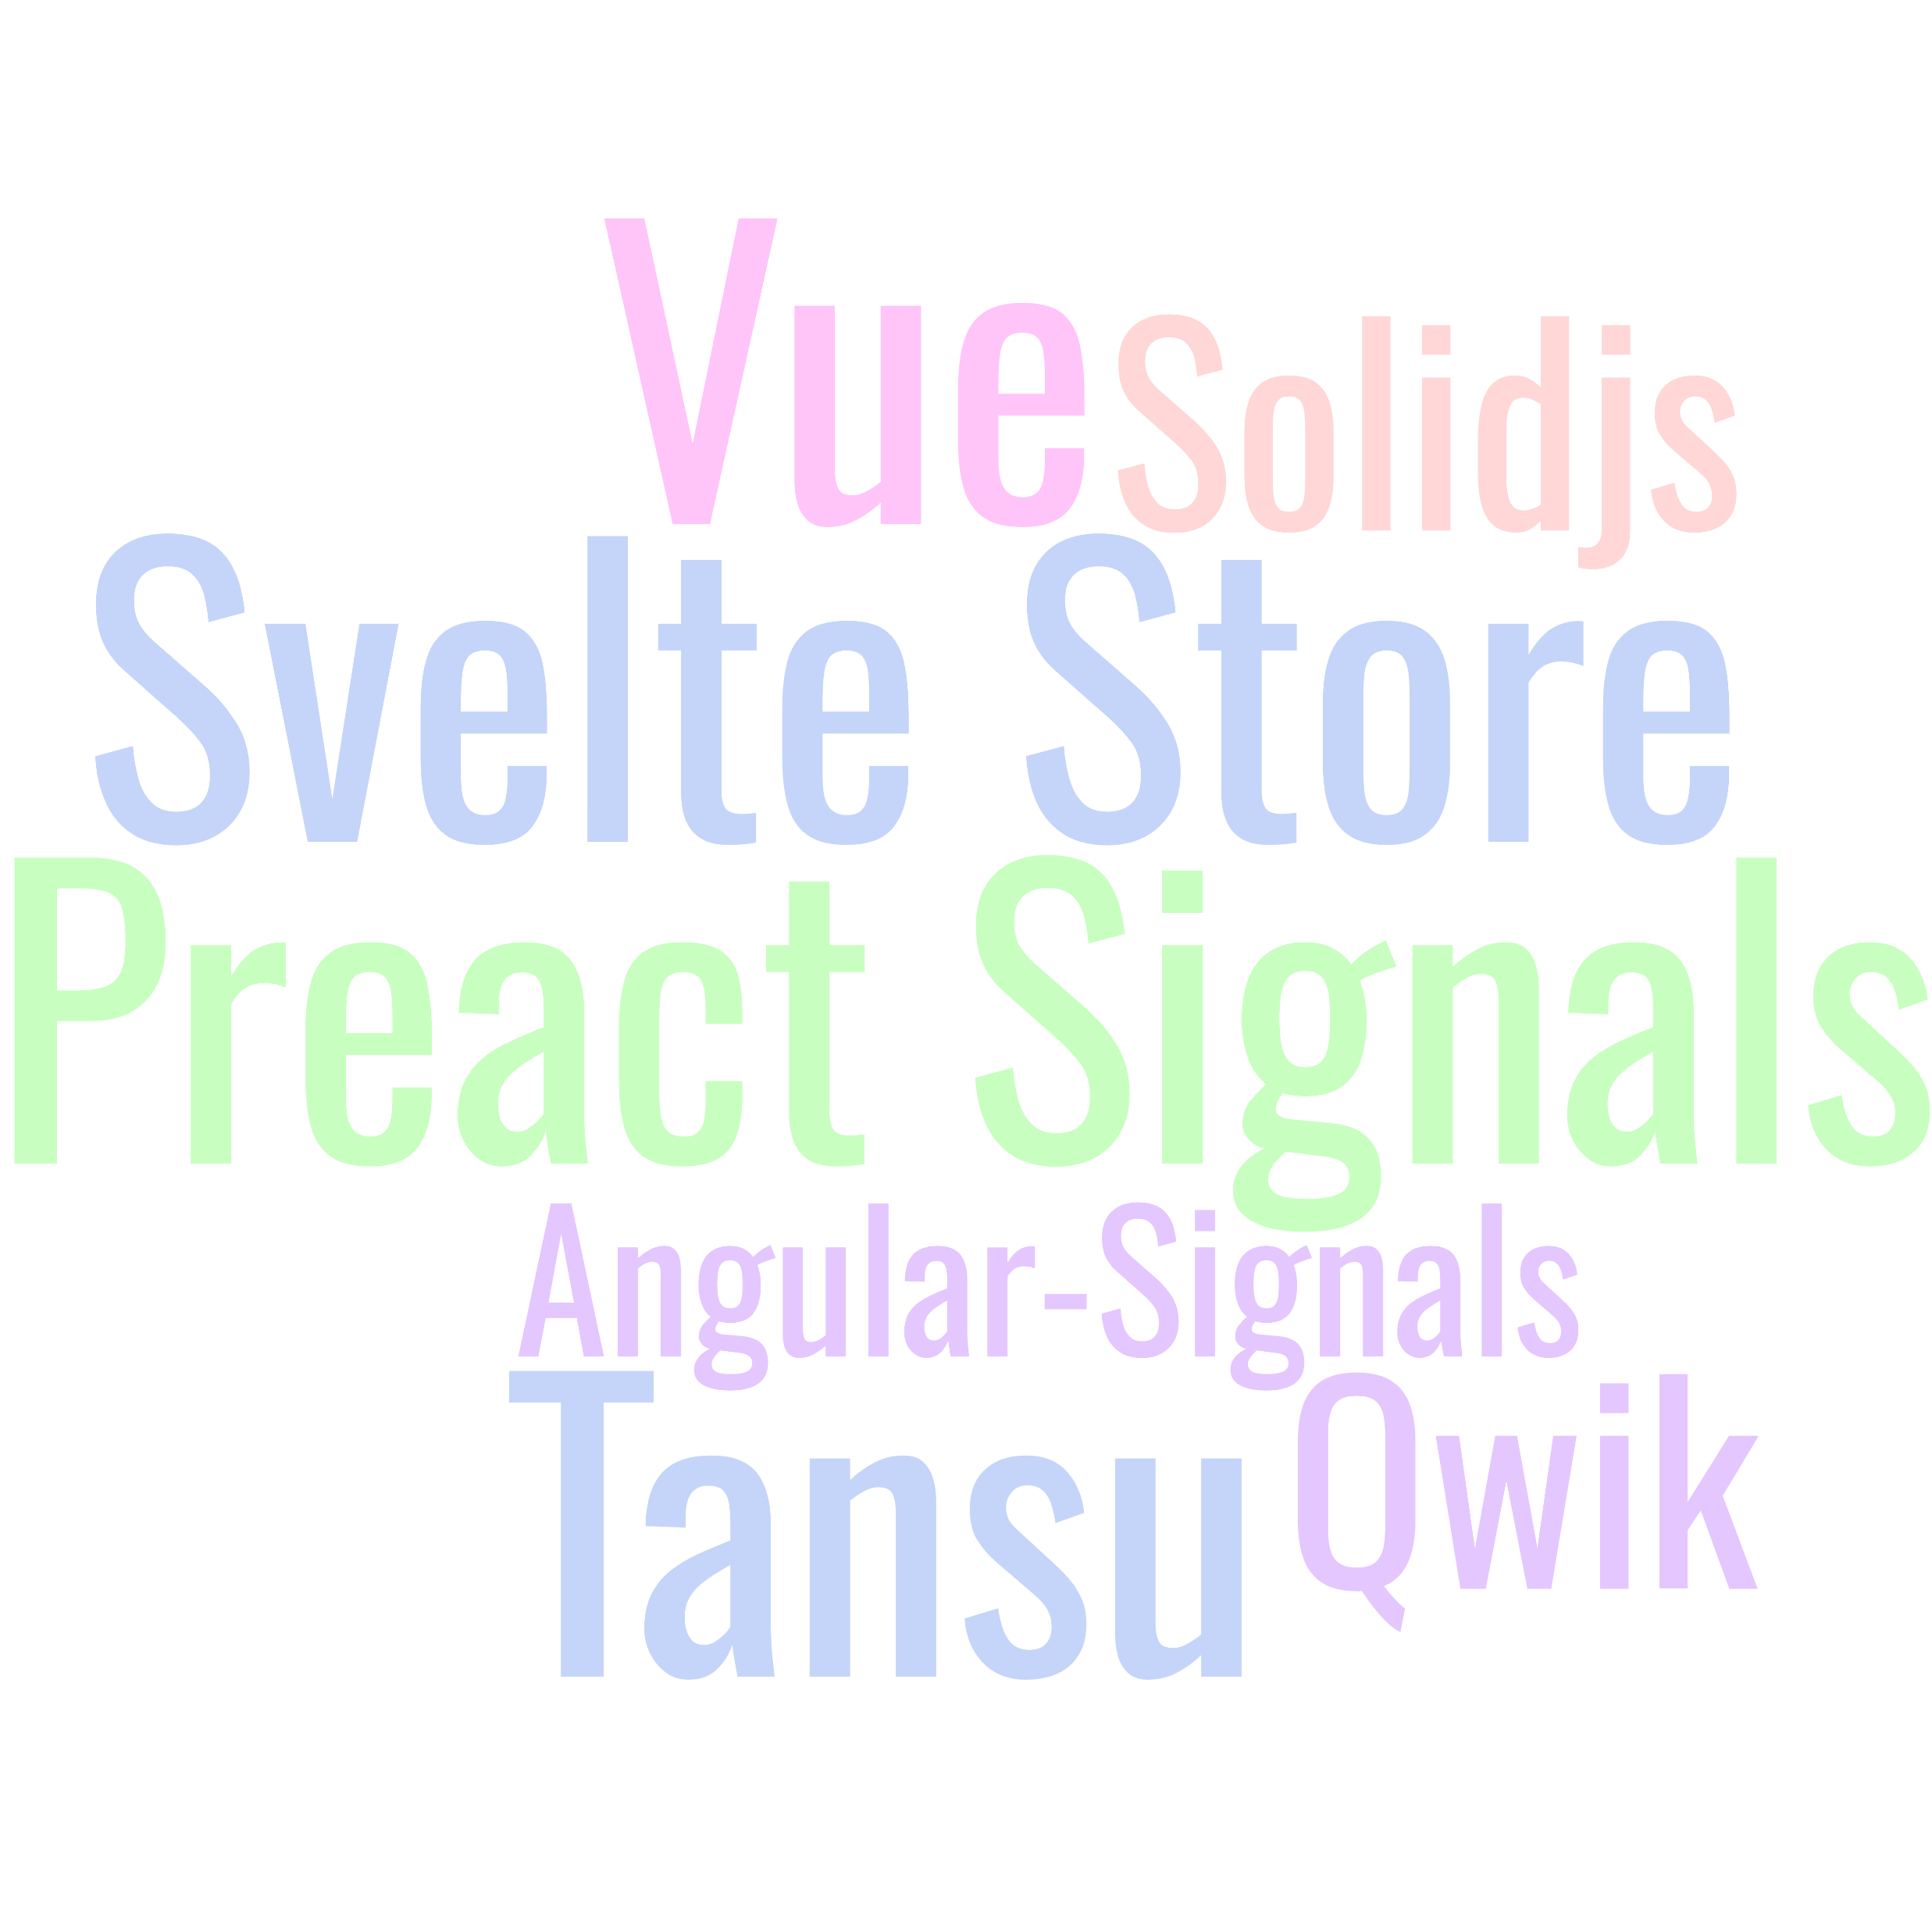
Notes:
A signal library is a library to do state management in a reactive way.
Signals is an event-driven programming paradigm that enables developers to create custom events and event listeners within their JavaScript code

Slide 6
Base store
readable
writable
asReadable
asWritable
Notes:
"headless" simply means that the software does not have a graphical user interface (GUI), like when you test with a browser headless the window that display the content is not here.

Slide 7
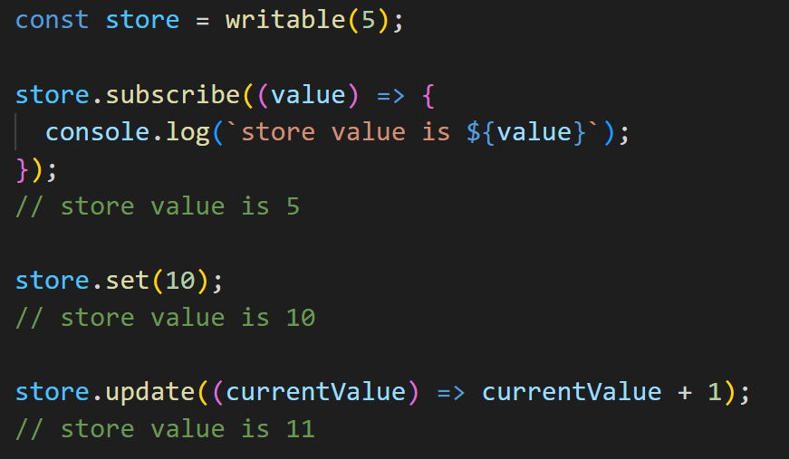
writable

Slide 8
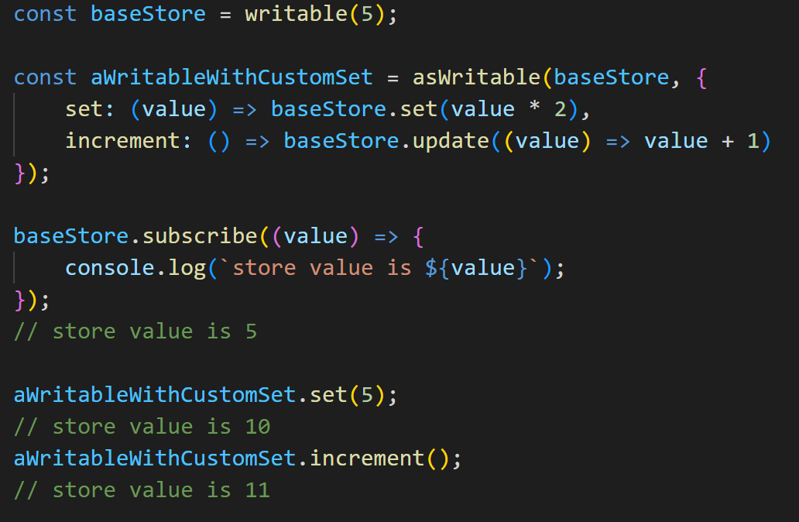
asWritable
Notes:
Same but for writable

Slide 9
readable

Slide 10
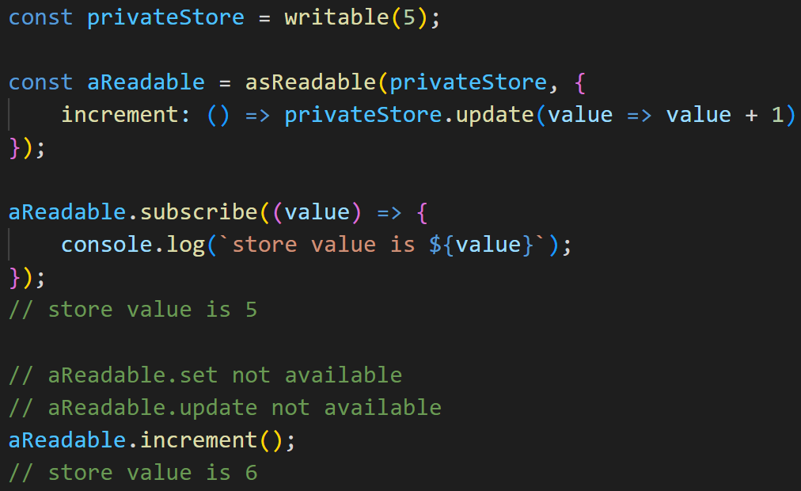
asReadable
Notes:
Can transform anything implementing the InteropObservable pattern into a readable, pretty useful when you are in a context where you use RxJS.

Slide 11
Computed store
derived
computed
Notes:
Computed store are readable store where the value is computed out of other store value.

Slide 12
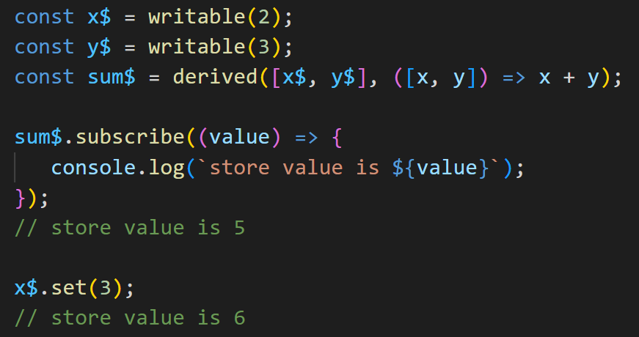
derived

Slide 13
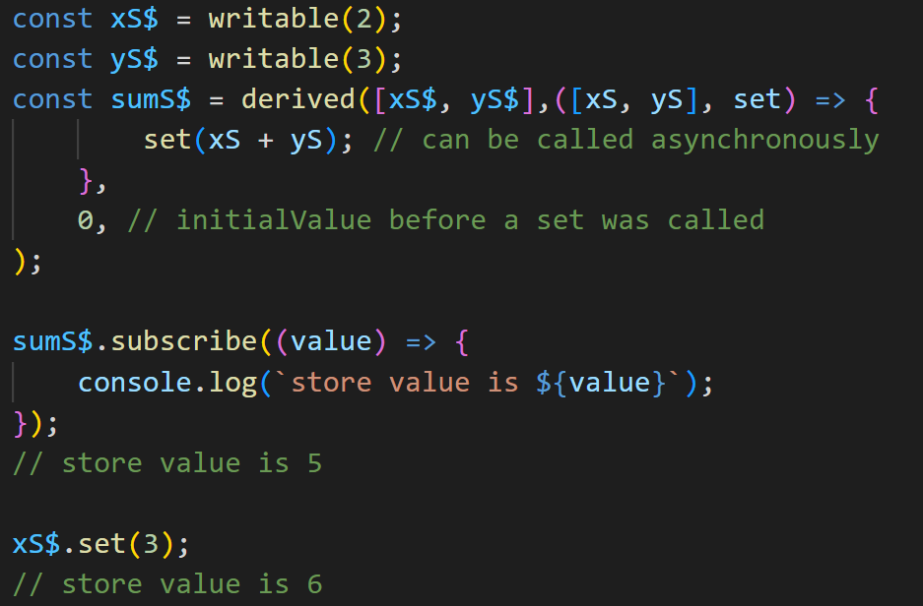
derived

Slide 14
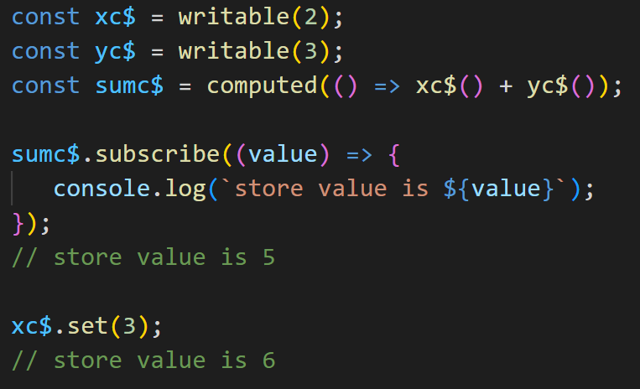
computed
Notes:
Show that we can call the store as it is function that return the value

Slide 15
Utils
get
batch
untrack
Notes:
"headless" simply means that the software does not have a graphical user interface (GUI), like when you test with a browser headless the window that display the content is not here.

Slide 16
batch
Notes:
here speak about Sherlock Lupin.
Synchronous.
Need for batch

Slide 17
Tansu’s features

Slide 18
Framework
agnostic
Notes:
Framework agnostic means that the library you create is usually in JS and TS and does not use dependencies on a specific framework like angular/react.
From the list I shown you at the beginning only the preact signal has a version framework agnostic.

Slide 19
Synchronous
Notes:
The subscriber are called synchronously when a store change. This is important for testing, debugging…
This is important to be able to plug it in different framework without side effect.
This why the batch function is important.

Slide 20
Lazy
Notes:
The computed store evaluation is done only if we have one subscriber to the store. Even if a dependency emit a new value.

Slide 21
onUse
Notes:
Framework agnostic means that the library you create is usually in JS and TS and does not use dependencies on a specific framework like angular/react.

Slide 22
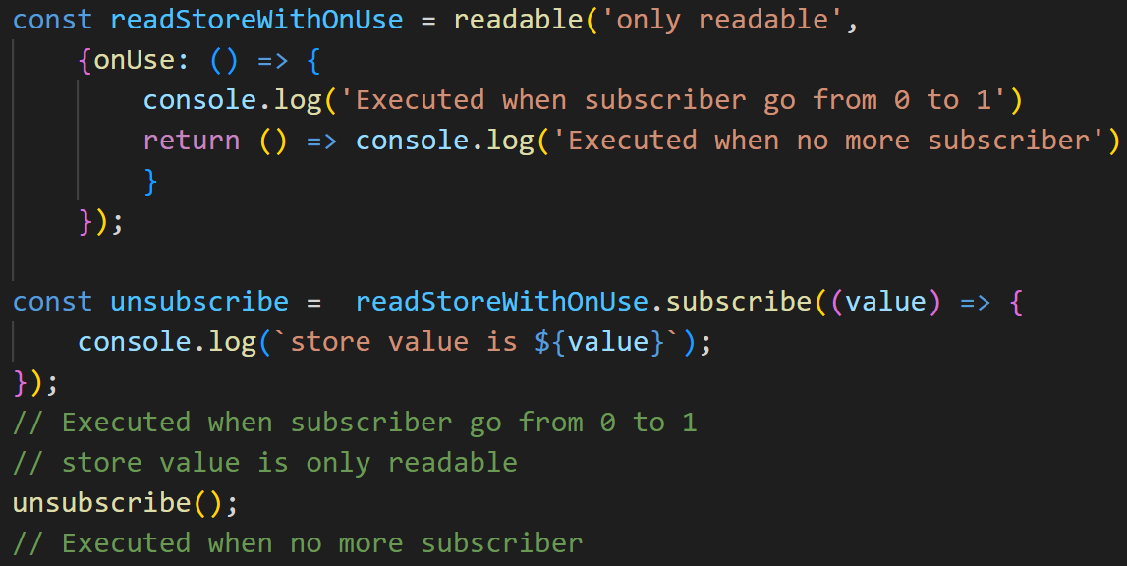
onUse

Slide 23
AgnosUI

Slide 24
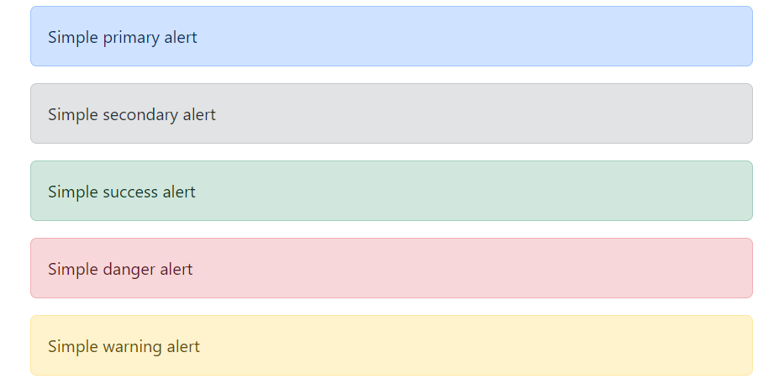
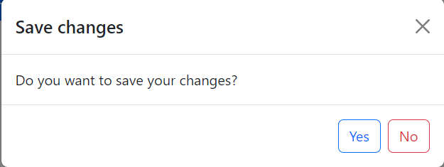
AgnosUI provides widgets
Notes:
AgnosUI is in fact multiple widgets library providing both widgets and utils. We all the core feature available in a framework agnostic way that are then used in headless builders of components in three framework react, svelte, angular and then on top of that we provide wrapper using the Bootstrap layout in the some three farmeworks. We currently have 7 widgets and 3 main utils. We intend to make all the bootstrap components that we have in our ng-bootstrap library + a few others.

Slide 25
AgnosUI goals
Framework agnostic
Reactive
Bootstrap
Usability (incl accessibility)
Headless / TailwindCSS
Highly Customizable
Highly Configurable
API compatible
Notes:
Note to be added here

Slide 26
Tansu in AgnosUI

Slide 27
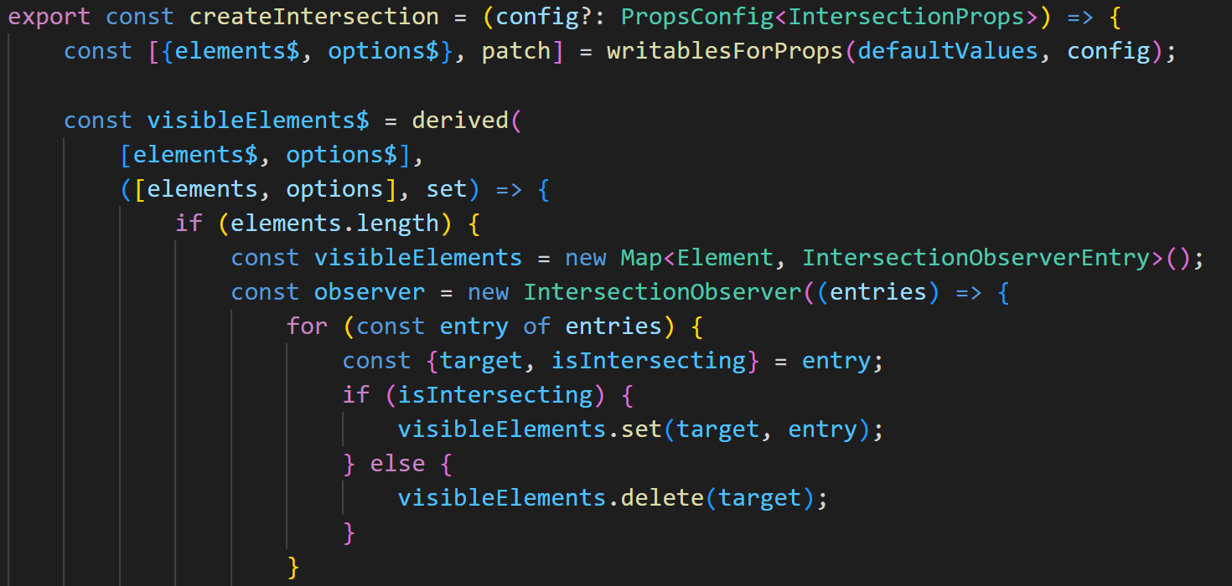
derived
Notes:
We are able to create framework agnostic utils that we apply in the different framework.
The derived can be asynchronous. Here used with the IntersectionObserver.
We are calling those function utils factory.
We have the same for component that we call component factory they produce all what is needed for the headless part of the component.

Slide 28
batch

Slide 29
computed
Notes:
All the stores are working reactively.
computed is of course used a lot. All props / input from component’s model are transform in reactive props and we use to compute the output global state the computed a lot.
outputs are readable, you don’t want to allow modifications from the user.

Slide 30
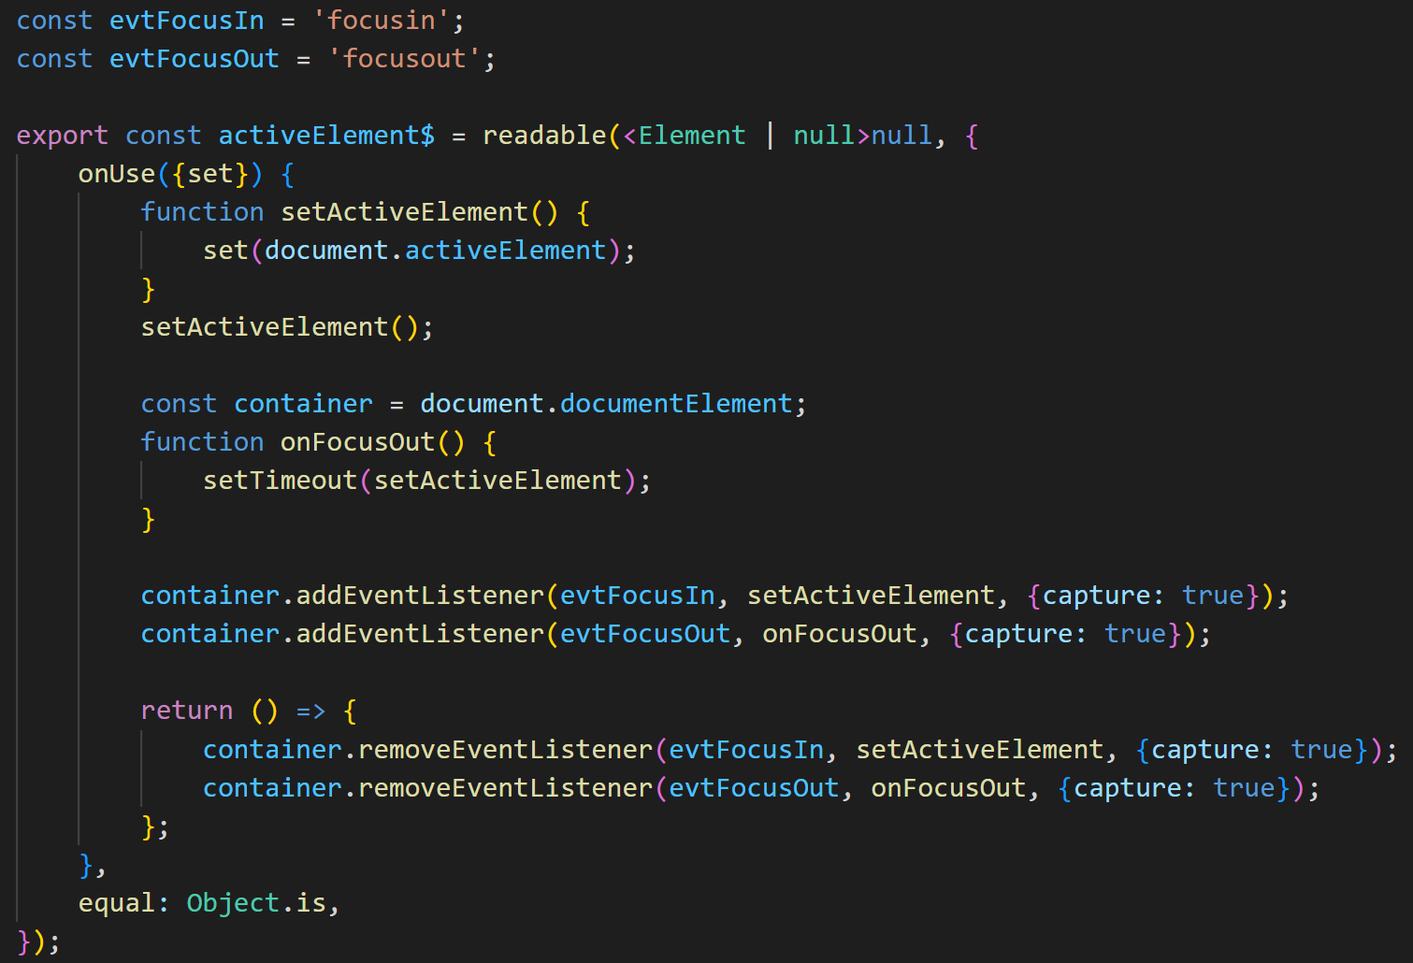
onUse

Slide 31
Future
Extend the component and util list
Add more documentation
For users
For contributors
Advertise it
Help people contribute

Slide 32
The one with the links
Have a look at:
https://github.com/AmadeusITGroup/tansu
https://amadeusitgroup.github.io/AgnosUI/latest/

Slide 33
Thank you

