Slide 1
CONFEDSS
Concolic execution and the puzzling practice of peripheral emulation

Slide 2
jeffrey@NFI:~$ whoami
Lead scientist of the exploitation team
Worked at the NFI for ~10 years
Favorite area of study is the overlap between hard- & software
Expertise in reverse engineering, exploitation, emulation and non-invasive hardware attacks

Slide 3
luke@NFI:~$ whoami
Member of the exploitation team
Worked at the NFI for almost a year
Conducted this research as part of Master Thesis at TU Delft

Slide 4
What does the NFI do?
Almost all forensic principles in one building:
Biological traces
Chemical and physcial traces
Digital and biometric traces
Notes:
Story of the Xray machine?

Slide 5
What do we do at the NFI?
Team exploitation, part of the device forensics team.
Extracting and decrypting evidence from digital devices
Only offline methods allowed
Evidence takes many forms, from phones and USB-sticks to crypto wallets and cars

Slide 6
How do we do this?
Reverse engineering
Exploitation
Fuzzing
Various hardware based methods

Slide 7
Reverse engineering – Abstraction layers
Primary bootloader (PBL)
Secondary bootloader (SBL)
Some known protocols, maybe some strings?
Aboot
Some strings, known interfaces, maybe some known device registers.
Linux Kernel
Lots of strings, symbols, well defined interfaces and known structures.
Userland
Lots of library calls, strings, symbols, well defined interfaces.

Slide 8
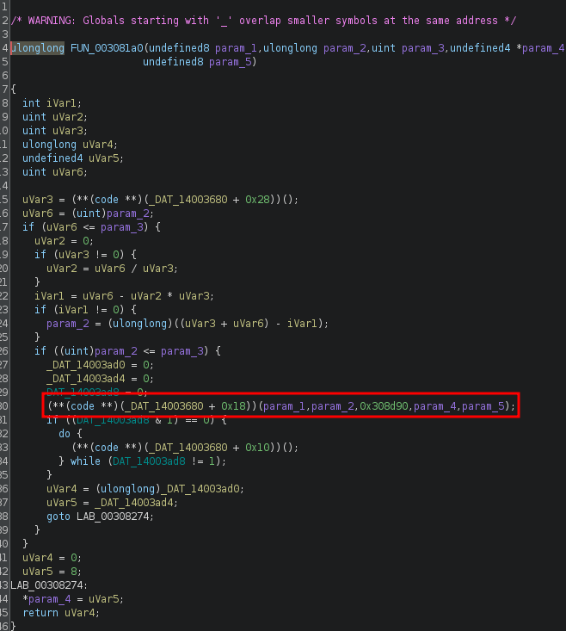
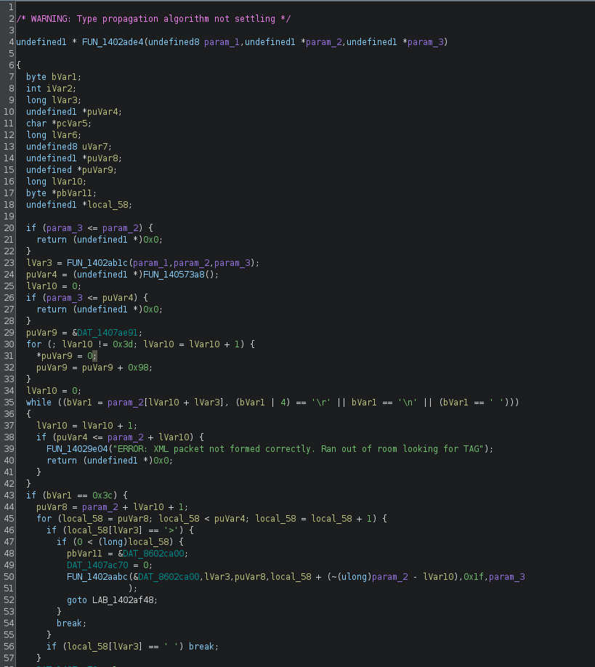
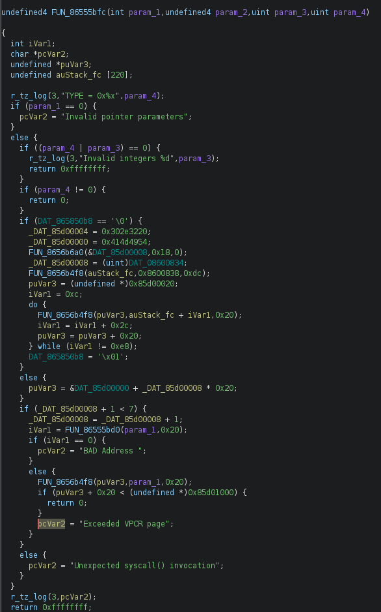
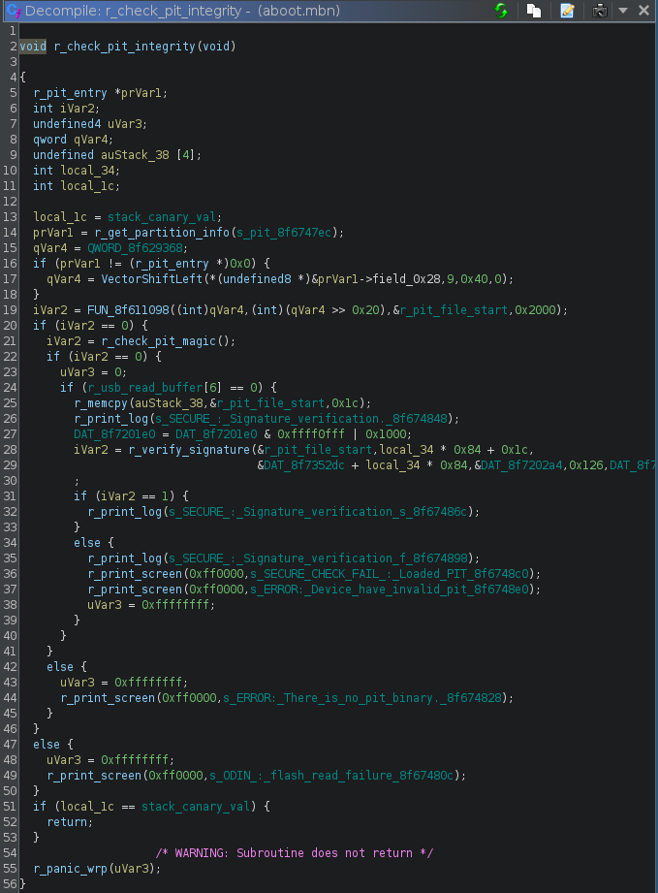
Reverse engineering - examples
Example:
Library
Example:
Kernel
Example:
Aboot
Example:
SBL
Example:
PBL

Slide 9
Normal solutions
Kernels can be emulated and debugged using QEMU or KGDB
Userspace can be debugged with normal GDB
Everything before that is signed and hard to emulate
State is unknown
Lots of unknown hardware is still being initialized
Lots of memory mapped peripherals

Slide 10
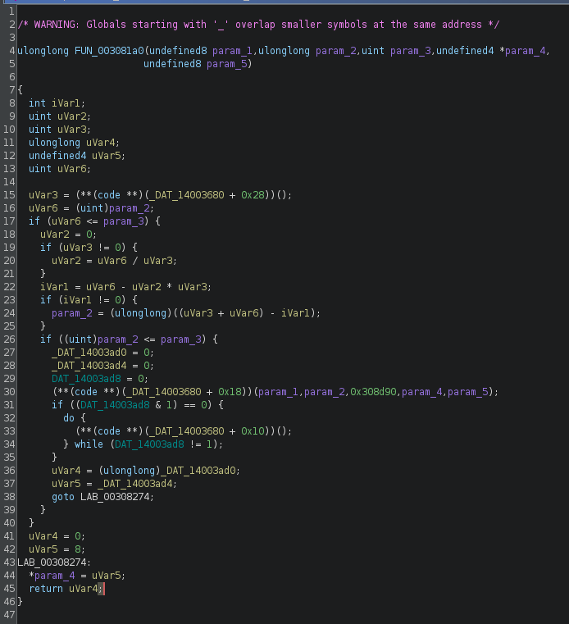
Static reversing – memory state
0x14003680
0x14008620
0x14008620
0x14008624
0x14008640
0x140086C0
0x14008638
0x1400883A
0x1400883A
actual_function

Slide 11
Static reversing – actual memory state
0x14003680
?????
?????
?????
?????
?????
?????
?????
?????
actual_function
Notes:
All these addresses depend on state setup earlier in the program, which is hard to keep track of statically.

Slide 12
Dynamic reversing - solutions
Nothing runs before the PBL, so we can assume a zeroed out memory state
All state is setup inside the emulator
Structs and their initialization become visible and understandable
Complex logic can be single-stepped to be understood

Slide 13
Dynamic reversing – How to emulate firmware?

Slide 14
Emulation problems – memory map
Offset is somewhat known by reversing
Status is known, all zeroes
No logic or “asynchronous state”
Offset is usually unknown
Status is unknown
State based on unknown logic
State changes asynchrously from CPU
DRAM
(uninitialized)
Uninitialized and unpowered
Offset is known
SRAM
Peripheral 1
Peripheral 2

Slide 15
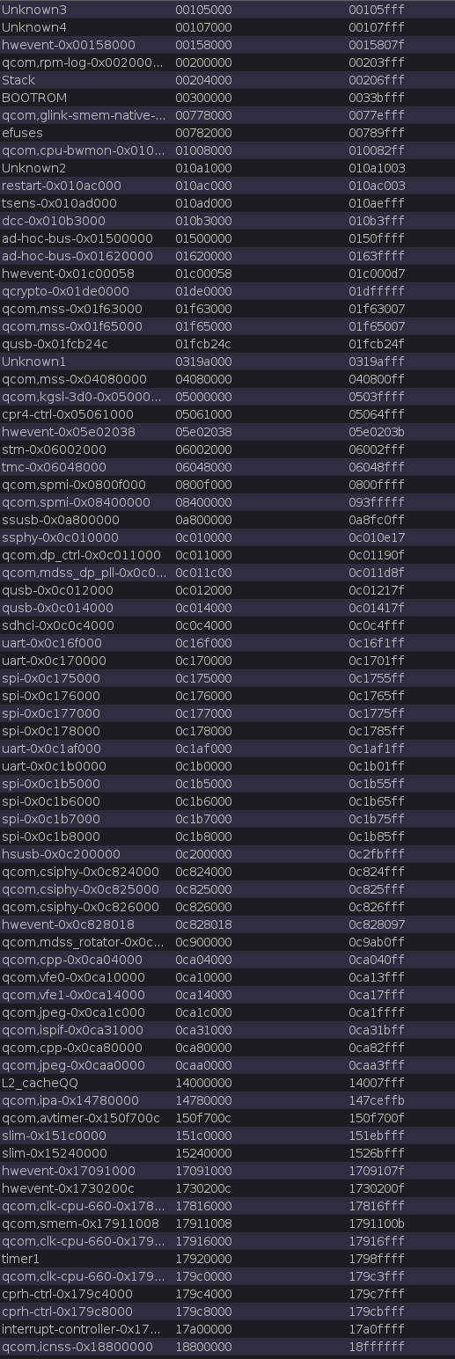
Emulation problems - peripherals
How to emulate unknown peripherals?
Write simple hooks
How many peripherals can there be?
Start with stub hooks and implement simple logic afterwards if needed

Slide 16
Peripheral Emulation

Slide 17
Peripheral Emulation: Goals
Automatic
Realistic
Generic

Slide 18
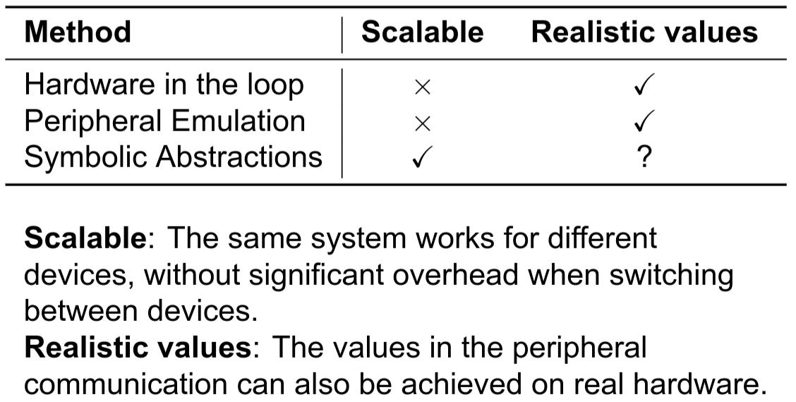
Peripheral Emulation: Solutions in Literature

Slide 19
Intermezzo: Symbolic Execution
a = α
b = β
c = 0
int func(int a, int b) {
if (a == 0) {
b = 9;
} else {
a = 4;
}
c = a + b;
return c;
}
α != 0
α == 0
a = 11
b = 5
c = 0
a = 4
b = 5
c = 0
a = 4
b = 5
c = 9
a = 4
b = β
c = 0
a = 0
b = 9
c = 0
a = 4
b = β
c = 4 + β
a = 0
b = 9
c = 9

Slide 20
Symbolic Peripheral Emulation
Multiple (many) states
Some lead to successful emulation
Others lead to infinite loops
Too many states to keep in memory
Only temporarily run symbolic execution
Concretise symbolic values “after a while”
Concrete + Symbolic ➔ Concolic

Slide 21
Symbolic Peripheral Emulation – Concretisation
What value?
Use different heuristics to add constraints – “Tactics”
Nice property (i.e. “return 1 from current function”)
Use several different tactics and alternate between them

Slide 22
Symbolic Peripheral Emulation – Tactics
DummyTactic
Continue to next instruction
ReturnTactic(n)
Return the value n from the current function
StepTactic(n)
Step n states and pick a state that did not end up in a loop

Slide 23
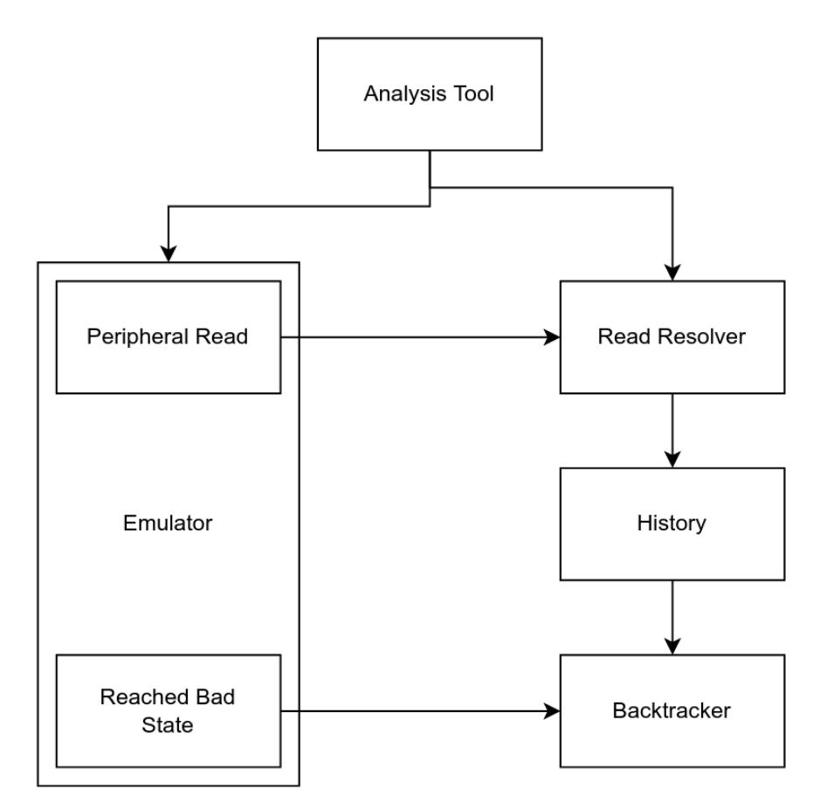
Peripheral Emulation – System
Analysis Tool (Ghidra)
Provides the binary
Emulator (qiling – unicorn – QEMU)
Uses hooks to detect Peripheral Reads / Bad States
Read Resolver (angr – z3)
Layer between emulator and symbolic execution
Chooses a Tactic and saves the result to History
History
A stack (LIFO queue)
Backtracker
Pops from History and resets Emulator

Slide 24
Peripheral Emulation – Tactic Selection
Keep a list of usable tactics
Pick the first one
Pick next one if:
No solutions
10 consecutive reads from the same address
Backtracking attempt
Backtrack if no tactics left
DummyTactic
ReturnTactic(0)
ReturnTactic(1)
StepTactic(5)

Slide 25
Example
Tactic
Constraint
Value
int get_val() {
return *peripheral_value;
}
void init_peripheral() {
*peripheral_status |= 1;
if (*peripheral_status & 2 == 0)
while (true);
if (get_val() < 5)
panic(“Error occurred!”);
while (true) {
if (*peripheral_status & 1)
break;
}
}
Dummy
…
0

Slide 26
Example
Tactic
Constraint
Value
int get_val() {
return *peripheral_value;
}
void init_peripheral() {
*peripheral_status |= 1;
if (*peripheral_status & 2 == 0)
while (true);
if (get_val() < 5)
panic(“Error occurred!”);
while (true) {
if (*peripheral_status & 1)
break;
}
}
Dummy
…
0
Return(0)
ERROR
Return(1)
ERROR
Step(5)
(x & 2 != 0) && (x != 0)
2

Slide 27
Example
Tactic
Constraint
Value
int get_val() {
return *peripheral_value;
}
void init_peripheral() {
*peripheral_status |= 1;
if (*peripheral_status & 2 == 0)
while (true);
if (get_val() < 5)
panic(“Error occurred!”);
while (true) {
if (*peripheral_status & 1)
break;
}
}
Dummy
…
0
Return(0)
(x == 0) && (x != 0)
ERROR
Return(1)
(x == 1) && (x != 0)
1
Step(5)
(x >= 5) && (x != 0) && (x != 1)
5

Slide 28
Example
Tactic
Constraint
Value
int get_val() {
return *peripheral_value;
}
void init_peripheral() {
*peripheral_status |= 1;
if (*peripheral_status & 2 == 0)
while (true);
if (get_val() < 5)
panic(“Error occurred!”);
while (true) {
if (*peripheral_status & 1)
break;
}
}
Dummy
…
0
Dummy
…
0
Dummy
…
0
…
Return(0)
ERROR
Return(1)
ERROR
Step(5)
(x & 1 != 0) && (x != 0)
1

Slide 29
Evaluation
What combination of tactics is “best”?
Execution time and number of peripheral reads
Accuracy: Compare against real hardware
Run sample programs on Raspberry Pi 4B
Compare memory, registers and instruction trace
Compare against Jetset
State of the art – pure symbolic approach
Run samples in Jetset
Compare execution time and data

Slide 30
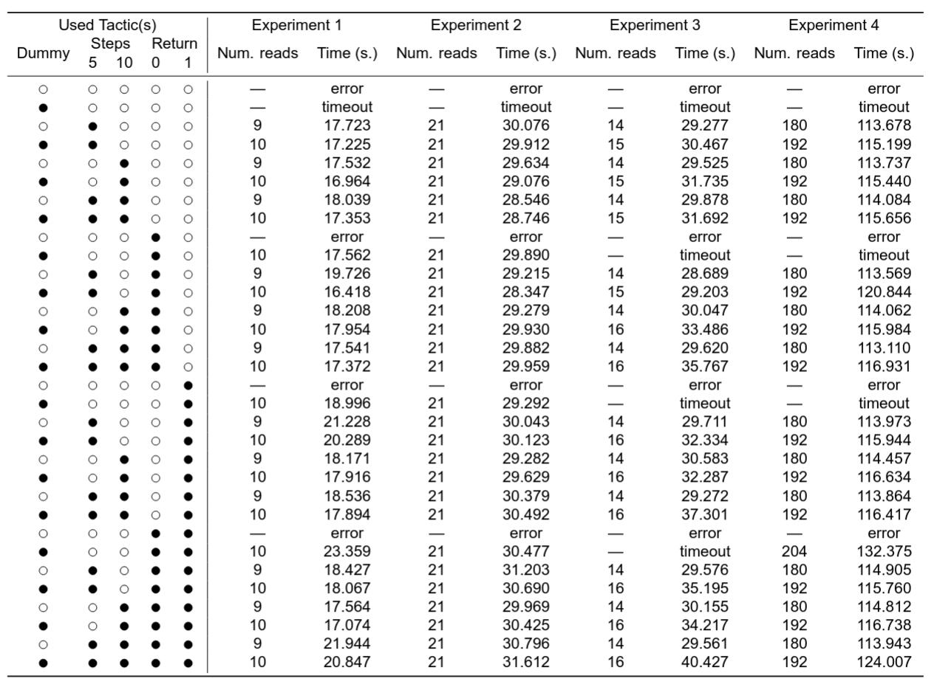
Evaluation – Tactic Combinations
Compare different combinations of tactics
Different paths are taken
More tactics is not always faster
Some combinations lead to errors
Multiple tactics are required
DummyTactic, StepTactic(5), ReturnTactic(0)

Slide 31
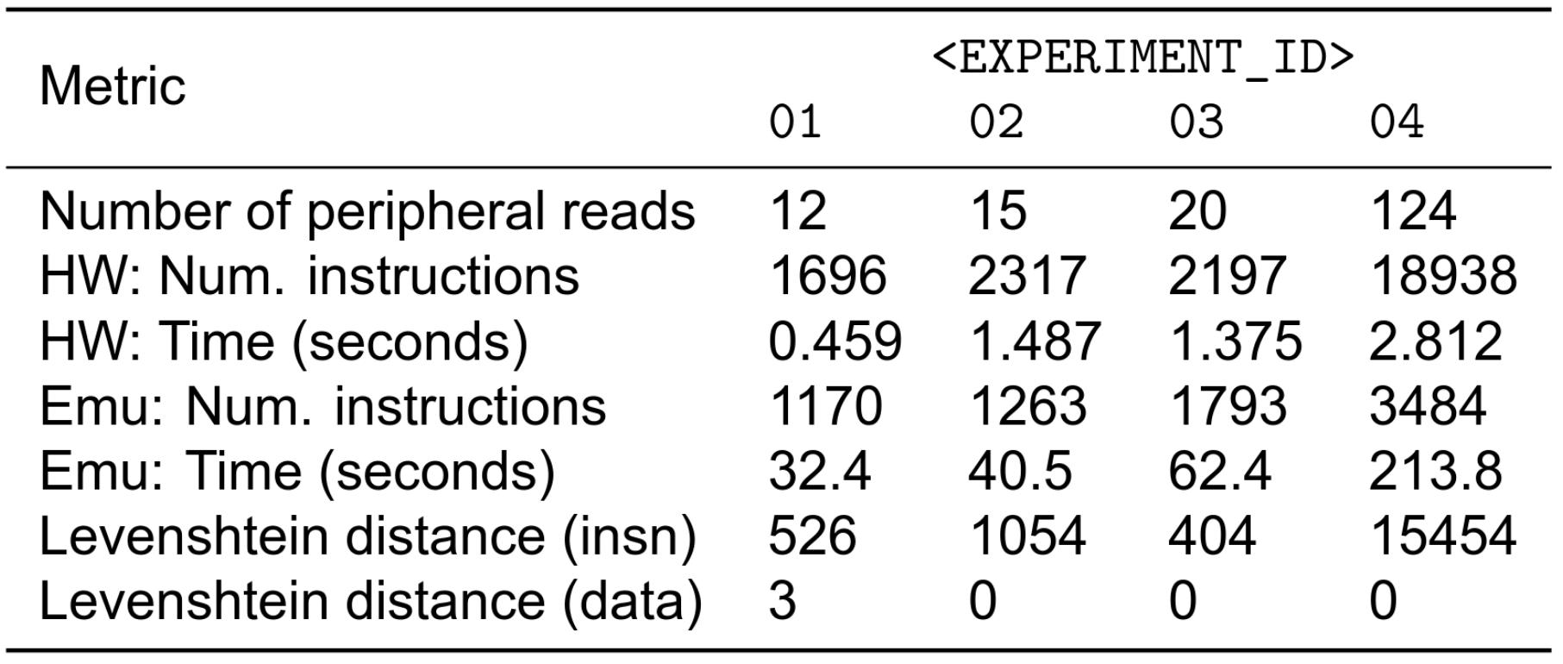
Evaluation – Accuracy
Data is nearly identical
Fewer instructions
Much slower

Slide 32
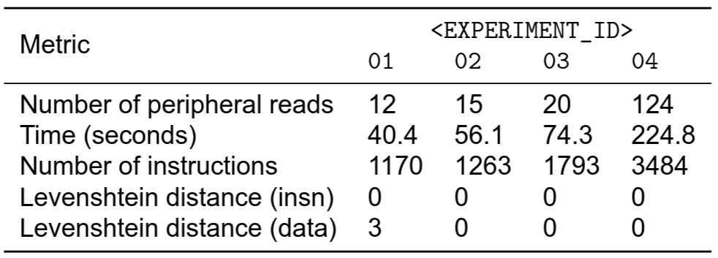
Evaluation – Comparison Jetset¹ vs. CONFEDSS
Data is nearly identical
Same number of instructions
A little slower
¹ 2021, Johnson, E. et al.: Jetset: Targeted Firmware Rehosting for Embedded Systems in 30th USENIX Proceedings

Slide 33
Wrongly concretised values
Values that are used long after they have been concretised
Communication overhead

Slide 34
Limitations
Wrongly concretised values
Values that are used long after they have been concretised
Communication overhead

Slide 35
Future Work
Delayed concretisation
Keep values symbolic for longer
Connect concretised values to symbolic versions
Tighter integration with emulator
Implement symbolic execution-related hooks in C
Reduce communication with emulator
Parallel evaluation of tactics

Slide 36
Summary
Automatic, generic and realistic peripheral emulation
We built CONFEDSS, which implements this system
Available at github.com/NetherlandsForensicInstitute/CONFEDSS
Questions?

