Slide 1
MAKING FOSS EASIER TO TEACH WITH SHARED COMPETENCY STANDARDS
WWW.SKILLDISPLAY.EU | FOSDEM 2024 - Designing Futures of FOSS Content Management with the Open Website Alliance

Slide 2
OPEN TO THE PEOPLE
There are lots of reasons to get started with a FOSS CMS
No or low entry cost barrier
Vast amounts of resources
Trainings, courses
Events, dev days, camps, …
A community to turn to

Slide 3
CHALLENGES FOR COACHING AND LEARNING
NO COMPARABILITY
OBSOLESCENCE
Did I come closer to my dream job?
What do I need to learn?
Is my learning resource still up to date?
REDUNDANCY
AMBIGUITY
How do I not bore my trainees?
What is the most effective training?
On what do I build my learning resource?

Slide 4
A GAP IN TEACHING
WHEN CREATING TRAININGS
What do I need to cover in my training? How do I guarantee not to skip something important? What knowledge can my trainees carry over from experience with a different CMS?
WHEN GOING FOR CERTIFICATION
Am I ready for certification? Who in my company can be enabled with little effort? Where are our deficiencies?

Slide 5
BUILDING A QUALITY COMPETENCY STRUCTURE
WWW.SKILLDISPLAY.EU

Slide 6
DEFINING A COMPETENCY
A denomination | ABOUT A CMS
A description | A content management system is a software application for the collaborative creation, …
Learning goals | I can explain what a CMS is. I can explain how content and design are separated in a CMS. I know about features and advantages using a CMS.
A maintainer | TYPO3 (Oliver Thiele)
A SKILL NEEDS TO BE
Identifiable „What am I learning“
Tangible „What will it take to learn the skill“
Transparent „Who says this is what I need to learn“

Slide 7
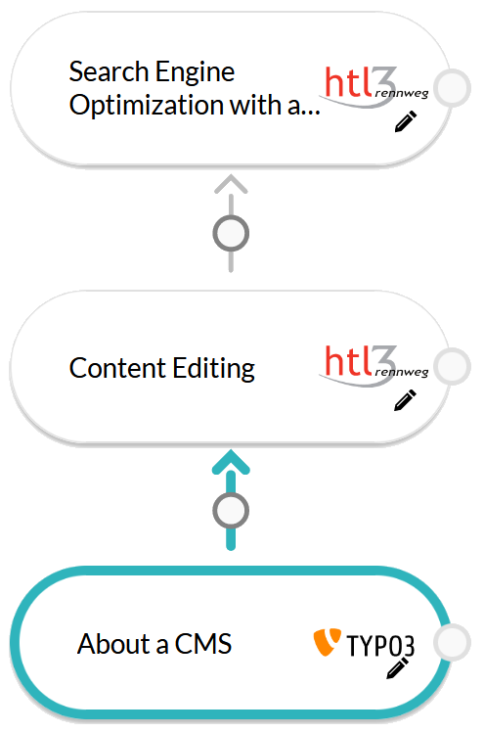
CONNECTING COMPETENCIES
A denomination | CONTENT EDITING
A description | Introduction to the possibilities of content editing.
Learning goals | I can explain the difference between a simple text editor and a WYSIWYG-editor. I know what frontend editing means.
Prerequisites | ABOUT A CMS

Slide 8
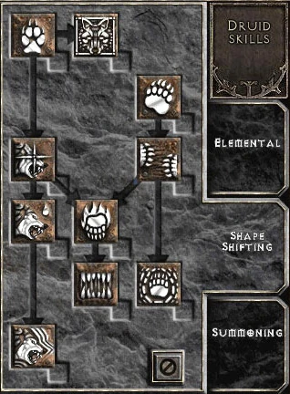
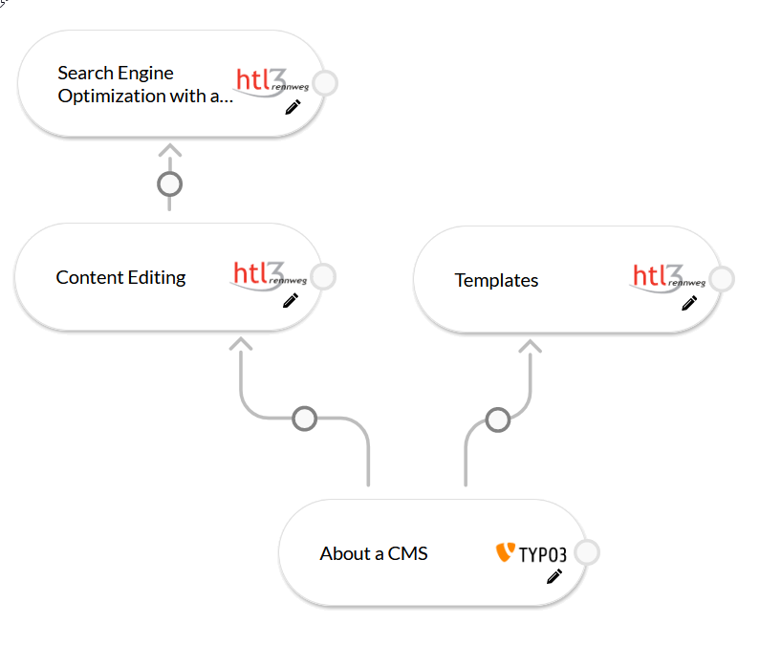
SKILL TREES WE‘VE SEEN THOSE BEFORE
Diablo2 Druid Shape Shifting Skills, Blizzard Entertainment

Slide 9
COMPETENCY STANDARD WHAT ARE THE BENEFITS?
WWW.SKILLDISPLAY.EU

Slide 10
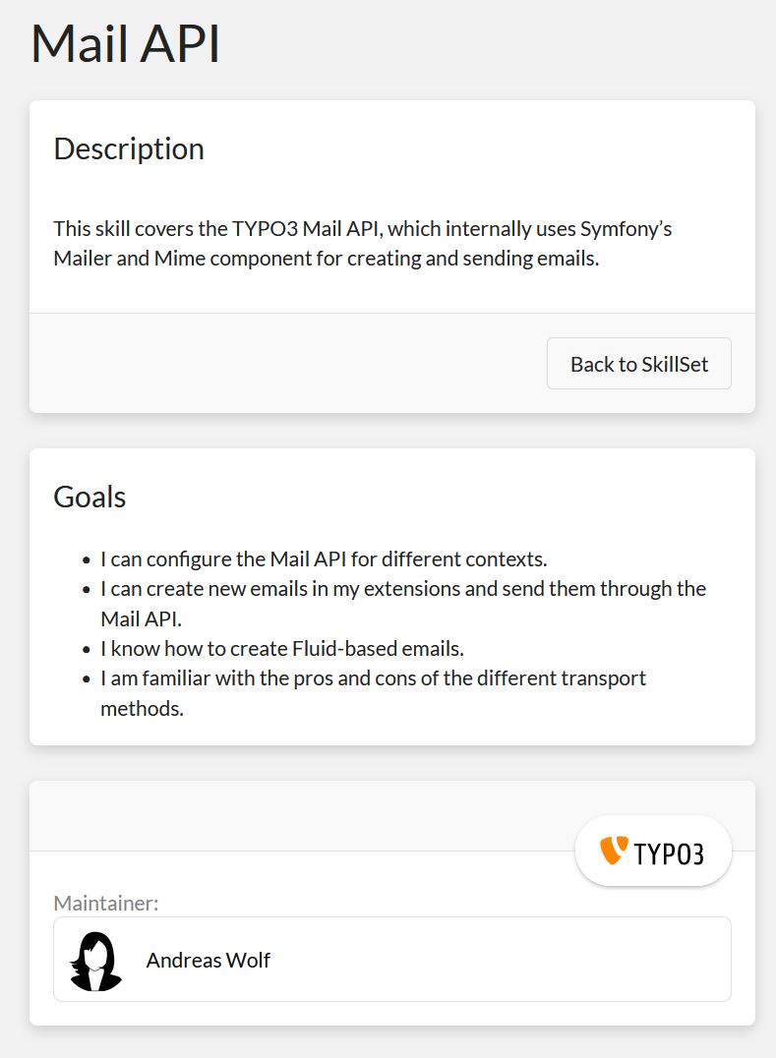
1. A COMMON LANGUAGE FOR „WHAT CAN I DO“
School grades are intransparent – a “Web Development C” or “4“ does not tell much.
A job resume or CV covers experience to varying detail – “5 years work as a Joomla dev” isn‘t that exact either.
Hard skill definitions provide a common language
- what I can do
- who made that definition

Slide 11
2. REDUCED REDUNDANCY
FOR SHARED TECHNOLOGIES
Suddenly I can track which projects could profit from my Doctrine skills. Based on the existing skill definitions provided by Doctrine.
FOR SHARED PRINCIPLES
Common principles shared across CMS projects can be pooled as prerequisites. If I understand image metadata, can handle a richtext editor, and understand caching approaches, I can do so in any CMS.

Slide 12
3. HIGHER COMPARABILITY
WHEN CHOOSING LEARNING RESOURCES
By defining competencies and linking resources and trainings
I can compare them based on which skills they cover
I can choose which resource helps the most on my learning path
I can see if it is still relevant or outdated
WHEN CHOOSING WHAT TO LEARN
With a shared language between FOSS projects
I can choose the one best suited for my needs and capabilities
I can search for similarities to expand my knowledge effectively… and take look outside my box

Slide 13
4. PROMOTING OUR SHARED VALUES
COLLABORATION & SYNERGIES
Open Source is a collaborative effort. Within each project, and across projects. With a shared competency standard we emphasize this right at the moment people start to engage with one or more FOSS projects.
INCENTIVISE FOSS USAGE
By bringing this mindest to our learning resources, we make our projects more accessible for learners, and incentivise teachers to integrate projects into their curricula – promoting FOSS at an educational level beyond monetary reasons.

Slide 14
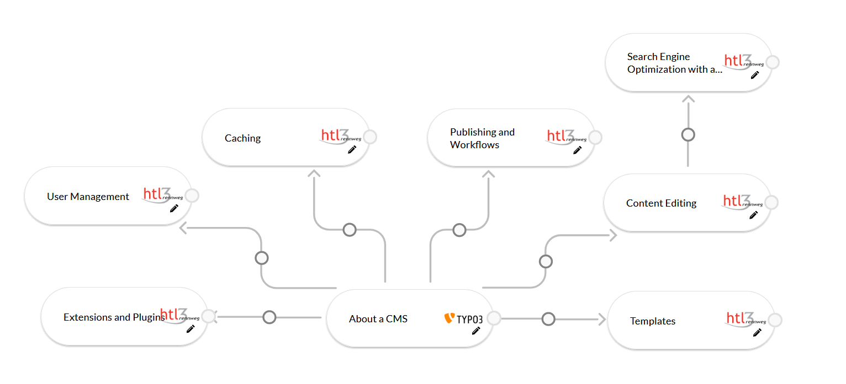
A (PRIMER ON A) SHARED COMPETENCY STANDARD
WWW.SKILLDISPLAY.EU

Slide 15
CMS BASICS
SKILL TREE
FOSS
BRAND
FOSS
BRAND
FOSS
BRAND
FOSS
BRAND
FOSS
BRAND
FOSS
BRAND
FOSS
BRAND
FOSS
BRAND
ENDORSE – EXPAND – BRAND – LINK
Created as part of an EU Erasmus+ Programme project with contributions from TYPO3 GmbH and HTL Rennweg Vienna.
By adopting and expanding its skill definitions, it could serve as a ready-to-use baseline for a shared standard – and gateway to existing material.

Slide 16
A BROAD
COMPETENCY STANDARD
FOR COACHING & LEARNING
By expanding on the basics, we can provide teachers and trainers with structures to teach CMS and provide learners with their individual entry points for their learning journey.
UNDER A SHARED BRAND
With a shared brand we can ensure the quality of skill definitions, build trust and cooperations to expand and maintain a shared competency standard. For autonomous learning, school education, and certification.

Slide 17
PUT THE POWER INTO THE HANDS OF THE COMMUNITY
WWW.SKILLDISPLAY.EU

Slide 18
OPEN SOURCE SKILLS
AS OPEN DATA
OPEN LEARNING
By offering skill definitions as open data we provide learners with individual learning goals, gateways to matching learning content right when they need it, and a standard to represent their competencies.
OPEN TEACHING
With an open standard we allow content creators to link their resources to the skills they cover, connecting them directly to learners. Personalized open learning paths save time when designing curricula, allowing teachers to comply with real industry standards.

Slide 19
BUT ALSO
CERTIFICATION
INTEGRATE INTO EXISTING CERTIFICATES
By defining which skills are required for which certificate we boost accessibility and make use of the competency structure to improve and maintain certifications.
CREATE NEW CERTIFICATION
We can cooperate on a certification for shared concepts, especially on entry level skills. Why not train Open CMS Content Creators, who are ready to dig into not only one project, but hone their skills across various CMS?

Slide 20
OVERCOMING
OUR CHALLENGES
No Comparability
Plan and track my progress on a grander scheme
Redundancy Efficiency
Identify shared skills to prevent redundant learning and content creation
Obsolescence Transparency
Living index through maintained skill definitions
Ambiguity Versatility
By linking trainings and resources to skill definitions

Slide 21
WHO WE ARE
SKILLDISPLAY
E-Mail: office@skilldisplay.eu
Website: www.skilldisplay.eu
SKILL MATRIX 2.0
We provide customized, individualized learning and development strategies based on a proven methodology.
SkillDisplay helps you build a maintainable quality competency structure as a base for training and development, for use with your existing tools (LMS, knowledge base, etc.)

Slide 22
MAKING FOSS EASIER TO TEACH WITH SHARED COMPETENCY STANDARDS
WWW.SKILLDISPLAY.EU | FOSDEM 2024 - Designing Futures of FOSS Content Management with the Open Website Alliance

