Slide 1
Running DOS & Unix on an 8-bit Commodore
Michał Pleban

Slide 2
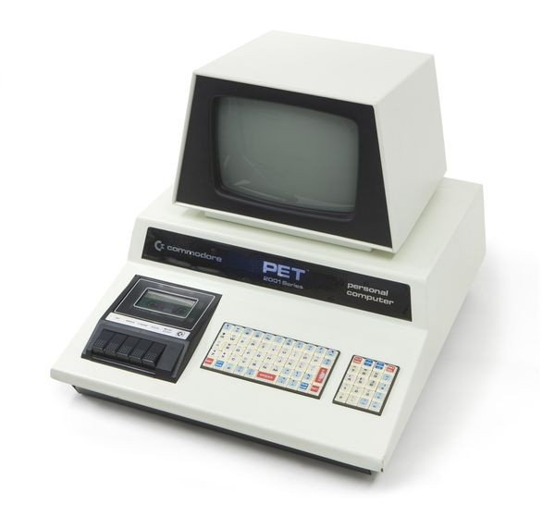
Commodore PET
1977

Slide 3
Commodore CBM-II – the PET successor
1977
1982

Slide 4
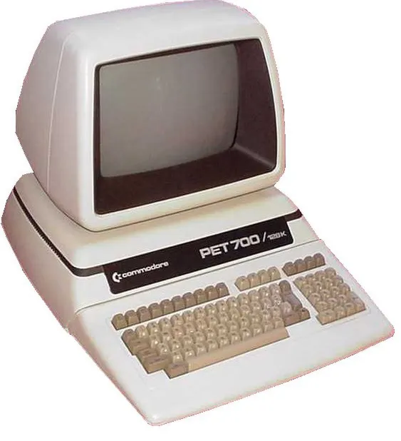
Commodore CBM-II – the PET successor
PET |  | CBM-II
6502 @ 1 MHz | CPU | 6509 @ 2 MHz
4 – 128 kB | RAM | 128 – 1024 kB
40x25 or 80x25 text | Graphics | 80x25 text
IEE-488 disk interface | Storage | IEE-488 disk interface
 | Sound | SID
 | Expansion | Second CPU interface

Slide 5
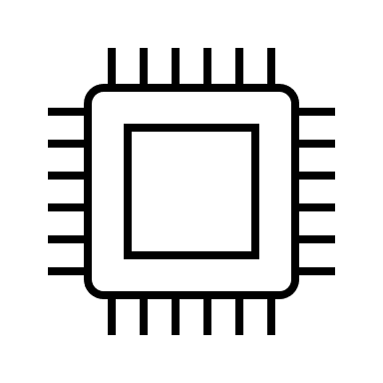
Multi-CPU architecture
Second CPU
Message passing
Main CPU
I/O
Memory access
Z80, 8088, 6809, …
6509
Bus arbitrator
Shared RAM

Slide 6
Multi-CPU architecture
The second CPU can be any 8-bit CPU.
Both CPUs have access to the main memory.
Only the main CPU has access to I/O.
One CPU executes code from the main RAM, the other one runs from private memory space.
The CPUs communicate by inter-processor calls.
An IPC call alerts the second CPU to proces the call using an IRQ.
Design principles

Slide 7
Inter-procesor calls
Second CPU → Main CPU
Main CPU → Second CPU
Second CPU (Z80) runs an operating system (CP/M)
The OS needs to read the keyboard.
Second CPU calls the main CPU to scan and read the keyboard.
Main CPU returns the key scancode.
Main CPU runs a scientific simulation.
The program requires time-consuming calculations.
Main CPU calls the second CPU (8088+8087) to perform calculations.
Second CPU stores the results in memory and exits.

Slide 8
Implementation – the 8088 card
8088 @ 5MHz
8087 socket (not working)
CP/M-86 1.0, CP/M-86 1.1, MS-DOS 1.25

Slide 9
Commodore MS-DOS 1.25

Slide 10
MS-DOS today
The PC platform

Slide 11
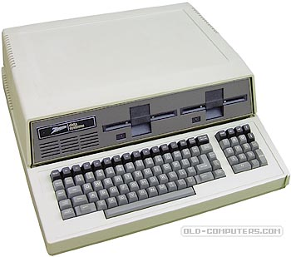
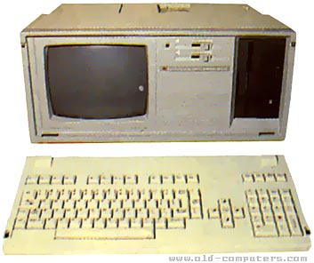
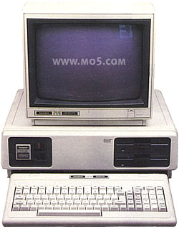
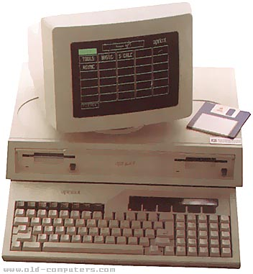
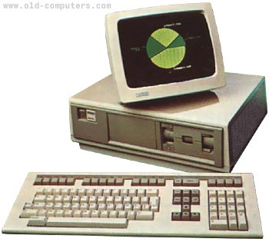
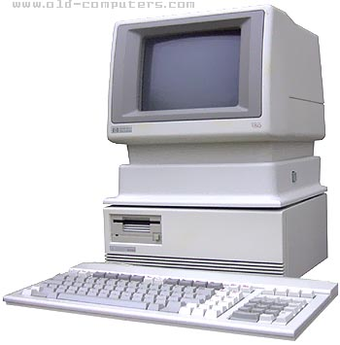
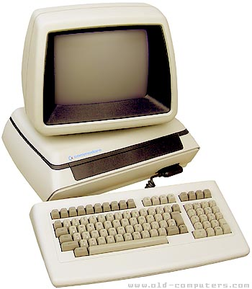
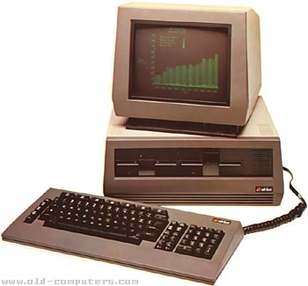
MS-DOS in 1982
(according to Microsoft)

Slide 12
MS-DOS in 1982
>
(in reality)
PC compatible
Not PC compatible

Slide 13
Can we do better?
Yes, we can™

Slide 14
Making it PC-compatible
1
PC BIOS interrupts
2
Video memory
3
Virtual I/O devices

Slide 15
Implementing the PC BIOS on the Commodore
Interrupt | Functions
10h | 00, 02, 03, 05, 06, 07, 09, 0A, 0E, 0F
11h
12h
13h | 00, 01, 02, 03, 04, 08, 0C, 0D, 10, 15, 16
14h | 00, 01, 02, 03
16h | 00, 01, 02
17h | 00, 01, 02
18h
19h
1Ah | 00, 01, 02, 03, 04, 05

Slide 16
Implementing PC video memory
Video memory on the PC
Video memory on the Commodore
RAM at B800:0000
RAM at $FD000 (private area for the 6509 CPU)
Copy on timer IRQ

Slide 17
Virtual hardware
Using a virtualization environment

Slide 18
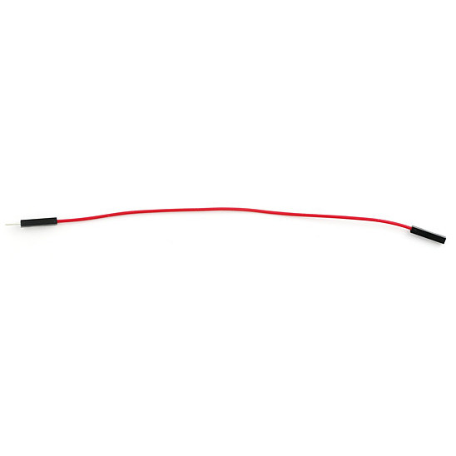
Virtualization environment
also known as A Piece Of Wire™
/IOREAD
/IOWRITE
/NMI
Address decoder
CPU

Slide 19
Commodore 900
1984

Slide 20
Commodore 900 specs
CPU | Z8001 @ 6 MHz
MMU | Z8010
Memory | 512 – 1024 kB
Graphics | 80 x 25 text 1280 x 800 bitmap
Storage | 20MB MFM drive 1 MB floppy
Operating system | Coherent 0.7.3
Connectivity | up to 6 RS-232 ports

Slide 21
Let’s emulate!
Notes:
It’s a great machine, but very rare. Because it was canceled, only a few dozen prototypes exist.
Unless you are very lucky or very rich, you can’t have one.
So how about we change that, and put a Z8000 procesor in the CBM-II to create a virtual Commodore 900!

Slide 22
What we need:
A Z8001 CPU + Z8010 MMU ($20 on Ebay)
1 MB of RAM
16-to-8 bit memory interface
Original Commodore 900 BIOS
A Piece Of Wire™
SD card to emulate the hard disk
Coherent OS disk image.
A lot of time (priceless)

Slide 23
The Z8001 card

Slide 24
Thank you for your attention!
https://github.com/MichalPleban

