Slide 1
Network Function Abstraction A delicate question of (CPU) affinity ?

Slide 2
About us
Hadi Rayan Al-Sandid
halsandi@cisco.com
Nathan Skrzypczak
nskrzypc@cisco.com
Hedi Bouattour
hbouatto@cisco.com
Notes:
- Members of the Vector Packet Processing (VPP) team at Cisco
- Nathan and Hedi are also maintainer of the VPP integration into Calico-VPP.
- Hadi Rayan Al-Sandid, halsandi@cisco.com
- Nathan Skrzypczak, nskrzypc@cisco.com
- Hedi Bouattour, hbouatto@cisco.com

Slide 3
Defining NF Abstraction
Introducing Network Functions
i.e. “Packet Processing Service”
Physical vs Virtual NFs
Limitations of coupling hardware and software
Benefits of Abstraction
Scalability, isolation..
SDN
Virtual Environment
Bare-Metal
Physical Appliances
VMs
Containers
Containers
Containers
VNF
VNF
VNF
PNF
PNF
PNF
Router
Firewall
Switch

Slide 4
Challenges
Issue: Cost of Abstraction
+ Overhead
+ Complexity
Can be mitigated with proper configuration
Focus: CPU Pinning
Virtual Environment
Bare-Metal
Physical Appliances
VMs
Containers
Containers
Containers
Perf. Loss
VNF
VNF
VNF
PNF
PNF
PNF
Router
Firewall
Switch

Slide 5
FD.io VPP
Open-source data-plane, running in user-space
Vector packet processing, with optimized graph structure for performance/scale
Extensible, with L2-L4 features out-of-the-box:
Routing/Switching
Crypto
NAT
And many more..
Previous FOSDEM Presentations:
“BGP/OSPF with VPP at >100Mpps” – FOSDEM 2022
“Fast Wireguard Mesh with VPP” – FOSDEM 2021
“High Performance NFs with VPP” – FOSDEM 2018
.. and some more!
…

Slide 6
Calico-VPP
Calico: open-source Kubernetes Container Network Interface (CNI) plugin
Calico-VPP: use VPP as data-plane, enabling high-throughput with IPSec/Wireguard.
Enabling fast secure and seamless communication in clusters
GA since December 2023.
Check it out: https://github.com/projectcalico/vpp-dataplane

Slide 7
Part 1: CPU Pinning problematics

Slide 8
CPU Pinning for Network Workloads
CPU Pinning: bind process/thread to a set of designated CPU(s)
Ensuring stable and predictable performance for deployed NFs
~100 Millions of packets processed per second for certain workloads
How do we select CPUs for pinning ?

Slide 9
Scheduling & Mem. Architecture Impact
Cache
Avoid migration
Reduce cache misses
Context Switching
Reduce context switch cost
..depends on scheduled workloads
CPU
CPU
CPU
CPU
Registers
Registers
Registers
Registers
L1 Cache
L1 Cache
L1 Cache
L1 Cache
L2 Cache
L2 Cache
L3 Cache

Slide 10
Scheduling & Mem. Architecture Impact
Cache
Avoid migration
Reduce cache misses
Context Switching
Reduce context switch cost
..depends on scheduled workloads
CPU
CPU
CPU
CPU
Registers
Registers
Registers
Registers
L1 Cache
L1 Cache
L1 Cache
L1 Cache
L2 Cache
L2 Cache
L3 Cache

Slide 11
Linux – Pinning Primer
Taskset
Taskset can be used to set/retrieve CPU affinity of processes and threads.
Library Functions:
pthread_setaffinity_np()
pthread_getaffinity_np()
System Call:
sched_setaffinity()
sched_getaffinity()
# Launching VPP with 2 threads (main + worker)
~ vpp “..cpu {main-core 0 workers 1}”
# Get affinity of VPP threads
~ taskset –p –a -c <vpp PID>
pid <vpp_main>'s current affinity list: 0
pid <vpp_wk_0>'s current affinity list: 1
# Modify pinning of VPP worker thread
~ taskset –p –a -c 4 <vpp_wk_0>
pid <vpp_wk_0>'s current affinity list: 1
pid <vpp_wk_0>'s new affinity list: 4

Slide 12
NUMA Architecture Concerns
In NUMA systems, CPUs are distributed into nodes with separate memory.
Latency penalty with CPU access to..
..memory in different NUMA node
..NIC in different NUMA node
→ Configuration should be NUMA-aware
Node 1
Node 2
CPU1
CPU2
CPU1
CPU2
CPU3
CPU4
CPU3
CPU4
Memory
Memory
CPU1
CPU2
CPU1
CPU2
PCI
CPU3
CPU4
CPU3
CPU4
Memory
Memory
Node 3
Node 4

Slide 13
NUMA Architecture Concerns
In NUMA systems, CPUs are distributed into nodes with separate memory.
Latency penalty with CPU access to..
..memory in different NUMA node
..NIC in different NUMA node
→ Configuration should be NUMA-aware
Node 1
Node 2
CPU1
CPU2
CPU1
CPU2
CPU3
CPU4
CPU3
CPU4
Memory
Memory
CPU1
CPU2
CPU1
CPU2
PCI
CPU3
CPU4
CPU3
CPU4
Memory
Memory
Node 3
Node 4

Slide 14
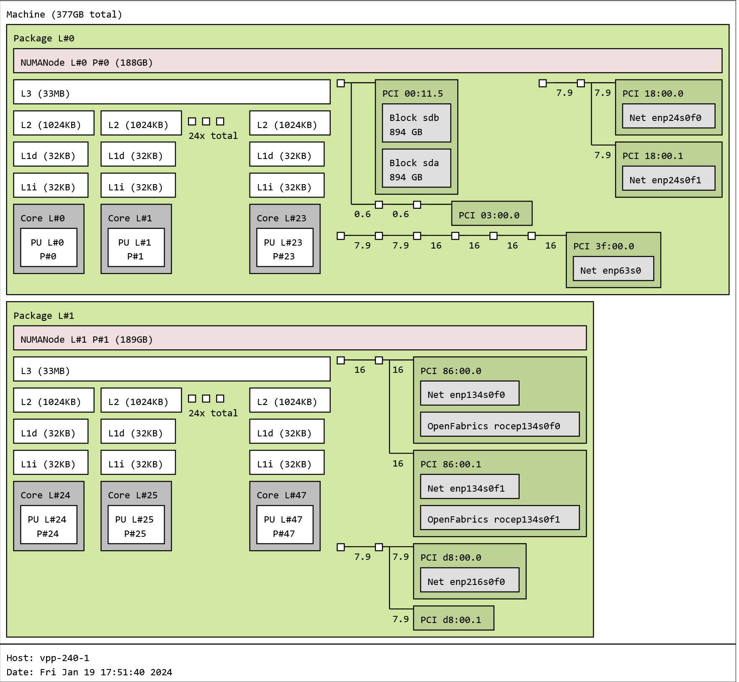
NUMA Architecture Concerns
Existing tools to get/visualize NUMA architecture
Lstopo
Output NUMA configuration to terminal/image file
e.g. `lstopo –v --output-format svg > mytopology.svg`

Slide 15
Recommendations
Pinning on core 0 might not be a good idea..
Kernel Boot Parameters:
Isolating cores with `isolcpus`
Modify IRQs affinity with ‘irqaffinity’
Reduce kernel noise with `nohz_full`

Slide 16
Experiments with CPU Pinning
Use-case:
IPSec/IKEv2 setup between two VPP instances
VPP instances using one core only
Using aes-gcm-128 for IPsec ESP, with TCP traffic
Network Namespace A
Network Namespace B
IPerf Client
VPP (Responder)
VPP (Initiator)
IPerf Server
tun
tun
memif
Traffic between VPP instances encrypted using IPSec

Slide 17
Experiments with CPU Pinning
Different scenarios to test core pinning
Performance loss in scenarios with improper pinning.

Slide 18
Part 2: Abstraction Challenges

Slide 19
Virtual Machines
Abstract hardware into several isolated systems
VM CPUs are represented as threads on host machine
→ Pinning vCPUs to resemble host topology & ensure NUMA awareness
VM Applications
VM Applications
Guest OS
Guest OS
vCPU
vCPU
vCPU
vCPU
Hypervisor / Virtualization Layer
Host OS
Hardware
VM Stack
Notes:
]

Slide 20
VMs – Pinning Primer
Pinning vCPUs in KVM/QEMU
libvirt, virsh utilities
Applications within VMs must also be pinned
Running `virsh edit <vm-domain>`

Slide 21
Containers
Containers share the OS kernel, and run as isolated processes in user space
Leverages Linux cgroups and namespaces
Ideal for orchestration and fast deployment of network workloads..
→ Ability to pin processes/threads to CPU directly from within containers..
Container App.
Container App.
Binaries/Libraries
Binaries/Libraries
Container Engine
Host OS
Hardware
Container Stack

Slide 22
Containers – Cgroup CPUset
Cpuset Controller enables constraining of CPU resources..
Useful to dedicate CPU resources to container..
Cgroupsv1 and Cgroupsv2
# Launching docker instance with CPU affinity [4-7]
~ sudo docker run -i -t --cpuset-cpus 4-7 ubuntu:22.04 /bin/bash
# Check enabled cgroups version
~ stat -fc %T /sys/fs/cgroup/
Cgroup2fs # or tmpfs for (v1)
# Check cpuset in current cgroup
root@XX:/# cat /sys/fs/cgroup/cpuset.cpus.effective
4-7

Slide 23
Containers – Cgroup CPUset Challenge
VPP with Configuration:
cpu {main-core 0 corelist-workers 1-3}
Pinning configuration of VPP in bare-metal
Takes CPU pinning configuration
[ 0, 1, 2, 3, 4, 5, 6, 7]
Host CPUs
/sys/devices/system/cpu/online

Slide 24
Containers – Cgroup CPUset Challenge
VPP with Configuration:
cpu {main-core 0 corelist-workers 1-3}
Pinning configuration of VPP in bare-metal
Takes CPU pinning configuration
[ 0, 1, 2, 3, 4, 5, 6, 7]
Host CPUs
/sys/devices/system/cpu/online

Slide 25
Containers – Cgroup CPUset Challenge
Container Instance
VPP with Configuration:
cpu {main-core 0 corelist-workers 1-3}
Pinning configuration of VPP in a container
[ 0, 1, 2, 3, 4, 5, 6, 7]
Host CPUs
/sys/devices/system/cpu/online

Slide 26
Containers – Cgroup CPUset Challenge
Container Instance
VPP with Configuration:
cpu {main-core 0 corelist-workers 1-3}
Pinning configuration of VPP in a container
[ 0, 1, 2, 3, 4, 5, 6, 7]
Host CPUs
/sys/devices/system/cpu/online

Slide 27
Containers – Cgroup CPUset Challenge
Container Instance
VPP with Configuration:
cpu {main-core 0 corelist-workers 1-3}
Pinning configuration of VPP in a container
VPP attempts to pin to restricted cores!
Environment awareness..
[ 0, 1, 2, 3, 4, 5, 6, 7]
Host CPUs
/sys/devices/system/cpu/online

Slide 28
Containers – Cgroup CPUset Challenge
# Launching Docker instance with cpuset 4-7
~ lscpu -e
CPU SOCKET CORE L1d:L1i:L2:L3 ONLINE
0 0 0 0:0:0:0 yes
1 0 0 0:0:0:0 yes
2 0 1 1:1:1:0 yes
3 0 1 1:1:1:0 yes
4 0 2 2:2:2:0 yes
5 0 2 2:2:2:0 yes
6 0 3 3:3:3:0 yes
7 0 3 3:3:3:0 yes
# VPP pinning fails..
~ vpp "cpu {main-core 0 corelist-workers 1-2}"
vlib_thread_init: could not pin main thread to cpu 0
Container Instance
VPP with Configuration:
cpu {main-core 0 corelist-workers 1-3}
Pinning configuration of VPP in a container
[ 0, 1, 2, 3, 4, 5, 6, 7]
Host CPUs
/sys/devices/system/cpu/online

Slide 29
Containers – Cgroup CPUset Challenge
# Launching Docker instance with cpuset 4-7
~ lscpu -e
CPU SOCKET CORE L1d:L1i:L2:L3 ONLINE
0 0 0 0:0:0:0 yes
1 0 0 0:0:0:0 yes
2 0 1 1:1:1:0 yes
3 0 1 1:1:1:0 yes
4 0 2 2:2:2:0 yes
5 0 2 2:2:2:0 yes
6 0 3 3:3:3:0 yes
7 0 3 3:3:3:0 yes
# VPP pinning fails..
~ vpp "cpu {main-core 0 corelist-workers 1-2}"
vlib_thread_init: could not pin main thread to cpu 0
Container Instance
VPP with Configuration:
cpu {main-core 0 corelist-workers 1-3}
Pinning configuration of VPP in a container
Proposed patch in VPP to introduce relative core pinning
[ 0, 1, 2, 3, 4, 5, 6, 7]
Host CPUs
Make VPP aware of cgroups constraints when pinning
/sys/devices/system/cpu/online

Slide 30
Containers – Cgroup CPUset Challenge
Container Instance
VPP with Configuration:
cpu {main-core 0 corelist-workers 1-3 relative}
Pinning configuration of VPP in a container
With relative option
[ 0, 1, 2, 3, 4, 5, 6, 7]
Host CPUs
/sys/devices/system/cpu/online

Slide 31
Containers – Cgroup CPUset Challenge
Container Instance
VPP with Configuration:
cpu {main-core 0 corelist-workers 1-3 relative}
Pinning configuration of VPP in a container
With relative option
Mapping
[0] = 4
[1] = 5
[2] = 6
[3] = 7
[ 0, 1, 2, 3, 4, 5, 6, 7]
Host CPUs
/sys/devices/system/cpu/online

Slide 32
Containers – Cgroup CPUset Challenge
Container Instance
VPP with Configuration:
cpu {main-core 0 corelist-workers 1-3 relative}
Pinning configuration of VPP in a container
With relative option
[ 0, 1, 2, 3, 4, 5, 6, 7]
Host CPUs
/sys/devices/system/cpu/online

Slide 33
Containers – Cgroup CPUset Challenge
Container Instance
VPP with Configuration:
cpu {main-core 0 corelist-workers 1-3 relative}
Pinning configuration of VPP in a container
With relative option
Mapping
[0] = 1
[1] = 2
[2] = 5
[3] = 6
[ 0, 1, 2, 3, 4, 5, 6, 7]
Host CPUs
/sys/devices/system/cpu/online

Slide 34
Containers – Cgroup CPUset Challenge
How does your environment expose available cores ?
How does your network workload fetch available cores ?
# Looking at Host Resources in different container runtimes with cpuset 4-7
# e.g. Docker instance
root@XX:/# cat /sys/devices/system/cpu/online
0-19
# e.g. LXC instance
root@XX:/# cat /sys/devices/system/cpu/online
4-7

Slide 35
Containers – Testing Network Workload with Calico-VPP
Similar to previous use-case (Ipsec/IKEv2 over VPP instances)
Twist: Introduce container abstraction, with Calico-VPP as data-plane between pods/containers.
Can we expect similar performance results with abstraction?
Pod A
Pod B
IPerf Client
tun
VPP (Resp.)
VPP (Resp.)
tun
IPerf Server
memif
memif
Calico-VPP Dataplane
Kubernetes Cluster

Slide 36
Containers – Testing Network Workload with Calico-VPP
Addition of another hop (Calico-VPP Dataplane)
Performance is still comparable to bare-metal with proper pinning!
~10Gbit/sec in BM
Iperf throughput (in Gbit/sec)

Slide 37
Closing Words

Slide 38
Summary
Need to switch to performant Virtual NFs ? Think VPP/Calico-VPP ☺
Be aware of your architecture when configuring
Stay tuned for more VPP!
Pim van Pelt: VPP: 100Mpps of MPLS on a Linux PC @ 2PM
Notes:
- Be aware of your underlying architecture and virtual environment when configuring and deploying network workloads
- No "one configuration fits all" solution, fine-tuning is needed for your network workloads to go full throttle!
- Thinking of deploying Virtual Network Function in your environment, think VPP/Calico-VPP :)
- If you want another great example of how careful configuration can allow your network workloads to achieve impressive throughputs, stay tuned for this afternoon's presentation by Pim van Pelt, where he'll delve more into VPP and the MPLS support for VPP's Linux Control Plane plugin, and showcase some high-performance routing pushing modest hardware to its limits.

Slide 39
Test Machine Specs
Intel(R) Xeon(R) Platinum 8168 CPU @ 2.70GHz (24 Cores, 48 Threads), 376 GB RAM, NUMA Nodes: 2, with NIC Intel XL710, running on Ubuntu 22.04.2 LTS (1-node development platform).

Slide 40
Questions ?

