Slide 1
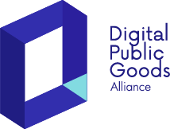
Scaling Open-Source Solutions to Achieve the Sustainable Development Goals: A Global Call to Action
Amreen Taneja, Standards Lead
Digital Public Goods Alliance
Notes:
I’d like to warmly welcome you all to this session on Scaling Open-Source Solutions to Achieve the Sustainable Development Goals: A Global Call to Action.
I’m excited to be here today with my brilliant colleague Mr. Omar Mohsine, Open Source Coordinator at the UN Office of Digital and Emerging Technologies. We’re also joined by some incredible members of the Digital Public Goods community, including representatives from the TOR Project, Chamilo, Open Food Facts, and Wikimedia.

Slide 2
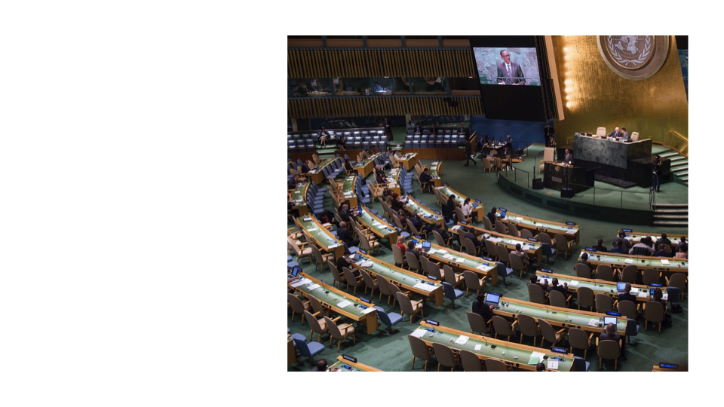
UN Sustainable Development Summit 2015
In 2015, 193 countries came together with one shared vision: A better world for all by 2030.
A commitment to people, planet, prosperity, peace, and partnerships.
The result? The 17 Sustainable Development Goals (SDGs).

Slide 3
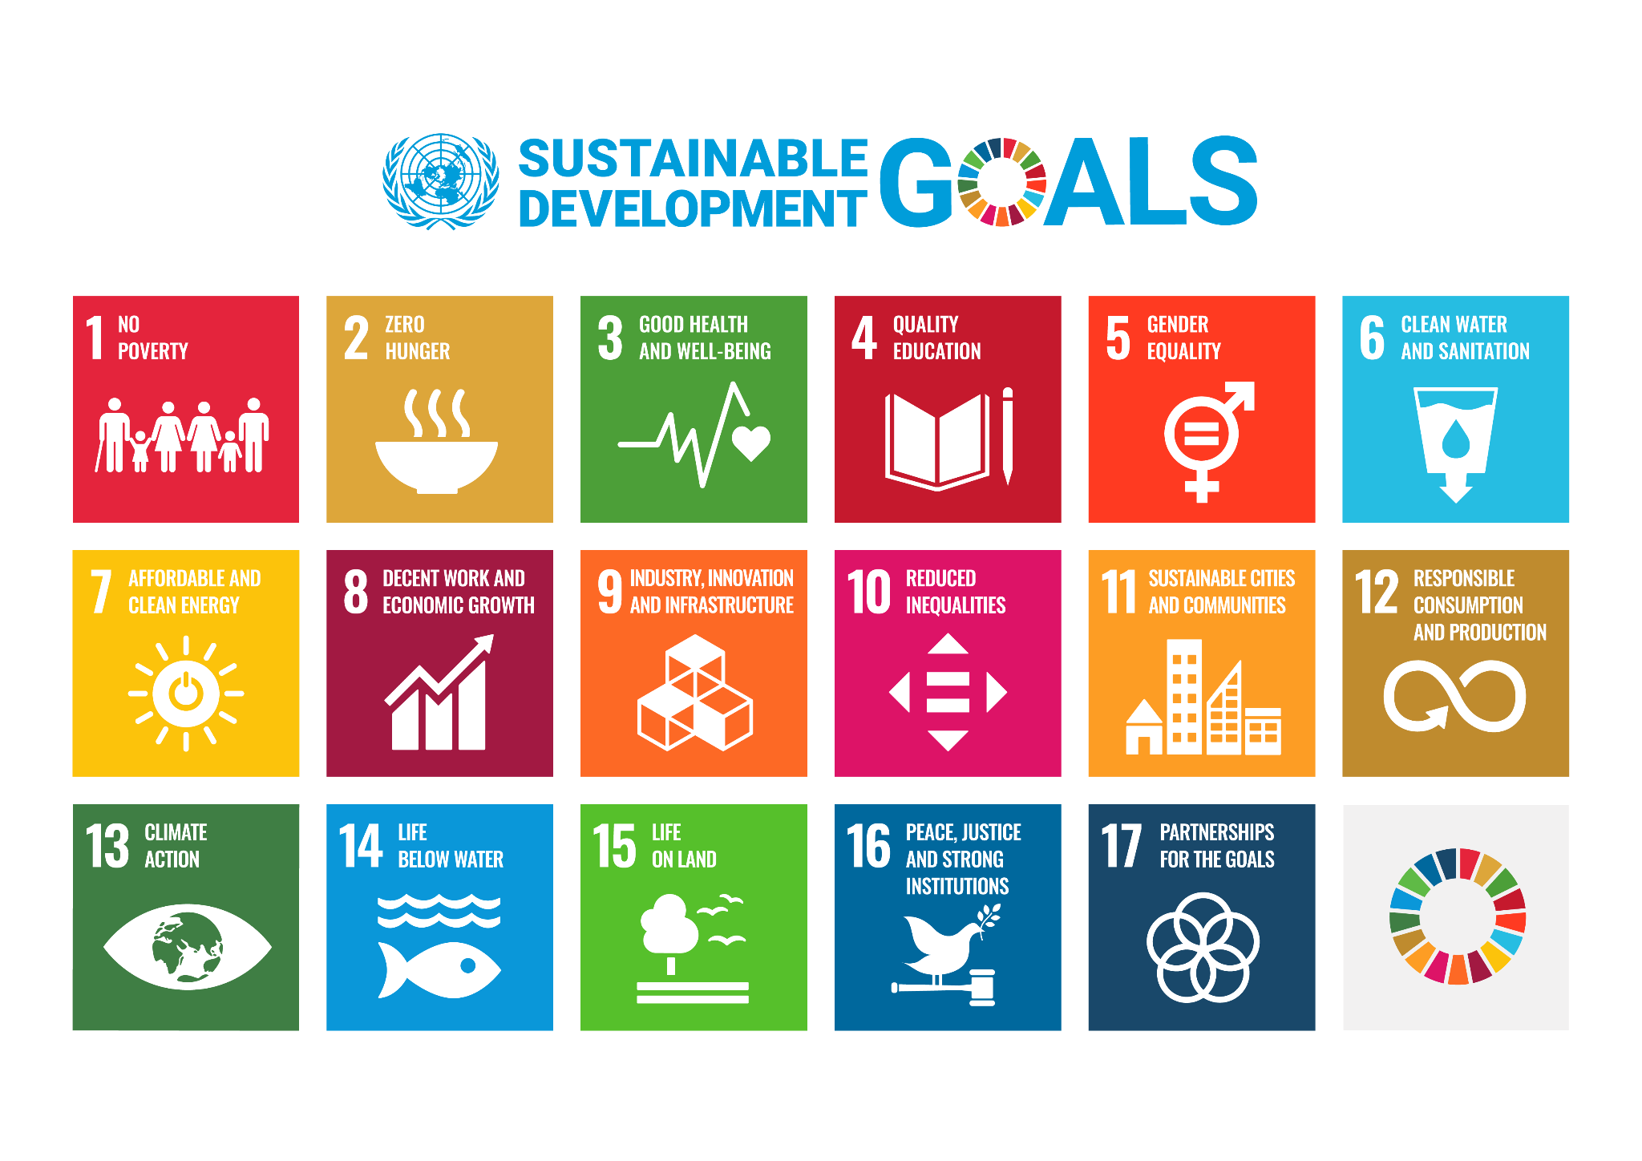
The SDGs: A blueprint for a Better Future
17 Goals. 5 years left.
From ending poverty (SDG 1) to ensuring global partnerships (SDG 17), these goals are interconnected and essential.
Technology, innovation, and collaboration are key drivers in achieving them.

Slide 4
45+
Members
180+
DPGs
The Digital Public Goods Alliance is a multi-stakeholder initiative launched in 2019 that accelerates the attainment of the Sustainable Development Goals by facilitating the discovery, development, use of, and investment in digital public goods.

Slide 5
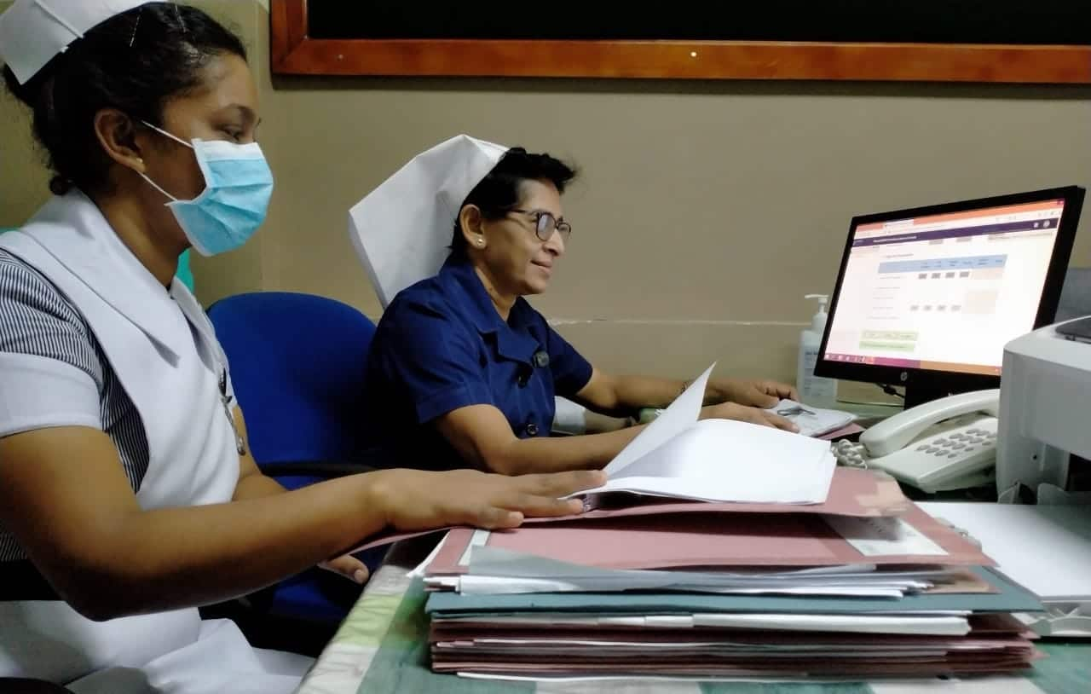
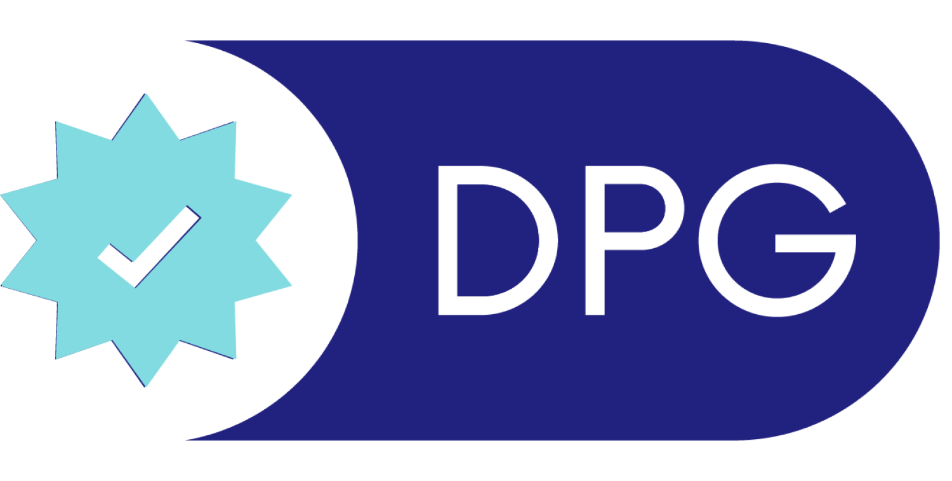
District Health Information System 2 (DHIS2), is the world's largest health management information system platform.
DHIS2 being used by
front-line workers in Sri Lanka
Sri Lanka,
January 2020
Notes:
So to give everyone a glimpse of what DPGs really are, let me begin with an example:
So we all remember COVID- It was something that very much directly affected our lives just till a few years back.
In Sri Lanka, the first suspected case of the COVID 19 was registered on January 27th, 2020.
Immediately local developers got to work building a Covid- 19 tracker for DHIS-2, an open source health information management system and a DPG being used by Sri Lanka.
Their tracker focused on the registration and tracking of travellers arriving from regions with a high risk of COVID-19 infection.
It was created within two days of that first registered covid case, and deployed at Sri Lanka’s airports just days later. But the speed and efficiency with which Sri Lanka was able to respond to this crisis is not the most impressive part of this story.

Slide 6
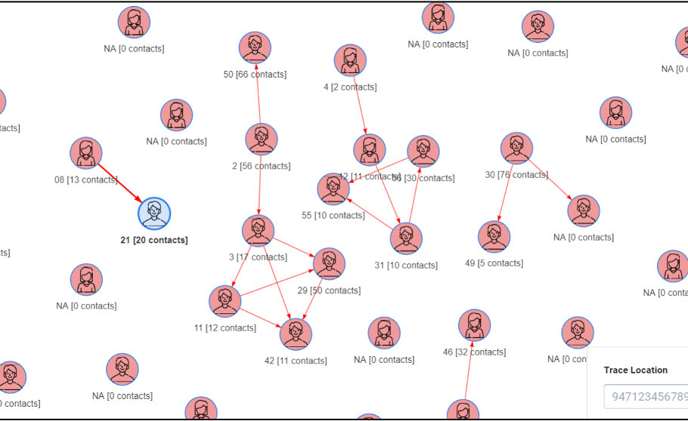
Sri Lanka,
January 2020
An app developed by HISP Sri Lanka to visualize and analyze contact relationships
Notes:
The most impressive part is how quickly this innovation was able to be pickled up and adapted by other countries.
So DHIS-2 is already being used by 100 countries around the world. That meant that when Sri Lanka shared their user guides with the global DHIS2 COVID-19 response team, the tracker was able to be implemented in over 35 countries, for surveillance and vaccinations.
That’s the kind of opportunity DPGs unlock!

Slide 8
Digital technologies: electronic tools, systems, devices and resources that generate, store or process data.
Digital Public Goods
Public Good: a commodity or service that is provided without profit to all society members, either by the governments, private individuals or organisations which that benefit the public well-being.
Notes:
So now a little bit of context on where this concept and definition came from.
The DPG definition was laid out by the Secretary General of the United Nations which delineates the 5 kinds of open source digital solutions that are recognised as DPGS- which are open source software, open data, open AI models, open standards and open content.

Slide 9
Digital Public Goods
Notes:
Digital public goods (or DPG) can sometimes just thought of as “free software” but they’re so much more than that.
When we talk about digital public goods we talk about a solution that:
advance the sustainable development goals
, that is open source and
that has taken steps in it’s design and development to avoid and mitigate harm.
For eg. Openstreetmap which is a DPG is a great example of this, built collaboratively, available to anyone to change and modify and presenting a solution to a common problem.

Slide 10
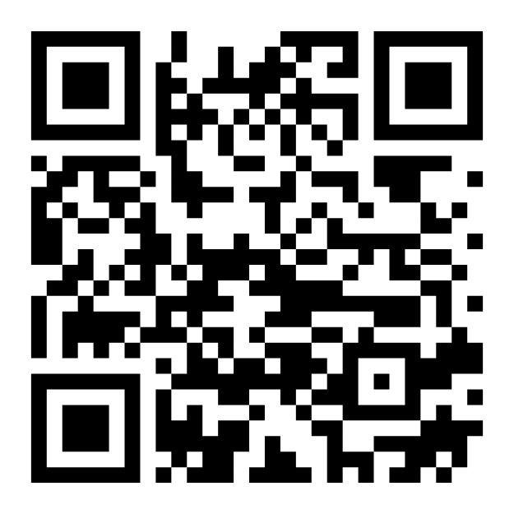
1. Relevance to the Sustainable Development Goals
2. Use of Approved Open Licenses
3. Clear Ownership
4. Platform Independence
5. Documentation
6. Mechanism for Extracting Data
7. Adherence to Privacy and Applicable Laws
8. Adherence to Standards & Best Practices
9. Do No Harm by Design
9.a) Data Privacy & Security
9.b) Inappropriate & Illegal Content
9.c) Protection from Harassment
DPG
Standard
Notes:
These components further come to life through the 9 indicators of the DPG standard which elaborates on what do no harm by design means for privacy, security, adherence to laws and best practices.
These 9 indicators create a baseline of requirements to earn recognition as a digital public good. One of the core functions of the Alliance is to steward and maintain the DPG standard and its application.

Slide 11
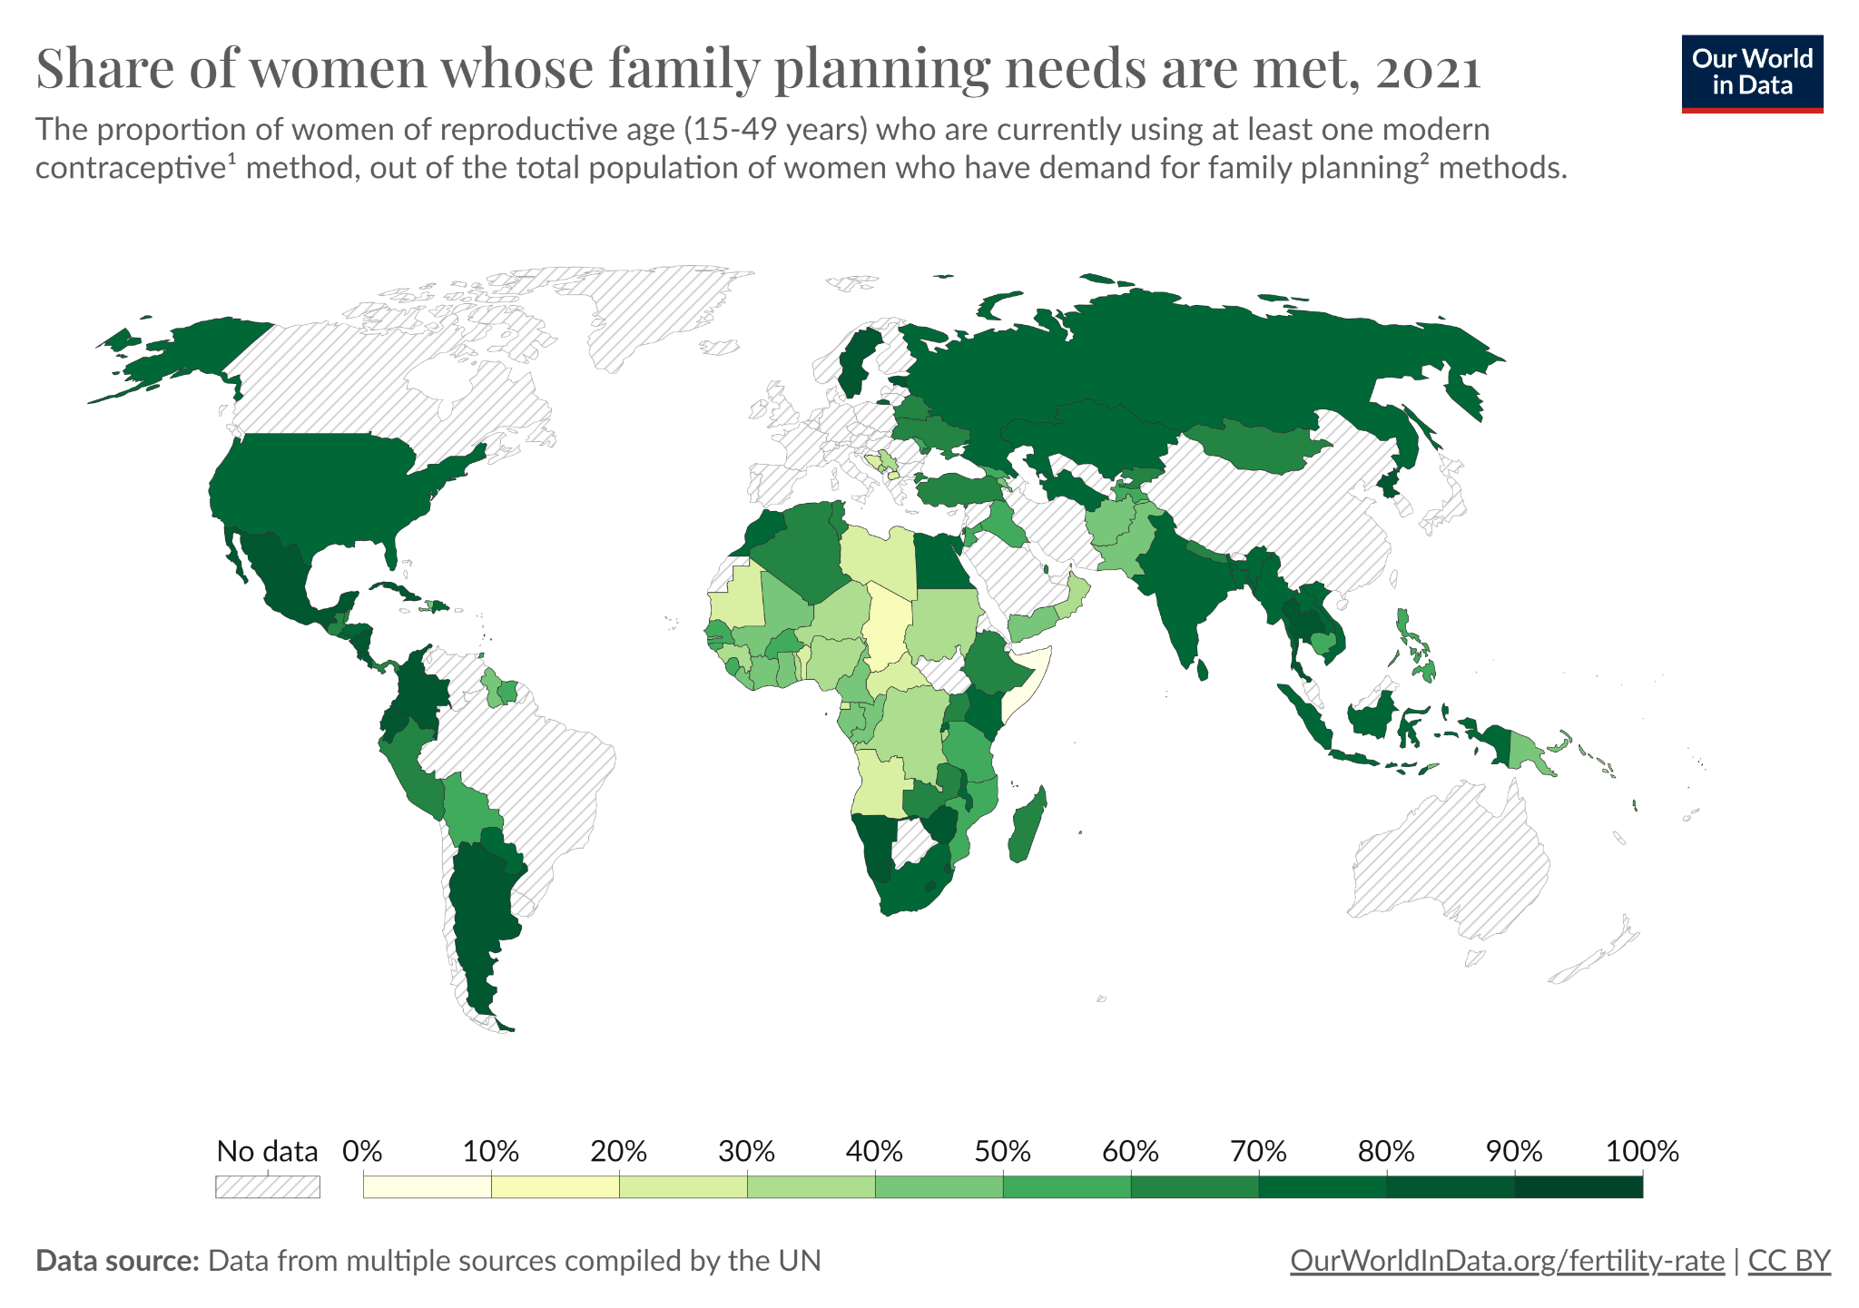
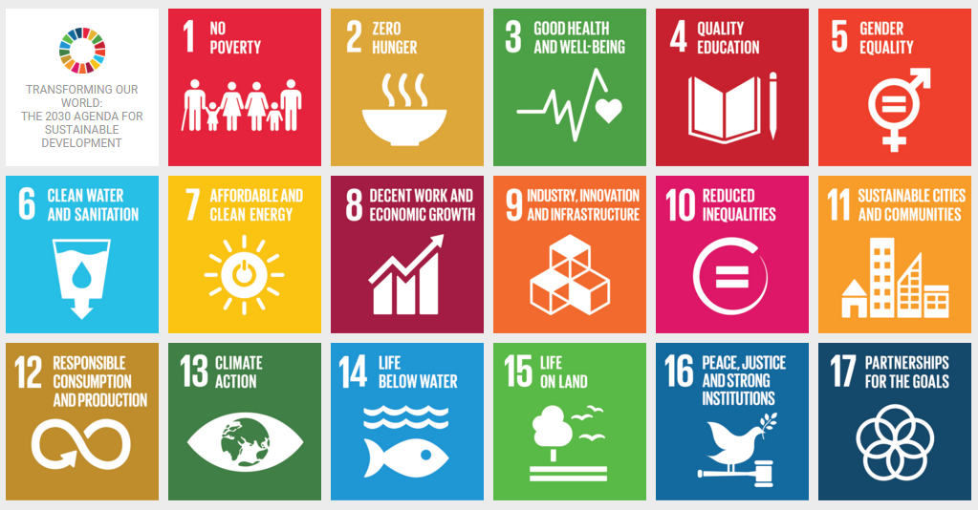
Indicator 1. SDG Relevance
Demonstrated efforts into advancing one or more goals

Slide 12
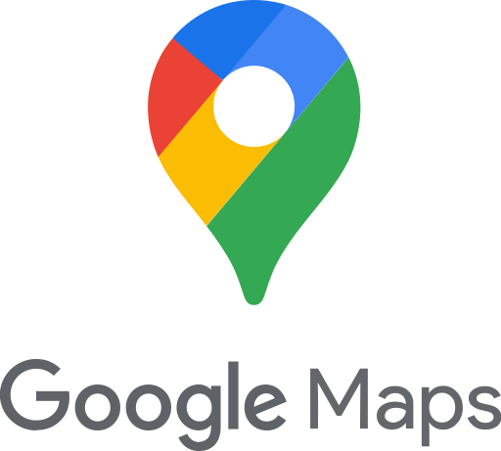
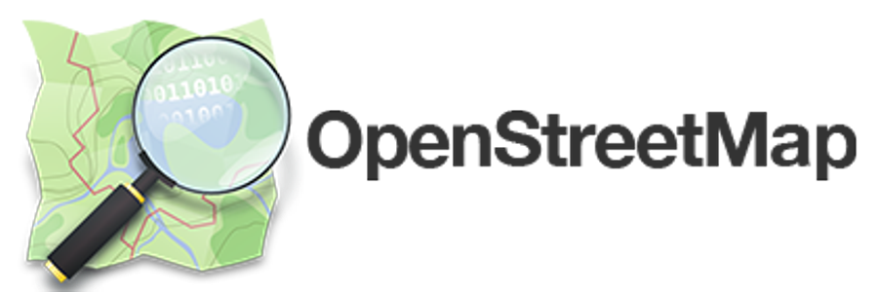
Indicator 4. Platform Independence
Prove independence from the closed component(s) and/or indicating the existence of functional, open alternatives
VS
Notes:
Good 👍
If closed components are used by the solution, show how this can be mitigated to replace the closed components with open source alternatives, providing clear and practical instructions (which preferably have been tried out and are not just theoretical), on how to swap out the closed components without compromising the core offering of the solution.
DPGs use many software libraries, programming languages, and frameworks to build solutions
A software product even if it’s open source, can have closed components (Google Maps vs OSM)
DPGs have open alternatives from mandatory dependencies that create more restrictions than the original license
Platform independence is about choice, but that choice needs to be easy to make by the implementer and not imposed by the software from the start. It’s avoiding vendor lock-in at all levels

Slide 13
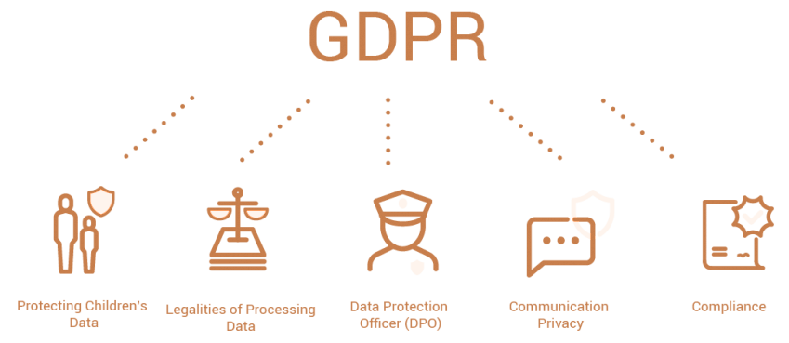
Indicator 7. Privacy and Applicable Laws
EU General Data Protection Regulation
The Indian Digital Personal Data Protection Act, 2023
US Persons with Disabilities Act 2020
Notes:
EU General Data Protection Regulation
Indian Information Technology Act
US Persons with Disabilities Act 2020

Slide 14
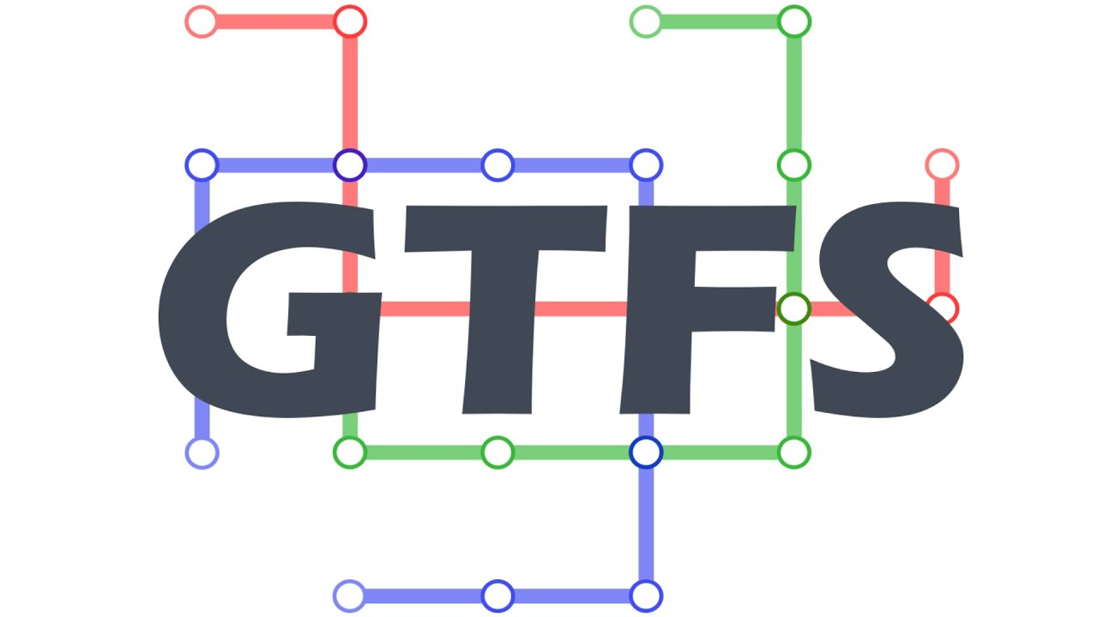
Indicator 8. Standards & Best Practices
Design for possibility of extracting or importing data in open formats
Open Standards
Best Practices
Notes:
Healthcare standards
Open data standards (public transport, fiscal data, infrastructure)
General best practices (principles for digital development)
Specific for use cases with children, financial systems, etc
Allow interoperability between solutions:
G2P Connect design principles and blueprints
Digital convergence initiative standards for social protencion
Transforming Social Protection with Interoperability: OpenSPP Meets OpenCRVS

Slide 17
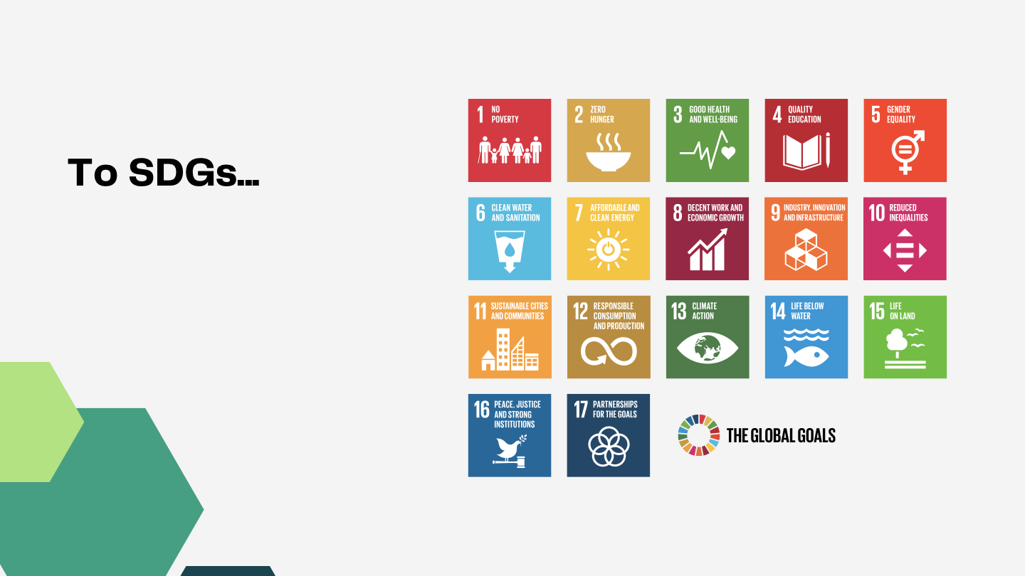

Slide 19
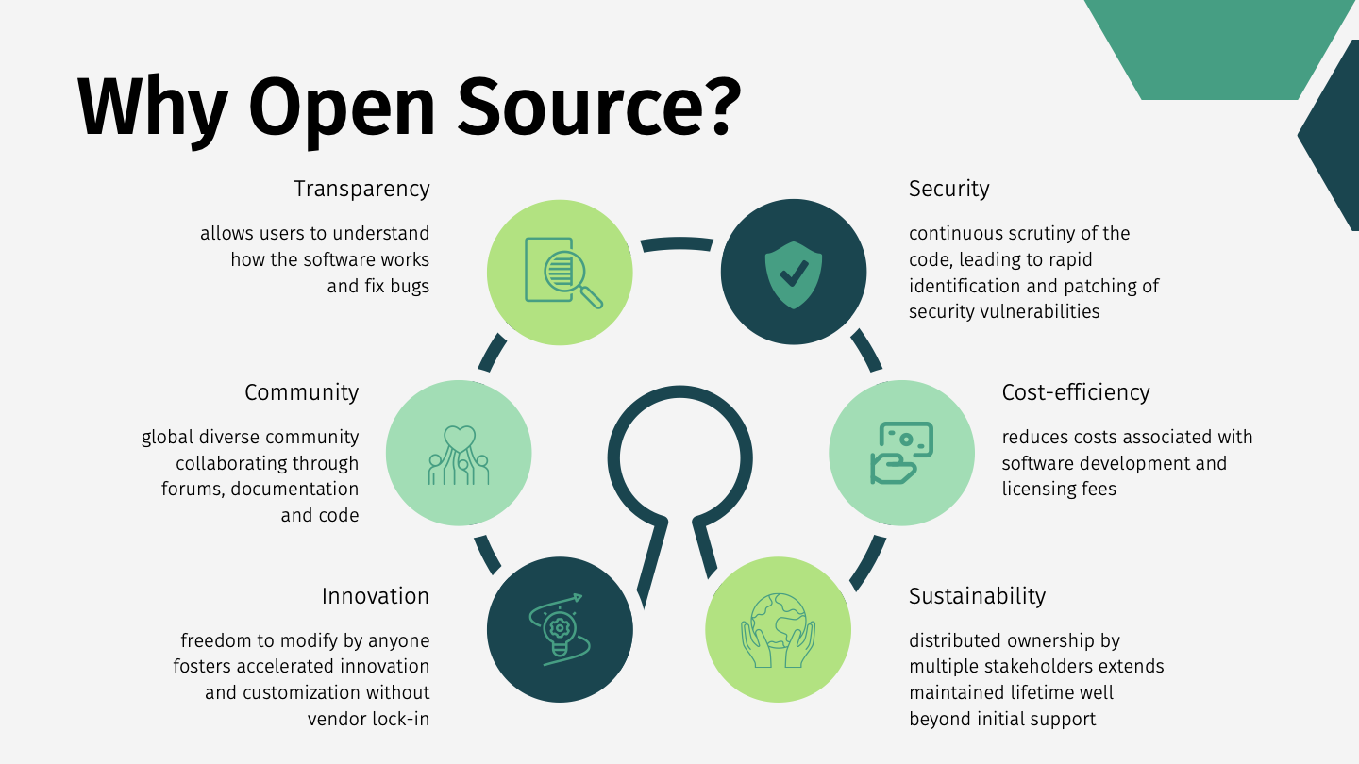

Slide 32
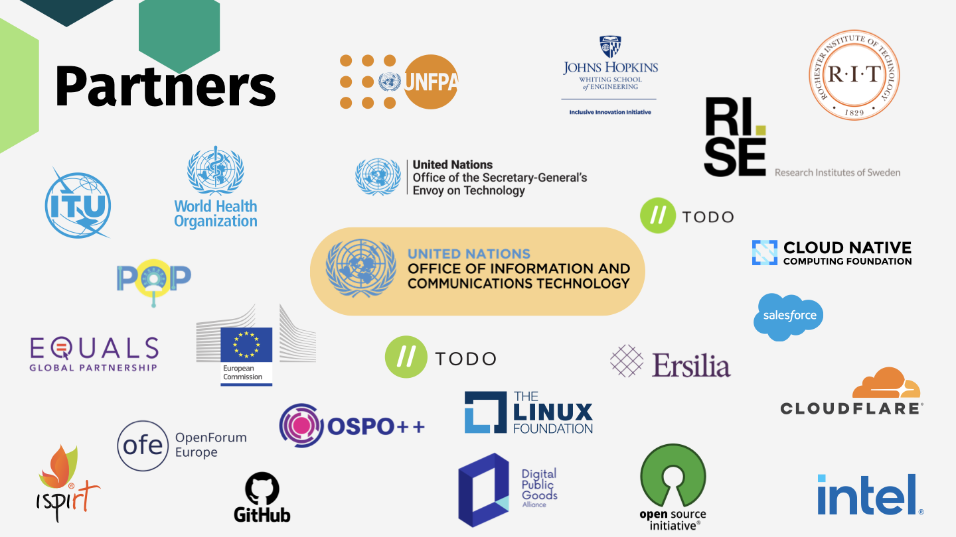

Slide 34
Time for some announcements!

Slide 35
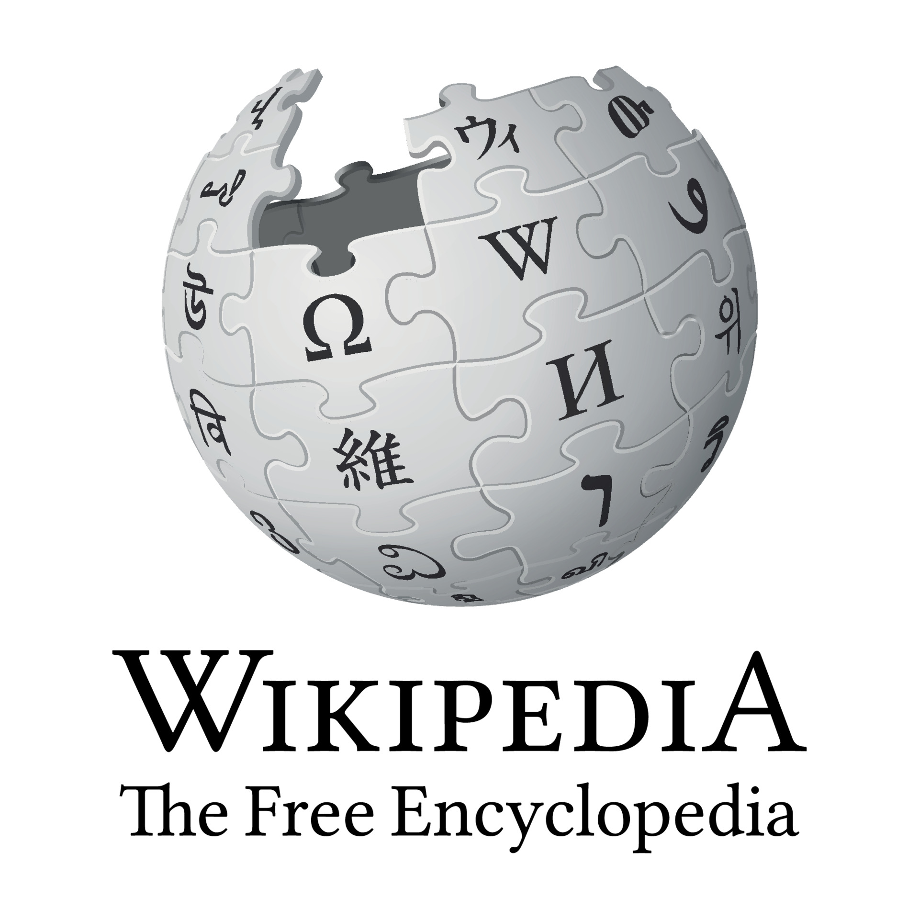
Wikipedia is now a
Digital Public Good!

Slide 36
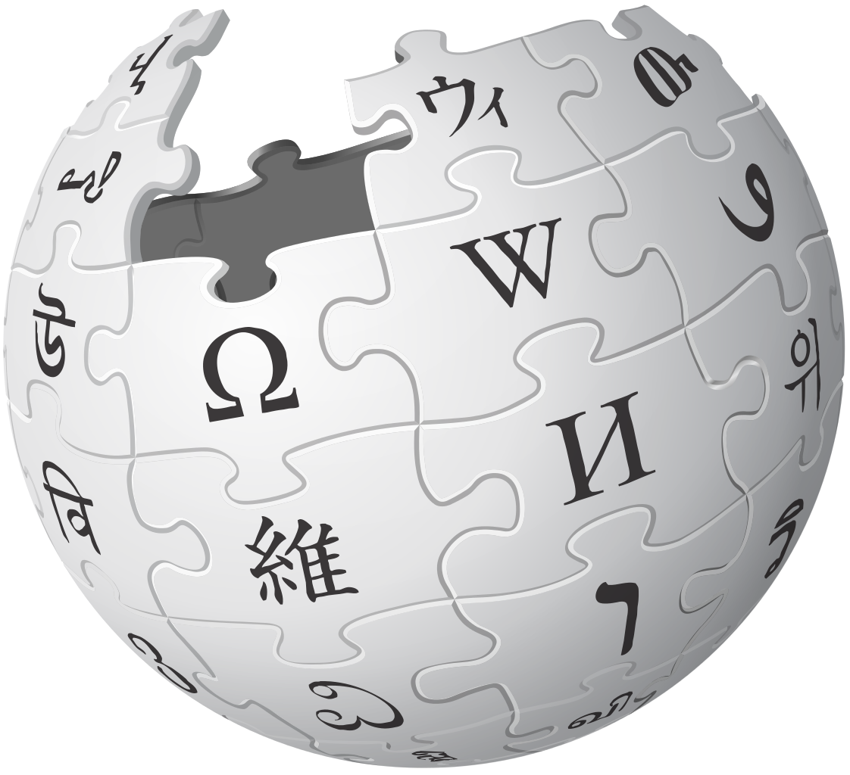
“Imagine a world in which every single human being can freely share in the sum of all knowledge. That’s our commitment.”
Notes:
lilli

Slide 37
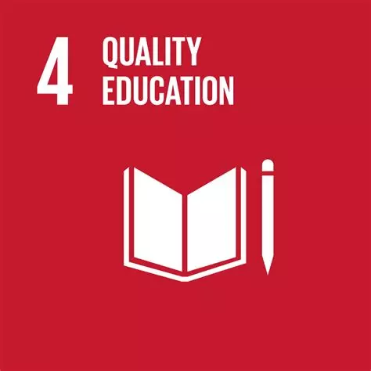
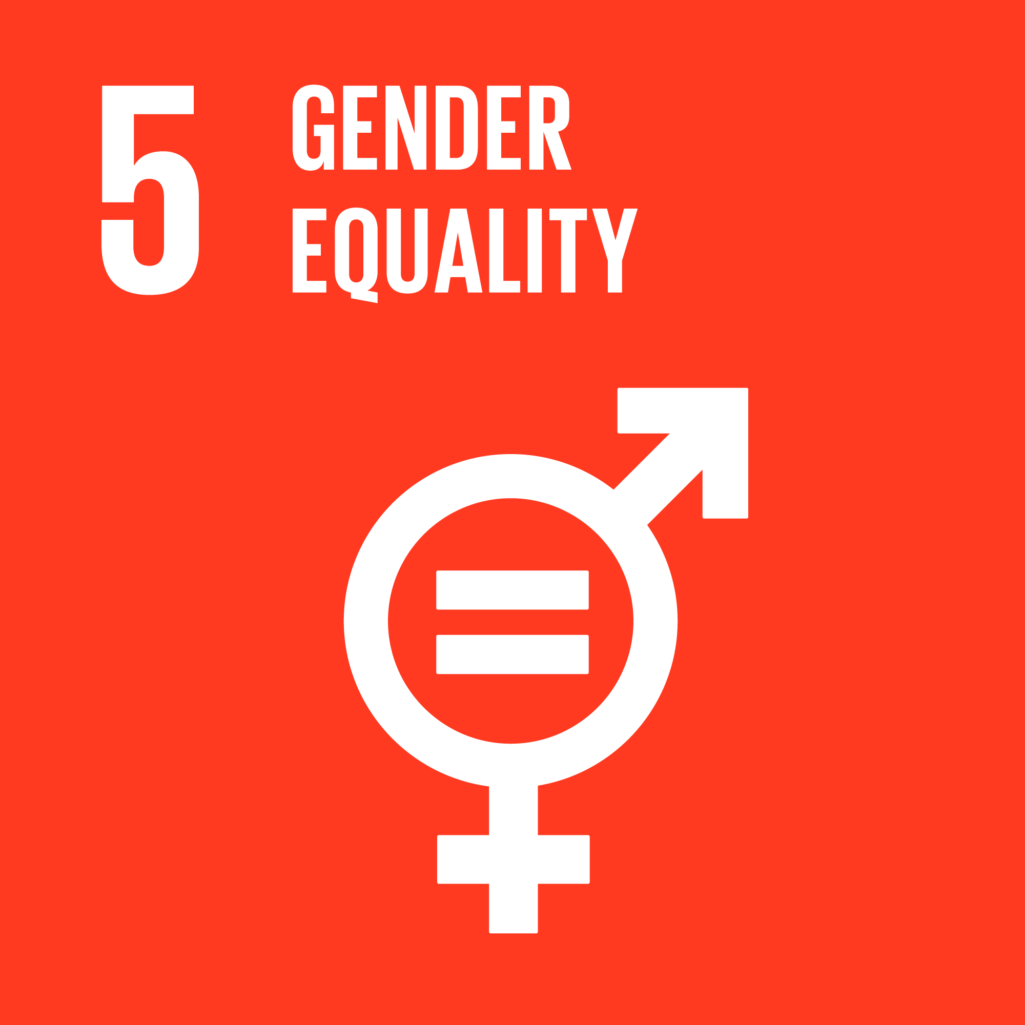
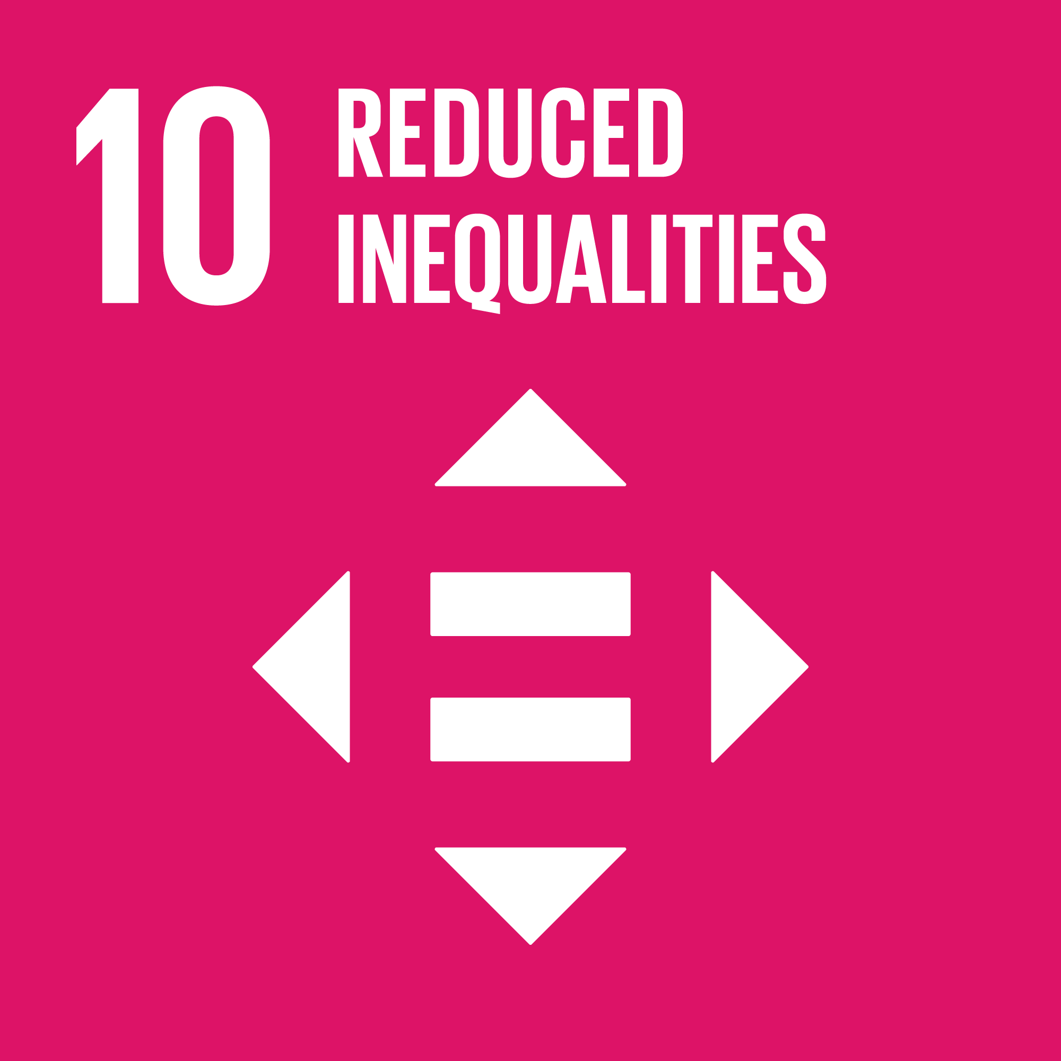
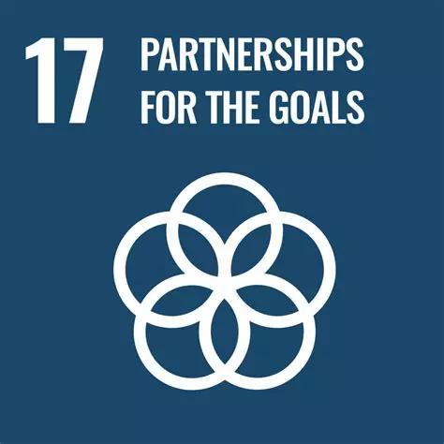
Wikipedia helps to achieve UN-SDG goals
4,5, 10, 16 & 17
Notes:
lilli

Slide 38
Wikipedia’s Role in Advancing SDGs
Free access to knowledge (SDG 4: Quality Education)
Wikipedia as a global educational tool
Supporting lifelong learning opportunities for all
Community-driven content creation (SDG 5: Gender Equality)
addresses gender bias on the platform by encouraging more women to contribute and ensuring that articles represent diverse perspectives
Notes:
lilli

Slide 39
Wikipedia’s Role in Advancing SDGs
Free access to knowledge (SDG 10: Reduced Inequalities)
Wikipedia as a global educational tool
Ensuring educational access in low-connectivity regions
Community-driven content creation (SDG 16: Peace, Justice, and Strong Institutions)
Enhancing transparency and fighting misinformation
Providing reliable and verifiable information
Notes:
lilli

Slide 40
Wikipedia’s Role in Advancing SDGs
Support for multiple languages (SDG 17: Partnerships for the Goals)
Bridging the digital divide
Collaborations with institutions and governments to expand access
Promoting linguistic diversity, preserving indigenous languages
Notes:
lilli

Slide 41
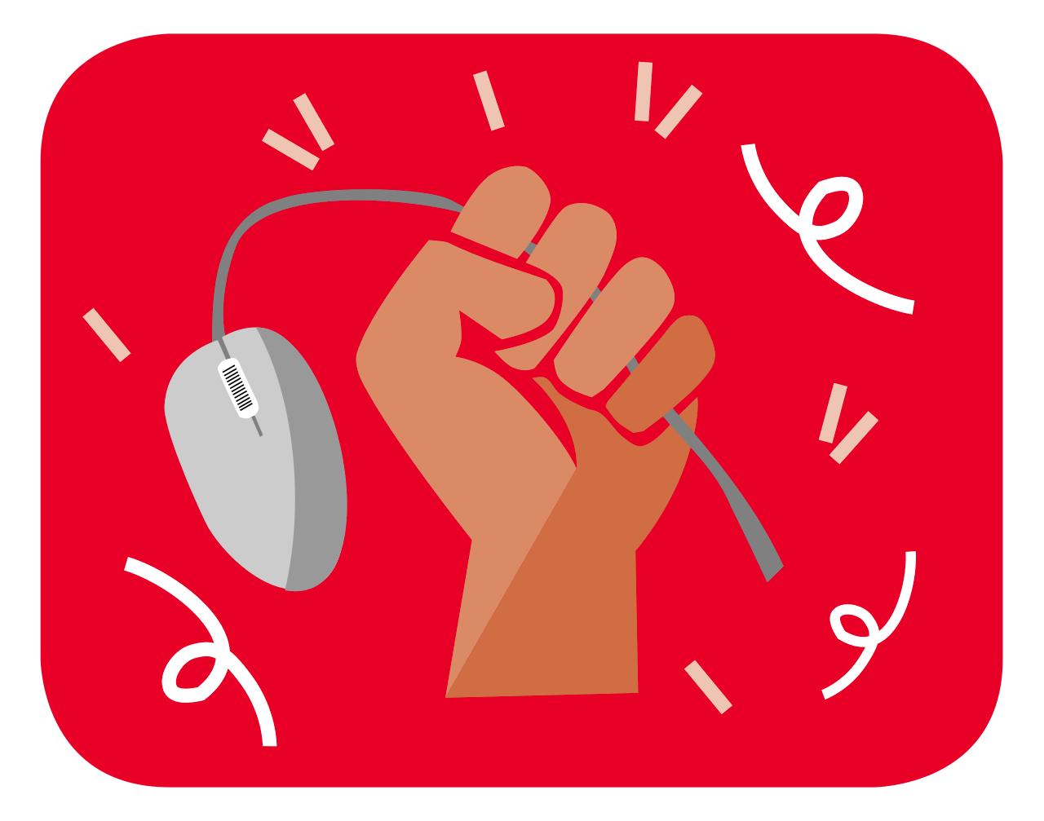
Conclusion & Call to Action
Wikimedia as a force for positive change
How you can contribute:
Edit Wikipedia, support Wikimedia projects, advocate for open knowledge
Final Thought:
Knowledge is a key driver for sustainable development – let’s make it accessible to all!
Notes:
lilli

Slide 42
Announcement No.2!

Slide 43
The TOR Browser is now a
Digital Public Good!

Slide 44
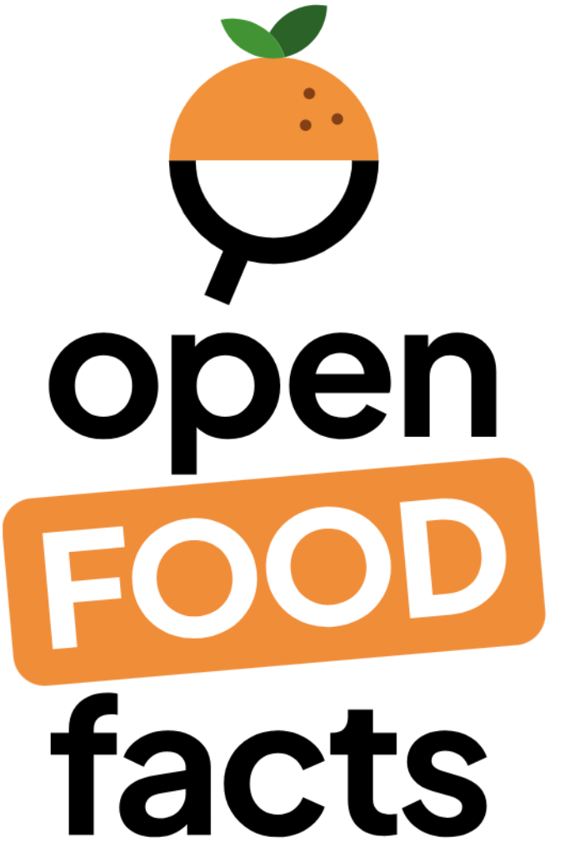
Open Food Facts is now
a Digital Public Good!
Notes:
Thank you, Omar, for sharing the incredible work being done by the UN to enable open-source technology and DPGs to scale and create even greater global impact.
Now, I’d like to bring this conversation to life by showcasing some real-world examples of the important work DPGs do and so today we have with us The TOR Project, Chamilo, Open Food facts and Wikipedia to share how their work is transforming lives and helping achieve SDGs
Each of these projects represents the power of openness, collaboration, and innovation in tackling global challenges. I’m excited for you to hear directly from them about their impact and vision for the future. With that, let’s start with our newest DPG- The TOR project!
Thank you so much.. For showcasing the imp. Work TOR is doing to help protect privacy and freedom online,truly helping to protect SDG 16- peace and justice… I would now like to call on stage Chamilo to share their story with us:
Thank you…. for sharing how Chamilo is making education accessible for everyone, truly supporting SDG4- Quality Education for all! I would now like to call on stage Open food facts- to share their story with us:
Thank you……for showing us how Open Food Facts is making food choices smarter and more sustainable—contributing to SDG2- Zero Hunger and SDG12 - Responsible Consumption. Last but not the least, I would now like to invite on stage wikimedia- to share their story with us:
Thank you….for explaining how Wikipedia is making knowledge open and free—helping us all get smarter and reach SDG4 i.e. attaining Quality Education globally

Slide 45
Open Food Facts’ Mission:
Reduce the impacts of the food system on health and the planet everywhere

Slide 46
We’re helping tackle UN-SDG goals 3, 12 & 13
Notes:
https://wiki.openfoodfacts.org/Sustainable_Development_Goals
http://world.openfoodfacts.org/presskit
By helping people choose food that is good for their health, using IARC-promoted Nutri-Score, we try to tackle UN Sustainable Development Goal #3.
3.4 By 2030, reduce by one third premature mortality from non-communicable diseases through prevention and treatment and promote mental health and well-being

Slide 47
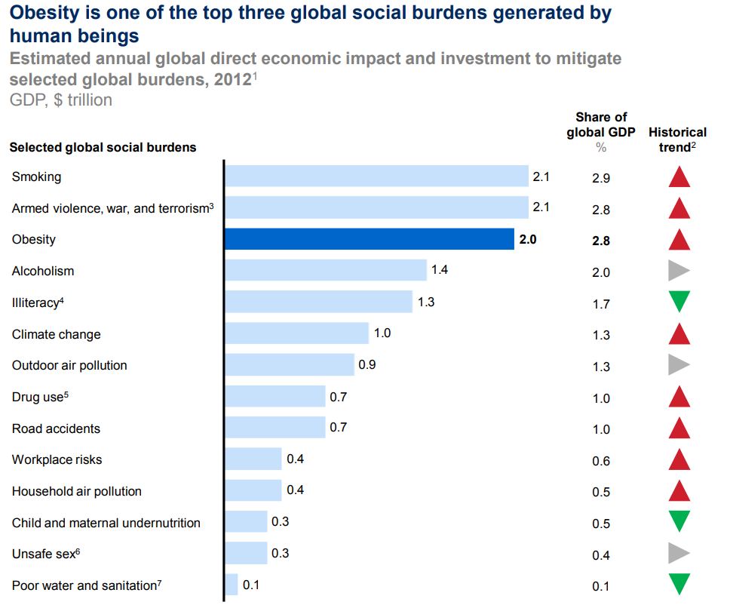
The impact of food on health and the planet
An observation: growing negative impacts
A global epidemic of obesity
Europe: 3% of GDP wiped (OECD)
France: 1 in 2 adults & 1 in 5 children are overweight
Annual cost: 20.4 billion euros (Public Treasury - 2016)
Globally, food accounts for 1/3 of carbon emissions, 70% drinking water consumption & the majority of packaging waste.
The obvious:
It is important and urgent to act.

Slide 48
Empower global citizens to have an impact
on their own health
on the environment
on the food system
Notes:
Building for disabilities
Blind people can’t read labels
Why don’t we speak them up
Building for France / for Europe / for the World
Building for disabilities
Building for the next billion people

Slide 49
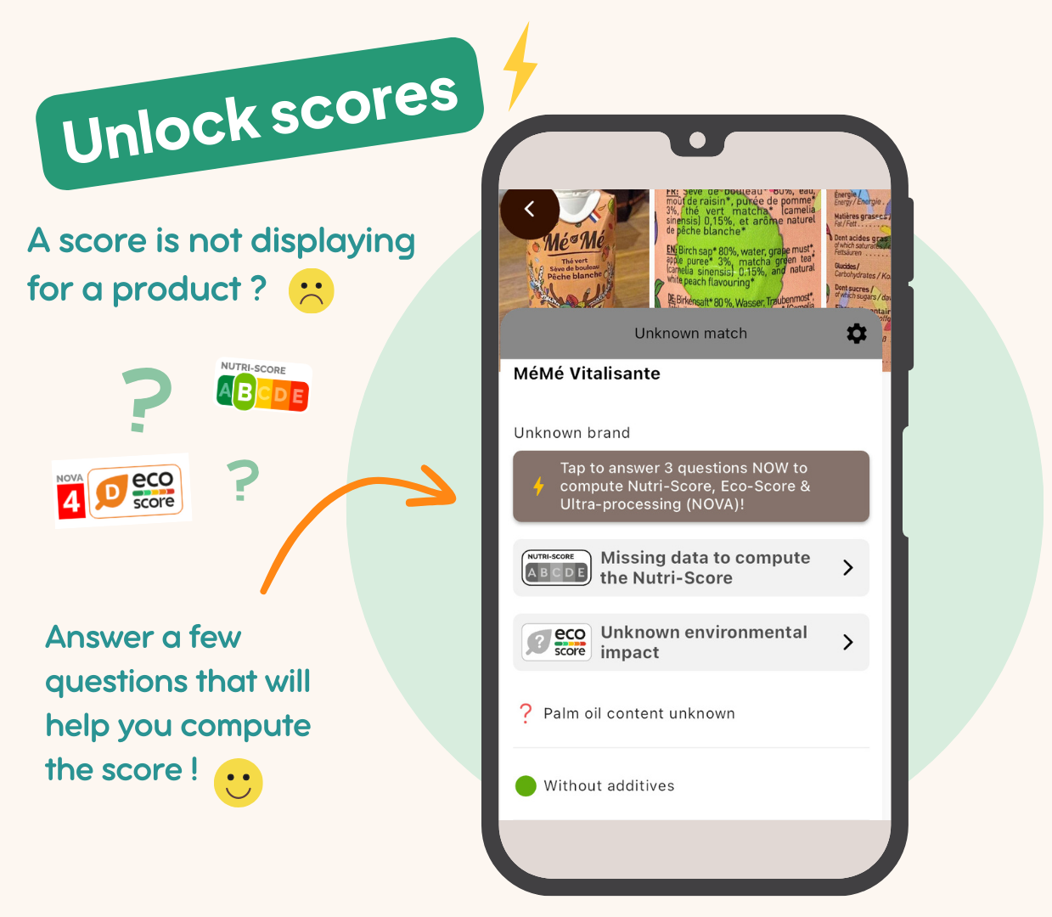
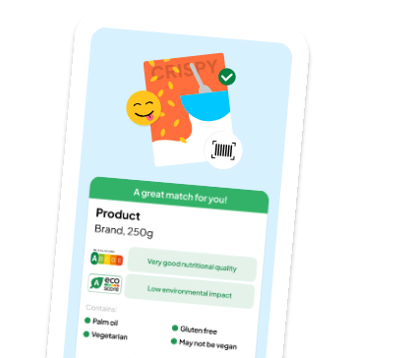
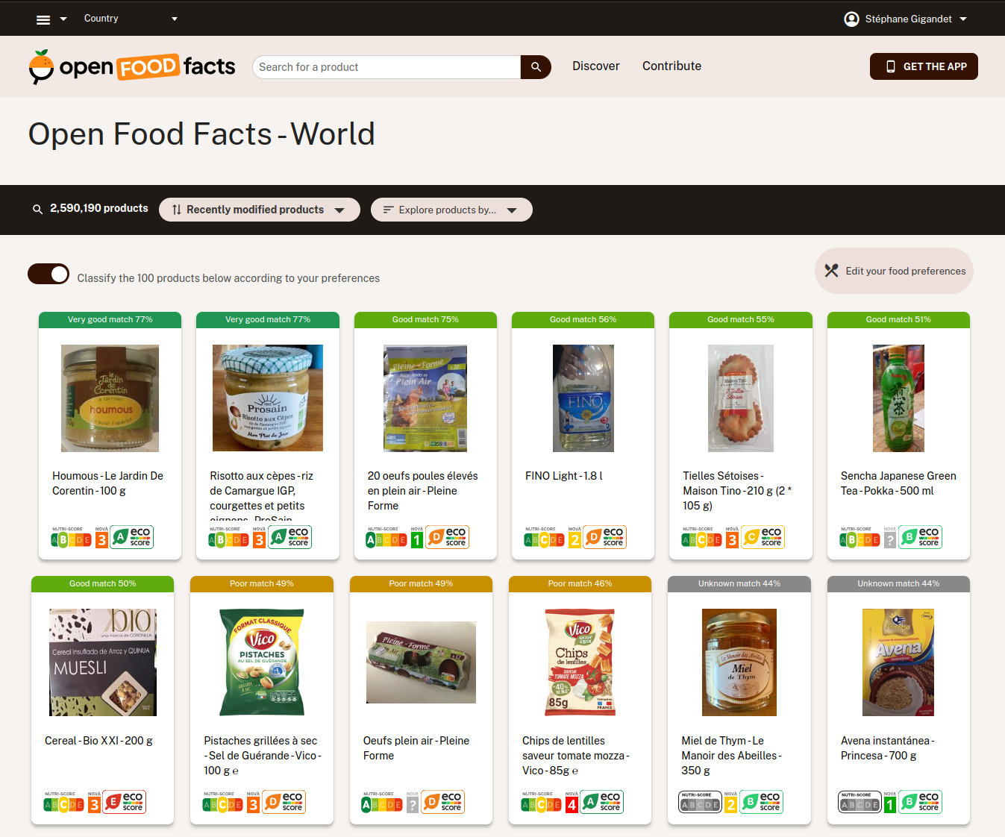
Scan almost any food to see its impact on the and yourself
If a score is missing, contribute with missing data to unlock it !
PLANET

Slide 50
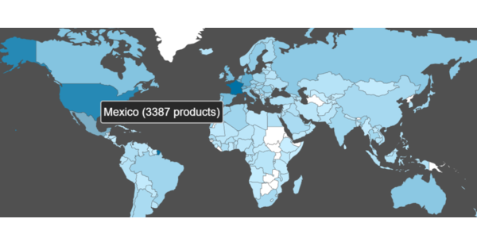
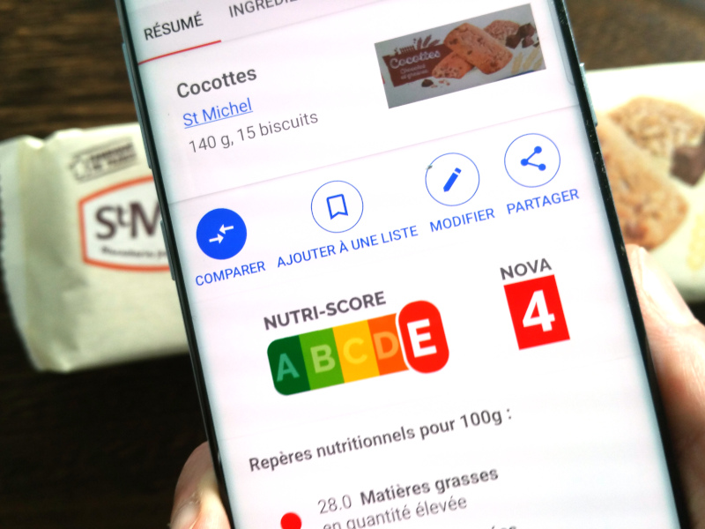
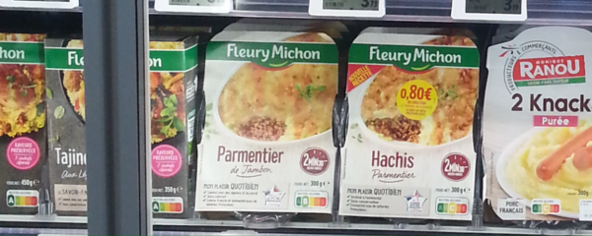
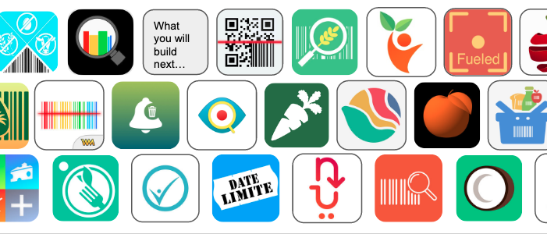
Our collective impact with Nutri-Score
Started displaying “Score 5C” on 15k products in 2015
Now computed worldwide on 630k products, using mobile crowdsourcing
Anyone can get it, even without manufacturer cooperation
Now available in real-life in 6 EU countries and under EU review
30% of French products have
a printed Nutri-Score
Newly-launched products have a better nutritional profile
Created an API ecosystem
around the Nutri-Score
2021 ScanUp study
Notes:
( France, Belgium, Switzerland, Spain, Netherlands, Germany, Luxembourg)

Slide 51
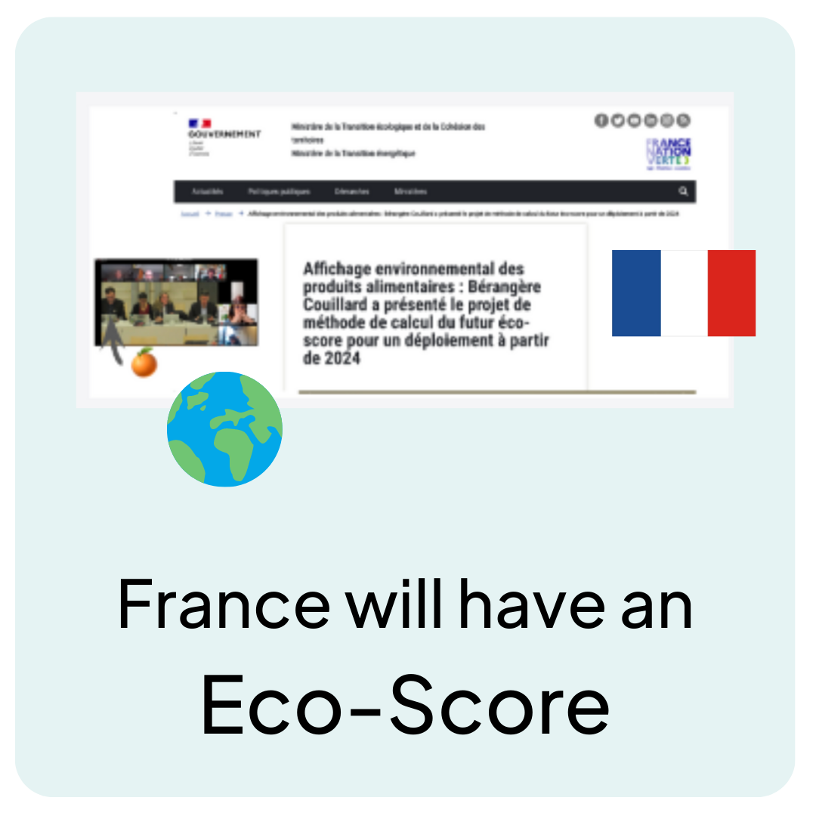
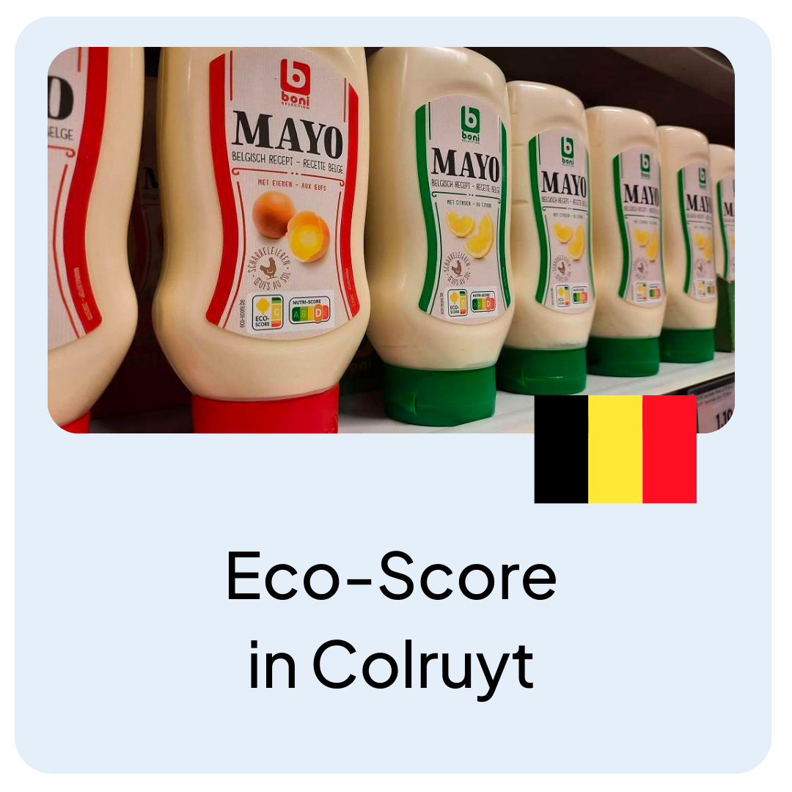
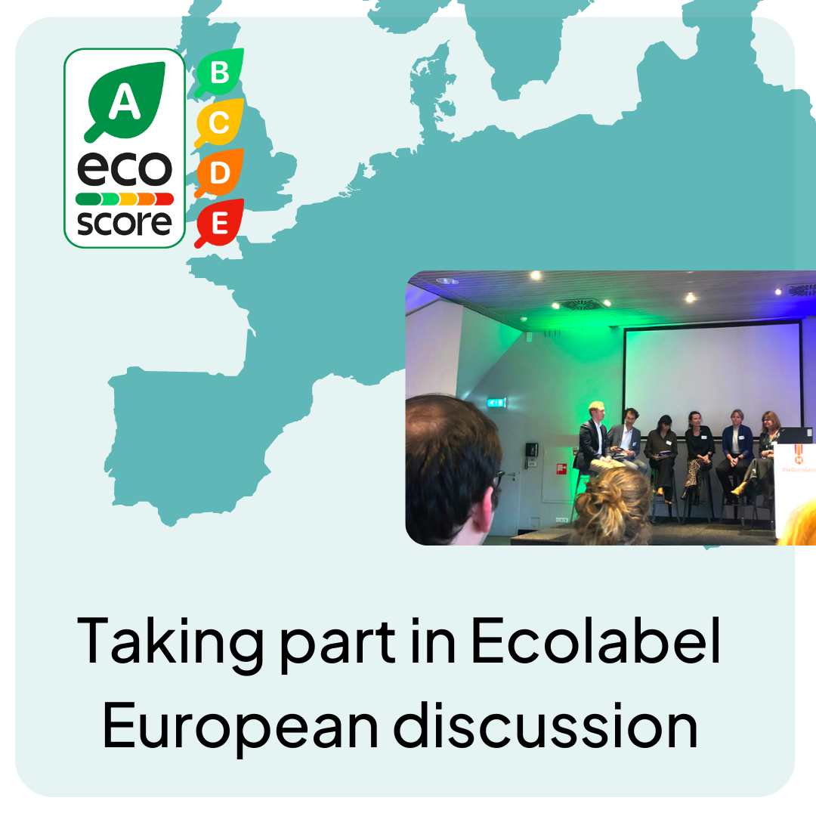
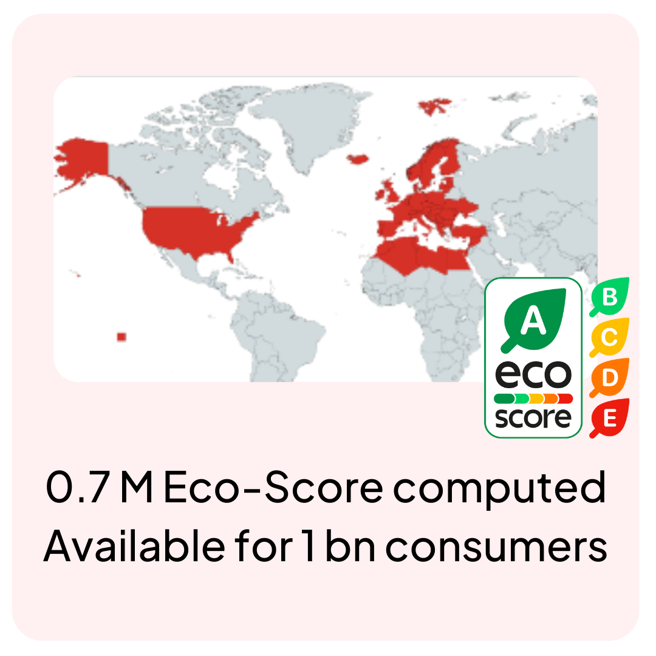
Civil society can accelerate policy: Eco-Score

Slide 52
Why Open ?
It’s in the name ;-)
Builds trust (in food and more)
Allows us to go faster in development
Allows us to partner more easily with producers, governments, other organisations
Allow others to build on top of it to go on topics where we wouldn’t be able to go

Slide 53
Benefits of inclusion in DPGs
We are happy to be recognized for what we are
A lot of credibility to start conversations with more governments

Slide 54
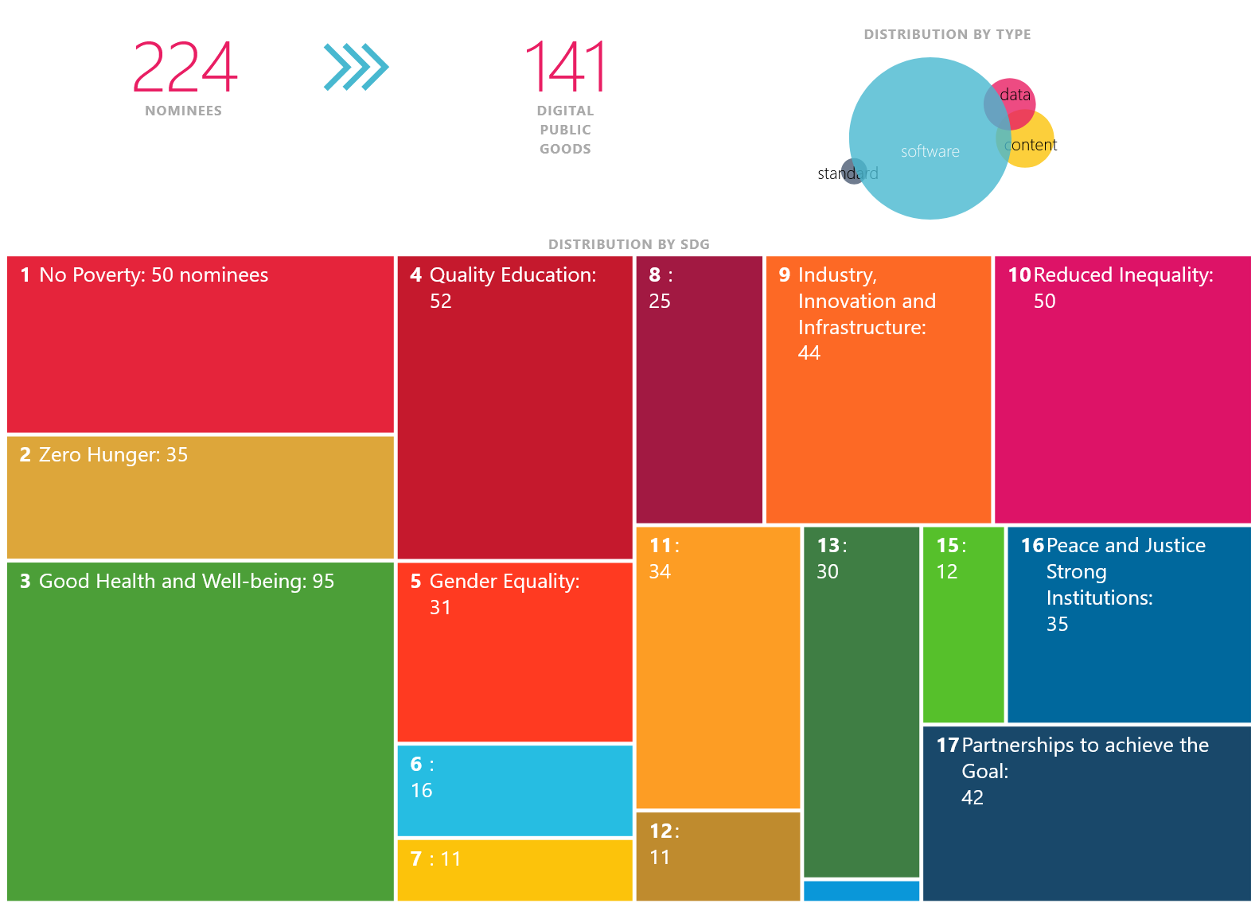
Quality Education
digitalpublicgoods.net/registry
Notes:
Chamilo is an Free Software e-learning platform, often called “LMS” for Learning Management System, that tackles the Quality Education goal, or SDG4 for shorts. My name is Yannick Warnier and I’m a founder and the leader of the Chamilo project.

Slide 55
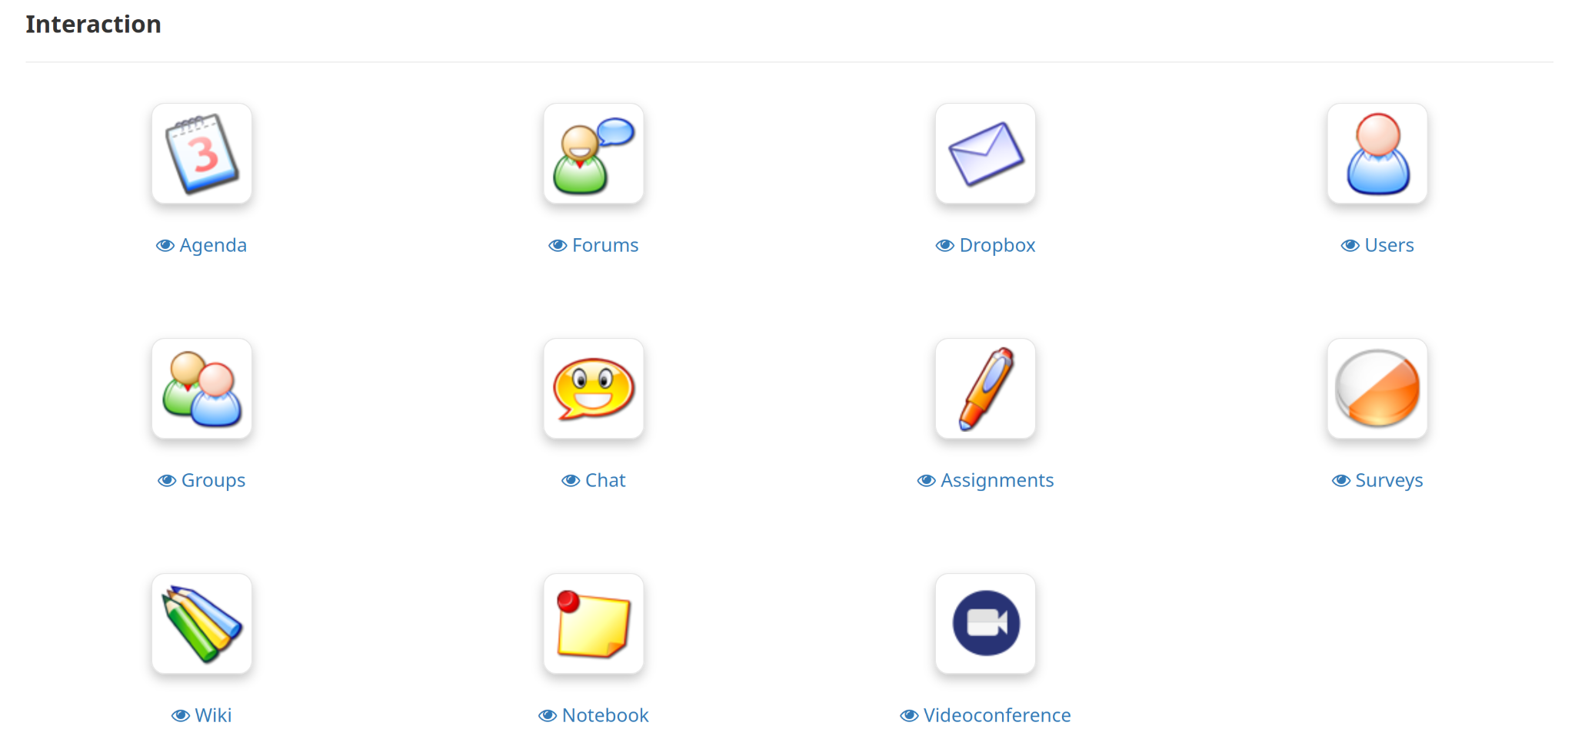
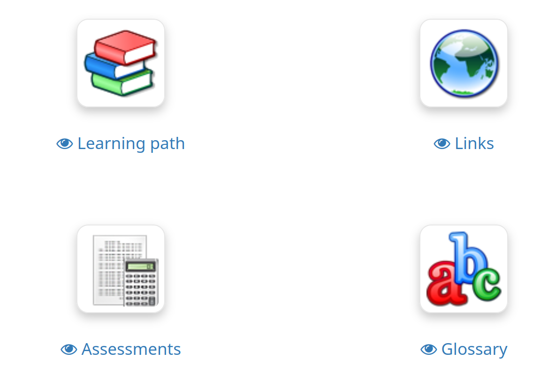
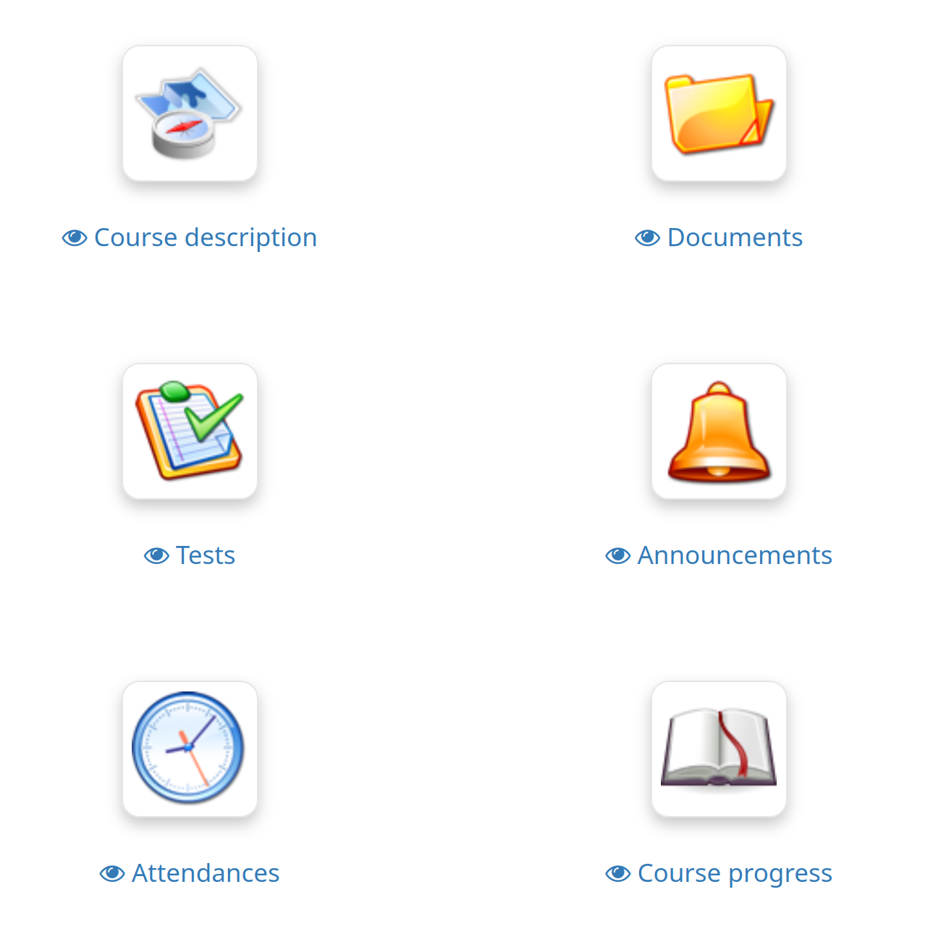
Chamilo’s Mission:
Improve the availability of quality education worldwide
Notes:
The mission of the Chamilo project, since 2010, has simply been to improve the availability of quality education around the world.

Slide 56
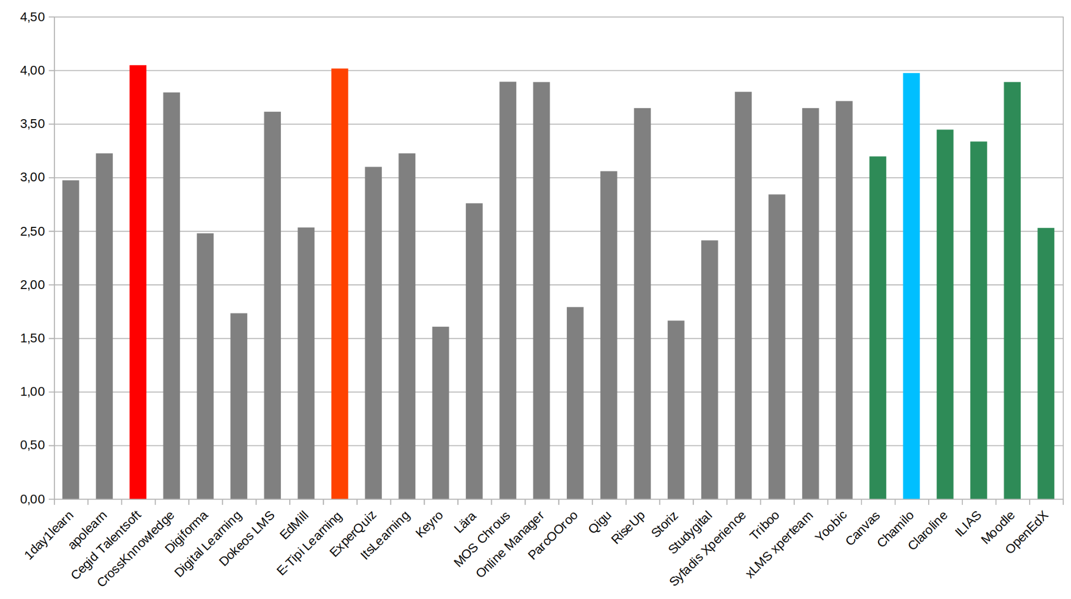
Our process
Provide FLOSS that is easy to use
Receive feedback from anyone, anywhere
Improve/Optimize
Repeat
FLOSS process huge pusher of feedback
Notes:
Our process is simple and is probably shared by many other Open Source projects out there: we provide the software on our website for download, together with a bunch of test platforms. We receive feedback from anyone, anywhere. We improve and optimize on that feedback, and repeat. This has allowed us to be ranked 3rd in a recent French study, quite thorough on LMSes. That’s on a total of 30 different LMSes, 24 proprietary LMSes and 6 Open Source LMSes. In general, we consider Chamilo as the 2nd most popular Open Source LMS. In that adventure, the Open Source process has been a huge pusher of feedback. We receive a lot of feedback and we love it. We clearly see how it allows us to improve.

Slide 57
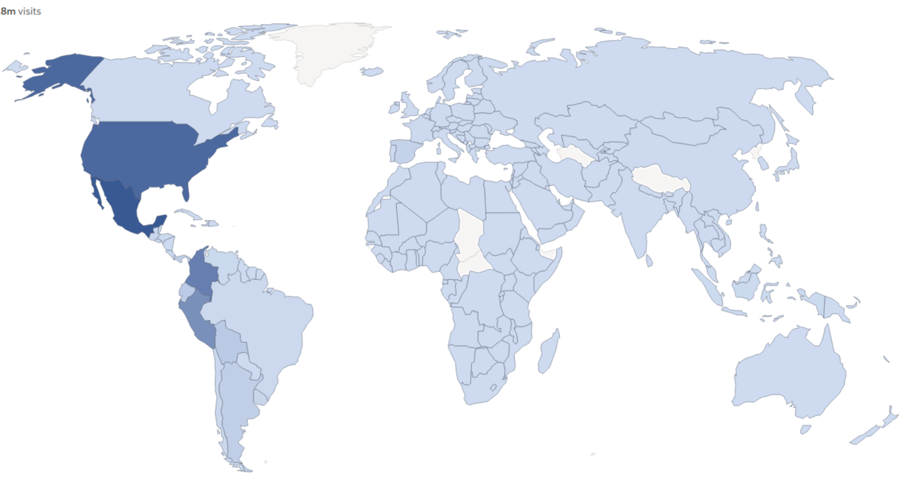
Impact on SDG 4
Reliability: >15 years
Reach (ease of use):
40M users (+4M/y), >80k portals, >180 countries
Portability: Can run school on Pi B+
Notes:
We believe that our impact on the SDG of quality education is mostly through 3 vectors: Reliability, Reach and Portability. We have been around for 15 years as a project, and 24 years if you include the software we forked from in 2010. The average lifetime of an LMS system in academies in the US, for example, is 11 years, so having been there for long is important. Our reach has now been of almost 40M users, that’s about 4M new users every year now, that use our software through one of about 80.000 installations in more than 180 countries. Our main focus is ease of use, because we believe that’s the only way to tackle a digital education gap, but we have a second goal that is efficiency of the software, which allows it, for example, to be installed on a Raspberry Pi B+ (yes, that’s a device from 2014 already).

Slide 58
Impact of Open Source on Chamilo
High maintenance cost (infra, PRs, security) 🥶
Most efficient way to “widespread” software 🙂
Big pusher for transparency/security 😎
Worldwide community of excellence 🥳
Notes:
Being an Open Source project has had several notable impacts on us. First, being Open Source has high maintenance costs. This includes infrastructure to develop and test, time to review pull requests in a friendly manner, and time to fix security issues, publish releases, document our work, etc. That’s a bad point because, sadly, nobody really wants to fund those efforts, so you end up *needing* to develop for-profit companies just to finance the development of Open Source.
However, we also believe that being Open Source is the most efficient way to spread software. And given we have a fully-functional piece of software, what we most want now is for users to enjoy it, but to do that, they need to know it exists. Making it no-strings-attached is a great way to push people to try it. Open source is also a big pusher for transparency and security
And it’s great to exist within a community of excellence, of people motivated to do good, well above the motivation to do good money. This breaks so many barriers. It’s really a big plus for us.

Slide 59
Benefits of inclusion in DPGs
Networking with like-minded projects
real-world readiness
Increased visibility (DPGA advocacy plan)
-> increases our impact
Notes:
Lat year, after a FOSDEM talk, we decided to ask for our project to be included in the DPGs. This has a series of requirements, a bit like a small ISO. We filled the form patiently and then the project got reviewed and approved. It’s a bit early now to talk about the benefits to us of being included in the DPGs, but mostly it just feels right to be in that group, because that allows us to network with like-minded projects that also have a real-world readiness. Many are prepared to tackle large projects, to provide to governments needs, for example. We also think it will provide us increased visibility over time because the DPGA has an advocacy plan (part of it is me being here today). And for us, and because we already have a battle-proof project, more visibility means more impact on SDG4. Thank you.

Slide 60
Thank you!
Notes:
Thank you all for being here today and for your inspiring contributions. With only 5 years left for the UN Sustainable development goals for 2030 , I encourage you all to actively participate in scaling Digital Public Goods, use your expertise to support SDG-driven initiatives, and join global efforts to create inclusive and an open digital ecosystem for public good. Together, we can build a better, more accessible digital future for all.
Thank you!

