Slide 1


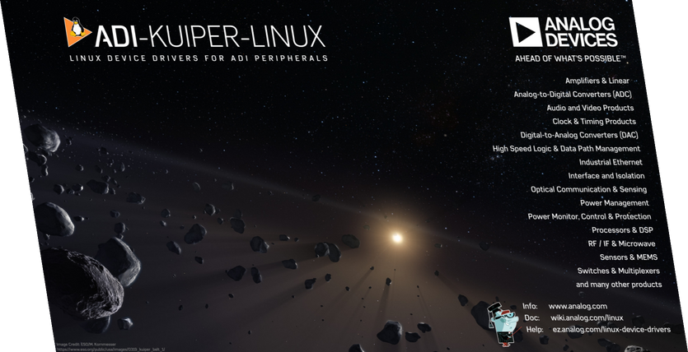


Refining the Release Strategy of a Custom Linux Distro
FOSDEM 2025

Slide 2
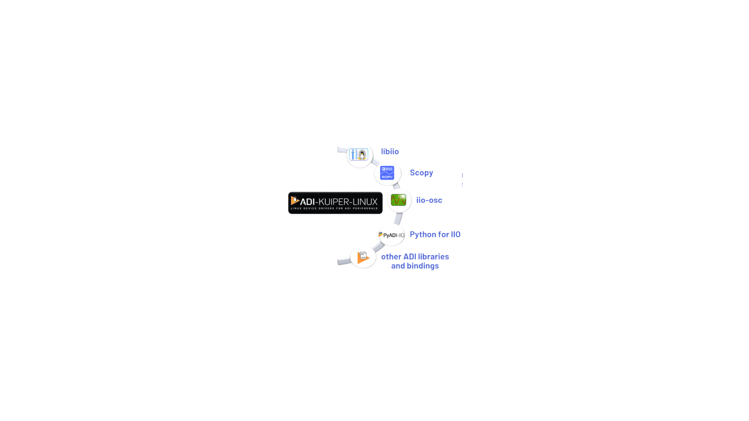

What is ADI Kuiper Linux?
Free, open-source Embedded Linux Distribution
Kuiper is the primary distribution for product evaluation boards made by Analog Devices.
Includes pre-built boot files for 140+ FPGA-based projects and 30+ Raspberry Pi-based designs and provides access to 1,300+ device drivers for seamless integration.

Slide 3



Main Discussion Points
What we had when we started
Changes that were made in order to improve the release process
The current state of our Linux Distribution

Slide 4
No modularity
The software components were predefined and installed during the build process
The previous release process
Components were built during image creation
This meant longer build time
The software components were released through Kuiper Linux image
This lead to longer release cycles due to bugs affecting only one software component

Slide 5


Release improvemens
Creating a
stabilization branch
Breaking down the monolith
Creating Debian packaging for components
Modular configuration for custom images
Expand component testing with custom Docker images
CI optimizations and improving collaboration

Slide 6
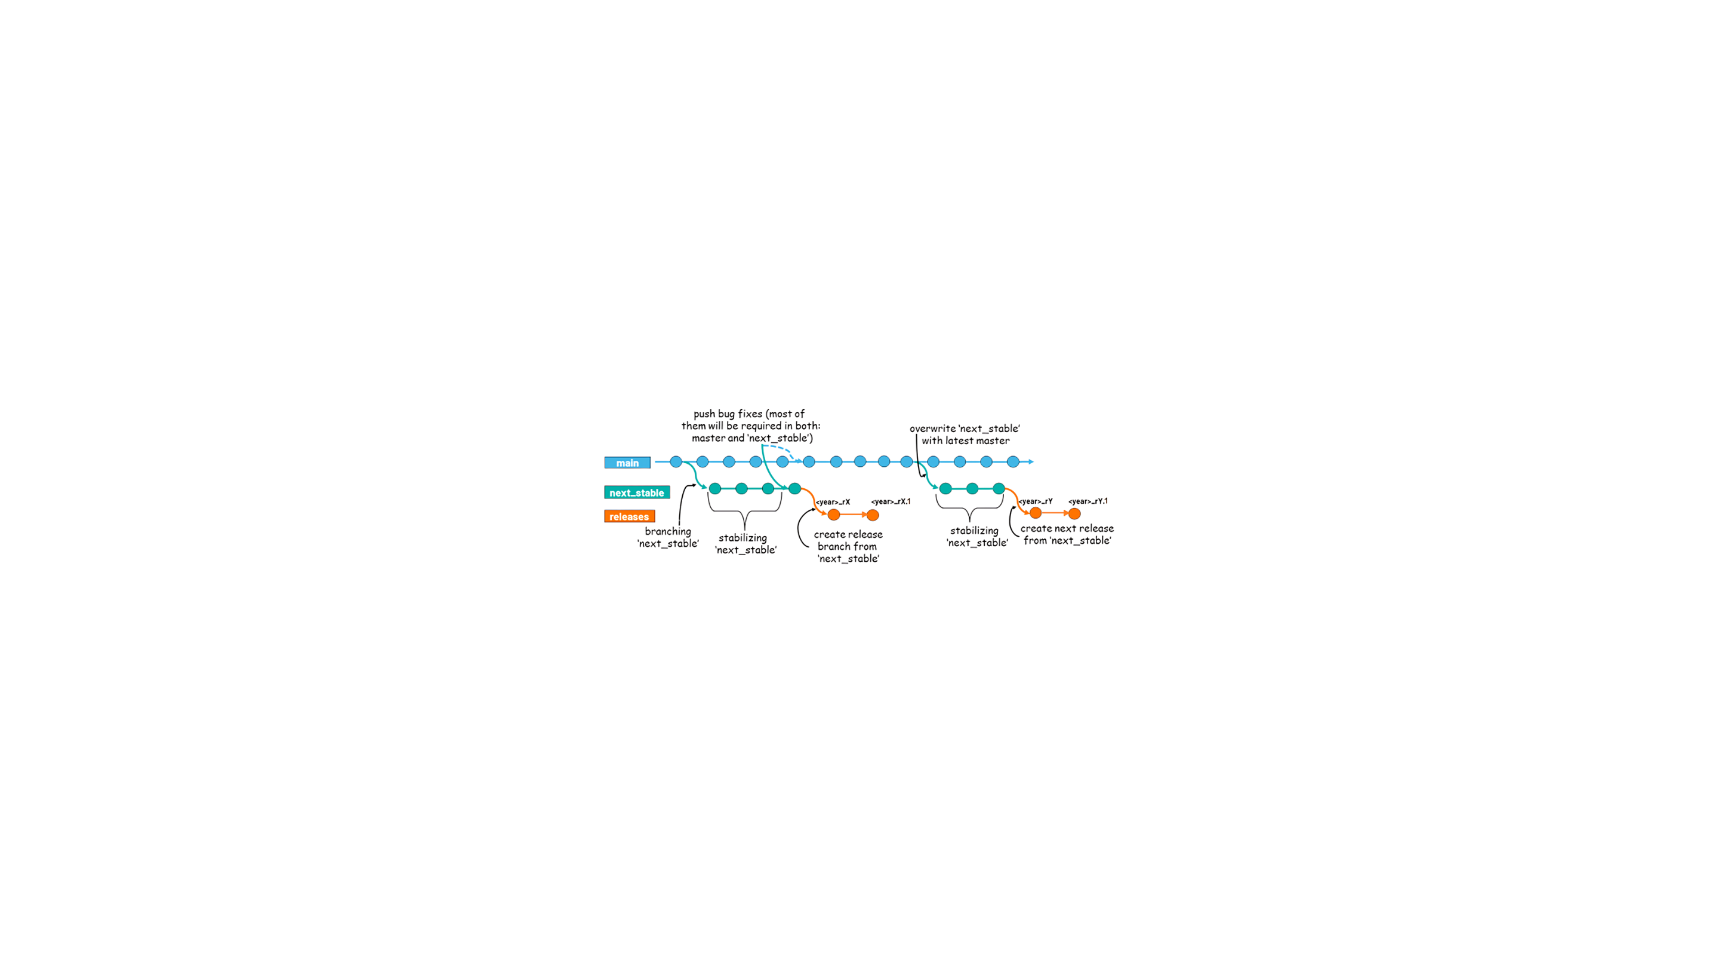
Stabilization Branch:
Isolating Release Development
Purpose:
Isolate release stabilization efforts from ongoing development.
Avoid disruptions caused by experimental or unfinished features.
Benefits:
Faster bug fixes and focused testing.
Stable release preparation without affecting the main branch.

Slide 7
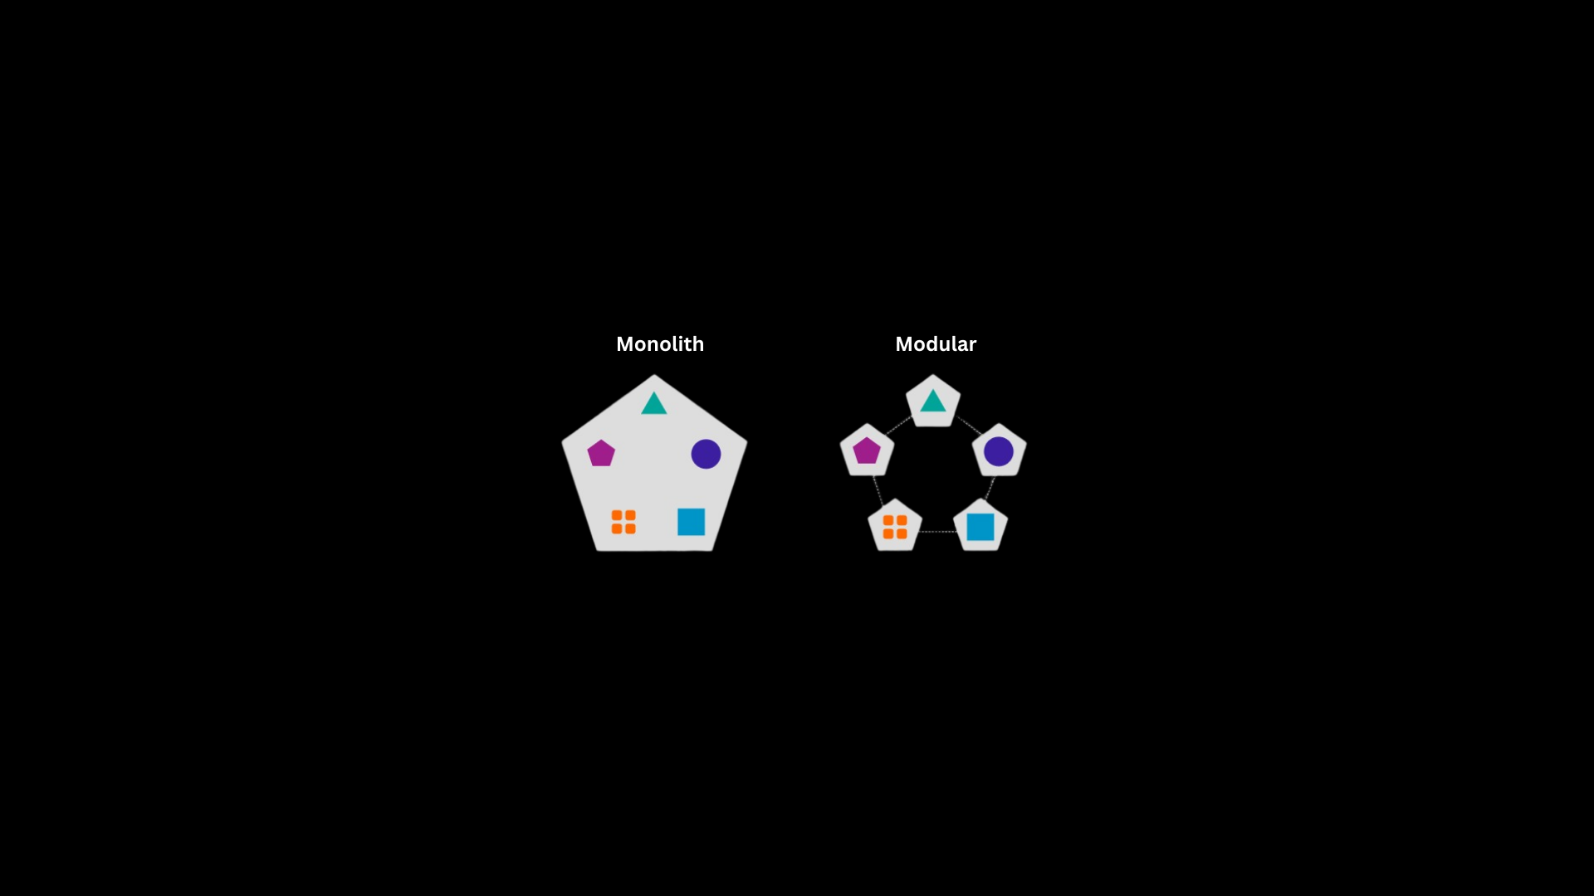
Independent Components Releases &&
Debian Packages
The release process is now divided into smaller, independent components
Prevent delays caused by bugs in a single component.
Faster releases and easier debugging.
Each component is released as a Debian package and uploaded to Analog Devices' Linux Package Repository.
Simplified distribution using standard Debian tools
Easier installation and rollback for users

Slide 8

Customizable builds through modular configuration
A new configuration file enables modularity
Users can build custom images by selecting only the tools and components they need.
New components or additional dependencies can be easily added
Users can use a dedicated extra script to include them.

Slide 9
Testing Software Componens with Dockerized Kuiper Images
Dual Testing Approach
Components are tested individually for standalone functionality, but also ensures compatibility within the Kuiper environment early in the process, by detecting and resolveing integration issues faster.
Lighter Docker Images
Because the image is now customizable, we can create a lighter image using only the necessary dependencies for testing, from which we can also create a Docker image.
Presentation about testing:
Advanced Test Harness Infrastructure for Validating ARM and FPGA-based Systems - Stefan Raus

Slide 10


Optimizing Builds with GitHub Actions
Moved from Jenkins to GitHub Actions
Build logs are accessible to all users.
Fresh build images available immediately after a commit is merged: this means users don’t need to wait for a release or to build the image manually.
Multiple build configurations
Four configurations are now available: a basic and a full image for each of the 32-bit and 64-bit architectures.
Improved Collaboration
Introduced a Pull Request Template for consistency and Codeowners to streamline reviews and approvals.

Slide 11
Customizable builds through modular configuration
With the help of the configuration file, the software components that need to be installed are selected.
The current release process
Components are built separately and exported as Debian packages
Faster and more flexible builds
Each software component has it’s own release
Prevents delays caused by bugs in a single component and improves flexibility and development efficiency

Slide 12
Thank you!
If you have questions you can write me
on this email address: andreea.andrisan@analog.com
or on LinkedIn: Andreea Andrisan

