Slide 1
Making NooBaa Resilient by Eliminating Single Points of Failure
Shriya Mulay
Vaishnavi Deshpande

Slide 2
Table of content:
Introduction to NooBaa
NooBaa Architecture
Understanding Single Point of Failure (SPOF)
Mitigating Single Point of Failure in NooBaa

Slide 3
Introduction to NooBaa
NooBaa is a software-defined storage platform that enables seamless management of object storage across diverse environments.
Multi-Cloud i.e, AWS,azure, gcp and/or any consumable storage.
NooBaa uses bucket policies which provides multi cloud capabilities like placement (mirroring, tiering,namespace),dedupe,compression.
The goal is to simplify the data flows by connecting to any storage from public/private clouds providing scalable services using same s3 API and management tools

Slide 4
Why Noobaa ?
Multicloud Solution:
Eliminates Vendor lock-in.
NooBaa provides an AWS S3-compatible API, the de facto standard, independent of any specific vendor or location.
Multi-cloud approach also increases availability by allowing you to keep your data in multiple locations while using a single access endpoint.
Storage Orchestration :
NooBaa can consume data from AWS S3, Microsoft Azure Blobs, Google Storage or any AWS S3 compatible storage Private Cloud.
NooBaa buckets have placement policies which determines where the data should be placed.
Bucket policies can be modified dynamically
NooBaa offers compression,deduplication,encryption on top of existing storage layer.
Agililty :
Migrate the data without any disruption in the services.
Workloads : media, backup,archiving,

Slide 5
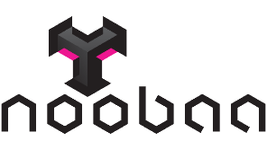
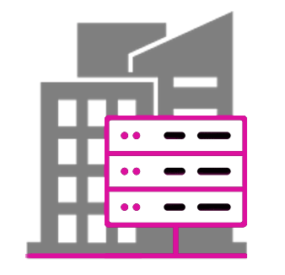
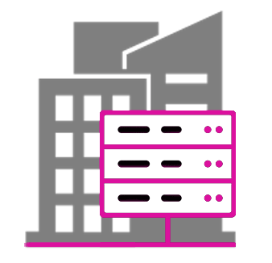
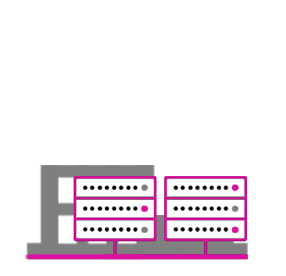
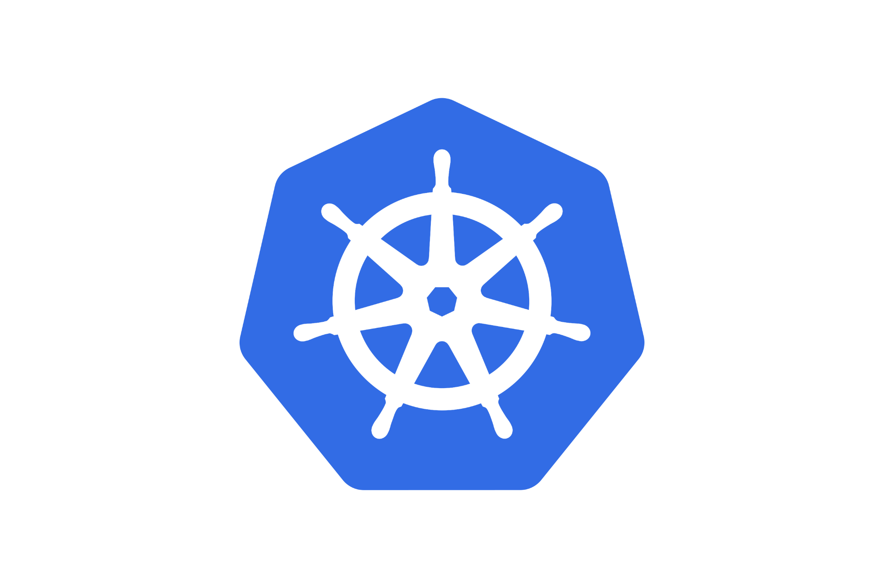
Noobaa Overview
DEPLOY AND MANAGE DATA SERVICES
App
Multi-Cloud Buckets
App
S3 API
Hybrid Buckets
App
Multi-site Buckets
‹#›

Slide 6
S3 Write
Fragment
Dedupe
Compress
Encrypt
Store
London DC
New York DC
Paris DC

Slide 7
Noobaa core components
NooBaa core - The brain
NooBaa db - The database
NooBaa endpoint - The s3 server
NooBaa agent

Slide 8
Noobaa architecture
HIGH LEVEL ARCHITECTURE
Scalable NooBaa Endpoint
S3 / Lambda API
auth,
chunking, dedupe, compress, encrypt
HIGH LEVEL ARCHITECTURE
Application
NooBaa Core
Optimized
utilization, resilience, performance, locality,
economics,
etc.
meta-data
Instructions
Data path
Cloud Resource
AWS S3
AWS S3-compatible,
Azure Blob,
Google cloud storage
Ceph Storage
Instructions
NooBaa db
Stores bucket metadata, configuration, analytics, etc.
Heartbeats
Scalable NooBaa Storage Node
stores chunks,
runs lambda functions, monitors host, sends heartbeats
‹#›

Slide 9
NooBaa Database metadata :
NooBaa Maintains below metadata :
Configurations
Accounts and Access Keys
Bucket and Bucket Policies
Backingstores and Cloud Connections
Objects :
Mapping objects to storage locations
Encryption Keys
Analytics :
System Status and statistics

Slide 10
Understanding Single Point of Failure (SPOF)
Noobaa DB stores critical metadata, such as the location of objects.
NooBaa database storage is scalable to handle increased load, ensuring flexibility.
Every operation of the NooBaa pass through database so incase any failure or corruption in that can lead to a disconnection between the data and I/O, resulting in system failure.
If the database layer is corrupted, it impacts overall NooBaa operations, creating a potential single point of failure.

Slide 11
Symptoms of noobaa db corruption
NooBaa db pod fails to come up :
MountVolume.MountDevice failed for volume "pvc-437a28c9-7095-42a1-8831-b8fd1ff93aa4" : rpc error: code = Internal desc = 'fsck' found errors on device /dev/rbd0 but could not correct them: fsck from util-linux 2.37.4
NooBaa db pod fails to start with :
2023-05-15T07:15:46.141871149Z pg_ctl: could not start server
2023-05-15T07:15:46.141871149Z Examine the log output.
Pgsql logs :
2023-05-15 09:23:16.742 UTC [24] PANIC: could not locate a valid checkpoint record
2023-05-15 09:23:19.009 UTC [22] LOG: startup process (PID 24) was terminated by signal 6: Aborted
All the NooBaa pods are up but NooBaa backingstore stuck in “connecting” phase :
The db dump fails with below error
pg_dump: error: Dumping the contents of table &quot;systems&quot; failed: PQgetResult() failed.
pg_dump: error: Error message from server: ERROR: invalid page in block 2 of relation base/16385/16398
pg_dump: error: The command was: COPY public.systems (_id, data) TO stdout;
command terminated with exit code 1

Slide 12
Mitigating Single Point of Failure in NooBaa
1. Using the external postgresql database
2. By cloning the pvc of db pod periodically
3. Taking the backup of database

Slide 13
Using external postgresql
External postgresql cluster can be used as a NooBaa db, as it provides database level replication which can avoid single point of failure for NooBaa database
External postgresql cluster also support ssl
Presuisite for external postgresql
Validate you have a working Postgres with the accessible endpoint from external pods
Database to save noobaa’s metadata.
CREATE DATABASE nbcore WITH LC_COLLATE = 'C' TEMPLATE template0;
Correct user and password in order to create new tables in this DB.

Slide 14
2. By cloning the NooBaa db PVC periodically
Kubernetes provides feature called clone which is point in time of copy of data
Cloning support is only available for CSI drivers.
Cloning support is only available for dynamic provisioners.
Clone the db volume periodically to backup the data and restore it when required.

Slide 15
Steps to restore the db using cloned volumes:
Clone the DB PVC Periodically to ensure up-to-date backups.
Restore Steps:
Scale down the NooBaa-db StatefulSet.
Delete the corrupted NooBaa-db volume.
Identify the latest healthy clone and create a new clone with original PVC name.
Scale up the NooBaa-db StatefulSet and check pod status.

Slide 16
3. Taking the backup of database
Take a backup of the NooBaa’s pgsql database.
So incase any failure happens we can just restore that healthy NooBaa db dump from the backup.

Slide 17
Steps to restore the db from database dump:
Take the backup of the NooBaa DB
Backup secrets to a local folder
Backup the PostgreSQL database and save it to a local folder
# kubectl exec -it noobaa-db-pg-0 -- pg_dump nbcore -f /tmp/test.db -F custom # kubectl cp noobaa-db-pg-0:/tmp/test.db ./mcg.backup
And restore it whenever needed
Stop the NooBaa Service before restoring the NooBaa DB
Verify that all NooBaa components (except NooBaa DB) have 0 replicas:
Clear older corrupted database from the NooBaa db pod
Restore DB from a local folder
# kubectl cp ./mcg.backup noobaa-db-pg-0:test.db # kubectl exec -it noobaa-db-pg-0 -- pg_restore -d nbcore test.db -c
Delete secrets and restore them from a local folder
Start the NooBaa service

Slide 18
Thank You !

