Slide 1
Access management in LXD
Mark Laing
Software Engineer (LXD)
Canonical
FOSDEM 2025
February 2025
Notes:
Hi
Mark
Software Engineer
LXD Team
What is Microcloud?

Slide 2
What is LXD?
LXD is a modern, secure and powerful system container and virtual machine manager.
Notes:
It’s also very simple
Powerful ReST API.

Slide 3
MicroCloud = LXD on rails
Workloads
Infrastructure
Networking
MicroOVN
Virtualisation and orchestration
LXD
Storage
MicroCeph
Operating System
Ubuntu
Snaps
Notes:
Initialises and configures
LXD, Microceph, and MicroOVN.
After microcloud init, we have a HA LXD cluster with remote storage and software defined networks.
The “micro” means repackaged into snaps with additional DQLite layer for ease of deployment.

Slide 4
Local network
MicroOVN
MicroOVN
MicroOVN
LXD
LXD
LXD
VM workloads
VM workloads
VM workloads
System container workloads
System container workloads
System container workloads
MicroCeph
MicroCeph
MicroCeph
Local storage
Local storage
Local storage
Ubuntu
Ubuntu
Ubuntu
node01
node02
node03
Notes:
LXD should run on physical machines for production use
Raspberry Pi Cluster
Server rack

Slide 5
Existing authorization
LXD Server
Project
Storage Pool
Identity
Instance
Profile
Storage volume
Network
Notes:
Project based. Tied to client certificates and mTLS. Access to all resources in project.
Simple but not granular, what to do?

Slide 6
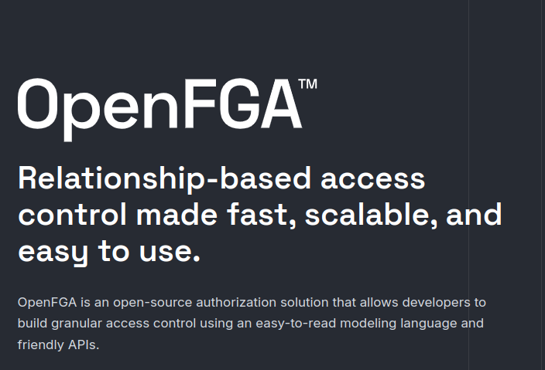
Notes:
Leverage ecosystem and language for access control patterns.
Model entities and their relationships in a system.

Slide 7
Fine-grained authorization
Does user X have relation can_exec with instance c1?
LXD Server
Project
Storage Pool
Certificate
Instance
Profile
Storage volume
Network
Notes:
OpenFGA request looks like a question
Relations can be direct
E.g. the user can be directly granted permission on a single instance

Slide 8
Fine-grained authorization
Does user X have relation can_exec with instance c1?
type identity
type instance
relations
can_exec: [identity]
Notes:
OpenFGA request looks like a question
Relations can be direct
E.g. the user can be directly granted permission on a single instance

Slide 9
Fine-grained authorization
Does user X have relation can_exec with instance c1?
LXD Server
Project
Storage Pool
Certificate
Instance
Profile
Storage volume
Network
Notes:
Or computed (inherited).
User can be granted permissions on objects of type instance in project Y.

Slide 10
Fine-grained authorization
type identity
type server
relations
admin: [identity]
type project
relations
server: [server]
operator: [identity] or admin from server
can_operate_instances: [identity] or operator
type instance
relations
project: [project]
can_exec: [identity] or can_operate_instances from project
Computed relation.
Computed relation.
Notes:
Or computed (inherited).
User can be granted permissions on objects of type instance in project Y.

Slide 11
Tuples, tuples, tuples…
# User is related to project via `operator` if they are related to
# server via `admin`.
USER server:/1.0
RELATION server
OBJECT project:/1.0/projects/default
# User has `can_exec` on instance if they have `operator` or
#`can_operate_instances` on project.
USER project:/1.0/projects/default
RELATION project
OBJECT instance:/1.0/instances/c1?project=default
Notes:
Or computed (inherited).
User can be granted permissions on objects of type instance in project Y.

Slide 12
External OpenFGA
Does user X have relation can_exec with instance c1?
OpenFGA
LXD
Notes:
OpenFGA intended to be deployed separately.
OpenFGA must know about user X and instance c1.
Have to sync “tuples”
Synchronisation hard to get right.

Slide 13
External OpenFGA
OpenFGA
LXD
Postgres
Postgres
Postgres
Notes:
HA postgres or MySQL required

Slide 14
Local network
MicroOVN
MicroOVN
MicroOVN
LXD
LXD
LXD
VM workloads
VM workloads
VM workloads
System container workloads
System container workloads
System container workloads
MicroCeph
MicroCeph
MicroCeph
Local storage
Local storage
Local storage
Ubuntu
Ubuntu
Ubuntu
node01
node02
node03
Notes:
In an RPi cluster, where will OpenFGA be deployed?
Need solution that works for us.

Slide 15
Embedded OpenFGA
LXD cluster member
OpenFGA server
OpenFGA Datastore
DQLite
Notes:
Run the OpenFGA server within LXD each LXD cluster member
OpenFGA datastore interface implementation understands our schema and reads tuples directly from DQLite.

Slide 16
OpenFGA Datastore
ReadUsersetTuples List all tuples where the “user” is a given type, that are related to a given object, by a given relation*.
ReadStartingFromUser List all tuples that are related to a given user*.
USER identity:{expand this part}
RELATION can_view
OBJECT project:/1.0/projects/default
USER identity:/1.0/auth/identities/tls/{fingerprint}
RELATION {filter on this or expand if not given}
OBJECT {expand this part}
* Not 100% accurate…
Notes:
Run the OpenFGA server within LXD each LXD cluster member
OpenFGA datastore interface implementation understands our schema and reads tuples directly from DQLite.

Slide 17
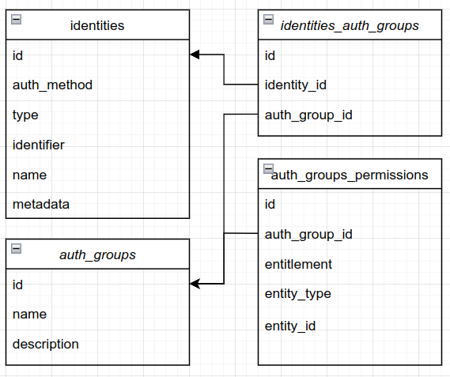
OpenFGA Datastore
Does user /1.0/auth/identities/tls/{fingerprint} have relation can_exec with instance /1.0/instances/c1?project=default?
Which groups does the identity belong to? Contextual tuples.
What permissions do members of these groups have? Cached per request.
Notes:
Run the OpenFGA server within LXD each LXD cluster member
OpenFGA datastore interface implementation understands our schema and reads tuples directly from DQLite.

Slide 18
Demo time!

Slide 19
Pros and cons
Pros | Cons
Works out-of-the-box OpenFGA + Postgres deployment not necessary! Cluster database is source of truth. Easier model migrations. | Complexity. Stored user information (GDPR). OpenFGADatastore interface updates. Further optimisation required.

Slide 20
Thank you listening! Questions?
Microcloud
OpenFGA
Mark Laing
mark.laing@canonical.com

