Slide 1
How hard is it to bring a professional level, sustainable, advanced CMS to market?
Michael Diedrick Jozi Schneider
Slides URL: byte.dev/fosdem

Slide 2
Greetings et Salutations!
Michael Diedrick Jozi Schneider
Slides URL: byte.dev/fosdem

Slide 3
About Us
Project Manifesto
Parts of a Web Application
Parts of a CMS
Roadmap and Timeline
Case in Point: Signup
Totals

Slide 4
Jozi
Michael
Travis
Sonal

Slide 5
Ryan

Slide 6
Happy Client

Slide 8
About Us
Project Manifesto
Parts of a Web Application
Parts of a CMS
Roadmap and Timeline
Case in Point: Signup
Totals

Slide 9
Project Manifesto
Every project needs a scope, but also needs an ethos including a list of things that it will NOT do.
Data Rules
Build Rules
Functionality Rules
Multiplication Factors

Slide 10
Project Manifesto: Data Rules
Data must be grokkable at every level and easy in/out.
Use a GUI for view / edit (like Sequel Pro)
Make it easy to export or switch databases
Make the DB itself simple - don’t use database for stored procedures or forced relationships / cascading, instead use software
Use denormalized data and interface (vs extra tables)
ORMs are an abstraction too deep – SQL works!

Slide 11
Project Manifesto: Build Rules
Programming is too complicated already.
Does Sass/Less save time? No, skip it.
Does Typescript give magical powers? No, skip it.
Does TDD work at small scale? No, skip it.
Do you need a build step, even? No, skip it.
Then define the tools and frameworks you should use.

Slide 12
Project Manifesto: Functionality Rules
We as programmers like new and shiny. Don’t (yet).
Should you build a billing system? Not yet.
Should you use websockets for live updates? No.
Should you build enterprise features? Not yet.
What about chat? Not until you need it.
What about administrator workflows / approvals? No.
We want to imagine a big future, but not build it until it’s clearly next. We’ll probably rebuild by then anyway.

Slide 13
Project Manifesto: Multiplication Factors
We added dark mode: 2 modes
We added builder mode: 2 modes
We added super admin mode: 2 modes
Now we have 2 x 2 x 2 tests for any interface change.
Mo modes, mo problems.

Slide 14
About Us
Project Manifesto
Parts of a Web Application
Parts of a CMS
Roadmap and Timeline
Case in Point: Signup
Totals

Slide 15
Parts of a Web Application
Defining CI/CD
Interfaces
Data interfaces
Users accounts
Performance

Slide 16
Parts of a Web Application: Defining CI/CD
Hosting, Staging
Proofs of concept and experiments
Process, language styles for version control
Data backup / restore
Build / deploy process

Slide 17
Parts of a Web Application: Interfaces
Front end frameworks (like Vue)
Component libraries (like Quasar)
Design system (from brand)
Overall systems for z-index, animation, build
Notifications, modals for errors & successes

Slide 18
Parts of a Web Application: Data interfaces
API architecture
Live data via websockets, long polling, etc.
Data synching and offline management

Slide 19
Parts of a Web Application: User Accounts
Login / logout / lost pw / 2FA / banning, etc.
Cookies, other auto-login systems
Billing / subscriptions

Slide 20
Parts of a Web Application: Performance
Error tracking
Error management (warning, bugs, notices, etc.)
Server processing time and time reporting

Slide 22
About Us
Project Manifesto
Parts of a Web Application
Parts of a CMS
Roadmap and Timeline
Case in Point: Signup
Totals

Slide 23
Parts of a CMS
Page management (pages and page elements)
Navigation management (hierarchical data)
Digital Asset Manager
Buckets (content on many pages)
Data Sources (for events, campaigns, etc.)
Themes
Settings
Admin accounts, processes
Search indexes, systems (front and back end)
Dashboards and specialized tools

Slide 24
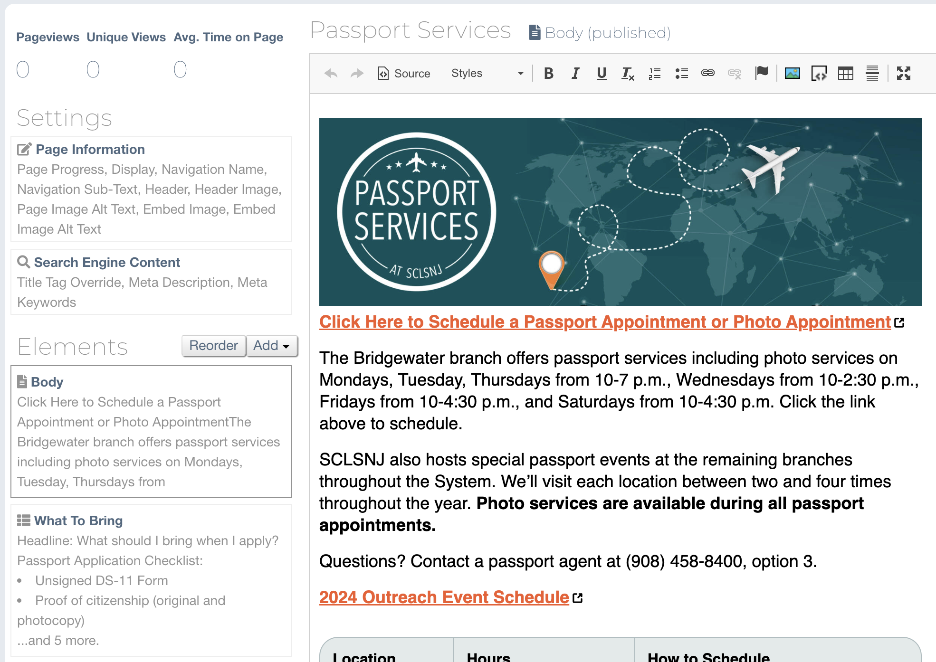
Parts of a CMS: Page Management

Slide 25
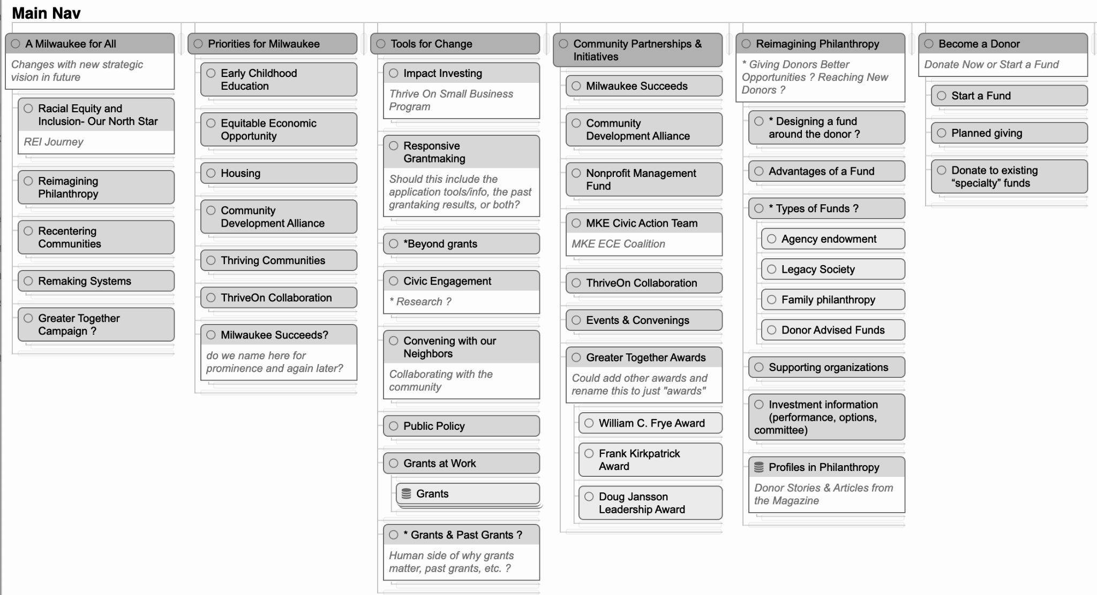
Parts of a CMS: Navigation Management

Slide 26
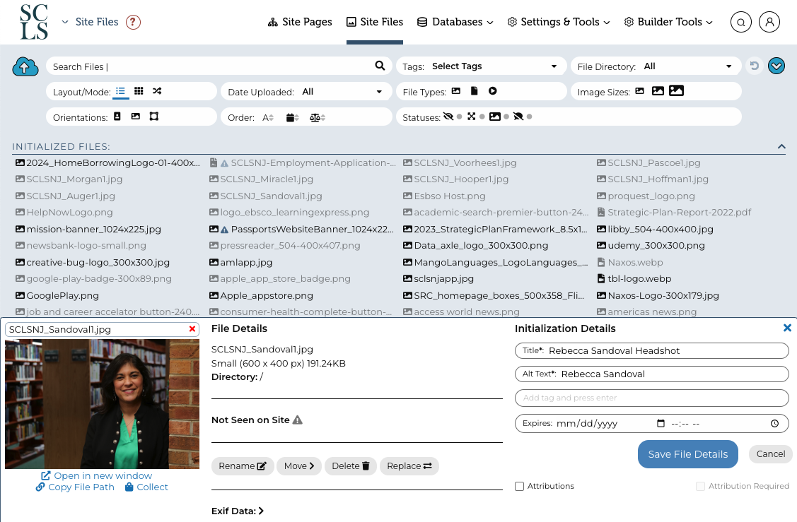
Parts of a CMS: Digital Asset Manager

Slide 27
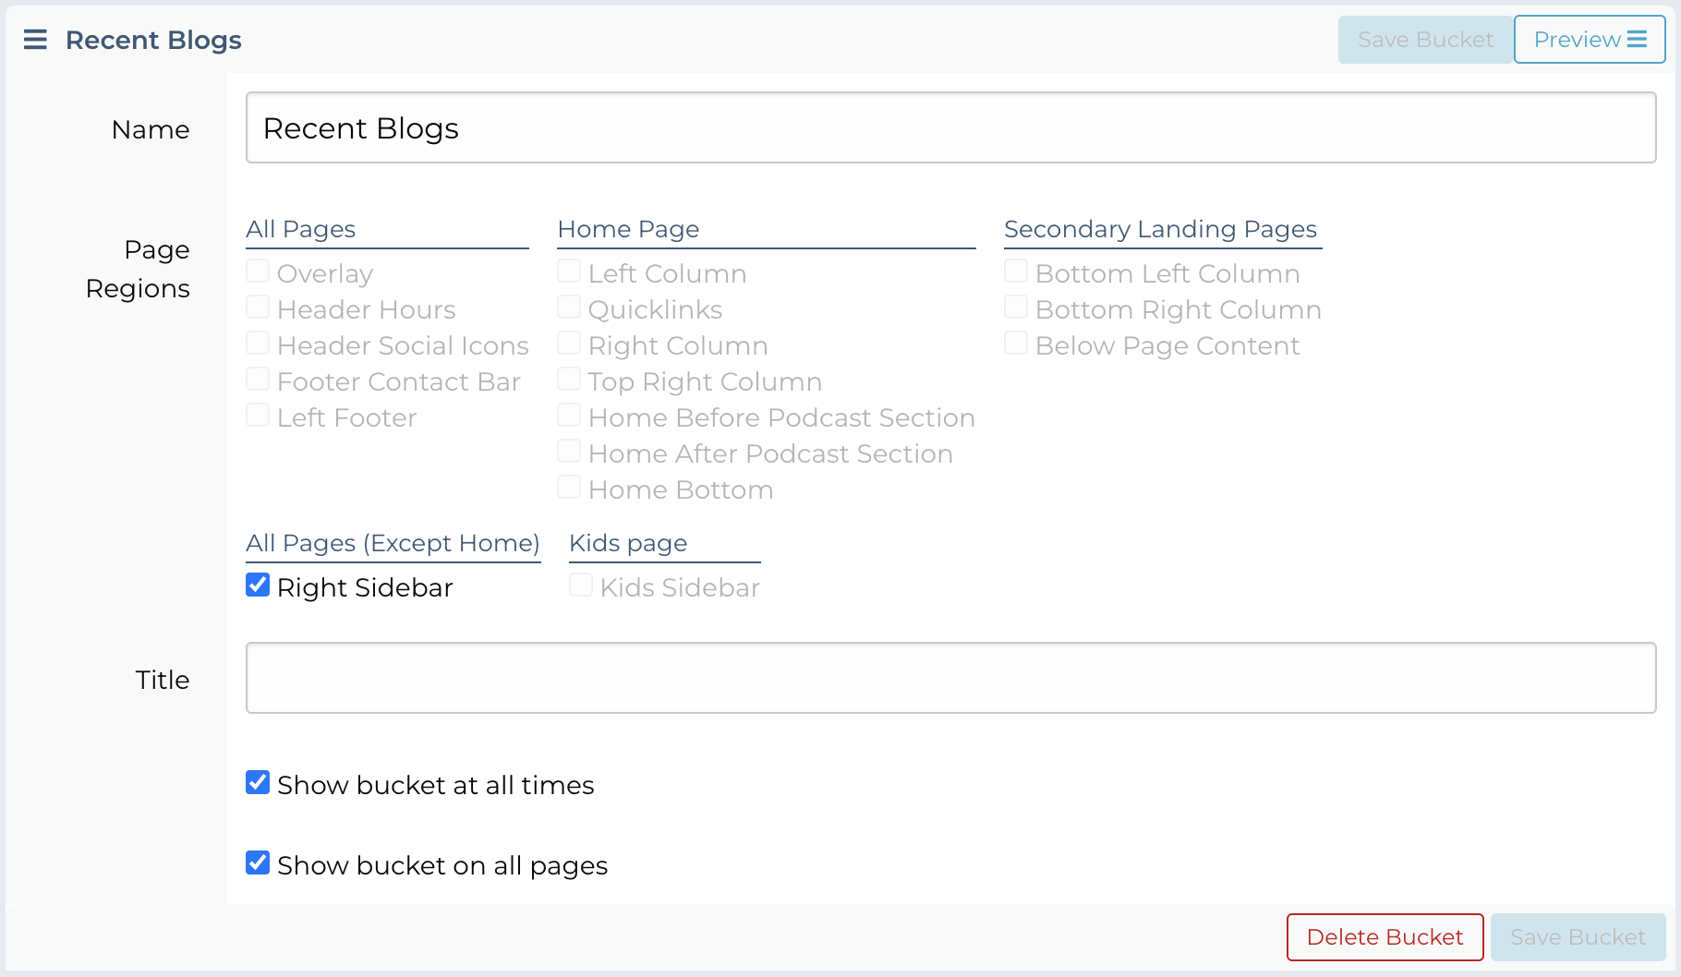
Parts of a CMS: Buckets

Slide 28
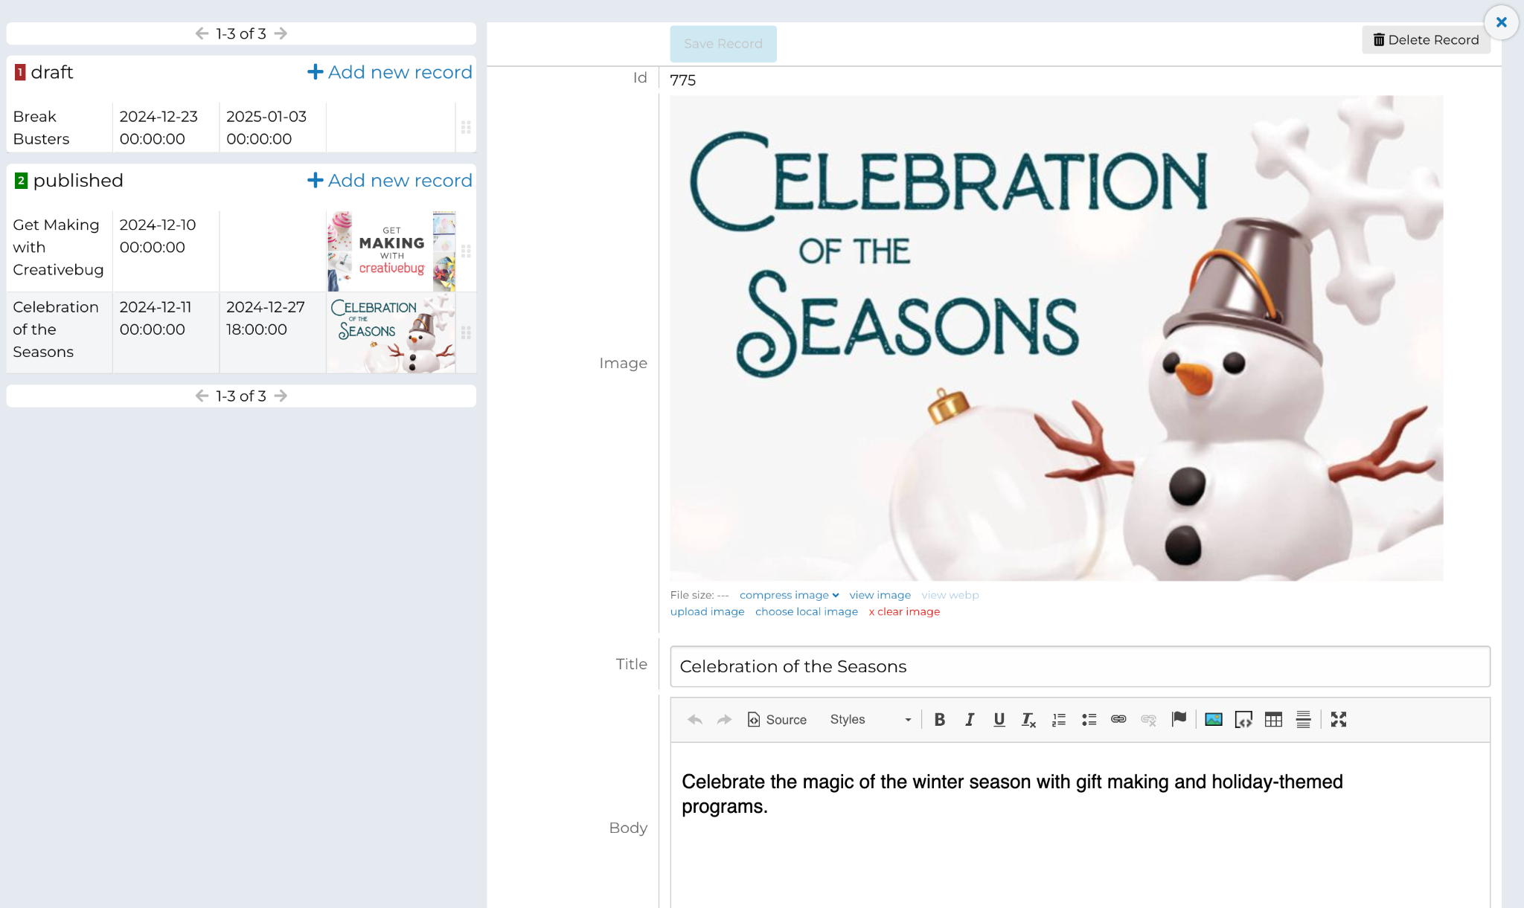
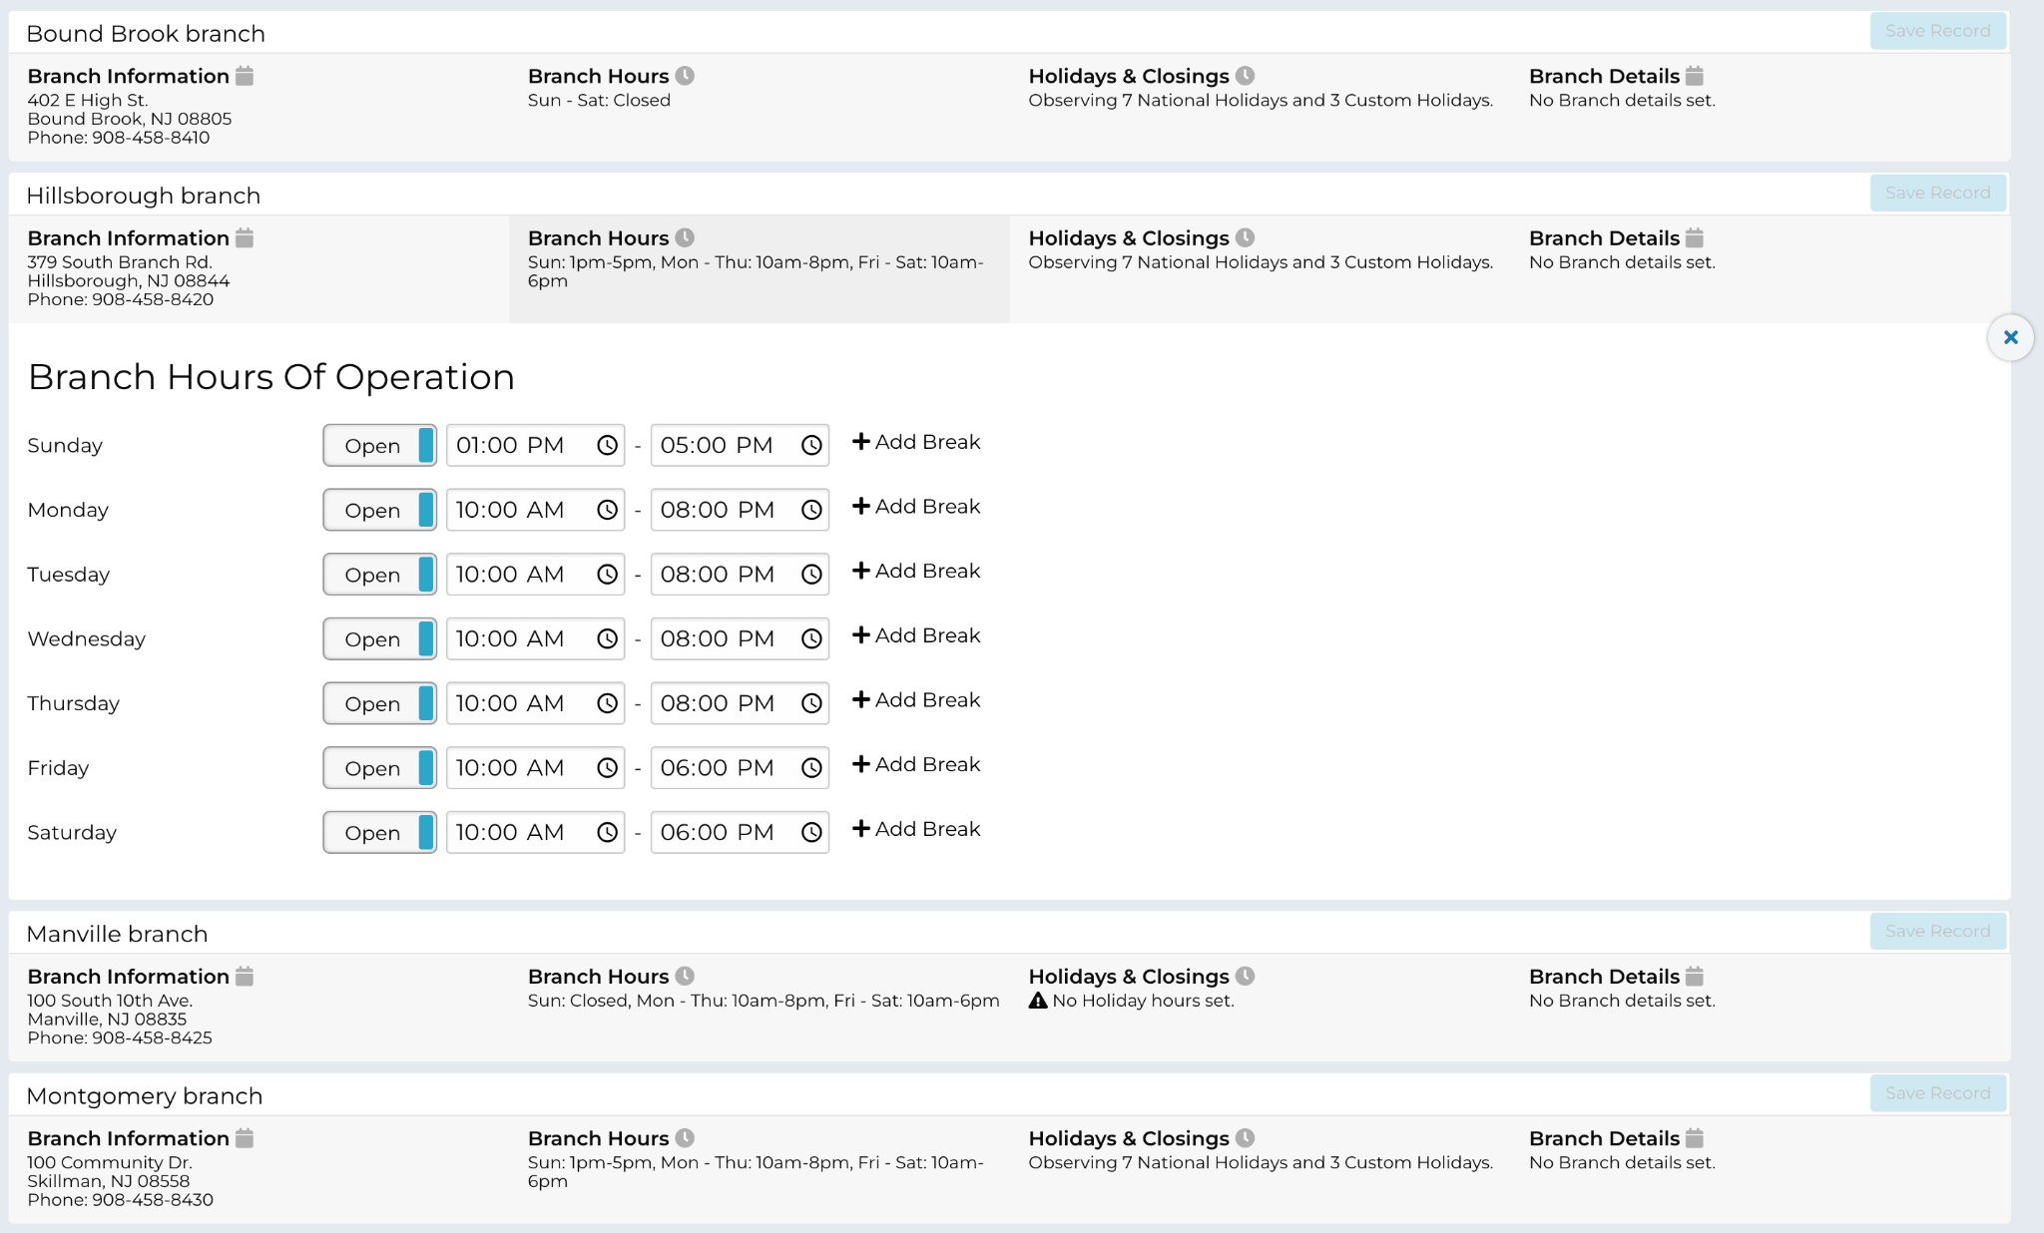
Parts of a CMS: Data Sources

Slide 29
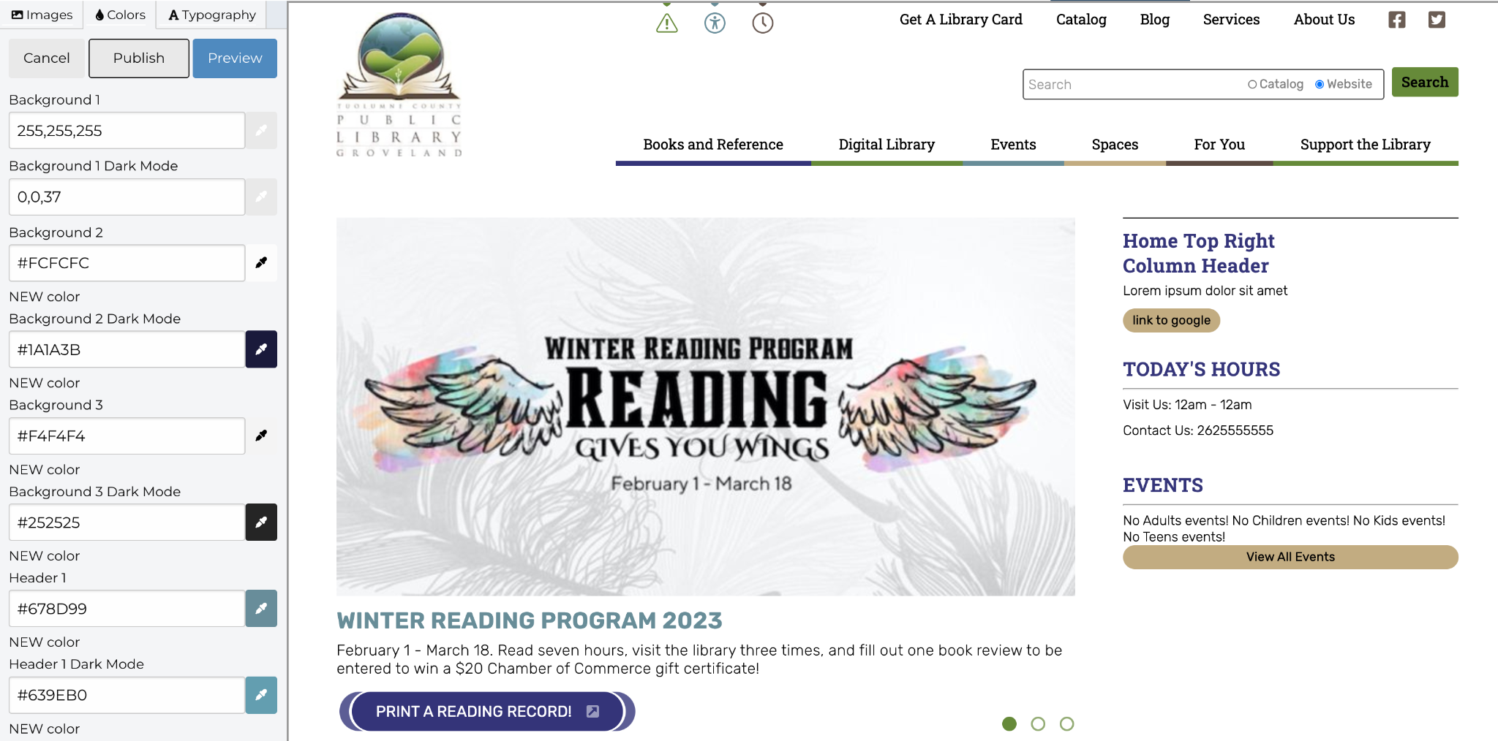
Parts of a CMS: Themes

Slide 30
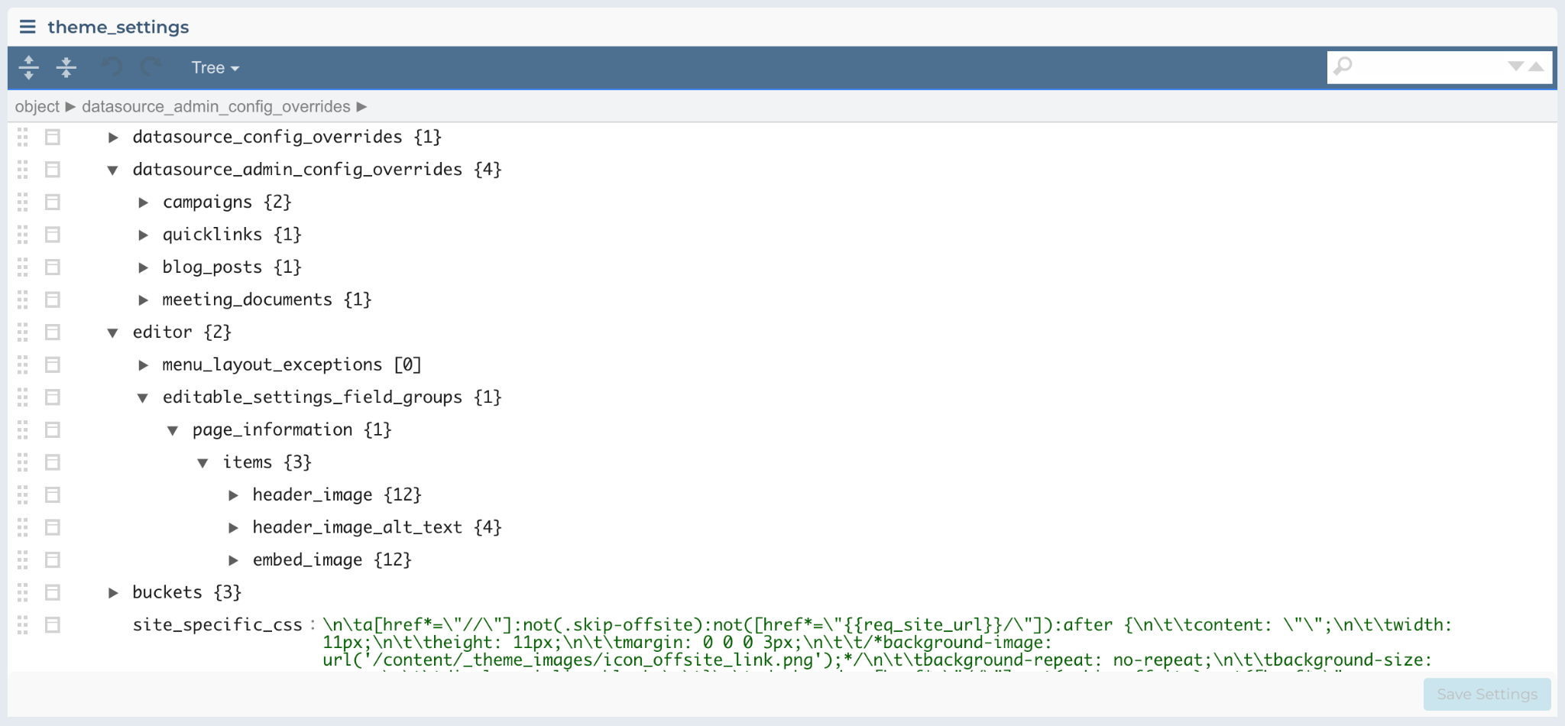
Parts of a CMS: Settings

Slide 31
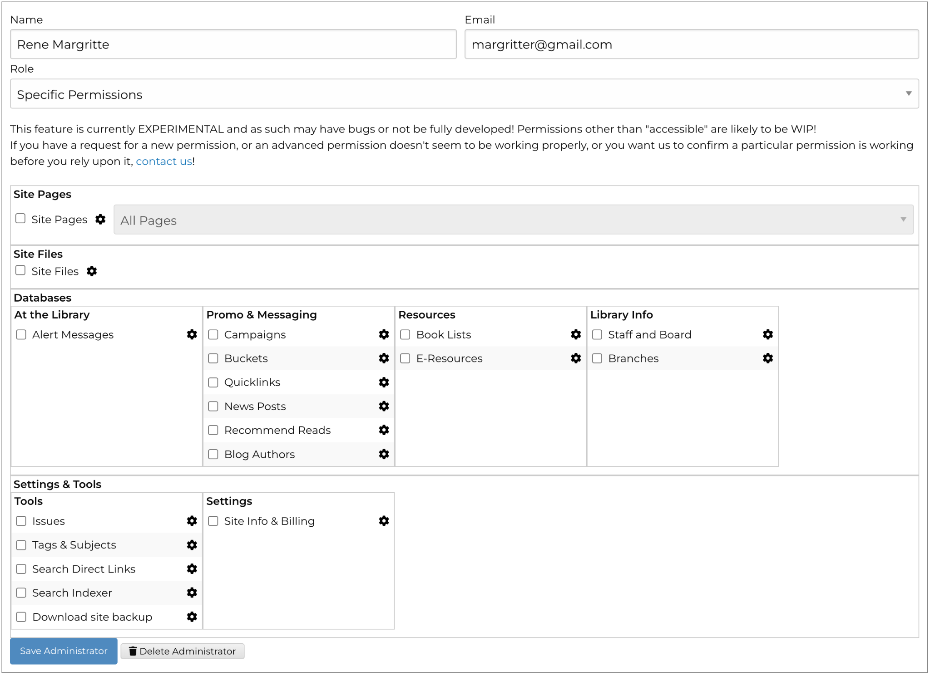
Parts of a CMS: Admin Accounts

Slide 32
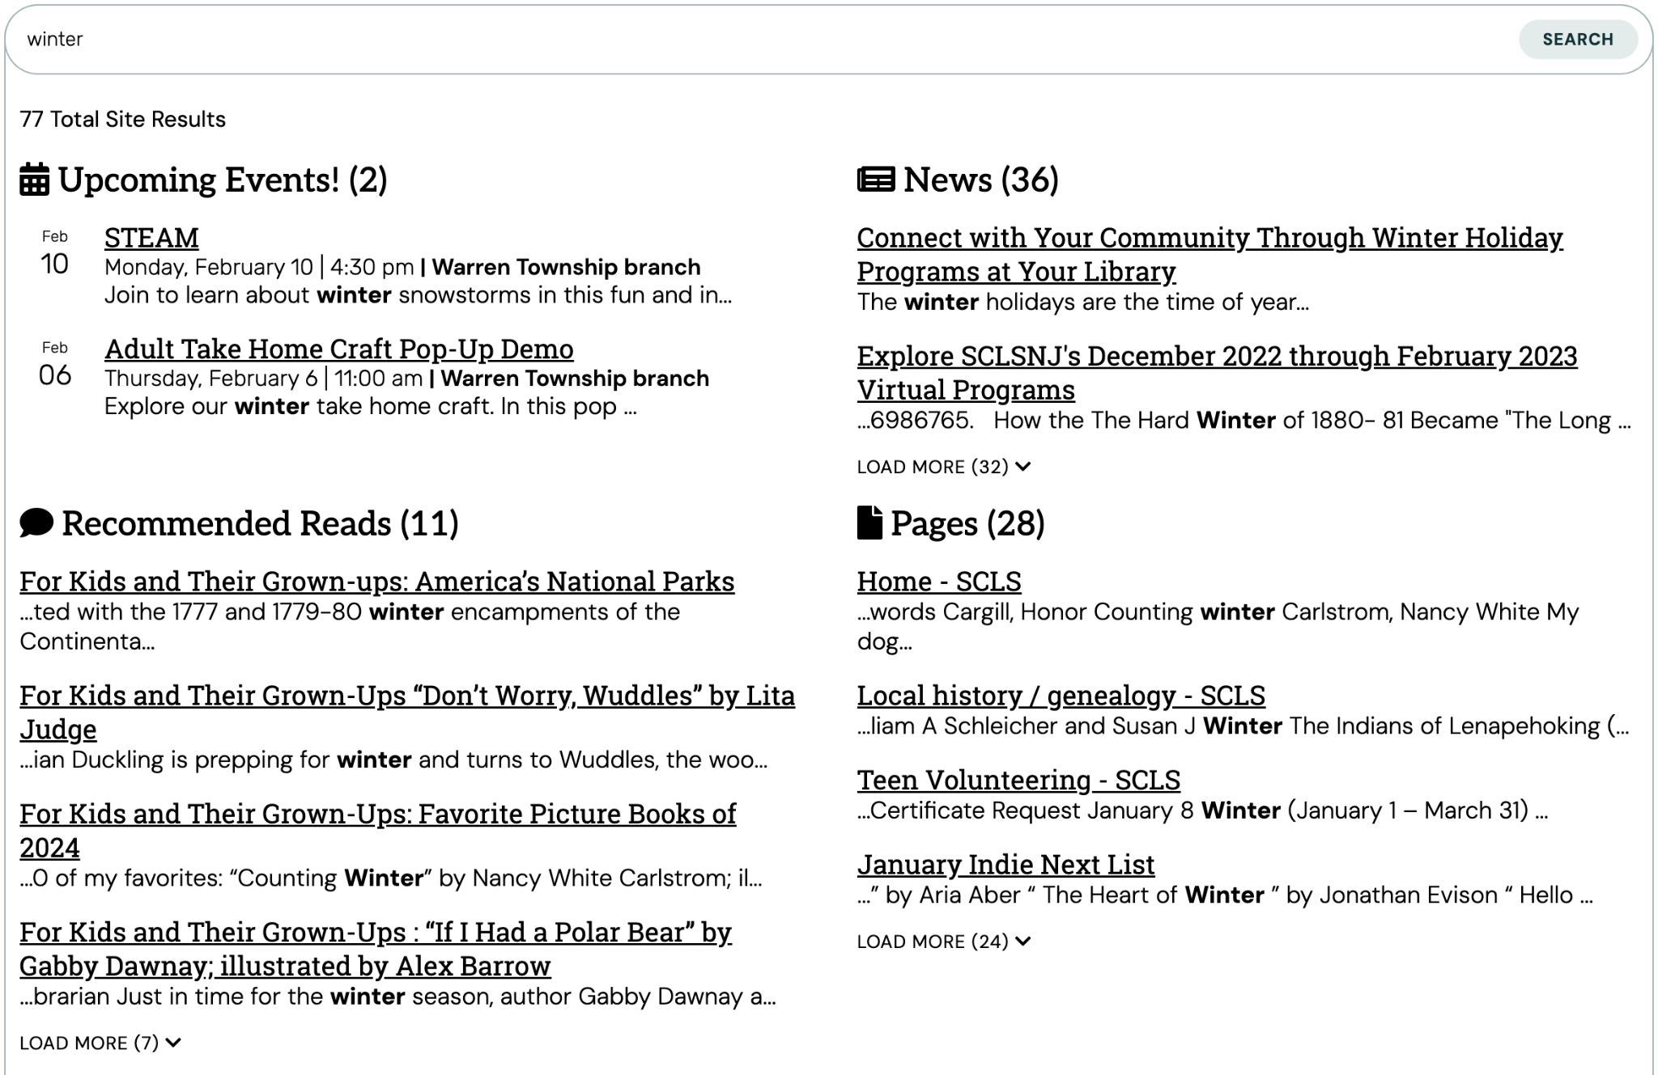
Parts of a CMS: Search Indexes

Slide 33
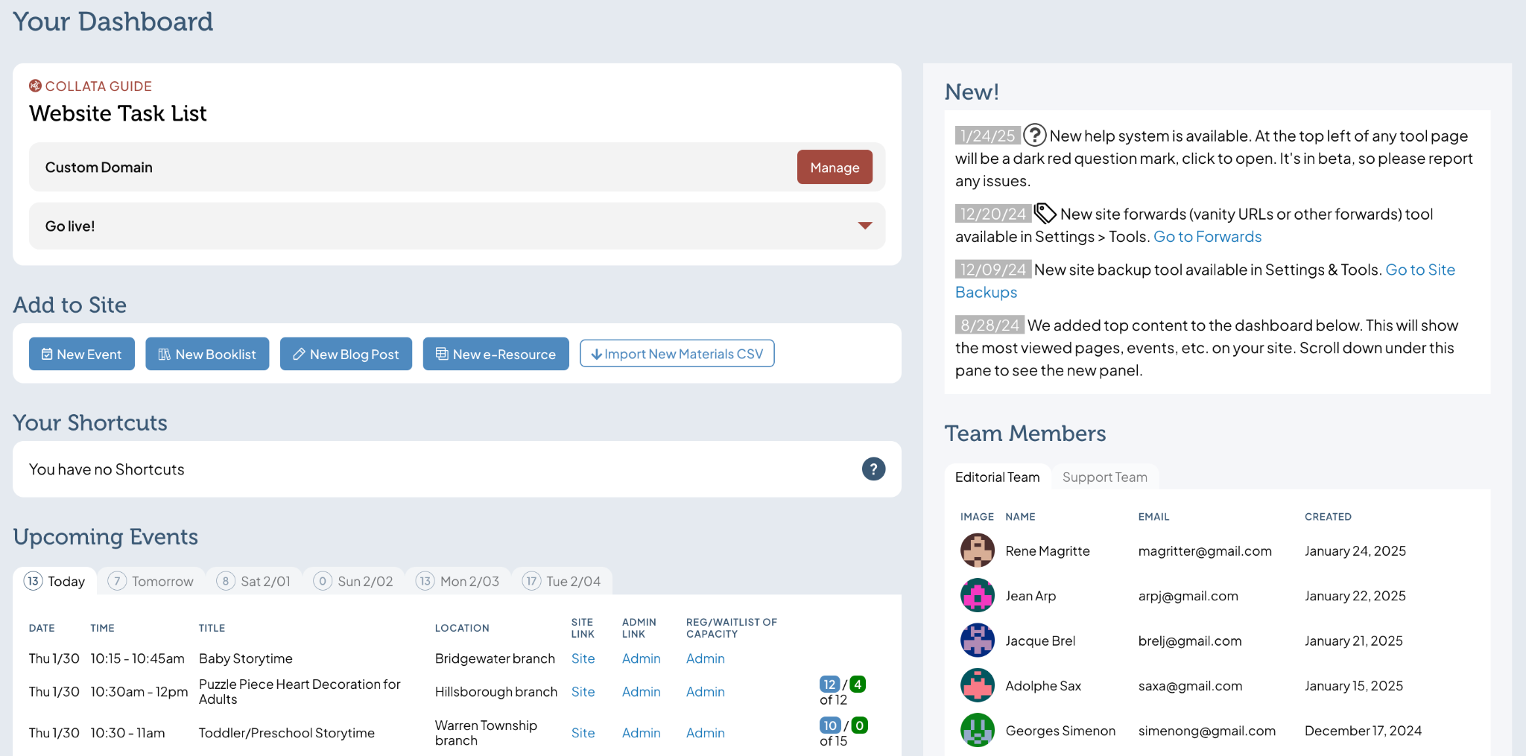
Parts of a CMS: Dashboards & Special Tools

Slide 35
About Us
Project Manifesto
Parts of a Web Application
Parts of a CMS
Roadmap and Timeline
Case in Point: Signup
Totals

Slide 36
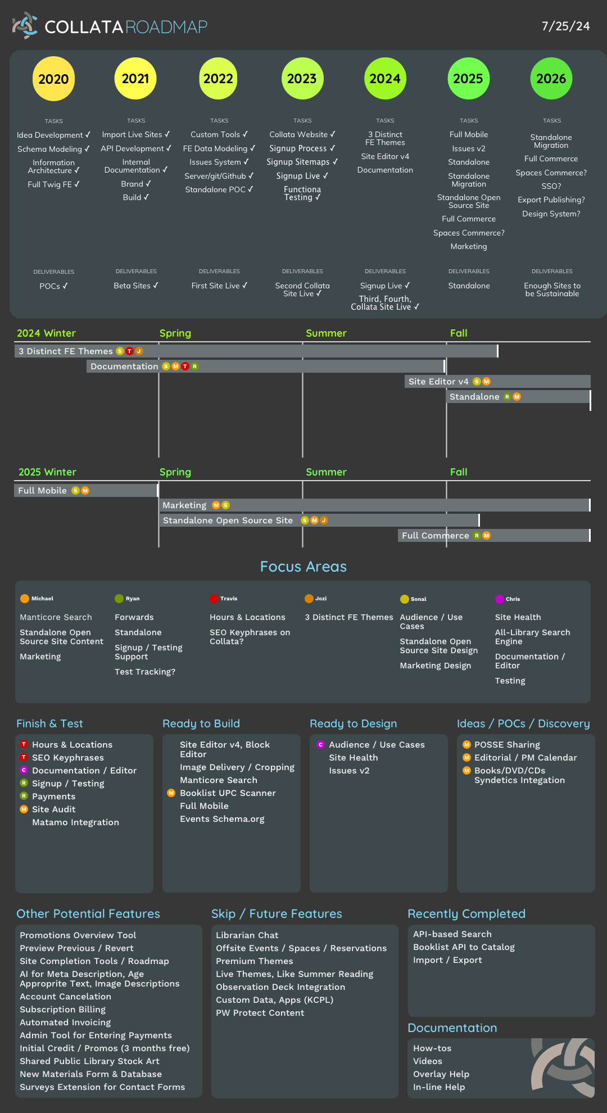
Roadmap & Timeline

Slide 37
Roadmap & Timeline: 2020
Idea Development ✓
Schema Modeling ✓
Information Architecture ✓
Full Twig Front End ✓
Deliverable: Proofs of Concept

Slide 38
Roadmap & Timeline: 2021
Import Live Sites (data checks) ✓
API Development ✓
Internal Documentation ✓
Branding ✓
Build System ✓
Deliverable: Beta Sites

Slide 39
Roadmap & Timeline: 2022
Custom Site Tools ✓
Front End Data Modeling ✓
Issues System ✓
Server/git/Github ✓
Standalone Open Source POC ✓
Deliverable: First Production Site Live

Slide 40
Roadmap & Timeline: 2023
Collata Website ✓
Signup Process ✓
Signup Sitemaps ✓
Signup ✓
Functional Testing ✓
Deliverable: Second Production Site Live

Slide 41
Roadmap & Timeline: 2024
3 Distinct Front End Themes
New Page Editor Design
Documentation
GCSV Export and Import System
Deliverable: Sign up live; Third and forth site live

Slide 42
Roadmap & Timeline: 2025
Full Mobile
Issues v2
Standalone and Standalone Migration
Open Source Site
Marketing
Deliverable: Fifth Site Live; Open Source Released

Slide 43
Roadmap & Timeline: 2026
Standalone Migration
Full Commerce
Export Publishing
Design System
Deliverable: ???

Slide 45
About Us
Project Manifesto
Parts of a Web Application
Parts of a CMS
Roadmap and Timeline
Case in Point: Signup
Totals

Slide 46
Case in Point: Signup
Purpose:
Actually create the site, configs, create administration accounts, create the site map, load branch information, choose a theme, etc.

Slide 47
Case in Point: Signup
Process:
Wireframe and design signup process (1 month)
HTML/CSS, JS (Vue application) (1 month)
Signup API (2 months)
Testing/Tuning (1 month)

Slide 48
Case in Point: Signup
Process:
Wireframe and design signup process (1 month)
HTML/CSS, JS (Vue application) (1 month)
Signup API (2 months)
Testing/Tuning (1 month)
Scope expansion (!)
Scope expansion (!!)
Scope expansion (!!!!)
Scope expansion (!)
Scope expansion (!!!!!)

Slide 49
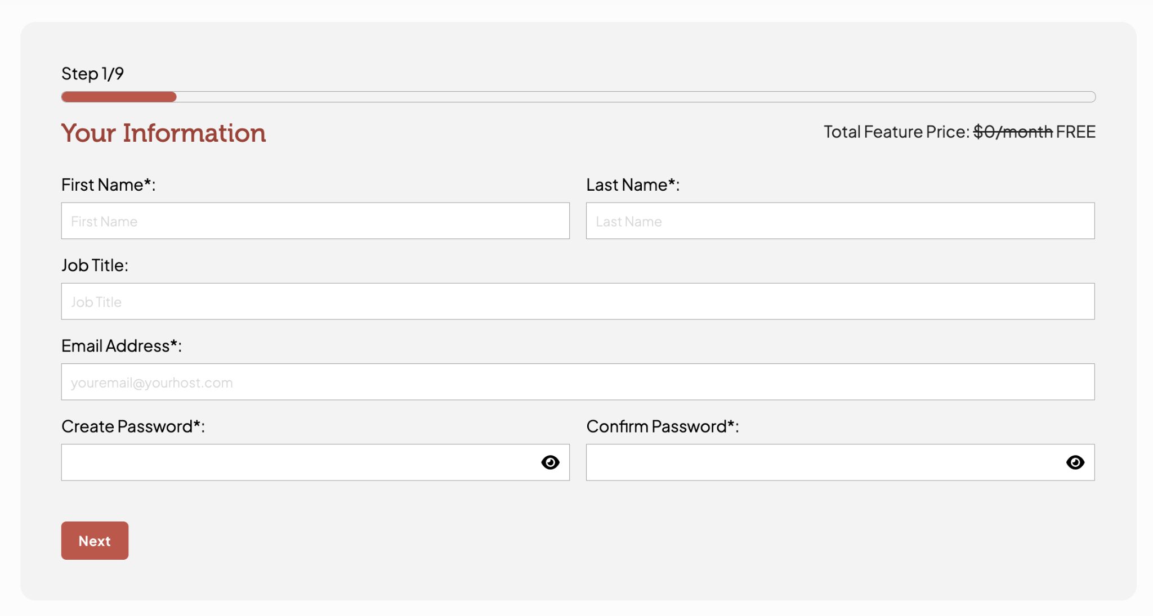
Case in Point: Signup

Slide 50
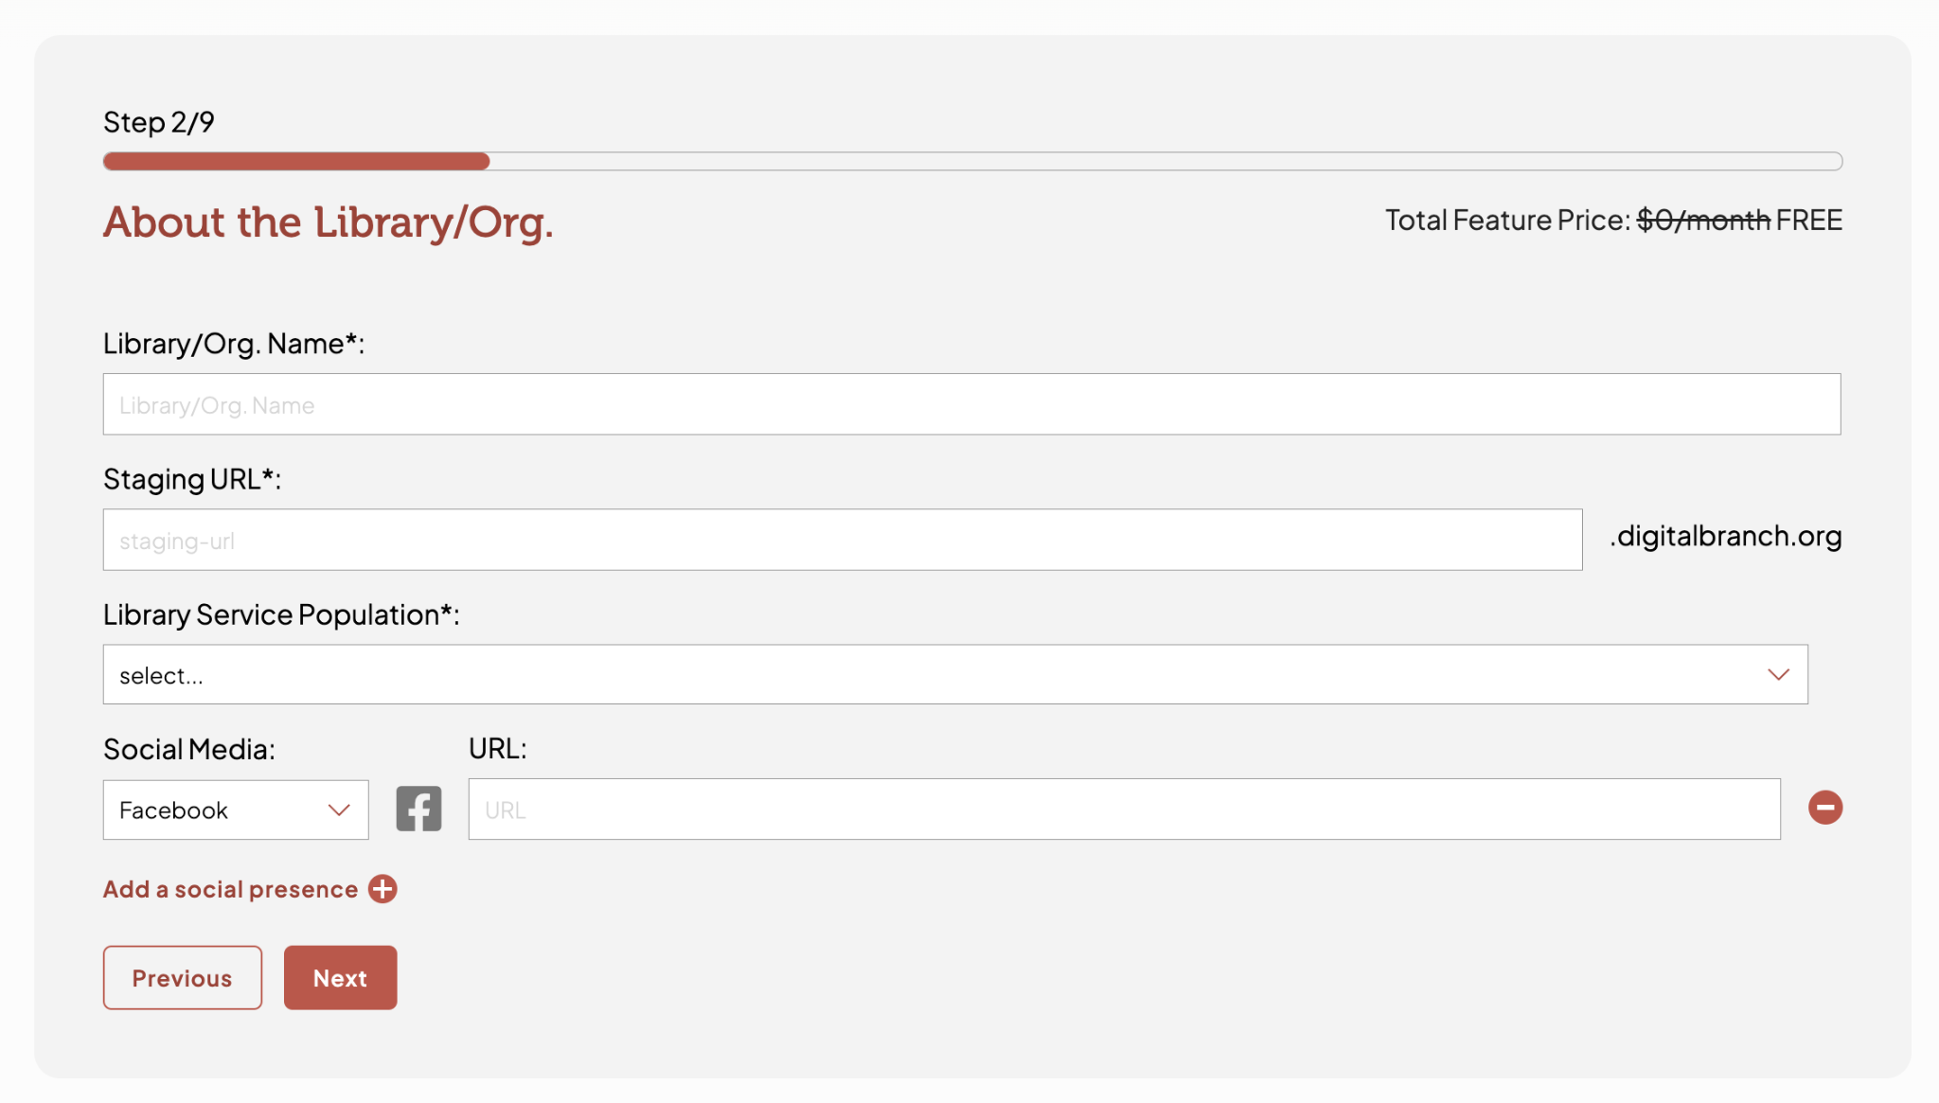
Case in Point: Signup

Slide 51
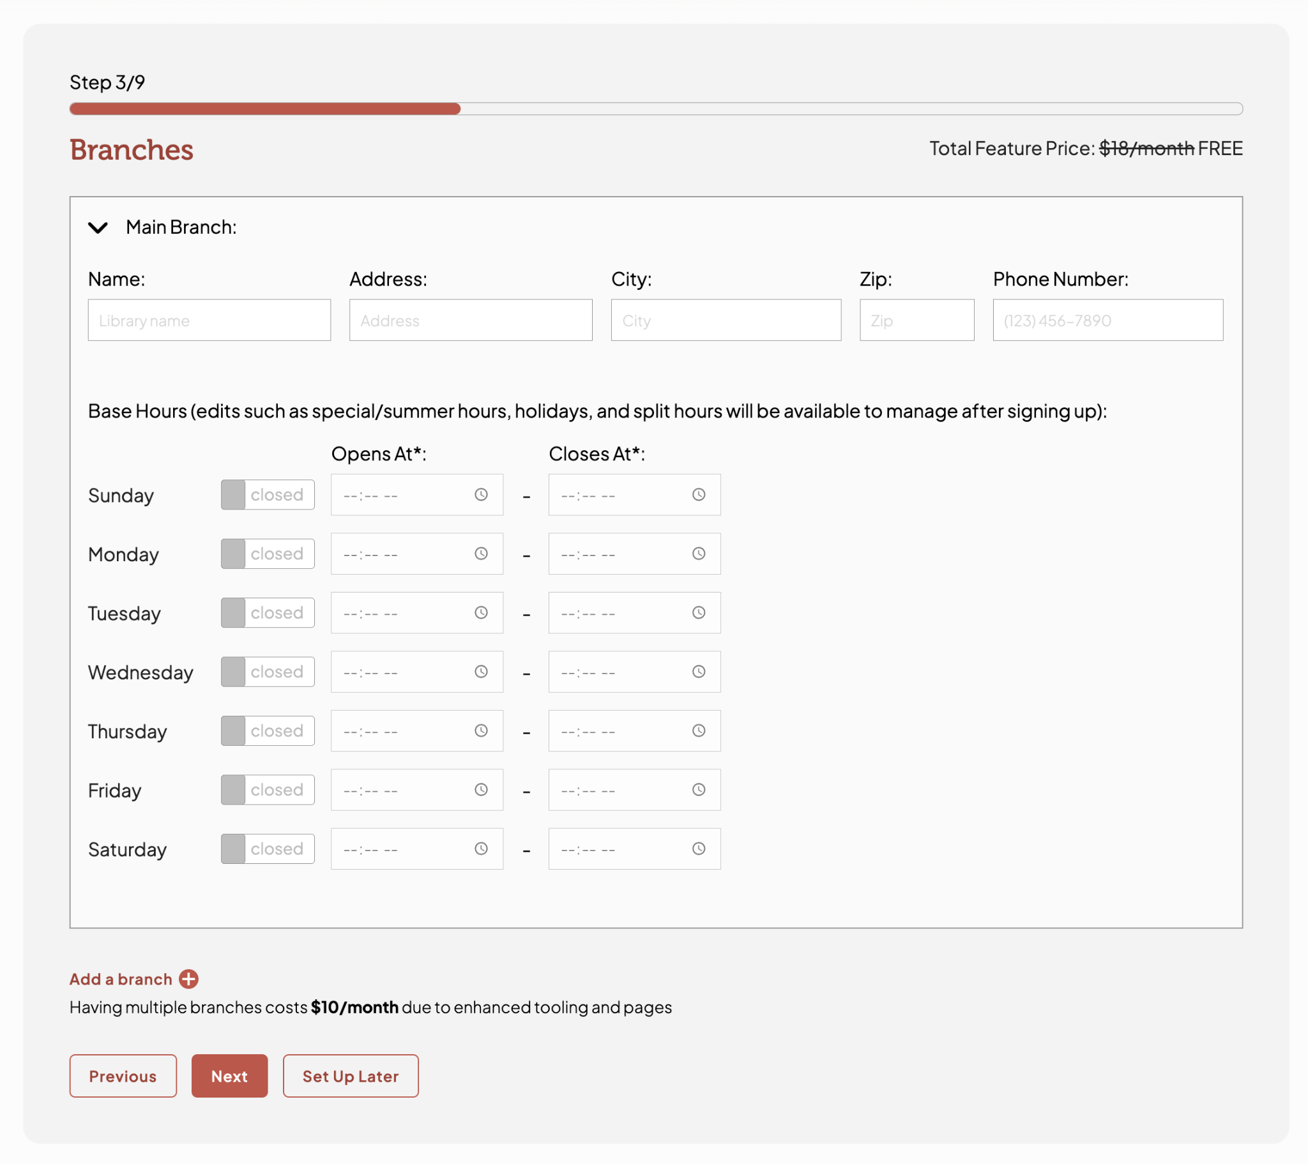
Case in Point: Signup

Slide 52
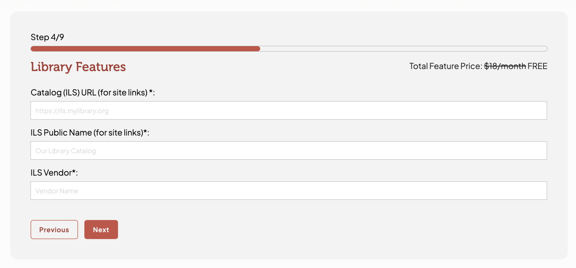
Case in Point: Signup

Slide 53
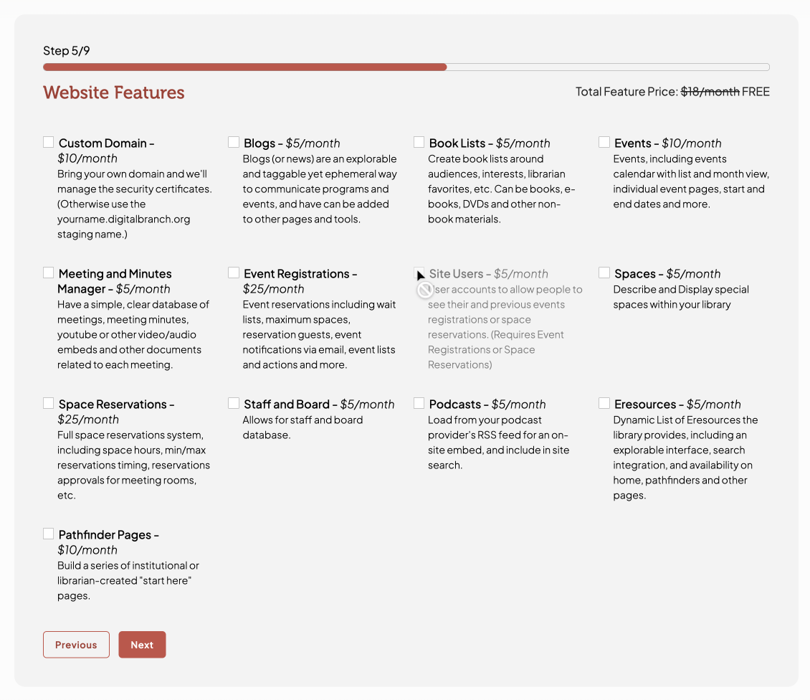
Case in Point: Signup

Slide 54
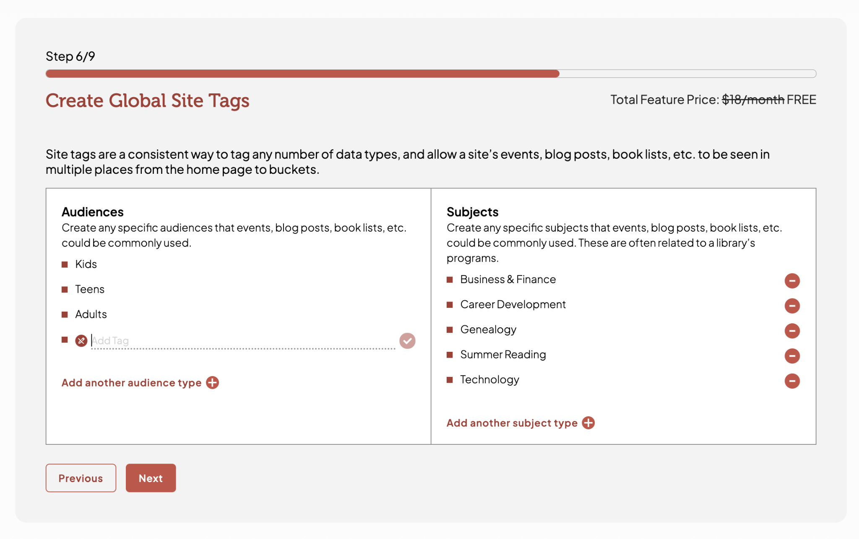
Case in Point: Signup

Slide 55
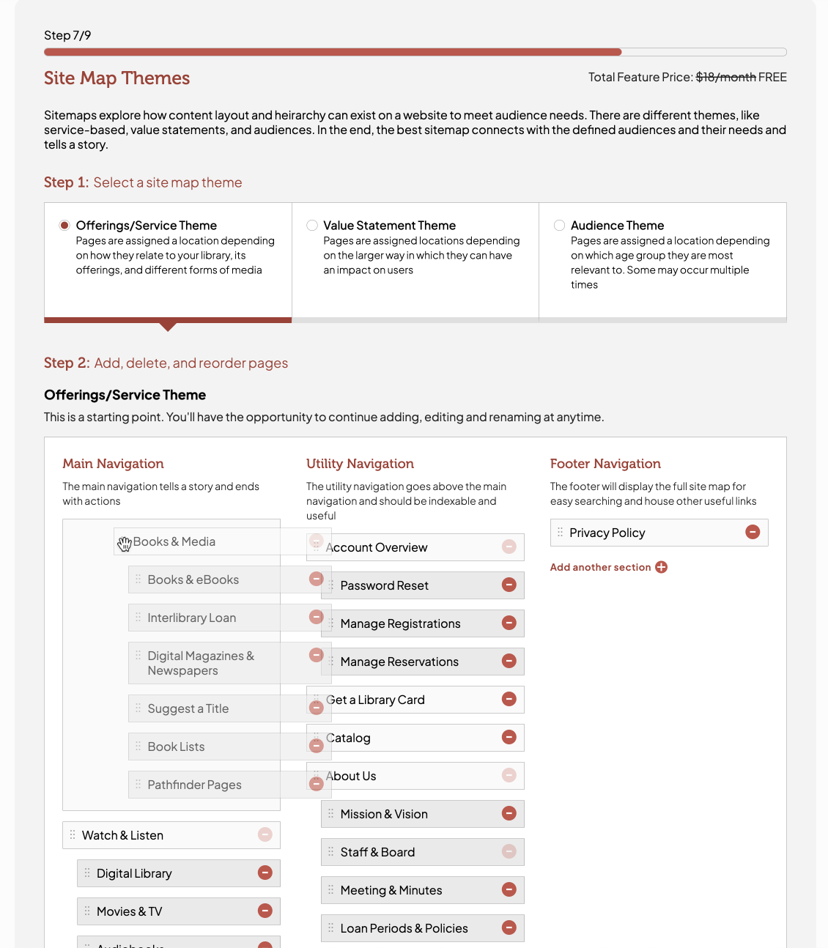
Case in Point: Signup

Slide 58
About Us
Project Manifesto
Parts of a Web Application
Parts of a CMS
Roadmap and Timeline
Case in Point: Signup
Difficulty (Time Totals)

Slide 59
Difficulty (Time Totals By Feature)
Signup
5 Months

Slide 60
Difficulty (Time Totals By Feature)
Digital Asset Manager
6 Months

Slide 61
Difficulty (Time Totals By Feature)
Front End
12 Months

Slide 62
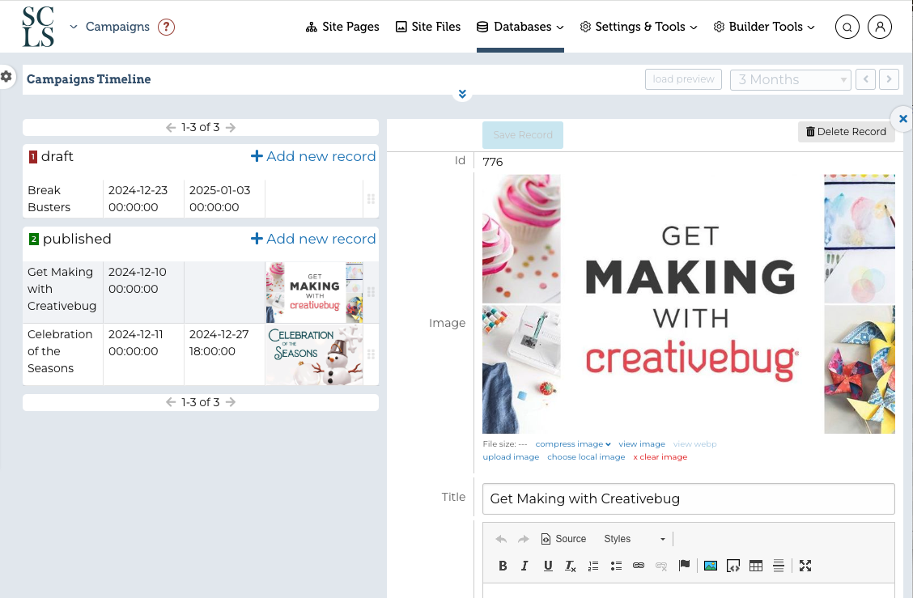
Difficulty (Time Totals By Feature)
Data Editors
16 Months

Slide 63
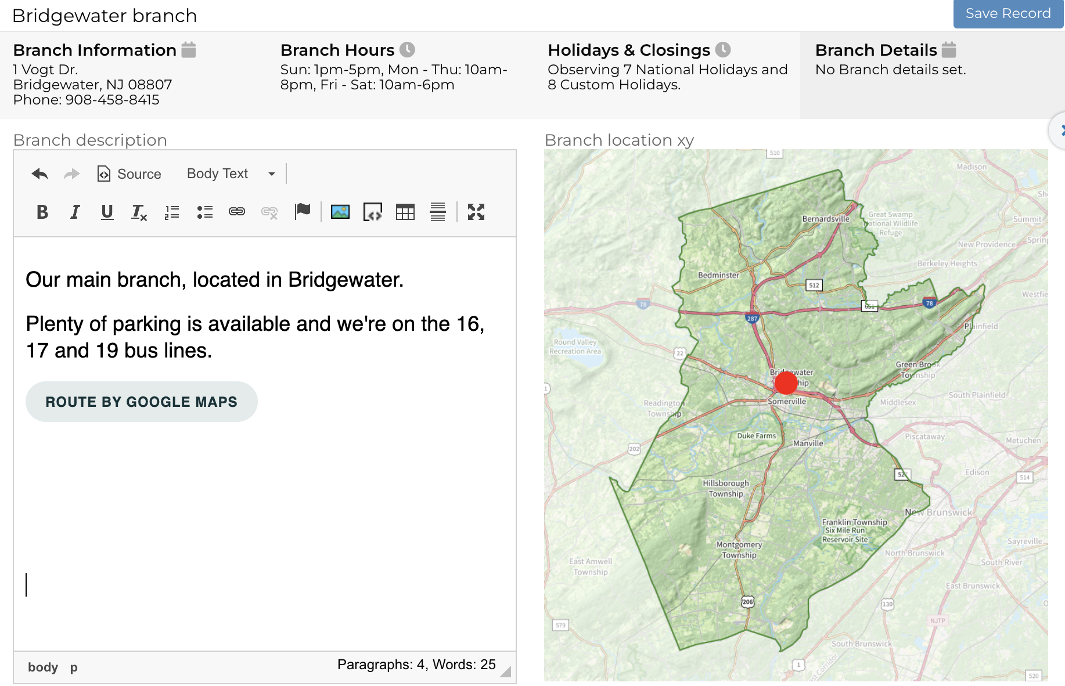
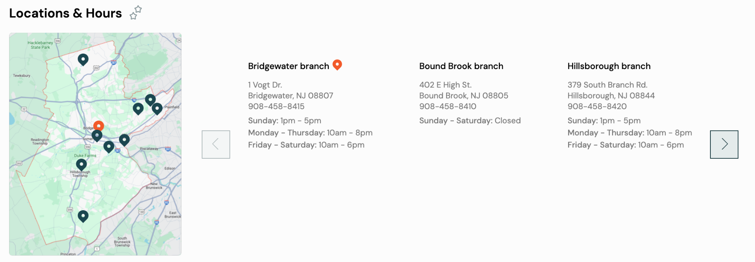
Difficulty (Time Totals By Feature)
Branches Map
3.5 hours
(usable by any data source)

Slide 64
Difficulty (Time Totals By Feature)
Success!
Being able to fulfill any client / internal requests
Adding substantial updates in a day or two
Letting experimentation and new ideas drive product

