Slide 1
FOSDEM 2025

Slide 2
The world is investing billions in open source software for supercomputers
ECP alone has built 80+ software projects that run portably across GPUs
Programming models
Tools
Math libraries
Applications
Data visualization
Packaging
Europe and Japan are beginning their own major software efforts
Industry has vast AI software stacks

Slide 3
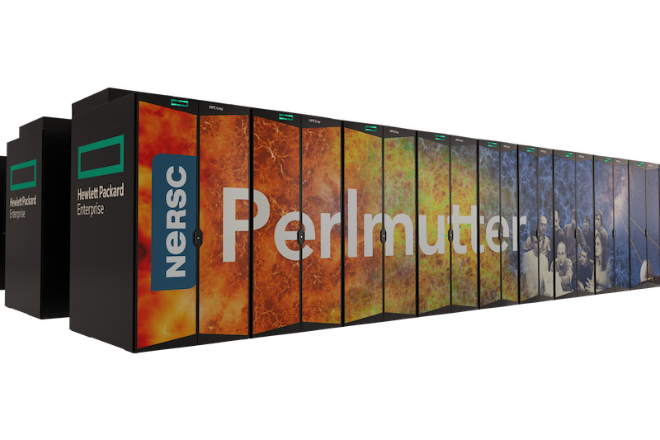
We want to bring HPC software to the world
Today’s HPC accelerators will quickly make their way to clouds and personal computers
The impact of supercomputer software isn’t limited to supercomputers
Leverage know-how developed on flagship HPC systems in industry
We need to lower barriers to use
HPC
Personal machines
Clouds, Servers

Slide 4
What is HPSF?
A neutral hub for open source, high performance software
HPSF supports projects that advance portable software for diverse hardware by:
Advocating for best practices
Increasing adoption
Aiding community growth
Enabling development efforts
Lowering barriers to productive use of today’s and future high performance computing systems

Slide 5
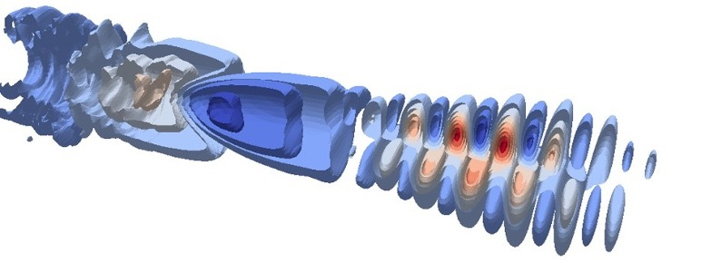
What kind of software is in HPSF so far?
Build and deployment tools
Solvers and HPC frameworks
Performance tools
HPC Applications
Parallel programming models
*
WarpX
Visualization tools
*in progress
Projects are welcome to overlap in scope and capabilities: we are not picking winners

Slide 6
HPSF Members
Premier
General
Associate

Slide 7
Governance
Governing Board (GB)
Collaborations
GB Committees
Events & Training
Outreach
Technical Advisory Council (TAC)
Working Groups
Technical Projects
CI & Testing
Facility Engagement
Spack
Kokkos
Apptainer
Benchmarking
Safety and Security
Viskores
HPCToolkit
E4S
AMReX
WarpX
Trilinos
Charliecloud
Chapel
Env Modules

Slide 8
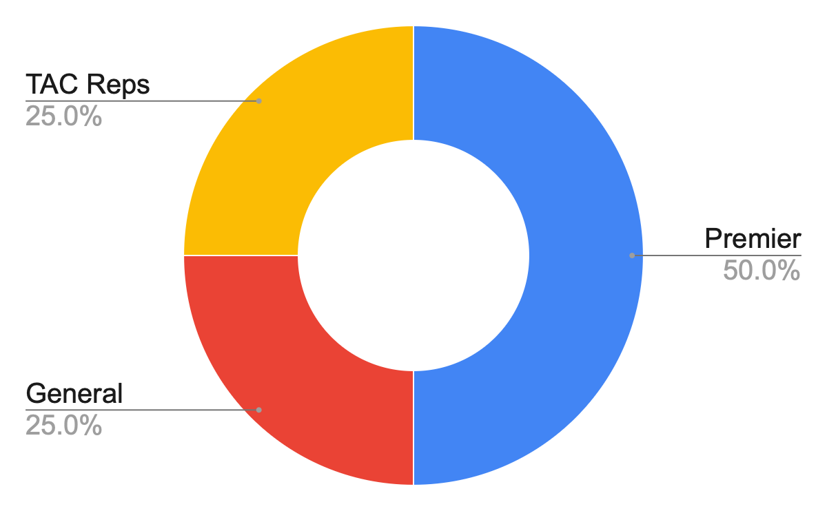
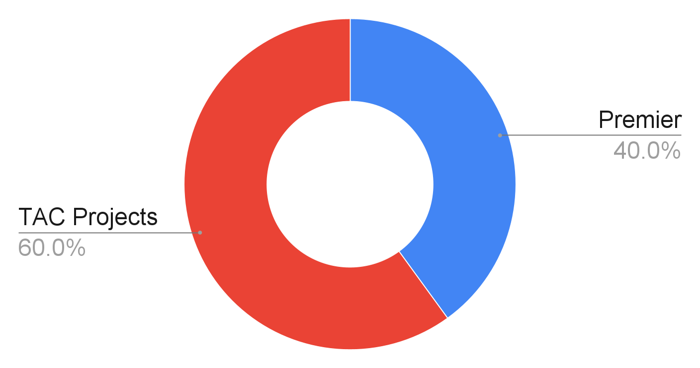
Representation in Governance
Governing Board
Technical Advisory Board
One for each Premier Member
One for every 5 General Members – up to 25%
One for every 5 Technical Projects – up to 25%
One for each Premier Member
One for every Core or Established project
TAC projects: have moved beyond sandbox level
≤ 2
(max)
4
4
6
≤ 2
(will grow)
(max)

Slide 9
HPSF Project Lifecycle

Slide 10
Project Lifecycle Goals
Signal project maturity
What does it mean to a user that a project is an HPSF project?
HPSF projects overall show a diversity of project maturity
Users can trust projects at each stage to meet certain criteria
Provide growth path
Concrete best practices and goals
Provides a target for projects as they mature

Slide 11
HPSF Project Stages
Sandbox
Indicates to users that a project is committed to open governance and working towards best practices.
Projects which are, or have the potential to be, important to the ecosystem of High Performance Computing.
Low barrier of entry to the HPSF
Established
Indicates to users that a project is proven in the user community and has robust development practices.
Projects which are major components of the High Performance Software ecosystem.
Projects are voting members of the HPSF Technical Advisory Committee (TAC).
Core
Indicates to users that a project has a sustainable cycle of development, maintenance, and support.
Projects which are used commonly in production environments and have large, well-established project communities
Projects are voting members of the HPSF TAC
Emeritus Previously established or core projects that are no longer under development.

Slide 12
Sandbox Project Criteria
Meet all requirements to be a Linux Foundation project
Have 2 TAC sponsors to champion the project & provide mentorship as needed
Project must align with the goals of the HPSF mission
Have a charter document […] use of one or more licenses approved as “open” by the Open Source Initiative.
Have a code of conduct
Upon acceptance, projects must list their status prominently on their website/README

Slide 13
Established Project Criteria
Meet all Sandbox project criteria
Document that it is being used successfully in production by at least three independent end users […].
Demonstrate development processes […] that lower barriers to contribution and ensure software quality necessary for increased adoption.
Demonstrate a substantial ongoing flow of commits and merged contributions.
Receive a 2/3 majority vote of the TAC to move to the Established Stage.

Slide 14
Core Project Criteria
Meet all Established project criteria
Have a defined governing body […] no more than 1/2 of whom are affiliated with the same employer. No single institution may control a voting majority of the governing body.
Have a documented and publicly accessible description of the project's governance, decision-making, and release processes.
Have a healthy number of committers from at least two organizations […].
Explicitly defined security reporting and incident mitigation processes […].
Provide evidence of widespread adoption in the HPC ecosystem or in some important component thereof.
Receive a 2/3 majority vote from the TAC to move to Core stage

Slide 15
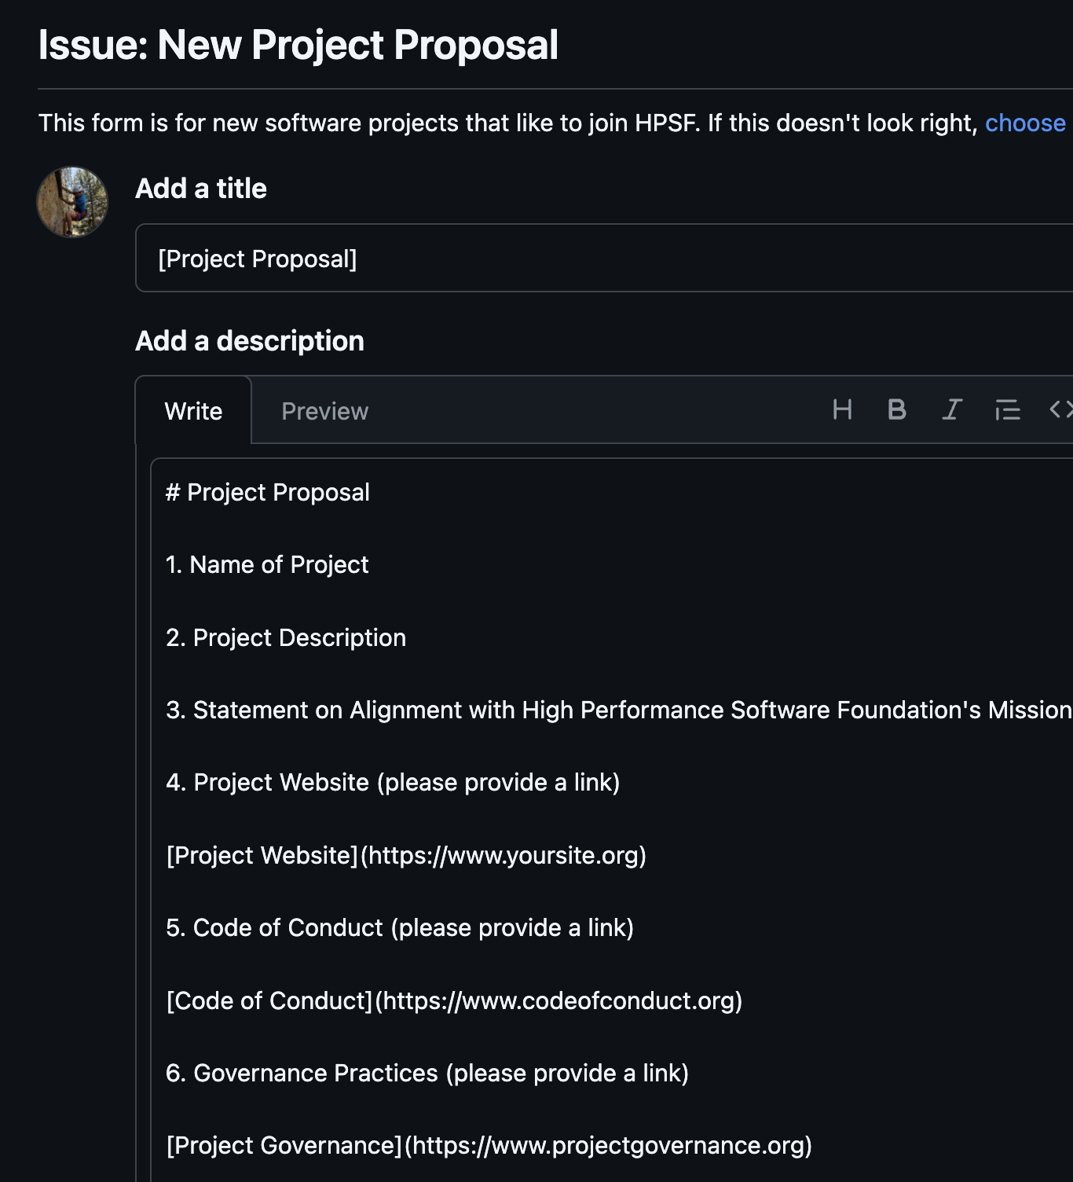
How to Join (for projects)
Talk to TAC members and find two sponsors
Submit a GitHub issue at https://github.com/hpsfoundation/TAC
Prepare a presentation on how your project meets lifecycle criteria
Work with TAC sponsors to schedule presentation to TAC

Slide 16
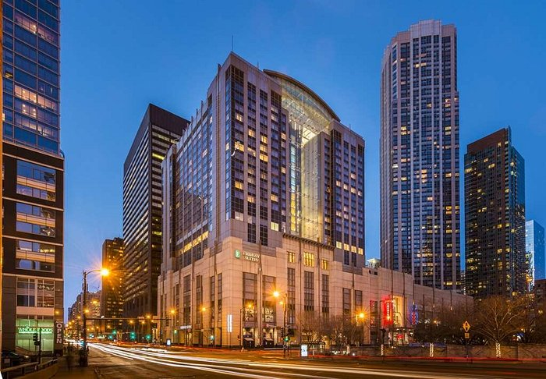
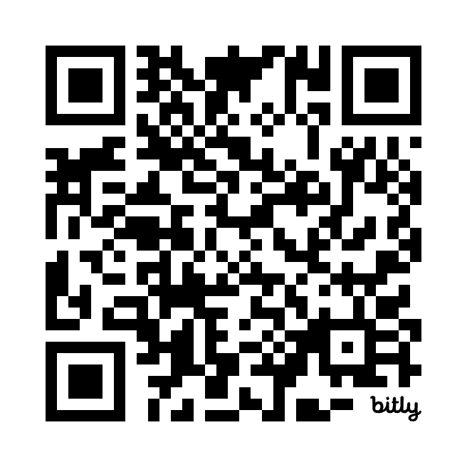
Announcing the first HPSF Conference!
May 5 - 8 2025
Embassy Suites Chicago Magnificent Mile
45 minutes from O’Hare
Renovated in 2018
Tentative program
Monday + Tuesday:
HPSF Plenary sessions
Presentations
Working group collaborations
Wednesday + Thursday
Project community meetings for individual projects
bit.ly/hpsfcon

